Slide 1
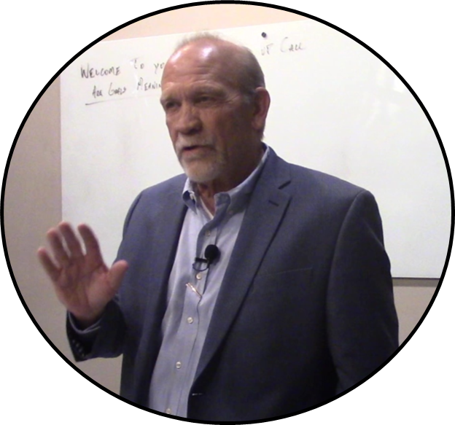
The Most Important Skill a Manager can Develop
Robert Morgan
Disruptive Leadership
801-633-8252
bobmorgan@vobconsulting.com
©VOB LLC

Slide 2
These presentation materials are provided by the presenter who is solely responsible for the contents of the presentation. NADA assumes no responsibility or liability for the contents of the presentation.

Slide 3
What is the #1 key to your Dealership’s success?
SEO, CTA, PPC, PPO, CTR, CPC, ABC, XYZ?
ZEN Dealer
Where do we spend our time?
Pareto’s Principal
We say we must change or die
We have to have real conversations.
Notes:
There are so many people at the top of our organizations who are not leaders.
In our business we give bonuses to people who are willing to sacrifice others so that we may gain.
We do what they say because they have authority, but we would not follow them.
We promote someone and then proceed to train them on administrative things and throw them to the wolves as a leader.
How many of your employees have enough trust in their Manager, they willingly do what is asked.
Leadership is a choice not a rank
We all go to meetings, 20 groups, conference. Is it the alphabet?
Story of ZEN Leader
I am guilty of this as well. If you get one concept that helps your team it is time well spent.
Pareto’s principle 80/20 Where do we spend our time. 80% is spent on the 20% that effects us. Admin and the top 20%. We leave the bottom 80 to a quick one to one or critique after the sale. This creates our turnover problem.
We continually say we must change or die.
Gallup Survey found that the quality of your managers and team leaders is the single biggest factor in your dealership’s success

Slide 4
Let’s have a one on one.
GM just asked for the goals. I better have a one on one.
What’s up Boss?
How about 12?
Kale, You got a minute?
Time for your One on One.
What’s your goal?
Ummm8
Notes:
We may laugh or cry. As I have traveled around the country this is the norm not the exception

Slide 5
We surveyed Dealerships across the Country. We asked four questions.
Do your Managers have a one on one?
30%
Managers, do you conduct one on one?
90%+
Reality
Actual scheduled one on one.
Everyday ?
10%
Once per month?
30%
80-90 % of our staff cannot accomplish their objectives alone.
We do not rise to the level of our goals. We fall to the level of our system
Notes:
We surveyed dealerships and asked them about one on ones. First the staff
Next the managers
Let us give them a break and define it
Actual scheduled one on one
Everyday
Once per month
80-90% cannot reach their goals without help. We have to know how to help them
Stop this madness
How do we know?
If we empty our cup and listen to our people. It will be an amazing experience for all

Slide 6
Coaches Review Checklist
Take time to make time
Before the meeting, Prepare- do some research and take notes.
If you schedule a review, nothing is more important. No interruptions.
Employee must understand that you care.
Decide what excellence looks like for each review
Make an agenda
Let the employee know what to expect.
Notes:
What do your managers say.
I do not have time. This is a way of saying I do not think it important. If we believe we do
Surprising if we take the time we make the time. Employees will put less effort into misguided plans and do what we expect
Why?
Do some homework, be ready
We tell our people all the time, you must be ready then we do it off the cuff.
If you schedule, and you must schedule it, nothing is more important. If you ask your managers to do this, it is more important than anything they are doing until it is over

Slide 7
Coaching Objectives
Schedule a time. This must be strict.
Ask these questions.
What is your purpose? Why do you do what you do?
What are your actual goals?
How should we measure your progress?
If we want our team to win, we must make it easy.
Notes:
I cannot stress this enough. If you schedule it do it. This review will only be as important as you make it.
What is your purpose? Do not stop at make a living. It takes time to find this, as Simon Sinek says. Why, Why , Why.
I teach the most important question that can be asked. Why?
Goals, your goals. This has to be their goals. Let them express it. Not the 12 every sales person sets.
This is tied to their purpose. What goals need to be set to start on the path to accomplishing their purpose.
How do you measure?
20 calls, 40 emails, 3 fresh ups, 1 referral. NO
This is their measurement and it is critical they set it up

Slide 8
KPI’s
Notes:
KPI?
This is stats. Now you have permission to micromanage. Personalized stats are critical

Slide 9
KPI’s cont.
Notes:
What do they need to do everyday to reach their purpose?
We must make it easy or they will give up.

Slide 10
Coaching Objectives cont.
How are we going to accomplish this? Action plan with KPI.
What do you want the future to look like?
Who is your best partner?
Last of all, how are you?
Notes:
What do you want the future to look like? Where do you see yourself in one, three five, ten years. Give them time to answer. You are finding motivational tools that will increase production
KPI? This is stats. Now you have permission to micromanage. Personalized stats are critical on next slide
Who is your best partner/ Story of Jeff White and Decker Ford
Last questions.

Slide 11
I am so sorry. I need to reschedule again.
What does your employee think when they hear this?
Relief?
Frustration?
Anger?
None of it good for morale
Notes:
I have to remind us about this. It is only as important as you make it.
What do they think
Relief. They hate them and we use them to belittle and make them fell bad.
Frustration you just told them they are not important. We all walk around with a hidden sign that says” Make me feel important.”
Anger, this is a time to get help or air a frustration and you took it away.
Do not do it

Slide 12
Observations
Spend 80% of your Time for 20% growth
Spend 80% of your time for 30% growth
2 salespeople averaging 20
3 salespeople averaging 15
85 X 20% = 17 more units
20 Unit average = 4 more per month?
20 salespeople averaging 9
180 X 30% = 54
9 Unit average 30% growth = 2.7 per month.
Which is easier?

Slide 13
Coaches Review
Absolutely the most high-level item a Manager can do
30% Growth
Higher levels of Employee engagement
Less stress for everyone
Notes:
The most important skill a manager can develop. Becoming an effective coach.
Leadership is a choice not a rank. Would your team follow their leaders? If you answer no, you need to change.
Leadership is not inherent, it can be taught.

Slide 15
The Most Important Skill a Manager can Develop
Your photo here
Robert Morgan
Disruptive Leadership
801-633-8252
bobmorgan@vobconsulting.com
©VOB LLC

