Slide 1
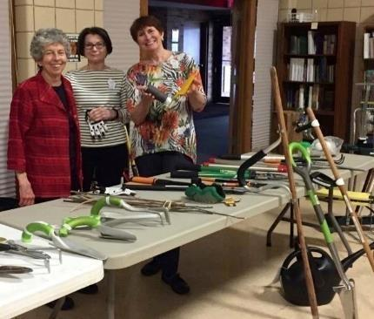

Enjoying Gardening Throughout Your Life
Gardening Basics · Good Body Mechanics · Hand Tools

Slide 2

Lifelong Gardening
MISSION
Our mission is to educate the public on principles and methods that enable gardeners to enjoy gardening throughout their lifetime.
Education is designed to teach:
How to modify the garden – accessibility and plant selection;
  2. How to modify the gardener – techniques and tools.
Notes:
This is Southeast Wisconsin Master Gardeners Lifelong Learning Project’s Mission.

Slide 3
Tools are Available to Handle
The SouthEast Wisconsin Master Gardeners demonstrate these enabling tools and equipment as a service to people interested in gardening. This is not an inclusive collection and does not represent an endorsement of these products or retailers.
Disclaimer
The gardening tools and techniques you see and experience today are designed to enable people with physical impairments to participate in gardening activities. These tools and techniques are also designed to prevent injury and pain while gardening. This information is general only and should not be construed as medical advice or treatment.
You should consult a physician concerning your own situation and any physical problems or medical questions you may have before putting these techniques and tools to use in your own garden.
Notes:
After reading Disclaimer in a fast “radio commercial” voice, reiterate we are not doctors. If you have a preexisting condition, check with your doctor about how much you can do in the garden.

Slide 4
Understand tool and gardening basics
Proper body mechanics for back and joint protection
Learn about tools and techniques that can be used for specific gardening tasks
Understand energy conservation and accessible gardening
Program
Objectives
Notes:
Review objectives with the audience; state these objectives in different words.

Slide 5
Handouts
Gardening Exercises and Body Mechanics Brochure
Lifelong Gardening Tips Brochure
Lifelong Gardening Information:
Basic Tool Considerations,
East Care Plant Selection,
Equipment - Enabling Tools for Gardening, Websites and Catalogs, Publications and Reference Books
Notes:
Show and discuss the handouts.

Slide 6
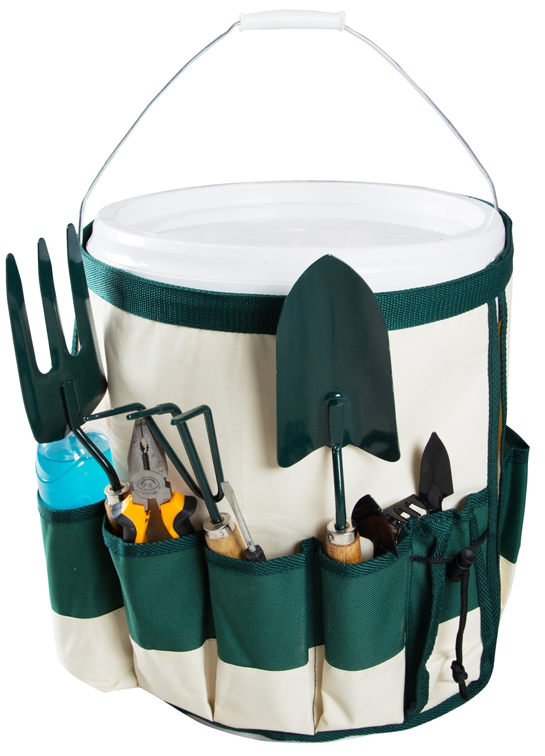
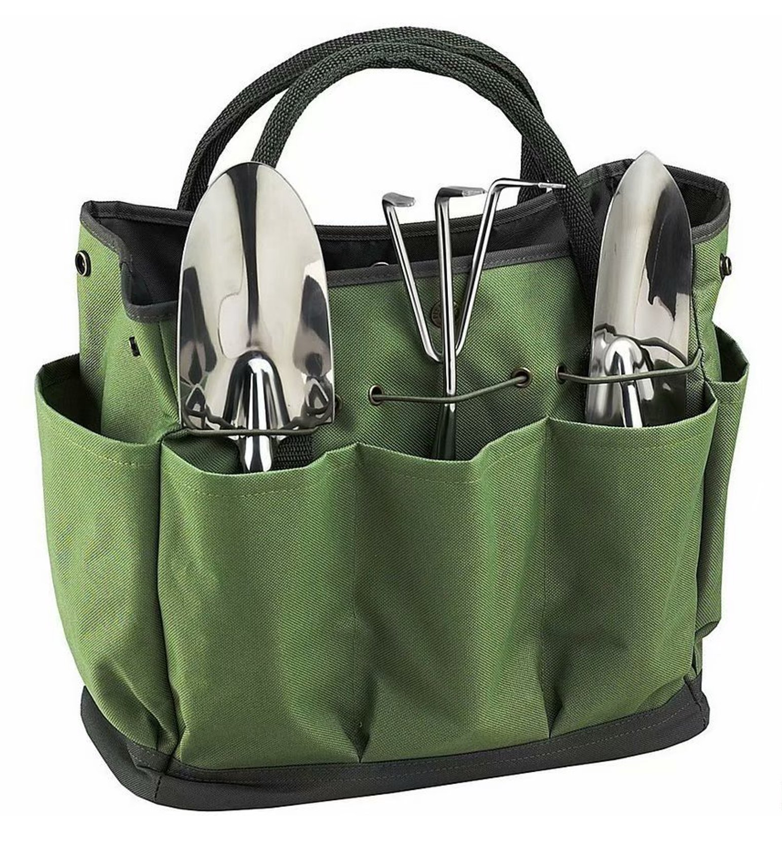
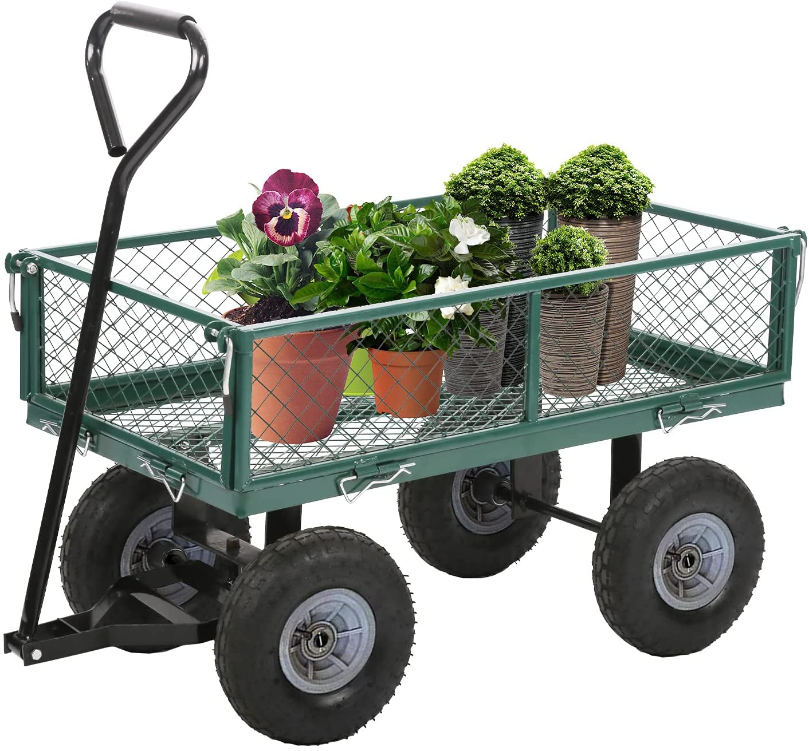
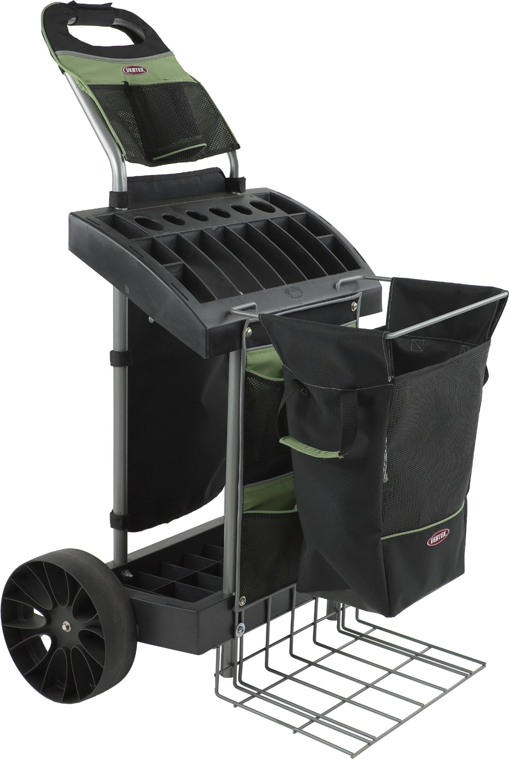
Gardening
Basics

Slide 7
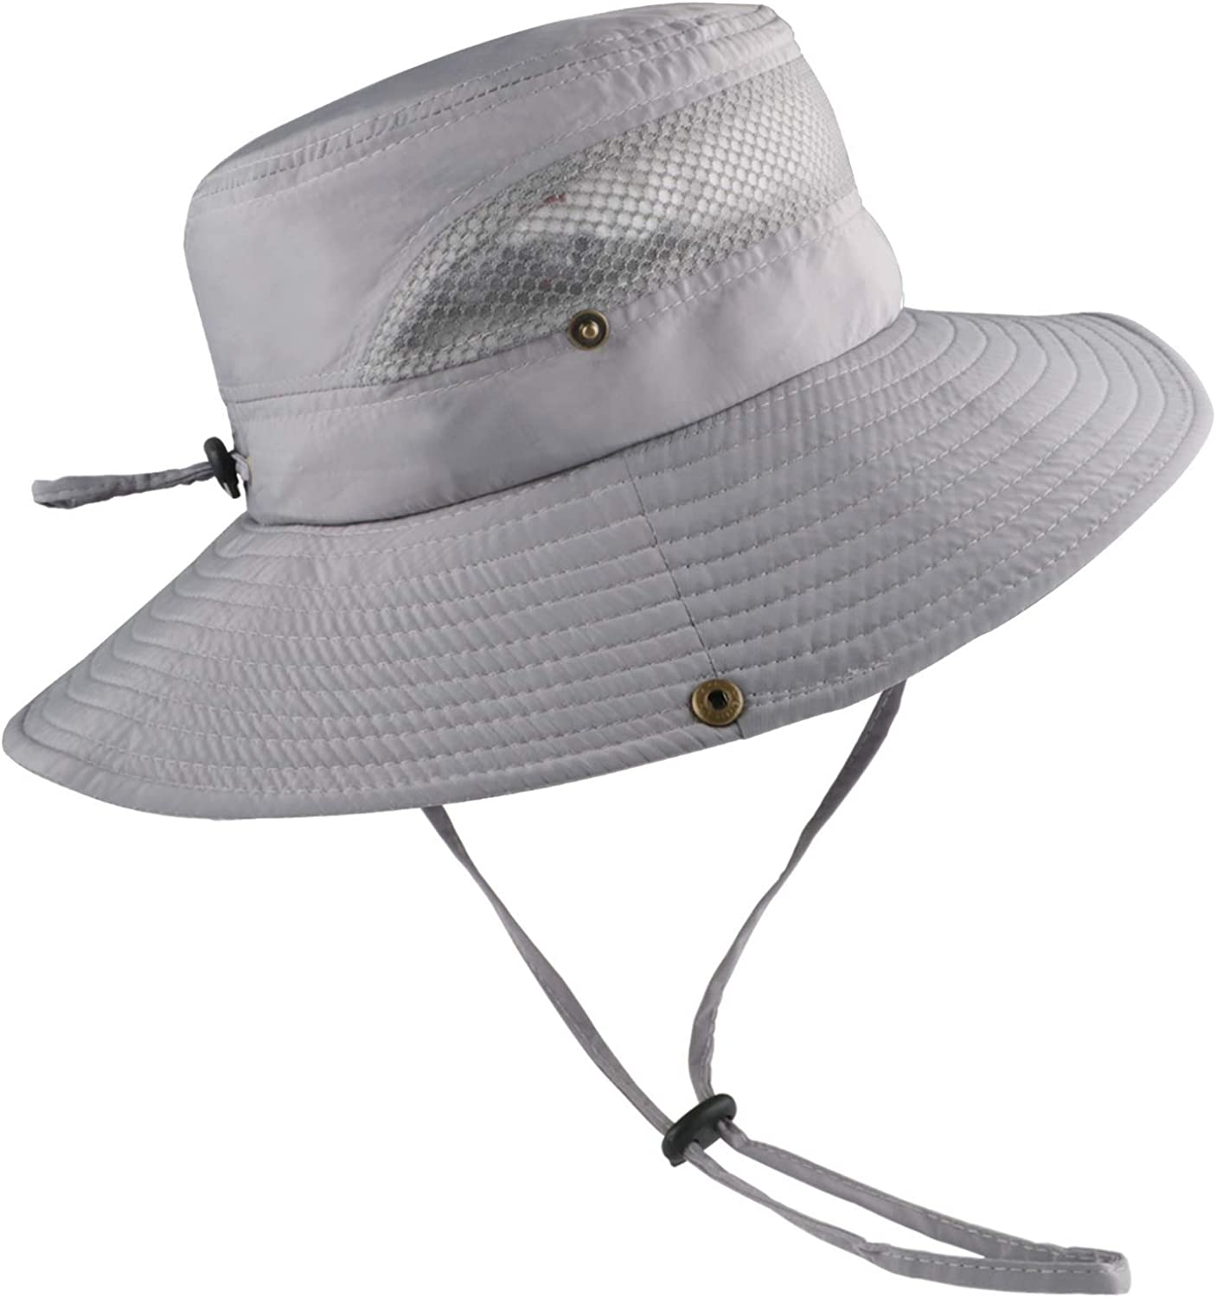
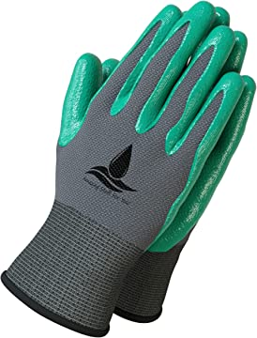
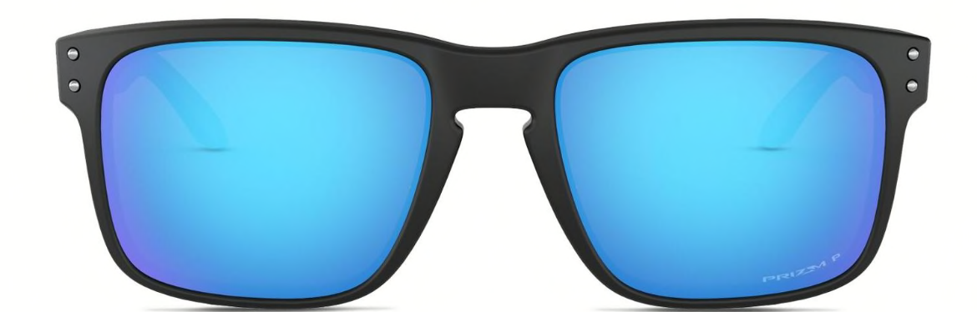
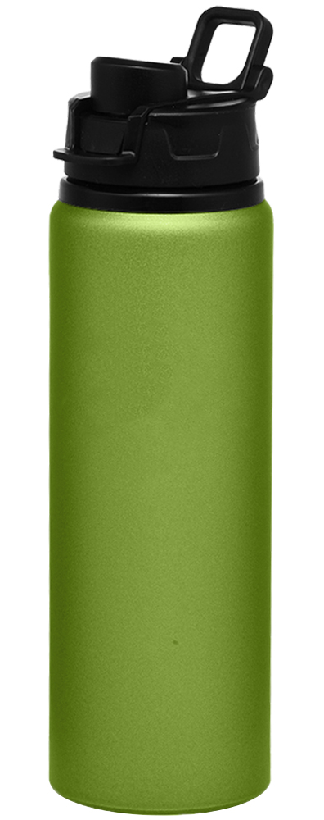


Be Prepared
  Warm up muscles with exercise
  Wear a hat, sunglasses, and
  sunscreen
  Have your cell phone
  Carry water
  Carry tools to avoid trips
  Wear gloves that fit you!
  Is Tetanus shot current?
Notes:
Prepare before heading out to the garden. Warmup exercises are included in the trifold handout received in your packet.
Review other items listed on the slide.
Ask Vanna’s what they have in their Garden Bags/Buckets.
Hats Sunglasses Sunscreen
Bug Spray Cell Phone Water
Favorite tools Gloves

Slide 8
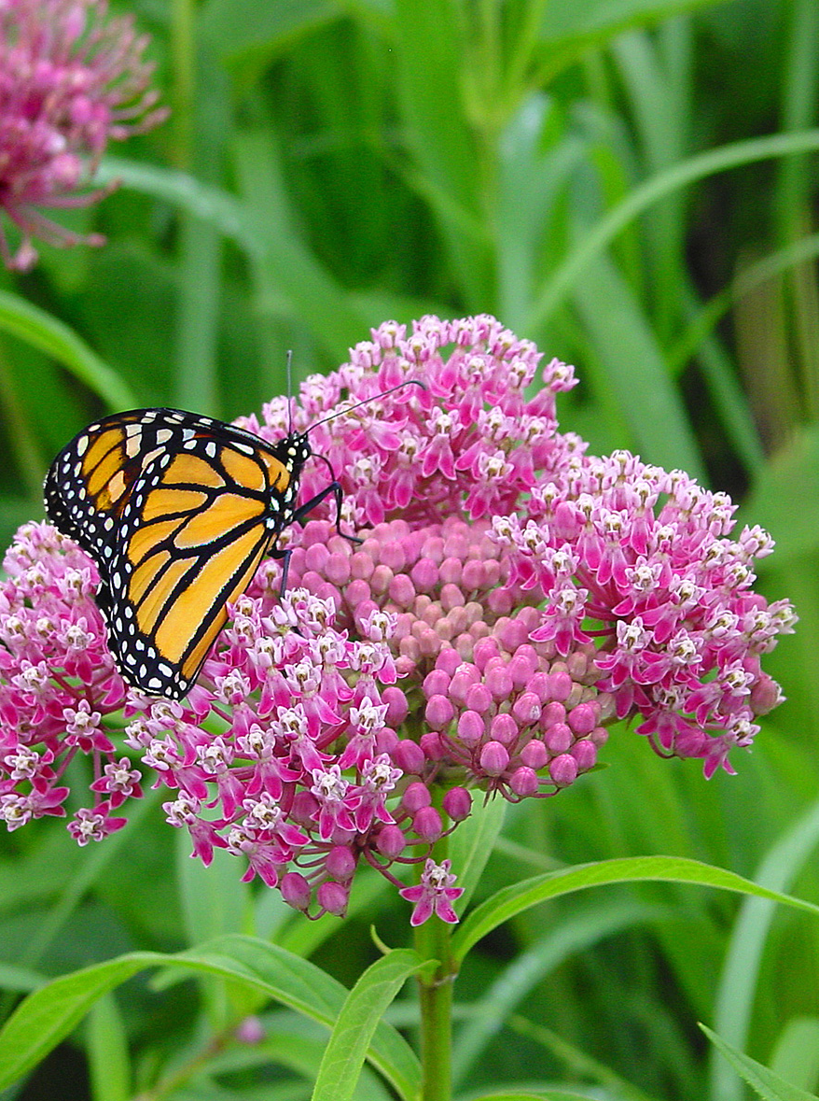

Do you suffer from arthritis?
Losing range of motion?
Limited mobility?
Aches and pains?
Notes:
Ask for a raise of hands to the questions.

Slide 9
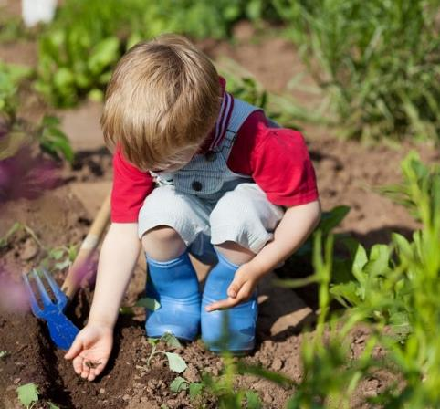
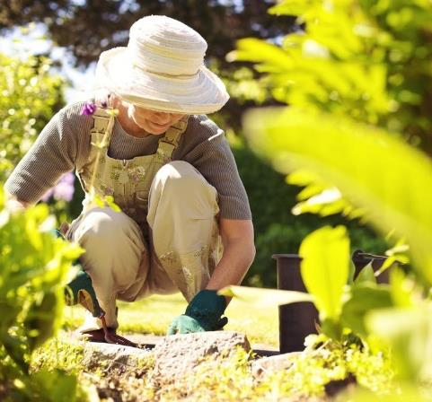
No matter where you are in your garden journey . . .
Notes:
Whether you are young or old. Ask the audience to picture themselves in their gardens.

Slide 10
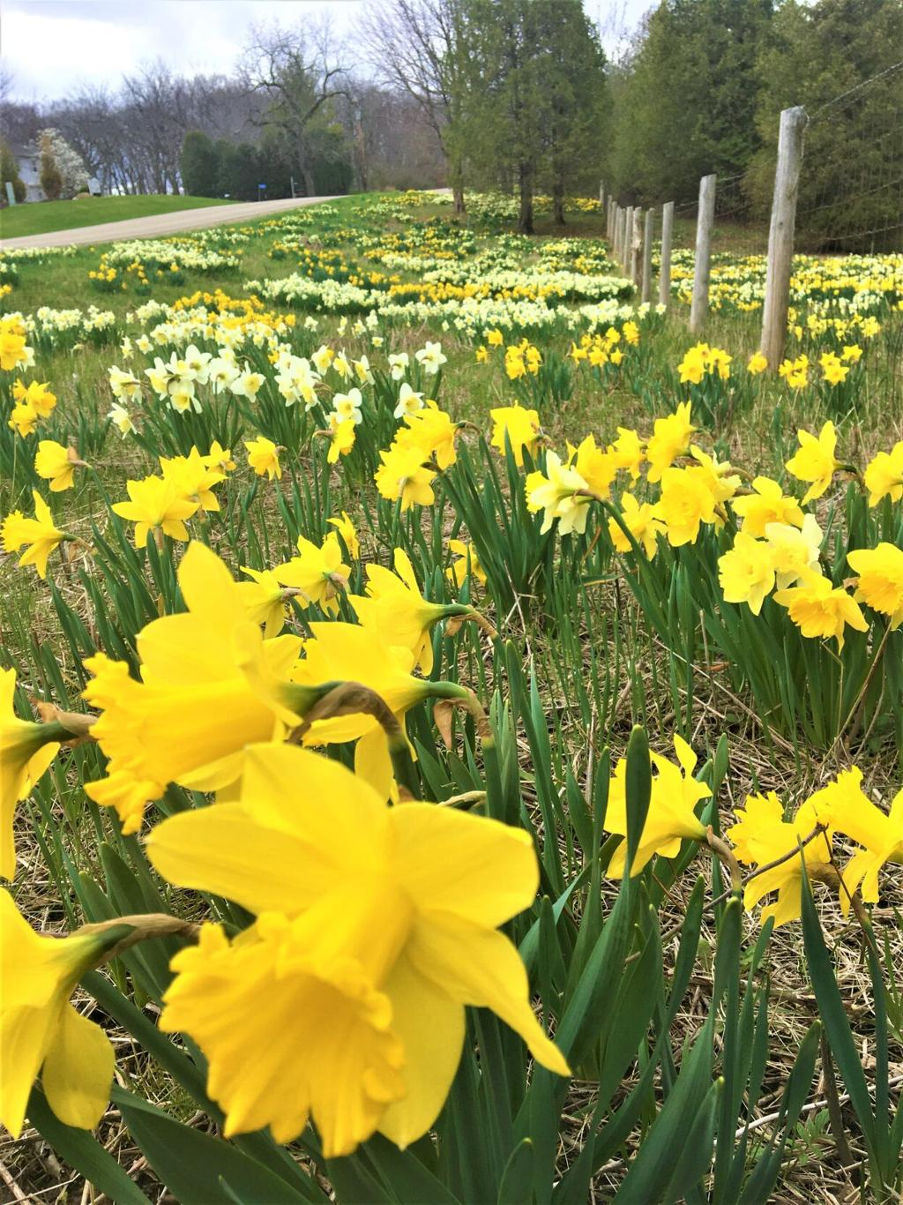
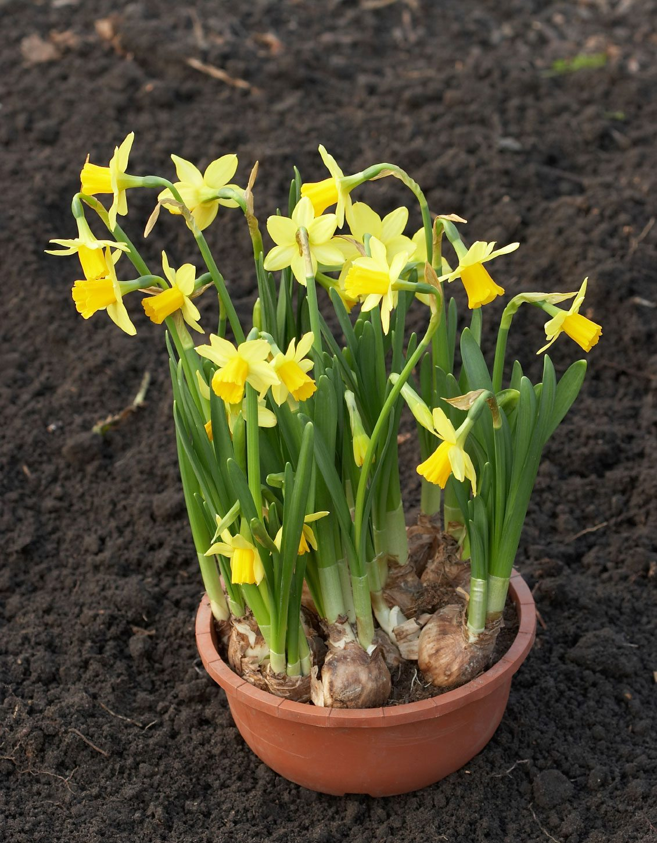
Consider the Scale of Your Project
Notes:
Are you planting a field or a flower pot?

Slide 11
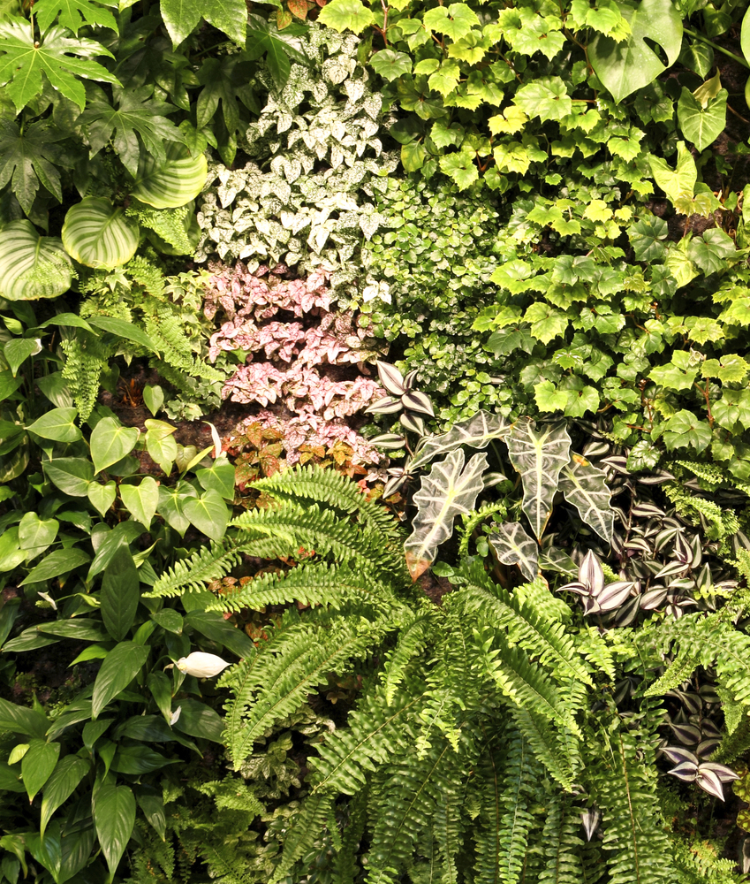
Horizontal or Vertical
Inside or Outside
Large or Small
Containers
Raised Beds
Trellises
Walls
Notes:
Many options depending on where and what you want to plant and most important, the space available to you.

Slide 12
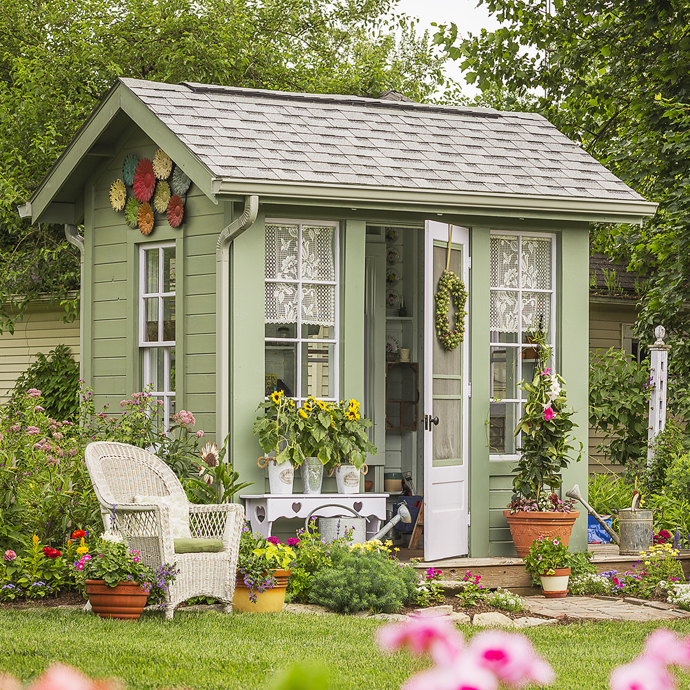
Whether you are totally into gardening for yourself . . .

Slide 13
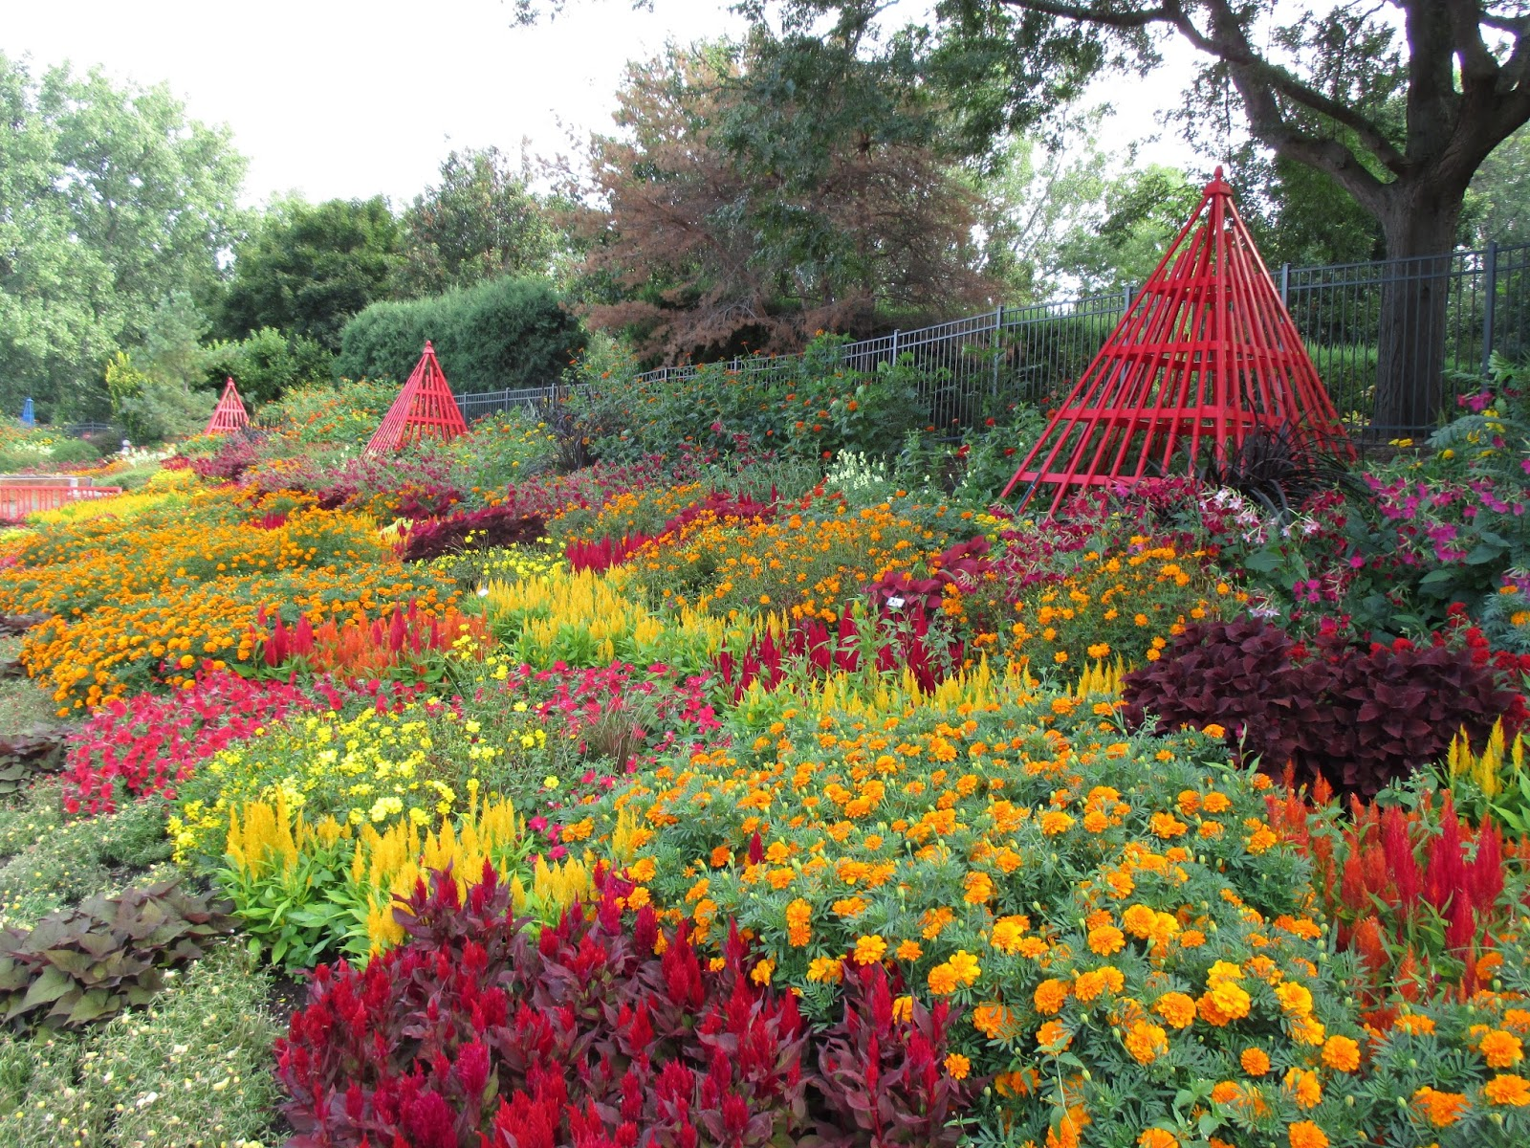
. . . or just love to see others do the work
Janesville WI Rotary Gardens

Slide 14
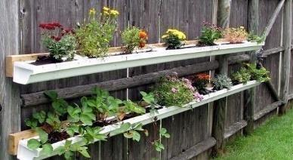
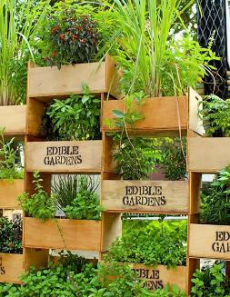
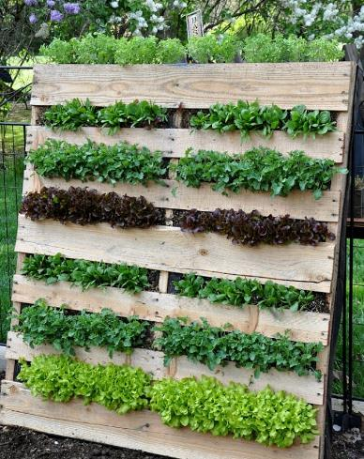
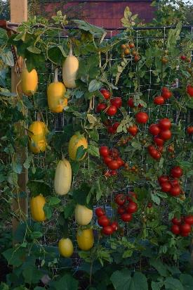
Go
Vertical
Reuse
Recycle
Reinvent Repurpose
Birdbaths
Containers
Pallets
Plant Towers
Pot Hangers
Rain Gutters
Bottles
Shoe Caddies
Notes:
Be innovative in your containers.
What other suggestions do you have?

Slide 15
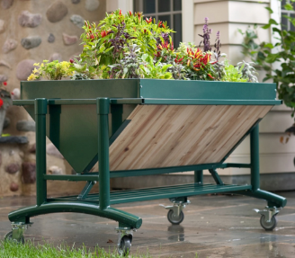
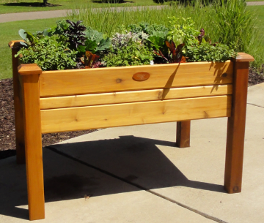
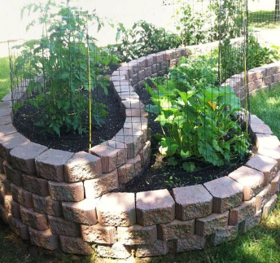
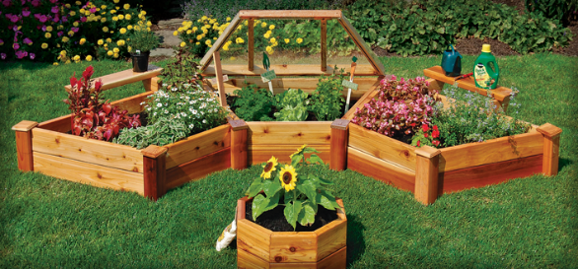
Raised
Garden
Beds
Notes:
“Belly button” gardening or ledge gardens.

Slide 16
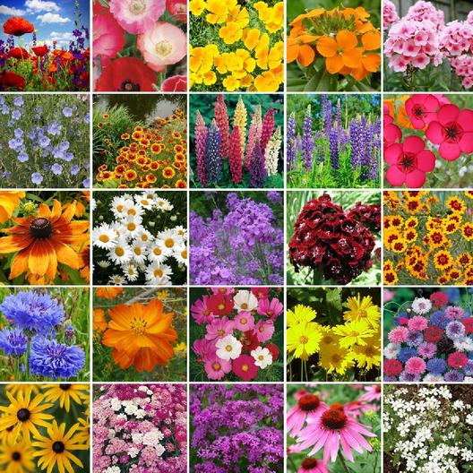
Endless Possibilities in Plant Selection
Consider site or container
Size of plants
Soil, light, and water requirements (zone)
Availability of varieties and cost
Personal preference
Notes:
Remember your level of commitment –
Do you want lots of colorful flowers – consider pots and plots of annuals –
Or do you prefer annual beds that require less maintenance?
Bulbs anyone? Do not forget to accent with beautiful foliage

Slide 17

Plant Selection
Choose plants that grow naturally in your area (zone, soil)
Shrubs are less maintenance than perennials, and perennials are less work than annuals
Avoid aggressive and invasive plants
Use groundcover and mulch to reduce weeding
Use containers and annuals for accent and color
Notes:
Discuss points on the slide with the audience. Tell story of something you planted that was not good.

Slide 18

Plants to Avoid
  Dividing
  Staking
  Deadheading
  Special care
  Disease prone
  Not hardy in your zone
  Food for wildlife
  Have a short lifespan
  Require extensive maintenance
Notes:
To save energy and reduce maintenance in your garden let’s review this list of the things to avoid and know what your level of commitment is.
For less maintenance in the garden – Avoid:
Deadheading needs
Special care --- Diseases in your area –
How often a plant needs to be divided or will you need to remove plants because they are not hardy in your zone.

Slide 19
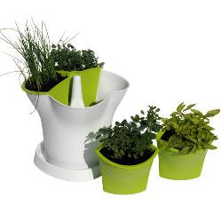
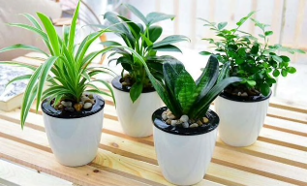
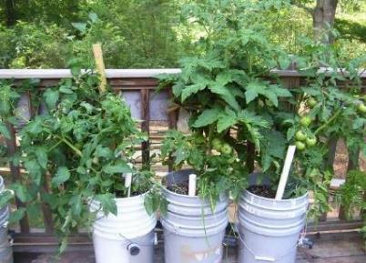
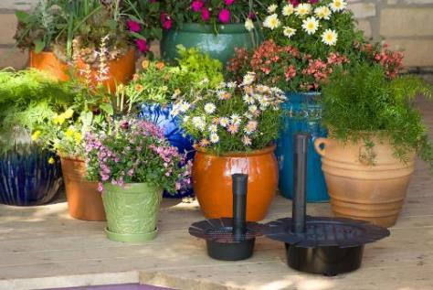
Containers, Self-Watering
Choose container size according to plant needs
Provide adequate drainage
Use proper potting mix
Put on wheels if moving
Consider access to water
Herbs
Self-Watering Systems

Slide 20
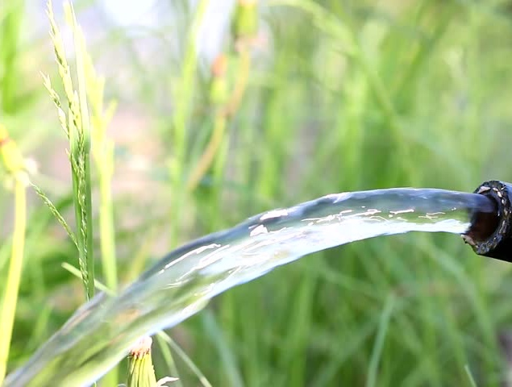
Accessibility to Water
Place garden or containers close to the house.
Use self-watering containers or irrigation.
Put containers where rain will reach them.
Mulch to conserve moisture.
Choose drought resistant plants.
Notes:
A 2.5 gallon water container weights 22 lbs. Can you lift that? Should you lift
that much weight? Show Fiskars two-handled watering can.

Slide 21
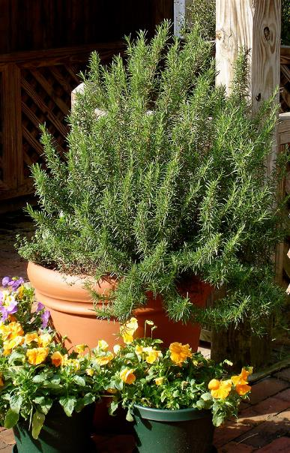
When to Water
Planter feels lighter in weight
Soil feels dry at finger depth
Plants begin to wilt
Weather has been hot, dry and windy
Experience
Notes:
Use the old fashion technique, your finger!

Slide 22
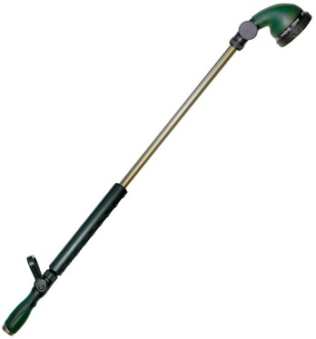
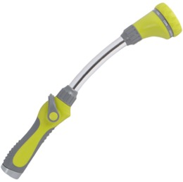
Watering Wand
Reaches into hanging baskets, low pots on the ground and into raised beds without need to bend or stretch to reach pots, decreasing risk of falls.
Conserves energy.
No need to carry heavy watering cans.
Reduces stress on joints and muscles.
Notes:
Make sure the watering wand has a metal loop that grips the handle so you
don’t have to squeeze the handle which causes stress.

Slide 23
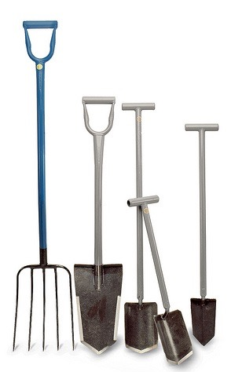
Tools
USE:
Light-weight, ergonomically designed tools
Long-handled tools; increase reach and decrease bending
Tools with smaller ends; reduce the weight of the tool
Two hands whenever possible; lopper vs. pruner
Notes:
Review 4 bullet points:
Ergonomic or modified tools help to save energy.
Long handles give you move leverage.
Smaller tool ends help you to lift and move weight that is easier on smaller muscles and saves energy.
Two-handed tasks save energy and allows for more strength to do a task.

Slide 24
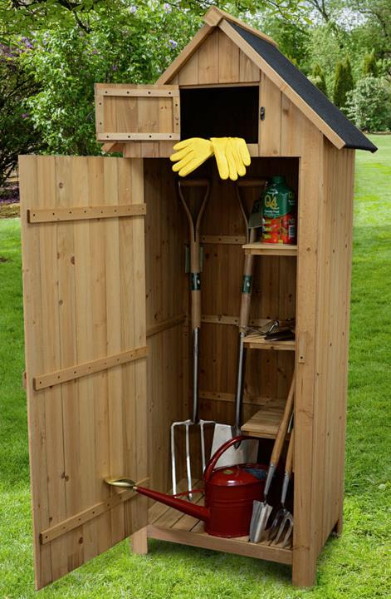
Store tools close to use, avoid carrying long distances and extra trips
Use a two-wheeled cart rather than a wheelbarrow
Keep tools clean, sharpened, and lubricated
Notes:
To save energy. Explain the three items listed on the slide. If you have a small urban garden a garden bag or bucket may be sufficient for your tools; but if you have a more expansive garden you might want to consider placing tools out in your garden, or a 2-wheeled cart to help move things. How about a golf bag or other means to move tools easily around your garden area.

Slide 25
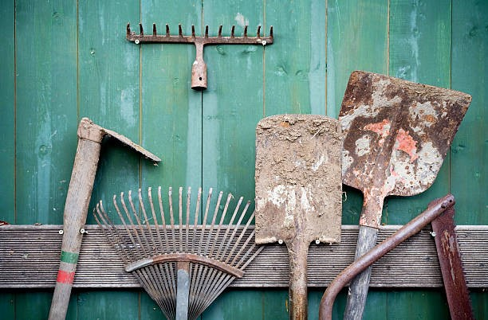
Garden Smarter Not Harder
Select the right tools for the job!
Notes:
The garden is also all about your tools and the care and use of these tools. If possible, don’t store them dirty; minimally, clean at the end of the gardening season.

Slide 26
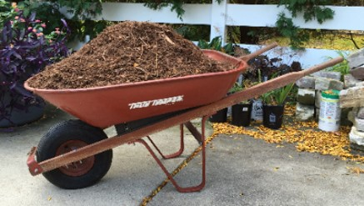
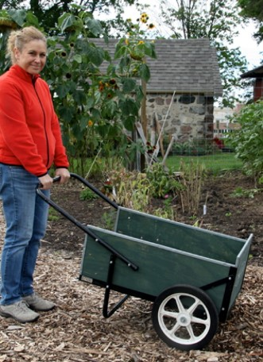
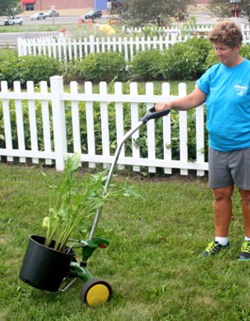
Use Wheels for Transport
Stress
Push is
Better
than Pull
Roll
Better
than Carry
Notes:
Balancing a wheelbarrow can put stress on the body, especially if you overfill it (can topple). Two wheels gives you more balance.

Slide 27

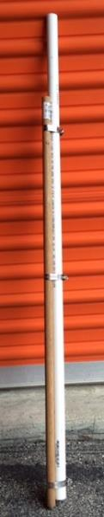
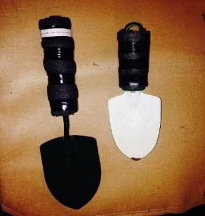
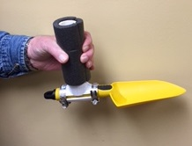
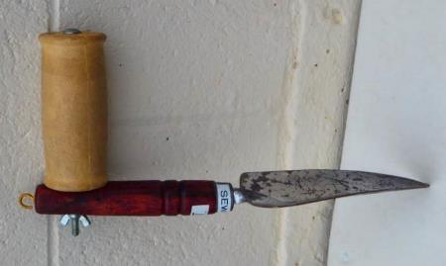
Modify Tools
Improve Favorite
Tools
Notes:
Demonstrate modifying a tool using pipe wrap and tape. Explain ease and low costs.

Slide 28
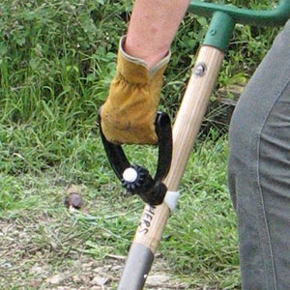
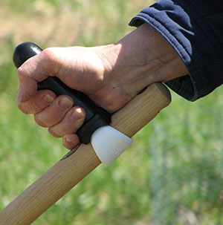
D - Grip
T - Grip
Back Saving Grips
Notes:
The D-grip mounts mid-way down the garden tool or snow shovel handle and gives lifting leverage to the forward hand. It also minimizes bending of the back.
The T-grip mounts at the upper end of a garden tool handle and gives pushing and pulling control to the back hand. It also minimizes bending of the wrist and allows for full-body leverage when pushing. Both handles are designed to offer arthritis and back pain relief and to reduce the risk of repetitive strain injuries, including Carpal Tunnel Syndrome and tendonitis. The plastic grip is easily movable from one tool to another; you may need to use a wrench for tightening.

Slide 29
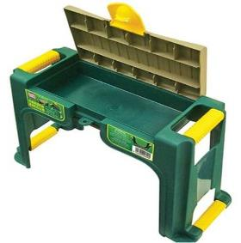
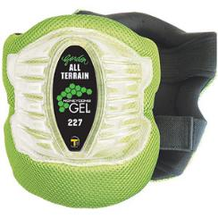
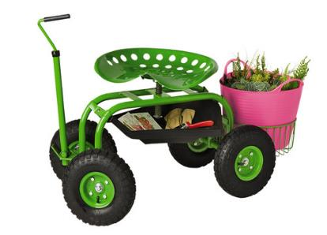
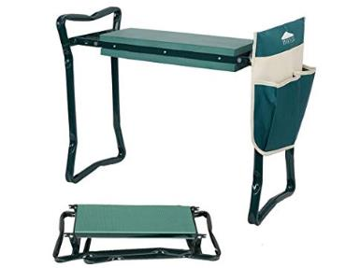
Seats and Kneelers

Slide 30


Pot Lifter
Allows two people to lift larger (up to 200 lbs.), awkward objects in the garden, resulting in energy conservation and less stress on back, joints and muscles.
Notes:
It equalizes the weight between two people.
For bringing your prize winning pumpkin from the garden.

Slide 31

PotMover Caddy
Carries any potted plant up to 20 inches wide by 30 inches tall and up to 100 pounds. Moves pots and containers with less energy and less stress on joints and muscles, particularly back, knee, and hip joints and muscles.
Notes:
Has adjustable lever that clamps onto the rim of pot to keep it on the foot for transportation.

Slide 32

Good
Body
Mechanics
To
Avoid
Notes:
Have you ever had the moment when you thought Oh NO – I have just done something that will hurt tomorrow????
Did you stretch before starting in your garden ????
Pay attention to your body. Pain = stop/change

Slide 33
Reasons to Use
Good Body Mechanics
Maintain balance and control
Prevent injury
Make tasks easier
Prevent unnecessary fatigue and strain
Notes:
Now we’ll discuss good body mechanics.

Slide 34

Body Mechanics
Eight Rules:
1. Maintain broad base of support
2. Bend at hips and knees; get close to an object
3. Use stronger (larger) muscles
4. Use your body weight to push/pull
Notes:
Review the first 4 rules. Each will float in on click.
Demo proper bending: from hips with knees above feet and rear pushed backward.

Slide 35


5. Carry heavy objects close/next to your body
6. Avoid twisting your body as you work
7. Avoid bending for long lengths of time
8. For heavy objects get help or use device/tool
NO
YES
Notes:
Review remaining 4 rules.
Remember twisting was a dance not a way to move loads.

Slide 36

Practice
Everyone Stand Up
Broad base of support looks like:
  Feet shoulder-width apart (8-10 inches)
  One foot slightly in front of other foot
  Balance weight on both feet
  Toes pointed in direction of movement
  Do not lock knees
How does this feel?
Bend from the hip with soft knees – use larger muscles
  Keep back straight and do not bend from the waist
Golfer’s bend
Notes:
Activity: Provide these directions.
Assistants can move through the group to assist learners who appear confused or struggling.
May want to restate a rule or two – remember to maintain a wide base of support and avoid bending for more than 7 minutes without a change in position.

Slide 37



Switch Tasks
Change Positions Often
Notes:
Change tasks and actions often every 10-15 minutes. Helps to prevent strains and muscle fatigue.

Slide 38


Sit to Do a Task
Take Frequent
Rest Breaks
Hydrate
Notes:
Sit if it works for your body. Notice the ladies are using a telescoping tool to weed with both hands; this helps center the tool to your body.
Take a rest and hydration break; maybe a short walk around the rest of your garden . . . remember to change tasks often.
Do you need more sunscreen or bug spray?

Slide 39




Use Larger Muscles and Joints
WRONG
Stress
Recruit
More
Muscles
Better
Notes:
Large muscles are better than using tiny muscles.
Look at Ann in the top right photo carrying the tray rather than pinching.
Two-handed tools are better that one-handed, especially if you’re working for more that 10 minutes.

Slide 40




Bend at
the Knees
Stress
Using
the
Shovel
Stress
Do Not
Twist
Notes:
The gardener on the upper left is shoveling in a manner that stresses the body – note the straight knees and rounded back.
The gardener on the upper right is lifting while straightening her hips and knees and not using her back to lift.
Placement of soil: In the bottom left photo the gardener is twisting her trunk to place soil in a container that is located away from the digging hole.
In the bottom right photo, the gardener has stepped around with the soil on the shovel to directly face the receptacle.
Note that a shovel that has an oversized head will hold a load of soil that is too heavy to be lifted comfortably.
Remember to keep the tool end sharp so that less effort is used cutting through the soil or plant roots.

Slide 41




Lifting and
Carrying
Bend at the
Knees
Do Not
Twist
Stress
Stress
Notes:
Lifting – where are your big muscles in this action? Use the hips and knees to lift and rotate your whole body.
Do not twist. Point both feet in the direction you are going.

Slide 42

Use Smaller Tool Ends
Notes:
Does your tool selection match your size/structure? The tool on the left is too big for this woman and she will hurt herself trying to move too much. With a larger rake you may gather more leaves, but will you be able to move them
safely especially if wet?

Slide 43


Raking
Dance
with
the rake!
Notes:
Demonstrate the incorrect way, then dance with the rake the correct way (vacuuming also).

Slide 44

Protect Joints
Notes:
Next, we’ll talk about protecting your joints.

Slide 45



Best Position
WRONG
Stressful Positions
Notes:
When standing and your hand is down to your side, this is the neutral position.

Slide 46



Best Position
Stressful Positions

Slide 47



Planting
Notes:
Adaptive tool or power tools? DIY large seed planter: PVC piping attached to a dowel or broom handle with clamps.
Make your time in the garden easier – and consider later actions.

Slide 48


Weeding
Stressful Positions
Too Much Stress on Back
Notes:
What is wrong in these pictures?

Slide 49




Too Bent
Best
Diamond Hoe
Best
Good
Positions
Notes:
Hoeing anyone – Talk about Diamond Hoe (should be 8’)
Describe the 3 positions in the upper right picture
Discuss alternatives – sitting and the correct posture for weeding a small patch.

Slide 50



Fiskars Uproot Weeder
Notes:
Handy tool - keeps you upright. Demonstrate weeder (no bending required).

Slide 51
Key Points to Remember
Keep a wide base of support
Keep Back Straight, bend at the knees
Avoid Twisting
Keep load close to body
Push rather than pull whenever possible
Notes:
Get audience involved; ask them to give points to remember.

Slide 52
Hand
Tools

Slide 53

Neutral Wrist
Notes:
How many of you have felt fatigue after your hand has been in one of these incorrect positions for a length of time? Now you can successfully demonstrate the neutral hand positions that will provide relief from some of this fatigue. Note: Incorrect wrist positions can contribute to carpal tunnel syndrome or other injuries.

Slide 54

Wrist Posture
The least stressful posture for the wrist is called the neutral posture.
The wrist normally assumes this posture when your hand is hanging comfortably at your side.
Notes:
When striking (as with a hammer) or performing repetitive motions with one hand, remember to keep your wrist in a neutral position. Also rest your wrists often by allowing your hands to hang alongside your legs or rest in your lap.

Slide 55




Poor
Position
Good Position
Notes:
The photos on the bottom show proper positions when using hand garden tools.
Poor position causes stress - the wrist is bent forward toward the palm and excessively toward the little finger.
The photos on the bottom show lines that indicate better wrist position; the hand tools used here are called “Radius” tools. Be sure to grasp the tool at the end of the handle; not on the curve of the handle near tool end.
Special equipment isn’t necessarily required, as long as you are aware of the potential for problems.
Consider changing tasks/positions frequently or alternating doing the task from your dominant to your non-dominant hand.

Slide 56


Good Positions
Notes:
These views show correct positions: the wrist and hand are properly aligned with the forearm.
On the left is a Peta Easi-Grip tool.
On the right you see an additional positioner: Peta fist grip tool with forearm cuff. This combination decreases stress on the wrist and redirects force to larger elbow joint and muscles.

Slide 57


Avoid Thumb Pressure
Stress
Better
Notes:
Thumbs have very small muscles. It is important to avoid continual pressure on your thumb.
If a gardener has arthritis, the thumb joint is usually painful.
Look for tools with levers or locks to greatly reduce joint impact.

Slide 58


Avoid Prolonged Pinching and Squeezing
Stress
Better
Notes:
Avoid extended use of very small muscles. A stressed grip causes us to use greater energy to perform the task.
Grasping over time can cause strain in arms, shoulders, neck, or back and can also raise blood pressure.

Slide 59



Use Better Methods
Stress
Seed Tapes
Commercial or Homemade
Seed Dialer
Notes:
Examples of energy-conserving items are seed tapes, dial planters, and adaptive planters.
Seed tapes can be purchased or made during the winter while hoping for spring. Show how to put a paint brush in a medium styrofoam ball for better grip.
Dialers: you fill and shake out seeds. Adaptive tool helps you plant while standing.

Slide 60



Stress
Size of
Proper
Grip
Better
Notes:
Point out what is right and wrong about the hand positions in the photos. Explain the proper grip photo with a demonstration: Have everyone in the audience form the letter “O” with their thumb and fingers to feel a natural grip without stress. You are using greater energy to clasp the tool and perform the job when grip is not correct.
Stress grip can cause blood pressure to rise and strain to arms, shoulders, neck and back.

Slide 61
Radius Hand Tools
Trowel Transplanter Weeder Cultivator
Notes:
Demonstrate proper grip on a Radius tool.

Slide 62



Peta Easi-Grip® Tools
“More Work for Less Effort”
Weeder
Cultivator
Trowel
Fork
Arm Cuff
Notes:
Have audience member experience a PETA tool without cuff, then add cuff
and see if they can tell the difference.

Slide 63



Peta Easi-Grip® Add-on Handles
Handle
(2/set)
Modify an existing tool

Slide 64


Peta Long Reach Easi-Grip® Tools
Work from a sitting position to reach the ground or into raised beds.
Ergonomically angled; keeps the hand and wrist in a neutral position, decreasing stress and pain at these joints.
Forearm cuff attached to tool relieves stress on the wrist muscles and joint by transferring some of the work to the larger elbow and shoulder muscles and joints.
Hoe
Cultivator
Trowel
Fork
Arm Cuff

Slide 65








Use Proper Pruners
Ratchet
PowerGear
Power Step
Bypass
Anvil
Left Hand
Cut & Hold
Small Hand
Notes:
There are many shapes and sizes of pruners. Please make certain that the pruner fits your hand. They also come left- or right- handed. Over-extending your fingers due to poor fit will cause injury over time and cause you to use more energy to perform the task.
Remember your first knuckle should show above the pruner handle when you begin to grasp the tool.

Slide 66


Select Pruner for Hand Size
Stress
Better
Notes:
Review proper fit and have assistant demonstrate proper fit.
Pictured is an anvil pruner. Ask the audience: What is it used for within the garden? Correct answer: dead material removal.

Slide 67


Anvil vs. Bypass Pruners
Anvil pruners tend to crush soft plant tissue.
Ideal for hard-to-cut, tough, dry or dead wood.
Bypass pruners work more like scissors where two blades pass by each other.
Closer, more precise cuts.
Notes:
There are two types of pruners: Anvil and Bypass. Each has important jobs to do in the garden. Use anvil pruners for removing dead growth (stems, stalks) from your plants. Bypass pruners are best used on live growth and make a clean cut across the stem of the plant.

Slide 68




PRUNING
Two Hands when Possible
Cut
and
Hold
Beware
5 minute maximum
on neck movements
Notes:
Demonstrate use of cut and hold tools on twigs or flowers.

Slide 69

Telescoping Hedge Shear
Telescoping handles extend from 28 to 41.5 inches to reach higher and deeper into your flowerbed without leaning or using a ladder.
Decreases your risk of falling.
Notes:
Telescoping pruners allow you to extend your reach to trim. Look for those with lightweight aluminum handles. This model weighs only two pounds, has a push button spring that lock the handles in place and has shock absorbers.

Slide 70


Gloves Should Fit
Poor Fit
Bio-Gloves
Best
Notes:
Bionic gloves vs. husband’s gloves

Slide 71



Spearhead Spade
Avail. 3 handle lengths
Radius Garden
Pro-Lite Ergonomic Carbon Steel Shovel
Shovels
Radius Garden
Root Slayer Shovel
Notes:
Compare the shovels

Slide 72


Slide 73


Using proper techniques and the right tools may allow you to enjoy gardening through life.

Slide 74

Thank you for attending!
Are there any questions?

