Slide 1
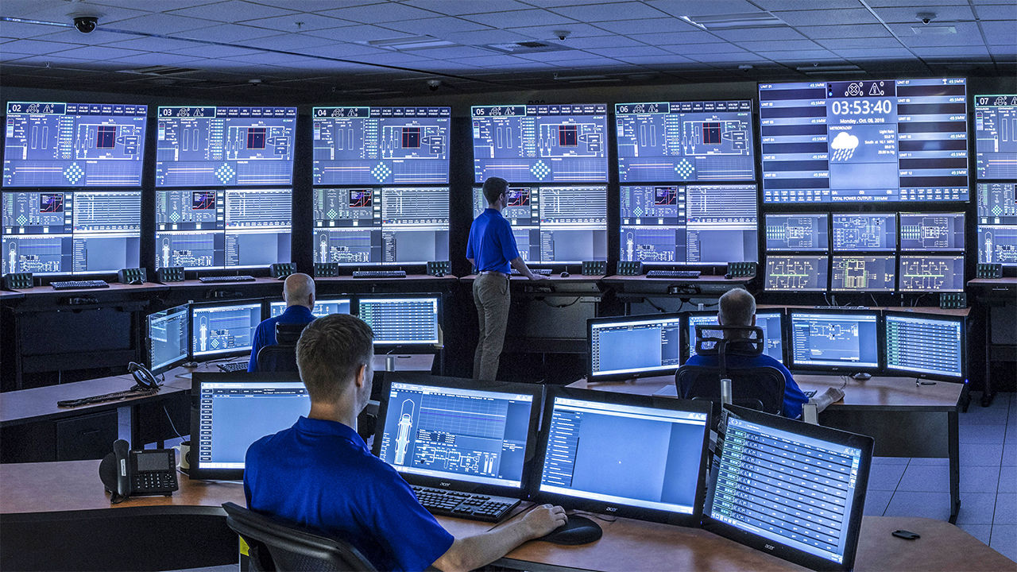


ACPEEC Sponsor Package
Date: April 2024

Slide 2




ACPEEC Sponsorship
We are thrilled to share that the 10th Annual Alberta Chief Power Engineers Education Conference Powered by Silverback is booked for October 29, 2025, at the Renaissance Edmonton Airport Hotel.
Our committee has been working diligently with your feedback from past conferences and are committed to bringing you the best experience for you and your team.
Sponsors are the foundation of the continued success of this conference, and we invite you to join at your preferred sponsorship level this year.
We are thankful for Silverback Steam & Heating Rentals for being our Presenting Sponsor.
We ask that you reach out directly to George Mitsopoulos at gmitsopoulos@pembina.com to confirm your sponsorship by June 30, 2025.
We look forward to seeing you and your teams at the 10th Annual Alberta Chief Power Engineers Education Conference Powered by Silverback this year!
$2500.00
$1500.00
$1000.00
$500.00
Key sponsor for break snacks located near their booth
All gold level items
Booth at Conference
Full Page Advertisement
Handout to Attendees
Supply Door Prize
Attend Hospitality Suite the Night Before
Booth at Conference
½ Page Advertisement
¼ Page Advertisement
Great opportunity for your company to meet leaders in the energy industry

Slide 3
ACPEEC Sponsor Levels
GOLD
SILVER
BRONZE
PLATINUM
$2500.00
$1500.00
$1000.00
$500.00
Premium Booth Location
Sponsor of Social Event
Full Page Advertisement
Handout to Attendees
Supply Door Prize
Hospitality Suite the Night Before
3 Complimentary Tickets for your team to join
Booth at Conference
Full Page Advertisement
Handout to Attendees
Supply Door Prize
Hospitality Suite the Night Before
2 Complimentary Tickets for your team to join
Booth at Conference
Half Page Advertisement
1 Complimentary Ticket for your team member to join
Quarter Page Advertisement
1 Complimentary Ticket for your team member to join
Great opportunity for your company to meet leaders in the energy industry

