Slide 1
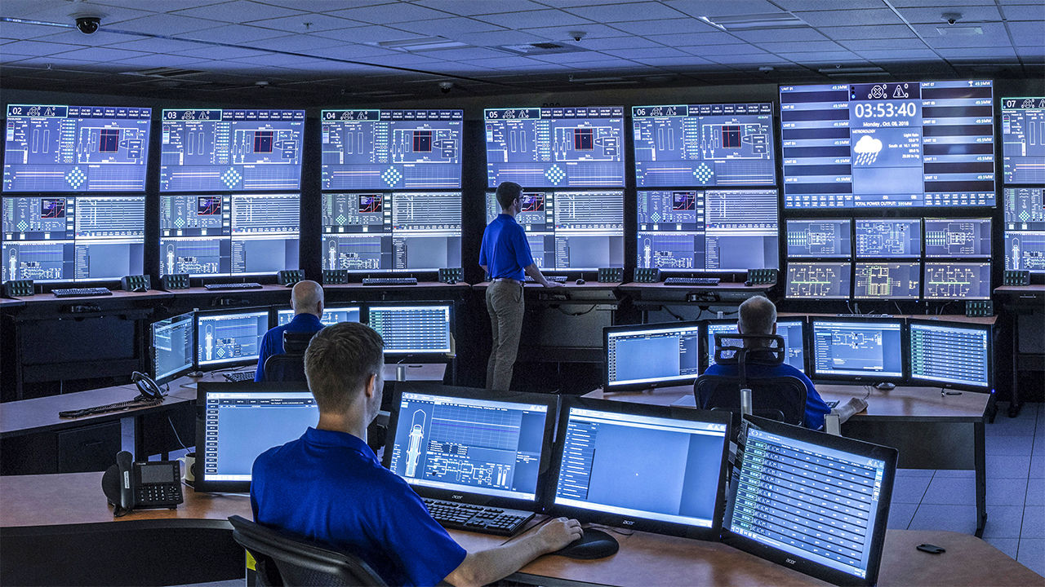

2025 ACPEEC PRESENTATIONS
Date: 2025-12-27

Slide 2


2025 ACPEEC Presentations
Please follow this link to access all 2025 ACPEEC presentations:
2025 ACPEEC Presentations
Feel free to share with your colleagues.
Looking forward to meeting you all at 2026 ACPEEC.
$1500.00
$1000.00
$500.00
Key sponsor for break snacks located near their booth
All gold level items
Booth at Conference
Full Page Advertisement
Handout to Attendees
Supply Door Prize
Attend Hospitality Suite the Night Before
Booth at Conference
½ Page Advertisement
¼ Page Advertisement
Please follow the link

