Slide 1
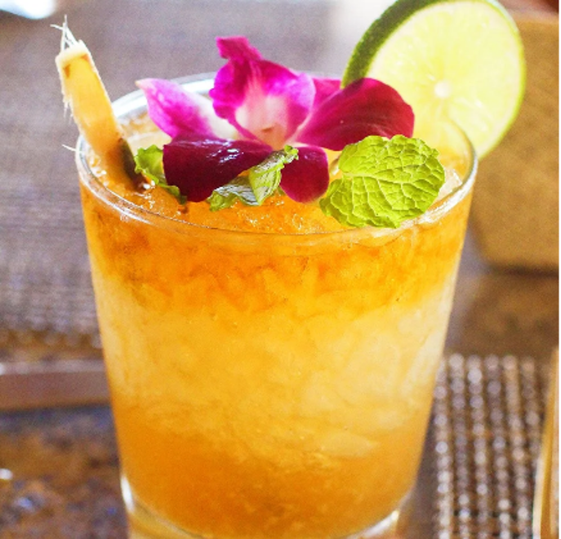
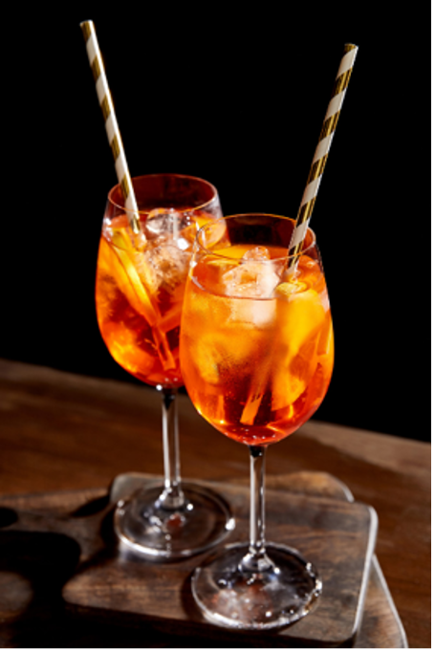
MAI TAI GLASS: TIKI OR ROCKS
APEROL SPRITZ GLASS: WINE
INGREDIENTS:
dark rum
½ oz overproof Jamaican rum
½ oz reserve rum
½ oz orange curacao
1 oz lime juice
½ oz orgeat
INGREDIENTS:
3 oz Aperol
3 oz dry Prosecco
1 oz soda water
METHOD:
Combine all ingredients into a cocktail shaker w/ ice and shake , Strain into tiki glass with pebble ice.
GARNISH:
Lime/Flower/Umbrella
METHOD:
Add ice to a wine glass until it is nearly full. Pour in the Aperol , Pour in an equal amount of Prosecco. Top drink off with a splash of club soda
GARNISH:
Orange Slice

Slide 2
MAI TAI GLASS: TIKI OR ROCKS
APEROL SPRITZ GLASS: WINE
INGREDIENTS:
dark rum
½ oz overproof Jamaican rum
½ oz reserve rum
½ oz orange curacao
1 oz lime juice
½ oz orgeat
INGREDIENTS:
3 oz Aperol
3 oz dry Prosecco
1 oz soda water
METHOD:
Combine all ingredients into a cocktail shaker w/ ice and shake , Strain into tiki glass with pebble ice.
GARNISH:
Lime/Flower/Umbrella
METHOD:
Add ice to a wine glass until it is nearly full. Pour in the Aperol , Pour in an equal amount of Prosecco. Top drink off with a splash of club soda
GARNISH:
Orange Slice

