Slide 1

Informational session: Station Renovation and addition
West Barnstable Fire Department

Slide 2
Please hold all questions until the end of the presentation

Slide 4
PRIOR PRESENTATION
Presentation to the West Barnstable Civic Association was held on October 21st.
This presentation highlighted the limitations and challenges of the current building
Presentation was recorded and is available on the WBCA website under the 2025 October Meeting

Slide 5
Station was built in 1988. Station has not been renovated or added to since.
Staffing has increased and the Fire Station is now staffed 24/7.
Year Barnstable Fire District Stations Were Constructed
Current
West Barnstable (1950) 1988
COMM HQ (1926) 1990 (Taj Mahal) Modern Living Quarters
COMM Sta 3 (1975) 2003 Modern Living Quarters
COMM Sta 2 (1926/1962) 2010 Modern Living Quarters
Hyannis (1964/1987) 2018 Modern Living Quarters
Cotuit (1938/1991) (started ren/addition 2026) Modern Living Quarters
Barnstable (1935/1974) (started new station 2026) Modern Living Quarters
(ren 2000/2001)

Slide 6
What we are proposing
Renovate the existing living areas of the fire station (excluding apparatus bays, shop, storage room) and construct an addition to meet the department’s current and future operational needs
Improvements will include appropriately designed male and female facilities, adequate administrative office space, and modernized living quarters that reflect today’s standards for firefighter health, safety, and functionality

Slide 7
These upgrades are intended to significantly enhance firefighter safety by incorporating best practices in separation of living and contaminated areas, improved air quality, and proper decontamination considerations
In addition, the project will have a substantial positive impact on morale by providing comfortable, functional, and well-designed living spaces that support personnel during long shifts

Slide 8
Modernized facilities will also strengthen the department’s ability to recruit and retain qualified personnel by offering a professional, equitable, and supportive work environment that meets the expectations of today’s workforce

Slide 9
facts
We are not asking for a new fire station
We are not asking for anything extra in the plans
Because of financial constraints, we are not asking to add to, renovate or update the following:
apparatus bays, basement, parking lot, hardscape, landscape, shop, or storage room above the shop

Slide 10
Cotuit FD’s current renovation/addition is $18 million dollars. We are not asking for anywhere close to that amount
Barnstable FD’s new station $35.2 million (Approved May 2025 District Meeting)
Orleans FD will be asking their taxpayers in May for approximately $60 million for a new fire station. We are not asking for anywhere close to that

Slide 11
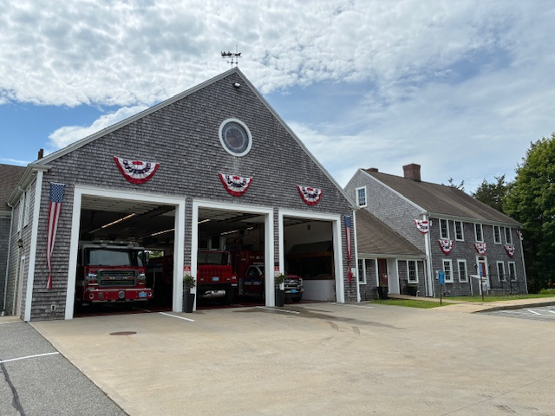
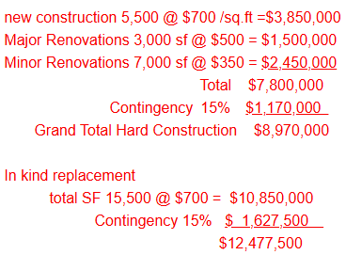

Feasibility study
Saccoccio & Associates Architects were hired through an RFQ on December 29, 2025
to complete a Feasibility Study
On March 17th, an online meeting was held with Saccoccio to discuss preliminary
numbers, and the first renovation and addition plans were shown. Facility Conditions
Index was discussed.
VERY PRELIMINARY NUMBERS FACILITY CONDITIONS INDEX

Slide 12
Building Committee met on March 26th to discuss the plans and the Facility Index Numbers. Saccoccio was then tasked with developing plans for a minor renovation and an addition

Slide 13
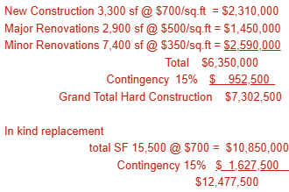
The Building Committee met on April 16th and agreed to request a total of three designs from Saccoccio, including plans for a minor renovation/addition,
a moderate renovation/addition, VERY PRELIMINARY NUMBERS
and a major renovation/addition
Due to this, the study has not been completed

Slide 14
Preliminary design recommendations:
1.) Renovate the main part of the building (residential area, not where the apparatus is parked or the shop)
2.) Add a two-story addition in the rear connected to the residential area
What will this do:
Add appropriate offices or workspace areas for:
District Clerk District Accountant Fire Chief
District Treasurer Shift Commander Deputy Fire Chief
Fire Prevention Officer Records Access Officer Administrative Assistant
*Shift commander bunk and locker, District Treasurer’s desk, and Records Access Officer’s desk are in the same room

Slide 15
Add/upgrade restroom and shower facilities (no individual bathrooms)
Modern and toxin-free living quarters for males and females
Add a vestibule area at the main entrance
Re-purpose the current communications area into an area that incorporates communications but also to evaluate walk-in medical calls, perform BP checks, Sharps Program box exchanges, and add firefighter workstations (this area is currently used by the Fire Prevention Officer. FPO does not have an office)

Slide 16
Add a decon room. Gear extractor and gear dryer will be placed into this room (gear extractor is currently in the basement. Dirty gear with toxins has to be brought through the living quarters and down to the basement)
Larger EMS supply room. (Current EMS supplies are in 3 places throughout the station)
Gear room: firefighting gear will not be stored on the apparatus floor
Personal effects storage/lockers per CBA

Slide 17
Dedicated fitness room (currently members leave the station and go to the YMCA)
Appropriate climate-controlled room for telecommunications equipment (currently this equipment is in the wet/damp basement)
Modernized commercial-grade kitchen (kitchen is original, 1988)
Appropriate conference area/dining area for smaller 8-10 person meetings (due to space constraints, cannot have two separate rooms)

Slide 18
Add an appropriate training/meeting room for the department and the publics use. Larger capacity and better access for the public (currently the room is too small for tables, chairs and people. Room is also used by the two full-time firefighters as a work area)
Modern HVAC suitable for a commercial building (truck exhaust comes through the door) A modern fire station’s HVAC is designed around health, safety, and efficiency — with strict separation of “hot zones” and “cold zones,” stronger ventilation, and energy-smart systems
Building will be brought up to the appropriate local, state and federal codes as well as energy code (sprinkler and fire alarm system is outdated)
ADA accessibility requirements: door and hallway widths, and ramps railings

Slide 19
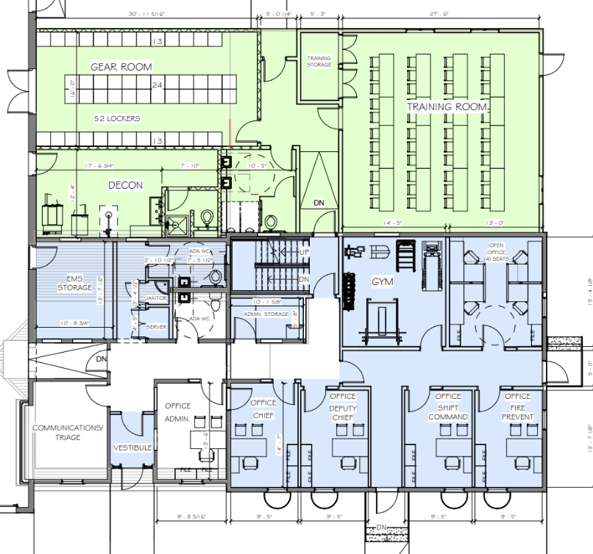
First Floor example of #2 moderate renovation/addition (April 14th)

Slide 20
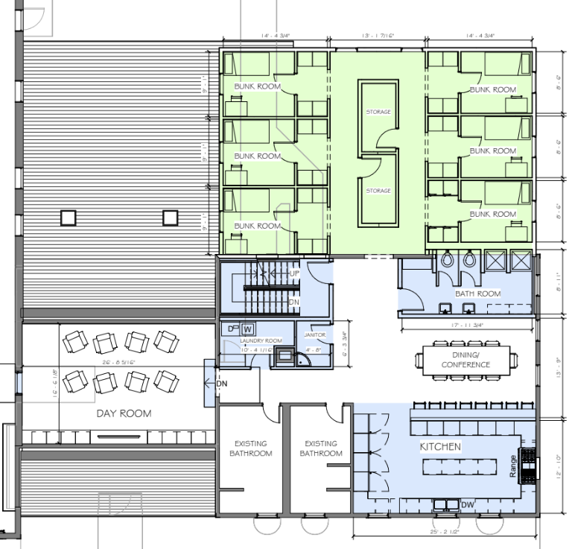
Second Floor example of #2 moderate renovation/addition (April 14th)

Slide 21
Next steps
Building Committee needs to recommend one of the three designs and present that design to the Prudential Committee for approval
With Prudential Committee approval, a Special District Meeting will be held in 2026
A yes vote at Special District Meeting will (this is what Article 14 would have done):
Appropriate funds so architects and engineers can begin the formal design work for the project
Allow the project to move through the three professional design stages:

Slide 22
Schematic Design- initial layout and concept of the building/renovation
Design Development- refining the design, systems, materials, and costs
Construction Documents: detailed plans and specifications required to bid and build the project

Slide 23
WHAT THIS RESULTS IN
✔ Produces complete architectural and engineering plans
✔ Establishes a reliable construction cost estimate
✔ Creates the documents required to go out to bid for construction
✔ Allows the district to return to voters with final plans and a firm construction price

Slide 24
IMPORTANT POINT
⚠️ A Yes vote does NOT approve construction yet. It only funds the design work needed to determine the final scope and cost of the project
A Yes vote pays for the professional plans so the district knows exactly what the project will look like and what it will cost

Slide 25
Future: 2027 District Meeting
If the Article at Special District Meeting is approved, residents will be asked to support an article to fund the construction of the project at the April 2027 District Meeting

Slide 26
cost
As a result of the Building Committee’s April 16th decision to obtain three separate design plans from Saccoccio, all three cost estimates will not be available until those plans have been completed and reviewed
Due to this, it has been recommended to the Prudential Committee to withdraw Article 14

Slide 27
Fire station tour
After questions, we will offer a tour of the station so attendees can see our current facilities and better understand the limitations and challenges of the current building

Slide 28
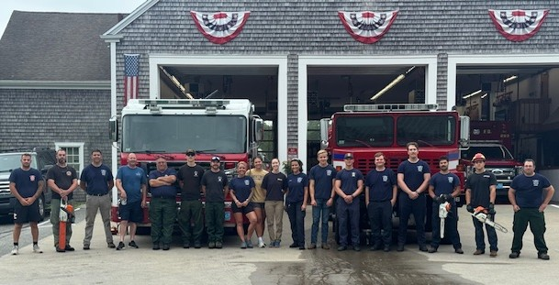
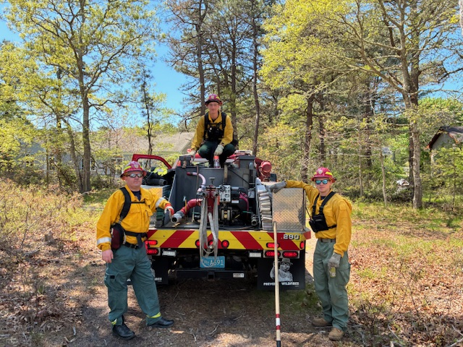
On behalf of the men and women of the wbfd, thank-you for your continued support Questions?

