Slide 1
Welcome To Troop 52’s
Court of Honor
August 30th, 2021

Slide 2
Opening Flag Ceremony
Pledge of Allegiance: I pledge allegiance to the Flag of the United States of America, and to the Republic for which it stands, one Nation under God, indivisible, with liberty and justice for all. Scout Law: A Scout is Trustworthy, Loyal, Helpful, Friendly, Courteous, Kind, Obedient, Cheerful, Thrifty, Brave, Clean, and Reverent. Scout Oath: On my honor I will do my best to do my duty to God and my country and to obey the Scout Law; to help other people at all times; to keep myself physically strong, mentally awake, and morally straight.

Slide 3

Merit Badge Achievements

Slide 4
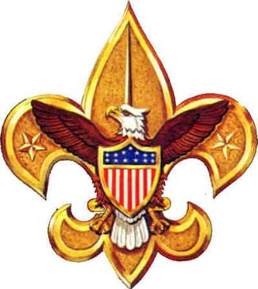
Special Awards

Slide 5


Mile Swim BSA Tyce Bogdon Snorkeling BSA Tyce Bogdon Dylan Chastain Brett Eaves Riki Goss Keaton Hampton Nicholas Royal

Slide 6
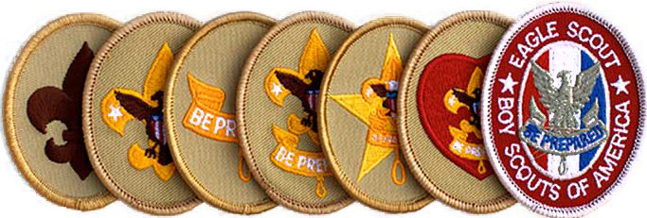
Rank Advancement Ceremony

Slide 7
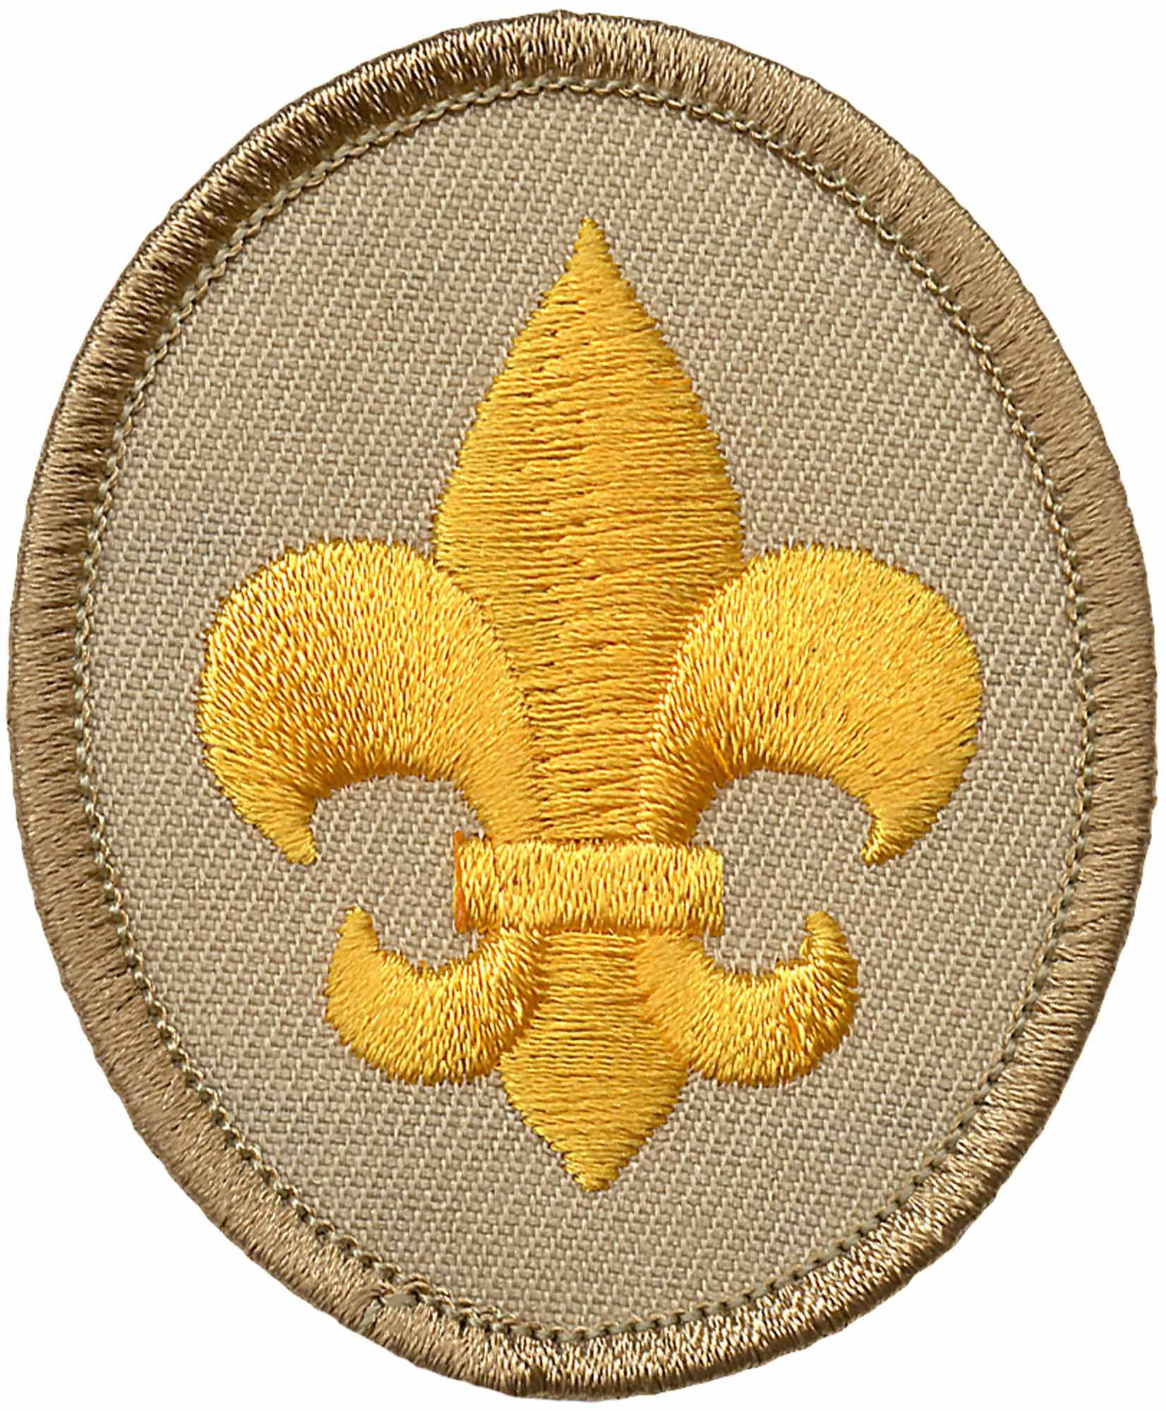
Scout Rank
Evan Johnsrud, Rohan Konda,
Nirujen Manoharan, Sarujen, Manoharan, Xander Palermo, Erik Schneider,
Maron Sfeir, Ankush Sudhakar,
Dominic Vugrincic, Leo Walters

Slide 8
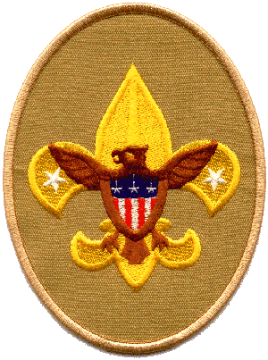
Tenderfoot Rank
Nicholas Dawson, Rohan Konda, Jake Royal, Maron Sfeir

Slide 9
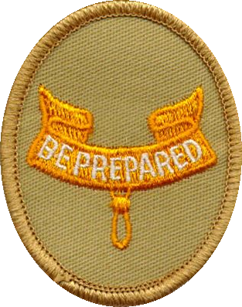
Second Class Rank Brooks Chalfant, Hudson Russell, Henry Semph

Slide 10
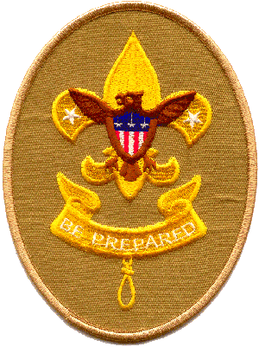
First Class Rank
Logan Campbell, Brett Eaves, Riki Goss, Henry Semph

Slide 11
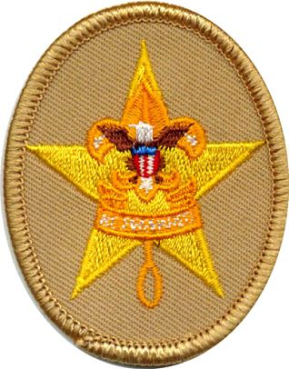
Star Rank Brant Doggett, Jacob Gomes, Keaton Hampton, Alejandro Loredo, Jeremy Suh

Slide 12
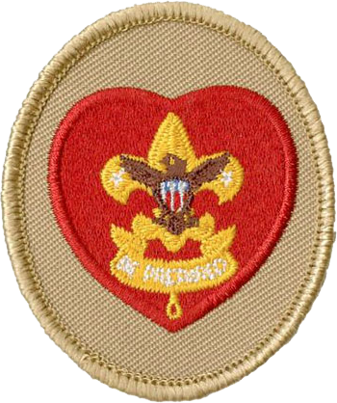
Life Rank Martin Becker, Ethan Ezell, Srijan Jagarlamudi, Aditya Rao, Andrew Segner

Slide 13
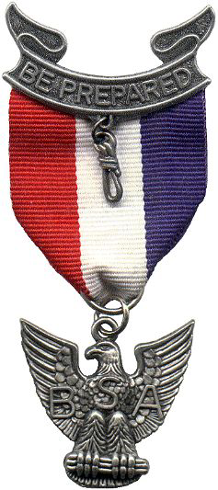

Eagle Recognition
Philip “Tommy” Wright
Henry Kelbaugh, III
Jamie Ezell

Slide 14
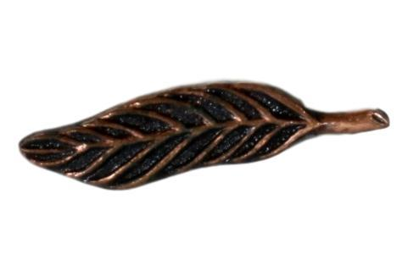
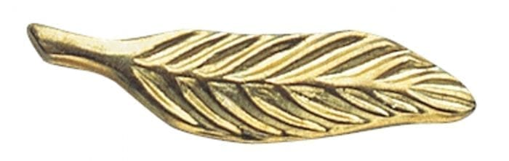
Palms Bronze Phillip “Tommy” Wright Henry Kelbaugh Jamie Ezell Gold Henry Kelbaugh Jamie Ezell

Slide 15
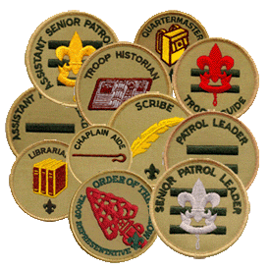
New Scoutmaster Installation Ceremony James Ezell

Slide 16


