Slide 1
Welcome To Troop 52’s
Court of Honor
January 9th, 2022

Slide 2
Opening Flag Ceremony
Pledge of Allegiance: I pledge allegiance to the Flag of the United States of America, and to the Republic for which it stands, one Nation under God, indivisible, with liberty and justice for all. Scout Law: A Scout is Trustworthy, Loyal, Helpful, Friendly, Courteous, Kind, Obedient, Cheerful, Thrifty, Brave, Clean, and Reverent. Scout Oath: On my honor I will do my best to do my duty to God and my country and to obey the Scout Law; to help other people at all times; to keep myself physically strong, mentally awake, and morally straight.

Slide 3
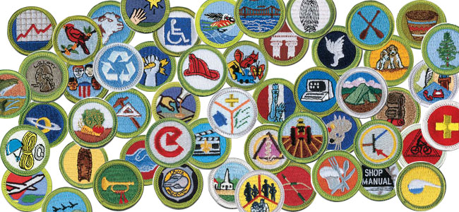
Merit Badge Achievements

Slide 4
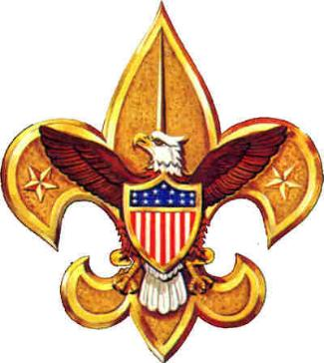
Special Awards

Slide 5
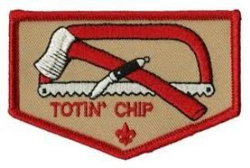
Totin’ Chip Jaxson Reiner Firem’n Chit Jaxson Reiner

Slide 6
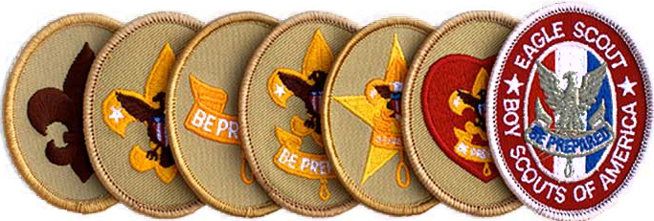
Rank Advancement Ceremony

Slide 7
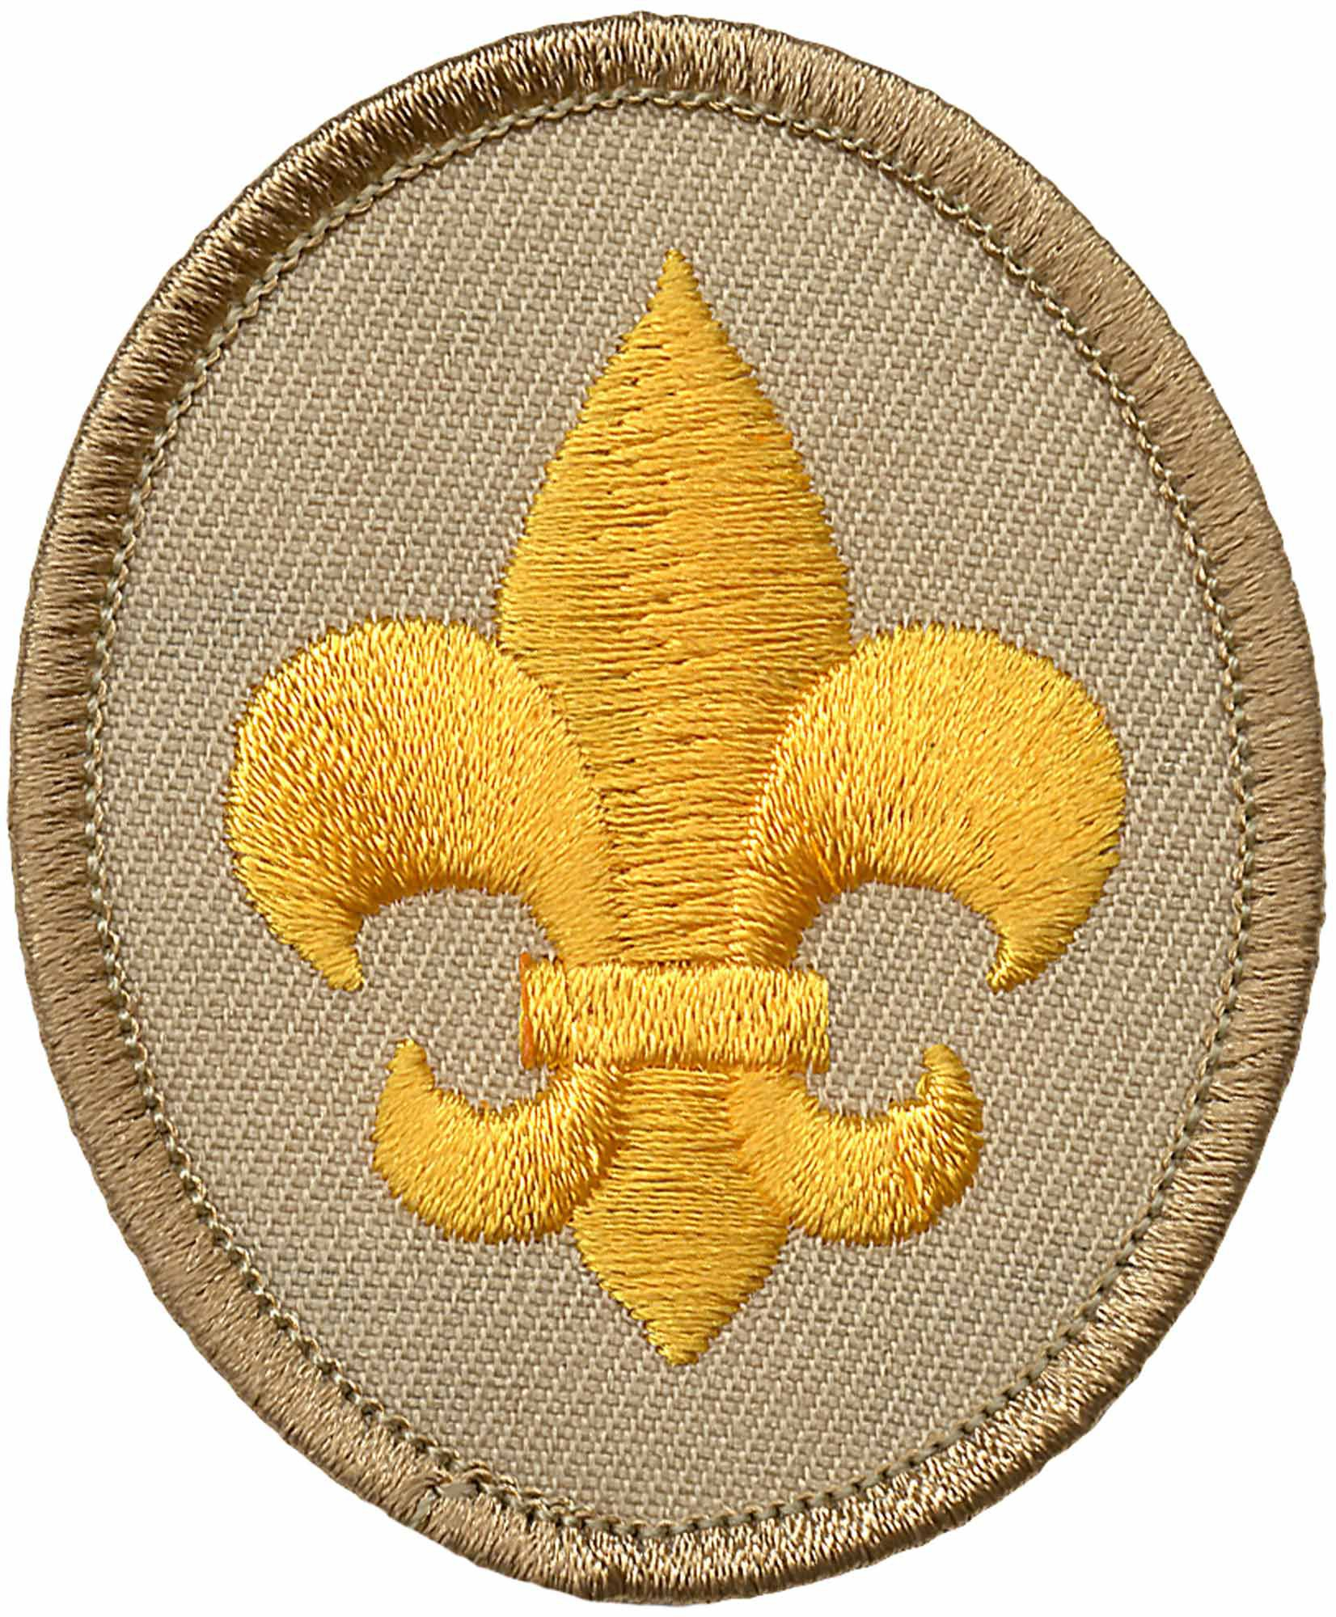
Scout Rank
Landon Bates, Jaxson Reiner

Slide 8
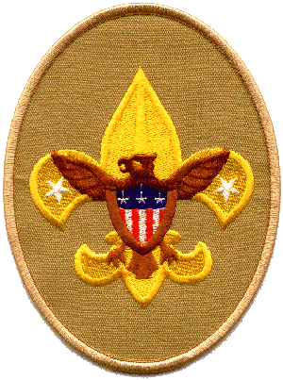
Tenderfoot Rank
Chase Doggett

Slide 9
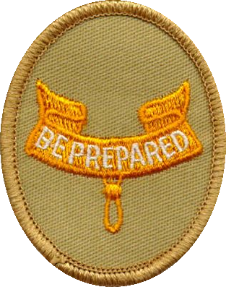
Second Class Rank Ian Schneider, Nick Dawson, Rohan Konda, Maron Sfeir, Jake Royal

Slide 10
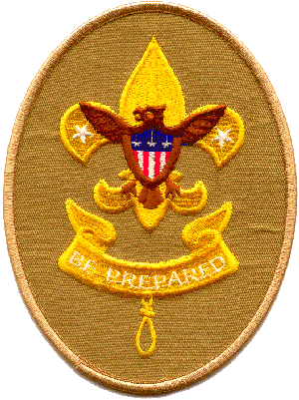
First Class Rank Andrew Block, Brooks Chalfant, Nick Dawson

Slide 11
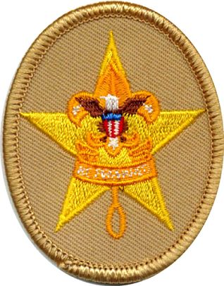
Star Rank Aaroosh Kolli, Connor Schulenberg

Slide 12
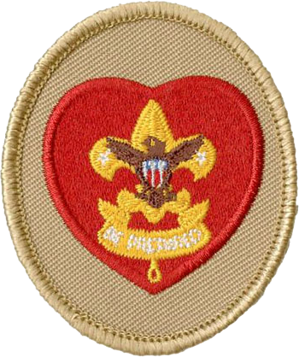
Life Rank Tyce Bogdon

Slide 13
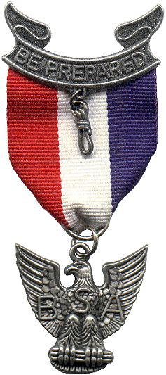
Eagle Recognition
Arthur Blake, David N. ”DJ” Brown, Trace Cottey, Jamie Ezell, John Gallagher, Parker Grovatt, Henry Kelbaugh, Brogan Leonard, Nick Longmore, Tarun Rajanala, Philip “Tommy” Wright

Slide 14
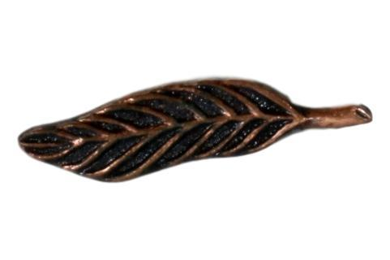
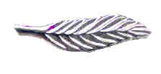
Palms Bronze Arthur Blake, David N. “DJ” Brown, Brogan Leonard, Parker Grovatt Gold Parker Grovatt Silver Riley Farnsworth

Slide 15
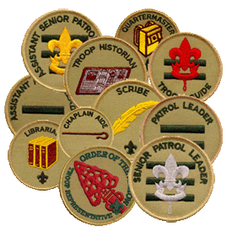
New Scoutmaster Installation Ceremony James Ezell

