Slide 1
Fishing Merit Badge
Requirement 4:
Demonstrate how to tie the following knots:
improved clinch knot,
Palomar knot,
uni knot,
uni to uni knot, and
arbor knot.
Explain how and when each knot is used.
March 2018

Slide 2
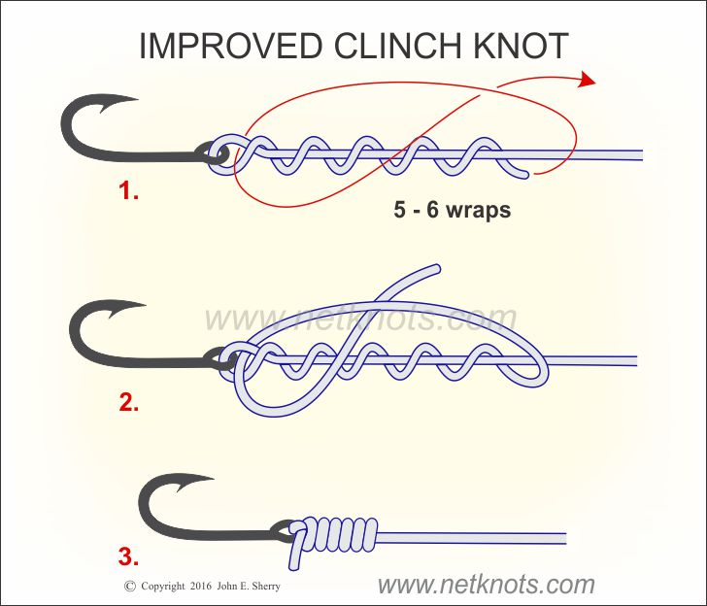
Fishing Merit Badge
Improved Clinch Knot:
Use: secure fishing line to a hook, lure, or swivel
March 2018

Slide 3
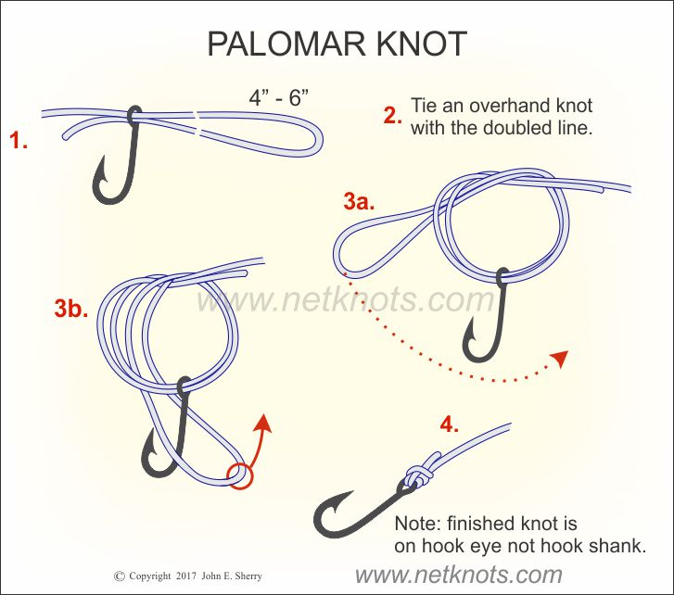
Fishing Merit Badge
Palomar Knot:
Use: simple knot for
attaching a line to
a hook, or a fly to
a leader or tippet
Strong and reliable
March 2018

Slide 4
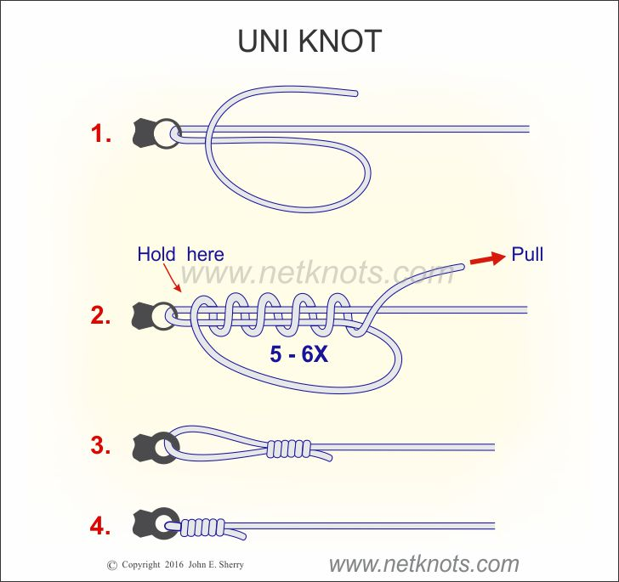
Fishing Merit Badge
Uni Knot:
Use: secure fishing line to a hook, lure, or swivel
March 2018

Slide 5
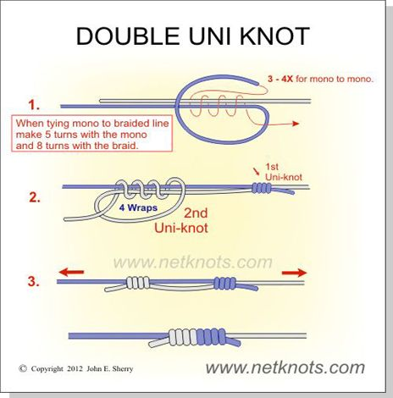
Fishing Merit Badge
Uni-to-Uni Knot:
Use: joining lines of similar or different strengths
March 2018

Slide 6
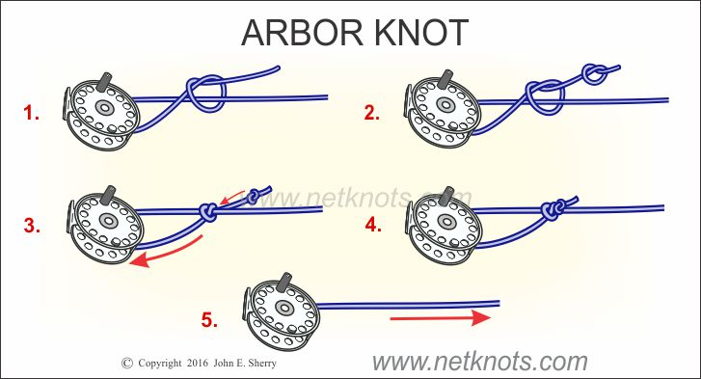
Fishing Merit Badge
Arbor Knot:
Use: tie fishing line to the spool of any type of fishing reel
March 2018

Slide 7
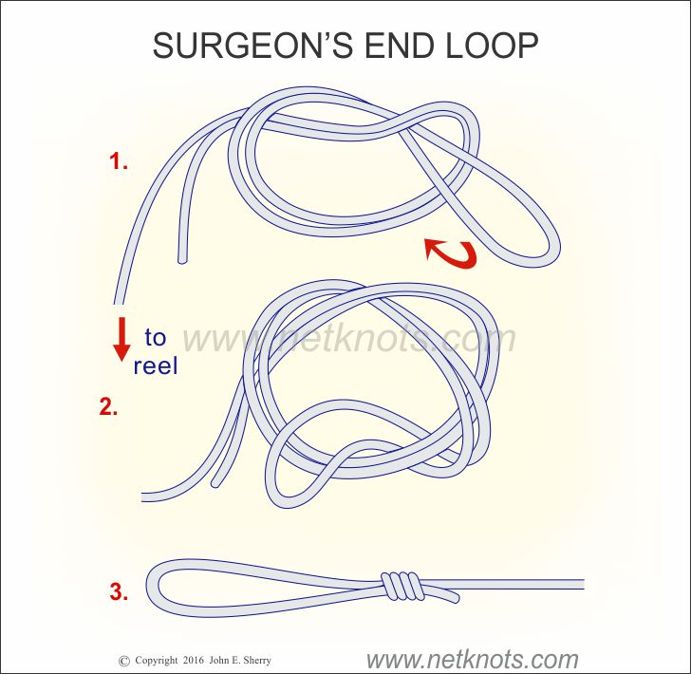
Fishing Merit Badge - EXTRA
Double Surgeon’s Loop:
Use: strong, trustworthy loop at the end of your line
March 2018

Slide 8
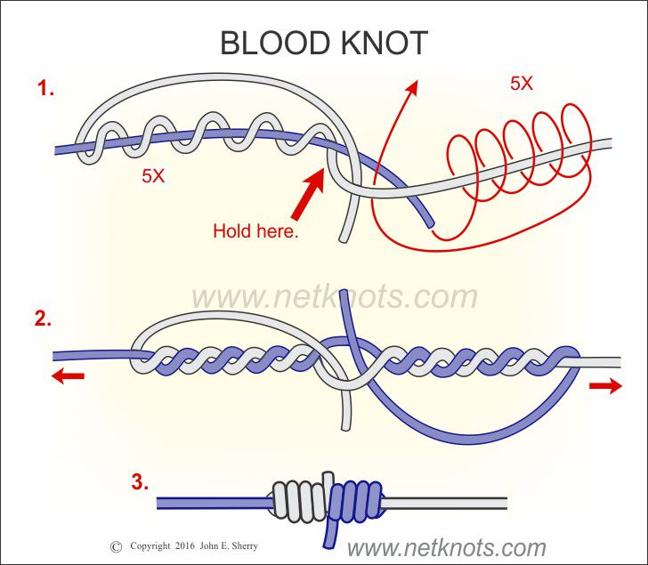
Fishing Merit Badge - EXTRA
Blood Knot:
Use: joining two lines together
March 2018

