Slide 1

Troop 52
Basic Rifle Shooting
Rifle Shooting Camp Out

Slide 2
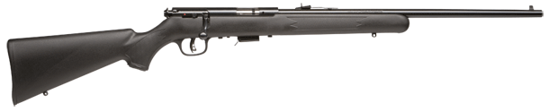
Rifle Parts
Bolt-Action Rifle (with open sights)
Chamber
Barrel
Rear Sight
Stock
Safety
Front Sight
Bolt
Grip
Butt
Muzzle
Forearm
Trigger
Magazine
Bolt Handle
Trigger Guard

Slide 3
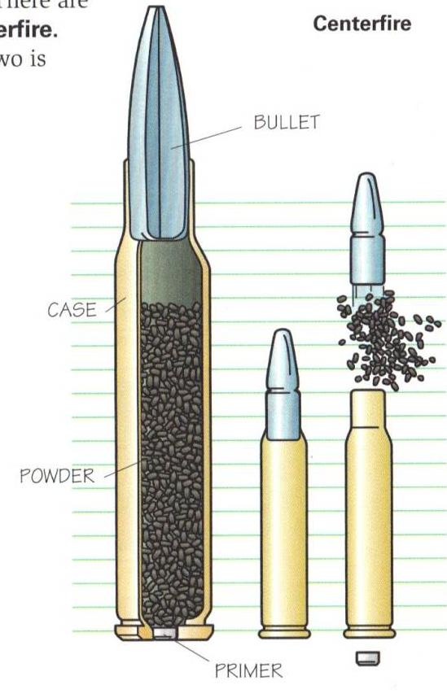

Rifle Ammunition
Rimfire v. Centerfire
Cartridge parts
  Case, primer, powder, bullet

Slide 4
Rifle Operation
To be demonstrated at camp out:
Loading
Unloading
Sight adjustment
Cleaning

Slide 5
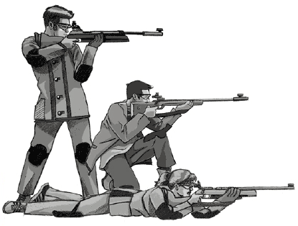
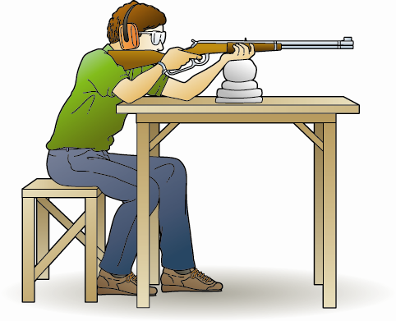
Rifle Shooting Positions
Standing
Kneeling
Prone
Bench Rest
Feet flat on the ground, legs relaxed
Slight lean forward
Relaxed but firm grip
Stock butt firmly on shoulder
Elbows on the table
Support hand under the forearm
Face firmly against the stock comb
Eye looking straight down the barrel
Align the position to target

Slide 6
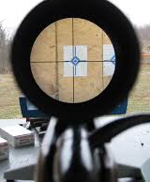
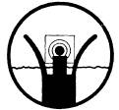
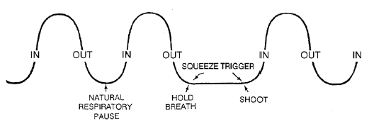
Rifle Shooting Fundamentals
Control your aim
Control your breathing
Slowly, smoothly squeeeeeze the trigger
Follow through

Slide 7
Rifle Malfunctions
Jam
  Usually semi-auto, spent cartridge fails to exit gun
Misfire
  “Click” - failure to fire
Hangfire
  “Click… … Bang” - delayed firing
Squib Load
  Fires, but weak
  Bullet may not exit the barrel

Slide 8
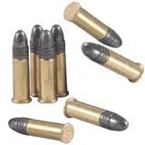
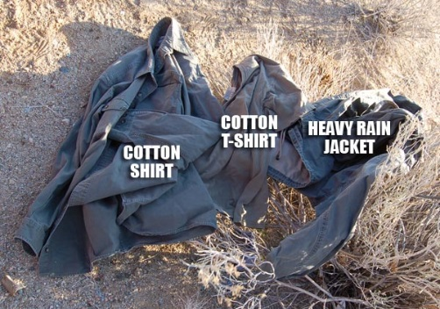
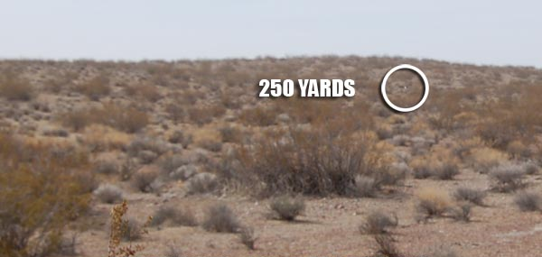
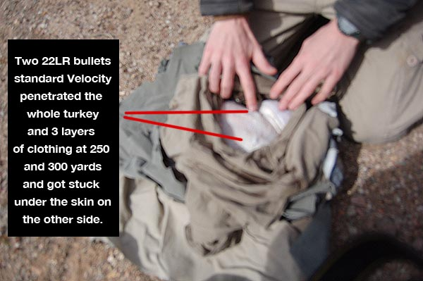
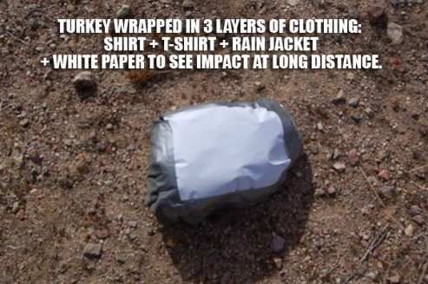
Can a .22lr Rifle Be Dangerous?
YES!!!
Turkey experiment:
100/250/300 yards
Standard .22lr ammo
Defrosted turkey wrapped in 3 layers of clothing
Result at 300 yards:
Shot completely through all 3 layers of clothes and the whole turkey!!!!
Source: http://www.freerepublic.com/focus/bloggers/2931390/posts?page=8

Slide 9
Always, Always, Always…
Safe Direction
Unloaded
Finger Off Trigger

Slide 10
Questions?

