Slide 1
Troop 52 Shotgun Shooting Basics
Shotgun Shooting Camp Out

Slide 2
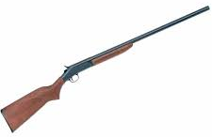
Shotgun Parts
Pump Action
Comb
Butt
Hammer
Single Shot Break-Open
Breech Release
Shotgun Chokes

Slide 3
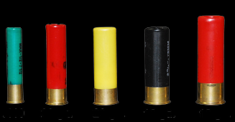
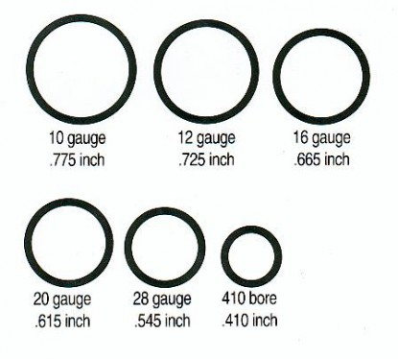
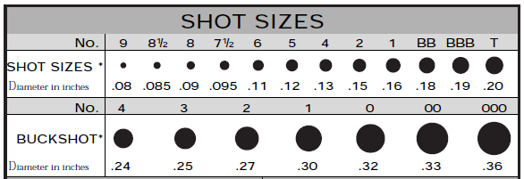
Shotgun Ammunition
.410 ga.
20 ga.
28 ga.
16 ga.
12 ga.

Slide 4
Shotgun Operation
Loading (demonstrated at camp out)
Unloading (demonstrated at camp out)
Cleaning (demonstrated at camp out)
Malfunctions
Misfire
Hangfire
Squib load

Slide 5
Shotgun Shooting Fundamentals
Solid stance
Shooting from dominant eye side strongly preferred
Gun mount
Hold the butt stock firmly to your shoulder
Cheek firmly touching the comb
Firm but relaxed grip on the gun
Both eyes open is preferred
Aim, lead, and swing with the target
Follow through

Slide 6
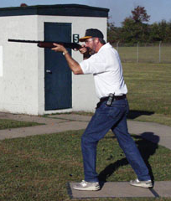
Shotgun Shooting Fundamentals
Correct Stance
Incorrect Stance

Slide 7
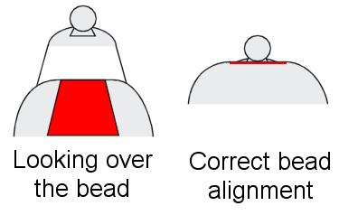
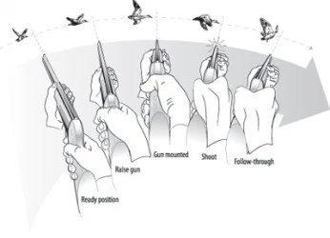
Shotgun Shooting Fundamentals
Aiming
Leading

Slide 8
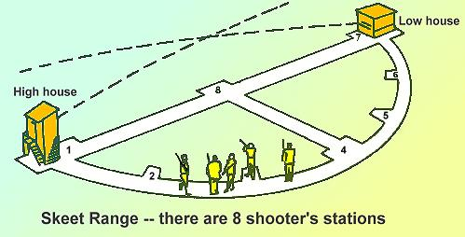
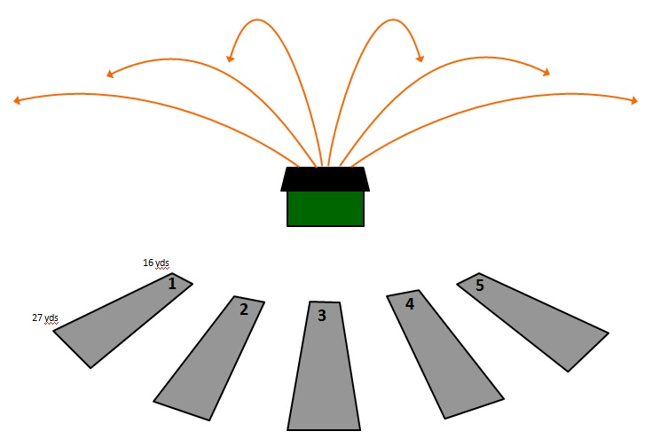
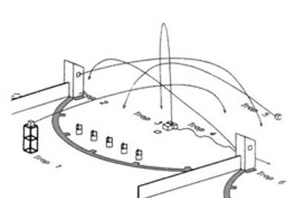
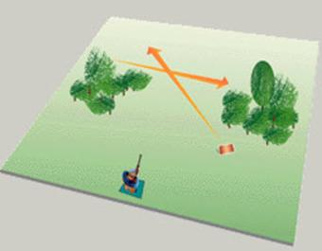
Shotgun Sports
Skeet
Trap
5-Stand Sporting Clays
Sporting Clays

Slide 9
Shotgun Sports
Where Can I Shoot Shotguns?
8707 Lindell Lane, Austin, TX 78724
512-272-4707
www.capitalclays.com
7030 E FM 1431, Marble Falls, TX 78654
(830) 265-4950
www.copperheadclub.com

Slide 10
Questions?

