Slide 1
Electric Vehicle Charging Infrastructure: Planning, Allocation, Challenges
Decarbonising Transport Through Electrification Network
Roisin Naughton
Principal City Planner, TfL
10th September 2021

Slide 2
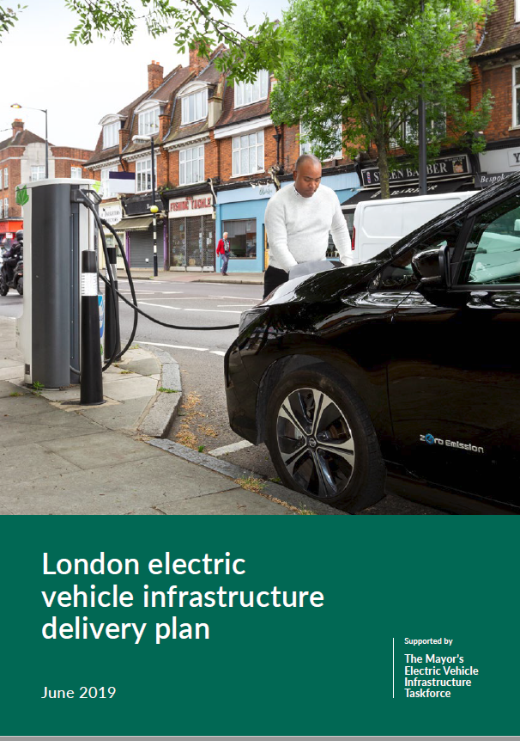
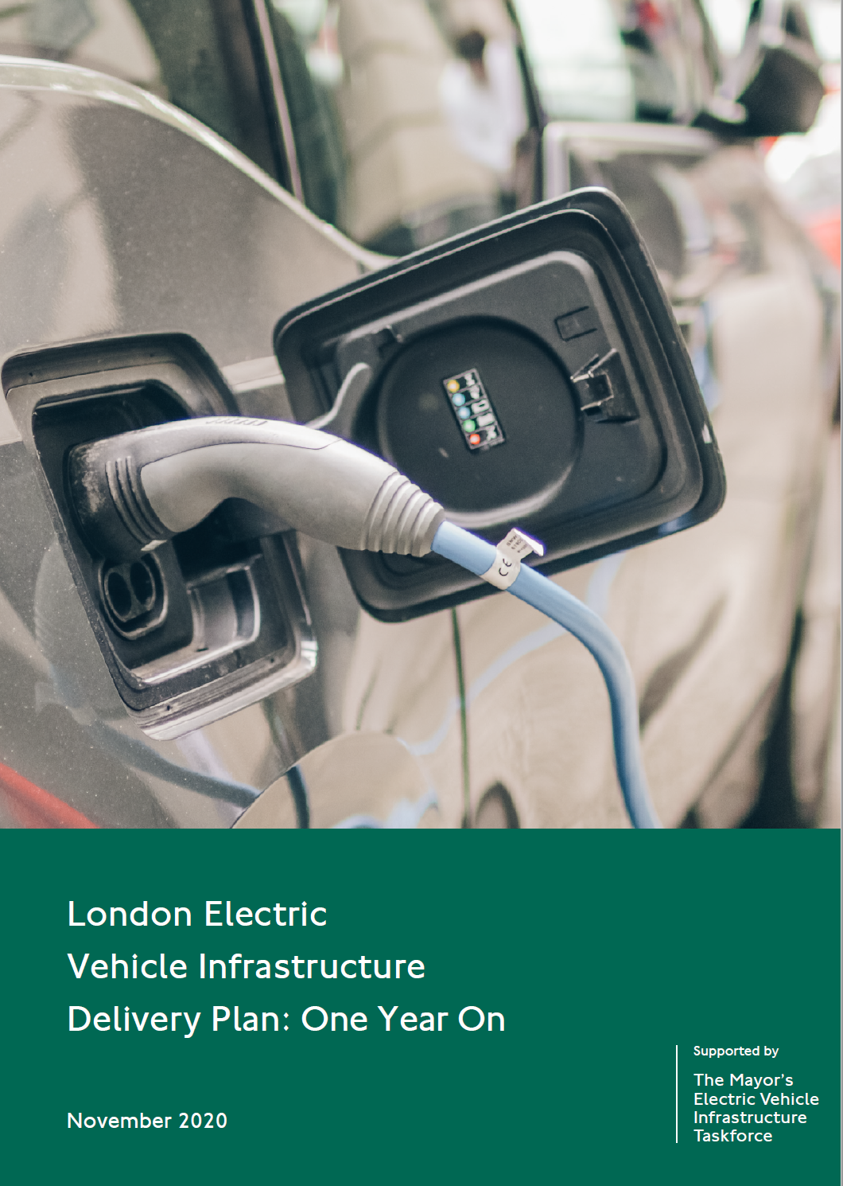
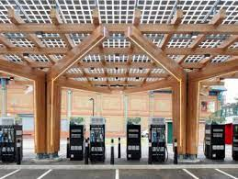
What have we done to date?
  May 2018 – the Mayor established the world’s first EV Infrastructure Taskforce
  June ’19 – London EV Infrastructure Delivery Plan
    Recognises that infrastructure is currently a barrier (not the only one) to the switch to EVs
    Included modelled projections for London’s infrastructure needs to 2025
    Identified set of enablers to overcome barriers
  Dec ‘19 – Guidance on charge point installation
  July ‘20 – EV coordination body, led by London Councils, was launched
  Nov ‘20 – One Year On report published
    Progress against enablers identified in the EV Infrastructure Delivery Plan
  Dec ‘20 – hit our target of 300 rapid charge points
  Sep ’21- opened ‘second’ of five rapid charging hubs
  with target to open one in every sub-region of London

Slide 3
Summary of Electric Vehicle Infrastructure Delivery
  Rapid charging project has delivered over 300 charge points (some dedicated exclusively for taxis)
  London now has over 7,600 charging points, incl. over 600 rapids; ~31% of the UK’s charge points
  Hub sites
    Stratford International (3rd party site) – launched Dec ’19
    Glass Yard (Greenwich) – launched Sep ’21
    Baynard House (City of London) – expected Spring ’22
  GULCS has delivered c.4,500 on-street residential charge points
  Feasibility work underway to determine how GLA group land could accommodate EV infrastructure
  Commercial opportunities for rapid hubs: exploring opportunities on TfL land
  Developing our 2030 EV Infrastructure Strategy
Device Type | August 2020 | August 2021
Slow / Fast | 5000 | 7000
Rapid | 400 | 600
Total | 5400 | 7600
No. of charging devices delivered by type from August 2020 to August 2021 (Data provided by ZapMap)
No. of charging devices by London Borough (Data provided by ZapMap)

Slide 4
Incentives & wider initiatives to encourage the use of EVs
  Zero emission capable vehicles pay either no vehicle tax (VED) or a reduced rate depending on CO2 emissions, vehicle list price and registration year
  Zero emission capable vehicles that meet the criteria are eligible for a 100% discount on the Congestion Charge
  Electrification of buses are currently 485 electric buses and 15 garages have electric infrastructure and power.
  As of 7th September 2021, London has 4,406 zero emission capable taxis
  Taxi drivers can get up to £7,500 towards a ZEC taxi via the plug-in vehicle grant. In addition, a £42m fund has been established to support vehicle owners who want to delicense their older taxis.
  Dedicated e-taxi bays are being installed to promote the greening of London's iconic black cab fleet.
  LoCITY is an industry-led programme to help the freight and fleet sector lead the way in improving air quality and reducing carbon emissions
  EU and Innovate UK funded projects (E-flex on V2G, WiCET on wireless charging for taxis etc.)
Notes:
CC - In Oct this year this will change to zero emissions only, and in 2025 it expires completely (to ensure the CC remains effective at reducing traffic levels)
Buses – the aim for the end of 2021 is to increase the number of zero-emission buses to a total of 700 which will include 20 double deck hydrogen buses. Our current commitment is to achieve a zero-emission bus fleet no later than 2037. We are exploring a number of ways to accelerate this target to 2030, including the current programmes of:

Slide 5
We need a clear Electric Vehicle Infrastructure Strategy
  The pace of recent delivery has been impressive, however, current public funding streams are coming to an end
  Private sector delivery has not delivered at the pace anticipated due to various reasons, particularly with rapid hubs
  2021 figures –Battery electric vehicle sales in the UK have increased by 36.5% from this time last year, while conventional petrol and diesel vehicle sales have decreased by 45% and 69% respectively (source: SMMT)
  The Government’s intention to end ICE sales by 2030 (previously 2040) will accelerate the switch to EVs
  London should have a clear strategy outlining:
    What the updated forecasts for EV infrastructure needs are
    How the public sector can further support the delivery of EV infrastructure and remove barriers for the private sector
    How much funding / support is required to achieve this
Collaborative approach to produce a London-wide strategy
Notes:
Overall UK new car market fell by 29.4% in 2020

Slide 6
What will the Strategy cover & Timescales
  Relevant policy context (national / local level)
  Market engagement & emerging themes
  Research on vehicle/infrastructure technology trends
  User experience and sustainability aspects of supply chain
  EV uptake & charging utilisation
  Forecasts for London’s EV infrastructure requirements (2030)
  Delivery mechanisms to support these needs
  The role of the public sector in supporting future delivery
Due to be published in October 2021

Slide 7
Thank you
Please get in touch if you are interested to know more about the Strategy.
Roisin Naughton
Principal City Planner, City Planning, TfL
roisinnaughton@tfl.gov.uk

