Slide 1


RSA REFRESHER TRAINING
SHOP LOCAL

Slide 2
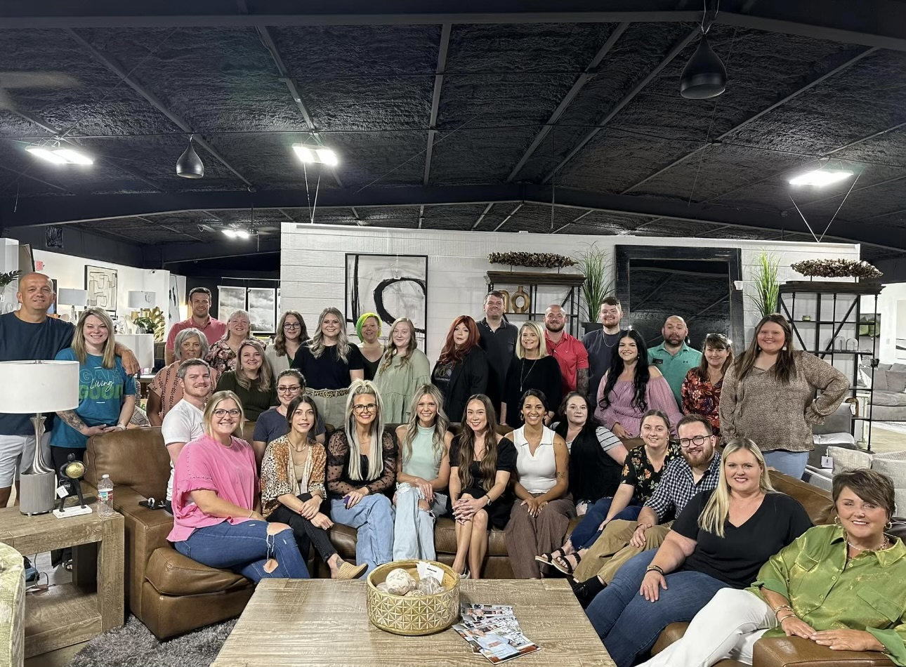
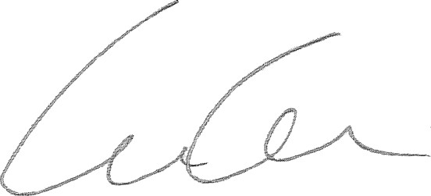
Welcome to GH Brands
5
Welcome to the GH Brands family!
We are a local family owned and operated business from right here in Northeast Arkansas. We were founded by my parents, Dan and Wanda Gamble, in 1990 in a tiny 6000 square foot store in the historic downtown of Manila, AR.
Since then we have grown year after year by doing the right thing for our customers and treating our employees like family. One thing I strive for is our company's vision statement which I read daily: "Furnishing lives by looking forward and giving back!" I personally think that is so important to help the community that helps us!
We all believe here that a win- win- win culture is important for everyone! This is where our great customers win, our tremendous employees win, and lastly, the company wins.
So, we are delighted that you have joined our brand! You will be a great asset to our team, and we look forward to a
positive employment relationship. There is always much to learn on a new job, not only about the work, but also about our culture and organizations processes. We want you to know that we are all anxious to see you succeed and there will be plenty of opportunity for you to learn and grow with our wonderful company.
So, on behalf of all of our employees and myself, welcome to our great team! Sincerely, Chris Gamble

Slide 3

Alignment
The whole reason that we have created a training platform for our team is to make sure that everyone is aligned. From the office personnel to the sales floor and delivery team, if we aren’t all aligned, it makes everyone’s job much more difficult and creates a culture that we here at GH Brands won’t tolerate.

Slide 4

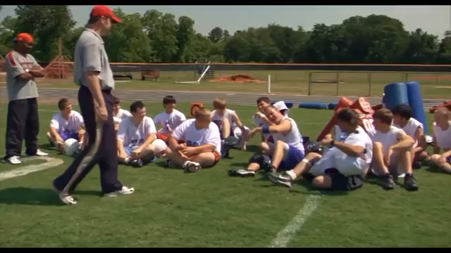

Slide 5
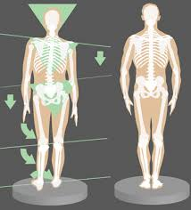

What happens when your spine is not aligned?
What happens when your tires are not aligned?
Not Being Aligned Creates Pain or Unusual Wear and Tear!

Slide 6
We must be ALIGNED!
Trust
You have to Trust in……
Leadership
Co-Workers
Other Departments
Programs
Mission-Vision-Values
Yourself
Ownership
“The Happiest Year of Your Life will Begin when you take OWNERSHIP of EVERYTHING in YOUR LIFE!” Dr. Kevin Elko
I Own It!
Good or Bad
Things I Do
Things I Didn’t, that Impact Me

Slide 7
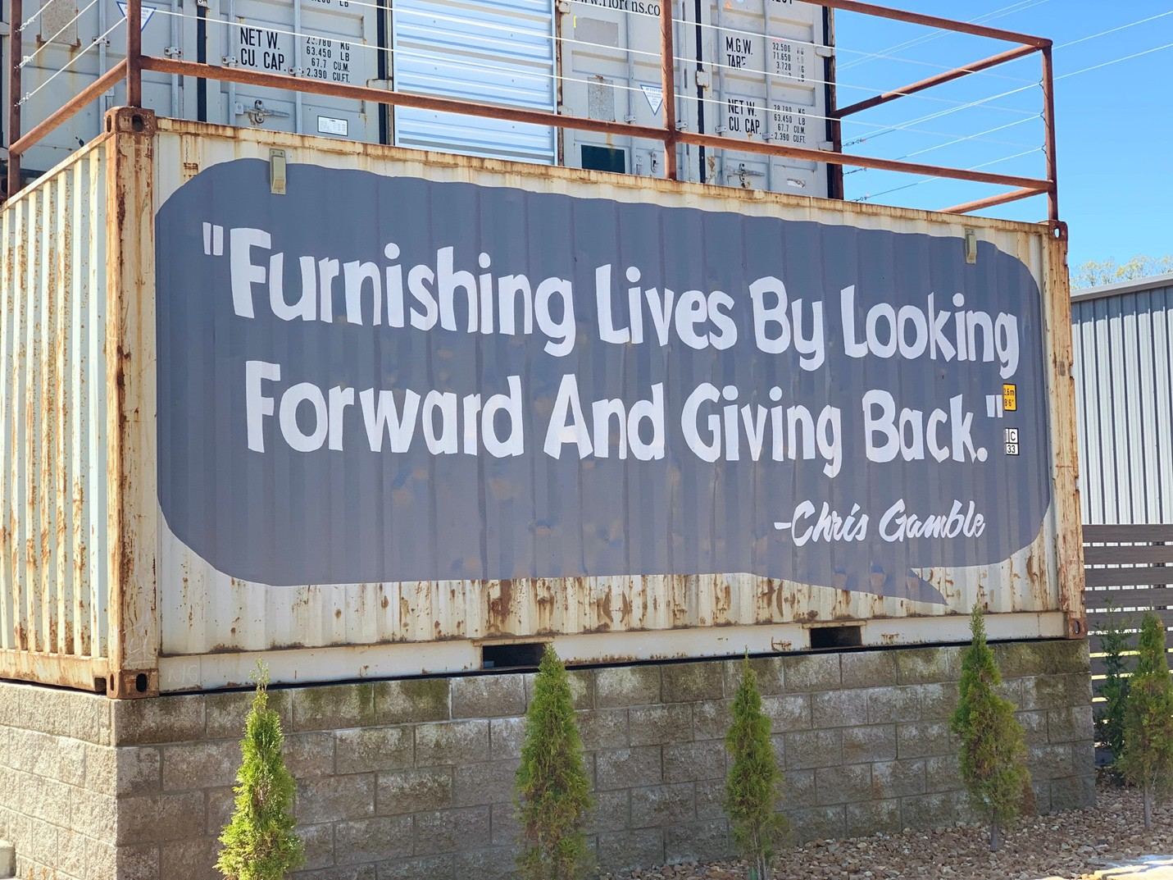
Our Mission and Vision
6
VISION
"Furnishing Lives by Looking Forward and Giving Back" - Chris Gamble
MISSION
"Our mission is to create a unique shopping experience that is built on value, integrity, respect, and trust. GH Brands wants to be the best furniture retailer, not the biggest."

Slide 8
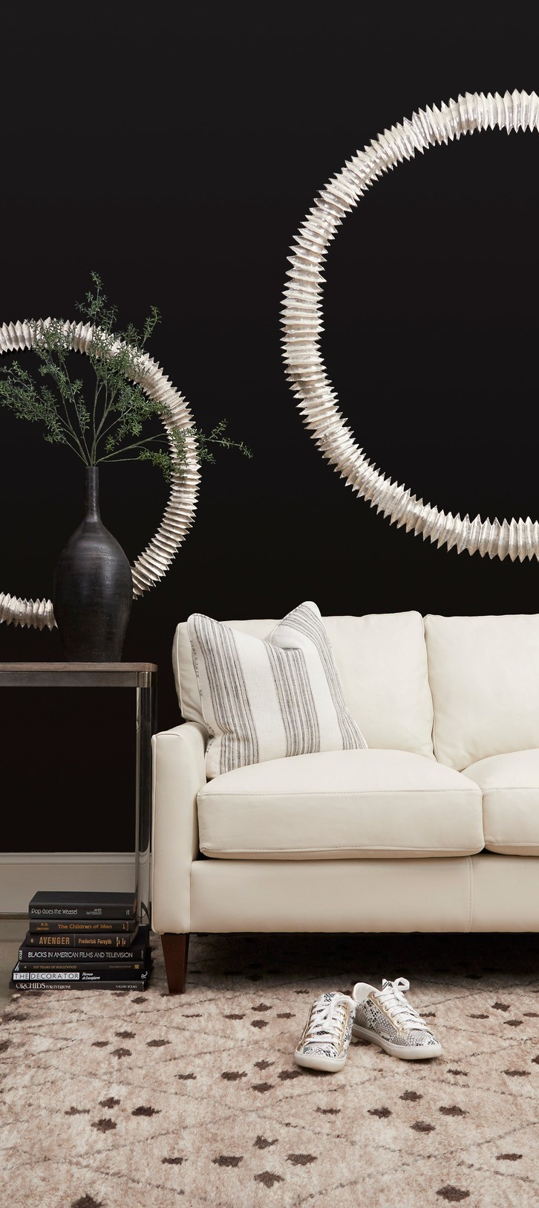
GH Brands Fundamental Beliefs
7
Win---Win---Win
Everything we do is created for everyone to WIN! Our customers, Our employees and the Company.
Think Sustainably
With high standards, accountability, and integrity we strive to make decisions that will
last longer than we do.
Keep it Real
Cultivate authentic relationships by building trust and exceeding expectations.
Continuous Learning and Innovation
Growing as a company and building individual capacity.
Make an Impact
Leave people and our community better than we found them.

Slide 9


You want to Win? TAKE the Shot!
No Shot No Score
Most People do not Shoot because they do not Believe they can Score!
Most things we Fail to do or Fail to Attempt is Due to what we Believe or Feel!
To Maximize your Results, Do What is Right, and Your Feelings will Catch Up!
You must Take the SHOTS!

Slide 10
Everything we do is about Taking the Shot!
Executing a Great NBG
Overcoming “Just Looking”
Asking the 3 Questions
Drawing the Room
Suggesting Product
Suggesting Fabrics
Selling Protection
Building the Ticket
Selling Rugs, Lamps, and Accessories, Etc.
Selling Delivery
Selling No Interest Programs
Overcoming Push Offs
Overcoming Put Downs
Going for the Sale
Selling Through the No’s
Continuing to Sell Through the No’s
Getting the TO
Getting the Review

Slide 11
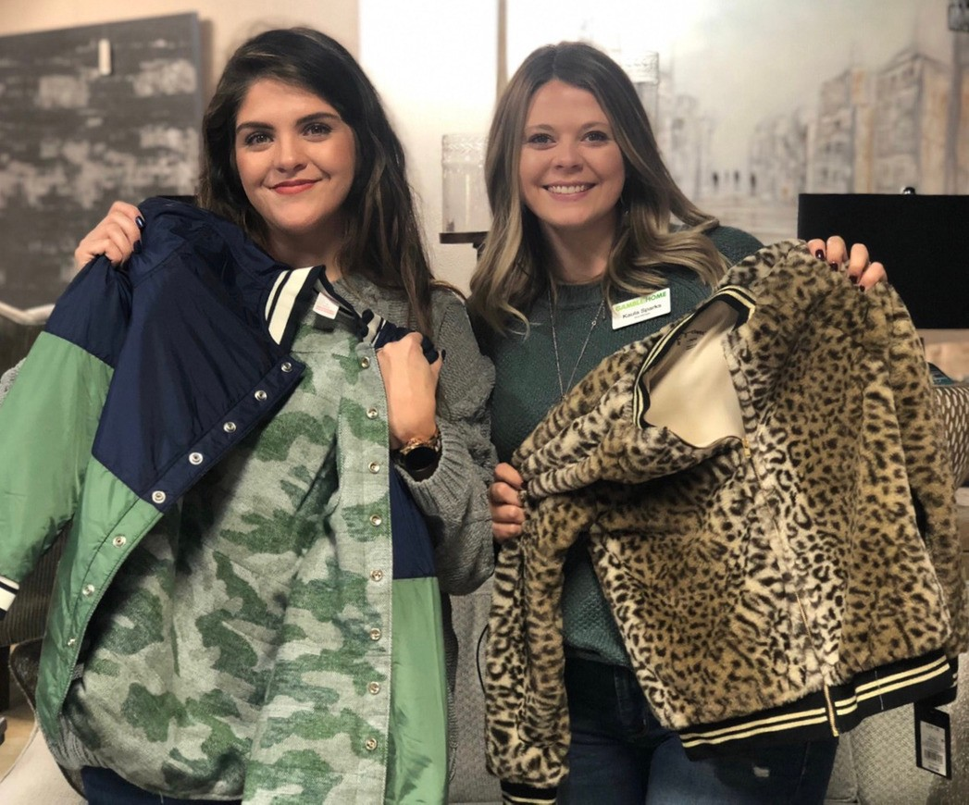
CORE VALUES
8
Value
Integrity
Respect
Continuous Improvement
Hard Work

Slide 12
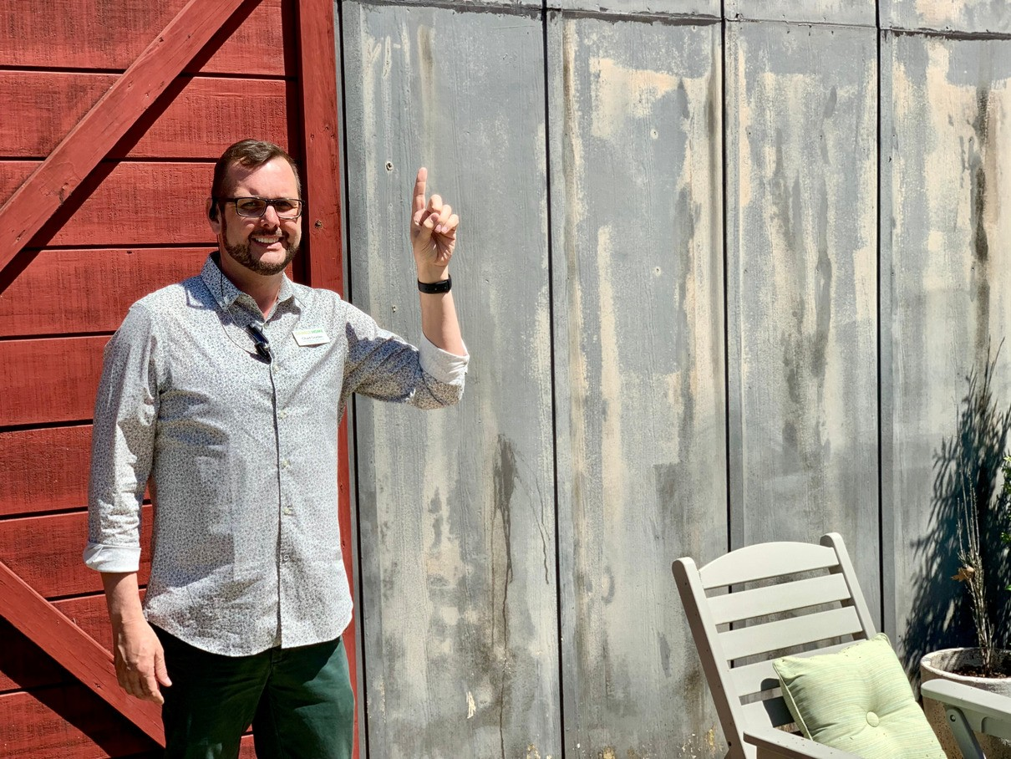
Custom Experience Platform
9
We will provide EVERY CUSTOMER with an uncompromising shopping experience that is without compare.
Honest and Transparent communication of expectations creates loyal customers.
Following through with the customer after the sale is the GH way.

Slide 13
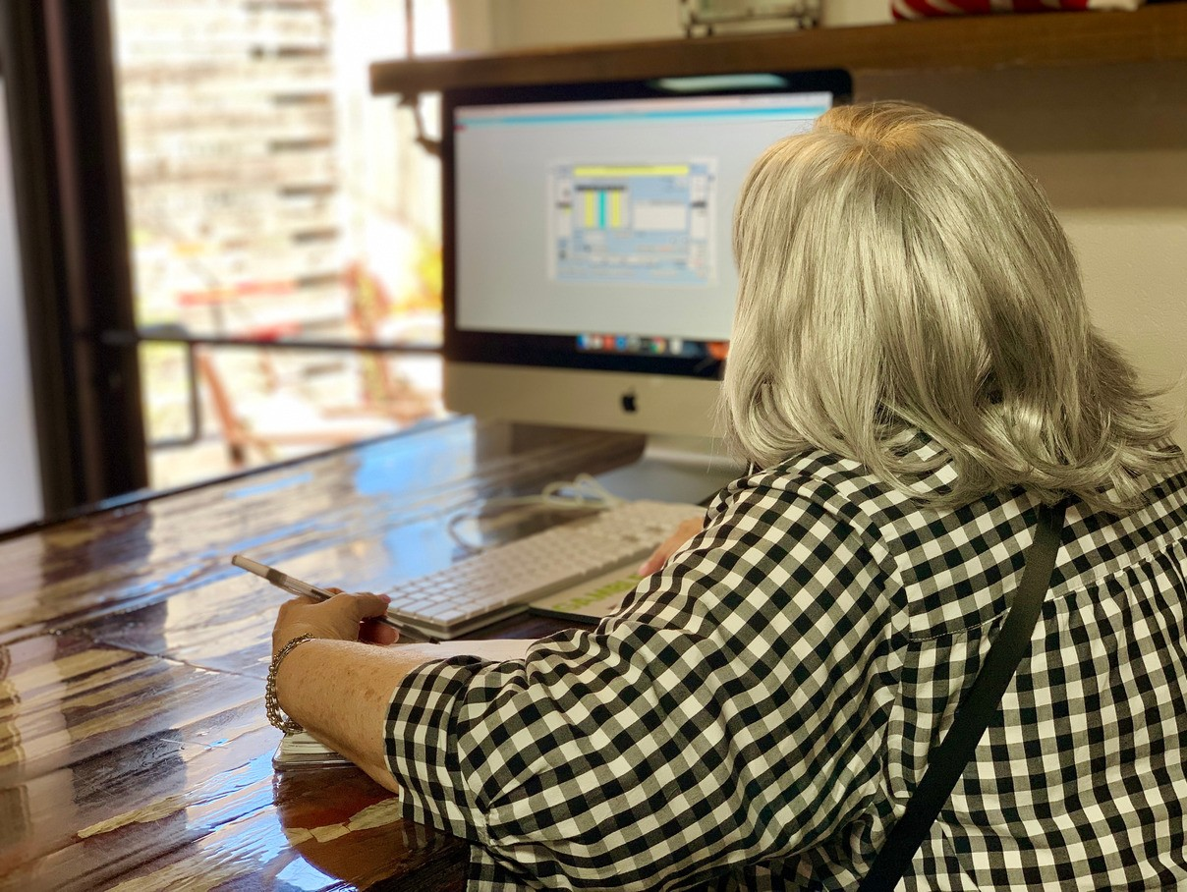
SELLING PLATFORM
10
Your job as an RSA/Designer is NOT to decide whether or not a customer will buy today, your job IS to bring them to the point of making a buying decision TODAY. TODAY CULTURE!
Embrace the reality of the experience (I am just looking, I am not going to buy today, I am going to get some lunch, I want to think about it, This is the first place I have shopped, etc...) and still follow the selling process. Do the right things the right way, and your feelings will catch up.
Set proper expectations for the customer with lead times, quality, product attributes, service levels, etc...

Slide 14
Customer Experience Disciplines
11
Get Personal --- Non-Business Greeting
Discover Opportunities --- Draw the Room
Present Product Solutions
Build the Ticket and Give a Child In Need A Mattress
Give the Customer "Peace of Mind"
Go For It --- The Easy Way
Follow Through
Personal Connection
Connect with and Engage the Customer
Be Fun, Endearing, and Build Credibility
Influence Outcomes
Do It Today --- Urgent, Today Culture
Extend the Relationship --- Communication Platform
Knowledge is Power and Confidence
Know Product Construction
Know Product Options
Know Product Lead Times
Know GH Processes

Slide 15
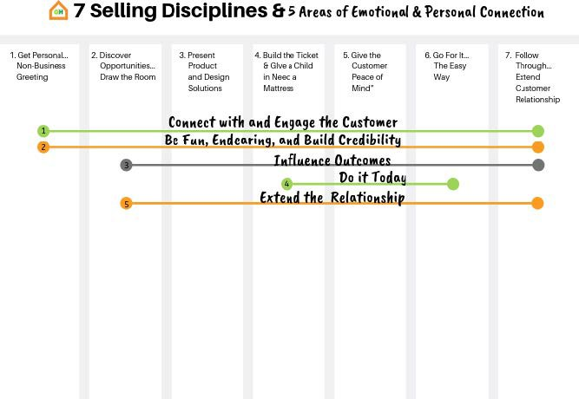
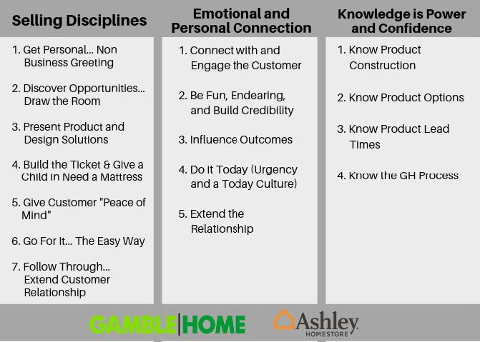
12

Slide 16
GH Brands Training Creed
13
I came here today to improve at my job.
I will be engaged.
I will actively listen.
I will participate.
I will learn.
... and by doing so, I will ensure that my customer, my company, and I all WIN!

Slide 17
The Customer Experience Be "Customer Ready"
14
It is your turn... ARE YOU READY? One of my favorite business and personal quotes comes from the book Fish. "Yesterday is history and tomorrow's a mystery, TODAY is a GIFT that is why it is called the PRESENT!" To be successful with our company and give your customer a great experience, you must be ENGAGED, PRESENT, and READY. Too many times sales are missed right up front because we are not ready to Engage the customer, Properly focused, and Present.
When we fail to approach the customer in this manner, we are easily knocked off course and the customer gains immediate control.
Be where you are supposed to be when "UP" or "NEXT."
Free yourself from distractions. Be present for the customer. Leave your personal life at home! She came here because she wants something NEW, she is excited, and you have to be as well.
Have all of your tools: Paper, credit application, pen, measuring tape etc...
SMILE!!! A smile brings a smile in return. People want to deal and associate with happy people. It is also harder in human nature to be rude or dismissive to someone who is
smiling and energetic. It is the universal language! I smile in every language known to society!
Be openly NICE!! It is FREE and people will be more likely to choose us and be good to work with if we are NICE, EAGER to PLEASE, and ACTIVELY ENGAGED!
Gamble Home 10 Ft Rule - We want to be known as a FRIENDLY, ENGAGING, and WELCOMING store. With this in mind, whenever you pass within 10 feet of a customer
in the store, you are to make eye contact, smile, and say "Hello." If they are alone, you are to ask if you can assist them in any way.

Slide 18
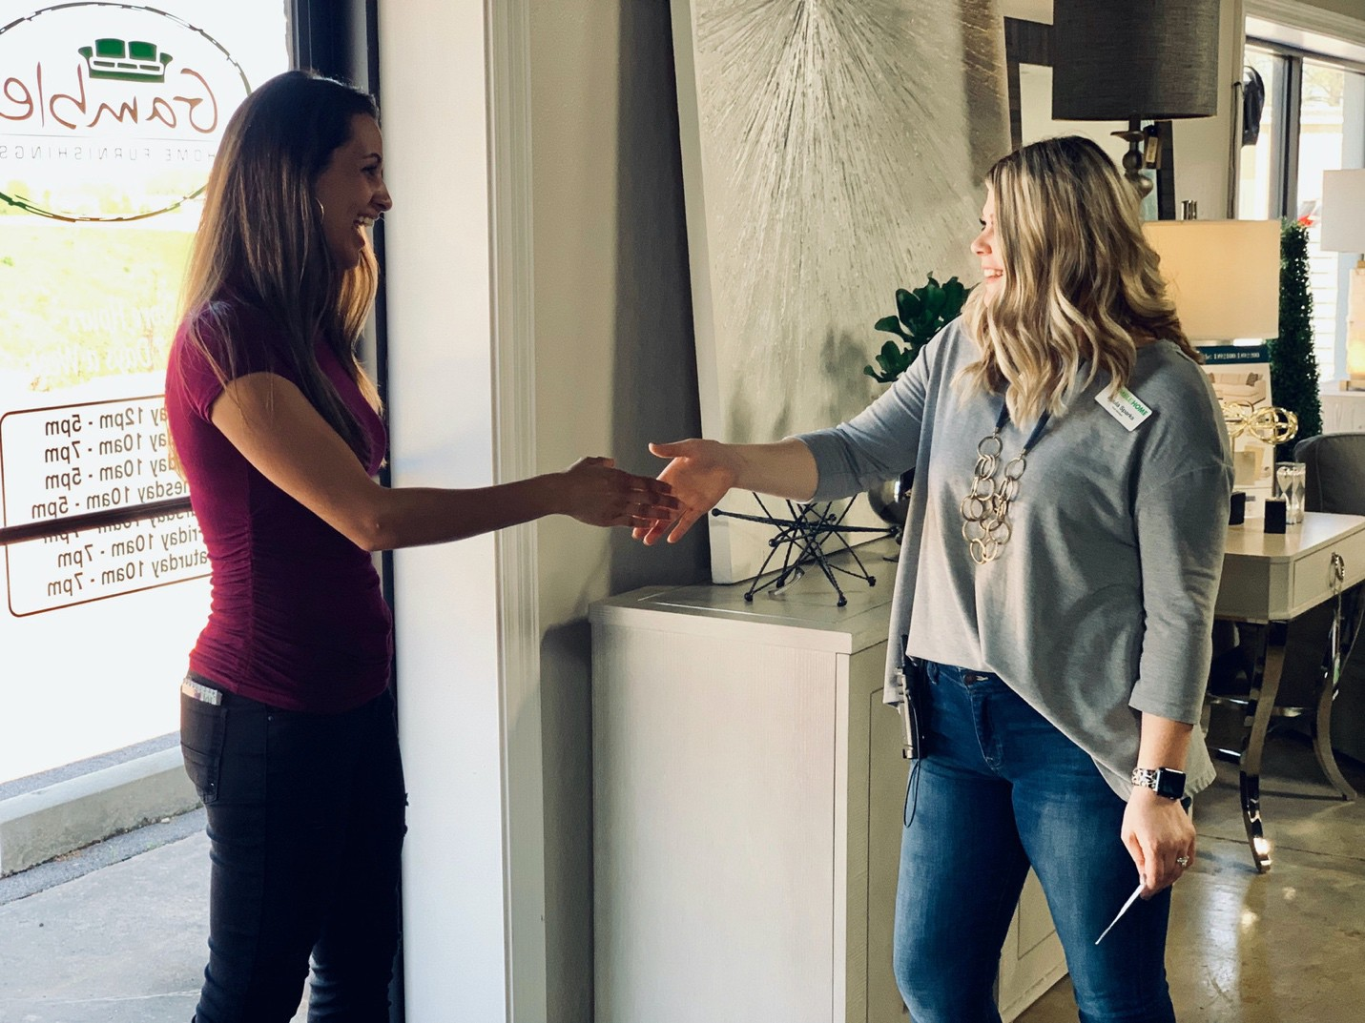
I. Get Personal – The Greeting
"You never get a second chance to make a first impression."
15
In the greeting you are looking to…
Connect Personally
Begin a Positive Experience
Pre-suede the Customer
Begin to Gather Information
Gain Control of the Situation
Leave the Greeting to Show Merchandise
Begin to Endear Yourself/Your Store/Your Products to the customer
Earn the right to Hang Out

Slide 19
16
Greet with Purpose
Lead with Non-Business Conversation
  Many times, customers enter the door having already stereotyped us as salespeople that only want to make the sale. Human nature causes us to pay back this label by applying a stereotype
to them in return (Looky Lou’s, Tire Kickers, TWA’s, “One of Those” customers). No one wins in this game of “Stereotype Bingo.” To break the customers resistance, we must break the stereotype. The best way to do this is by doing something that is not stereotypical. Thus, the Non-Business Greeting.
  Things to talk about include: Kids, cars, weather, non-controversial current event, clothing, jewelry, school or other affiliation, something they are doing, or a funny story. To do this you
must be PRESENT and FOCUSED on the customer.
Once you have made "fast friends" with the customer there are 3 questions that must be asked up front:
  My name is . What is your name?
    There is power in the exchange of names. Once you have both humanized yourself, it is very difficult for the customer to be dismissive (Not impossible, but more difficult).
    People love to hear their name, so once you get it do all you can to continue to use it.
  Do you live here in ?
    You are looking for common ground and conversation.
    Many times, you will also find out that the customer has recently moved/relocated which reveals that they are in fact buying something.
  What project are you working on?
    Most ladies always have multiple projects on the board.
    This is a more professional way to ask what they are doing, looking for, etc...
    If they answer with a room, ask ”Is that room square or rectangular?”
It is imperative that you do not vary from asking these questions early even if the customer tells you exactly what they are looking for. The reason is that this helps you to CONNECT and ENGAGE with them, and that is critical regardless of the level of engagement.
Pre-Suede your customer.
  For instance, “I bet you are the type of person that likes to help others, and I want to thank you in advance for your purchase because a portion of the proceeds from every sale goes to our Give Back Initiatives. For example, if you buy a Mattress that is $799 or more, we give a mattress to a local child that doesn’t have a bed to sleep on! So, thanks!”

Slide 20
17
Owning and Embracing "Just Looking"
Acknowledge and Spin "Just Looking"
Customer: “I am just Looking.” RSA: “Great, that is where the process starts!” or “Great, everyone that has bought from me this week has said that exact same thing!” or “Great, have you been in our store before? We have a very unique layout!”
Customer: “I am just looking for a living room.” RSA: Alright, so you are buying a new living room, that’s great!” Many times, this will get agreement from the customer.
Handling the Adamant "Just Looking" Customer
Customer: “I am REALLY JUST LOOKING!” RSA: “Awesome, enjoy the store and know that I am here to help and give great service.” or “Absolutely, Let me tell you about the big sale we have going on today!” or “Let me tell you about our campus. Shop Local Park is made up of 5 different buildings and over 70,000 Sq Ft of great furniture and home décor. I am willing to bet that this will be the most unique and fun shopping experience that you will have ever had!”
Gauging Customer Regard
Poor/No Regard - Customer is highly dismissive and not wanting to interact. Use adamant the "Just Looking" technique above and still ask the 3 questions.
Lukewarm/OK Regard - Customer is not pushing you away, but not giving you much. Spend time
building personal rapport, talk about personal things: Buy a Bed Give a Bed/Community Give Back/Hope to Dream, and utilize “Power Statements.”
High Regard - Begin transitioning into "Discovering Opportunities." Do not release and STAY ENGAGED — They like you. You still must ask the 3 questions.

Slide 21
18
Ashley Power Statements
Ashley is the largest retailer of Home Furnishings and Mattresses in the WORLD!
Ashley gives back! Through our Hope to Dream initiative, we give new mattresses to children in need in our local community. Because of Ashley and our partners, over 50,000 children have
received new beds every year for the last 7 years!
We are proud to bring you, what we feel is, the “Best Looking” furniture store in . You will not find a store in a major city that looks any better than our store does!
Gamble Home Power Statements
Gamble Home is a Locally Owned and Operated Business that gives back to the community through the “Gamble Gives Back” Initiatives like Buy a Bed, Give a Bed, our Annual Toy Drive, and the Back to School Backpack Drive. We work with LOCAL organizations such as Christians for Kids, the Paragould Children’s Home, the Walnut Ridge Children’s Shelter, and Families Inc. to help improve the lives of children in need in our local communities. None of this would be possible without the continued business and support from our local customer---YOU!
Gamble Home carries the widest variety of furniture and home décor in North East Arkansas and possibly the whole state. We have great manufacturing relationships with brands you know and trust, and we also have searched out unique finds. You will find merchandise that fits all styles and budgets. We offer Value, Style, and Quality that is on trend and affordable.
Gamble Home has a layout that is like no other. We have over 70,000 square feet in five different buildings that make up Shop Local Park. Free transportation is provided between
buildings so that you can see all we have to offer.
Buy it Today, Get it Today -- We have the largest selection of products in Arkansas and the Mid- South that you can buy and take with you today!

Slide 22
19
Keys to a Successful Greeting
Be Ready--- Be where you are supposed to be and focused on what you need to do.
SMILE!!! A Smile brings a smile in return. People want to deal and associate with happy people. It is also harder in human nature to be rude or dismissive to someone who is smiling and
energetic. It is the “Universal Language,” I smile in every language known to society!
Expect "Just Looking/I’m not going buy today!" -- Be mentally prepared for this or any response. Lack of proper focus will lead to poor fundamental execution which will surely get you
a stereotypical response and have an adverse impact on what you believe about the customer. You must connect with the customer to connect to the fact that they are in the store intentionally and those intentions are to buy at some point, most often today.
Embrace the #1 buying signal you get --- They drove here, got out of their car, and came into the store. (Gamble's Main Store specifically ---- No one drives out here by accident because we are off the beaten path, and it is not easy to get into the parking lot. They are here on purpose, with purpose, to buy something!
Keep to the program. Trust the process and stay on track. Do the right things and your feelings will catch up.
Give your name and get theirs — It is Biblical. People aren’t made to be rude and dismissive; they learn to be. If they have your name and you have theirs, you become more human and they will have a harder time being rude or dismissive.
Take Control and Stay in Control.
Never take the 1st “Just Looking” for an answer. Always try to overcome using the techniques in this training.

Slide 23
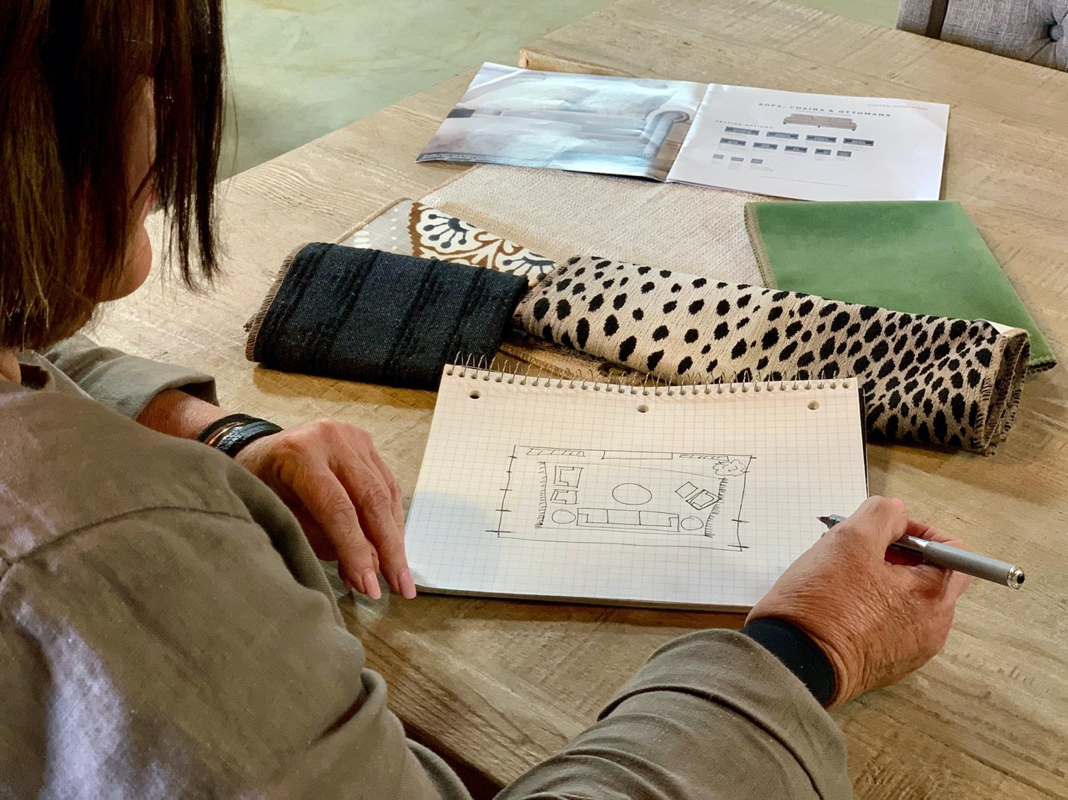
II. Discovering Opportunities - Draw the Room
21
Drawing the Room is the #1 communication tool you have in your arsenal. Thus, it is the "one thing" that changes everything in selling home furnishings.

Slide 24
22
If they have told you a room or product then DRAW THE ROOM!
  Ask “Is your room square or rectangular?”
  Once a response is heard, draw a square or rectangle on paper.
  Hand the paper/pad to the customer and have them draw out their room (doors, windows, TV, fireplace, built-ins, pathways, adjoining rooms, sight lines, current furniture and placement). It is key to have them do it—their PARTICIPATION is critical to maximize impact.
  Ask about the room: What are the wall colors, floors, lighting, and what do they want to keep?
  How do they intend to “Do Life” in this space?
  If they want to change the layout, draw another room blank so you can collaborate!
  Proceed to products that fit their Style and Lifestyle preferences.
If they are adamant about looking, LET THEM GO----but STAY ENGAGED! Many times, the “Just Looking” response is given as a stereotypical, learned response. For example, you executed a poor greeting, they had a poor experience at the last store, they're having a bad day, they have had a poor experience here before, or they do not realize that you can really be of help!
  You must stay where you can see them and be FULLY PRESENT! LISTEN WITH YOUR EYES!
  Re-Approach with purpose! Refrain from the stereotypical re-approach (You still ok, you have any questions, are you finding everything ok, any questions yet, etc...) Instead, if you re-approach at a product, possible responses are...
    This sofa is so comfortable because of the Down-Blend seating!
    This is actually one of our best-selling groups!
    Take a seat! This is one of the most comfortable sofas in the store! Did you know that this bedroom group is the number one selling bedroom group in the history of the world? (Porter)
    Hey , I wanted to tell you that you can get $6000 in furniture for $100 month and Interest Free with our Preferred Customer card.
    Hey , I wanted to tell you about the great sale we have going on today!
Your reapproach must be INTENTIONAL!
What are your product preferences? (Style, Color, Features)
How will this be used?
When do you need it?
What is your budget for this project?
Are you going to be taking advantage of our Interest Free offers?
If you cannot find the perfect thing, use what you have to create the “perfect” thing for your customer or something they will LOVE. Customers often ask for specific things that you may not have, ”Unicorns” if you will. If you cannot find the “Unicorn,” then you must give alternatives.
How do you Overcome or Redirect this situation?

Slide 25
23
Ask what they are using it for.
In your mind, come up with an alternative from what you have in store that could/should work.
Use one of the following statements:
“Ms. Jones, I am not going have that exact thing, but I have something over here that I think will be perfect!” “Ms. Jones, I do not have that exact thing, but I have something over here that you are going to Love!” Embrace the POWER OF POSITIVE SUGGESTION!
The #1 communication tool you have in this business is to DRAW THE ROOM! It is also the most effective bridge to a makeover appointment, and it is guaranteed to INCREASE both Closing Ratio and Average Sale.
8 things that happen when you DRAW THE ROOM:
Totally open communication and feedback.
You and the customer go to their home in your minds. You never have to leave the store.
In the customer's mind, you transition from “salesperson just trying to sell them something” to someone who is helping them achieve a beautiful home/space.
You learn more about the layout, use/lifestyle, and product needs.
You are more credible and knowledgeable.
It reduces the chance of “will not fit.”
It gives more time to influence.
It increases engagement with the customer.
ALL OF THESE ARE CRITICAL PIECES TO SELLING THAT ARE HARDER TO ACHIEVE BY OTHER MEANS! DRAW THE ROOM is also....
Your best discovery tool
A ticket building tool
Confidence building tool
Closing tool
Future business tool
Accuracy tool
More fun way to do the job
Credibility building tool
I am not saying that sales will not happen without drawing the room, they will, I am saying they will happen more often, and they will be larger when you Draw the Room!

Slide 26
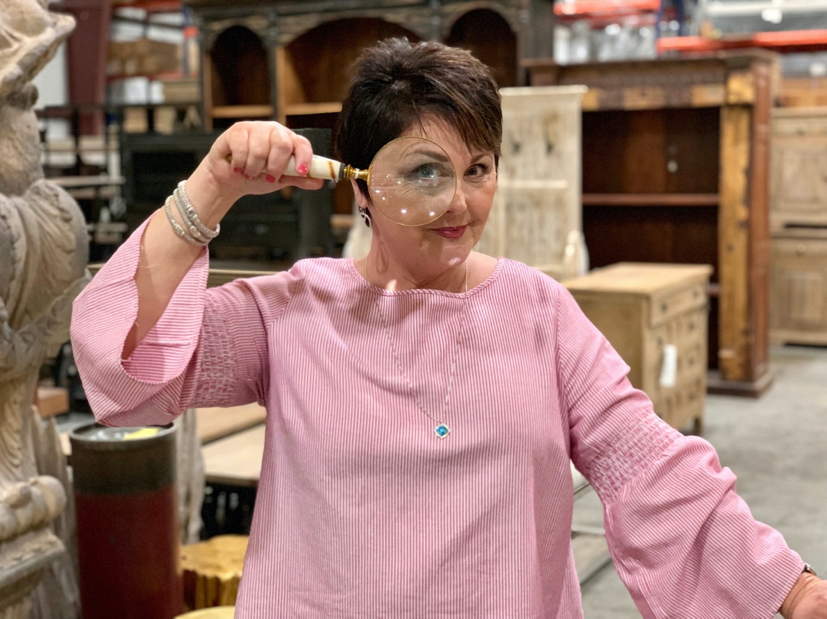
III. Present Product Solutions
25
It is often said the first part of the sale is a "fact finding mission" and the second part is a "fact giving mission." By using your knowledge of product, process, offers, etc..., you influence the outcome that both you and your customer want.

Slide 27
26
Keys to A Great Presentation
Know your Product.
  Construction
  Styles
  Uses
  Options
  Procurement (How to Order and Quote Lead Times)
Demonstrate the Benefits.
  Give 2 benefits per feature.
    Feature - What a product does.
    Benefit -What a product does for me.
  Get them to sit, use, operate, touch, and lie down on the product. Customers are 22% more likely to purchase a product if they touch or feel it.
  Customers are 90% more likely to remember your presentation, and you, through demonstration
Capture the power of Pre-Suasion (Part I). Use possessive language:
  You are going to LOVE your new living room furniture!
  Sit down on your new sofa.
  Lay right here on your new mattress.
Capture the power of Pre-Suasion (Part II). Endear to Influence.
  Mr./Mrs. Customer, I am going to do for you.
  Mr./Mrs. Customer let me get that for you.
  Mr./Mrs. Customer, for you, I will make sure that I .
Make your product GREAT and the PERFECT THING for them with your language, body language, and actions.

Slide 28

IV. Build the Ticket and Give a Child in Need a New Mattress
27
There are only 2 ways to increase sales:
Sell to more people.
Sell more to the people you are already selling to.
In this section following, we will talk about #2 listed above. Building the Ticket (Increasing Average Sale) is accomplished through specific behaviors that require intentional actions from you, the RSA. Adding just $200 to each sale will add $72,000 in annual volume to the volume of an RSA doing $40,000 per month. This will turn into $2,000,000 in additional sales for the company at current employee levels. WOW!

Slide 29
28
To Build the Ticket you must....
Suggest Additional Purchases.
  Mattresses, Chairs, Recliners, Tables, Rugs, Lamps, Accessories, Pillows, Accent Cabinets, etc...
  Protect the customer with Peace of Mind Protection.
  Give the customer Peace of Mind with In-Home Delivery.
Harness the Power of Financing. The average sale amount from financed sales is 2-3 times higher than non-financed orders. Also, it is proven that a customer with a store branded card is 50% more likely to buy from that store than anyone else.
  Sell the possibility of Long-Term Financing to every customer.
  Ask for down payments; down payments reduce the chance of cancellations.
Sell Swank, iComfort and Beautyrest Black (Tempurpedic if Applicable).
  Higher AUSP on mattresses will drive the average sale up.
  When you sell Swank Mattresses, you are giving your customer something they will not get elsewhere; a lifetime warranty!
Power Up. Sell Power Base and Power Reclining.
Step up Selling. Sell better goods when possible, do not sell out of your own “pocketbook.”
Draw the Room. The average sale is 2.5 times larger when we draw the room in comparison to when we do not.
Get in the Home. Makeover Sales average over $7500 each and will explode average sales.
Give a Child in Need a New Mattress
65% to 85% of the people that come into your store either want or need a mattress somewhere in their home, but less than 20% ask for them. You have to uncover this want or need through bringing up mattresses/healthy sleep to EVERY customer!
If you want to make them a customer for life, give them the gift of a good, healthy night’s sleep!
Sell Comfort
Selling the health benefits of a comfortable night’s sleep is the Gamble way.
Take the customer to the Triple Choice and do a “Rest Test” to determine the comfort level the customer prefers: Soft, Plush, or Firm.
By determining the comfort level, you can narrow down the options that matches that feel for your customer.
  This creates a better experience because the customer becomes more confident in you.
  You stay in control and eliminate confusion or the customer jumping all over the mattress room – in turn, you are more likely to get the sale.
Every presentation should be a “Power Presentation.” Put the customer in Zero-Gravity and explain
the Healthy Sleep benefits of both the mattress and the power base.
CSD then P. Comfort, Support, Durability, THEN Price.

Slide 30
29
Comfort- Comfort is the #1 reason that people choose a mattress and there is not a close second. This is the most important and most used furniture item in the home. The health benefits of a great night’s sleep are well documented. A comfortable mattress promotes better sleep which in turn, improves all facets of a person’s life: Work, Quality of Life, Personal Health, Mood, Productivity, Energy, etc...
Support - Customers want to know that the mattress they choose will give them good
support. Do not allow them to confuse support with firmness. Most “like” models at the same price points have the same support systems, wire gauge is usually the same. The difference in feel is driven by the Comfort Layers like foam feel and filler material.
Reassuring your customer of this will allow them to choose the mattress that feels the most comfortable.
Durability - They want to know if it will last. Use the Warranty and explain that we only use
suppliers that use the best of materials to build our mattresses.
Then Price - There are certain customers that are on a budget and they want the best
mattress they can get for a “price.” I can assure though that not one customer I have ever encountered goes home and sleeps on a price! Do not fall victim to selling your customer, that can afford a great mattress, an inferior mattress because YOU decided that they could not afford the best, or at the very least, the best they could afford.
The first thing you are to say to the customer upon entering the Mattress Room is...
“I want to thank you up front for making the difference in the life of a child in need! You see, when you buy a mattress for $799 or more here at Gambles/Ashley, we give a bed to a child in need and I wanted to just let you know up front that I appreciate the opportunity to not only help you get a great night’s sleep, but also provide a good night’s sleep to a little one.”
How to overcome “I want to think about it” with a mattress. Most times with a mattress customer this is due to one of 3 reasons:
They hope to go and find the exact same mattress you have shown them cheaper.
They hope to find a similar mattress elsewhere for less money.
They want it now.
All 3 of these can be overcome. Since less than 1% of Mattress Customers return to purchase, it is IMPERATIVE that we attempt to reveal and overcome these objections while they are in the store.
“Mr./Mrs. Customer, most times when a customer wants to “think about” a mattress purchase, it really means they are going to continue shopping in hopes of either finding the exact same mattress cheaper elsewhere or finding a similar mattress cheaper elsewhere. Which of these applies to you?”
If they say “the same cheaper” tell them, “The majority of our mattresses are priced with MAP
pricing. This means Manufacturers Assigned Pricing; they tell us what to price them and because of this we are always going to have the lowest price you can buy it at. Now with this being the case, I know that you would rather get this mattress from me and help a child in need along the way, wouldn’t you?”

Slide 31
30
If they say similar cheaper you say, “Great! There is no need to leave, I have a similar one here cheaper!” and take them to a similar feeling mattress in your department that is less money.
If it is out of stock and they are leaving ask them directly if this is the issue, many times a customer
that needs/wants a mattress NOW will allow you to take them to a different bed that you have in stock. By asking, you at least know and can try to overcome.
The Power Presentation
Ask the customer if they sleep on their Side, Back, or Stomach? Once they tell you, help them select a pillow that they will use during the demonstration. This is the pillow that you will SELL THEM!
Put the customer in Zero Gravity. Have the customer lay on the mattress and lift their feet up a little (stop when they say they are comfortable) and then their head (stop when they are comfortable). As you raise them up tell them that they will begin to feel the pressure release from their low back and ask if they are feeling that (they will say yes almost every time). Once they are comfortable, begin to tell them about the benefits of healthy sleep.
Most people do not sleep well and toss and turn because their current mattress is either inferior or old. Either way, they toss and turn at night because their brain is waking them up and telling them that they are uncomfortable or in pain in places such as their shoulders, their arm asleep, lower back pain, neck pain, they are stuffed up from allergies, they have snored themselves awake, or they are keeping their spouse awake). All the while they are not spending the adequate amount of time in Stage 4 and 5 REM sleep to allow their bodies the opportunity to produce, release, and absorb the self-curing and healing chemicals that we need to wake up refreshed and rejuvenated.
The mattress technology they choose addresses the issues above by giving them individualized
support and comfort. All of our mattresses are designed to relieve pressure points and thereby you will have more un-interrupted sleep. Spending more time in stage 4 and 5 REM sleep allows your body to produce collagen and other chemicals that refresh and rejuvenate our bodies and minds. By sleeping with less interruptions, we wake up more rested which results in being sharper, less achy, and we just feel better all the way around.
The power base is just to enhance better sleep. It takes the pressure off of joints, elevates head and shoulders to reduce snoring, relieves stuffy head and sinus pressure, promotes better circulation, reduces heart rate, and promotes better breathing. Elevating feet improves circulation and reduces swelling. It also allows for comfortable reading, working on laptops/tablets, watching TV, or just hanging out in the privacy of your room.
Highlight any additional features on the base/remote.
Utilize Long Term Financing/No Interest Selling
Quote Monthly Payments.
Long Term Financing with Premium Power Base sets has proven to be a most effective selling tool for closing!

Slide 32
31
No matter if they have said they are paying cash or credit card, still quote the mattress with Long Term No Interest Financing payment options. You will find that you will begin to sell more mattresses and BETTER MATTRESSES with POWER!
Sell Pillows, Sheets, Peace of Mind Protectors, and Power Peace of Mind! Remember the by-product of giving great service and Peace of Mind to the customer is Above Average compensation!
Fact: The pillow is 20% of your comfort in sleeping. A crappy pillow will ruin a GREAT MATTRESS! Most people have terrible pillows. Give your customer the entire experience and sell the pillows.
Most people want new sheets and if you know they are changing mattress sizes, they are going to
NEED them. Do not sell yourself short, get out of your own pocket (stop playing God), and sell them the sheets. Many will buy them.
90% of customers that do not buy a protector from you will go to a store and buy an inferior one prior to the delivery of their mattress. Sad thing is that they will not only get an inferior protector, but they will also not have any Peace of Mind coverage to protect their warranty. Sell them the best one! If you sell them the benefits, they might just buy it. Also, by selling the best one, it makes the lesser priced ones seem very affordable.
I do not know if we have missed selling the Power Base Protection a single time since we began selling it! People want “Peace of Mind” on the motor and electrical components of the power base. Allow them to take advantage of it.
Keys to accomplish:
Go for No. What did the Customer say NO to?
Sell the benefits of better products and of completing the room.
Cost vs Price. Sometimes the more expensive product is less cost over time. Mattresses are a perfect example of this. A customer that buys a $500 mattress has to get another one in 3-5 years. So in 15
years they spend $2500 on mattresses and never sleep as good for one night as they would on the first night of the 10th year on a $2000 mattress.
Do the right things the right way and your feelings will catch up. Smash your “Crystal Ball.” Unlock the “Art of Possible” by Drawing the Room and introducing better goods.
Do not prejudge the customer.

Slide 33
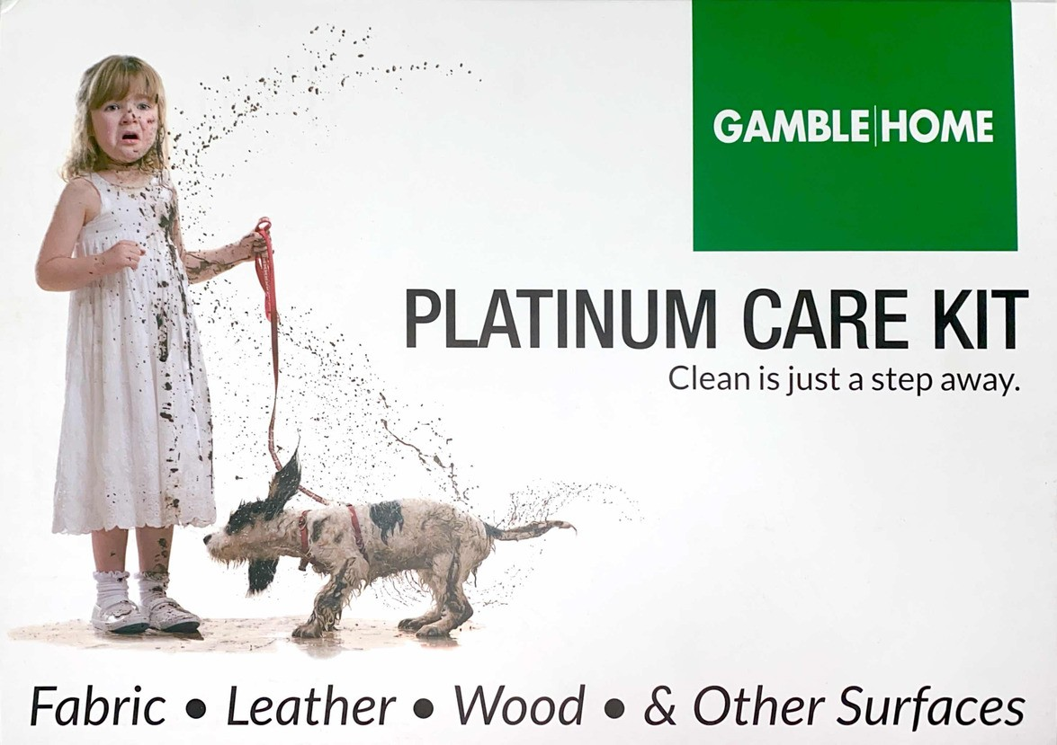
V. Give the Customer "Peace of Mind"
33
"I can't promise you that accidents will not happen, but I can promise you will NOT have to live with them!”

Slide 34
34
INTRODUCING THE PEACE OF MIND PLATINUM TOTAL CARE PACKAGE
As you all know the “Peace of Mind” program here at Gamble Home/Ashley presents a Win, Win, Win proposition for all involved. Our ownership has always looked tirelessly for ways to add value for our Customers and also create ways for you to deliver that value that makes your job easier and more rewarding (Financially and as a Customer Servant).
With this in mind we are tremendously excited to introduce the Premium Total Care Package as part of our Peace of Mind program. We sincerely feel that the addition of this offer along with other recent changes will be the catalyst that will help us provide more customers than ever before with “Peace of Mind” and provide you with the by-product of doing just that. We also believe that with this tool we will see 10% plus in “Peace of Mind” sales.
Why do we sell the "Peace of Mind" protection plan? There are 2 main reasons:
PROFIT
  The company makes a profit when we sell the plan and this profit is critical to our existence.
  Additionally, the company profits from the residual effects of a guest having the peace of mind that if something goes wrong, they have the resources to get it corrected.
Please be aware that you profit from the sale of protection plans in the same way that the company profits from them. You profit from the upfront commission from the sale of the plan and the residual business from a happier and well-adjusted customer.
The customer profits from having the plan in the following ways...
It covers the cost of any accidental damage covered under the plan helping the guest keep their investment looking good and lasting longer.
There is a value in peace of mind -- the customer knowing that if there is an accident not covered by the manufacturer, they will be taken care of. The plan covers the oops and uh-ohs of life.
It is a "no use, no lose plan." If the customer never has a claim, they will get the amount they paid for the plan back in the form of a store credit!
CUSTOMER SERVICE
  Our manufacturer's warranties are limited warranties that only cover defects in quality workmanship.
  This plan covers real life things that happen accidentally in the home: rips, cuts, tears, burns,
stains, spills, and PET DAMAGE on upholstery; gouges, deep scratches that penetrate the surface, stains, spills on the surface, fading, peeling and cracking of the finish, and PET DAMAGE on wood products are covered for 5 years with no deductible. These are things that the manufacturer does not touch and are the real-life things that most people deal with on their products in their home.

Slide 35
35
c. There is also a plan to extend the coverage of power bases for up to 10 years on moving parts, motors, and labor. Most vendors only have 2 years of full coverage for parts and labor.
In the past, before these plans existed, guests did not have the resources to cover accidents and damage that they, or someone else, caused to their merchandise. The manufacturer will not touch the dyes that cause the stains/damages that this plan covers. Therein lies the beauty of the program. The customer now has the manufacturer warranty for quality issues and the protection plan for real life things that happen in their home.
So, basically, this is a win, win, win proposition! The customer, you, and the company all win when the customer has the plan. This is crucial because this allows you to be persistent and sell it for the customer's benefit!
This is why we sell this program. The following is HOW TO SELL IT!
You have to be the expert. It is critical that you know all manufacturer warranties as well as the details of our protection plan. Product knowledge is the confidence with which we sell. Know as much detail as possible even down to memorizing the price levels. The more you know about it, the more believable you are.
Sell it to every guest early and often. The number one reason we fail to sell protection is that we do not bring it up at all. The number two reason is that we "offer" it instead of "sell" it. There is a big
difference between "telling and selling." Stop telling and start selling! The number three reason that we fail to sell it is that we bring it up too late. These misses are easily remedied by making sure that we give every customer the opportunity to make an educated buying decision.
You have to believe in the product, and more importantly, the customer's willingness to buy it. If you do not believe in the program and that the customer will buy it, then you will give up at the first
hint of rejection. Belief in the product and selling It for the customer's benefit is the key to selling past the no's that you are going to encounter! Selling past the no's show the customer that you truly believe in the product, and when they see that you truly believe they are more likely to purchase from you.
Eliminate the term "Extended Warranty" from your vocabulary. Refer to it as "Peace of Mind" and at the very least "Protection."
The “Total Care Package”
The exclusive “Premium Total Care Package” is a combination of the Premium Care Package (With Free Lifetime Refills) and our comprehensive Peace of Mind Plans. We will present this as Total Care for their home with bonuses.
Bonus #1- The Premium Care package and all of its benefits
Bonus #2- Savings on the Combination. Buying each of these individually is a value on its own. Buying them together will save you EVEN more while providing you with maximum “Peace of Mind” and VALUE!

Slide 36
36
What is the “Premium Care Package”?
It is a box of Furniture Care Goodies that every home needs and it contains:
10 oz. All Purpose Cleaner
10 oz. Leather Conditioner and Protection Cream
10 oz. Glass/Hard Surface Cleaner and Protector
10 oz. Wood Polish
10 oz. Upholstery and Carpet Pet Stain/Odor Remover
Ink Lifter
Touch Up Markers
Wax Fill Sticks
2 Microfiber Cloths
2 Sponges
Brush
Upon purchasing your customer will get free refills on the liquid products for a life! They just have to bring the original empty containers to the store!
How much does it cost?
Retail Price is $249.99, and retailers nationwide are selling them for full price with great success.
Selling the “Premium Total Care Package”.
Introduce the “Premium Care Package” to your customer and tell them about the benefits. It is $500 worth of Gamble’s/ Ashley approved care products and that value is much more when you add in the fact that we provide lifetime refills on the liquid products and that these products can not only be used on our furniture but on their other personal items (Their other current furniture, clothing, car upholstery, etc.)
They can buy the Premium Care Package alone for $249, or if they take advantage of the Premium Total Care Package, they can get a reduced price because they are buying it in conjunction with the Peace of Mind Plan.
All of the basic “How to” of selling Peace of Mind apply.
ALWAYS- Price in the Premium Total Care Package up front and sell it first. We can always just go back to the Peace of Mind.
Remember and execute on these important keys to selling...
Price it in EVERY TIME! When the customer asks for a price, make sure that you include POM, delivery, and tax. Give them the whole total. This accomplishes a couple of key things:
o If you have not told the customer about the plan, go no further until you SELL the plan and give the customer an opportunity to make an educated decision.

Slide 37
37
o By pricing it all in, we give ourselves the opportunity to sell it to keep it on the ticket rather than add it on the ticket. Utilize the column/triple close pricing strategy.
Persistence pays off!!! When you sell past no, you give credibility to the program and give yourself an opportunity to have success. Many times, I hear "I don't want to be pushy." My answer to that is don't be pushy. Pushy people only care about themselves. Be persistent. Persistent people are for all involved: the company, the customer, and themselves. Be persistent and show them you care. Most sales are closed on or after the 5th attempt, and most times with protection, we give up on the first no.
Sell if for the customer! If you sell it for their benefit, they sense your sincerity. If you sell if for the money, they sense your pushiness. The income you get is a by-product of taking care of the customer with something they need and will give them Peace of Mind!
Break it down by the day. A $749.99 plan cost the guest $150 per year, $12.33 per month. So, for
about 41¢ a day you can protect over $5000 in merchandise. We all waste more than 41¢ a day. If I told you that you could drop 41¢ a day in a jar and it would assure you that your furniture would be protected for 5 years, it would pretty much be a no brainer!
Treat and speak to people like they not only need, it but want it. For example: "Are you going to take advantage of the protection plan?" "Were you going to get the extended warranty or not?
  Instead:
§ "I am sure you are going to want the protection on this merchandise.
§ "I have the protection priced in on the order for you."
§ "I am going to make sure you have the 'Peace of Mind' we talked about on all of your merchandise."
Utilize selling statements to make it make sense...
  "Mr./Mrs. Guest, I cannot assure you, and you cannot assure me, that nothing will happen to your merchandise. I can, however, guarantee you that if something accidentally happens to your merchandise, you will be taken care of. I can also guarantee you that if nothing happens and you do not file a claim, I will give your money back in the form of a store credit! I can also guarantee that if something happens, you will be glad you had it."
  "Mr./Mrs. Customer, one thing you need to know about us here at Gamble's/Ashley is that we sell this plan for your benefit. There is no stronger statement we can make to that end than to be so committed to you that we are willing to give the money for the protection back to you if you have no claims during the five-year period. So, as you can see you have nothing to lose." "I cannot promise you that accidents won't happen, but I can promise you that you won't have to live with them."
Create a moment of misery. To sell life insurance you, have to talk about death. To sell car insurance
you, have to talk about wrecks. To sell health insurance you, have to talk about getting sick. I have seen where people have had issues with their product and have been taken care of because they had protection. I have also seen where people had the same issue and there was nothing that could be done. It is sold on "what if," BUT they do not lose it they do not use it!
Embrace the math. To have the best success with Peace of Mind/Protection, you must the embrace the 2-6-2 rule. The 2-6-2 rule states that out of 10 buying customers that two will NOT buy the protection even with your best presentation, two WILL buy the protection at whatever price you tell them, provided you bring it up to them and explain the value, and the remaining six customers are on the fence, meaning that a compelling sales presentations executed correctly will bring success

Slide 38
38
with over half of these six opportunities. The only thing that erases the 2-6-2 rule is not correctly "selling" the Peace of Mind/Protection plan to all 10 guests that purchased. In other words, sell it correctly to every customer every time! If you do not get it at the higher price, your manager can help you get it from there.
T/O all misses. Sometimes all it takes is another person coming in and saying the exact same thing that the RSA told the customer.
The news flash here is that the secret formula to selling protection is as follows:
Sell it every time, for them.
Have a heart to take care of the customer.
Make it make sense. It is hard to argue logic.
T/O the miss. It is very powerful and credible for the manager to come in and tell the customer the exact thing you just told them!
Setting the Foundation for a proper T.O.
The Gamble 10-ft Rule applies to the TO. Anytime a manager comes within 10-ft of you and your customer, you should introduce them. "Hey [manager name], I want you to meet my guests". Make this introduction about you being so excited about your manager getting to meet your customer, not the other way around.
Do your job correctly and the TO becomes less awkward and less intrusive.
TO EVERY MISS. EVERY TIME. NO EXCEPTIONS.
Once the TO happens, let your managers do their thing. They may say "Hi" and leave straight away, they may hang out for a while, but keep in mind while the TO manager is there, it isn't to take your sale, but to assist in pushing your sale forward. To avoid any confusion, or your customer becoming overwhelmed, DO NOT talk over the manager while they are speaking to the customer. Your customer should never feel that you and your manager aren't on the same team. We want to create a unified front for our customers at all times.
The TO has absolutely nothing to do with how well you can do your job. We fully trust and believe in your abilities, but it's always nice for the customer to be introduced to someone that they feel has more authority. This would be the go-to person for final pricing, any invoices changes, etc. It's all about making the customer feel special and making sure your customer gets the best service possible.
Throw away your pride. TO.
TO-ing properly creates an environment of trust between you, management, and the customer. The customers are then less likely to want POM, or any other items removed from the invoice when they reach the sales counter.
Examples of a Proper T.O.
Hey, [insert manager name], check out what [customer's name] picked out! It looks so good and I wanted you to see! [Customer name], this is my manager, [manager's name].

Slide 39
39
"Hey, [manager's name], can we get your opinion on these two fabrics we are in between for the pillow option? This is my customer, [customer's name].
Once this transaction happens, let the conversation flow naturally. The manager will exit when they feel like it is time and move on to help others. The idea is for that connection and trust to be built for later when they are needed for a push back from the customer.

Slide 40
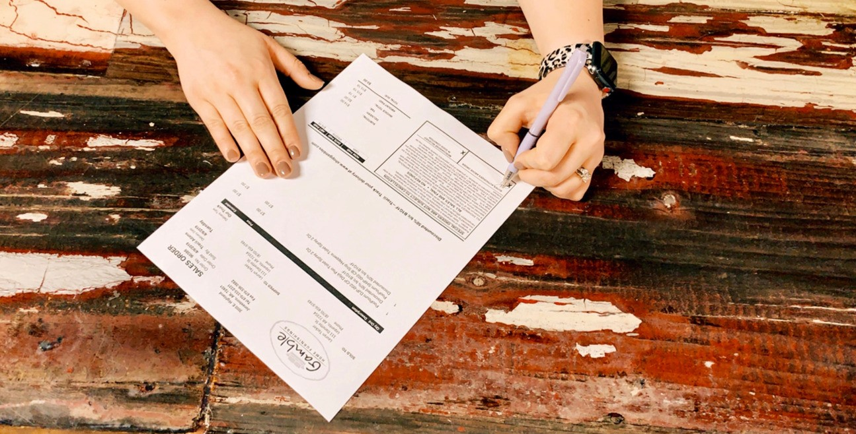
VI. GO FOR IT! The Easy Way!
41
95% of sales made in retail furniture stores EVERY DAY are to people who said either they were "just looking" or "We are not going to buy anything today".

Slide 41
42
Top Reasons We Fail to Close the Sale
Wrong/Misguided RSA Beliefs
  Actions follow beliefs. If you believe the lie that they are “just looking” or “not going to buy
today,” then you are more likely to skip critical points of execution in the sale (Proper Non Business Greeting, Draw the Room, Look for Buying Signals, Attempt to Close). When we do not believe that the customer is buying or will buy, we fail to do the things that make us the most successful. You have to “Ignore the Rhetoric” and execute on the plan. Do the right things the right way right and your feelings will catch up.
Poor Greeting Execution
  Many times, the customer comes in with stereotypical expectations.
    You are like all salespeople.
    You are going to “bother” them.
    You can’t help them & will not just let them look.
  We, in return, stereotype them.
    They just want to look and be left alone. (They said so/Lie)
    They are going to be or are short/rude if I persist. (Lie)
    They said they were not going to buy. (Possible Lie)
  We are not Ready and/or Properly Focused
    We are not in the position to greet.
    We are in a great conversation that the customer interrupted.
    Life is happening.
    We are dealing with a customer issue.
All of the above things will throw us off of our game if we allow them to. Selling is what we are paid to do and the customer entering our business is the lifeblood of our business. They deserve our undivided attention and that is the expectation set forth by the company.
Additionally, “just looking” is a learned response. Who taught you how to say it?
The fact is that when you execute the greeting properly, you establish control of the interaction and you will:
Get more favorable responses/interaction with the customer and therefore you will feel more like you have a chance.
It will also lead to you doing more things right in the process, which will lead to more success.
You earn the right to “Hang Out.” Top performers leave the greeting to show merchandise to 6 - 8 out of every 10 customers. Low performers usually only leave the greeting with 2-3 out of every 10.
Executing a good greeting entails focused and intentional behaviors. When you are focused and intentional, you cannot be pushed off so easily.
3. We do not ask

Slide 42
43
a. You do not get because you do not ask. When you ask for the sale, you open conversations that you otherwise would not get to have and sometimes they just say YES! Find a way to ask that you are comfortable with and GO FOR NO!
We do not ask enough
  Most sales are closed on or after the 5th attempt. We rarely ask once.
  In the book “Go for No” it says that “all of your Yes’ are hidden in No’s.” You cannot be afraid to get No. It means you still have selling to do.
We are afraid that we will be viewed by the customer as being “Pushy”
  Through the years, I have been told this more than any one thing as the main reason that
RSA’s do not do many of things that make them more successful. “I do not want them to think I am being pushy!” My response to this is, and ALWAYS has been, “Well then DO NOT BE!” I do not want you to be pushy either, but I do want you to be forward and GO FOR IT!
  If they leave without buying, you have the same thing that you would have had if you didn't ask, NOTHING!
  Less than 5% of people actually come back so what do you have to lose? The answer is SALES.
  The 95% that aren’t buying from you wouldn’t recognize you on the street.
  75-80% of them are not buying from us NOW.
  Customers lie to you all the time: “I will be back,” “We are starving and need to get some
lunch and think about it,” or “I need to measure.” BLAH, BLAH, BLAH. The issue is that you do not know which ones are lying, so to maximize your opportunities you have to GO FOR IT!
  You must overcome this fear and embrace the following facts:
    They came here of their own free will.
    The strongest buying signal you get is that they drove into the parking lot, got out, and came in the store. It is a hint that they are in the process of buying something. Most likely sooner than later.
    If you do not sell them, there is a 75-80% chance that someone else will.
    This is how you make your living.
    You have nothing to lose—Be Forward.
Now that you know why we do not close business, let’s talk about how to CLOSE THE SALE. The EASY CLOSE!
The fear of asking for the sale is difficult for some to overcome. I had to find a way to make going for the sale less intimidating and basically EASY! So, I developed what I call the EASY CLOSE!
The Easy Close is asking questions that are easy for you, the RSA to ask, and easy for the customer to answer.
It is a “hybrid” close that utilizes the assumptive close combined with the alternative/minor point. Either combination will close the sale.

Slide 43
44
Example 1:
“Mr./Mrs. Customer, you told me that you definitely want the sofa and love and you were thinking about either the chair or a recliner. So, do you want to go with the chair or the recliner?”
Whatever the answer, chair/recliner/neither, you assume the sale is done at that moment and start writing the ticket.
Example 2:
“Mr./Mrs. Customer, are you going to take advantage of our interest free programs or pay cash?” Once they answer, you assume the sale and roll with it.
There are hundreds of combinations of this close and, as you can see, the questions are easy to ask. The worst response you will get is when they say, “Oh I am not ready right now.”
Right now, does not mean “NOT TODAY,” it means I need either more information or more convincing! Time to sell.
Your key to success with this close is centered around 3 things:
You must do it.
You must take the answer to the question as signal to proceed with the sale.
If the answer is “Not right now” it means you have more work to do. You must not take it as an absolute no. Press on and solve the “Magic Problem.”
The Triple Close
The triple close is used in calculating final comparison pricing for your customer.
When getting a price together, make sure that you take the time to give them 3 options.
Long Term Financing price and payment with full total, including Peace of Mind, Delivery, and Tax.
36 Months price and payment with full total as above.
Cash price with full total as above.
These 3 options (Triple Close) are then presented to the guest as their “options” and you ask which one they want to go with. When they respond with the one, they want, you take it as a final decision and proceed accordingly.
A huge KEY to executing the TRIPLE CLOSE is to get your customer to LEAN IN to see/review the totals. In the book “Pre-Suasion” it explains that studies have shown that the level of acceptance and ultimately the

Slide 44
45
success rates of proposals are increased greatly when the customer is put in the position to lean in closer to you, and you to them, to deliver the proposal.
Handling “I want to think about it.”
This is one of the more common push offs/objections that you get. Although we cannot overcome this every time, we can overcome it MORE TIMES if we execute on some proven strategies.
Get them to think about it while still in the store.
  Do not give them their “Ticket to Leave.” Too many times as soon as we hear “I want to
think about it,” we immediately assume that the customer is leaving an we hand them our card (Ticket to Leave). Getting them to stay in the store to think can be the difference between getting the sale or the customer leaving and purchasing elsewhere.
  Customer: “We really want to go and think about it.” RSA: I tell you what, you guys sit right
here on your new furniture and I will go and get you a total and check stock on your merchandise.” Once you say this, begin to walk away and then turn around and ask, “Hey Mr./Mrs. Customer, were you guys going to pay cash or take advantage of our Interest Free Programs?” If they say Interest Free, ask for their Driver’s License and start the process of getting them approved. If they stop you and say they are not ready at that point, then proceed to get them a price on paying cash and utilizing LTF (Long Term Financing). If they say cash then say, “Great, cash is the lowest price. I will get that total and be right back.”
  Make sure your customer has something to “think about.” Many times, we send them on
their merry way, and they do not know the price, lead times, availability, etc. Do not allow your customer to go out on the street without this critical information to consider. Grant Cardone says “If you do not make a proposal, you will not close the sale,” “If you do not solve the Magic Problem, you will not close the sale,” and “If you do not deal with all of the influencers, you will not close the sale.”
Use the 4 C’s. Clarify/Confirm/Commit/Close
  Customer: “Even though we drew out the room I really need to go and measure.”
  RSA: Clarify - “So you said you need to go and measure?”
  Customer: “Yeah just want to be sure.”
  RSA: Confirm - “If you get home and measure and this will fit, is this the one you are going to get?”
  Customer: “Yes, I really like it!”
  RSA: Commit - “So, can I call you late this afternoon and see if it fits?” Or “If it fits when can I expect you to come back and take care of it?”
  Customer: “Sure or I will probably be back on Saturday.”
  RSA: Close - “Mr./Mrs. Customer, based on the drawing and what you explained that you
have in your home currently, I am certain this will fit. I tell you what, why don’t we go ahead and get the order locked in and in the event that it doesn’t fit, we can start over and switch to something else. That way I can reserve the stock/lock in the price/get your financing done to save you time/save you the time of having to drive back out/etc..., etc.…”
If you cannot close, then get an appointment time set for a return visit.

Slide 45
46
The intended outcome is to gain COMMITMENT.
Commitment to buy TODAY Or
Commitment to a Home Makeover visit Or
Commitment to a Return Appointment (With time set) Or
Commitment to take a Follow Up Call
Important Keys to Closing
Most sales are closed on or after the 5th attempt. We usually don’t even ask.
YES Mansion is at the end of NO BLVD. Go for NO!
“I want to think about it” and “No” are where the “real” selling starts.
Often, they will not buy if you do not “Go For It.”
Great presentations and execution of the Selling Disciplines will increase the chances of the sale just happening and you not having to ask.
Learn the “art of negotiation”.
You cannot score if you do not shoot!
Pre-Suasion though the Triple Close.

Slide 46
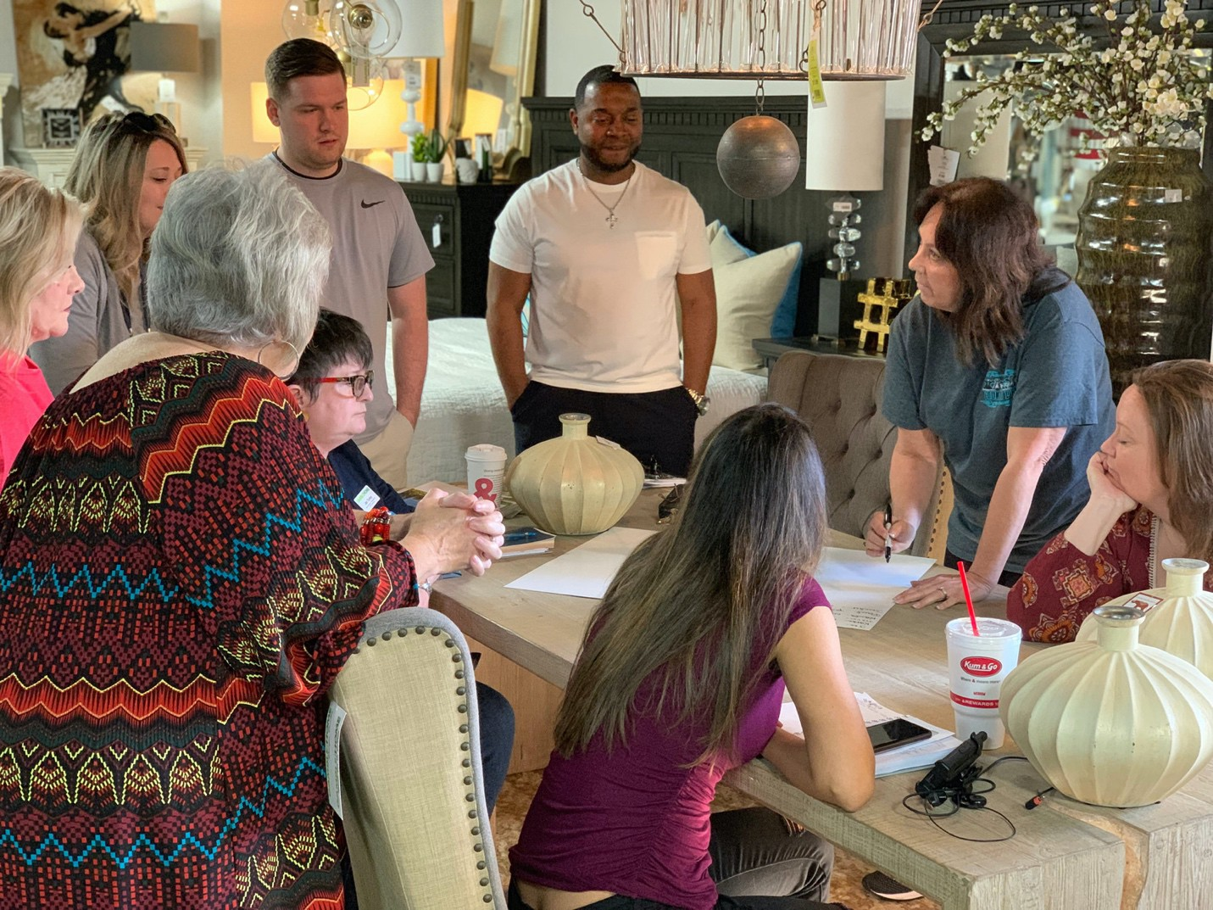
VII. Customer Relationship Building and Follow Through
47
This section will be broken down into two parts:
Transactional Integrity when the customer buys.
Prospecting with Purpose when the customer does not buy.

Slide 47
48
Transactional Integrity when the customer buys:
  Write it right - One of the biggest costs in this business comes from having to correct correctable errors. Ordered wrongs, leaving Items off the ticket, and pricing errors are all examples of correctable errors. Doing accurate work by double and triple checking work is key. Eliminating Pricing Errors- Have the Manager on duty check your work when pricing Special Orders. Leaving Items off the ticket and ordered wrongs can be eliminated by covering the ticket with the customer line by line.
  You must go over the ticket line by line with the customer and have them sign off that the items are correct.
  Quote it right- A major point of contention and dissatisfaction from customers comes from
us quoting inaccurate lead times or quoting accurate times and having factory delays that
we fail to communicate to the customer. This also can lead to cancellations from customers. Although factory delays are out of our control, the issue with lead and arrival times can be helped greatly by the RSA taking the following actions:
    Quote correct lead times because you want, to not because you have to.
    Quote correct lead times with confidence.
    When you have the customer sign the ticket, tell them 2 things every time as you have them sign the ticket:
      “Mr./Mrs. Customer, as I told you we are ordering this merchandise specifically for you and it will take 6-8 weeks (or whatever the lead time for the vendor or product is) and if it arrives early, we will give you a call. Please read this and sign the bottom for me.” What this says, basically, is the lead time I am quoting you is an estimate and since we are ordering this specifically for you there are no cancellations.
      “Now I need you to guarantee me something! Even though our product
arrives early or on time 95% of the time, there are times when a product will be delayed by the factory due to delays in production or raw materials. These delays are totally out of my control and if this were to happen with your order, I need you to guarantee me that you will be patient, do I have your guarantee?”
    Check the status of your orders every 2 weeks and call to update your customer even if we are on track. Especially make this call if there is a delay. The customer will appreciate the service. Also, the difference between a customer being mad or being disappointed is who made the call. If they have to call us, they will say things like “we sold them and forgot about them” or “I have had to call every time” or “I am getting the run around” and they will be MAD. If you call them and keep them updated, then they may be disappointed, but they will not be mad because you set correct expectations and followed up. They never had to make the call.
    An unintended issue that occurs when we fail to keep the communication with the
customer going after the sale is that they will have very little patience for mistakes or issues if they had to wait with no communication, except them reaching out to us. Our lack of follow through and positive communication will have them in a more frustrated state when the merchandise finally arrives and if there is damage,

Slide 48
49
ordered wrongs, etc..., the customers frustrations often boil over and it makes it very difficult on our warehouse and customer service teams. Consequently, the opposite occurs when we do provide the customer with timely follow up and communication (We called them to regularly keep them updated). In these cases, the majority of customers that have issues are much more inclined to allow us to take the steps we want to take to provide service. They are more patient and understanding and this is almost solely due to your timely communication even in the event of a delay.
vi. Another very important topic to discuss here actually happens during your sale. We
must set accurate and thorough expectations for the customer as it relates to: product quality, product characteristics (distressed finishes, natural leathers, variations of color in natural products, etc..., lead times, delivery process, and more). Many times, customers are irritated or anxious about things because we failed to set good expectations for them.
Prospecting with Purpose when the customer does not buy:
  The customer got out of the store without buying. What do you do now? Do we just let
them go and hope they will return, or should we follow up and maximize our mathematical chances of earning their business? As a company, we have made a commitment to maximize our chances and expect the following to happen with the guest that does not buy on the first visit.
As soon as the customer leaves you must:
Formulate a plan to get back after that customer.
Make notes as to what they looked at and the sale pricing that you gave them.
If you entered a quote, you have to commit to a follow up time. The sooner, the better.
  Get customer information from EVERY CUSTOMER. Every customer represents opportunity, but if they leave and we do not get their information, we increase the probability that they will not choose us!
Ask for it and capture it from them.
Utilize the $300 prospect slip to gain their information. This information is gathered primarily for the RSA to have a way to follow up to gain a sale.
This gives you the information in an easy format to keep and follow up. Notate what
they are looking for, prices you quoted, when they need it, and any important information you may need.
The best way to get them to fill it out is to stick it in front of them and say “Here, fill this out for me.”
Use information to follow through to a YES or an absolute NO! 65% of people buy
within 24 hours of the 1st time they shop. Another 20% buy within 72 hours. Customers are 50% more likely to buy from the first store or RSA that re-engages them once the shopping has begun. We must reconnect quickly and with PURPOSE!
iii.

Slide 49
50
Calling customers is the best and most effective method of follow up. When you call depends on where the customer is in their buying process.
If you got them really close and you know they are shopping call them later that day. “Mr./Mrs. Customer, this is at Gambles, is this a good time to talk? Great, I was just following up to see if you had any questions about what you looked at earlier today?” You may take questions in any direction needed based on what was discussed earlier in the day. We have seen great success in saying, “I know your time is important, I tell you what, if you will give me your credit card, I can go ahead and get that ordered for you.”
If they were actively looking but not “hot on the trail” just make sure you call them back within 24 hours. “Mr./Mrs. Customer this is at Ashley did I catch you at a good time? Great, I just wanted to call and thank you for shopping with me yesterday. I know you have a choice and I want to thank you for choosing to shop with us. I also wanted to see if you had any questions about what you looked at yesterday?” Let the conversation flow from there and attempt to set an appointment for them to return.
If you got their info but they really never slowed down or expressed real interest in anything, the call
needs to be: “Mr./Mrs. Customer this is at Gambles. Is this a good time? Great, I just wanted to call and tell you thanks for shopping with us. I know you have a choice and I am honored that you chose to shop here at Gambles. Do you have any questions about anything you saw in the store? Thanks again and I hope to see you again soon.” Attempt to see if there was interest in any product or finance offers and attempt to uncover the next project and again gain an appointment for a follow up visit.
  Email and text are to be used if you cannot get them to answer. If they start to interact, ask them to call. Nothing replaces the ability to convey enthusiasm, energy, and importance like
your voice.
  Keep these in an organized manner as you should have anywhere from 10-50 prospects that
you are actively working at any given time. Some are immediate prospects, some are building, or are having to delay the purchase for another reason. If you know these things and can formulate a strategy that ties in your offers, follow up, relationship building, sending special offers, and timing, then you will find that you actually have a living, breathing pipeline of business that keeps you engaged and busy even when it may be a down traffic time.
    Send Thank You Cards. Many times, we send thank you notes to people that
purchase and we should continue to do that. Sending a thank you to someone that just shopped with you is an easy and cost-effective way to ENDEAR yourself to a prospective customer. Think about it, how many times have you received a thank you for buying, much less for just shopping? This is huge and will pay off in a big way.

Slide 50
51
A real-life example about the Power of Thank You notes.
“Early in my career, I was selling furniture for Rhodes Furniture in Dothan, AL. I was the youngest and least experienced RSA on the team, and I couldn't get out of my own pocket, so I was struggling. In fact, I was put on notice to be terminated. I couldn’t lose my job because I had a 2-year-old daughter and a wife and had no real job skills. I went and looked for another job and ran into a man that changed my life. I had applied for a sales position with Terminix because my best friend worked there (He is now the VP of Sales Training for the entire Southeast US). I will never forget Mr. Don because he looked at 22-year-old me and asked me a very good question, “If you are being let go for not selling, then why would I want to hire you to sell?” He went on to tell me to go back and ask my Manager what he thought I needed to do specifically to succeed and do it. And if it didn’t work out to come back and he would give me some kind of job. I took his advice and 1 of the 3 things that my manager told me that I could do to succeed was to send thank you notes to every person that I talked to, not just the ones that bought. It sounded like busy work to me, but I took his advice and within a week I began to notice some strange things happening.
We had a shadow box by the office for all to see that had comment cards from customers about their experience with our store. Our delivery drivers gave out the comment cards and because they were the last contact and had a hard job, the majority of the comment cards would have their names on them, a few had some of the office staff on them, and none had RSA’s names. Not until after I started to send thank you notes. I have always taken pride and care to be nice to my customers, after all my Grandmother taught me that “Being nice was FREE!” But all of a sudden, the cards started showing up with my name on them. “Taylor was great to work with,” “Taylor is an asset to your company,” “The reason we bought from Taylor was the Thank You card he sent us.” It wasn’t long before 85% of the cards in the case mentioned me by name. Now I made a couple of other adjustments (getting my manager more involved, getting out of my own pocket) but I do not think that any one thing I did had the same impact that sending thank you notes to every customer had!
People started showing up to the store asking for me by name and many times they would say, “I got your note, that was so nice. We couldn’t buy from anyone else but you after that!”
When I would call people to follow up or tell them about a sale and say “This is Taylor at Rhodes, is this a good time?” they would respond “I got your note, that was so thoughtful, what can I do for you?”
With all of that said, there is power in being personally nice and grateful. It saved my job and put me on a career path that has been rewarding in every way imaginable! Try it consistently for 90 days and see what happens! You will be glad you did!
Studies show that RSA’s that execute a consistent prospecting and follow up regimen experience a 25-50% lift in business within 2 weeks and sustain this increase as long as they stay consistently committed to the program. The book “Pre-Suasion” says when we put ourselves in front of the customer, we are in consideration. A phone call, a thank you note, a sale flyer, a pamphlet, a text, an email, or all of the above. Staying in constant contact is a sure way to make sure that you maximize your opportunities!
Selling is a numbers game and this strategy just gives you one more channel and one more chance to do business. When embraced and worked properly it produces HUGE Results.”

Slide 51
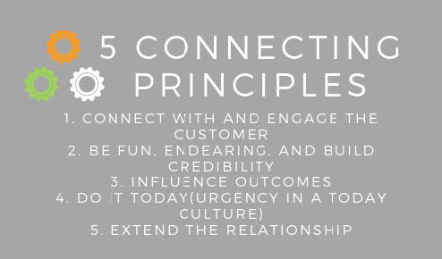
5 Principles of Emotional and Personal Connection
53
Selling is both an ART and a SCIENCE.
In our case the Science is the 7 selling disciplines we just covered.
The art of selling is comprised of God given “selling talent” and God given “connection and relationship skills” along with Intentional actions and behaviors that are proven to enhance the personal relationships and connections that we make with people. In other words, authentic personalized salesmanship.
Each of the 7 Selling Disciplines absent of the traits above will ultimately fail and lead to robotic interactions that yield minimal results. Buying is an emotional process and therefore, to be wildly successful, we must connect emotionally with the customer. Additionally, when the customer experience is presented with the 5 stages of emotional and personal connection matching the timing of the delivery of the 7 Selling Disciplines, it becomes another WIN, WIN, WIN proposition. Everyone wins: the customer, you, and your company.

Slide 52
54
The 5 Stages of Emotional and Personal Connection in Selling Home Furnishings.
To harness the Power of Authentic Personalized Salesmanship, you must consider several factors:
What is your motivation? Most of us have a desire to help a customer make their home more beautiful and get a good buy in the process. We do not desire to lead them astray or push them into something. With this established, all feelings of guilt or pushiness should disappear because it is not what you are about or doing.
Why are they here? They came here of their own free will to hopefully find beautiful things for their
home and get a good buy in the process. Sounds like you and the customer are a “Perfect Match,” a “Match made in Heaven,” If you will.
Customers would rather deal with an Excited, Energetic, Happy, Knowledgeable, Fun and Confident person. Someone they can “CONNECT” with.
With all of that established, these 5 stages are going to be matched with one or several of the 7 selling disciplines to guide the customer experience and maximize our chances of MUTUAL SUCCESS with our customer.
Connect and Engage. We have to make “Fast Friends” and begin to build trust immediately. To do this, we must connect and engage. This stage actually begins at the greeting and carries throughout the entire selling process and is enhanced by Drawing the Room, selling Peace of Mind, Questioning Skills, and Actively Listening. If engagement dwindles, connection and trust will dwindle along with it. Our chances of MUTUAL SUCCESS will dwindle as well. Additionally, if we fail to connect and engage at the greeting, we may never get the opportunity for MUTUAL SUCCESS.
Be fun, endearing, and build credibility. Immediately after you have earned the right to “Hang Out,” you must begin to endear yourself, your store, and your products to the customer. One sure way to do this is to “Be Fun” by “Having Fun.” It is proven that if a customer is laughing and having fun with their RSA, they are significantly more likely to buy. While this is taking place, you can also enhance your credibility through the questions you ask while drawing the room and the information you begin to give about products. This stage will also carry through much of the sale as “Having Fun,” endearing yourself through doing things for your customer, and building credibility through your knowledge and confidence are critical in gaining the influence needed to achieve MUTUAL SUCCESS.
Influence Outcomes. Ultimately the outcome we all desire is new, beautiful furniture, accessories, and a great night’s sleep for our customers. Even the customer desires this. Being trusting (Having
Credibility), engaging, endearing, and fun automatically opens the door for you to have Influence with your customer. By now, if you have executed the process properly and used your God given talents and abilities, the customer is under your influence and you just have to EMBRACE the IDEA and FACT that you have this influence and are going to use it honestly and respectfully to achieve MUTUAL SUCCESS!
Do it Today. (Urgency and a Today Culture) The honest use of urgency in selling is powerful. When you have time restrictions, limited stock, or the end of a sale, the sincere use of urgency will often lead to MUTUAL SUCCESS and in these cases, you feel more comfortable in wielding this closing tool. Developing and putting into use the urgency of a “Today Culture” will yield you the same MUTUAL SUCCESS and can do so honestly. The premise of a “Today Culture” is embodied by the realization

Slide 53

55
that oftentimes your only chance at MUTUAL SUCCESS with your customer is while they are in your store. The keys to adopting a “Today Culture” for yourself are:
Embracing the fact that your best chance at selling the customer is NOW, the chance of them coming back are WELL LESS than 5%.
Emotion + Great Experience + Fun + Urgency = MUTUAL SUCCESS! Find something to be urgent about and if you cannot find anything else to tap into, the urgency of honoring their time and just getting this done now while they are here.
If you want to increase your chances that they will come back, then get them closer to buying TODAY! You see “Mental Possession” is the birthplace of “Physical Possession,” but unless you make them strongly consider buying, then mental possession will never take place. If you do it with emotion and urgency, it becomes more desirable. The “Today Culture” and urgency will begin to be used in the Product and Buying presentation phase and will need to be fully present in the closing phase of the disciplines.
5. Extending the relationship. This stage is going to be used at the Point of Sale or the point of the customer leaving. We need to extend the relationship either way. If MUTUAL SUCCESS is achieved, we must extend the relationship through the process until delivery as discussed in step 7 (Customer Relationship Building) and with a “thank you.” If they do not buy, we must extend the relationship through following through with “Thank You for shopping” cards and calls to earn our way to MUTUAL SUCCESS!

Slide 54

56

