Slide 1


Slide 2
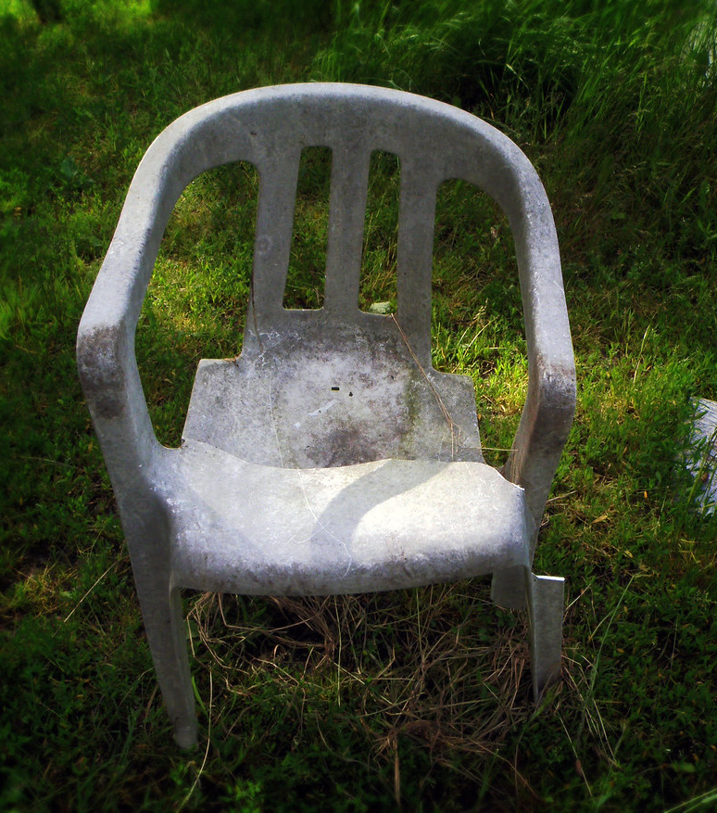

Service order quick reference guide
This Photo by Unknown Author is licensed under CC BY-SA-NC

Slide 3
Stock or Customer Info Basics
*Three photos needed (overall, issue, and S#/Model tag)
*Specific Location of Issue(s)
EXAMPLES:
-Outside Back Panel
-Inside Backrest
-Seat (Left Facing/Middle/Right Facing
-Arm (Left Facing/Right Facing)
-Legs (Front/Back)
**If you move the item to 999-Make sure a transfer is done
**Anything you do for a service order, input the notes into the service order.
EXAMPLE: Swapping out for customer-put that you have an exchange already in for the customer on the service order.
**MAKE SURE YOU VERIFY THE PHONE # FOR THE CUSTOMER TO BE CONTACTED**

Slide 4
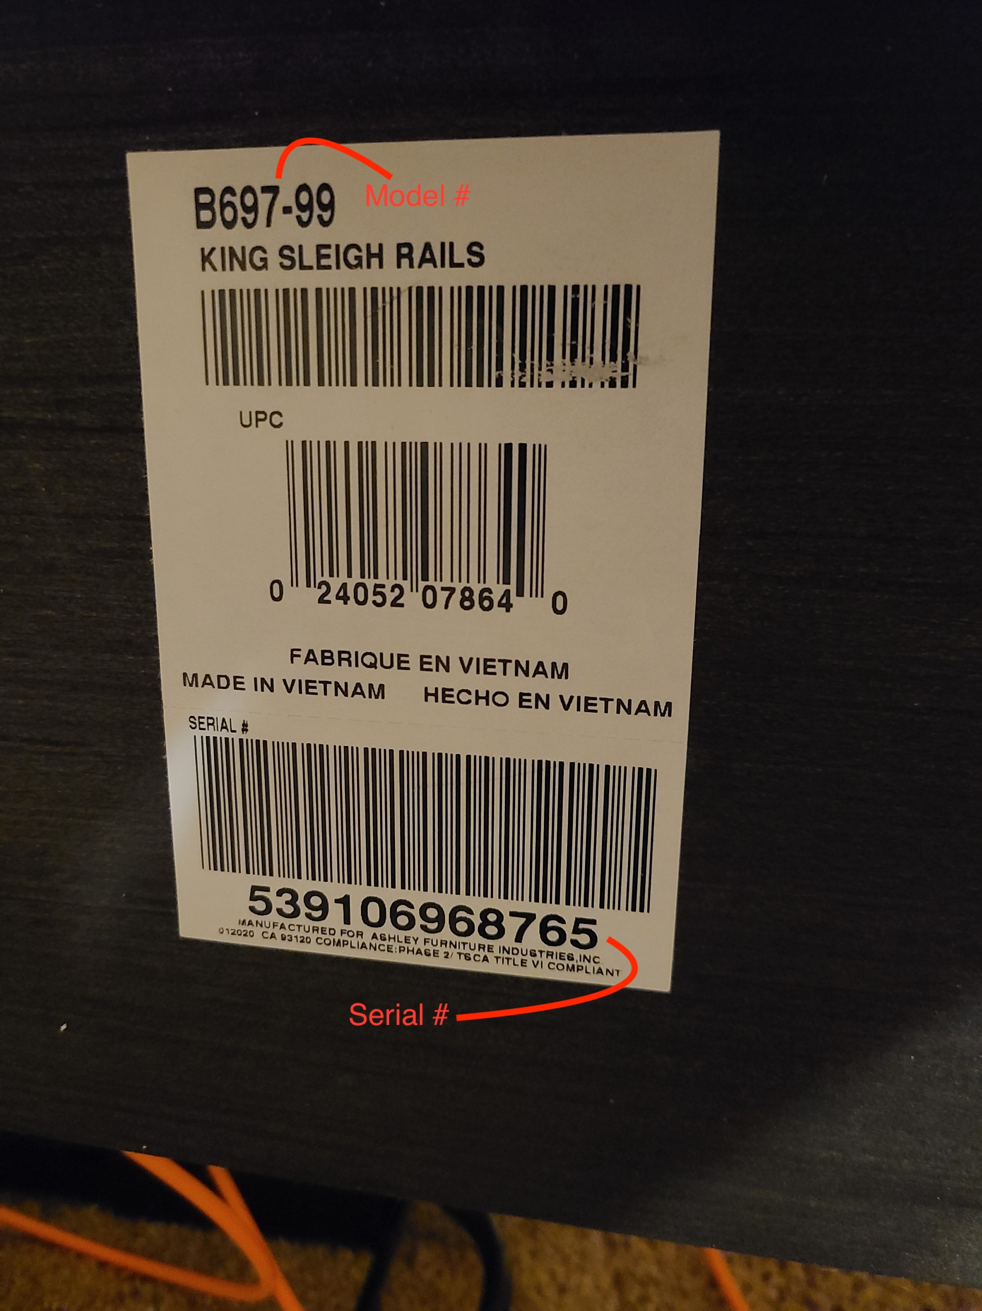
ASHLEY CASEGOOD (BED/DINING)
Tag usually can be found under item or on the back panel of item.
Each item will have a different serial number, even if the model number is the same.
Tag is required for all claims through Ashley to order parts or to get credit.

Slide 5
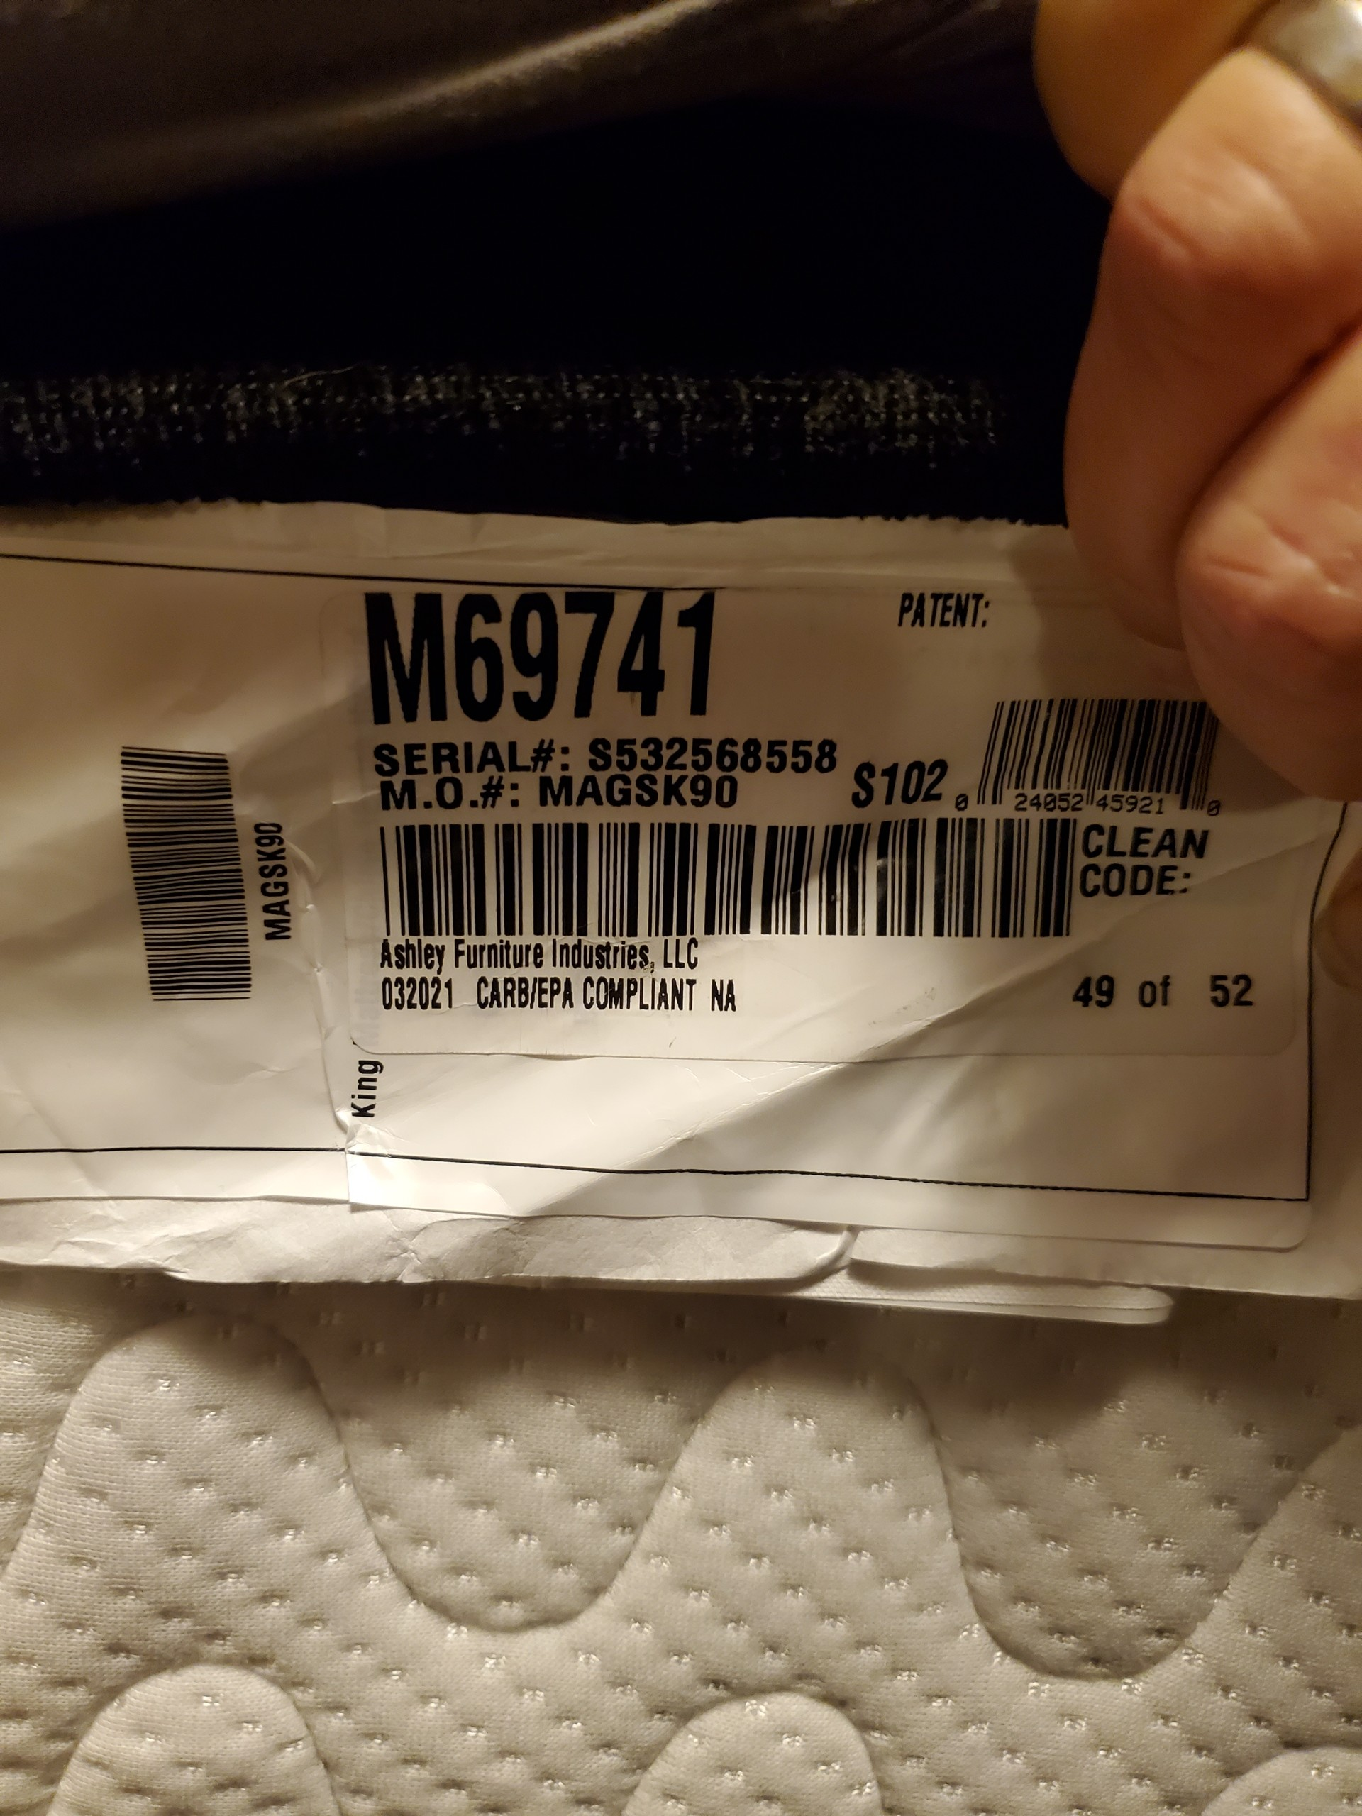
ASHLEY MATTRESS
Will have a serial number/Model tag sewn into the mattress
Removal of tag voids the warranty
Stains on mattress voids the warranty

Slide 6
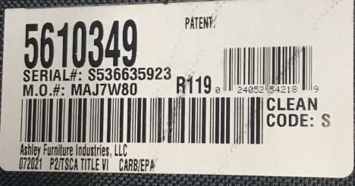
ASHLEY UPHOLSTERY/LEATHER
Stationary-Tag is usually found under cushions or underneath item on dust cover
Motion-Tag is usually found underneath the footrest when reclined.

Slide 7
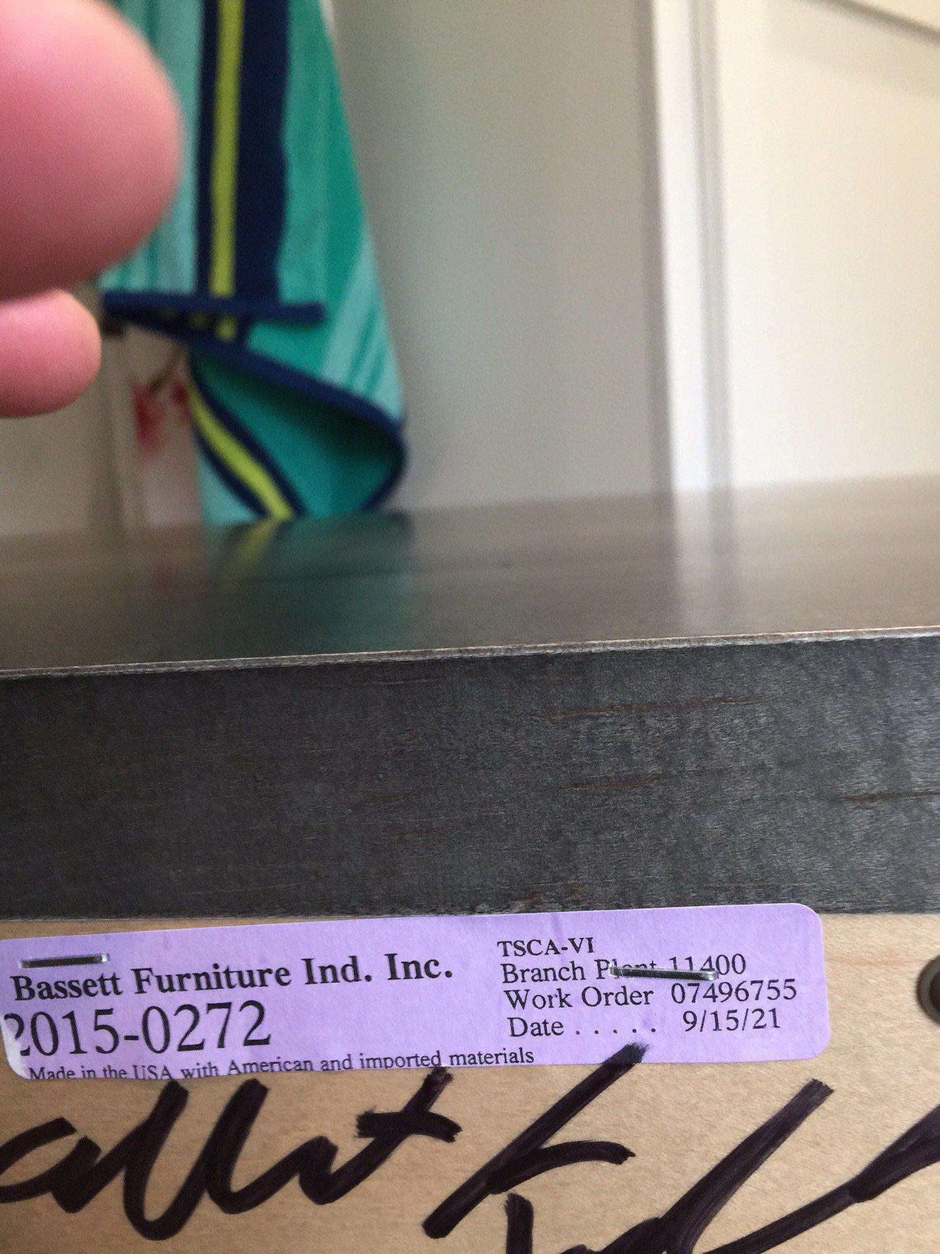
BASSETT CASEGOODS
Tag is usually found in behind item on back panel.
Bassett work order # is considered the serial number.

Slide 8
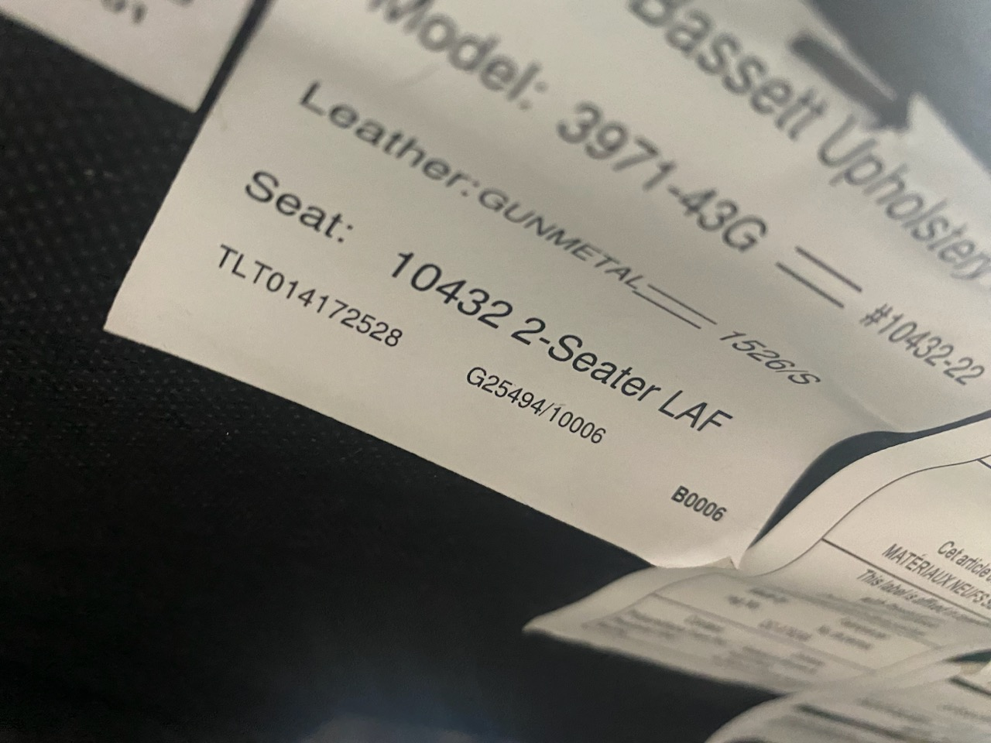
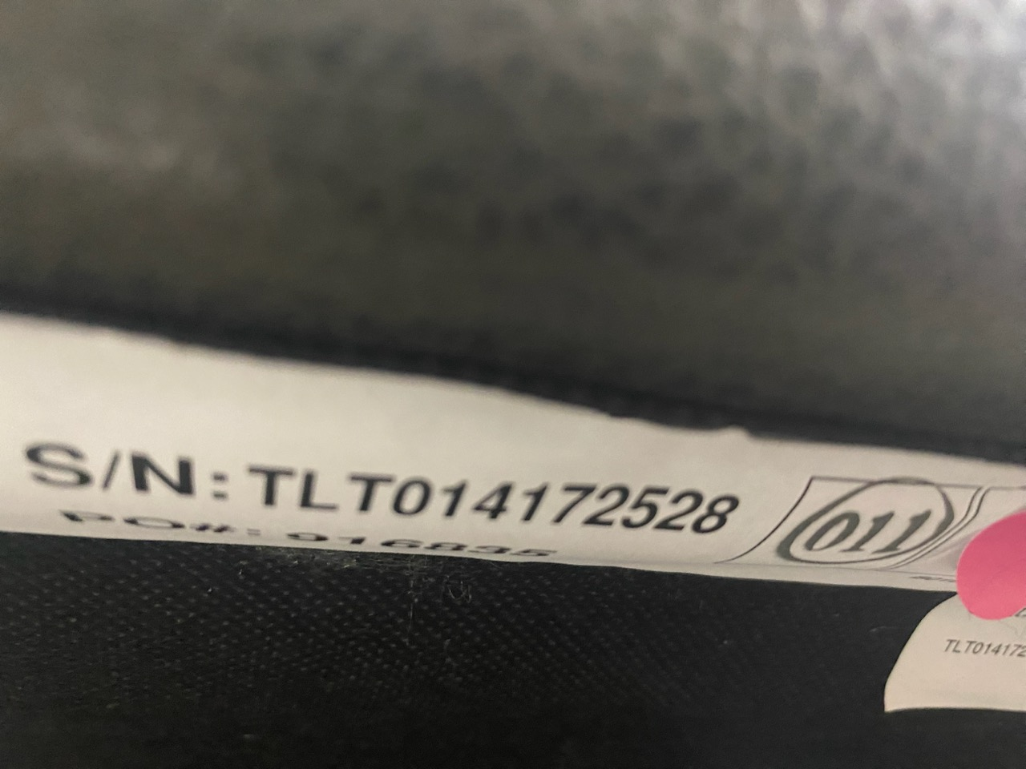
BASSETT CLUB LEVEL
The tags are usually sewn into the bottom on the dust cover of the items.
Usually has two tags-Both are needed.

Slide 9
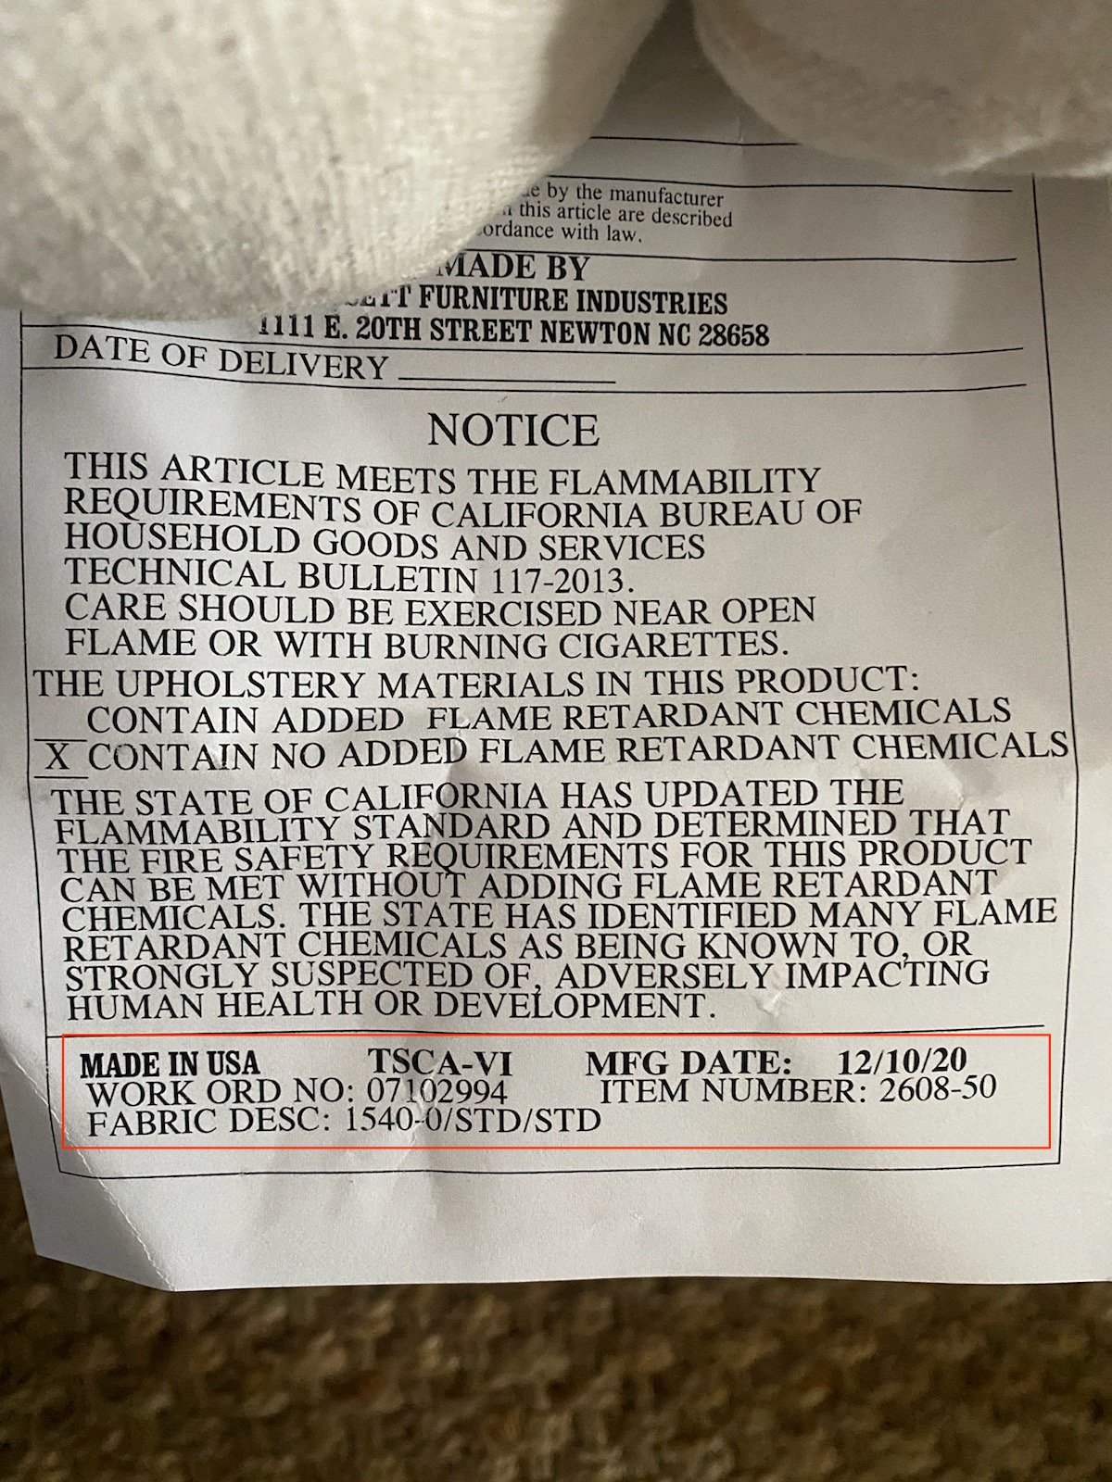
BASSETT UPHOLSTERY/LEATHER
Stationary-Usually found underneath the cushions or underneath on dust cover.
Motion-Usually found underneath the footrest of item when reclined.
Work order # is Bassett’s Serial #.

Slide 10
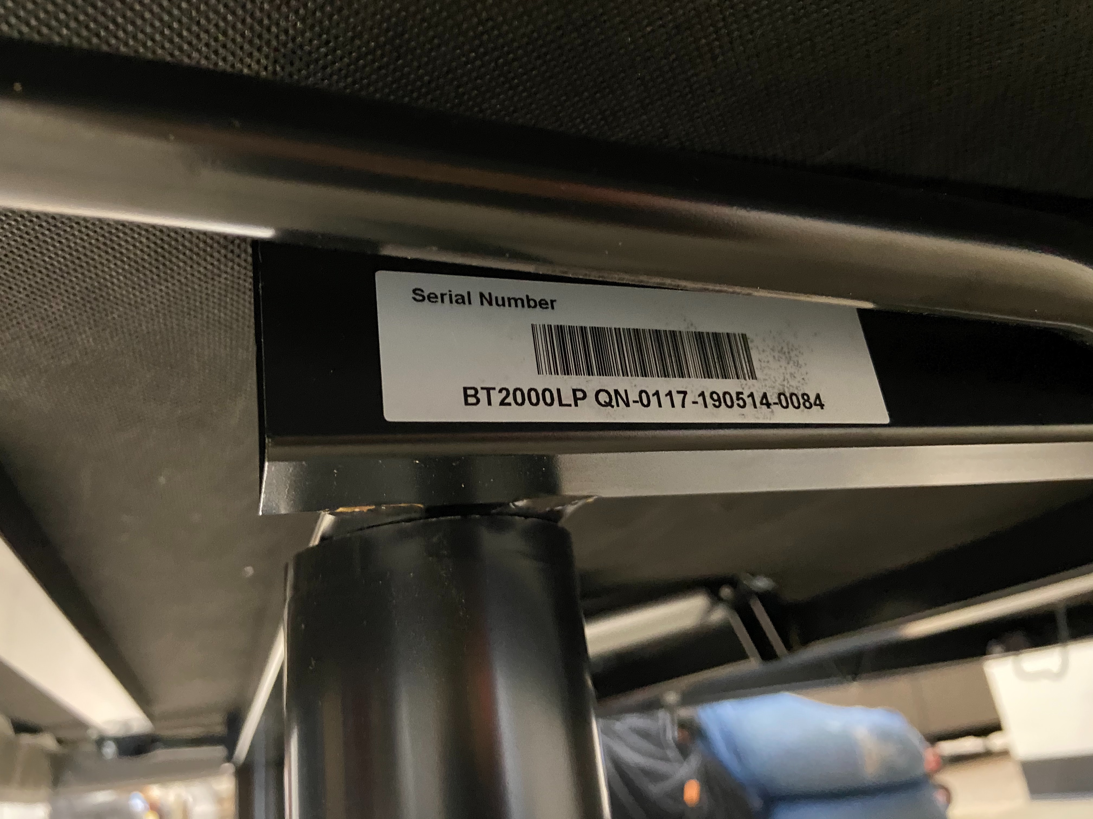
BEDTECH
Serial number is required-can be found on base frame/back of usual manual/back of battery cover
Most cases Bedtech will contact the customer directly once Claims provides customer info to troubleshoot with the customer.

Slide 11
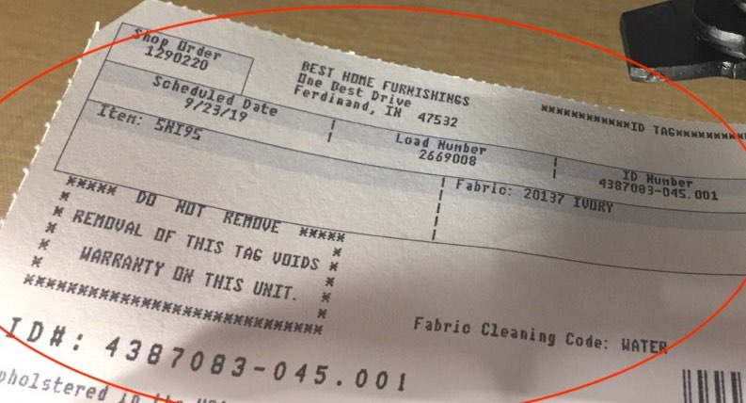
BEST CHAIR
Tag can be found underneath footrest of item or attached to the frame of the item underneath.
ID# is the serial # for Best items.

Slide 12
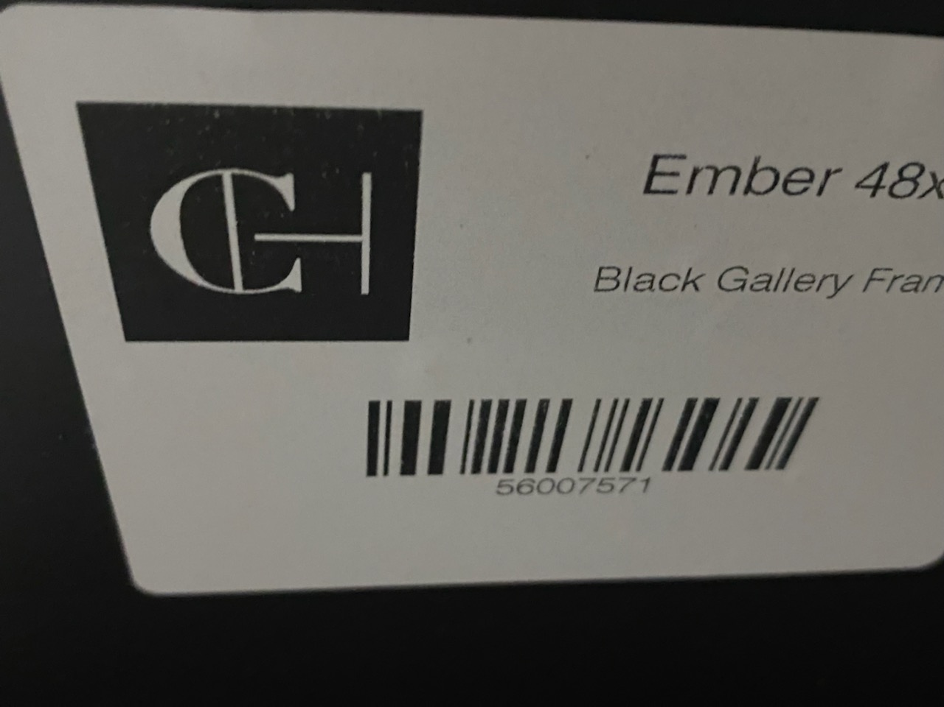
CLASSIC HOME
Has only a model number tag. Is required for claims submitted.
The tag is usually underneath the item.
All claims must be reported within a 10 day time frame from receipt of item into our warehouse.

Slide 13
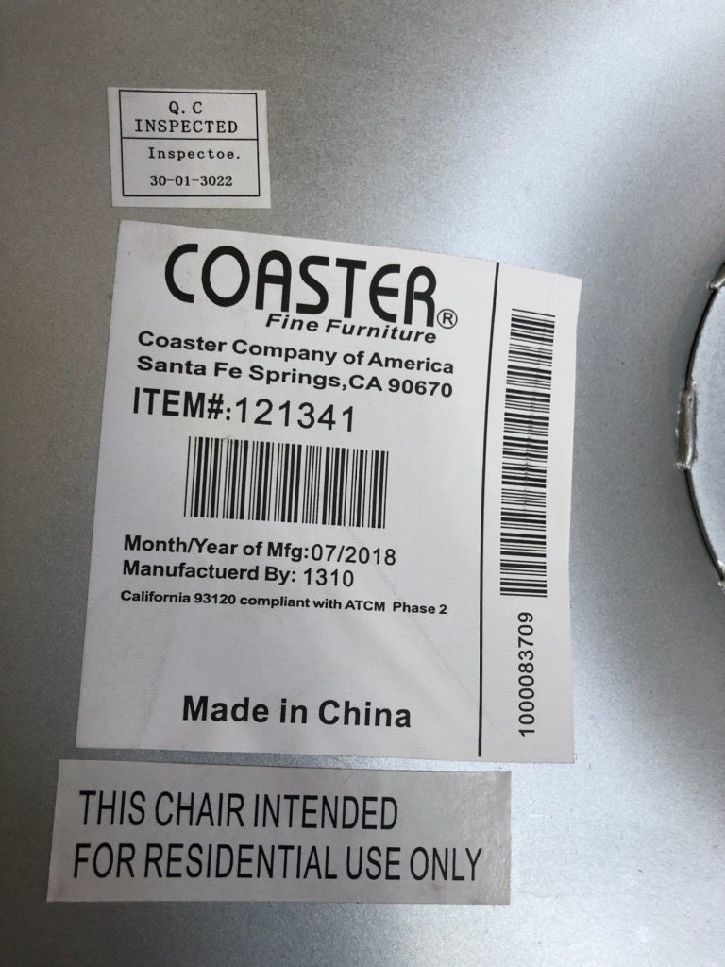
COASTER
Tag is usually found on the back of the item
Items do NOT have serial numbers only a manufacturer tag
Coaster Company of America warrants that its merchandise is free from manufacturing defect (workmanship and/or material) and will either give credit or replace defective parts to the retailer for a period of up to one (1) year from the date of purchase.

Slide 14
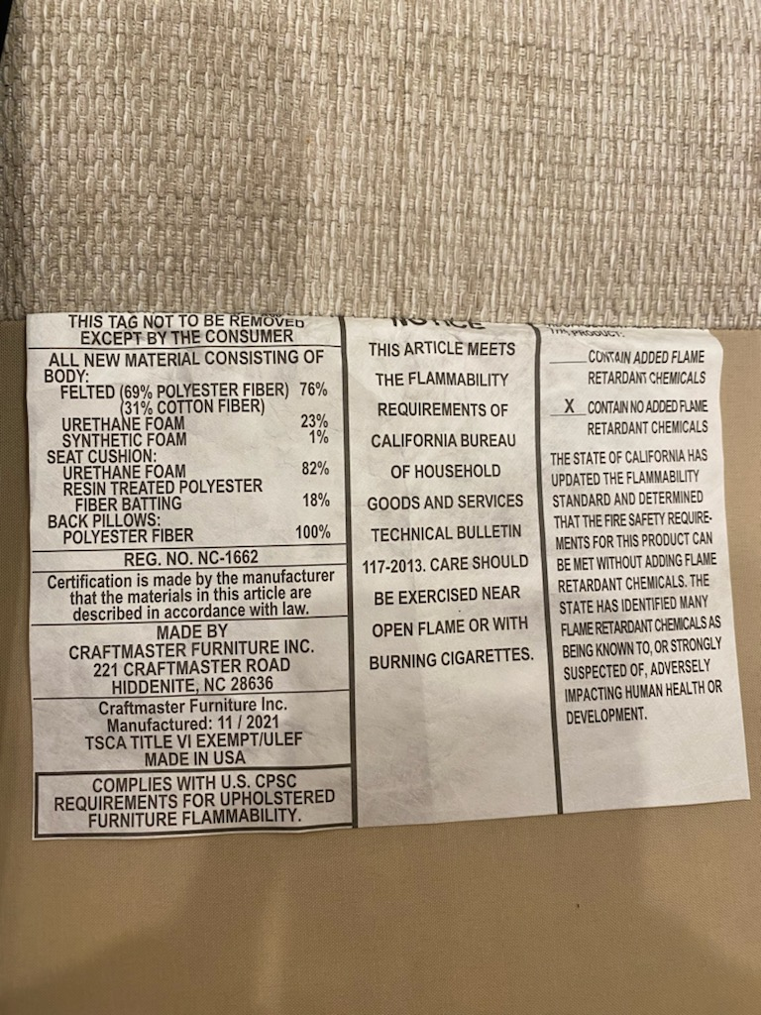
CRAFTMASTER
Tag is usually found underneath the cushions.
Items do NOT have serial numbers only manufacturer tags

Slide 15
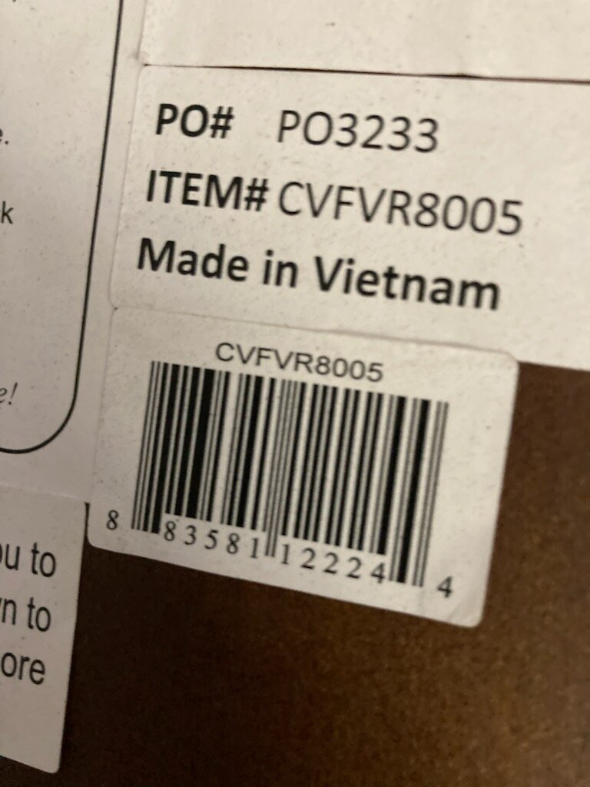
CRESTVIEW
Tag is found underneath or on back of item
Items do NOT have serial numbers only manufacturer tag
Most claims must be reported within 10 days of receipt of item for claim approval.

Slide 16
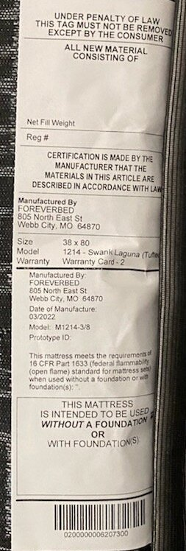
CROFT MATTRESS
Tag is sewn into mattress and is required for claim processing.
If customer wants mattress rebuilt, there is NOT a replacement mattress given for customer use during the time the mattress is away for rebuild.

Slide 17
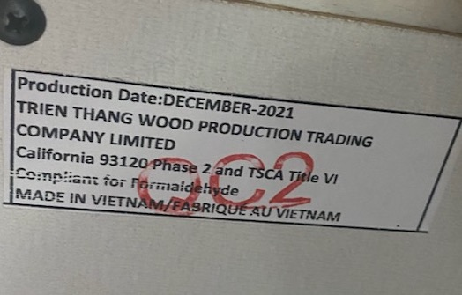
ELEMENTS CASEGOODS
Tag is found on back of item.
Items do NOT have serial numbers
Has a 1 year warranty only.

Slide 18
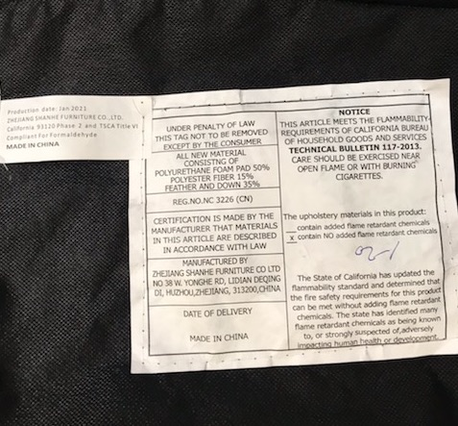
ELEMENTS FABRIC
Tag is usually sewn onto the dust cover underneath item.
Items only have a manufacturer tag not a serial number
Has a one year warranty only

Slide 19
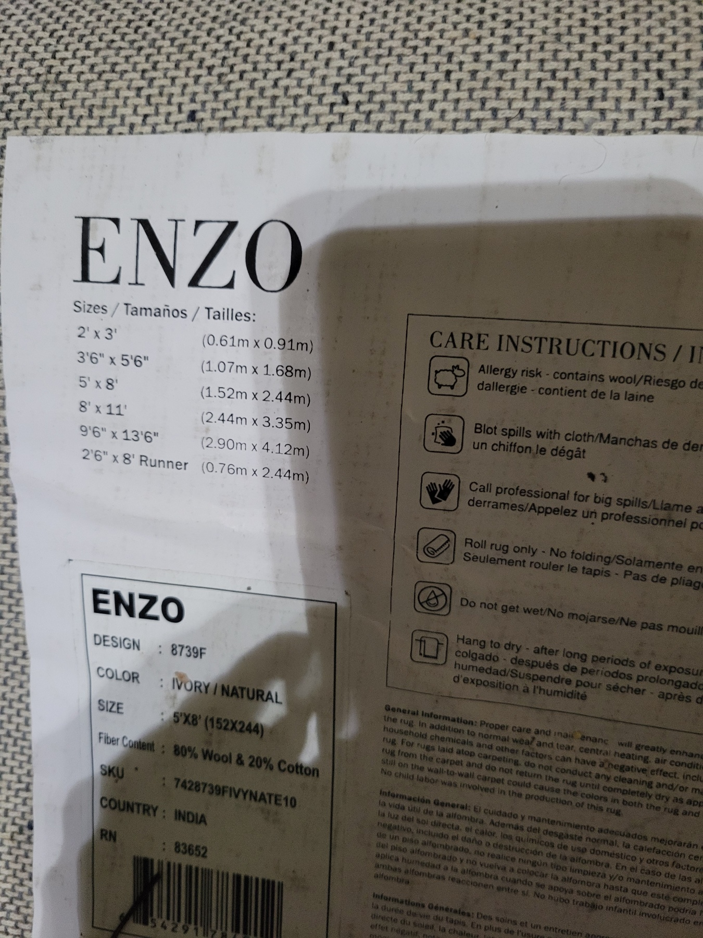
FEIZY RUGS
Tag is found underneath the rug on one of the four corners.
Most rugs will show defects within the first 10 days if defective due to manufacturing.
Wool Rugs-Natural shedding will occur and is not considered a defect.

Slide 20
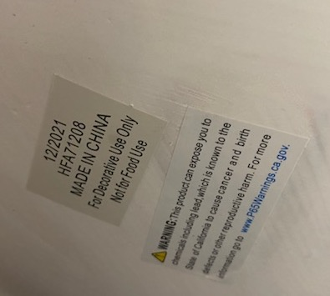
HARP & FINIAL
Tag is found underneath item.
No serial numbers only manufacturer tag
HARP & FINIAL DOES NOT SALE REPLACEMENT PARTS FOR OUT OF WARRANTY ITEMS

Slide 21
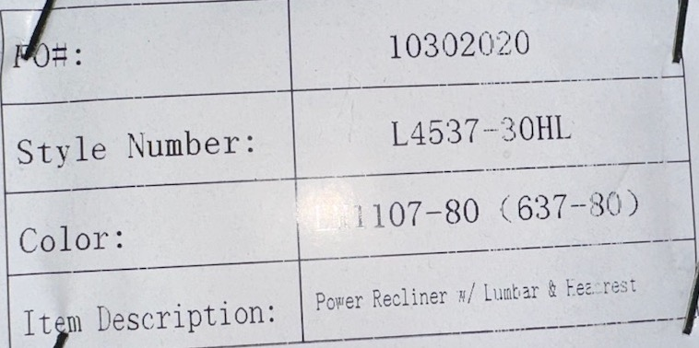
HIGH LIFE
Tag is found underneath footrest of item

Slide 22
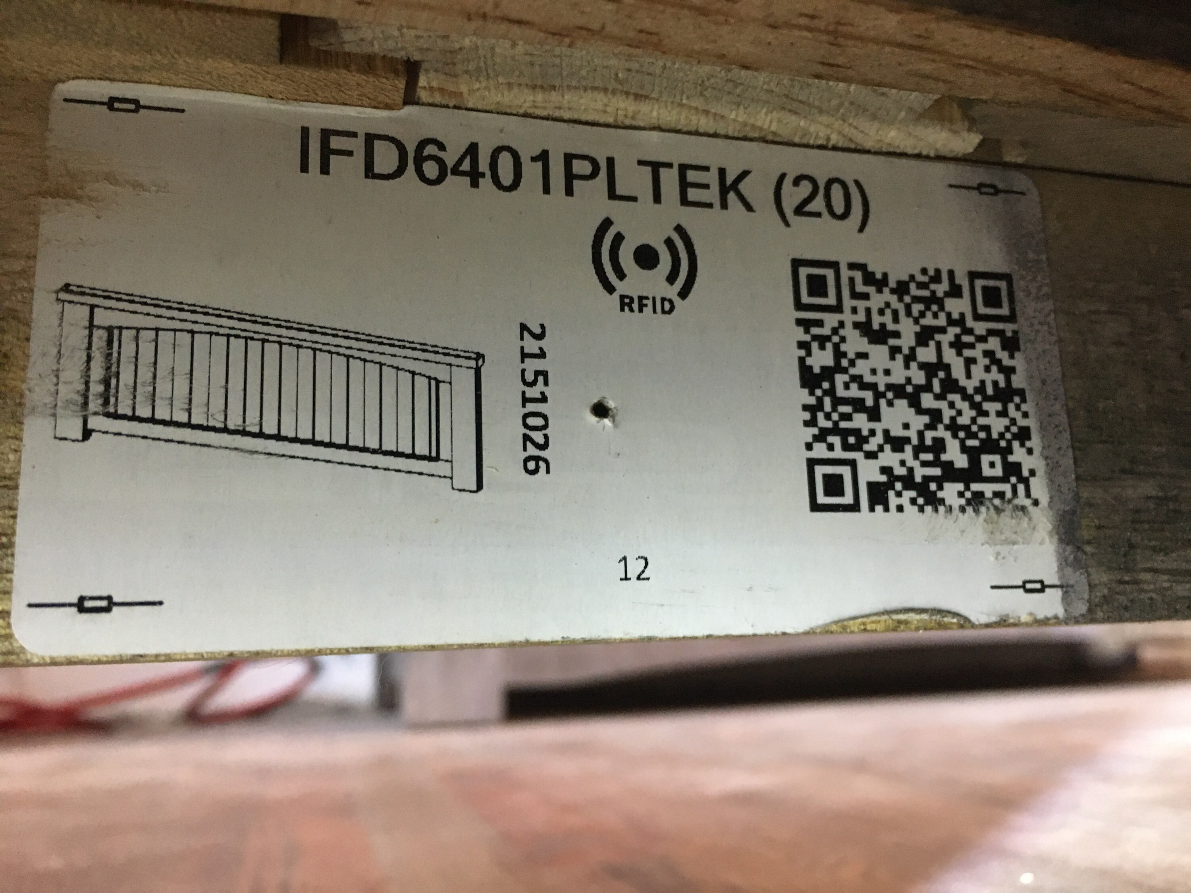
INTERNATIONAL FURNITURE DIRECT (IFD)
Tag is usually found on the back of the item
Items do NOT have serial numbers only manufacturer tags
Has only a 1 year warranty

Slide 23
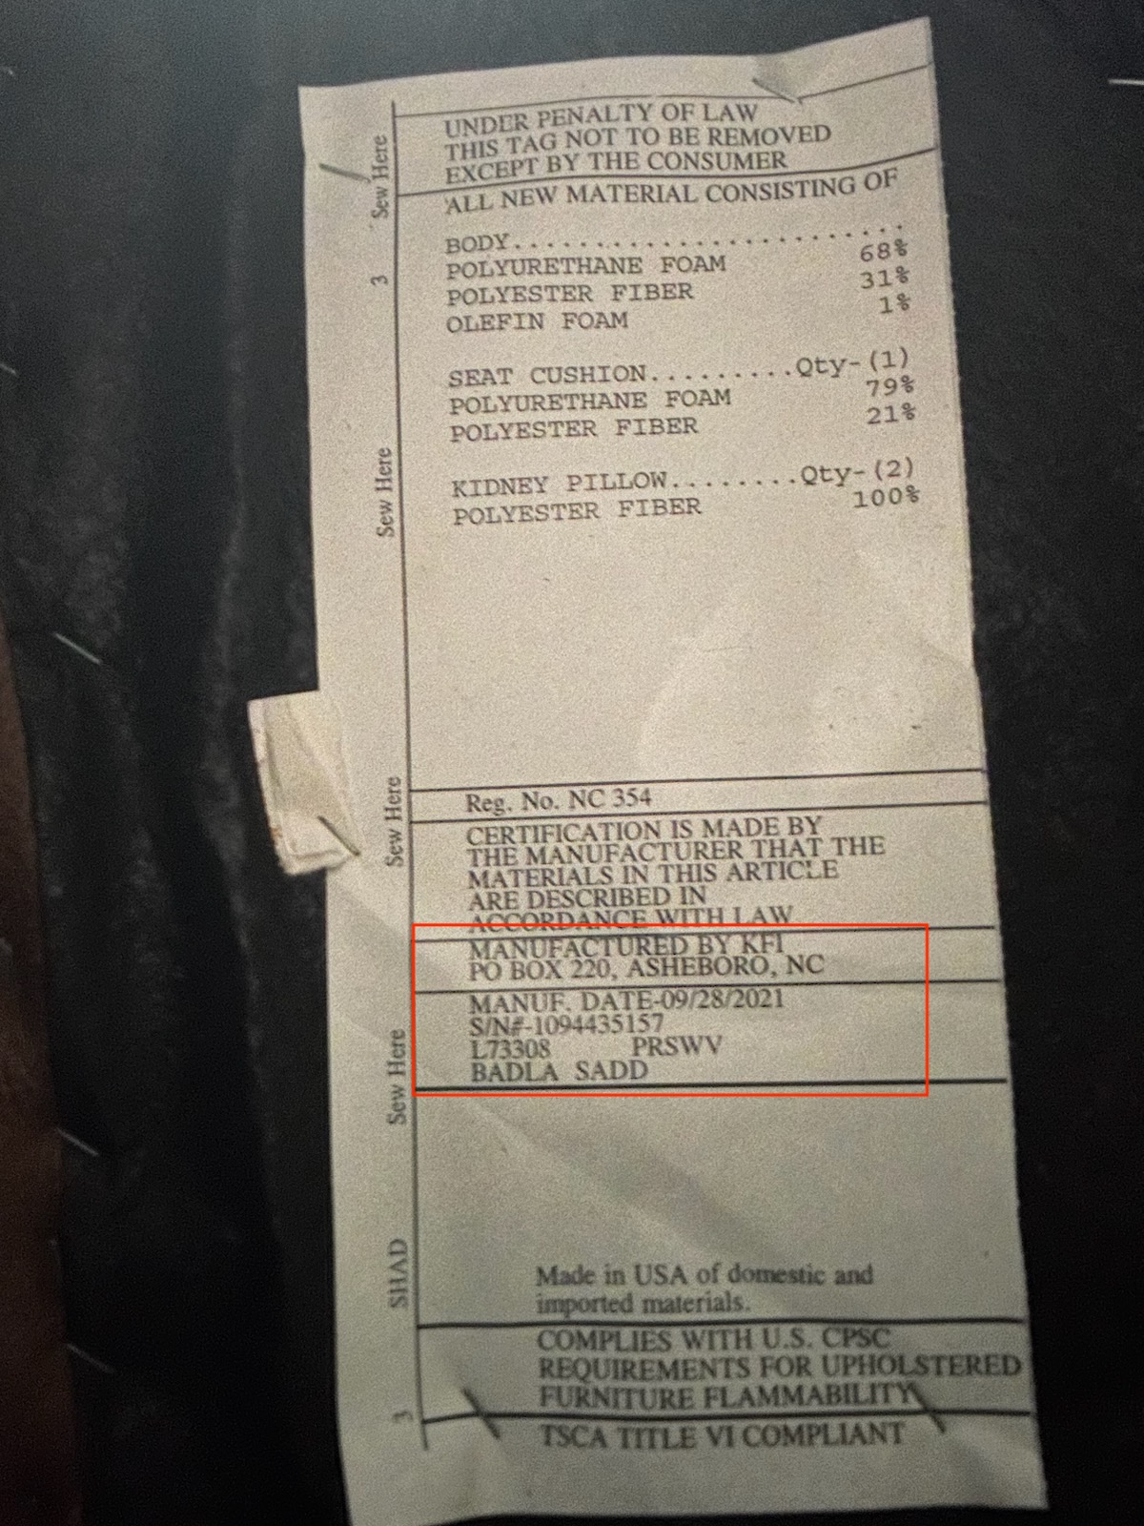
KLAUSSNER
Stationary-Tag is found underneath cushions or dust cover underneath item
Motion-Tag is found underneath the footrest when reclined
Reference Klaussner warranty on their website for the different time lengths on various sections of the items coverage

Slide 24
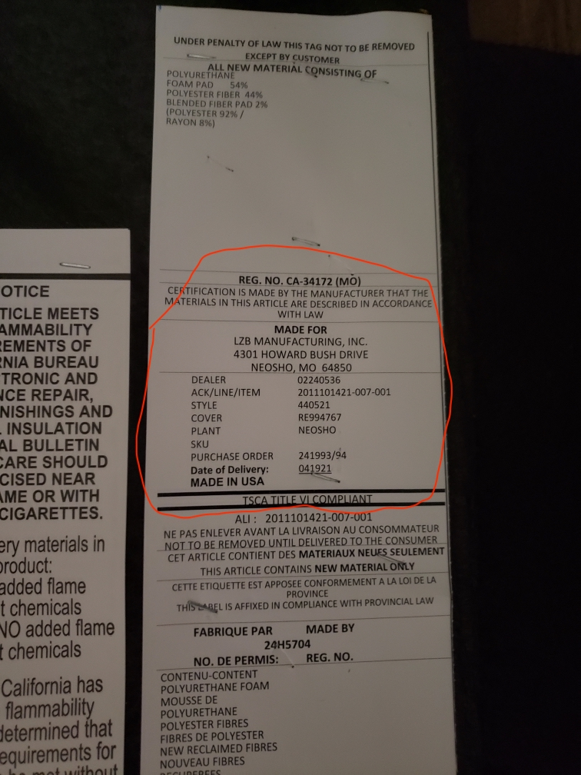
LA-Z-BOY
Stationary-Tag is found underneath cushions or underneath on the dust cover
Motion-Tag is found underneath the footrest when reclined
Visit www.la-z-boy.com/content/customercare/parts-warranty for the full list of the warranty lengths on various parts of the items

Slide 25
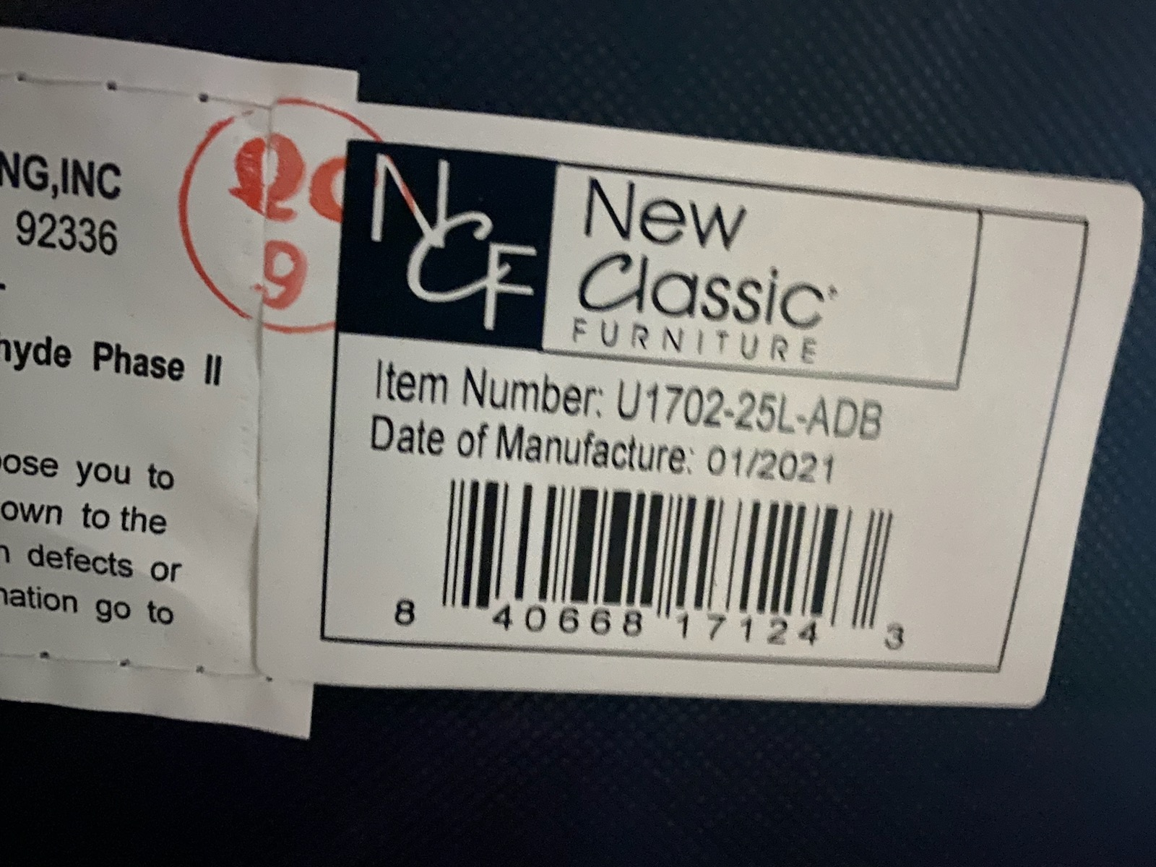
NEW CLASSIC
Found underneath footrest of motion items or on the back of the case good items
Items do NOT have serial numbers only have manufacturer tags

Slide 26
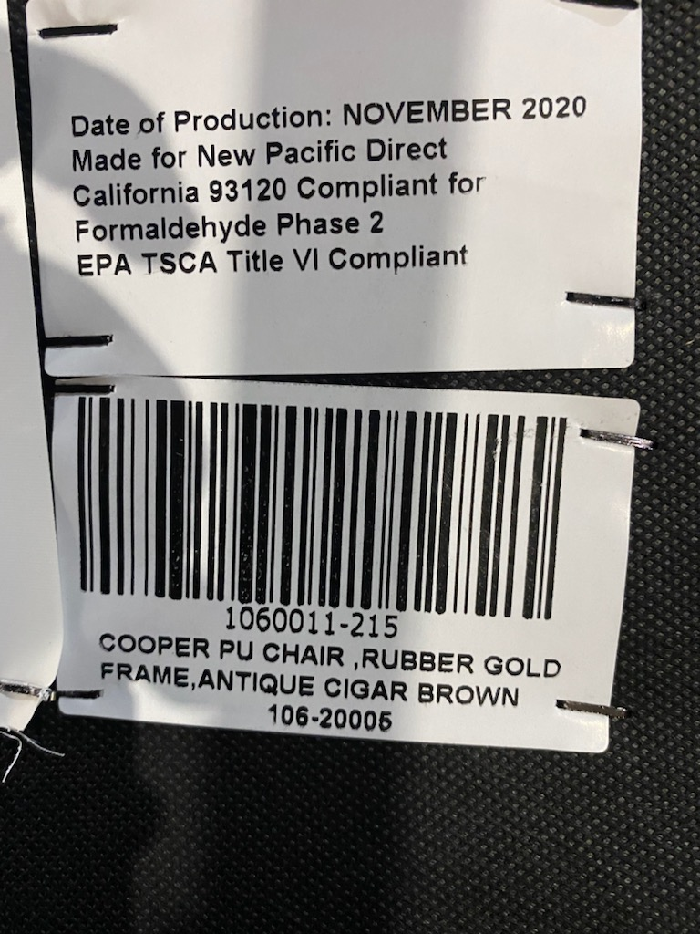
NEW PACIFIC DIRECT (NPD)
Tag is found underneath the item or on the back of most case good pieces
Items do NOT have serial numbers only manufacturer tags
NPD warrants that its merchandise is free from manufacturing defects and will either give credit, replace defective parts, or replace defective merchandise for a period of one year from the invoice date.

Slide 27
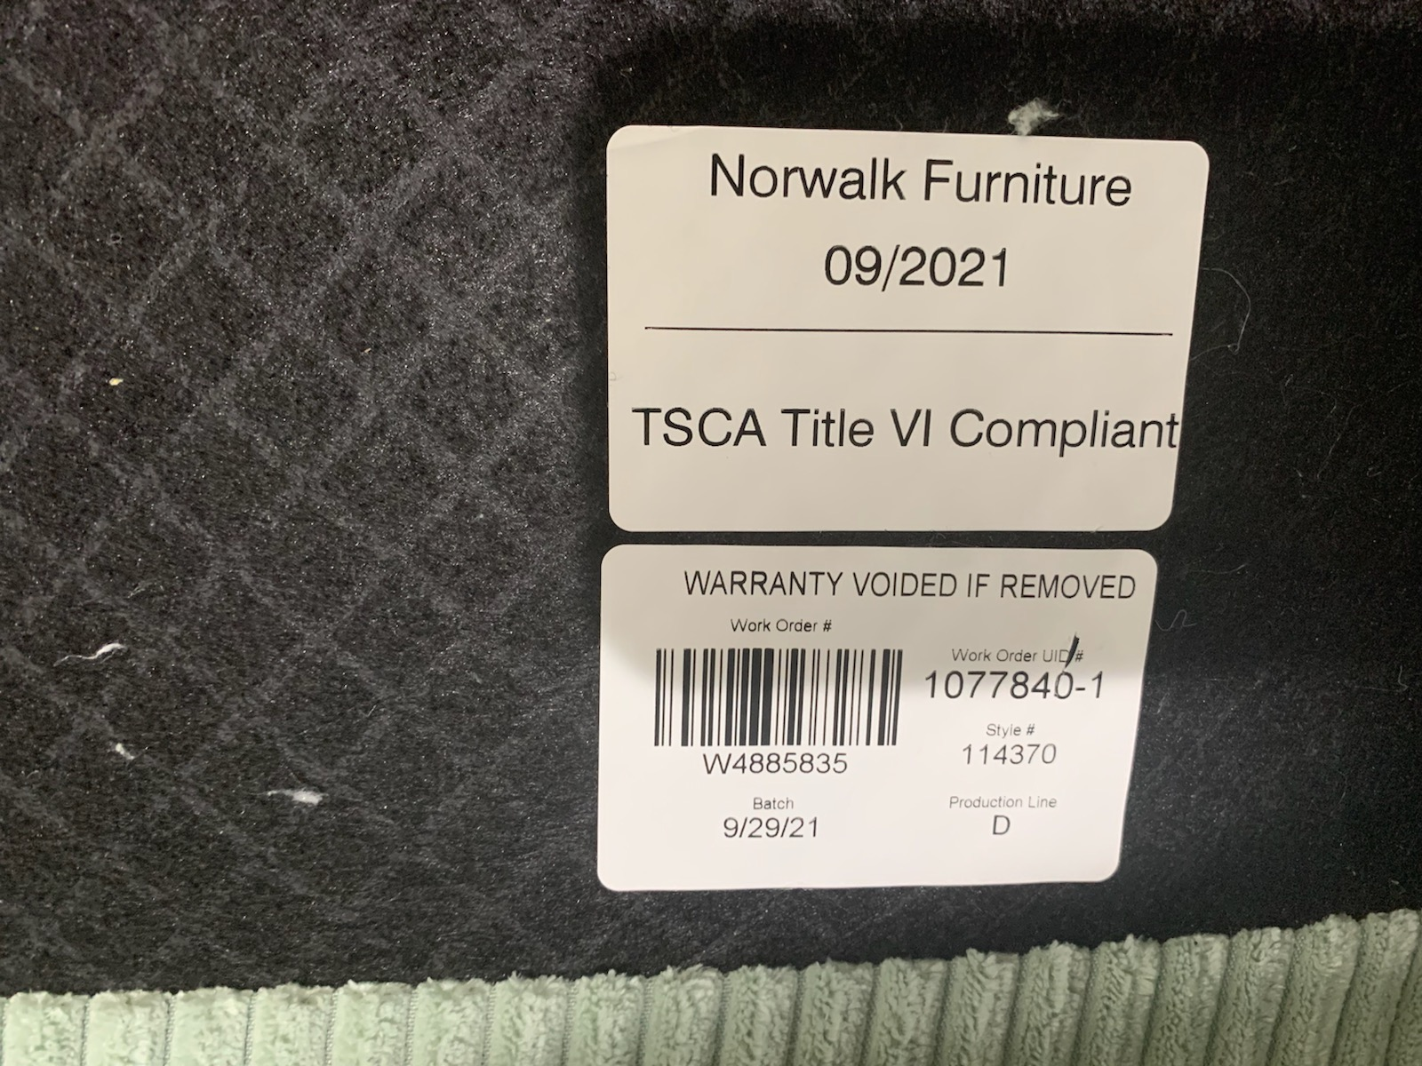
NORWALK
Tag is found underneath cushion or footrest of item

Slide 28
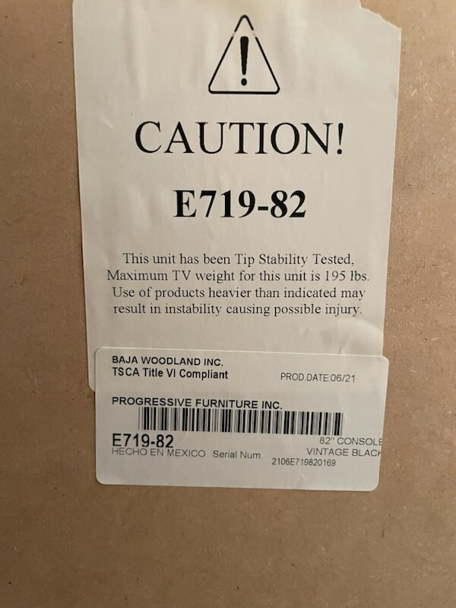
PROGRESSIVE FURNITURE
Tag is found on the back of items
Warranty is only 1 year

Slide 29
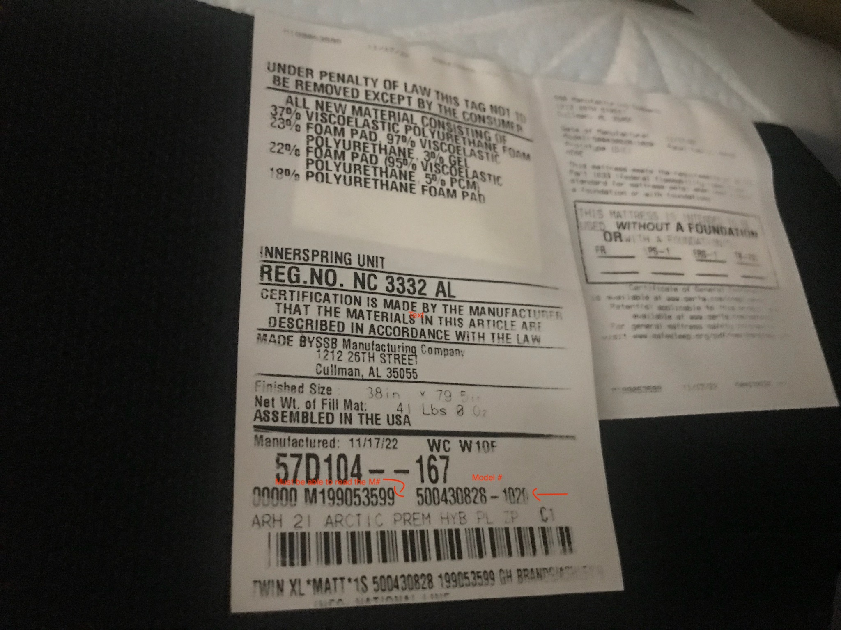
SERTA MATTRESS
Law tag is found sewn into mattress
Photo of tag must be legible –M# & Mattress number
Removal of law tag voids warranty
Stains on mattress voids the warranty
Improper support system voids the warranty

Slide 30
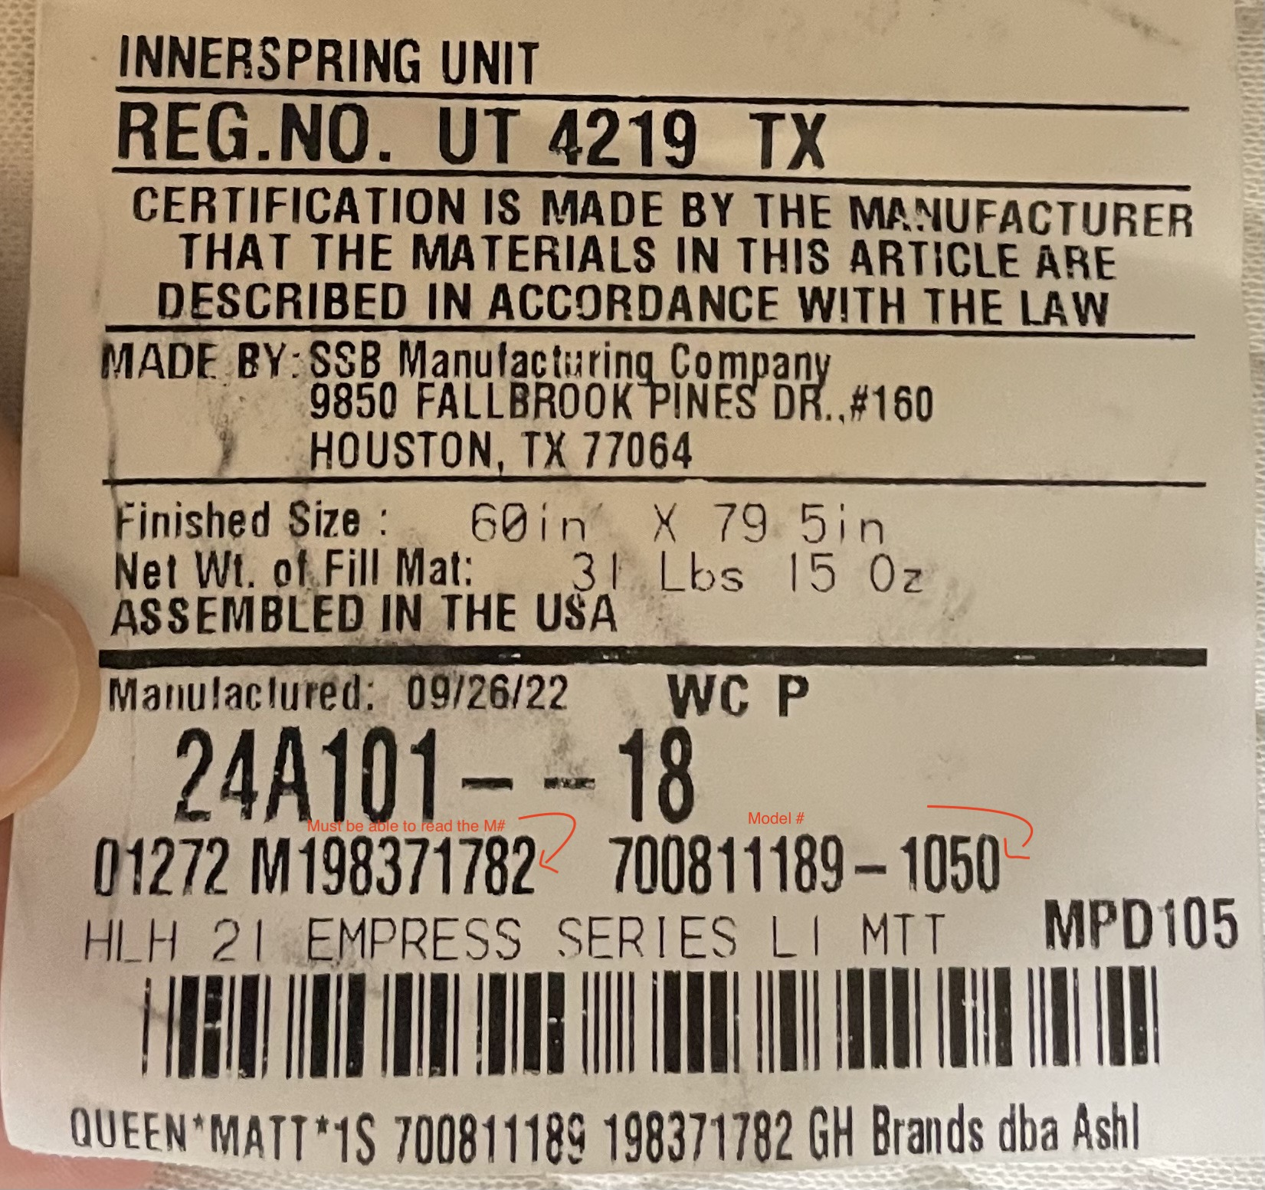
SIMMONS MATTRESS
Tag is sewn into the mattress
Photos of the tag must be legible-M# and Mattress number
Removal of Law tag voids the warranty
Stains on the mattress voids the warranty
Improper support system will void the warranty

Slide 31
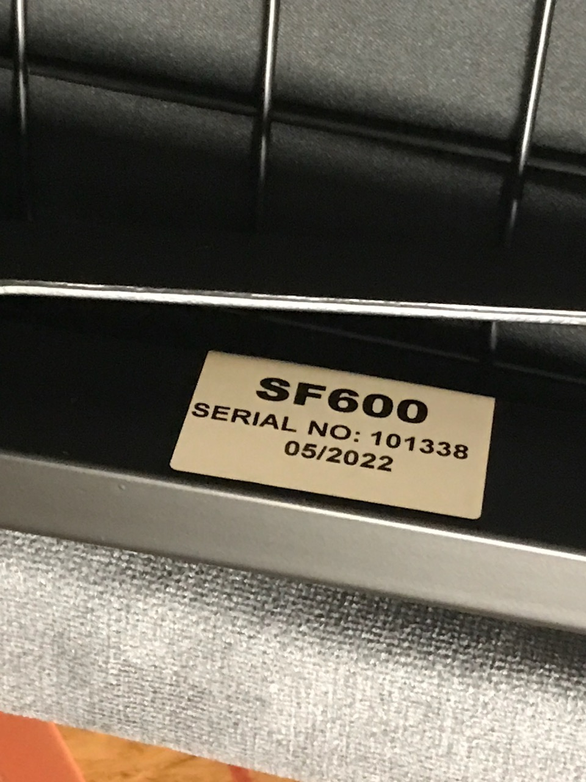
SMART FLEX
Tag is found on the frame of the base or user manual
Customer contacts Smart flex directly to troubleshoot 888-444-9888

Slide 32
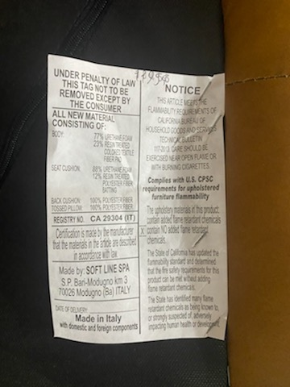
SOFTLINE
Tag is found underneath cushions or underneath item on dust cover
Has a two year warranty

Slide 33
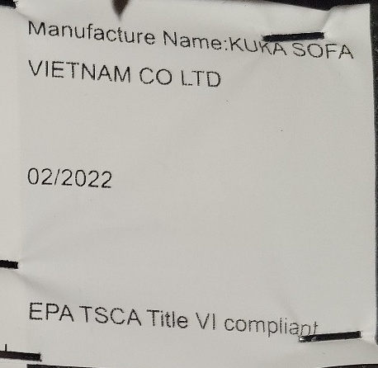
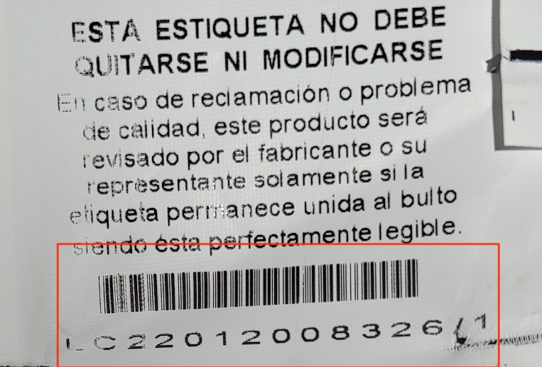
SWANK (KUKA)
Tag is found underneath cushions or underneath on the dust cover
Warranty varies for different parts of the item

Slide 34
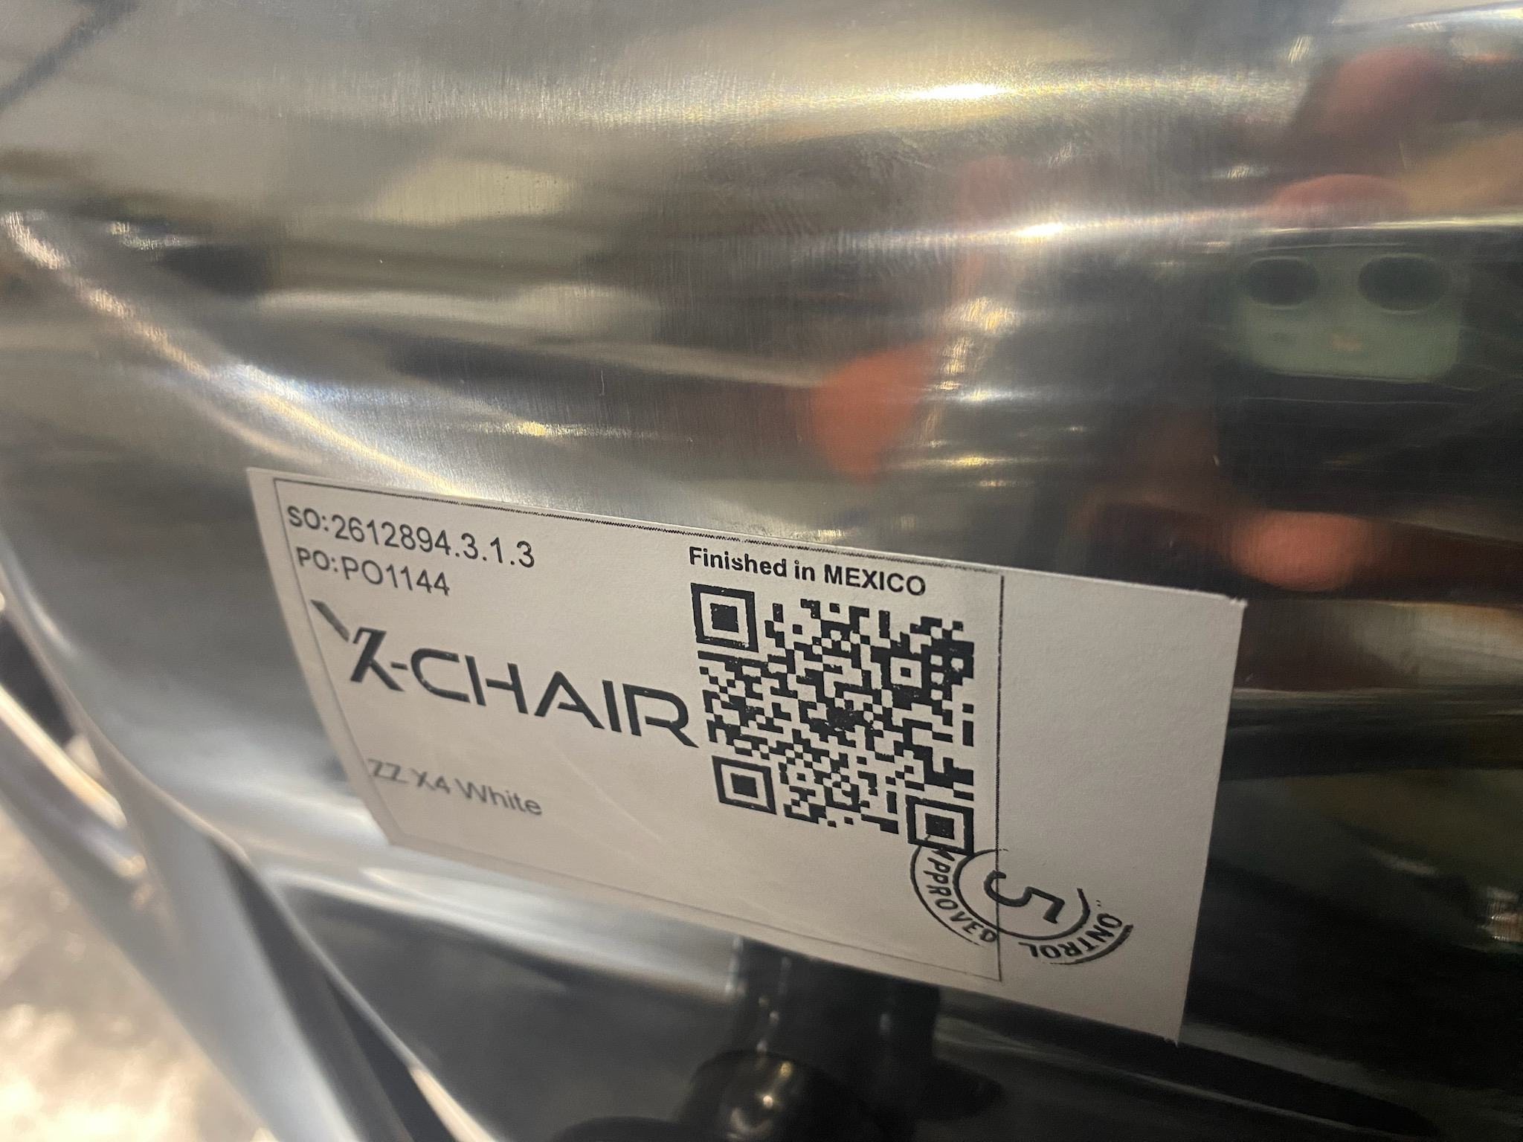
X-CHAIR
Tag is located on the back of the base
Visit X-Chair.com for the various warranty lengths on the items

