Slide 1

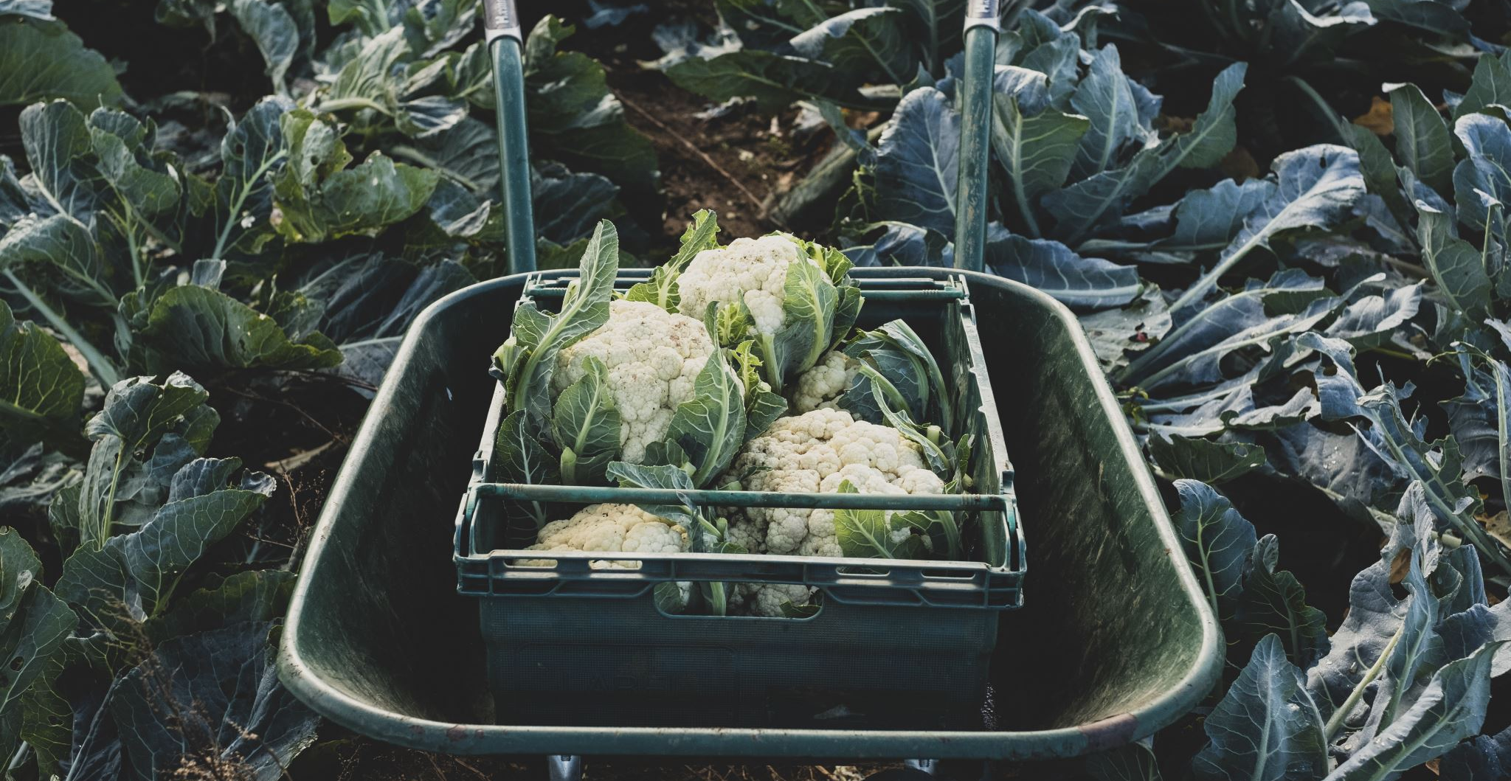


Simple Composting

Slide 2
Why Compost?
Reduces household waste
Food waste generates 8–10% of global greenhouse gas emissions, making it the biggest contribution to climate change.
Improves soil health and fertility
It also improves soil structure.
It mimics nature quicker
Adding a compost as a mulch acts the same as leaves, dead plants and organic matter laying on top of the soil decomposing slower.
Reduces cost and Carbon Footprint
Packaging, shipping and fuel

Slide 3
How Does it Work?
Mix of Materials
Composting needs a balance of green (nitrogen-rich) waste like veg scraps and grass, and brown (carbon-rich) waste like cardboard and dry leaves. This balance keeps microbes active. 3:1carbon rich
Oxygen
Turning or aerating the pile introduces oxygen, which helps microbes break things down efficiently. Avoid compacting the compost.
Moisture and Warmth
A moist but not too wet heap warms up as microbes work, speeding decomposition.
Notes:
Micro organisms

Slide 4
How Does it Work?
You Need Heat
Optimum Hot Compost
49ºc to 70ºc rapid decomposition
Pathogen Seed Destruction
Minimum 55ºc for several days
Too Hot
Above 70ºc reduces beneficial microbe activity
Notes:
Micro organisms
tiny living organisms—including bacteria, viruses, fungi, algae

Slide 5
How Does it Work?
Trouble Shooting Temperature
Not Heating
Add nitrogen (green) grass clippings etc. ensure proper moisture content
Dropping
Turn pile to add oxygen
Too Hot
Turn pile to cool down to release excess heat
Notes:
Micro organisms

Slide 6
What Can You Compost?
Fruit and vegetable scraps
Coffee grounds
Tea bags (plastic-free)
Grass cuttings
Leaves
Cardboard and paper (non-glossy)

Slide 7
What Should You Avoid?
Meat and dairy products
Cooked foods
Glossy or coated paper
Pet waste
Invasive weeds

Slide 8
How to Compost
Layer greens and browns
Keep the pile moist but not soggy
Turn regularly to aerate
Ensure good airflow for decomposition

Slide 9
Different Types of Composting
Cool Heap
Leaf Heap
Slow Heap
Hot Bin

Slide 10
Management
With all types of composting good management is key. This is the most important thing

Slide 11
To Compost
Or Not To Compost

Slide 12

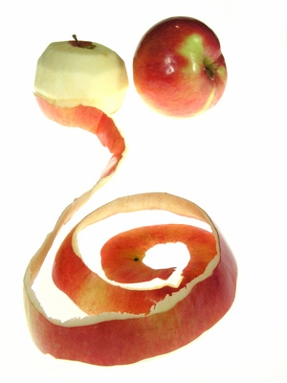
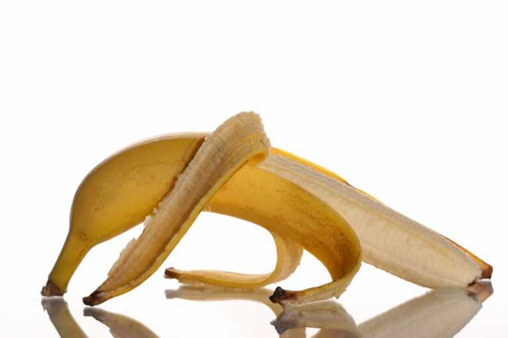

Slide 13
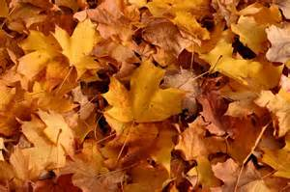

Slide 14

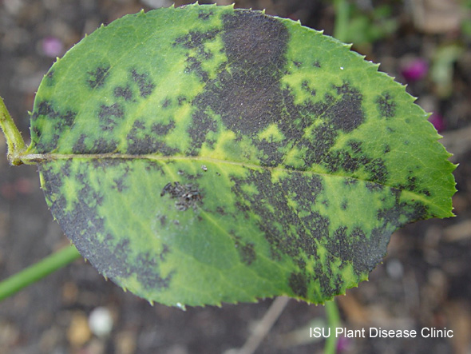

Slide 15
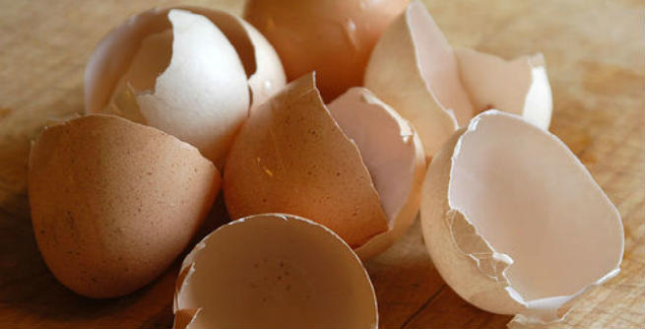

Slide 16

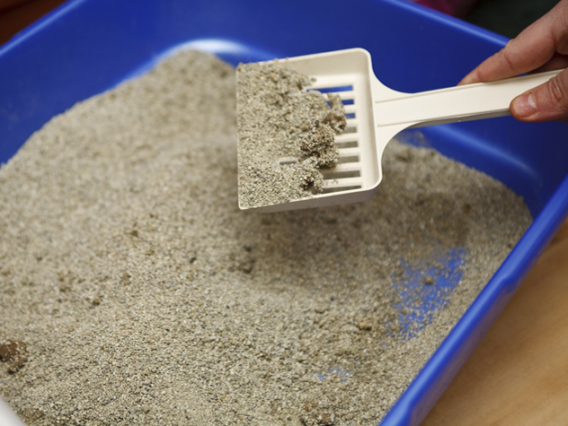

Slide 17
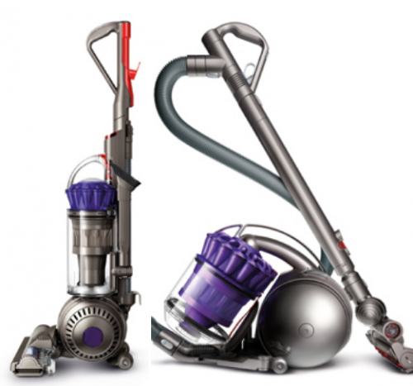

Slide 18
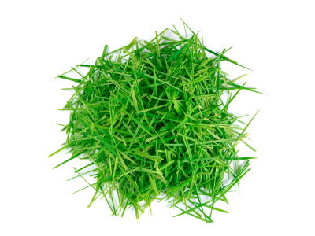

Slide 19
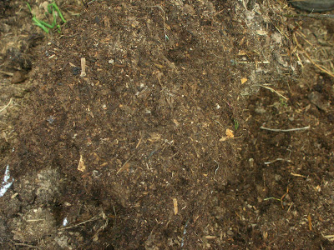
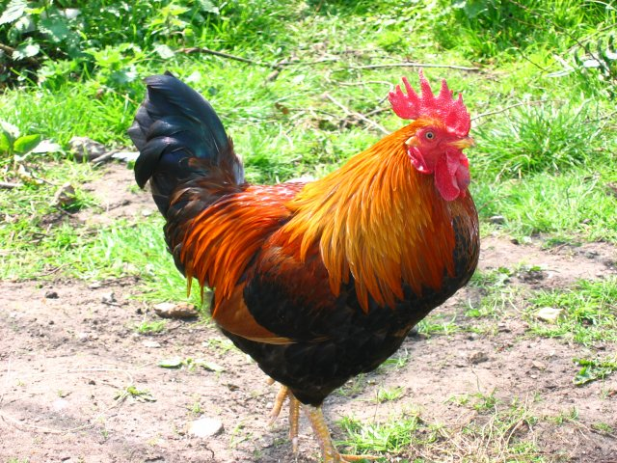

Slide 20
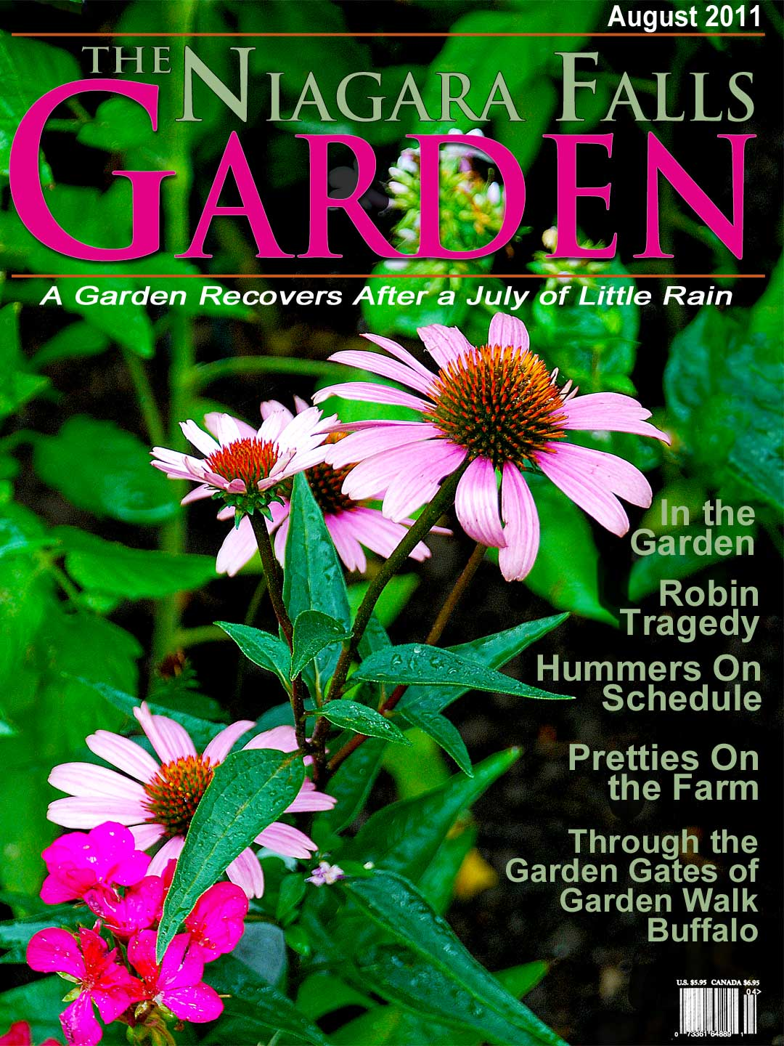
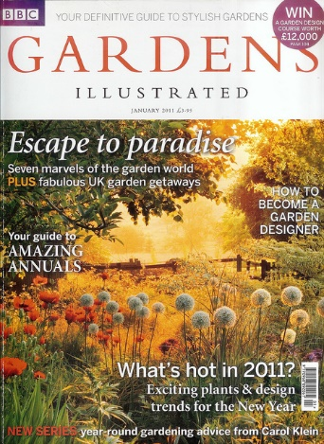
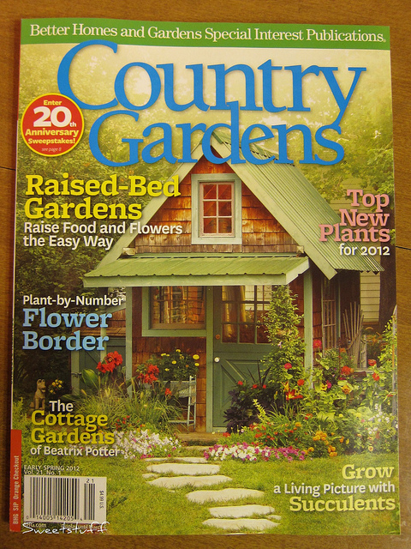

Slide 21
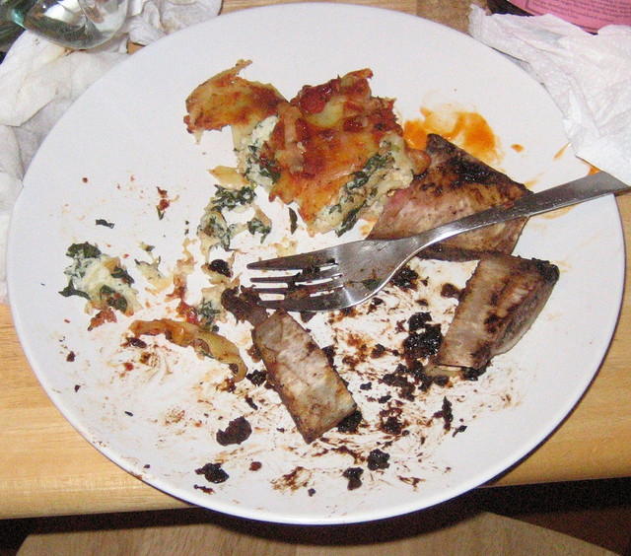

Slide 22
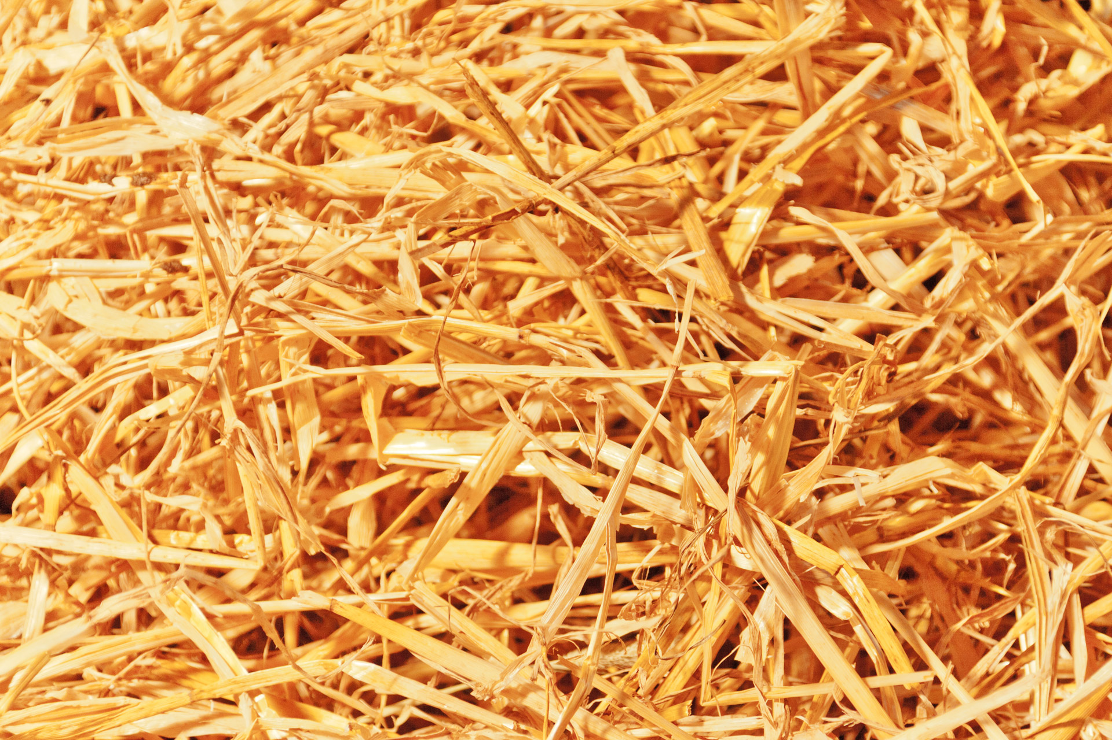

Slide 23
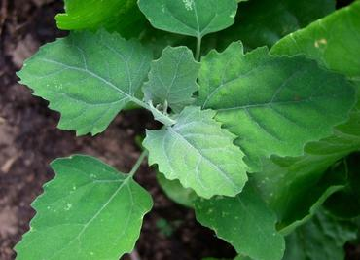
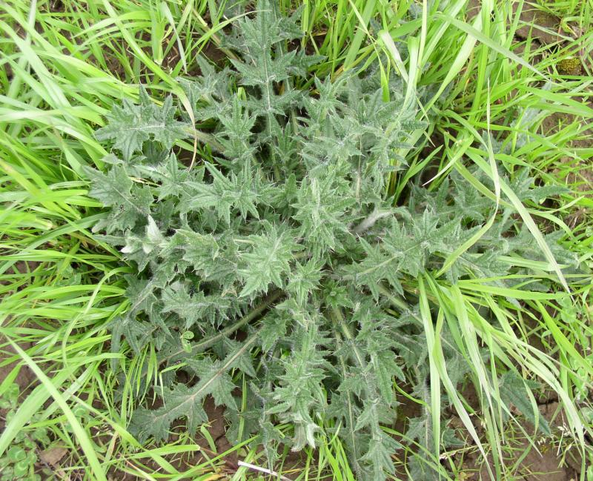
Notes:
Fat Hen

Slide 24
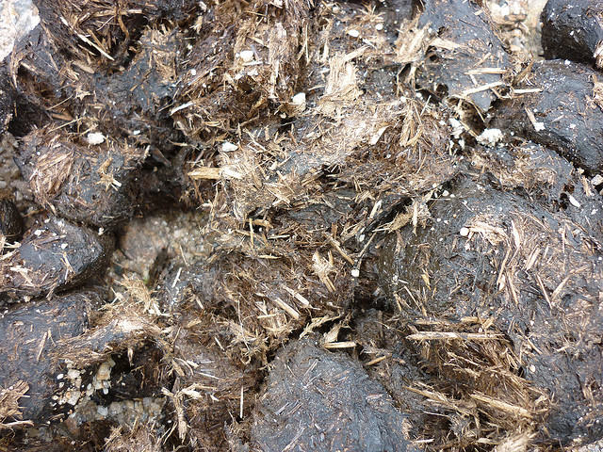
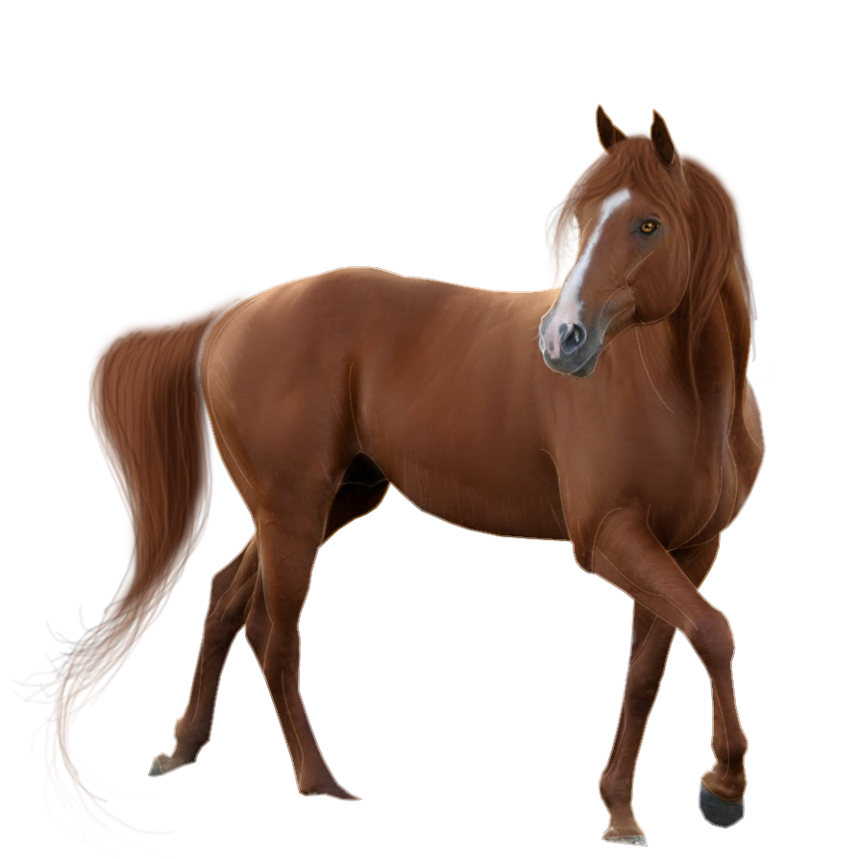

Slide 25
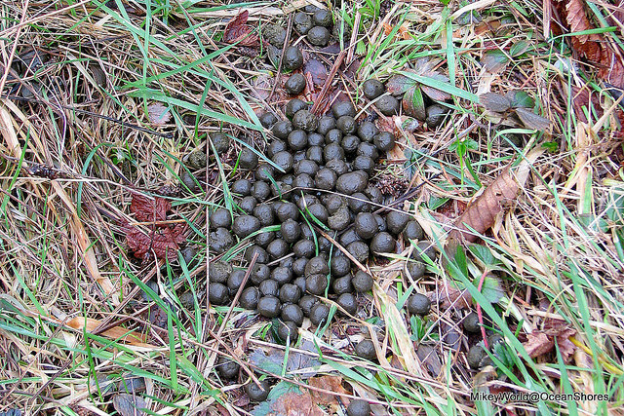

Slide 26
