Slide 1
Understanding DiSC Styles Everything DiSC Workplace
Half-day program

Slide 2
Welcome
Your name
Your role
What will make today successful for you

Slide 3
Objectives
Learn the basics of DiSC®
Identify your style and explore its impact
Understand other’s styles
Strategies to start bringing DiSC into your everyday interactions

Slide 4
What is DiSC?
Self-assessment
Interpersonal model of human behavior
Used by more than 40 million people
Emotional awareness tool
Communications tool
Offers common/neutral language

Slide 5
Building the Room
Basic differences of people
Which words describe your best
Active ----------------------------------- Thoughtful
Questioning ----------------------------------- Accepting
Notes:
Before you begin, prepare four flipchart posters as shown below, or use the poster templates in the Support Materials folder to have them professionally printed in advance. (You do not have to use this slide – just facilitate the activity)
Place each poster on one of the four walls of the room as follows:
“Active” poster in the front of the room.
“Thoughtful” poster in the back of the room.
“Questioning” poster on the left side of the room (as you face the front).
“Accepting” poster on the right side of the room.
Place a blank flipchart sheet and markers at each corner of the room.
Active
Fast-Paced
Assertive
Dynamic
Bold
Questioning
Logical
Objective
Skeptical
Challenging
Accepting
People-Focused
Empathizing
Receptive
Agreeable
Thoughtful
Moderate-Paced
Calm
Methodical
Careful
Instructions:
Ask participants to stand up
Instruct them to stand at either the front (Active) or the back (Thoughtful) of the room, based on the words they think tend to describe them best.
Instruct them to stand at either the left (Questioning) or the right (Accepting) of the room, based on the words they think tend to describe them best.
Have the groups put those two identifiers together:
If you answered Active and Questioning, please come to this corner. (Direct them to front-left corner.)
If you answered Active and Accepting, please come to this corner. (Direct them to front-right corner.)
If you answered Thoughtful and Accepting, please come to this corner. (Direct them to back-right corner.)
If you answered Thoughtful and Questioning, please come to this corner. (Direct them to back-left corner.)
5) Talk amongst this group and write down some ideas on why you answered the questions this way… what are some examples of your showing these differences>
6) Back to seats
7) Debrief on learning (if you have facilitation kit, show intro video)

Slide 6
Cornerstone Principles
Cornerstone Principles
All styles equally valuable
DiSC one measure
Understanding self first
Understanding others
Awareness builds more effective relationships
Notes:
Have participants open the report. Ask them to turn to page 2 to see the blue box in right corner. Important principles. Provide a synopsis of each of these.
Then consider any other element you want to include, e.g.,
Neutral, common language
Not meant to label (person with this style)
Report to be personalized (you will do this on page 4 with an activity)
Conversation starter

Slide 7
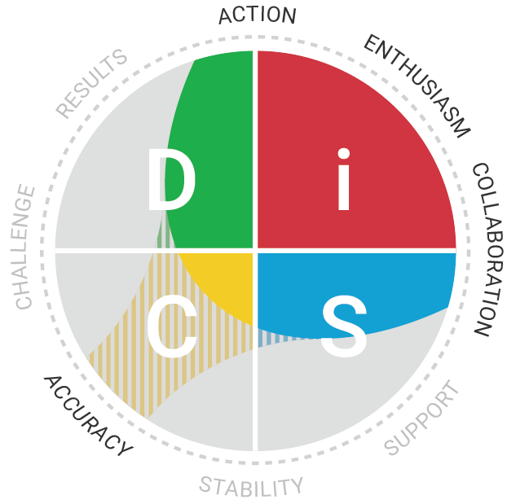
DiSC Style
Primary/Secondary
Style Inclination
Shading
Priorities
Additional Priorities
Notes:
7
Go over style. Turn to page 3 to see dot location.
Then review page 5, which looks at a different map, that includes shading and priorities.
Location
The location of the communicates important information about the person’s DiSC style.
Three regions within each basic style where a person’s dot may be located (illustrating 12 different regions), indicated their primary and secondary style.
(For each of these dots, clear i style, though answers could have shifted the dot to include a D or S secondary style.
Inclination
How close is the dot to the center of the circle?
A dot’s distance from the edge of the circle shows how naturally inclined a person is to encompass the characteristics of his or her DiSC style.
People whose dots fall close to the center of the circle are less inclined toward a particular style and find it fairly easy to relate to the priorities of other styles.
A person whose dot is close to the outer edge of the circle is probably very committed to his or her DiSC style. Close to the center mean a slight inclination.
A person’s plot point can indicate how much energy it can take to flex to someone else’s priorities.
Circumplex
The circumplex model is statistically significant, in that a priority (word around the circle) has more association to the priority next to it than across from it. This relates to the strong levels of multi-dimensional scaling.
Shading + Priorities
The eight words around the Everything DiSC Workplace map represent priorities, or the primary areas where people focus their energy.
The three words closest to your dot are your primary priorities, and your personalized shading indicates whether you stretch to include any additional priorities.
You will notice that these unexpected priorities are marked by striped shading.
Sometimes people have four or five priorities.
Your priorities describe what is important to YOU, and all combinations of priorities are equally important and valuable.
Having five priorities is no better than having three, and vice versa.
By learning about your priorities, you can gain a clearer picture of your style.
You will also start to understand how you might relate to other styles.

Slide 8
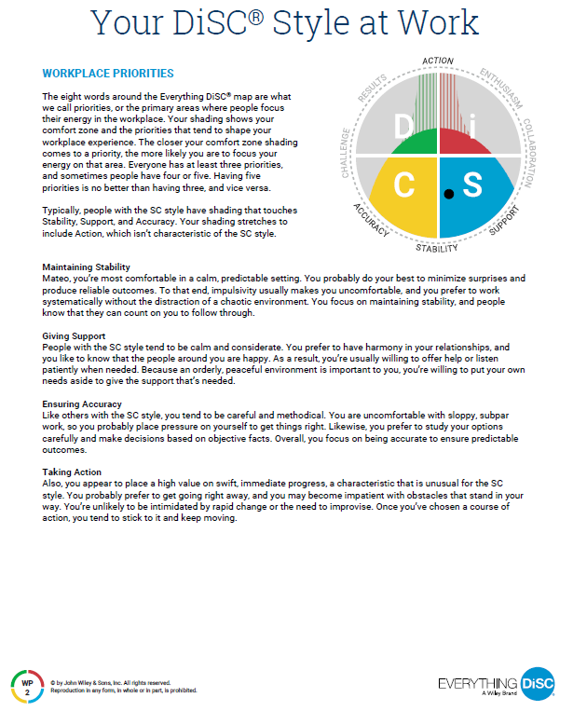
Your DiSC Style Overview
Read and personalize Page WP-2
= like you
X = not like you
? = not sure
Underline three statements that best describe you
x



?


10 minutes
Notes:
8
Have people “personalize

Slide 9
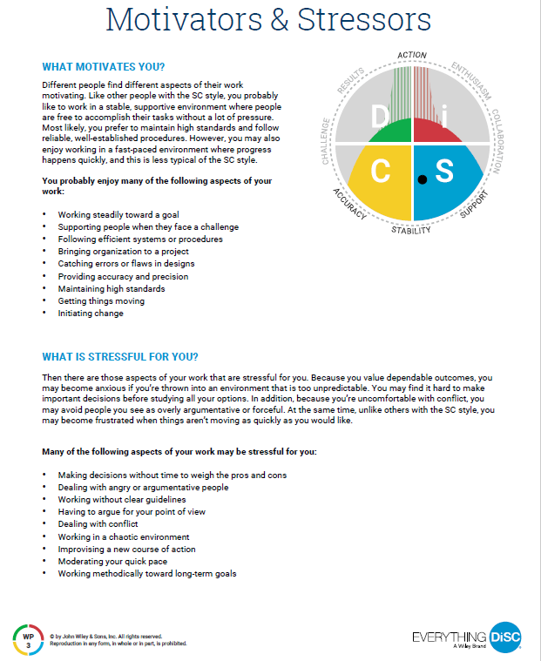
Your Motivators and Stressors
Read and personalize Page WP-3
Underline one statement from each category that best describes you
= like you
X = not like you

? = not sure
?

x

Notes:
9
Pair/Group/Trio:
Discuss what you chose
Give examples of how they have been true for you

Slide 10
A Day in the Life
Present a day in the life of someone with your style
Create a poster
Use your profile and self-knowledge
Use pictures and words
Notes:
ACTIVITY:
Split groups by primary style
Instruct them to create a poster indicating a day in the life of someone of that style (8-10 minutes)
Materials: flip chart paper, markers participants can use anything else they want, encourage style expression
Have each group take a turn presenting its poster. (5 min each)
Allow the first group to present. Continue until all four styles have presented.
If others do not ask questions, here are some possible follow-up questions:
What is your greatest contribution to the workplace?
How are you misunderstood?
What is your biggest fear?
How do you prefer to receive feedback?
ask:
What did you learn about styles that are different from yours? What Aha moments did you have hearing from other styles?
Take a variety of responses and facilitate discussion.

Slide 11
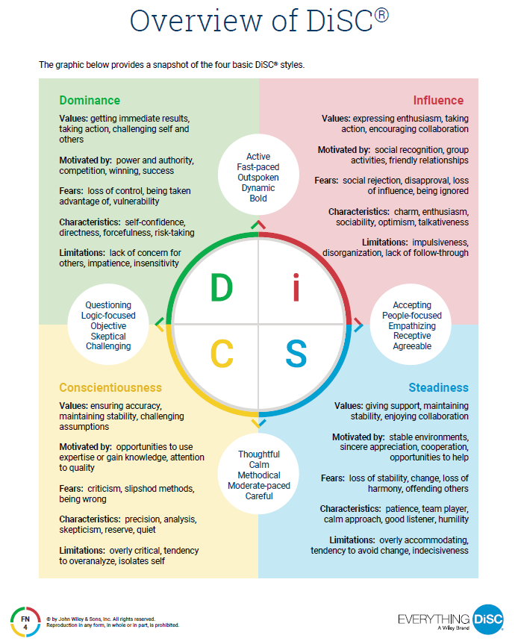
Style Poster Presentations

Slide 12
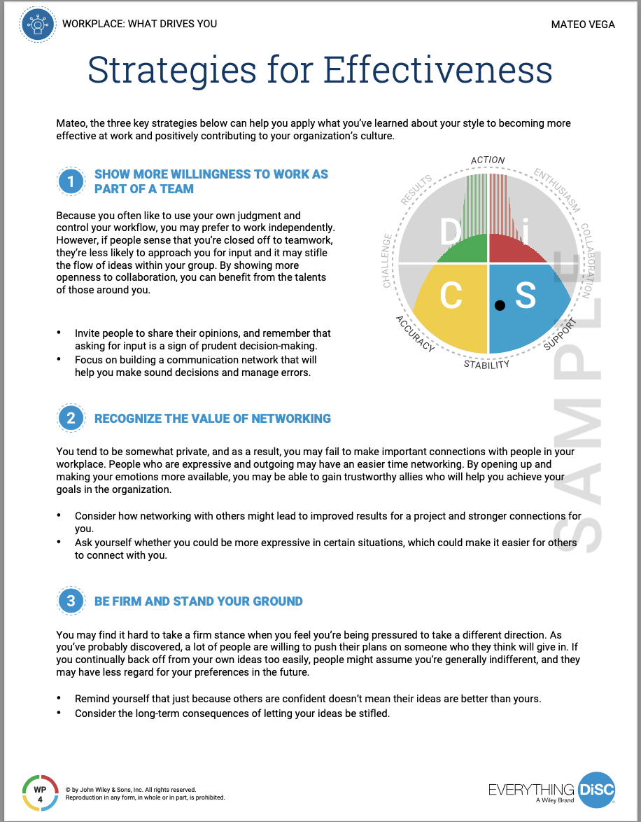
Action Plan
Write an action plan
Refer to ideas from profile page WP-4
Create a strategy on one of the three items
When would you need to apply this strategy?
What outcomes do you hope to achieve with this strategy?
What can you do or say to put this strategy into action?
Who could support you in this action?
7 minutes

Slide 13
Using DiSC to Improve Relationships
Write down the DiSC® style of someone you want to work more effectively with
If you don’t know, ask yourself…
Are they more fast-paced or cautious?
Are they more questioning or accepting?

Slide 14
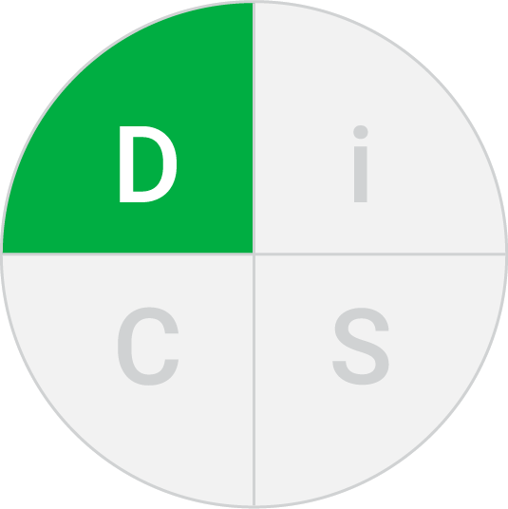
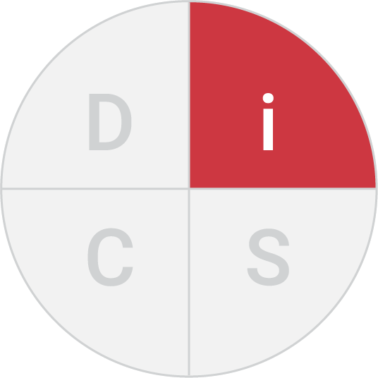
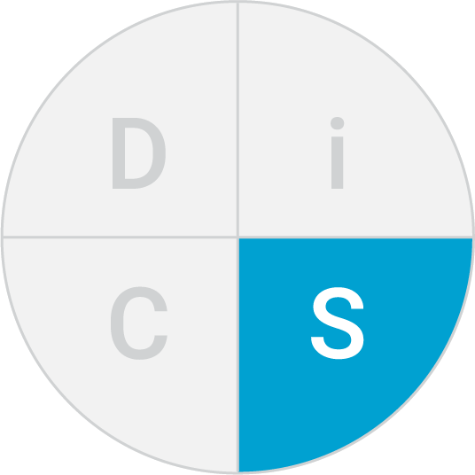
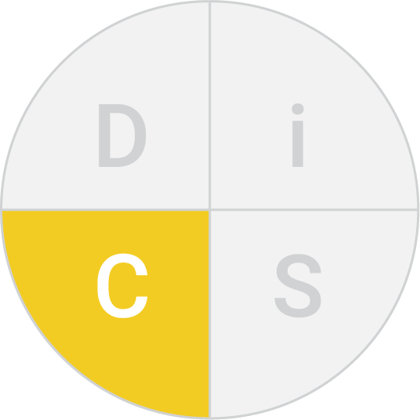
Action Planning
If you chose D
If you chose i
If you chose S
If you chose C
go to page WP-6
go to page WP-7
go to page WP-8
go to pageWP-9

Slide 15
Action Planning
Part 2
If you chose D
If you chose i
If you chose S
If you chose C
go to page WP-11
go to page WP-12
go to page WP-13
go to page WP-14
Read the three sections
Mark one strategy in each section to try

Slide 16
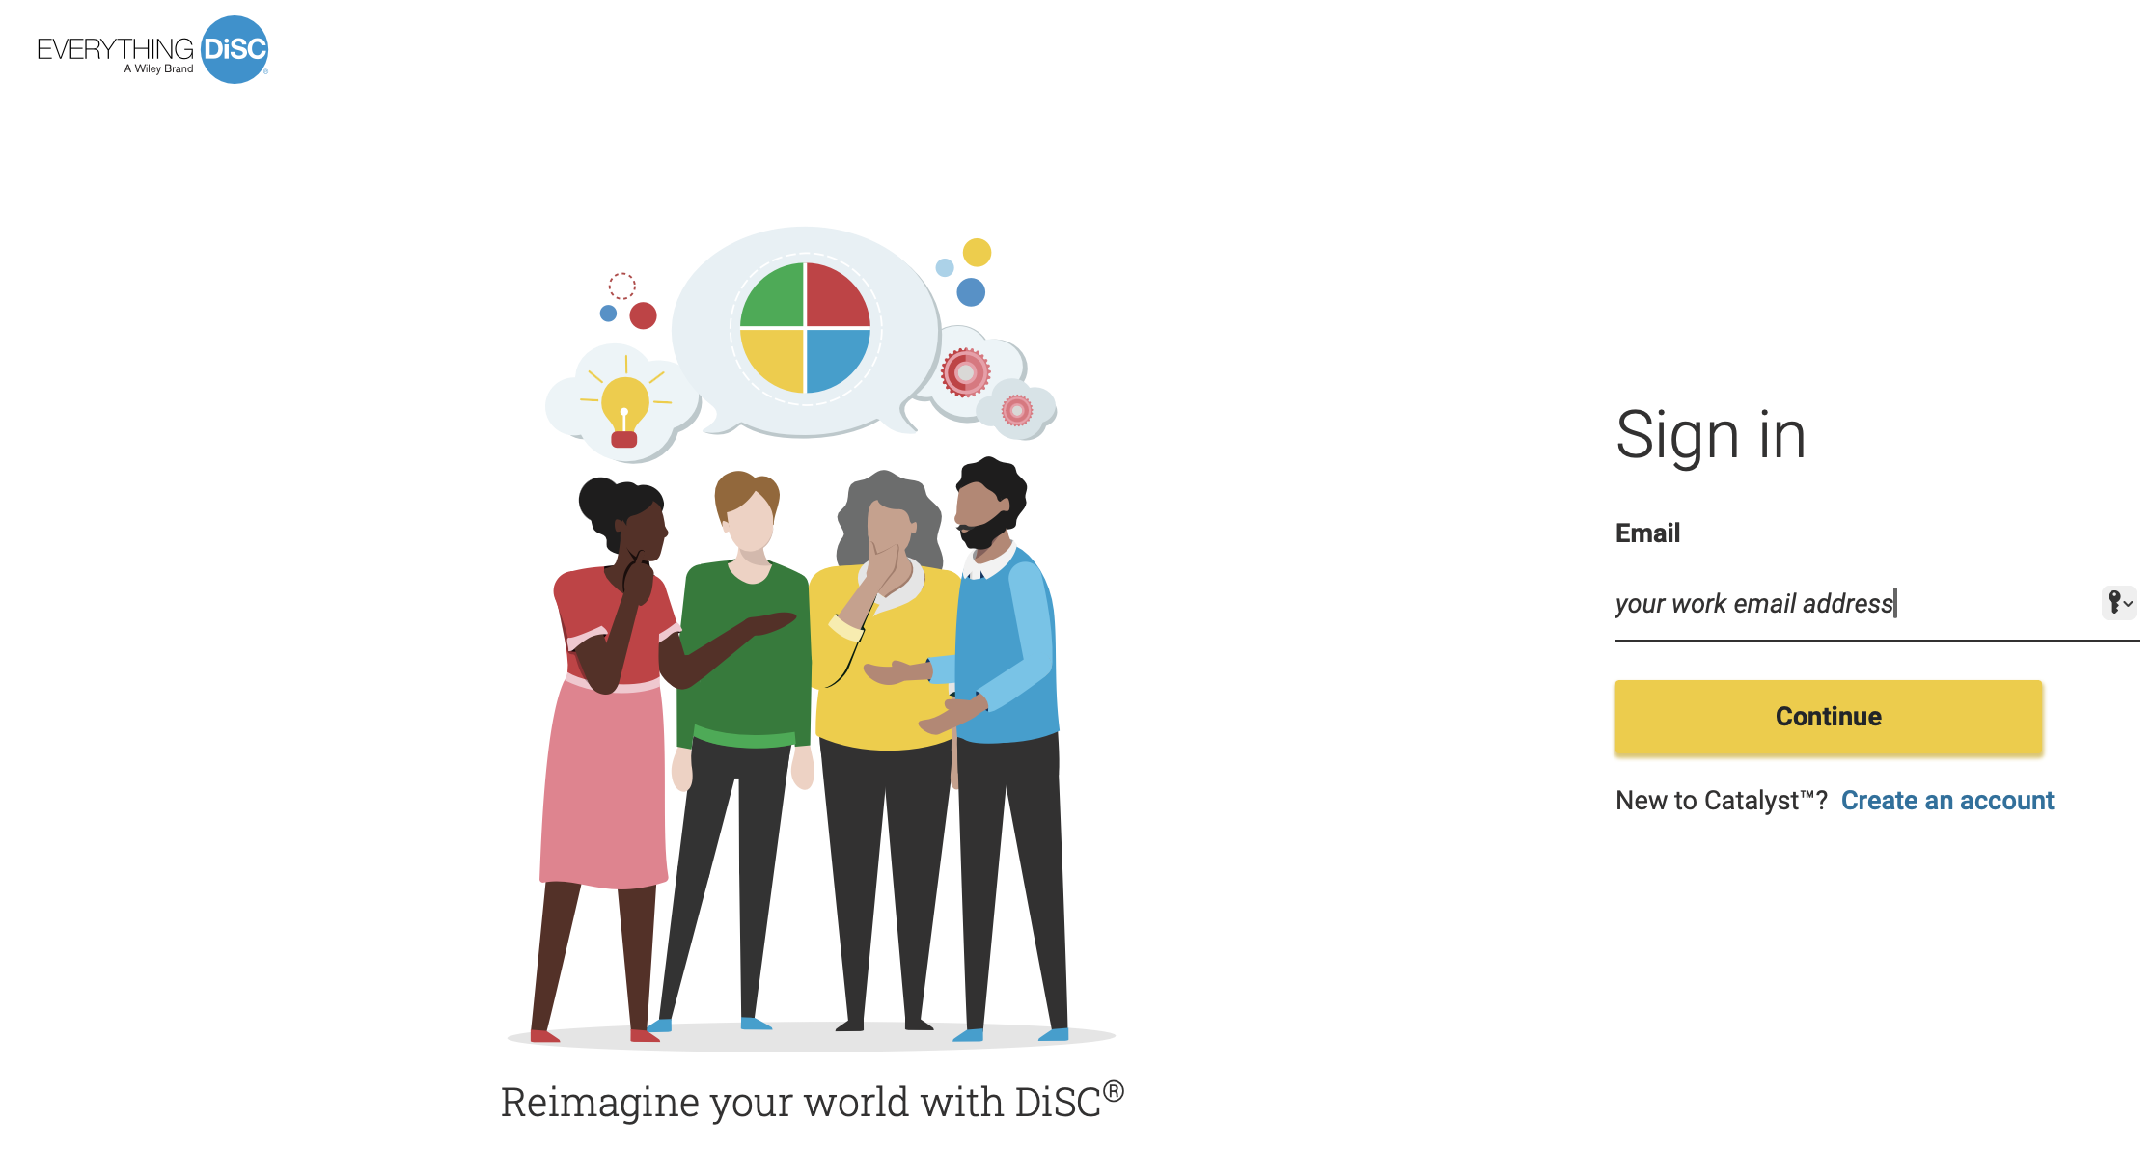
Compare
Go to catalyst.everythingdisc.com
Review with your partner

Slide 17
Wrap-up
Your Take away
Notes:
Ask participants to share one AHA and one thing they will look to practice starting this week.

Slide 18
Extra slides

Slide 19
Dominance
D
Priorities: | Results
Motivated by: | Power and authority
Fear: | Losing control
Key Behaviors: | Directness, forcefulness
Notes:
These 4 slides can be used as reinforcing message after Day in the Life activity.

Slide 20
Influence
i
Priorities: | Collaboration
Motivated by: | Relationships and recognition
Fear: | Social rejection, loss of influence
Key Behaviors: | Charm, optimism, energy
Notes:
Notes

Slide 21
Steadiness
S
Priorities: | Stability
Motivated by: | Helping others
Fear: | Change
Key Behaviors: | Patience, calmness

Slide 22
C
Concientiousness
Priorities: | Accuracy
Motivated by: | Demonstrating expertise
Fear: | Making an error
Key Behaviors: | Analytical skills, thoroughness
Notes:
Notes

Slide 23
Flexing to Styles
Be straightforward and direct Get to the point quickly Make efficient use of time Expect candor Do not be emotional Act quickly, he/she decides fast | Let them speak/explain their ideas. Acknowledge their ideas and emotions. Find ways to collaborate. Schedule time for chatting. Have fun!
Talk to them about the objective, fact-based aspects of projects. Don’t take their skepticism personally. State the facts and your position logically. Don’t try to force a decision or pressure for a quick decision. Give plenty of detailed information. | Use an easy-going approach. Pause, give them time to think. Ask for their opinion and hear their point of view. Slow down your presentation. Show warmth and concern.
Notes:
Optional Slide – discuss flexing to different styles as follow-up to previous activity

