Slide 1
DisC DEBRIEF
MY COMPANY
THIS Team
October 30, 2020

Slide 2
today
Understand DiSC
Build self awareness
Increase understanding of styles
Identify strategies

Slide 3
Requests
Participate
Be present
Be curious

Slide 4
Our group today
Notes:
Instruct people to put their initials in the circle, or you fill them in advance.

Slide 5
On a continuum of
Active to Thoughtful,
where would you place yourself?
LG
BB
KW
SB
JB
Notes:
Fill in the appropriate initials. Right now they include the participant for our session.

Slide 6
On this continuum of Questioning to Accepting,
where would you place yourself?
BB
JR
KW
LG
SB
Notes:
Fill in the appropriate initials. Right now they include the participant for our session.

Slide 7
DiSC Introduction
VIDEO
Notes:
If you do not have a facilitation kit/video, you can guide participants through the theory by explaining:
The model starts with a circle (draw circle)
It measures pace (draw horizontal line)
It measures skepticism (draw vertical line)
This creates 4 quadrants (write D-i-S-C in each quadrant)
Each of these quadrants describes 4 different styles.
The D stands for Dominance. Some words to describe someone of this style would be: Direct, Firm, Strong-willed, Forceful, Results-oriented
The i stands for Influence: Some words to describe someone of this style would be: Outgoing, Enthusiastic, Optimistic, High-spirited, Lively
The S stands for Steadiness: Some words to describe someone of this style would be: Even-tempered, Accommodating, Patient, Humble, Tactful
The C stands for Conscientiousness: Some words to describe someone of this style would be: Analytical, Reserved, Precise, Private, Systematic
There are words around the circle (write them) of Active, Enthusiasm, Collaborative, Support, Stability, Accuracy, Challenge, Results

Slide 8
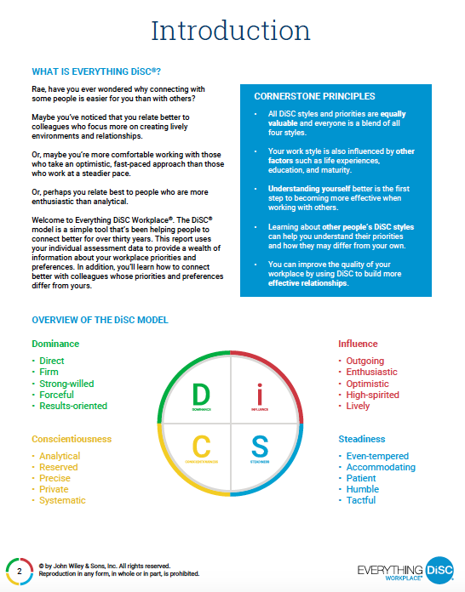
Cornerstone Principles
All styles equally valuable
We have access to all style traits
DiSC is one measure
Understanding self first
Understanding others
Awareness builds more effective relationships
Notes:
Describe the essential principles of the model, making sure people understand this is not to label people, but to provides insights and identify new behaviors to be more effective with others.

Slide 9
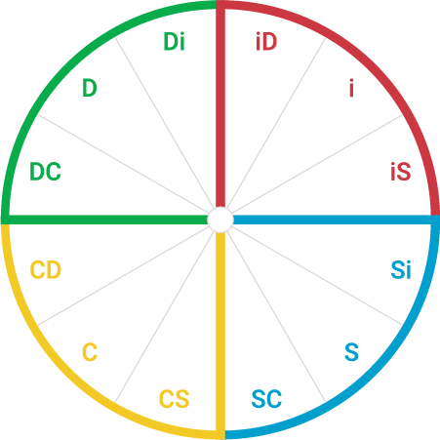
Your DiSC Style
See page 3
Notes:
Describe the dot placement on page 3. This is how the algorithm placed you from the way you answered the questions on the assessment. The closer your dot is to the outside edge of the circle says how inclined you are toward that style. So you could be slightly, moderately or strongly inclined toward your style. Having a dot on the outer edge may mean that you particularly agree with the results.
Alternative, have people turn to page 4 of their report and ask: what did people think about this narrative of their style (NOTE: assign pre–work to read and highlight this page parts they agree with/don’t agree with)
OR: use breakout rooms to have them discuss with a partner what was and was not accurate for them

Slide 10
Your DiSC Style
Notes:
Have people place their dots on the circle. As they place them, ask them to say something that is particularly resonant from their report. You could also invite them to say what did not resonate, so that people can understand how they might not entirely agree or attach to that style.

Slide 11
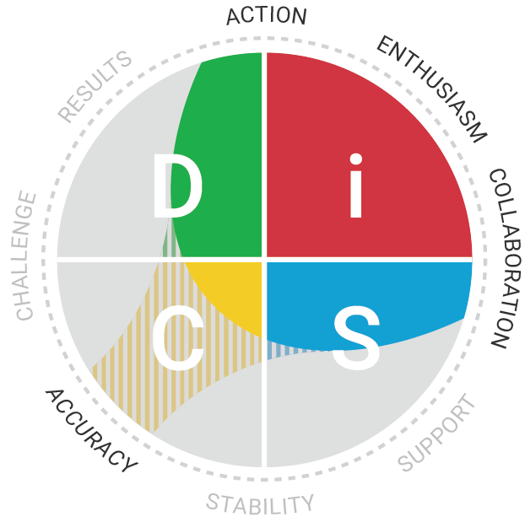
Priorities
Your priority
How does it show up for you in your work?
Across the circle…
Notes:
Have people look at page 5 of their report. This describes their priorities. Everyone has 3, some can have 4 or 5. this example shows how someone who is an i-style may have an extra priority, which means that it is not indicative of their style. Someone who is an i-style and prioritized enthusiasm, collaboration and action may not prioritize Accuracy – as they are ready to get on to the next task. Yet, this person does and answered enough questions to get this extra priority.

Slide 12
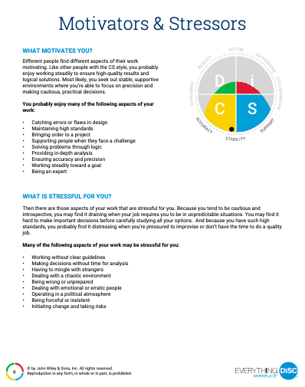
Motivators & Stressors
Highlight one for each
I get paid for this ?!
I get paid for this !!
Notes:
See page 6. find something in each bulleted section that you agree with.
Suggestion: use breakout rooms to discuss with a partner.

Slide 13
Other resources in your report…
Overview of styles (page 7)
Understanding reactions (pages 8-11)
Strategies for other styles (pages 12-15)
Increasing workplace effectiveness (page 16)
Style index (pages 17-20)
Notes:
We will not be going through these pages in this session, but I want you to know the that this report is a resource for you going forward.
Overview of styles (page 7) – this is a summary of the DiSC model, giving specific information about each style
Understanding reactions (pages 8-11) – this section describe how you may react to each of the DiSC styles and how their priorities may be different than those of your style
Strategies for other styles (pages 12-15) – once you understand your reaction, you can turn to the corresponding pages within this section to identify actions to try to become more effective with a specific style, generally, when solving problems together and when you are in conflict.
Increasing workplace effectiveness (page 16) – this page provides three areas that might be areas of focus for someone of your style. Consider identifying one to focus on in the coming days or week.
Style index (pages 17-20) – This section shows nuances within each of the primary styles, with a page for each, e.g., page 20 shows the C style and how that could be difference than a CS or a CD

Slide 14
SCAVENGER HUNT
Working with D |  | Working with i
3 Priorities/ main trait(s) |  | 3 Priorities/ main trait(s)
Key contribution |  | Key contribution
Fear |  | Fear
Strength overused |  | Strength overused
Strategy for working w/D |  | Strategy for working w/i
Working with C |  | Working with S
3 Priorities/ main trait(s) |  | 3 Priorities/ main trait(s)
Key contribution |  | Key contribution
Fear |  | Fear
Strength overused |  | Strength overused
Strategy for working w/C |  | Strategy for working w/S
Notes:
An idea to use with a break out session. This is an alternative to a Day in the Life we talked about on November 6.
With us, I asked each of you to answer one specific question for each of the styles. If we have 4 people, I might ask each person to fill out one style. If I had 15 people, I might break the group into primary styles and have them complete their style.

Slide 15
SCAVENGER HUNT
What might be a natural tension between a D and S?
What could be a suggested strategy?
What might be a natural tension between an i and C?
What could be a suggested strategy?
Notes:
An alternate slide to use to have people think about the differences across the circle

Slide 16
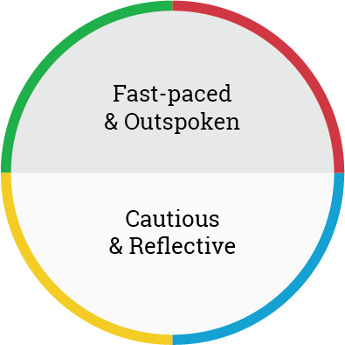
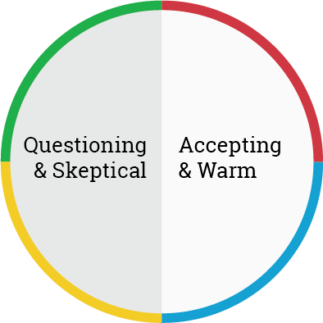
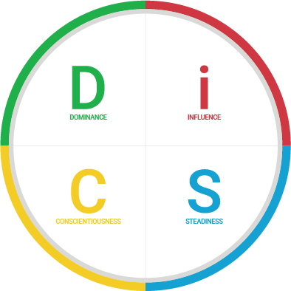
People-Reading Principles
Practical application
Way to understand other needs
Isn’t meant to label people
All styles have strengths and limitations
No good or bad styles
Remember everyone is a blend of all four styles
Increase accuracy by focusing on observable behaviors
Body language
Tone of voice
Expression
Choice of words
Three steps
Active
Thoughtful
Thoughtful
Questioning
Notes:
Practical application of DiSC, even when another person hasn’t told us their style - quick way to assess another person’s style
Build ability to read others
Never fully sure, but people reading gives a base of knowledge
When people reading, we want to observe actual behavior. Specific tips include:
body language
tone of voice and expression
choice of words
Step 1: consider whether person is more fast-paced and outspoken or mor cautious and reflective.
Step 2: consider whether person is more questioning and skeptical or more accepting and warm
Step 3, combine answers to determine person’s DiSC style (see NEXT slide)
Ask people to consider someone they would like to be more effective with.
Have them guess their style.
Have them go to the page for that style (pages 8-11)
Have them go to the page for that style (pages 12-15)
Answer a few questions, e.g.,
STEP 1: HOW YOU REACT TO THIS STYLE (See the page about this persons style: D-8; i-9; S-10; C-11)
Read the four adjectives in the rectangle of how someone of this style may seem to you. Consider their approach with people or to a recent situation. What did you appreciate about their approach/style?
Step 2: HOW similar are the motivations?
Step 3: increasing effectiveness (See the page about this persons style: D-12; i-13; S-14; C-15)
Look at the strategies for when you are trying to connect with someone of this style. See the bullet points.
What might be something to try?
Look at the strategies for when solving a problem with someone of this style. See the bullet points.
What might be something to try?
Look at the strategies for when things get tense with someone of this style. See the bullet points.
What might be something to try?

Slide 17
Take aways
LG
SB
BB
JR
KW
Notes:
Fill in the circles with the initials of your participants and have each person share a key insight.

Slide 18
THANK YOU

