Slide 1

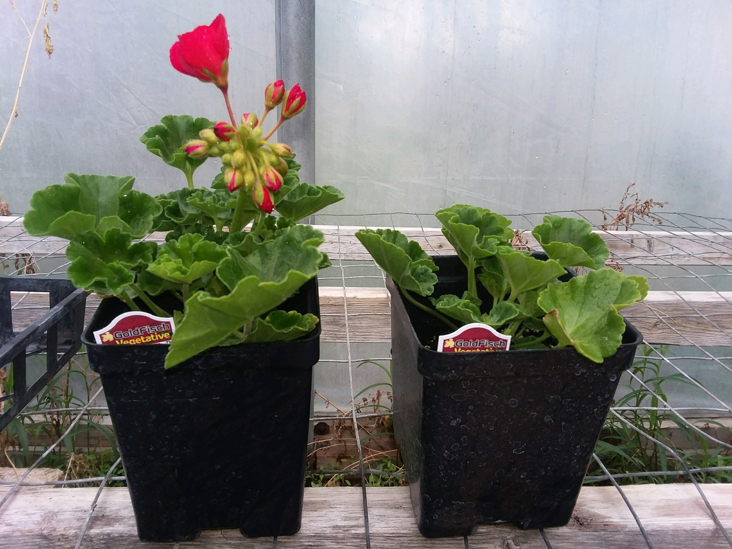


Case Study: Foliar Applied
Location: Redfield, SD
Variety: Geraniums
Photo Taken: May 1, 2017
Comment: Reduced Time to Sale by 6 Weeks
Treated
Untreated
FOR MORE INFO:
Contact Tony Hagen
at Chlorobiome
Phone: 605-880-4193
Tony.Hagen@Agrovive.com

Slide 2
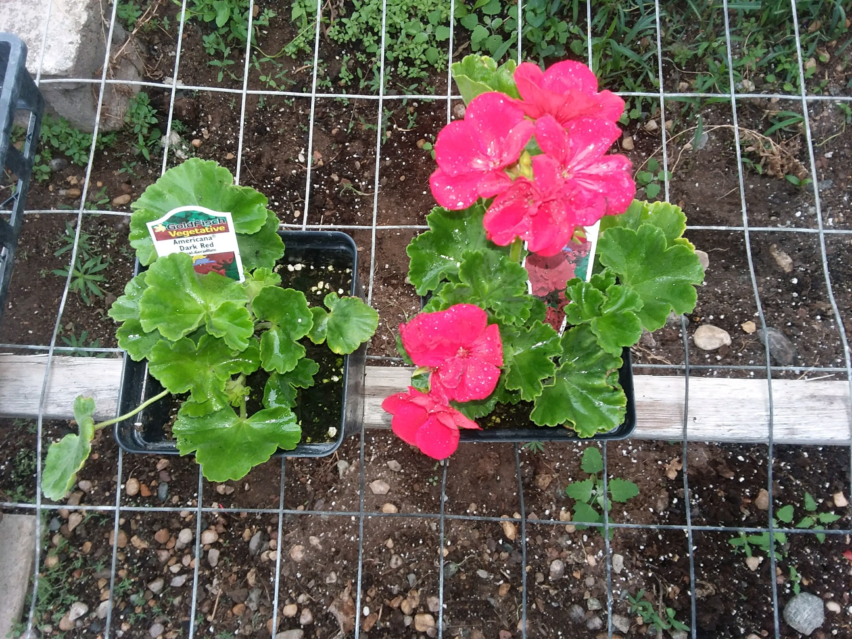
Case Study: Foliar Applied
Location: Redfield, SD
Variety: Geraniums
Photo Taken: May 1, 2017
Comment: Reduced Time to Sale by 6 Weeks
Untreated
Treated
FOR MORE INFO:
Contact Tony Hagen
at Chlorobiome
Phone: 605-880-4193
Tony.Hagen@Agrovive.com

Slide 3

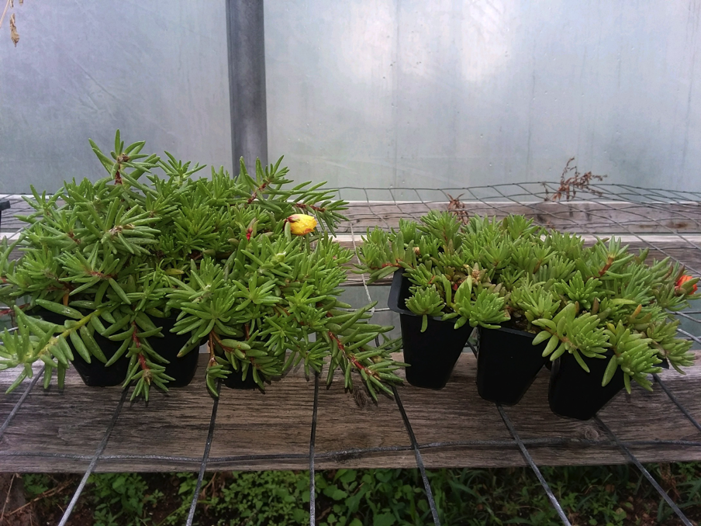


Case Study: Foliar Applied
Location: Redfield, SD
Variety: Moss Roses
Photo Taken: May 1, 2017
Comment: Increased Vigor and Blossom Size Making it a Premium Sale Product Pricing.
Treated
Untreated
FOR MORE INFO:
Contact Tony Hagen
at Chlorobiome
Phone: 605-880-4193
Tony.Hagen@Agrovive.com

Slide 4
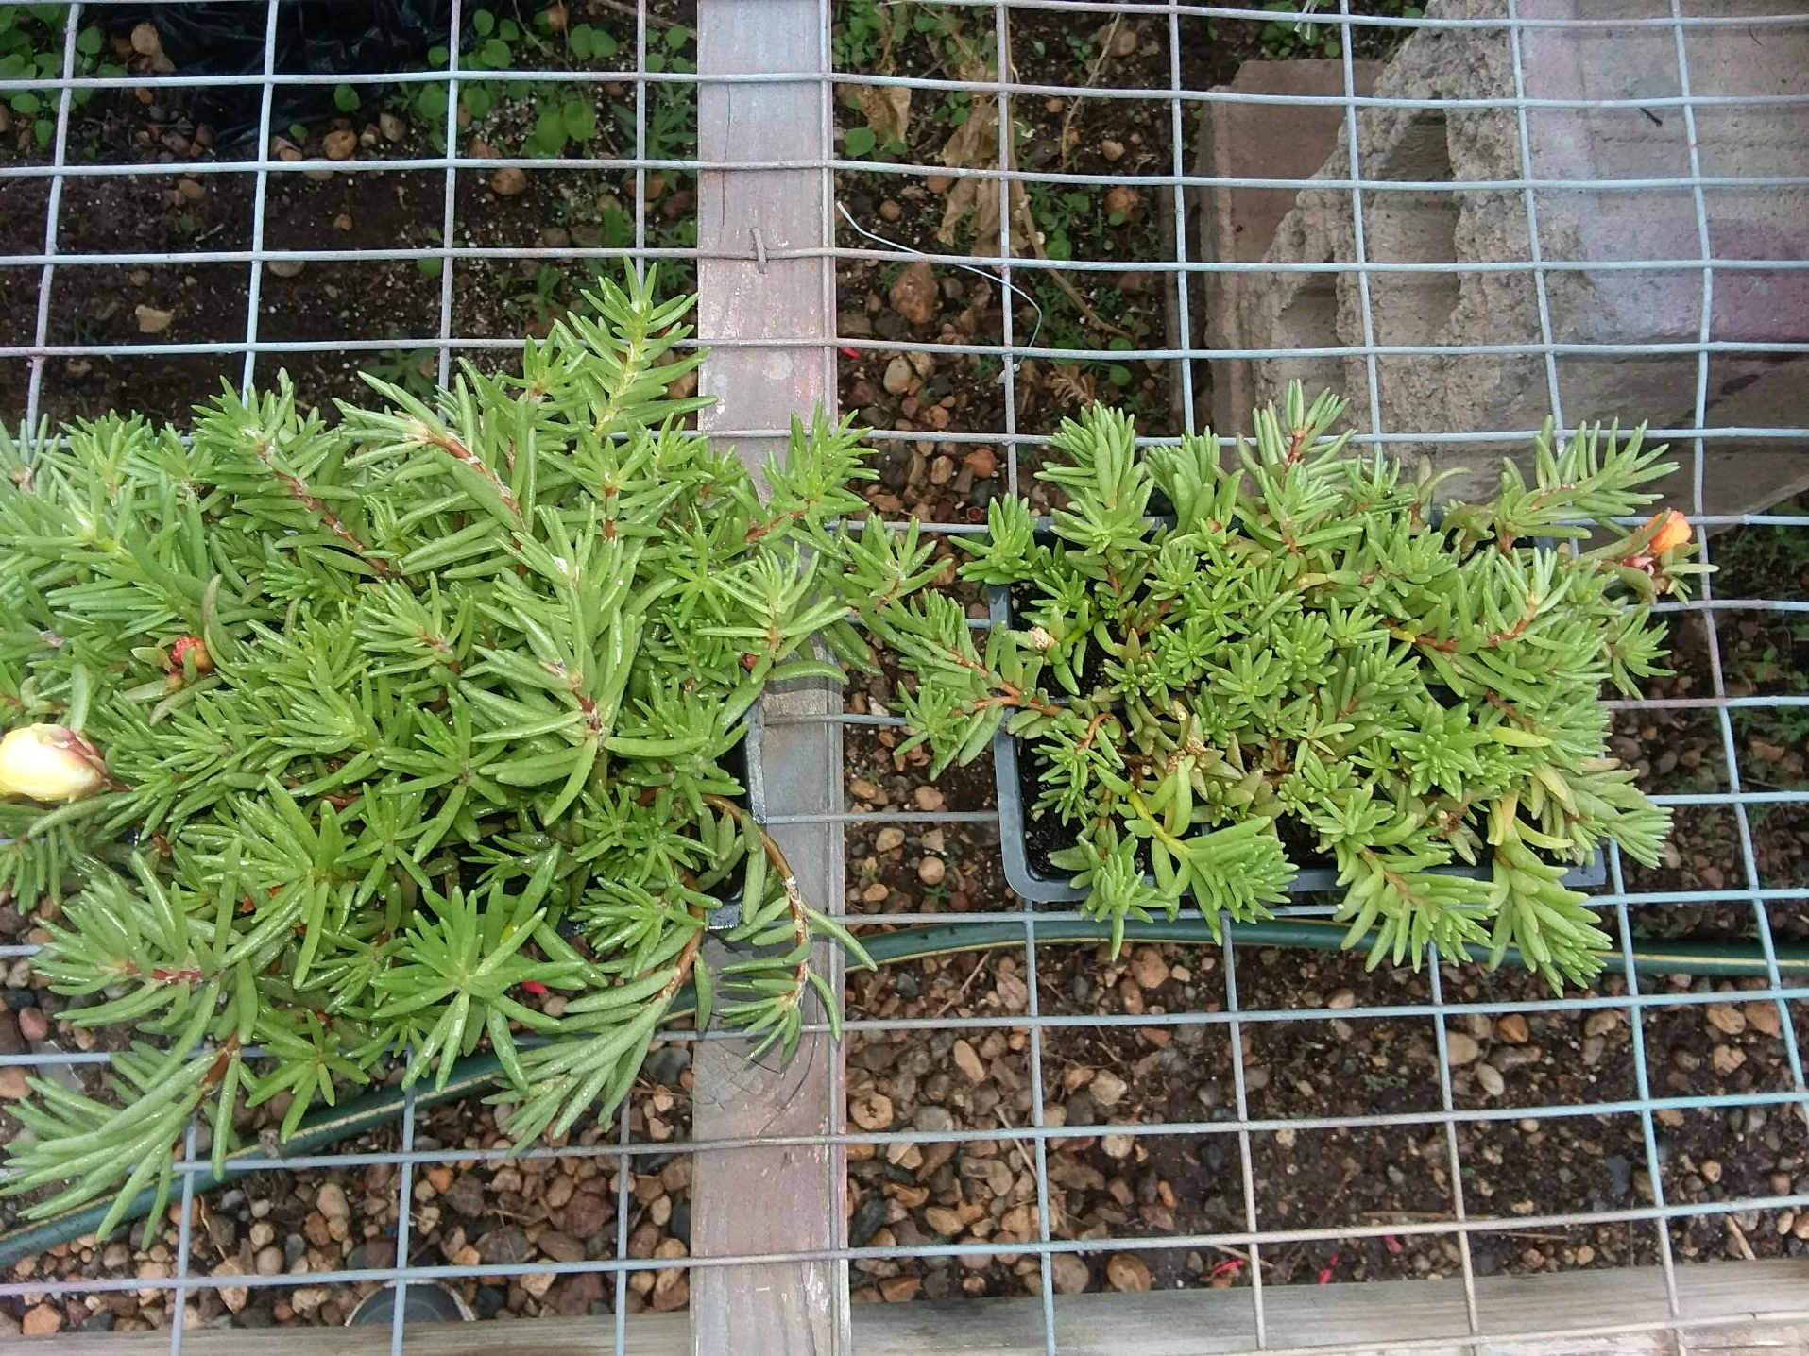
Case Study: Foliar Applied
Location: Redfield, SD
Variety: Moss Roses
Photo Taken: May 1, 2017
Comment: Increased Vigor and Blossom Size Making it a Premium Sale Product Pricing
Treated
Untreated
FOR MORE INFO:
Contact Tony Hagen
at Chlorobiome
Phone: 605-880-4193
Tony.Hagen@Agrovive.com

Slide 5
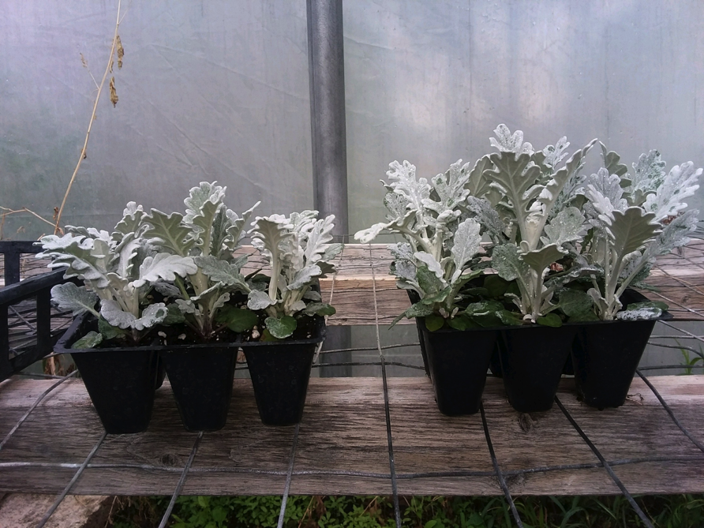
Case Study: Foliar Applied
Location: Redfield, SD
Variety: Dusty Miller
Photo Taken: May 1, 2017
Comment: Increased Vigor Makes it a Premium Sale Product Pricing.
Untreated
Treated
FOR MORE INFO:
Contact Tony Hagen
at Chlorobiome
Phone: 605-880-4193
Tony.Hagen@Agrovive.com

