Slide 1

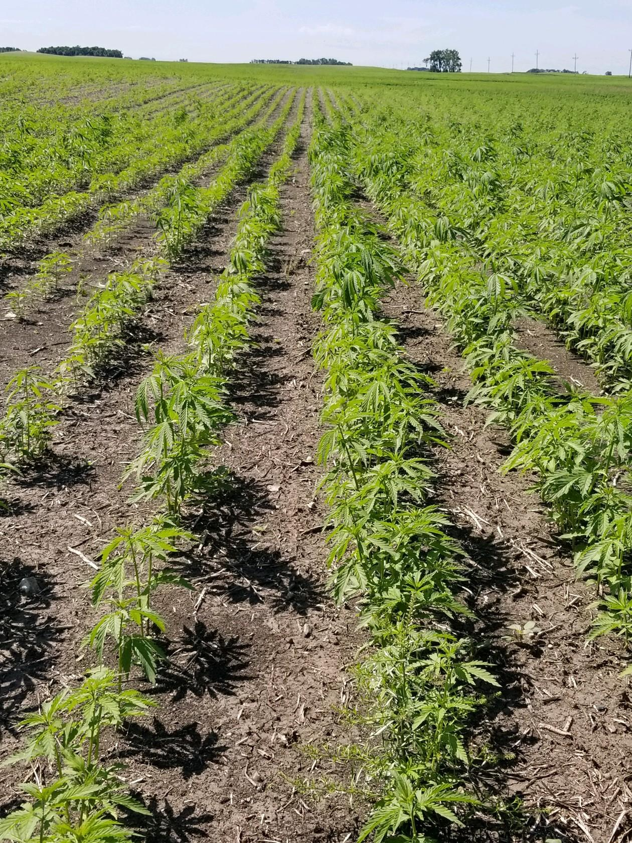
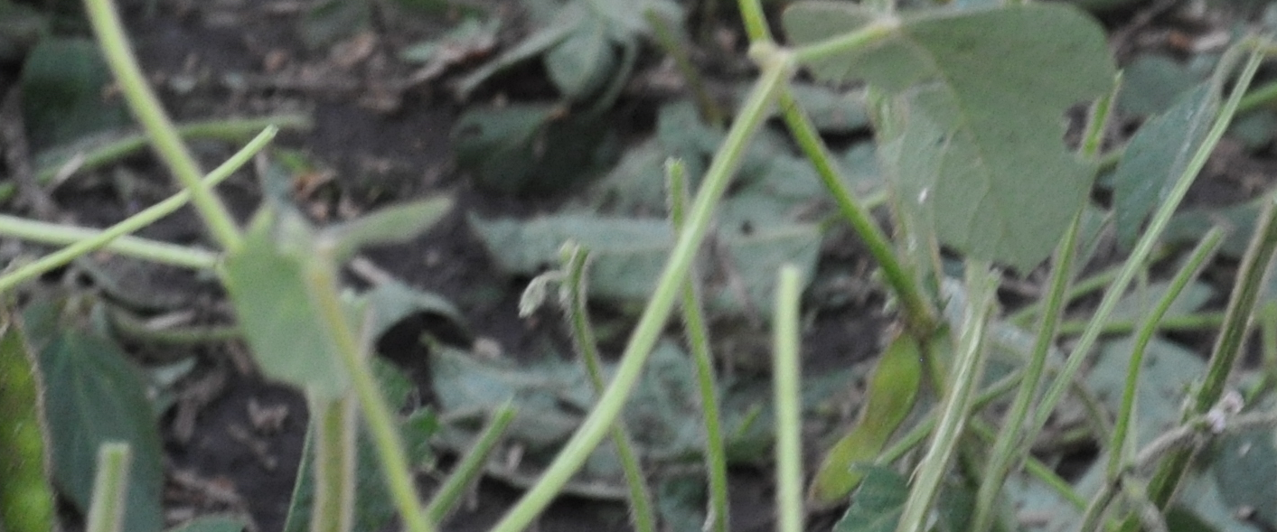
Case Study: Seed Treatment
Location: Bismark, ND
Planted: May 31, 2019 (Seed Treat)
Crop: Hemp
Photo Taken: June 28, 2019
Untreated
Treated
For More Information:
Contact: Tony Hagen
Phone: (605)880-4193
Email: Tony@Agrovive.com

Slide 2
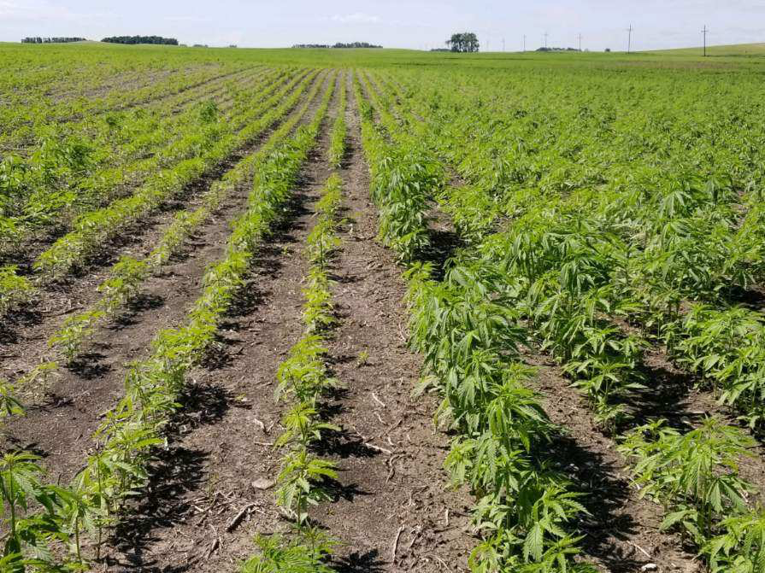
Case Study: Seed Treatment
Location: Bismark, ND
Planted: May 31, 2019 (Seed Treat)
Crop: Hemp
Photo Taken: June 28, 2019
Untreated
Treated
For More Information:
Contact: Tony Hagen
Phone: (605)880-4193
Email: Tony@Agrovive.com

Slide 3
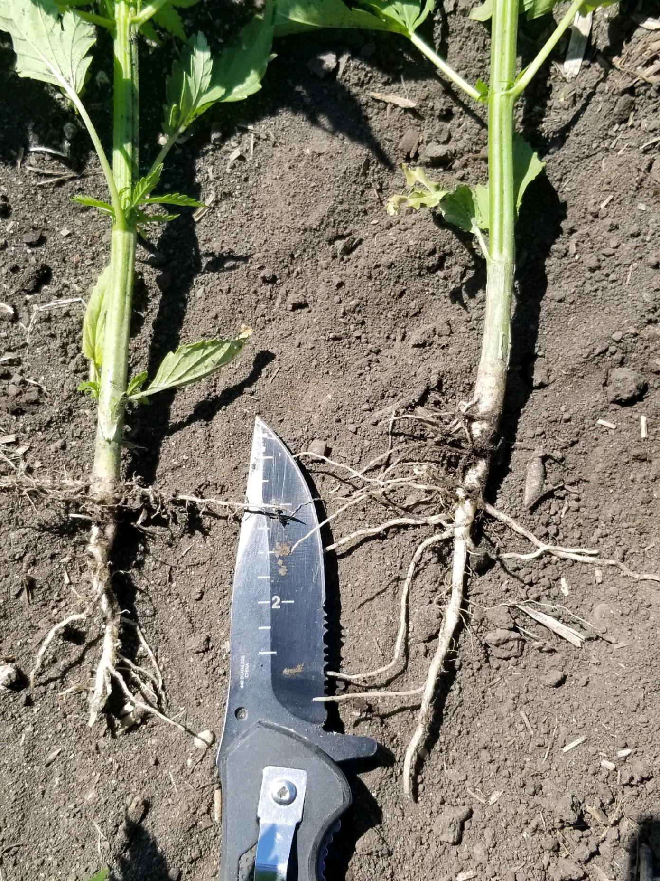
Case Study: Seed Treatment
Location: Bismark, ND
Planted: May 30, 2019 (Seed Treat)
Crop: Hemp
Photo Taken: June 28, 2019
Untreated
Treated
For More Information:
Contact: Tony Hagen
Phone: (605)880-4193
Email: Tony@Agrovive.com

Slide 4
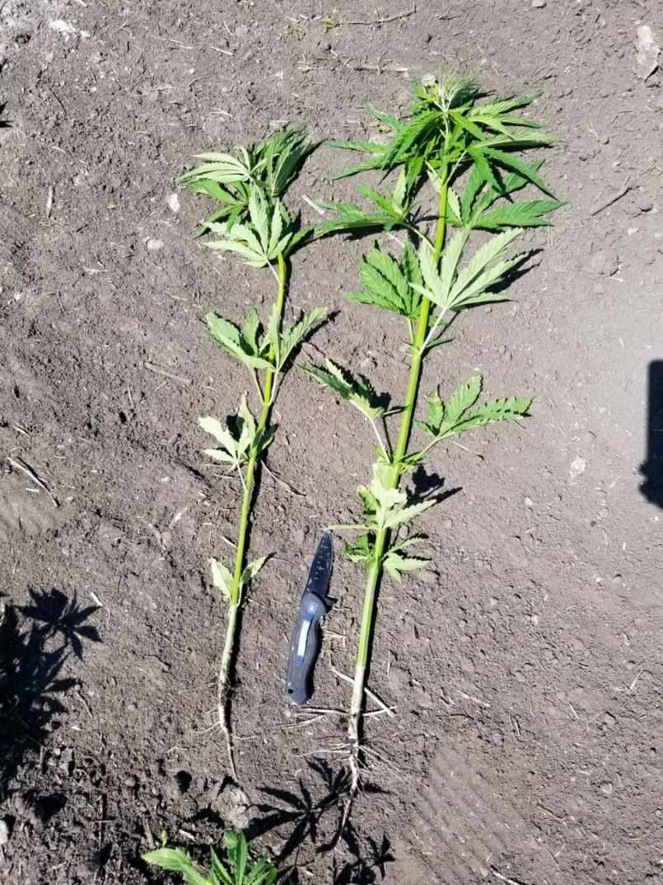
Case Study: Seed Treatment
Location: Bismark, ND
Planted: May 30, 2019 (Seed Treat)
Crop: Hemp
Photo Taken: June 28, 2019
Untreated
Treated
For More Information:
Contact: Tony Hagen
Phone: (605)880-4193
Email: Tony@Agrovive.com

Slide 5
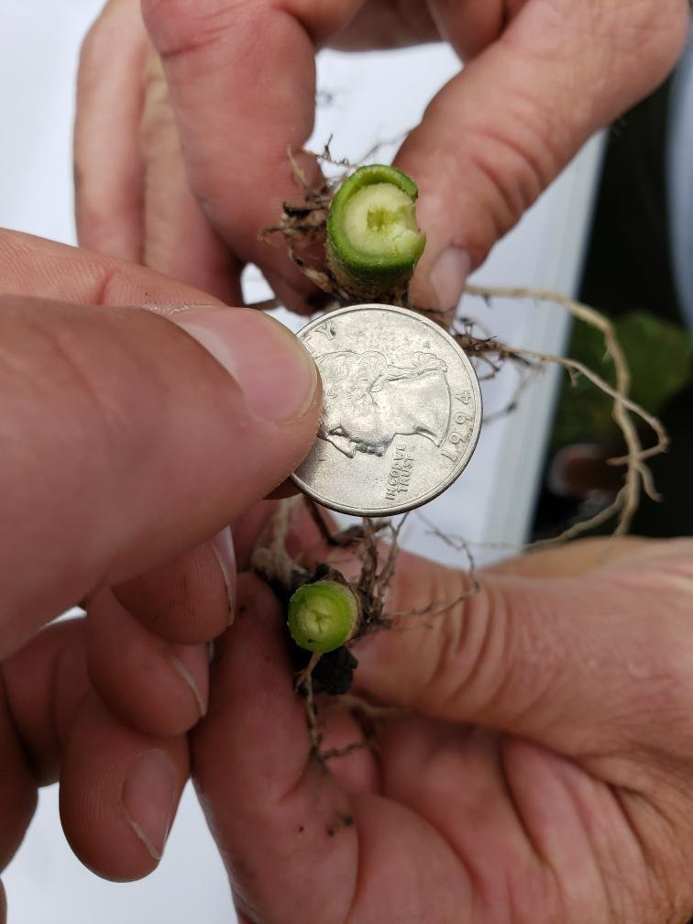
Case Study: Seed Treatment
Location: Bismark, ND
Planted: May 31, 2019 (Seed Treat)
Crop: Hemp
Photo Taken: July 8, 2019
Treated
Untreated
For More Information:
Contact: Tony Hagen
Phone: (605)880-4193
Email: Tony@Agrovive.com

Slide 6
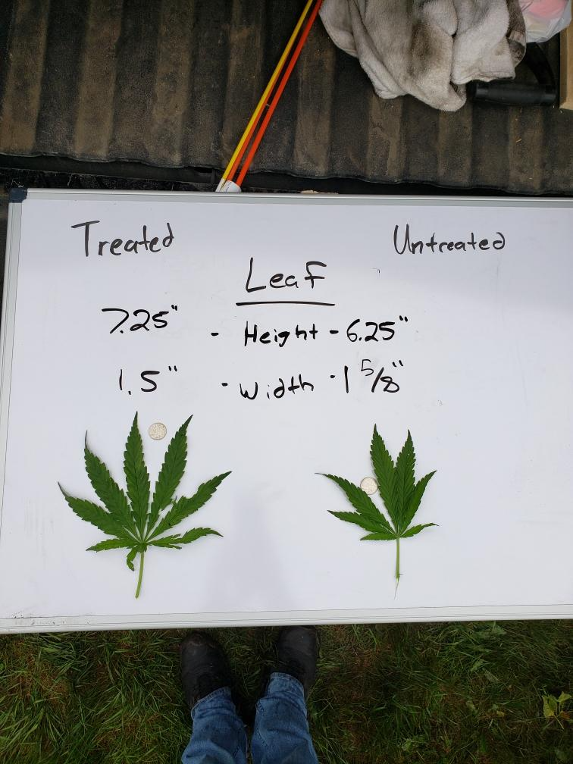
Case Study: Seed Treatment
Location: Bismark, ND
Planted: May 31, 2019 (Seed Treat)
Crop: Hemp
Photo Taken: July 8, 2019
Treated
Untreated
For More Information:
Contact: Tony Hagen
Phone: (605)880-4193
Email: Tony@Agrovive.com

Slide 7
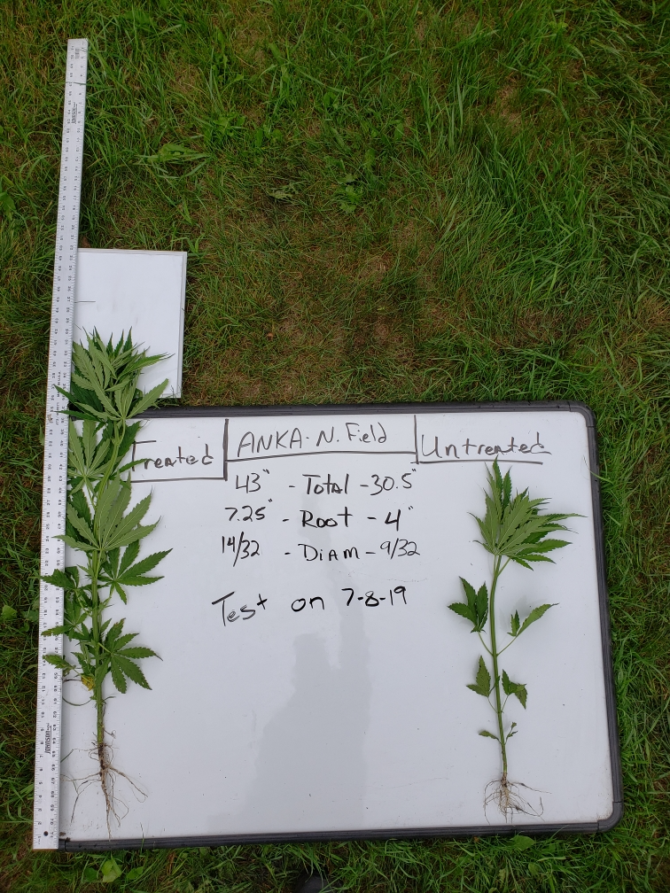
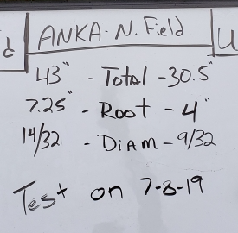
Case Study: Seed Treatment
Location: Bismark, ND
Planted: May 30, 2019 (Seed Treat)
Crop: Hemp
Photo Taken: July 8, 2019
Treated
Untreated
For More Information:
Contact: Tony Hagen
Phone: (605)880-4193
Email: Tony@Agrovive.com

Slide 8
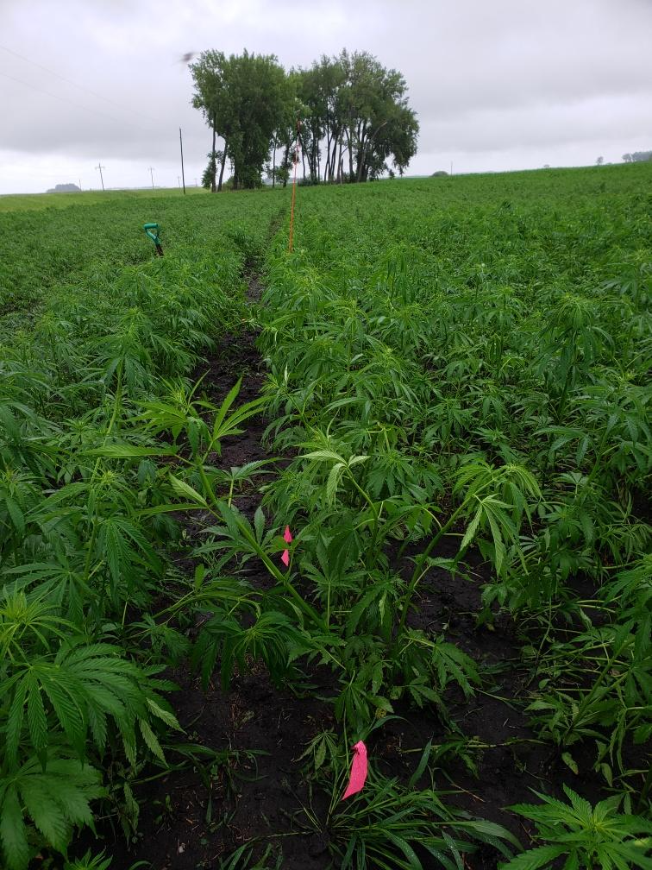
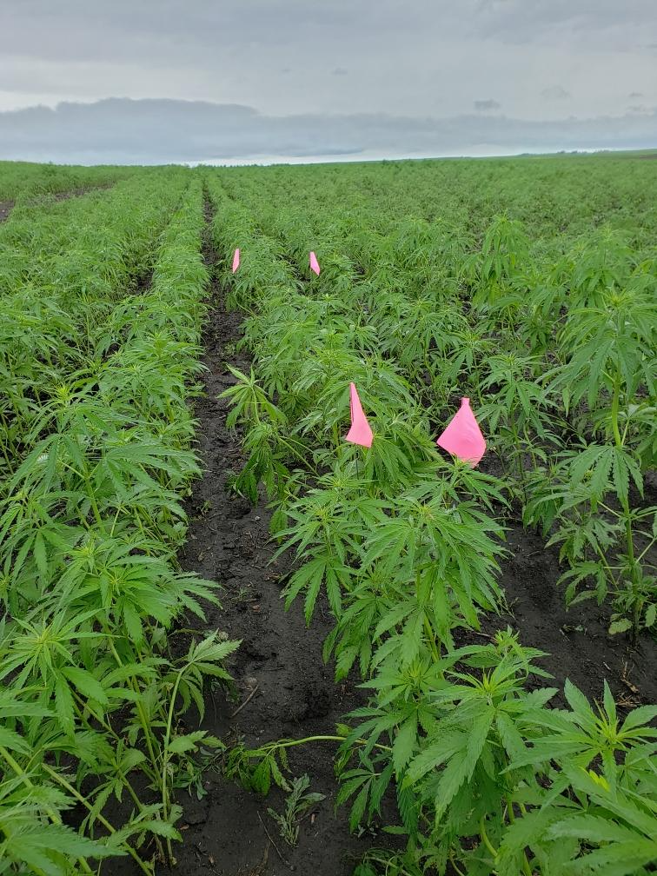
Case Study: Seed Treatment
Location: Bismark, ND
Planted: May 31, 2019 (Seed Treat)
Crop: Hemp
Photo Taken: July 8, 2019
Treated
Untreated
Note the Flags as Height Reference
For More Information:
Contact: Tony Hagen
Phone: (605)880-4193
Email: Tony@Agrovive.com

