Slide 1

Orthobiologics in Sports Medicine:
Evidence-based Applications for Injury Recovery and Performance
Steven T. Brown, MD CAQSM
Associate Professor
Division Chief of Sports & Exercise Medicine
Director of Orthobiologics
Director of Point of Care Ultrasound

Slide 2
Disclosure Statement
I have NO financial disclosure or conflicts of interest with the presented material in the presentation.
Sports & Exercise Medicine

Slide 3
Learning Objectives
Explore the Science of Orthobiologics
  Examine the biological principles and mechanisms behind platelet-rich plasma (PRP), stem cells, and other regenerative therapies in musculoskeletal healing.
Assess Clinical Evidence and Indications
  Analyze current research and clinical data supporting the use of Orthobiologics for common sports injuries, including tendon, ligament, and cartilage disorders.
Optimize Integration into Sports Medicine Practice
  Identify best practices for incorporating Orthobiologics treatments into rehabilitation and return-to-play protocols while addressing safety, efficacy, and ethical considerations.
Sports & Exercise Medicine

Slide 4
Introduction & Agenda
Overview of Orthobiologics
Orthobiologics and the FDA
PRP Mechanisms and Clinical Evidence
Stem Cell Mechanisms
Integration into Practice
Q&A Session
Sports & Exercise Medicine

Slide 5
Orthobiologics?
The term “musculoskeletal regeneration” is widely considered to encompass therapeutic solutions for musculoskeletal conditions that harness the benefits of biology to improve healing, reduce pain, improve function, and provide an environment for tissue regeneration.^{1,2}
Orthobiologics are biological substances derived from the body that are used to treat musculoskeletal disease, injury, and disability, focusing on the growth, replacement, and repair of cells, organs, and tissues specific to the health needs of patients. ^{1,2}
Sports & Exercise Medicine
Notes:
Murray IR, Makaram NS, Sherman SL, et al. We need robust nomenclature for Orthobiologics: letter to editor. Am J Sports Med. 2020;48(12):NP52–NP54.
LaPrade RF, Dragoo JL, Koh JL, et al. AAOS research symposium updates and consensus: biologic treatment of orthopaedic injuries. J Am Acad Orthop Surg. 2016;24(7):e62–e78.

Slide 6
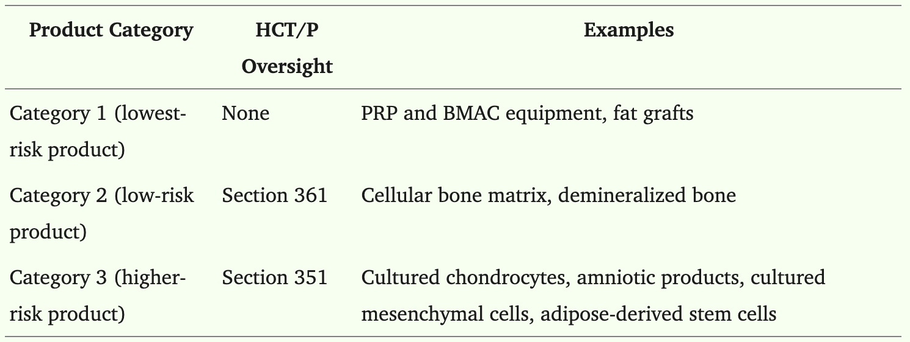
FDA Classification for Orthobiologics
The FDA employs a tiered approach to the regulation of human cells, tissues, and cellular and tissue-based products (HCT/Ps) based on their assessment of patient risk and public safety.^{1,3}
Murray IR, et al. Regulatory and Ethical Aspects of Orthobiologic Therapies. Orthop J Sports Med. 2022 Nov 30;10(11):23259671221101626.
Sports & Exercise Medicine
Notes:
3. US Food & Drug Administration. Guidance for industry: expedited programs for regenerative medicine therapies for serious conditions. February 2019. Accessed May 15, 2022.

Slide 7
FDA Classification for Orthobiologics
Products in Category 1 are those considered to be low risk and, although still regulated as HCT/Ps, do not require Premarket Approval (PMA)/Biologics License Application (BLA). ^{1,4,5,6}
  Examples include whole blood, blood-derived products, bone marrow, human organs for transplantation, and extracted human products such as collagen.^{1,3}
These biologic agents must be^{1,5}:
  Minimally manipulated
  Used in a homologous fashion
  Not combined with any other agents.
Platelet-rich plasma (PRP) and bone marrow aspirate concentrate are the most widely used products under this classification.
Sports & Exercise Medicine
Notes:
4. Belsky K, Smiell J. Navigating the regulatory pathways and requirements for tissue-engineered products in the treatment of burns in the United States. J Burn Care Res. 2021;42(4):774–784.
5. US Department of Health and Human Services. Guidance for industry: Current Good Tissue Practices (CGTP). Accessed on December 15, 2021.
6. US Food & Drug Administration. Code of Federal Regulations—Title 21, Volume 7. Accessed May 15, 2022.

Slide 8
FDA Classification for Orthobiologics
Category 2, comprising lower-risk products, falls under Section 361, and those HCT/Ps require only minimal oversight.^{1,7}
For an HCT/P to be regulated under Section 361, the product must be^{1,8}:
  Minimally manipulated
  Used in a homologous fashion
  Not combined with any other agents
  Have no systemic effects
Producers of Section 361 products need to comply with current good tissue practices, register their establishment with the FDA, provide a list of HCT/Ps produced each year, and label these products in accordance with FDA guidelines.^{1,8}
Sports & Exercise Medicine
Notes:
7.Yano K, Speidel AT, Yamato M. Four Food and Drug Administration draft guidance documents and the REGROW Act: a litmus test for future changes in human cell- and tissue-based products regulatory policy in the United States? J Tissue Eng Regen Med. 2018;12(7):1579–1593.
8. US Food & Drug Administration. Regulatory considerations for human cells, tissues, and cellular and tissue-based products: minimal manipulation and homologous use. July 2020. Accessed on December 15, 2021

Slide 9
Minimal Manipulation
Central to these products is the concept of “minimal manipulation” of biologic products.
  Such manipulation is characterized as only slight modifications of cells or tissues, with preservation of the product’s inherent biological properties. ^{1,8}
    Examples include centrifugation, cutting, antibiotic treatment, gamma irradiation, ethylene oxide sterilization, lyophilization, and cryopreservation.^{1,8}
“More than minimal manipulation” is defined as processing that alters the biological characteristics of cells or tissues. The FDA would include activation, encapsulation, genetic modification, or expansion of cells or tissues under this umbrella. ^{1,8}
  Other examples of more than minimal manipulation include enzymatic degradation, the addition of chemical or biological elements to a product, and mechanical emulsification.^{1,8}
    Examples include cultured cartilage cells, cultured mesenchymal stem cells, and enzyme-digested fat or stromal vascular fraction. ^{1,8}
Sports & Exercise Medicine

Slide 10
FDA Requirements for Orthobiologics
HCT/P products that do not meet these criteria are regulated under Section 351 as higher-risk products, and a BLA is required to certify the “safety, purity, and potency” of a preparation. ^{1,9,10}
While the Section 351 designation was created to ensure patient safety, obtaining premarket approval is complicated, costly, and time-consuming. ^{1,9,10}
Sports & Exercise Medicine
Notes:
9. Zlotnicki JP, Geeslin AG, Murray IR, et al. Biologic Treatments for Sports Injuries II Think Tank—current concepts, future research, and barriers to advancement, part 3: articular cartilage. Orthop J Sports Med. 2016;4(4):2325967116642433.
10. Wallach JD, Ross JS, Naci H. The US Food and Drug Administration’s expedited approval programs: evidentiary standards, regulatory trade-offs, and potential improvements. Clin Trials. 2018;15(3):219–229.

Slide 11
Other Paths to Patients
The Regenerative Medicine Advanced Therapy designation, introduced in 2016 as part of the 21st Century Cures Act, is a special designation for products intended to treat serious or life-threatening conditions. ^{1,11}
  The recent designation of osteoarthritis (OA) as a “serious condition” has enabled a number of products with preliminary data supporting symptomatic and functional improvement in the setting of OA to follow this fast-track pathway. ^{1,12}
Products exempt from Section 351 or 361 oversight are considered on an individual basis, with one outcome being considered via the so-called 510(k) medical device pathway. ^{1,3,13,14}
  This pathway allows FDA clearance for medical devices that represent substantial equivalence to preexisting devices in the market. ¹
Sports & Exercise Medicine
Notes:
11. Barlas S. The 21st Century Cures Act: FDA implementation one year later. Some action, some results, some questions. Pharmacol. Ther. 2018;43(3):149–179.
12. Murphy L, Schwartz TA, Helmick CG, et al. Lifetime risk of symptomatic knee osteoarthritis. Arthritis Rheum. 2008;59(9):1207–1213.
13. Day CS, Park DJ, Rozenshteyn FS, Owusu-Sarpong N, Gonzalez A. Analysis of FDA-approved orthopaedic devices and their recalls. J Bone Joint Surg Am. 2016;98(6):517–524.
14. US Department of Health and Human Services. 510(k) summary: American Biotech Labs. Report No. K082333. November 2009. Accessed May 15, 2022.

Slide 12
Clearance vs. Approval
It is essential to distinguish between the terms “clearance” and “approval,” as they are not interchangeable. ^{1,15}
For example, FDA clearance allows PRP to be used for a wide range of different orthopaedic indications. ^{1,15}
  PRP treatments offered for musculoskeletal indications are considered off-label use, which transfers liability from the manufacturers of the device to the individual providing it. ^{1,15}
  While off-label treatments are not FDA approved, it is important to understand that their use is not necessarily improper or illicit. ^{1,15}
Sports & Exercise Medicine
Notes:
15. Beitzel K, Allen D, Apostolakos J, et al. US definitions, current use, and FDA stance on use of platelet-rich plasma in sports medicine. J Knee Surg. 2015;28(1):29–34.

Slide 13
Orthobiologics and the FDA
The U.S. Food and Drug Administration (FDA) has given 510(k) clearance to the equipment used to collect and prepare PRP and BMAC. ^{1,15}
However, the FDA has not approved PRP or BMAC itself for direct injection for most uses. ^{1,15}
  The FDA does not consider PRP or BMAC, which comes from a patient's blood, a drug. ^{1,14,15}
  While the FDA clears the devices used to produce these products, this doesn't mean the PRP or BMAC treatment itself is FDA-approved for all uses.
  Many PRP uses are considered off-label. ^{1,15}
Sports & Exercise Medicine

Slide 14
Orthobiologics and the FDA
There are currently no FDA-approved products containing umbilical cord blood, amniotic tissue cells, or exosomes that are approved for general use, orthopedic injuries, or autoimmune diseases.¹
Sports & Exercise Medicine

Slide 15
Platelet-Rich Plasma (PRP)
PRP is derived from the patient's own blood.¹
  Contains a high concentration of platelets and growth factors.
  These growth factors promote tissue repair and regeneration.
Commonly used in tendon, ligament, and joint injuries.
Sports & Exercise Medicine

Slide 16
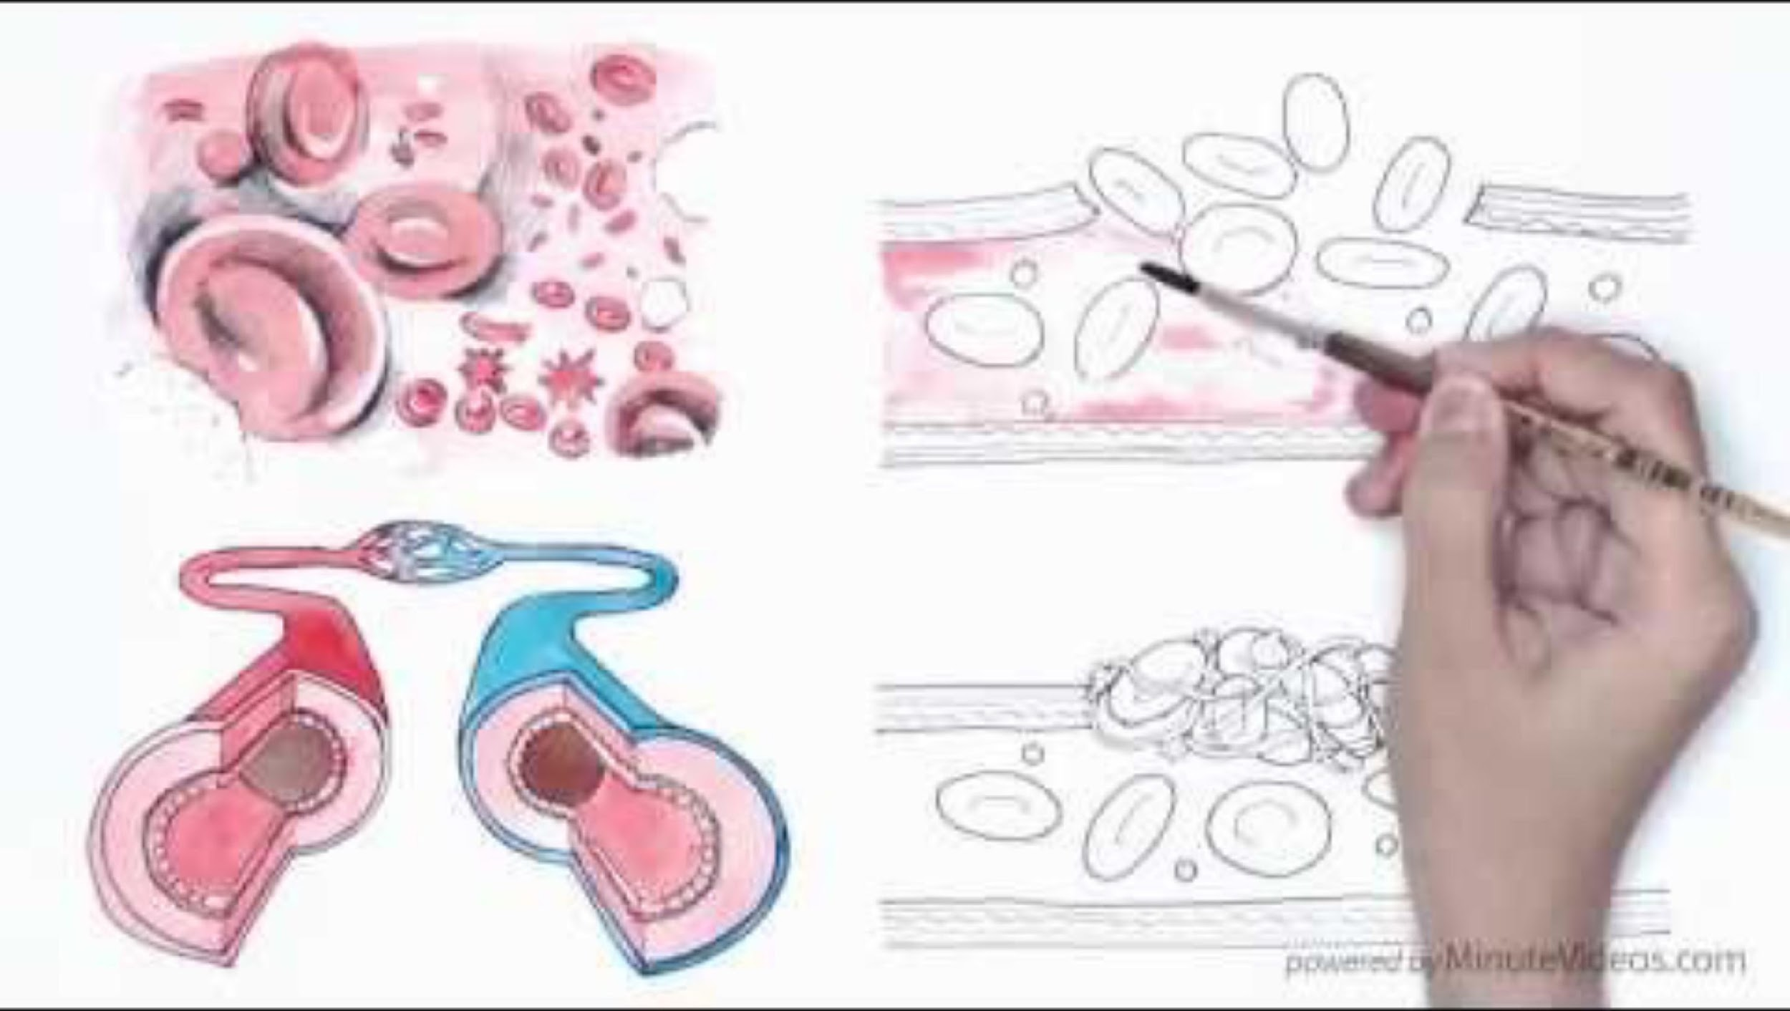
Sports & Exercise Medicine

Slide 17
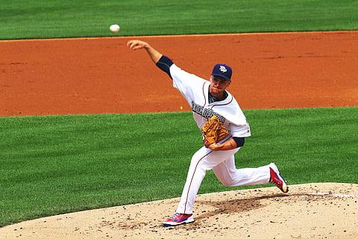
PRP and Shoulder Pathologies
Condition & Population | Study Type | Key Findings | PMID
Rotator cuff tendinopathy / partial tear | RCT (Kesikburun et al. 2013) | No significant difference vs. saline at 1-year in WORC, SPADI, VAS, ROM | 23893418
 | Meta-analysis (Lin et al. 2020) | PRP provided significant long-term (>24 wk) pain relief (SMD 0.42), but no clear functional improvement | 32231127
Subacromial impingement syndrome (SAIS) | RCT (Nejati et al. 2017) | PRP no better than exercise therapy at 6 mo; exercise was superior at earlier time points | 28567426
Arthroscopic rotator cuff repair (ACR) | Meta-analysis (Cai et al. 2015; Warth et al. 2015) | PRP reduced retear rates and improved scores (Constant, UCLA, SST) | 26456434, 25450417
 | RCT (Liu et al. 2021) | Up to 6 mo, leukocyte-rich PRP (LR‑PRP) improved ASES vs control; no difference at 12 mo; retear rates similar | 34159208
 | RCT (Leukocyte‑poor vs control, 2024) | No functional/structural difference at 12 mo; LR vs LP PRP unclear benefit | 38587033
Long-term (10‑year) follow-up of ACR + PRP | RCT follow‑up (Randelli 2022) | No long-term benefit in function or healing rates | 34052372
Sports & Exercise Medicine

Slide 18
Summary of Evidence
Tendinopathy / partial-thickness tears
  High-quality RCT (Kesikburun) shows no benefit from PRP vs saline at 1 year.
  Meta-analysis (Lin et al.) indicates long-term pain reduction, but inconsistent functional outcomes.
Subacromial impingement syndrome
  RCT shows no advantage of PRP over exercise therapy; exercise was superior in early follow-up.
Rotator cuff repair augmentation
  Meta-analyses suggest reduced retear rates and modest functional improvements.
  Mixed RCT findings: early functional gains may occur with certain PRP types, but no lasting differences at 12+ months.
Long-term outcomes
  A 10-year follow-up study reports no sustained benefit of PRP augmentation in rotator cuff repair.
Sports & Exercise Medicine

Slide 19
Clinical Considerations
Evidence strongest for surgical augmentation in rotator cuff repair (reduced retear risk).
Non‑surgical shoulder tendinopathies and impingement show limited or no functional benefits.
Short-term functional gains may be seen, particularly with leukocyte-rich PRP, but benefits often fade by 12 months.
These findings underscore the importance of:
  Injection formulation (LP vs LR PRP)
  Proper patient selection (e.g., surgical candidates)
  Awareness of timing (early gains vs long-term results)
Sports & Exercise Medicine

Slide 20
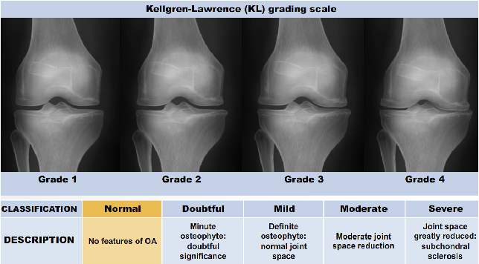
PRP and Knee OA
Study / Authors | Type | Population / Comparator | Key Findings | PMID
Patel et al. (2013) | RCT | PRP vs. Saline (78 pts, Kellgren 1–3) | PRP improved WOMAC and VAS scores at 6 months; better than placebo | 23299850
Smith et al. (2016) | RCT | PRP vs. Placebo | PRP improved KOOS, EQ-5D, VAS vs placebo over 6 months | 26831629
Cole et al. (2017) | RCT | PRP vs. Hyaluronic Acid (HA) | PRP showed greater improvement in IKDC and pain/function scores at 6 months | 28146403
Di Martino et al. (2019) | RCT | PRP vs. HA vs. corticosteroid | PRP had longer-lasting benefit (12 months) vs HA/steroids
Meheux et al. (2016) | Systematic Review | 6 RCTs, 661 knees | PRP better than HA and placebo in VAS, WOMAC, IKDC at 6–12 months | 26432430
Dai et al. (2017) | Meta-analysis (Level I) | 10 RCTs | PRP significantly improved pain/function at 6 and 12 months vs HA/placebo | 28012636
Saraf et. al (2025) | RCT | PRP (1 vs 2 vs 3 injections) | All groups improved; 2–3 injections had slightly better sustained results | 40291970
Wang et al. (2023) | Meta-analysis | PRP vs. HA/placebo | PRP showed superior pain and functional improvement, with dose-dependent effects | 6950089
This Photo by Unknown Author is licensed under CC BY-SA
Sports & Exercise Medicine

Slide 21
Summary of Evidence
Level 1 evidence supports PRP as effective for mild-to-moderate knee OA (Kellgren-Lawrence grades 1–3).
Compared to saline, HA, and corticosteroids, PRP provides:
  Better pain reduction (VAS, WOMAC, KOOS)
  Improved function (IKDC, EQ-5D)
  Durable effects up to 12 months
Repeated injections (2–3) may enhance outcomes over a single injection.
*Formulation, leukocyte content, and injection protocols vary across studies.*
Sports & Exercise Medicine

Slide 22
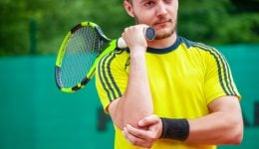
PRP and Tennis Elbow
Study / Authors | Type | Population / Comparator | Key Findings | PMID
Mishra et al. (2014) | RCT (double-blind) | PRP vs. active control (bupivacaine) | Significant pain reduction at 24 weeks in PRP group; 84% improved vs. 68% control | 23825183
Krogh et al. (2013) | RCT (triple-blind) | PRP vs. glucocorticoid vs. saline (60 pts) | No statistically significant difference between PRP and placebo at 3 months | 23328738
Peerbooms et al. (2010) | RCT | PRP vs. corticosteroid (100 pts) | PRP superior at 1 year (VAS and DASH); corticosteroids better at 1 month | 20448192
Gosens et al. (2011) | RCT (follow-up) | 2-year follow-up of Peerbooms et al. | PRP maintained superior outcomes over corticosteroids at 2 years | 21427152
Tang et al. (2020) | Network Meta-analysis | 10 RCTs, PRP vs. autologous blood vs. steroids | PRP most effective for long-term pain relief; corticosteroids best for short-term improvement | 31736257
Arirachakaran et al. (2016) | Network Meta-analysis | 10 RCTs, PRP vs. autologous blood vs. steroids | PRP can improve pain and lower complications, AB can improve pain and disabilities but has more complications | 26362783
This Photo by Unknown Author is licensed under CC BY
Sports & Exercise Medicine

Slide 23
Summary of Evidence
Short-term (0–3 months):
  Corticosteroids often outperform PRP in rapid symptom relief.
Mid- to long-term (6–24 months):
  PRP consistently outperforms corticosteroids, autologous blood, and saline in terms of sustained pain relief and function.
Meta-analyses and network analyses support PRP for long-term relief in chronic cases unresponsive to conservative treatment.
Sports & Exercise Medicine

Slide 24
Clinical Considerations
Best candidates:
  Chronic (>6 months) with recalcitrant lateral epicondylitis
PRP vs. steroids:
  Steroids provide early pain relief but are associated with recurrence
  PRP promotes tissue healing and offers longer-lasting results.
Protocols:
  Evidence varies between leukocyte-rich vs. leukocyte-poor PRP
  Injection technique and post-procedural rehab may influence outcomes.
Sports & Exercise Medicine

Slide 25
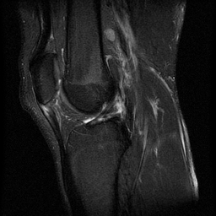
PRP and Patellar Tendinopathy
Study / Authors | Type | Population / Comparator | Key Findings | PMID / Link
Dragoo et al. (2014) | RCT | PRP vs. dry needling (23 athletes) | PRP group had better improvement at 12 weeks and 6 months | 24481828
Vetrano et al. (2013) | RCT | PRP vs. ESWT vs. dry needling | PRP group showed greatest improvement in VISA-P at 6 months | 23408591
Barman et al. (2022) | Systematic Review & Meta-analysis | PRP in patellar tendinopathy (various RCTs) | Evidence supports PRP effectiveness for pain/function improvement; need for further high-quality RCTs | 9066802
This Photo by Unknown Author is licensed under CC BY-SA
Sports & Exercise Medicine

Slide 26
Summary of Evidence
Moderate evidence for PRP improving symptoms in chronic patellar tendinopathy, especially compared to dry needling and ESWT.
Sports & Exercise Medicine

Slide 27
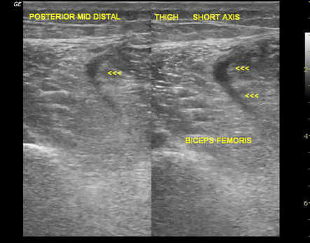
PRP and Hamstring Injuries
Study / Authors | Type | Population / Comparator | Key Findings | PMID
Hamid et al. (2014) | RCT | PRP vs. rehab alone (28 athletes) | Faster return-to-play (26.7 vs. 42.5 days); reduced reinjury rate | 25073598
This Photo by Unknown Author is licensed under CC BY-SA-NC
Sports & Exercise Medicine

Slide 28
Summary of Evidence
Conflicting evidence; smaller RCTs show benefit, but additional trials are needed
Emerging evidence supports the use of Platelet Poor Plasma (PPP) for muscle injury.
  After treatment with platelet-poor plasma, patients on average returned to full, unrestricted participation in sport at 29.4 (±7.2) days postinjury, with a statistically significant improvement in pain as early as 2 weeks postinjection.
    Kruse RC, Volfson E. Platelet-Poor Plasma for the Treatment of Acute Hamstring Muscle Injuries in Collegiate Football Athletes: A Cohort Study. Clin J Sport Med. 2024 Nov 22;35(4):529-533. doi: 10.1097/JSM.0000000000001305. PMID: 39576137.
Sports & Exercise Medicine

Slide 29
Stem Cell Therapy
Stem cells are undifferentiated cells capable of becoming specialized cells.
They can regenerate damaged tissues and modulate inflammation.
Sources include bone marrow and adipose tissue.
Sports & Exercise Medicine

Slide 30
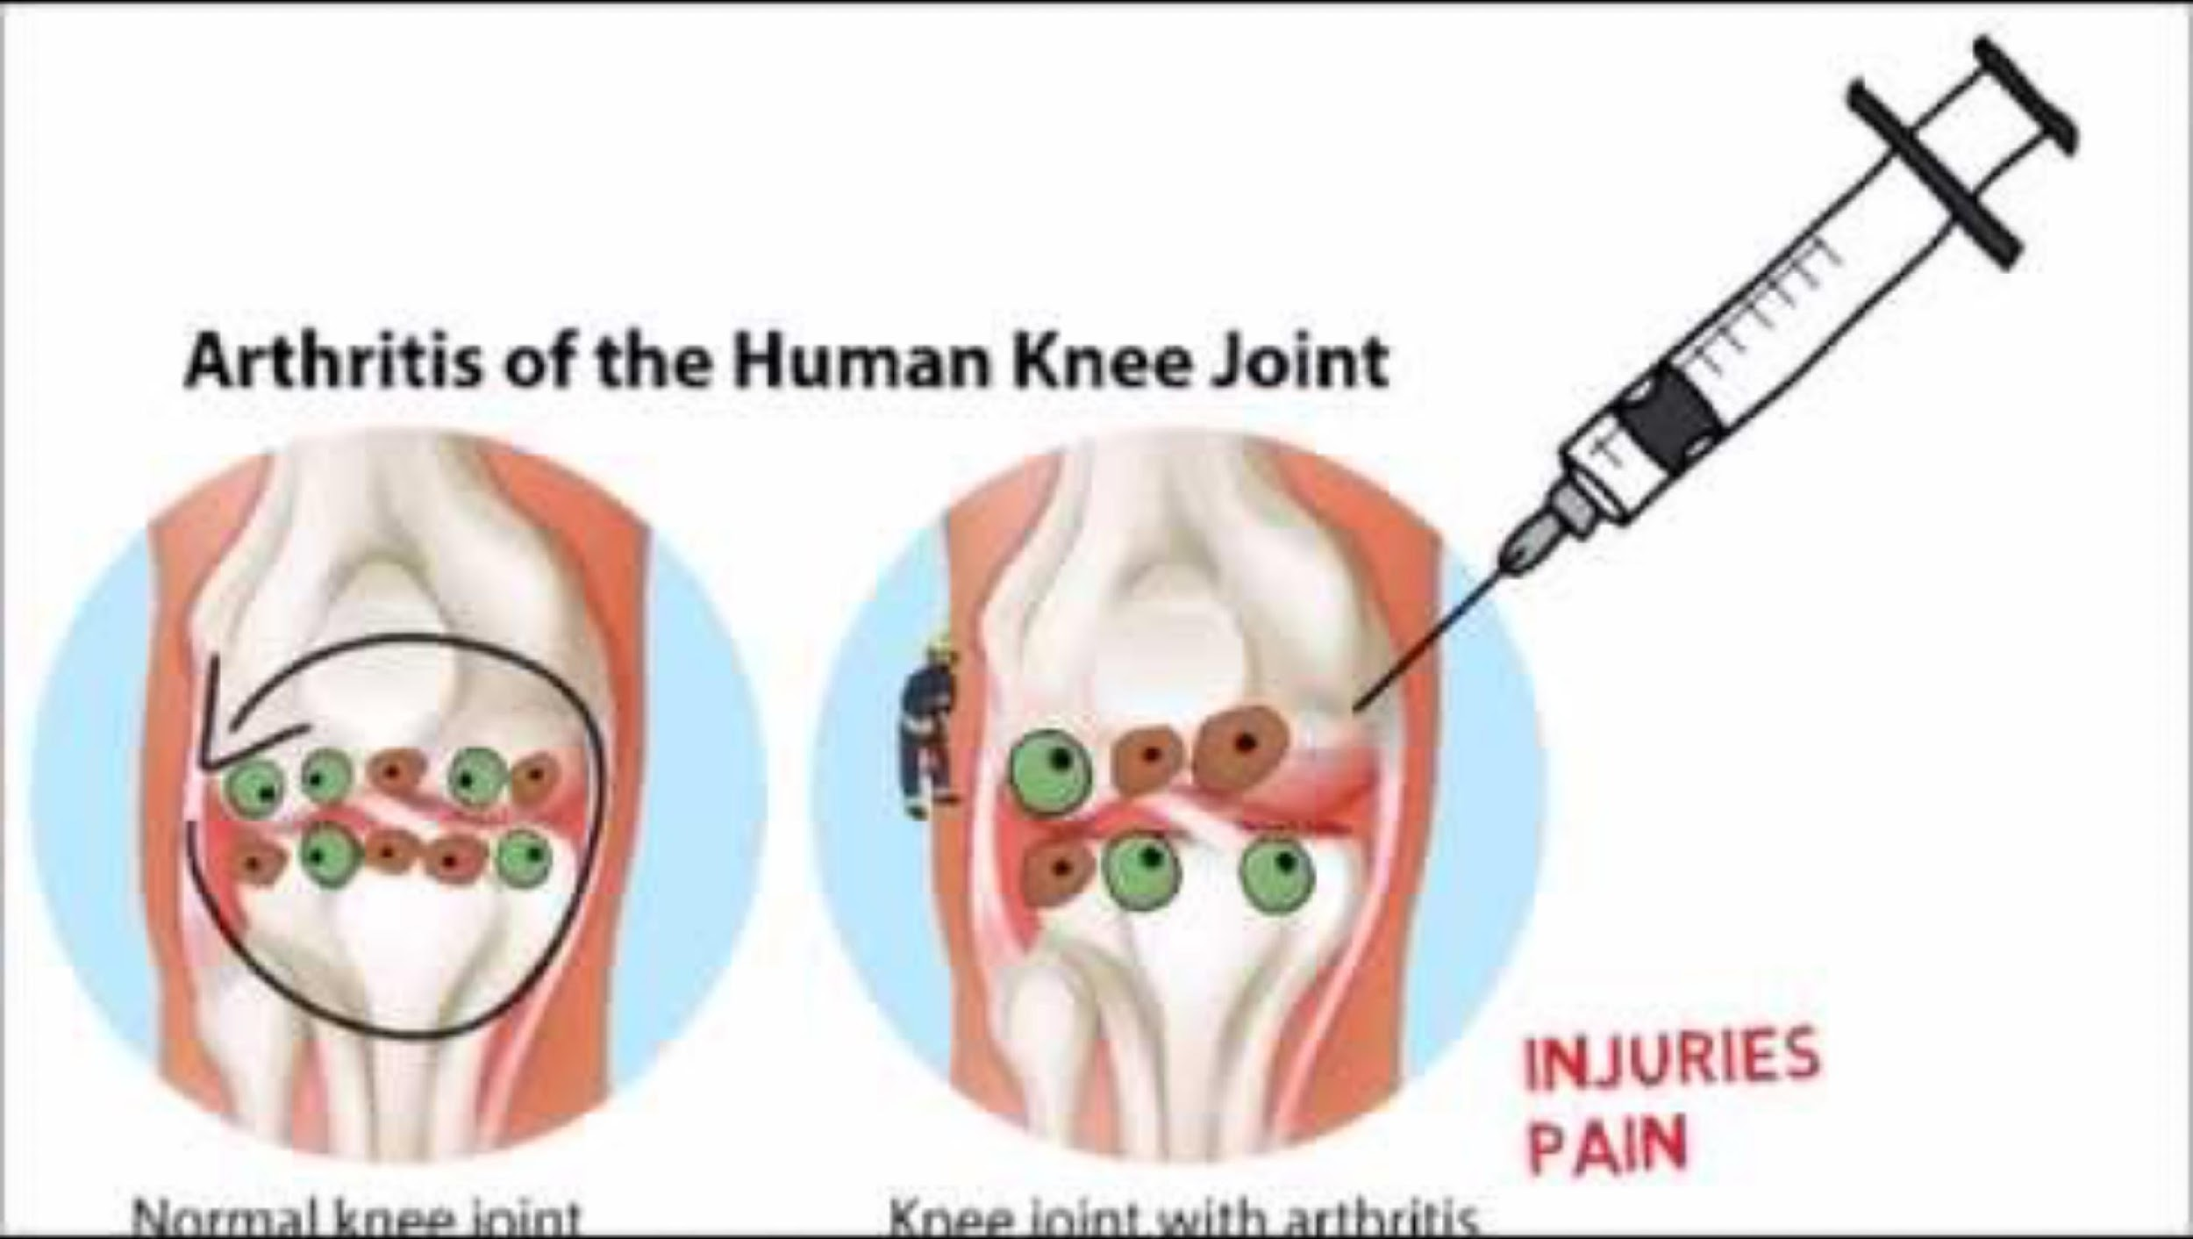
Sports & Exercise Medicine

Slide 31
Integration into Practice
Incorporating Orthobiologics isn’t just about the injection. It’s a team effort.
  PTs and ATs play a crucial role in timing post-procedure rehab and monitoring recovery.
  Not every patient is a candidate, so clear criteria and communication across the care team are essential.
Return-to-play decisions should factor in both biological and functional recovery.
  We can’t rely solely on how an MRI looks or how good someone feels after the shot.
  Functional testing, pain-free loading, and communication between MDs, PTs, and ATs help ensure safe and durable RTP decisions.
Sports & Exercise Medicine

Slide 32
PRP gives us potential, but it’s our collaboration that delivers outcomes. Recovery is never one person’s job; it’s a team sport.

Slide 33

Contact
Sports & Exercise Medicine

Slide 34
Works Cited
Murray IR, Makaram NS, Sherman SL, et al. We need robust nomenclature for Orthobiologics: letter to editor. Am J Sports Med. 2020;48(12):NP52–NP54.
LaPrade RF, Dragoo JL, Koh JL, et al. AAOS research symposium updates and consensus: biologic treatment of orthopaedic injuries. J Am Acad Orthop Surg. 2016;24(7):e62–e78.
US Food & Drug Administration. Guidance for industry: expedited programs for regenerative medicine therapies for serious conditions. February 2019. Accessed May 15, 2022.
Belsky K, Smiell J. Navigating the regulatory pathways and requirements for tissue-engineered products in the treatment of burns in the United States. J Burn Care Res. 2021;42(4):774–784.
US Department of Health and Human Services. Guidance for industry: Current Good Tissue Practices (CGTP). Accessed on December 15, 2021.
US Food & Drug Administration. Code of Federal Regulations—Title 21, Volume 7. Accessed May 15, 2022.
Yano K, Speidel AT, Yamato M. Four Food and Drug Administration draft guidance documents and the REGROW Act: a litmus test for future changes in human cell- and tissue-based products regulatory policy in the United States? J Tissue Eng Regen Med. 2018;12(7):1579–1593.
US Food & Drug Administration. Regulatory considerations for human cells, tissues, and cellular and tissue-based products: minimal manipulation and homologous use. July 2020. Accessed on December 15, 2021
Zlotnicki JP, Geeslin AG, Murray IR, et al. Biologic Treatments for Sports Injuries II Think Tank—current concepts, future research, and barriers to advancement, part 3: articular cartilage. Orthop J Sports Med. 2016;4(4):2325967116642433.
Wallach JD, Ross JS, Naci H. The US Food and Drug Administration’s expedited approval programs: evidentiary standards, regulatory trade-offs, and potential improvements. Clin Trials. 2018;15(3):219–229.
Barlas S. The 21st Century Cures Act: FDA implementation one year later. Some action, some results, some questions. Pharmacol. Ther. 2018;43(3):149–179.
Murphy L, Schwartz TA, Helmick CG, et al. Lifetime risk of symptomatic knee osteoarthritis. Arthritis Rheum. 2008;59(9):1207–1213.
Day CS, Park DJ, Rozenshteyn FS, Owusu-Sarpong N, Gonzalez A. Analysis of FDA-approved orthopaedic devices and their recalls. J Bone Joint Surg Am. 2016;98(6):517–524.
US Department of Health and Human Services. 510(k) summary: American Biotech Labs. Report No. K082333. November 2009. Accessed May 15, 2022.
15. Beitzel K, Allen D, Apostolakos J, et al. US definitions, current use, and FDA stance on use of platelet-rich plasma in sports medicine. J Knee Surg. 2015;28(1):29–34.

Slide 35
Questions?

