Slide 1

Scanner:
https://www.amazon.com/gp/product/B00EUMXPC4/ref=ppx_od_dt_b_asin_title_o00_s01?ie=UTF8&psc=1

Slide 2
Step 1 – Log in to National Site www.combatvet.us
Step 2 – Click on ID SWIPE, Click on Add New Event (Slide 4)
Step 3 – Choose Attendance or Voting (Slide 5)
Step 4- Event Name – Start with Chapter Number, Event, and LASTLY PUT THE DATE ON THIS LINE (Slide 5)
  For Example – 23-0, Annual Meet and Greet , 25 Dec 2019
Step 5 – Enter the date of the Event (Slide 5)
Step 6 – Event Description is Optional but can be helpful for others that are reviewing the event (Slide 5)
Step 7 – Click on Create Event (Slide 6)
Step 8 - If this is going to be a sanctioned event, only the SR can annotate this box as true. (Slide 8)
  Please have the event loaded 72 hours prior to the event to give the SR enough time to annotate event as Sanctioned
  201 File Comment Log defaults to True but needs to be changed to false for non-sanctioned events.
  201 comments should be limited to Sanctioned Events and Disciplinary Actions ONLY. Please DO NOT use 201 file for Monthly Meeting Attendance. If you are unsure please ask.
Step 9 – If you would like to add people to help run the event click on Add Clerk (Slide 9), Select Members
Step 10 – When you are ready to start the event click on Start Event (Slide 10)
  This will move your event from Open Event to Started Event
Step 11 – Find your event in the Started Event section and click on Work Event (Slide 12)
Step 13 – When the event is over click on Close Event (Slide 13)
Step 14 – Now, please find your event in the Closed Event section (Slide 14)
Step 15 – Click on Event Report (Slide 15), Click on .pdf (Slide 16) and save .pdf to your computer
Step 16 – The event creator MUST go into the Closed Event section and DELETE the event (Slide 17)
  Only the Event Creator can delete events. Events should be deleted NLT 14 days after the event has closed

Slide 3
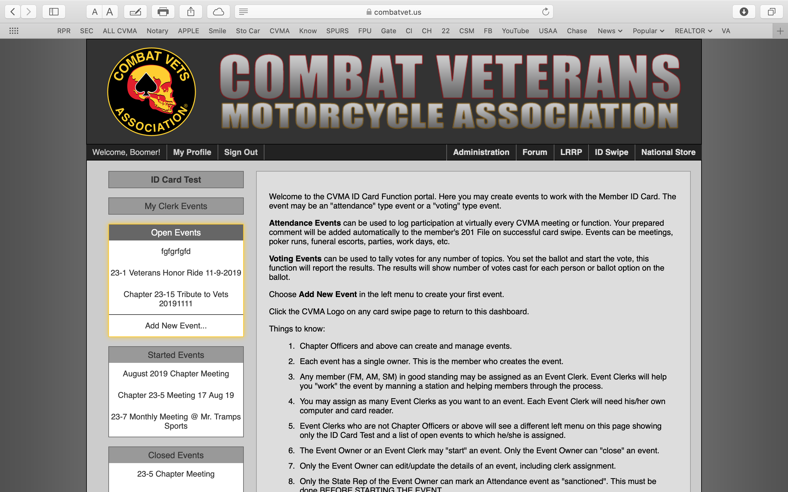

Open events are events that have been created but have not yet been started.

Slide 4
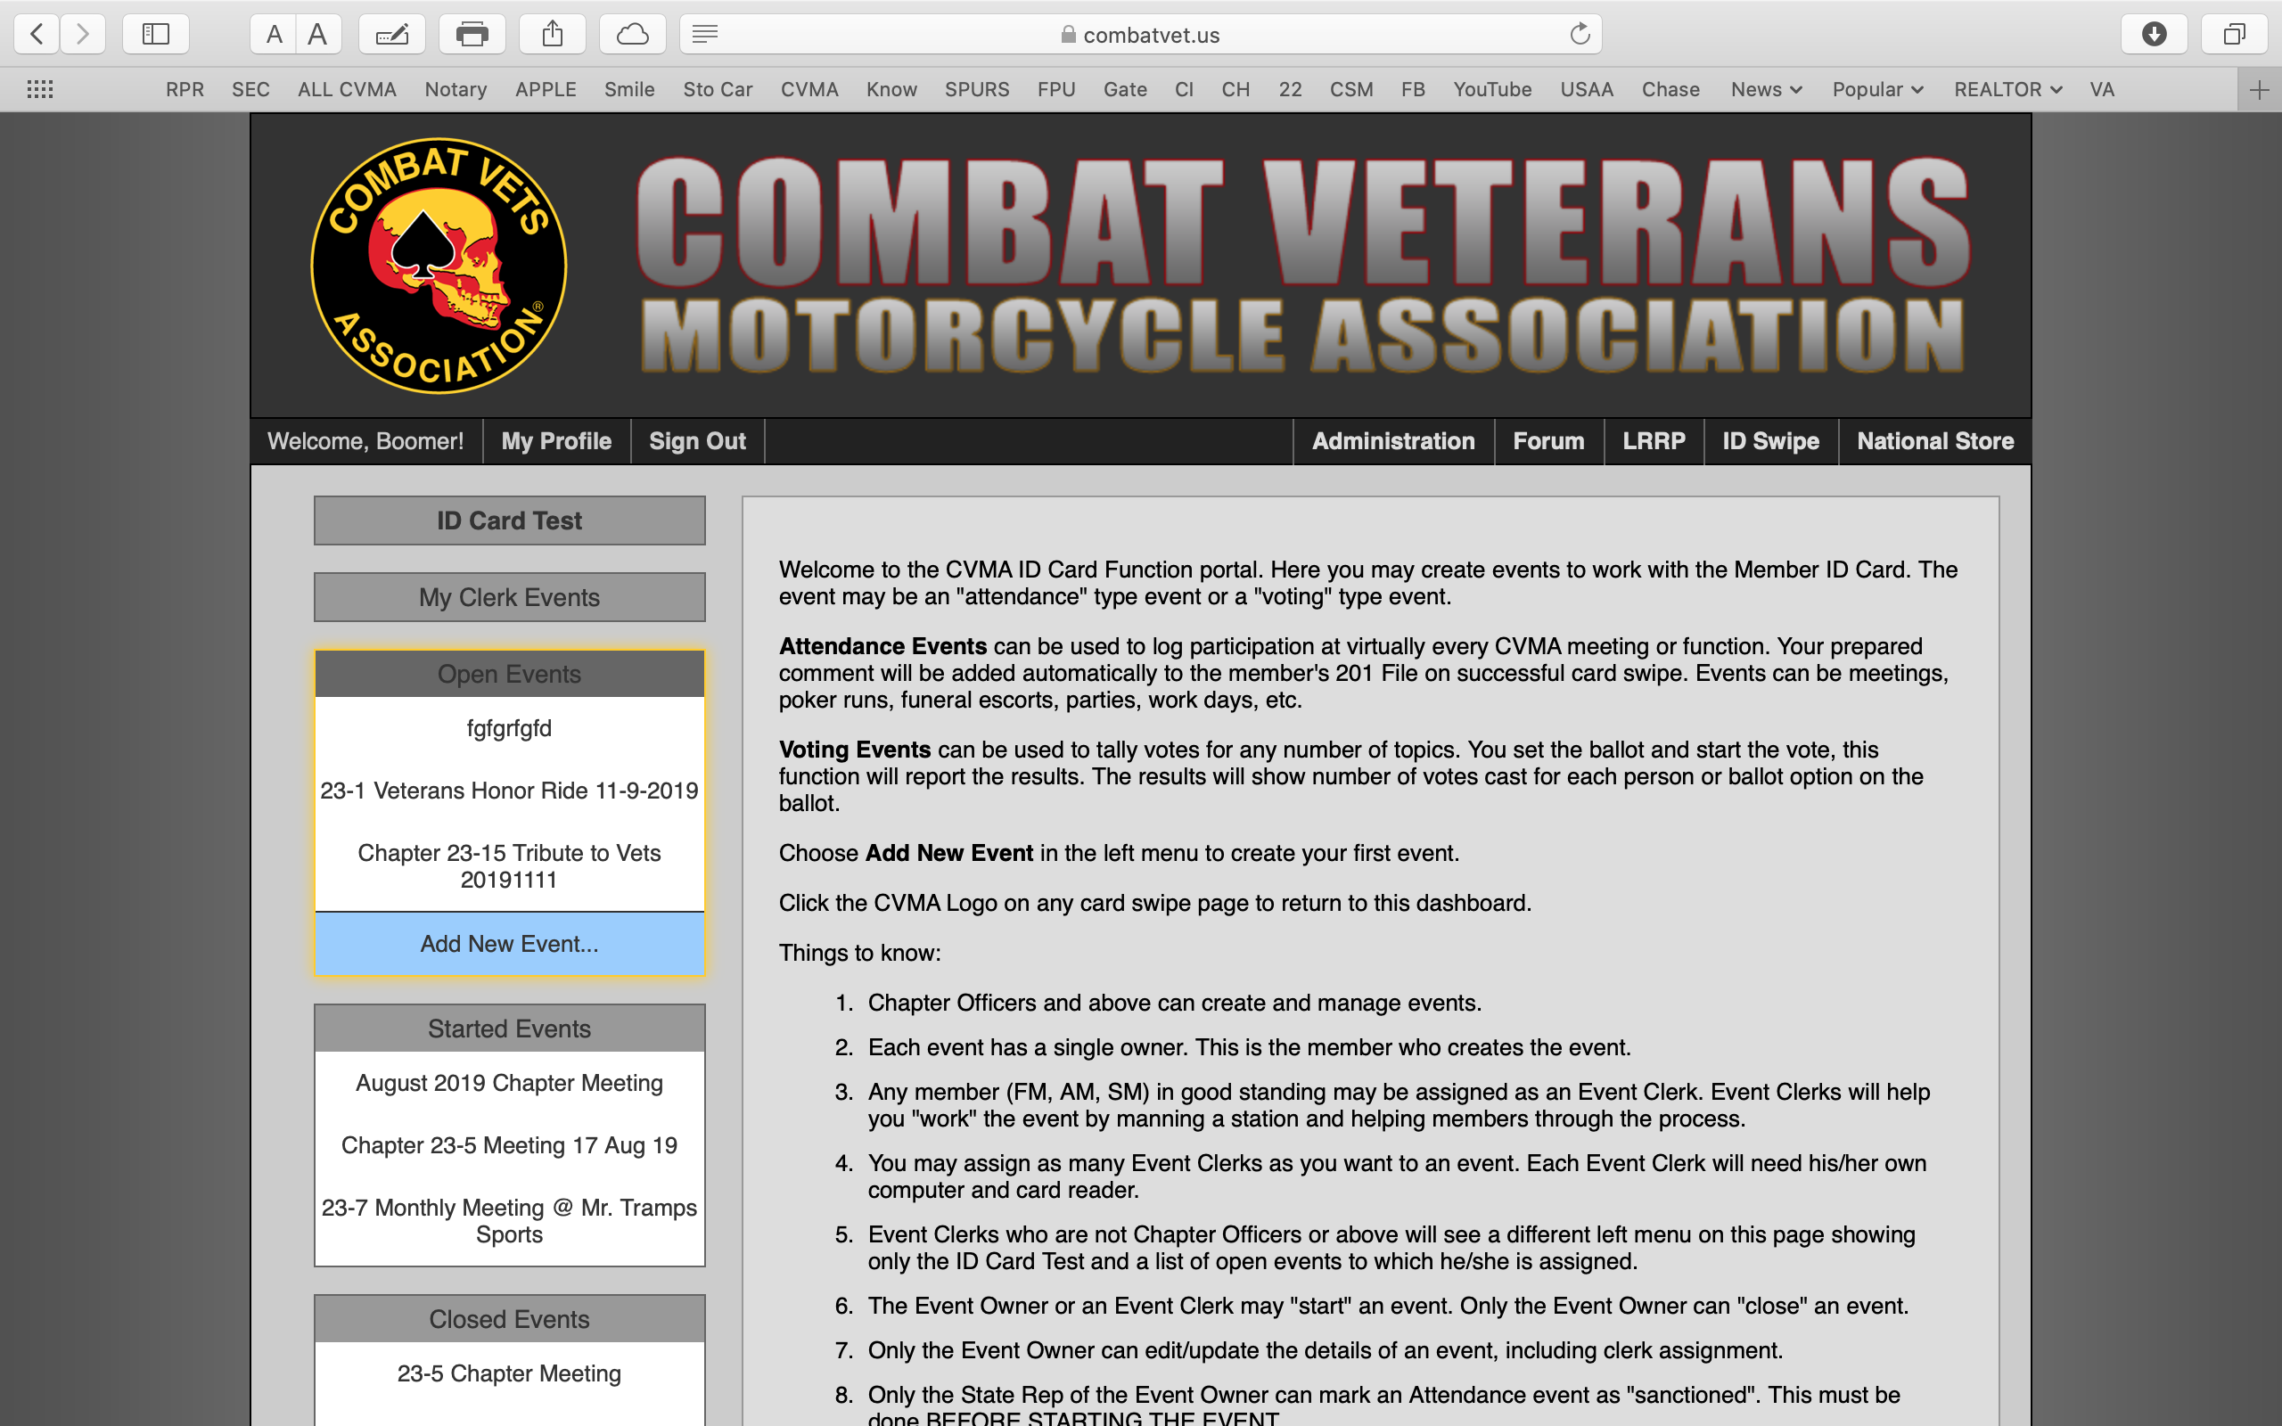
See Step 2, to start a new event click on Add New Event

Slide 5
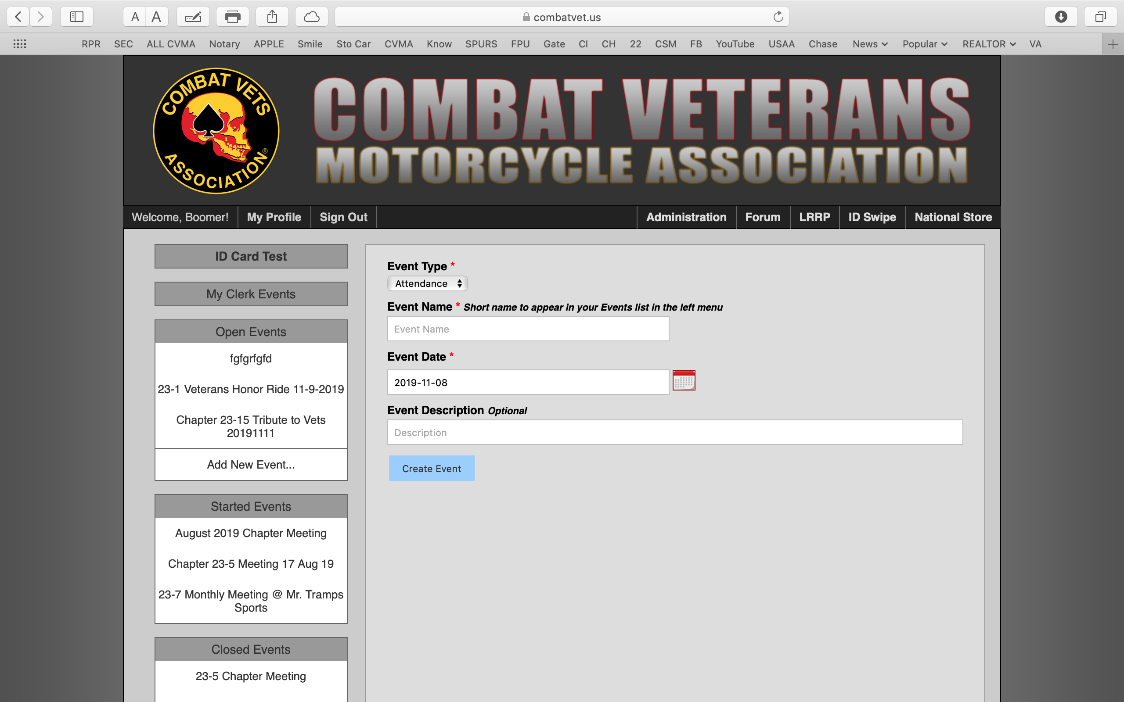
See Step 3
See Step 4
See Step 5
For Event Type choose Attendance or Voting
Event Name – Start with Chapter Number, Event, and LASTLY PUT THE DATE ON THIS LINE
For Example – 23-0, Annual Meet and Greet , 25 Dec 2019
Event Date – Enter the date of the event. Yes I know you already did that in the Event Name but do it again there is a reason.

Slide 6
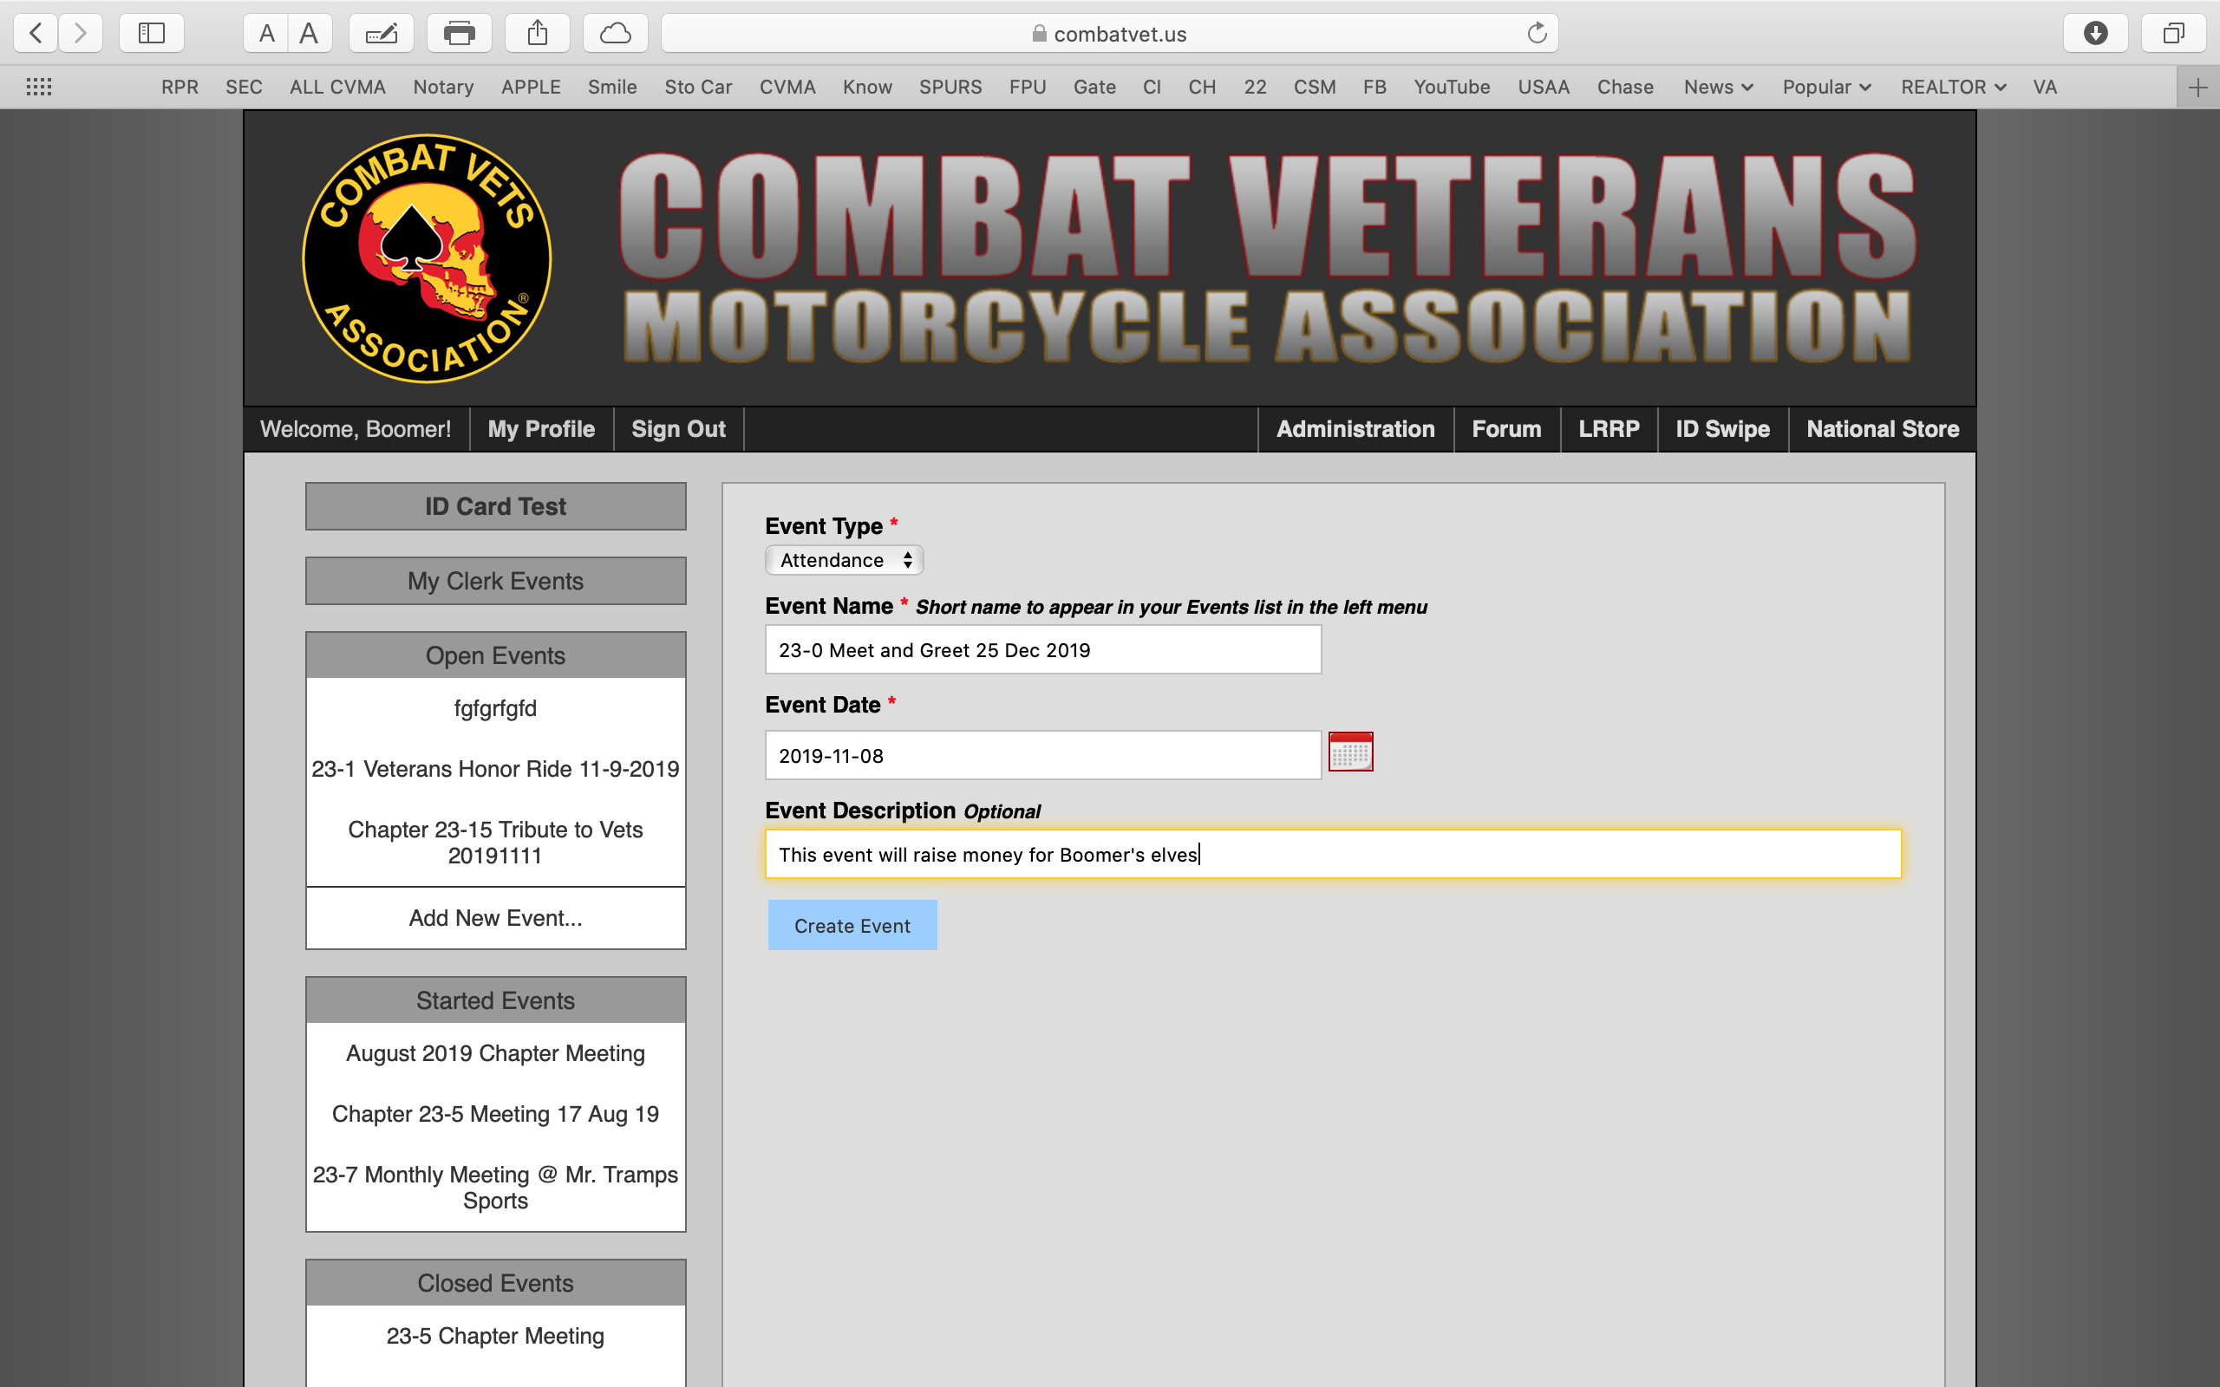


Do not forget to put the date on the Event Name line. This date will pull down to the 201 File

Slide 7
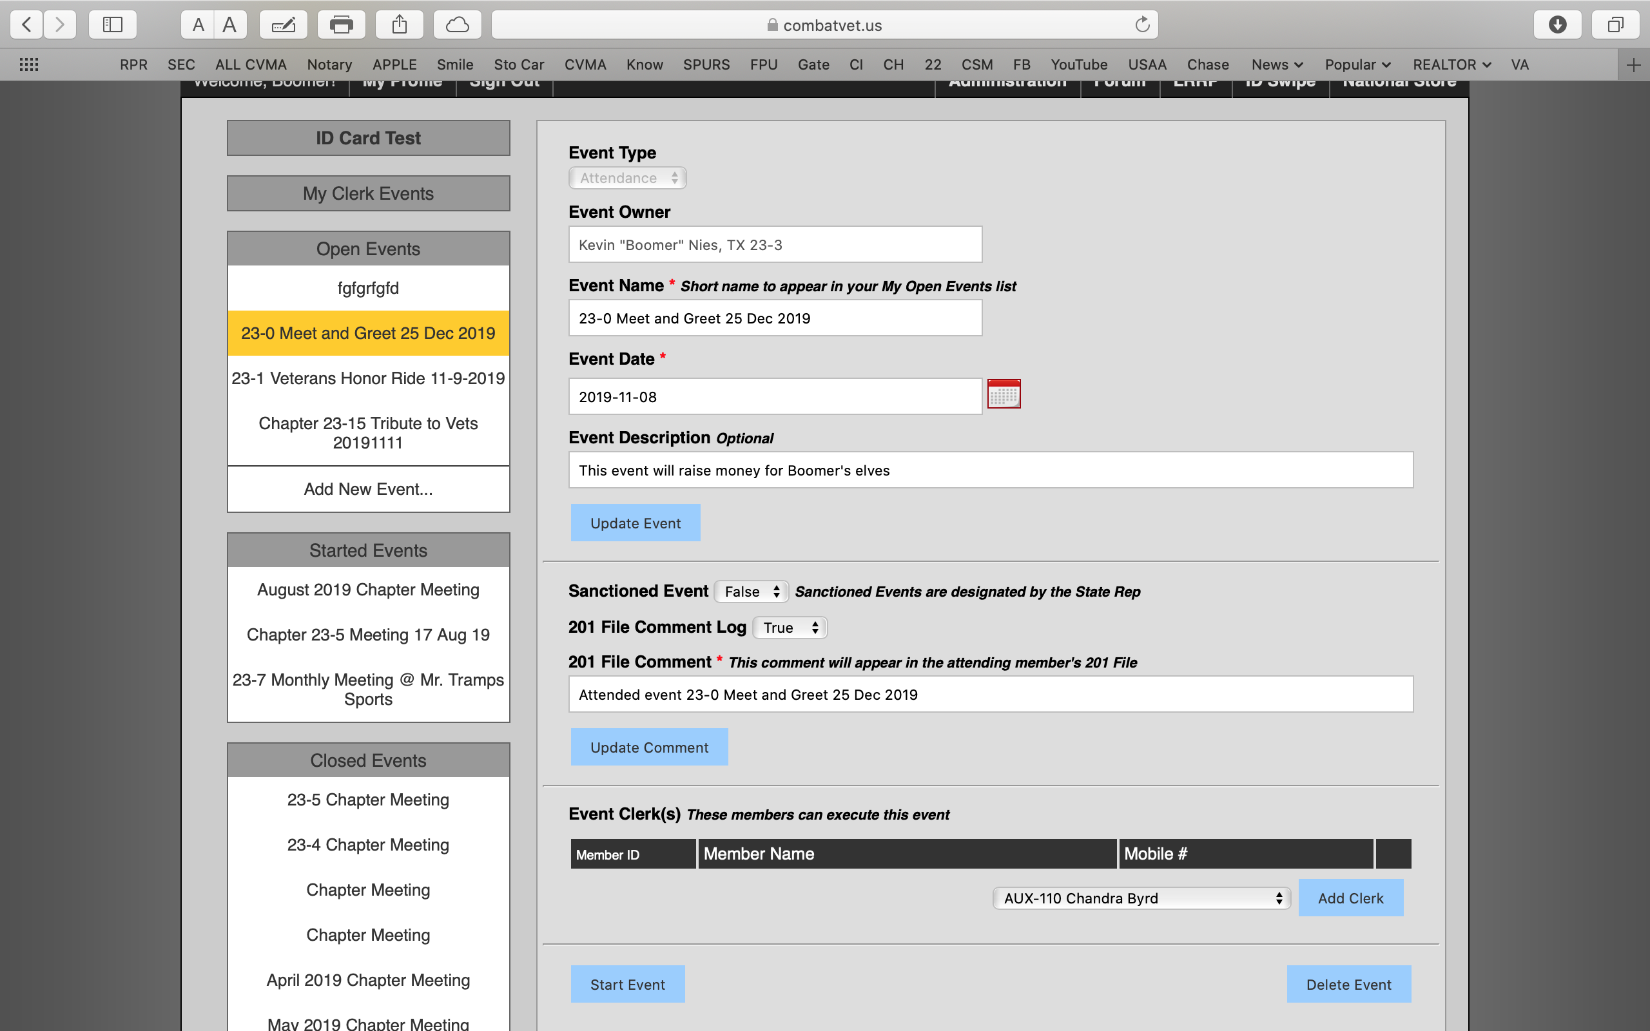


Notice the date in the Event Name pulls down to the 201 File.

Slide 8
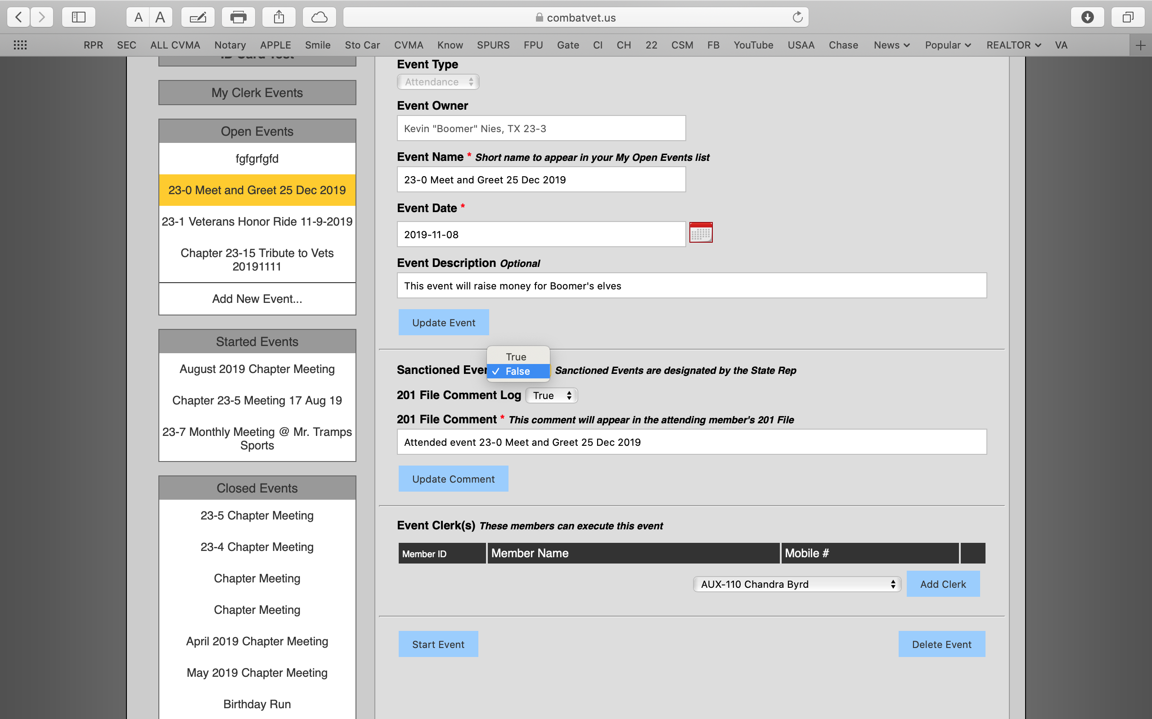

If this is going to be a sanctioned event, only the SR can annotate this box as true. Please have event loaded 72 hours prior to the event to give the SR enough time to annotate as Sanctioned.
Only sanctioned events and disciplinary actions should be annotated on the 201 at the chapter level.

Slide 9
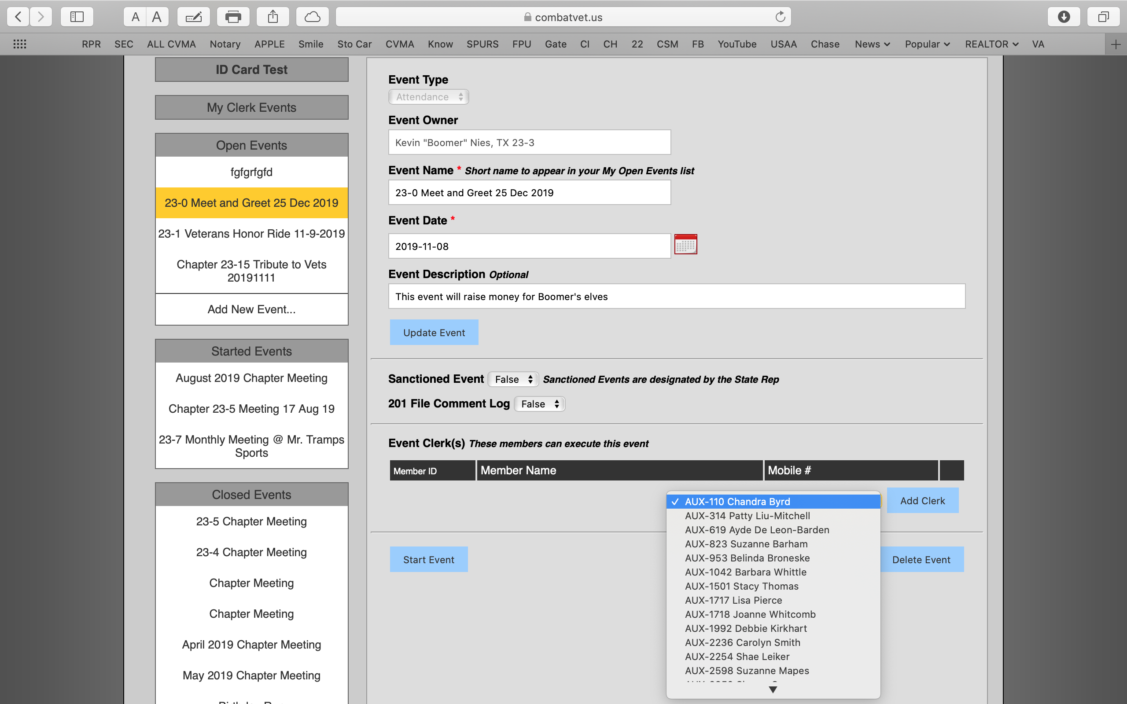


Do not forget to click on Update Event.
You can add a clerk to help with the event if they have their own computer and their own card swipe. You can add as many clerks as you need. Clerks will login under their own account.

Slide 10
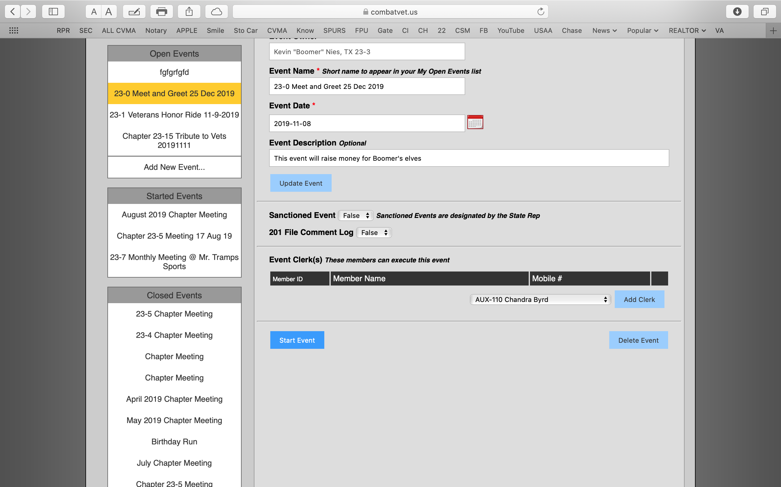

Click on Start Event

Slide 11
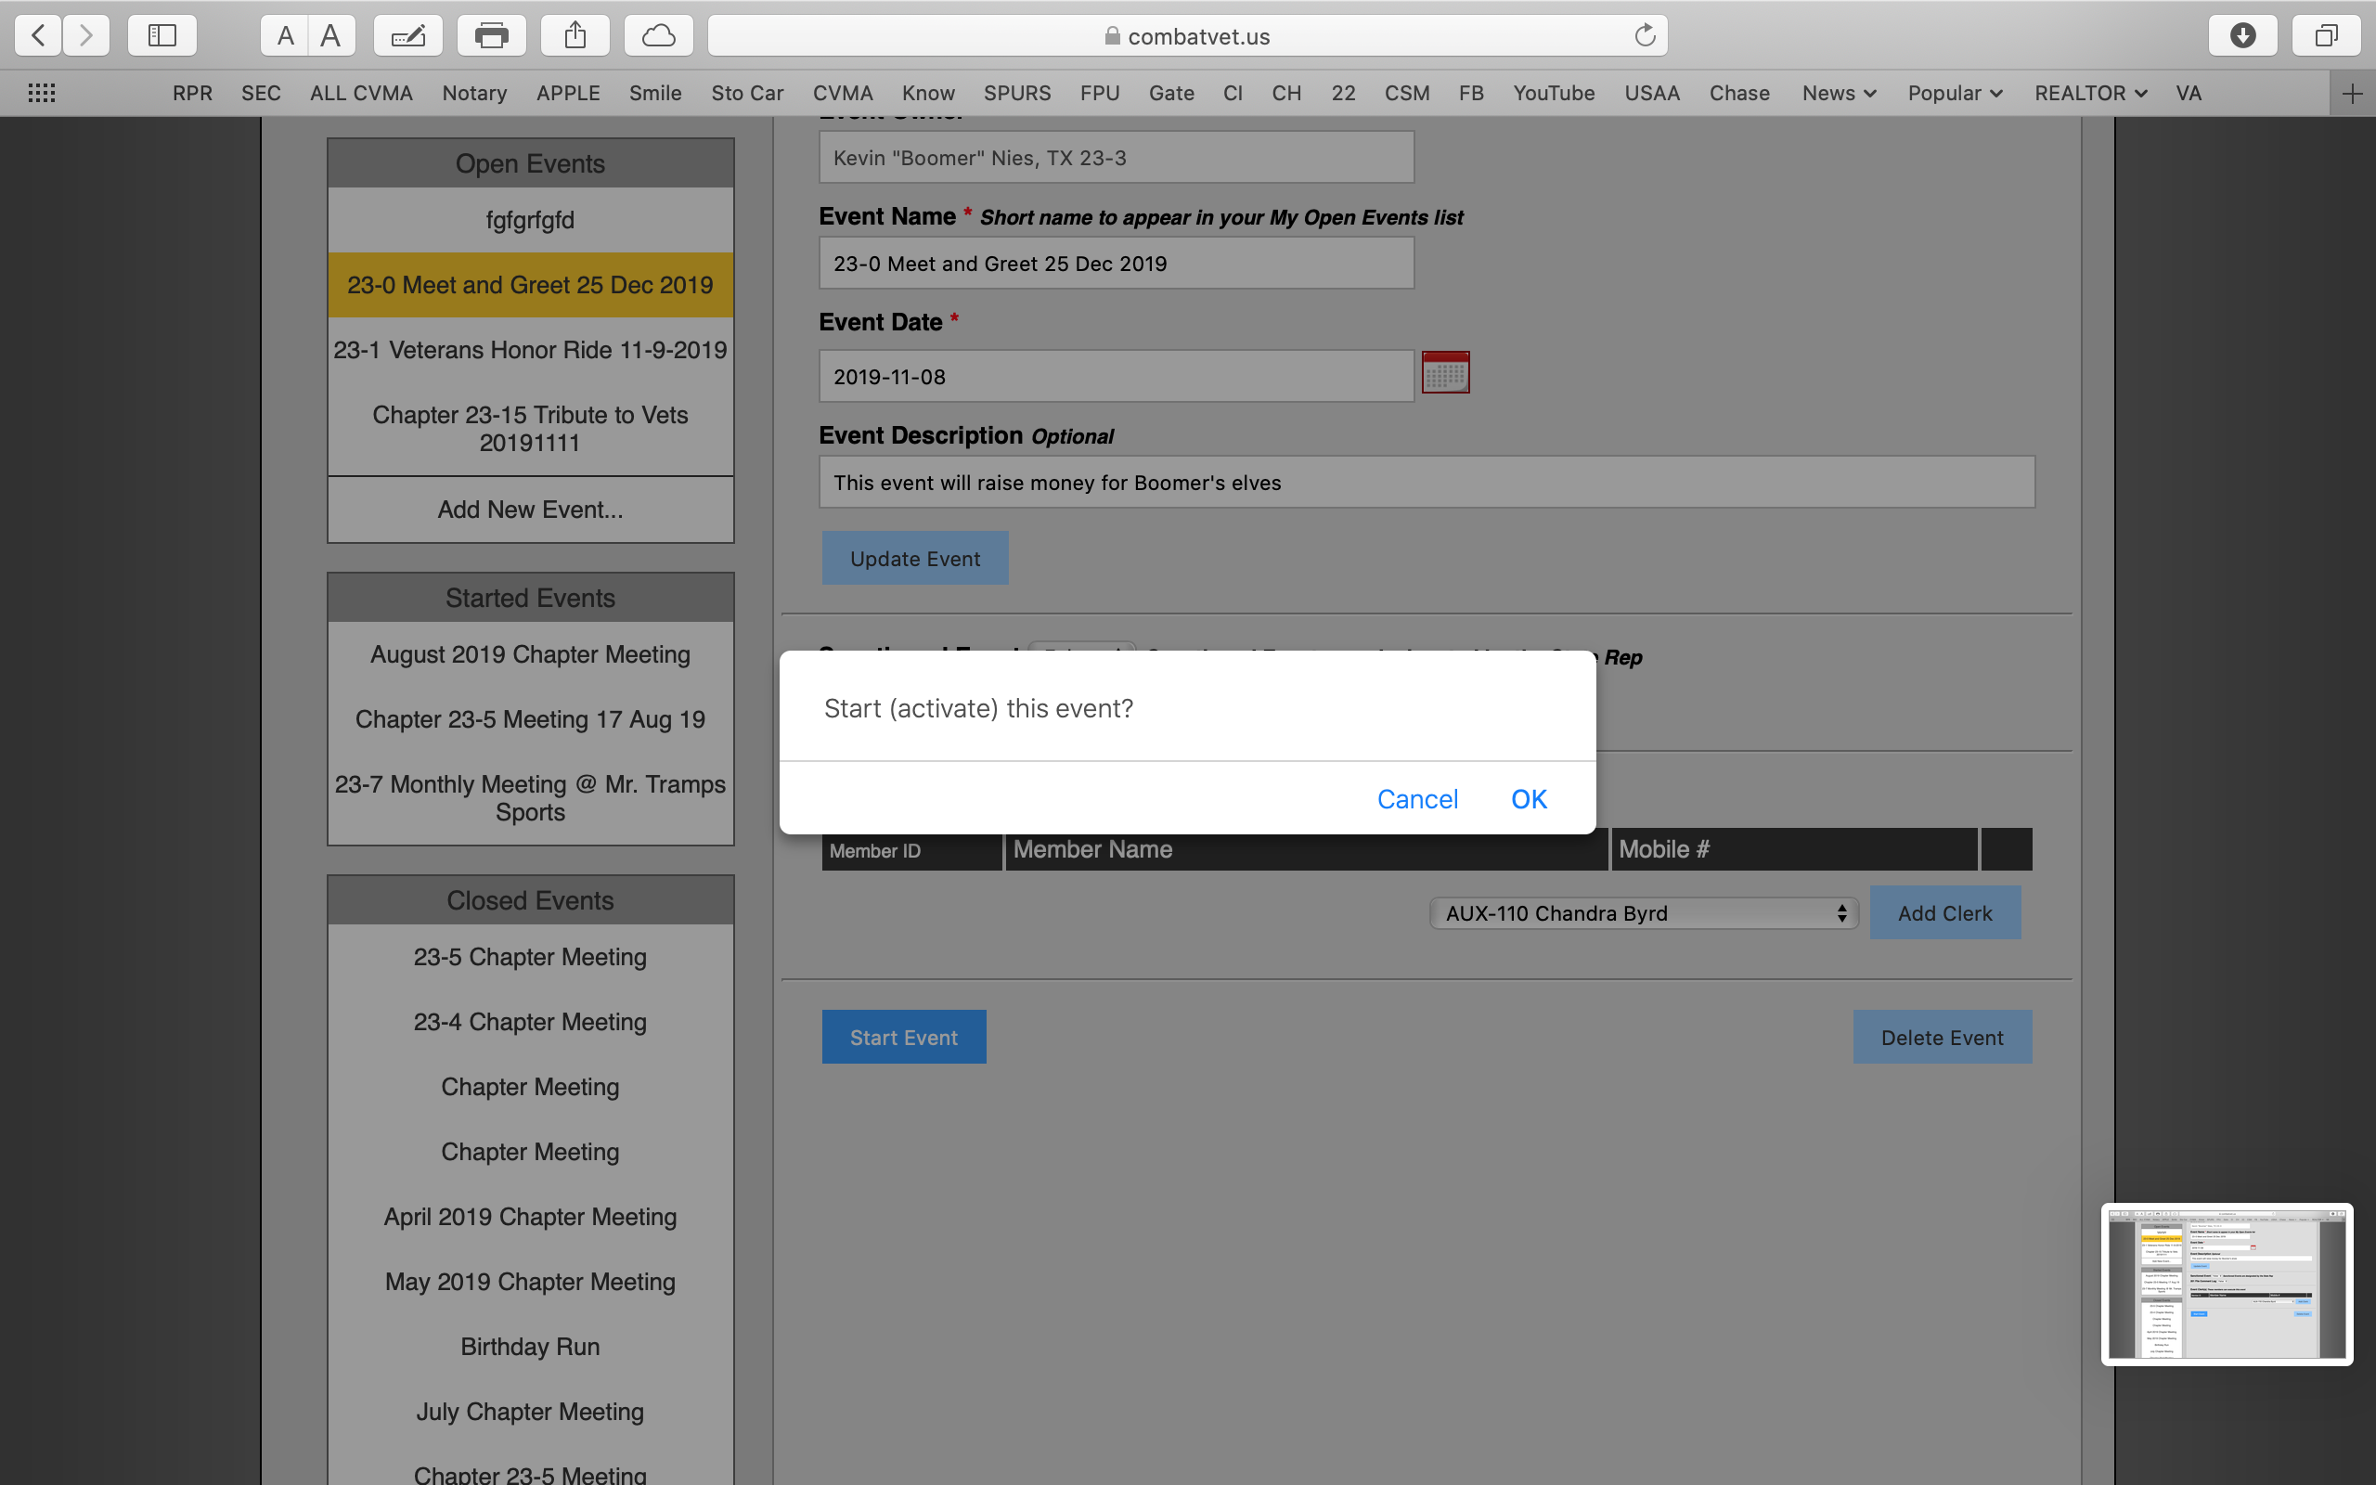

If you are ready to start the event click OK. If not, click Cancel

Slide 12
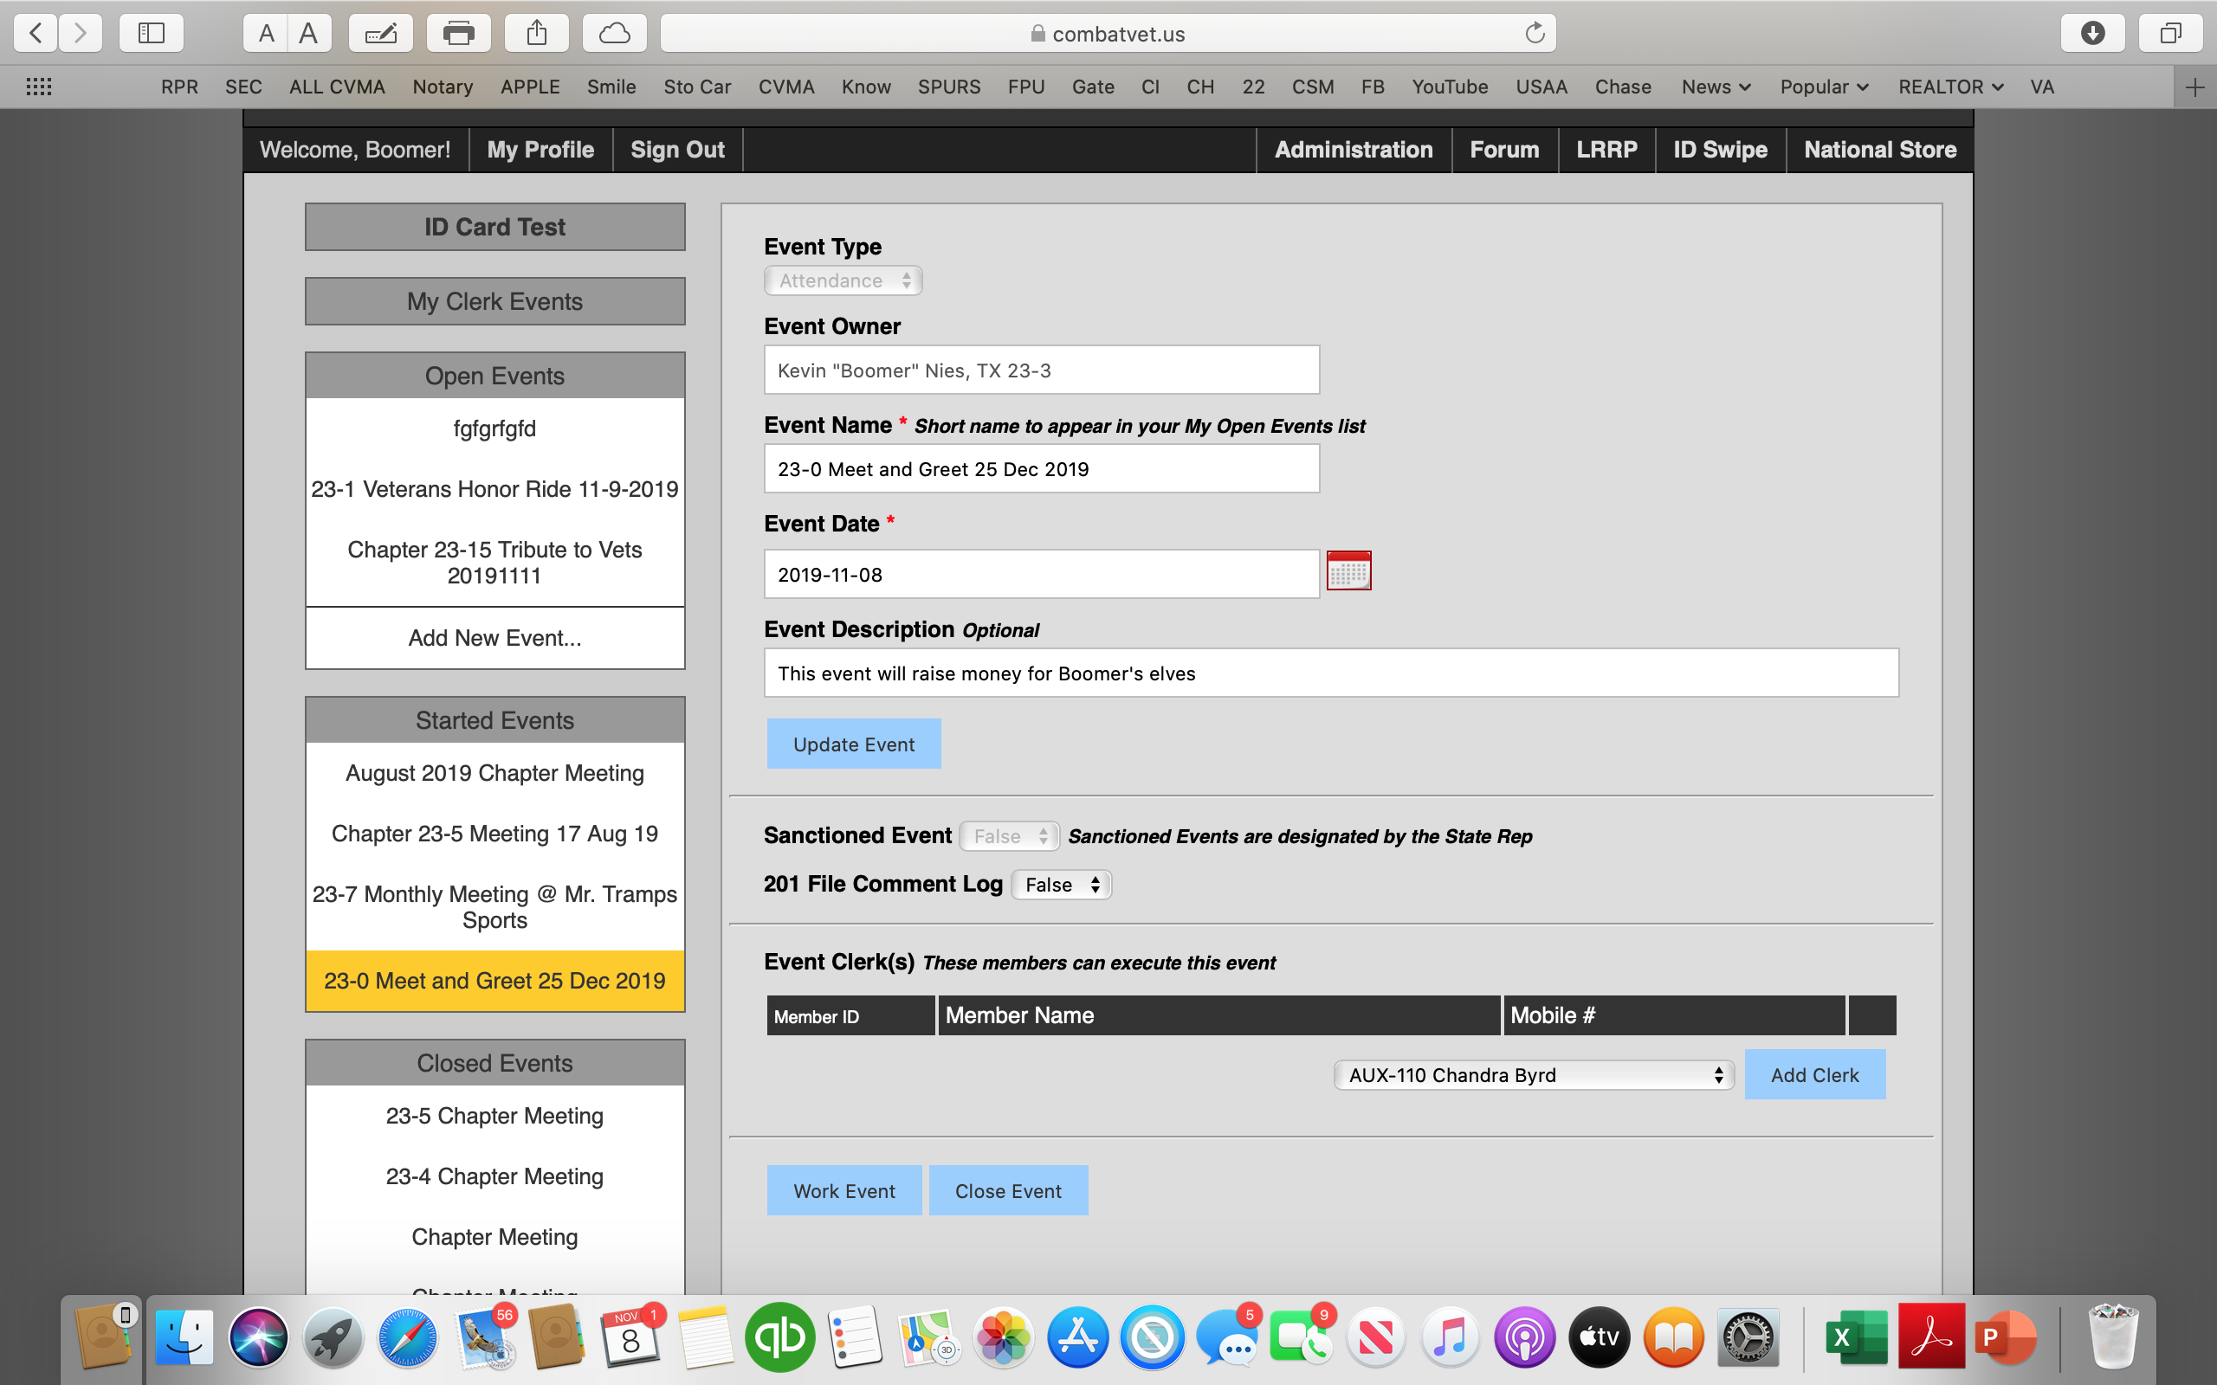



Your event will now be located under Started Events.
You can now click on Work Event to swipe in ID Cards.

Slide 13
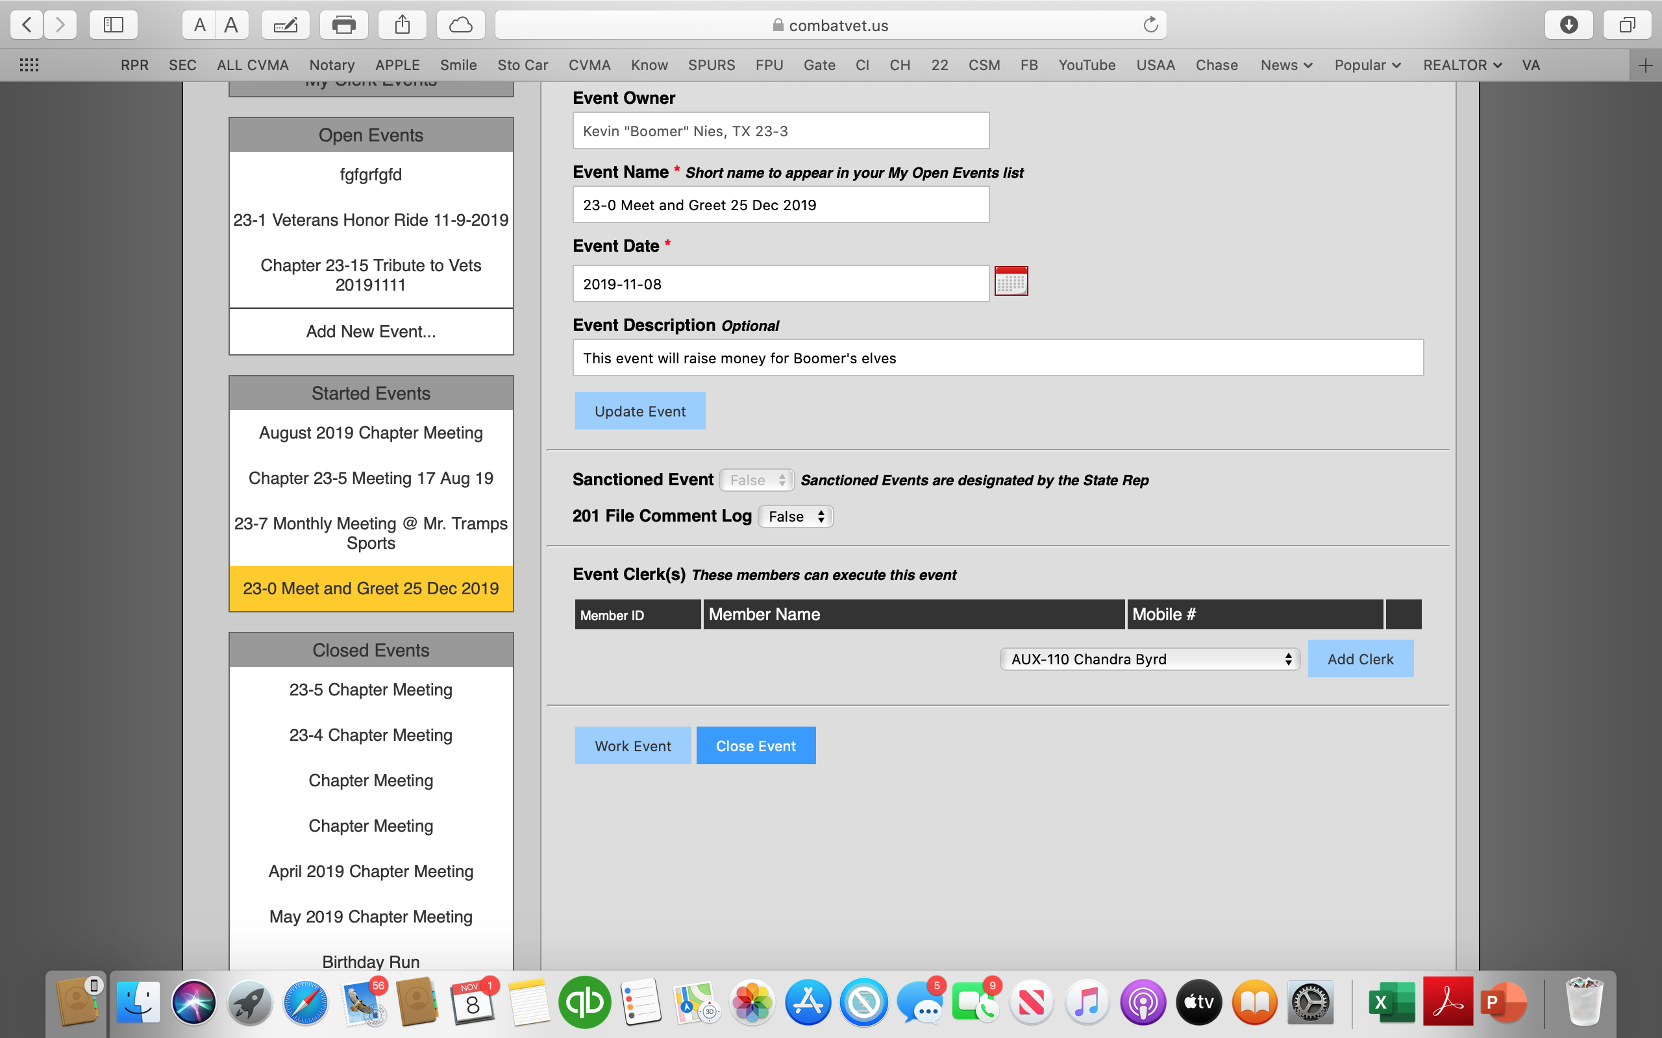


Now that the event is over click on Close Event.
This will now move your event to the Closed Event Section

Slide 14
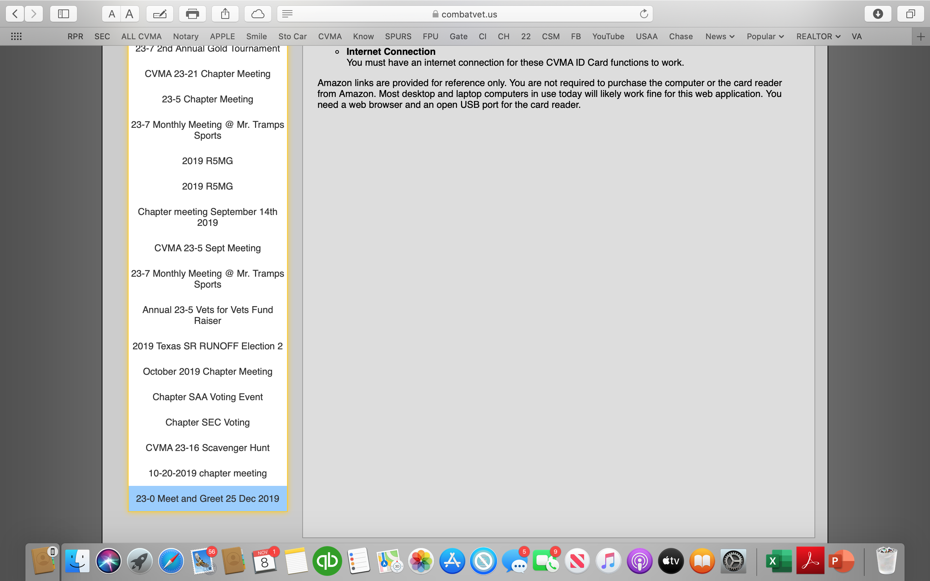

Find your event in the Closed Event section and open it.

Slide 15
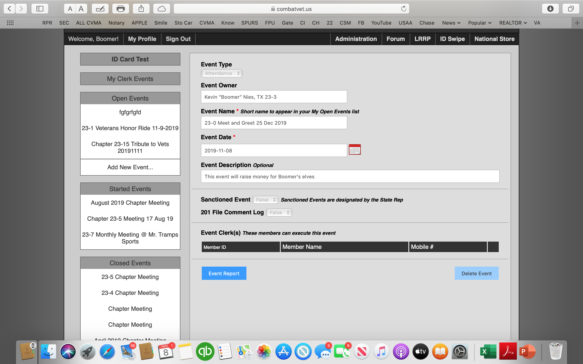

Click on Event Report

Slide 16
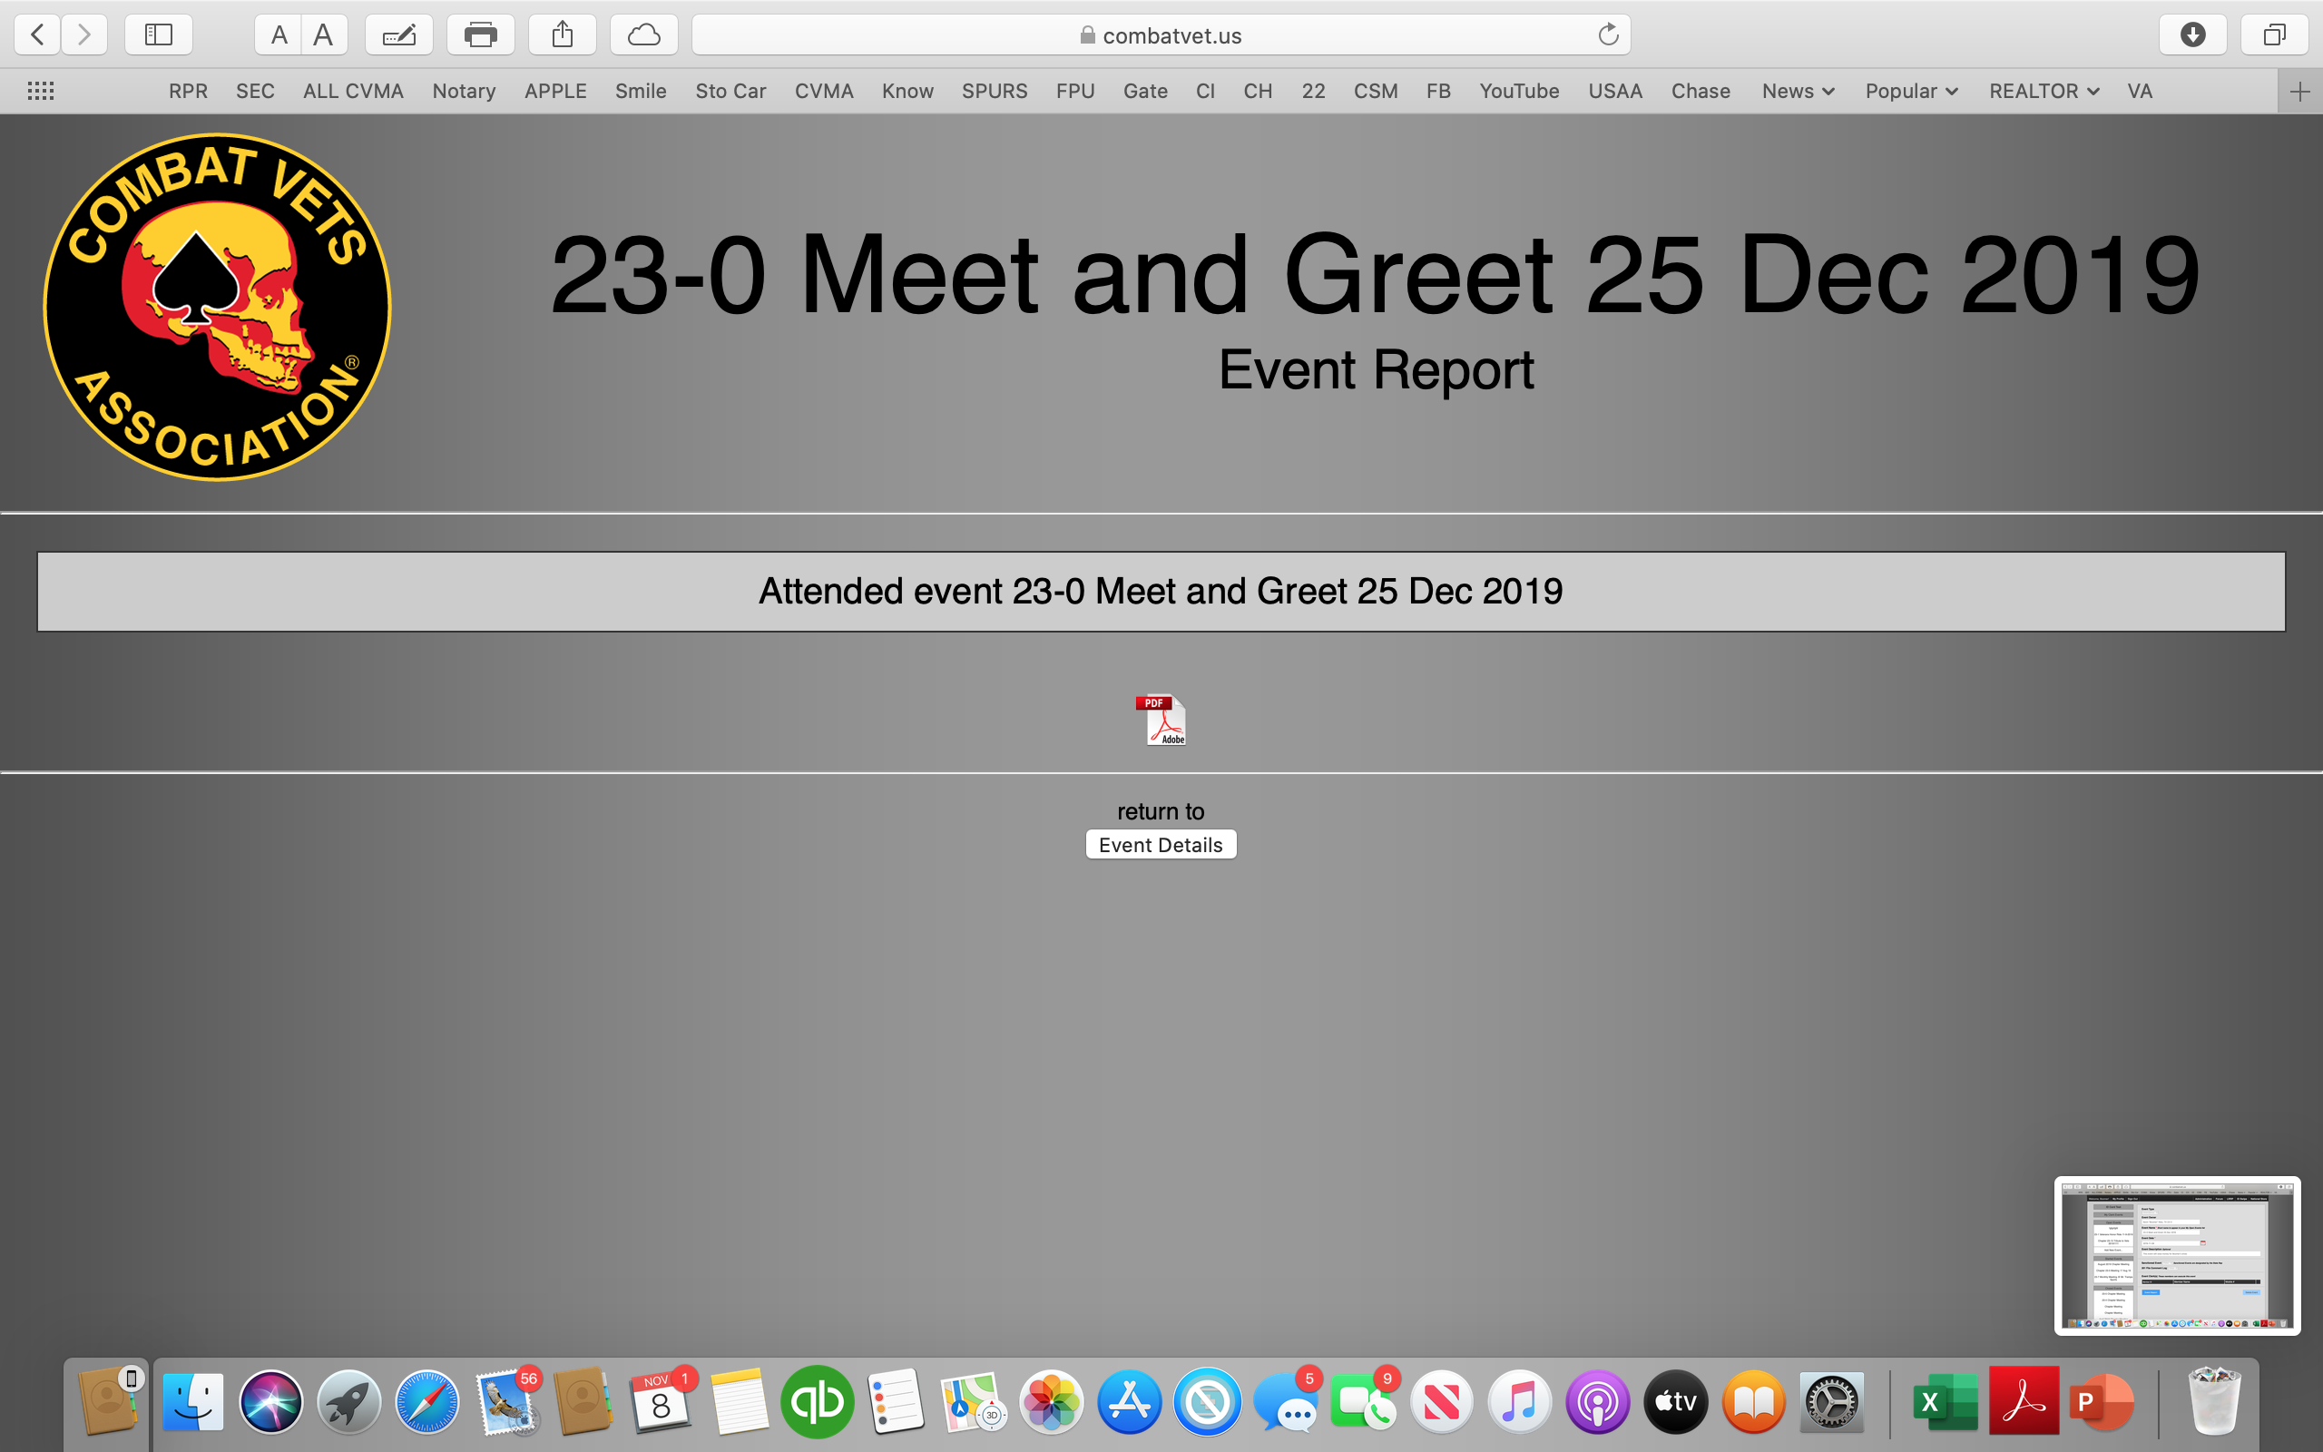

Click on .pdf file and save it to your computer.

Slide 17
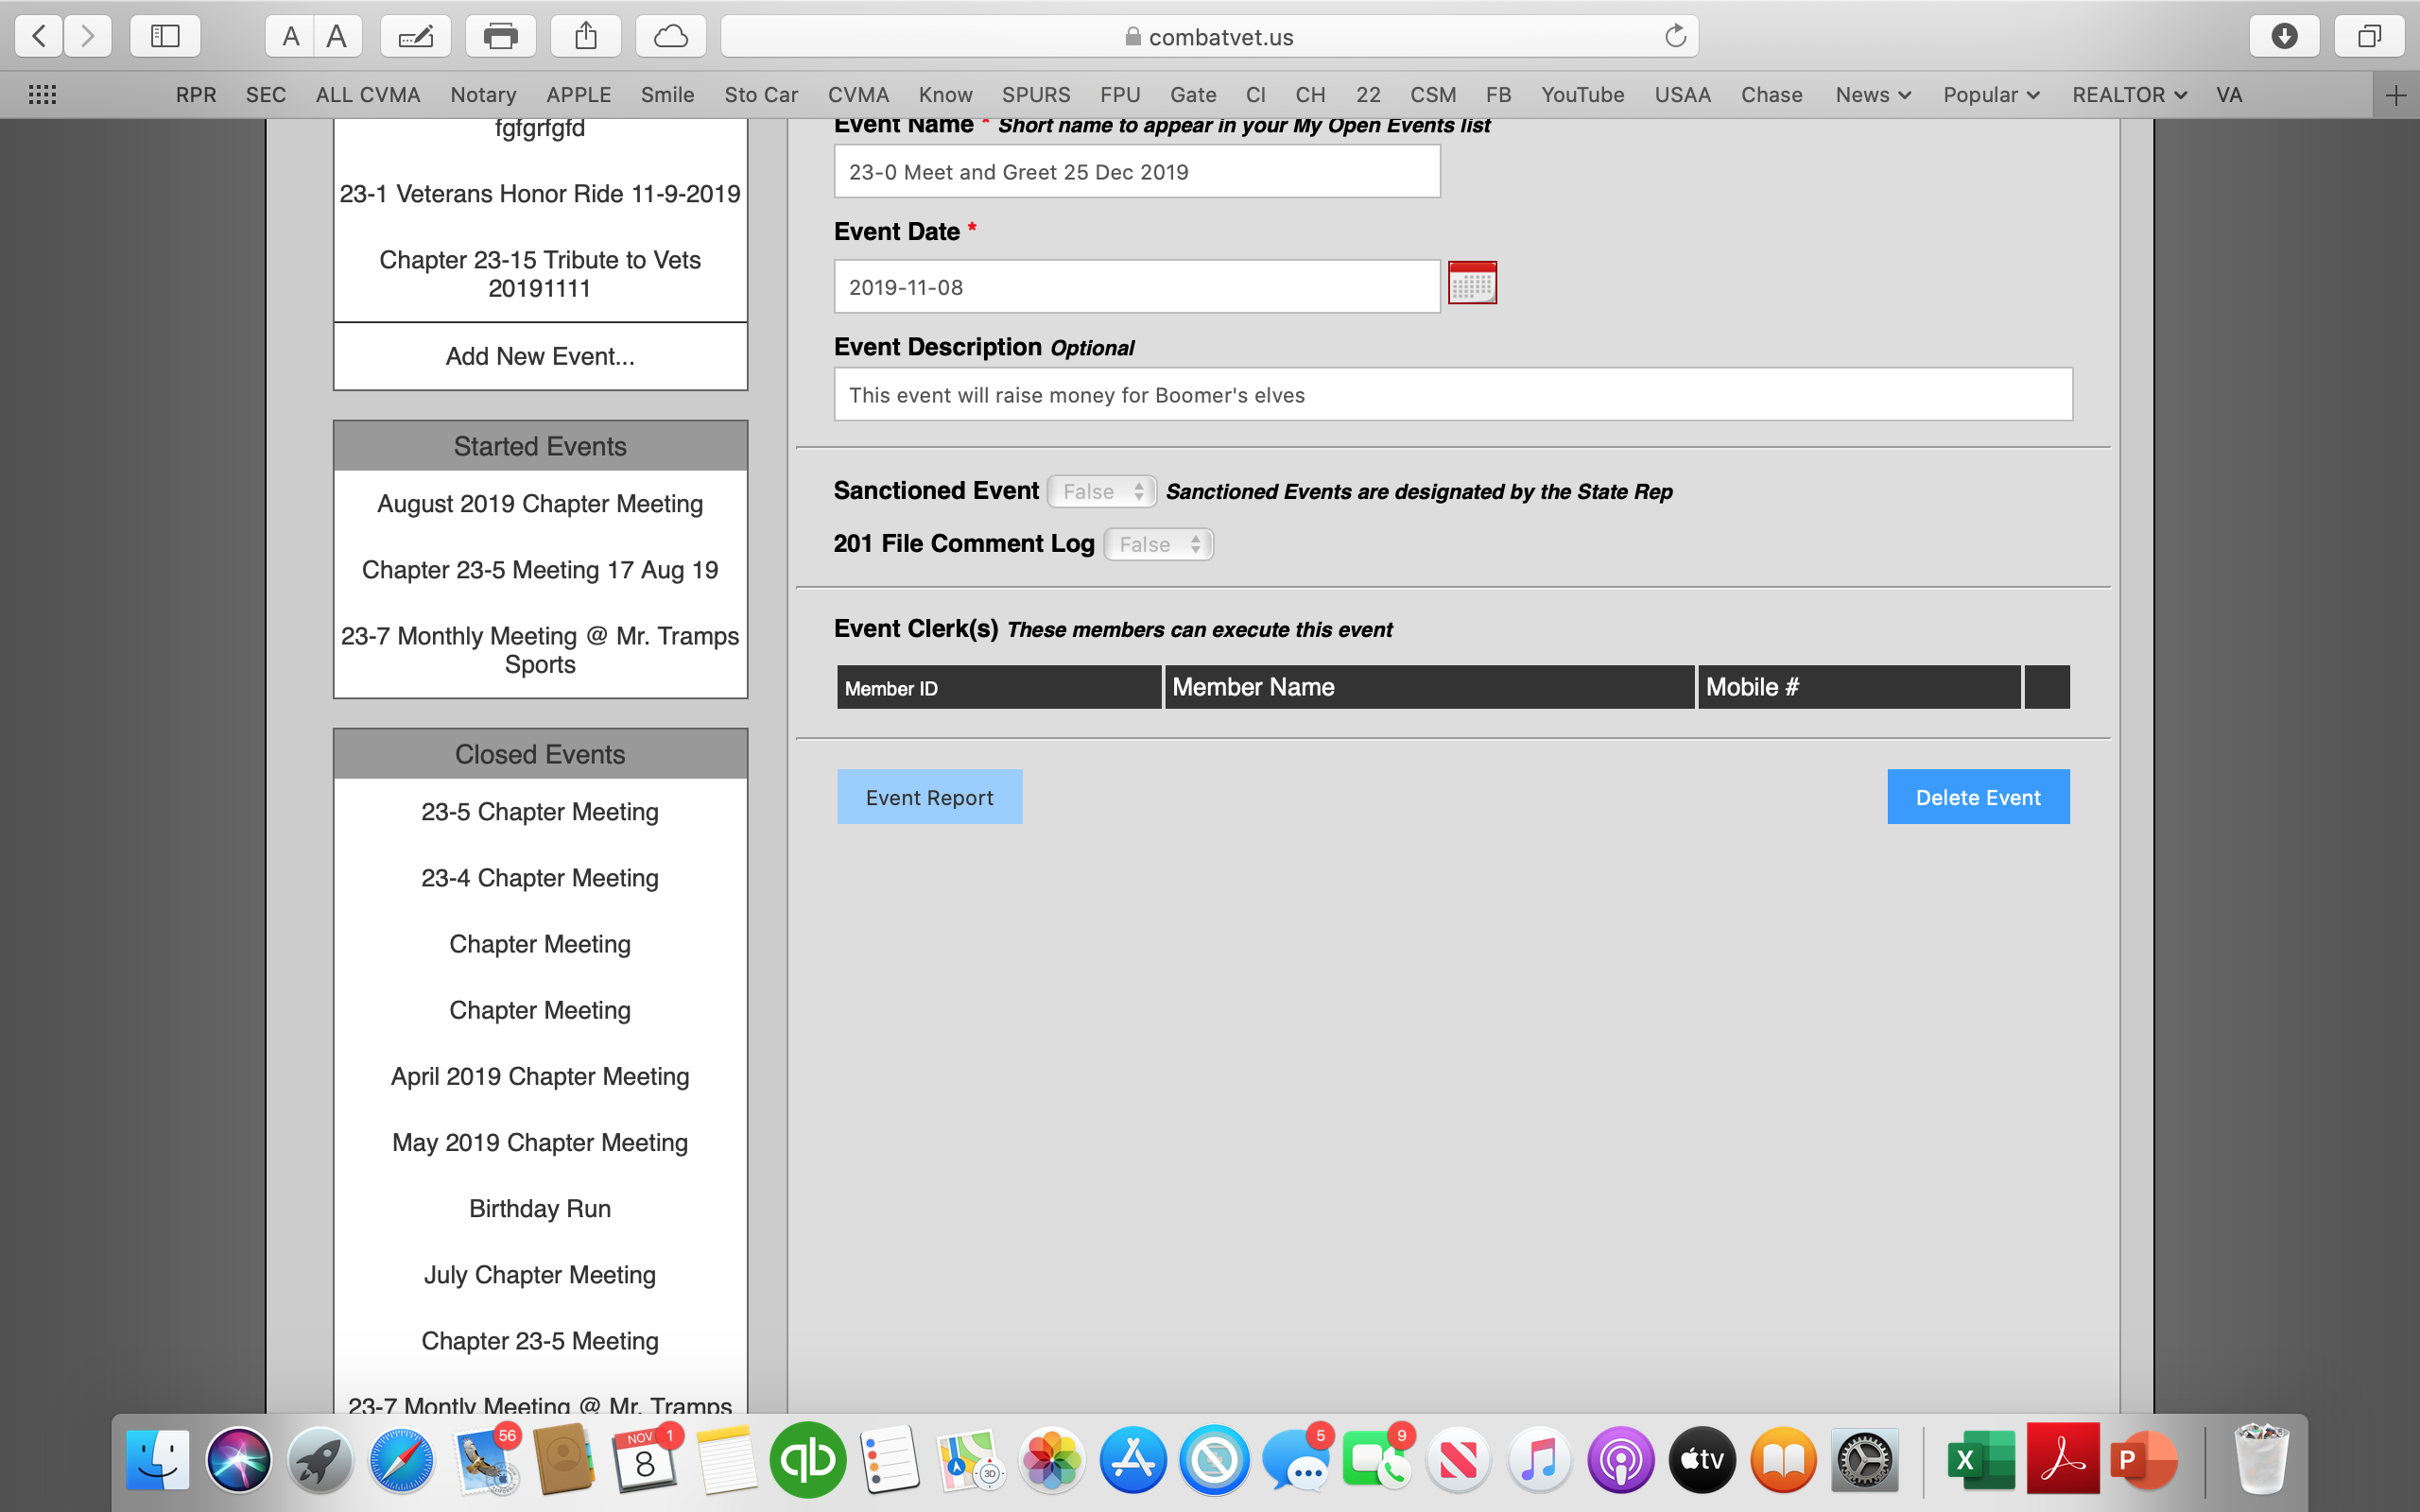

After you have saved your .pdf file to your computer go back and click on Delete Event.
After you click on Delete Event you click Ok to delete the event from the ID Card Swipe area

Slide 18
