Slide 1

Windows 11 & AI
What It Is, What You Control, and What You Don’t Have to Use

Slide 2

Why We’re Here Today
Growing Importance of AI AI technologies are increasingly present in our daily routines, from smartphones to home appliances.
Clarifying AI Concepts Today's presentation will help explain what AI is and how it works.
Addressing Concerns and Misconceptions We aim to ease any worries about AI by providing straightforward information and answers.
Notes:
In this slide, we will talk about why we are discussing AI and its impact on our daily lives. It is important to understand how AI is becoming a larger part of our everyday activities and how this presentation can help clarify any confusion or worries you may have about AI.

Slide 3

Reassurance
Familiar Interface Windows 11 can look and feels much like previous versions, making it easy to navigate.
AI Features are Optional You can choose to use AI features or ignore them completely.
No Pressure to Change Adapting to new technology is a personal choice; you can continue using your computer as you always have.
Notes:
It's crucial to reassure our senior audience that they are not required to adopt new technologies if they don't want to. Windows 11 is designed to feel familiar, and AI features can be bypassed.

Slide 4

What Is AI? (Plain English)
Simple Definition Artificial Intelligence, or AI, refers to computer programs that can perform tasks to make our lives easier.
Pattern Recognition AI identifies patterns based on rules set by humans, allowing it to learn from data.
No Independent Thinking It's important to know that AI does not think or make decisions like humans; it follows programmed instructions.
Notes:
In this slide, we will explain what Artificial Intelligence (AI) is in very simple terms, ensuring that everyone can grasp the basic concepts. AI helps us understand how technology can assist us daily, especially for seniors who may feel overwhelmed by new advancements.

Slide 5

AI You’ve Already Used
Email Spam Filters Automatically sorts and filters unwanted emails, helping keep your inbox organized.
Autocorrect Features Corrects spelling and grammar mistakes in text messages or emails, making communication easier.
Photo Recognition Technology Identifies and organizes photos based on faces or objects, simplifying photo management.
Notes:
In this slide, we will explore some of the AI technologies that many seniors might already be using in their daily lives, often without even realizing it. Understanding these can help demystify artificial intelligence and show its practical benefits.

Slide 6
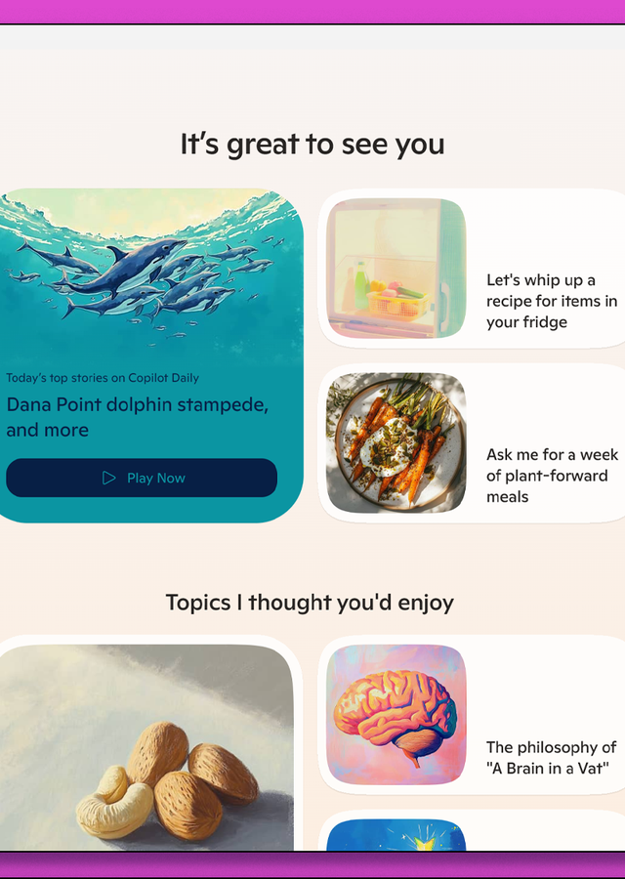
Where AI Shows Up in Windows 11
Search Suggestions AI enhances search results, providing more relevant options as you type.
Photos App Functionality AI helps organize and edit photos, suggesting improvements automatically.
Voice Typing AI enables voice-to-text functionality, allowing easier text input without typing.
Notes:
In this slide, we'll explore some of the specific features in Windows 11 that utilize AI technology. These features are designed to make your computing experience smoother and more intuitive, especially for seniors. We'll discuss how these tools can help you in your daily tasks and make using your computer easier.

Slide 7

Important Reassurance
AI Features Are Optional Most AI features in Windows 11 are not required and can be easily turned off.
No Impact on Performance Your system will perform well even if you choose not to use any AI functionalities.
Windows Works Well Without AI Windows 11 will continue to operate effectively without engaging AI features.
Notes:
Today, I want to reassure you about Windows 11 and its AI features. Many people sometimes worry about how new technologies like AI might affect their computing experience. It's important to know that you have options and control over these features. Let's go through some key points to clarify this.

Slide 8

How AI Can Help (The Good)
Reduces Typing Effort AI tools can help seniors write emails and messages faster with voice-to-text features.
Improves Search Functionality AI enhances search engines to provide more relevant results, making it easier to find information.
Aids Photo Organization AI can automatically sort and tag photos, helping seniors keep their digital memories organized.
Notes:
In this slide, we will explore the beneficial aspects of AI that can assist seniors in their daily activities. These technologies do more than just simplify tasks; they also enhance our quality of life by making technology easier to use. Let’s look at how AI can reduce typing efforts, improve search capability, help organize photos, and make technology more accessible to everyone, especially seniors.

Slide 9

Real Benefits for Seniors
Voice Typing Seniors can easily dictate text using voice recognition, reducing the need for typing.
Assistance with File Retrieval AI can help locate documents and photos quickly, saving time and effort.
Reading Support AI can read text aloud, helping those with vision impairments to engage with books and articles.
Notes:
In this slide, we will explore how AI technology can significantly enhance the daily lives of seniors. The focus is on practical tools available to assist them with common tasks, making technology more accessible and beneficial.

Slide 10

AI Is Not Perfect
Tendency to Guess AI models often make educated guesses rather than providing absolute answers.
Erroneous Confidence Sometimes AI operates with a high degree of confidence, even if the answer is wrong.
Lack of Understanding Consequences AI doesn't grasp the broader implications of its actions or suggestions.
Notes:
While AI is a powerful tool, it is essential to understand that it has limitations. We will explore these limitations today to increase awareness and help manage expectations about technology. AI can help, but it's not flawless and understanding these shortcomings will enable better use of these technologies in our daily lives.

Slide 11

Things You Should Never Trust AI With
Medical Decisions AI should never replace human judgment in healthcare.
Legal Matters Relying on AI for legal advice can lead to serious complications.
Financial Advice AI tools may provide guidance, but financial decisions should be made by professionals.
Notes:
Today, we will discuss important areas where AI should not be relied upon. While AI can assist us in many ways, there are critical areas where human expertise is essential. Let's go through these areas together to understand why caution is important.

Slide 12
Common Concerns
(And They’re Valid)
Privacy Issues
Concerns about how personal data is collected and used.
Data Handling
Fears regarding security and the possibility of data breaches.
Overwhelmed by Technology
Feeling confused or left behind due to rapid changes in technology.
Loss of Control
Anxiety over the potential of AI making decisions without user input.
Notes:
In this slide, we address the common concerns that seniors have regarding AI technology. It’s important to validate their feelings and acknowledge the challenges they face in this rapidly changing digital landscape. We will discuss privacy issues, data handling, feelings of overwhelm, and the fear of losing control over these new technologies. By providing reassurance and clarity, we can help seniors better understand these tools and empower them to make informed choices.

Slide 13

Can You Turn AI Off?
Turn Off Copilot You can disable Copilot to stop interactions.
Limit Suggested Apps and Features Turn off recommendations in the Start menu for a clean experience.
Adjust Privacy Settings Modify settings to restrict how much data AI can access.
Notes:
Today, we're discussing how you can manage AI features on your Windows 11 device. It's important to know that you have control over these technologies, and you can adjust them to suit your comfort level. Let's look at some specific examples of features that can be turned off or limited.

Slide 14

What Can’t Be Fully Turned Off (And Why)
Virus Protection Essential for detecting and removing malicious software.
Spam Filtering Helps to keep your email inbox free from unwanted, harmful messages.
Security Monitoring Continuously checks for threats to keep your system safe.
Notes:
In this slide, we will discuss important AI functions in Windows 11 that cannot be completely disabled. These features are critical for maintaining your security and ensuring your computer remains protected from threats. Understanding what these functions do can help you feel more comfortable using your device safely.

Slide 15

Simple Rules for Using AI Safely
Don’t Share Personal Information Avoid giving out your name, address, phone number, or financial details.
Be Wary of Unknown Sources Only interact with AI from trusted websites and companies.
Think Before You Click Check links and offers carefully to avoid scams or misleading information.
Notes:
In this slide, we will discuss how seniors can interact with AI safely. It's important to keep personal information secure and be aware of online interactions. Let's go through some basic guidelines that can help.

Slide 16

You Have Three Choices
Ignore AI Feel free to avoid using AI entirely if it doesn't interest you.
Use Specific Features Explore and use selected AI features that could make your life easier.
Explore Further Take time to learn more about AI, its benefits, and how it might help you.
Notes:
Today, we are discussing the three different approaches seniors can take regarding AI. It's important to understand that each choice is valid based on your comfort level and needs. Whether you want to ignore AI altogether, just try out a few specific features, or fully explore what AI can offer, each path is a personal decision and should feel right for you.

Slide 17
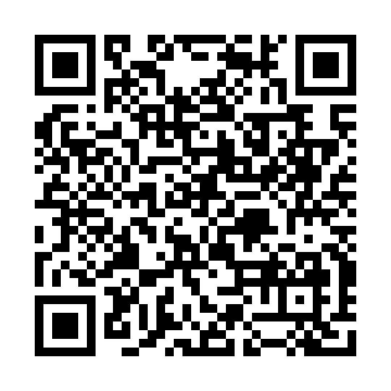
Questions & Answers

