Slide 1


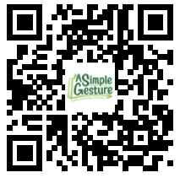
Thank You!
Your Food Donation makes a difference!
Your Pantry Needs:
Canned Meats are especially great
Cereals: healthy, &/or bran, and low sugar
Canned fruits and vegetables
Peanut Butter, other high protein spreads
Rice and Pasta; flavored rice kits
Upcoming Pick-Up Events:
August 1st
September 12th
October 3rd
November 7th
December 5th
January 9th
Please spread the word! Give this card to your friends, neighbors and co-workers to JoinSG.org, signing up is quick and easy.
Email;
info@SimpleGesture.org
More Info;
www.SimpleGesture.org
Notes:
Rohnert Park Thank You Generic

Slide 2

Sorry We Missed You!
We came by to pick up your bag of food.
But its ok! You can still participate!
Donating money is VERY HELPFUL!!! Scan the QR code.
Upcoming Pick-Up Events:
August 1st
September 5th
October 3rd
November 7th
December 5th
January 9th
Email;
Info@SimpleGesture.org
More Info;
www.SimpleGesture.org
Notes:
Healdsburg Sorry Nov 1

Slide 3


Of families in Sonoma County struggle getting food on the table
Thank you for Registering!
https://sgevents.org/378
More info? www.SimpleGesture.org
Notes:
Rohnert park church campaign with cash donation

Slide 4
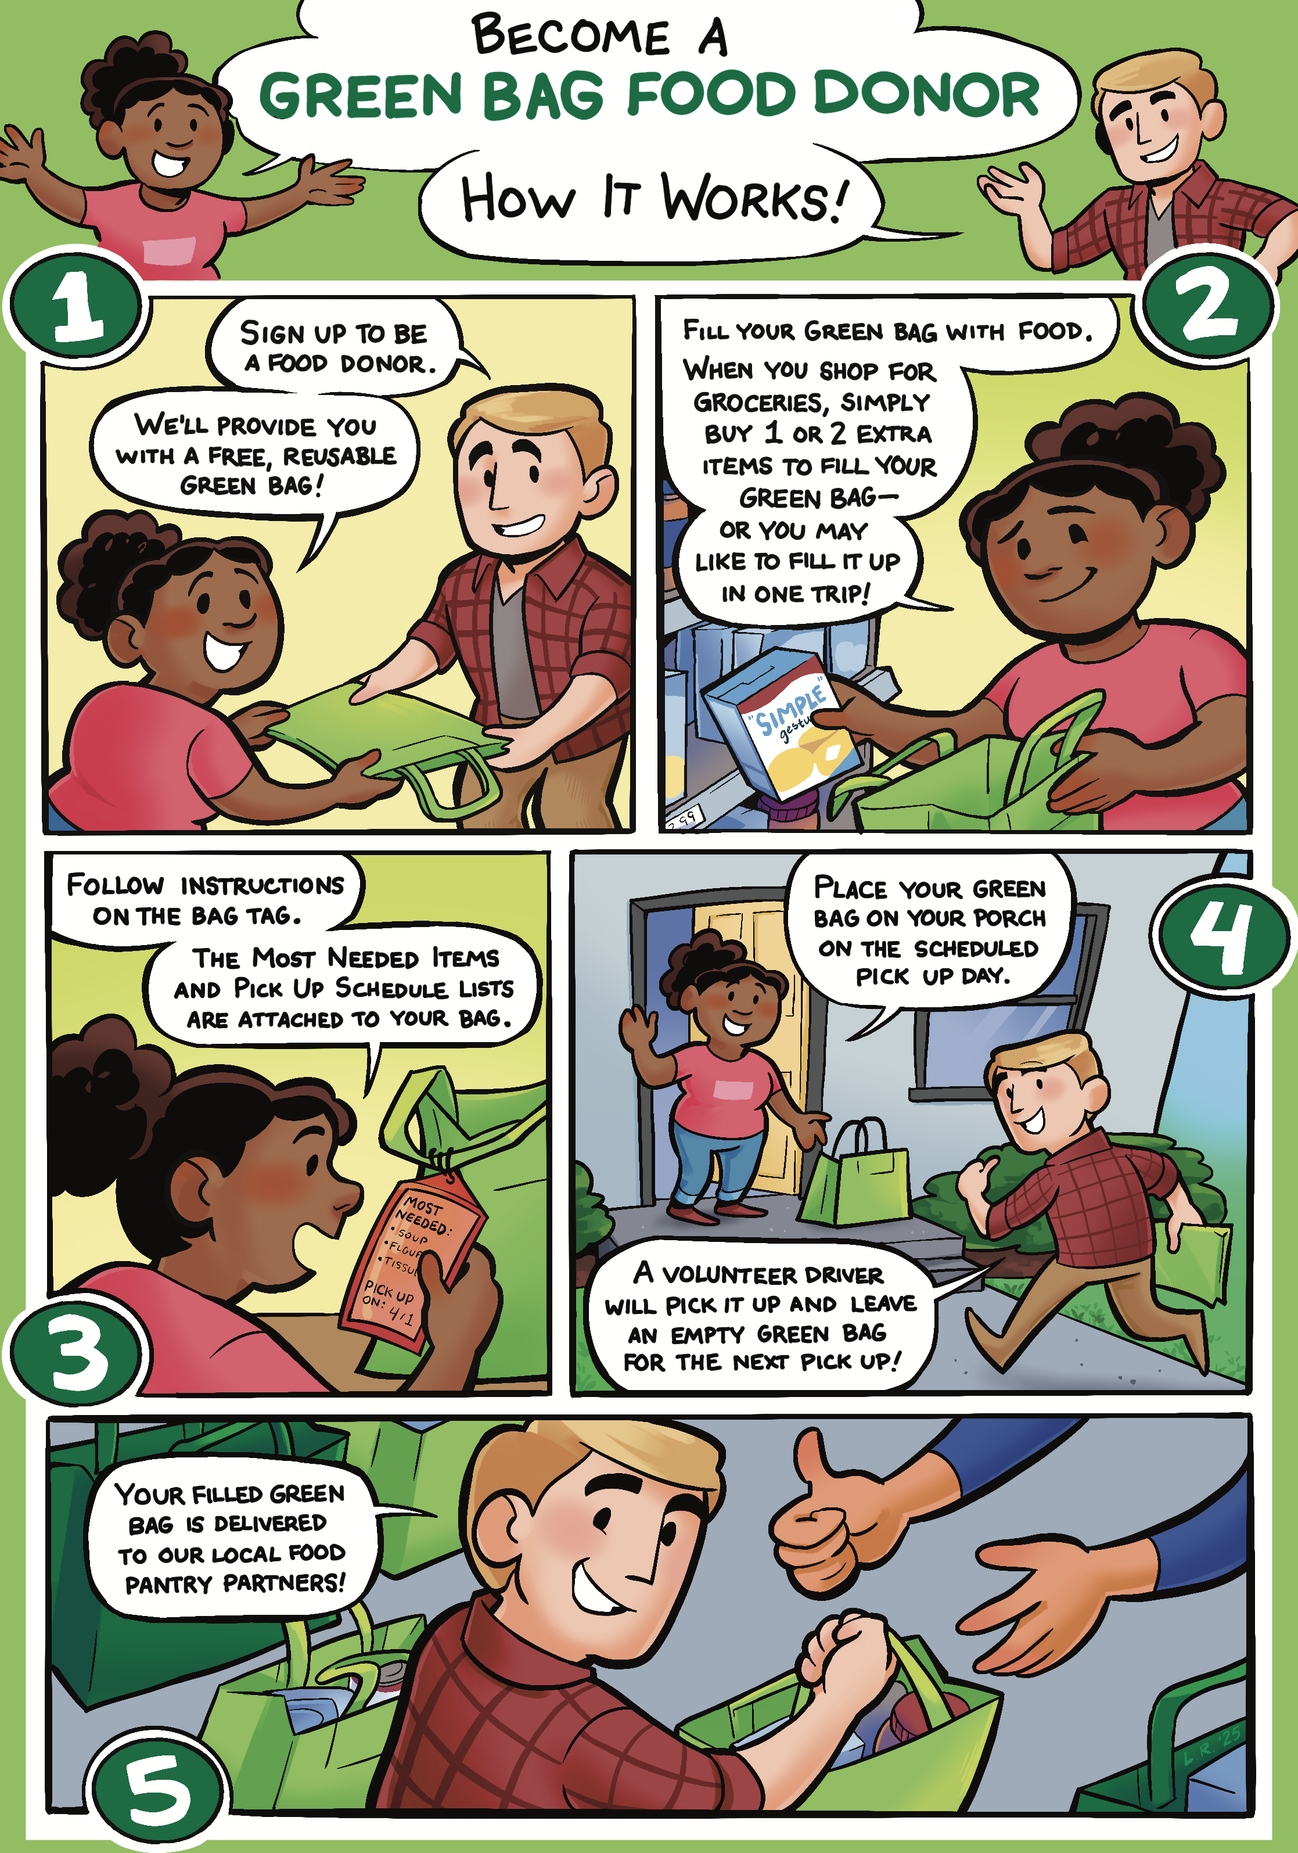
SIMPLE GESTURE Food Donor
Notes:
cartoon

Slide 5
START A CHAPTER:
Rotary clubs love it
  Members want to participate, it’s a big impact
  It doesn’t take a lot of time
  Its already very organized
  It’s a game changer for your local pantry
  It helps your community thrive
We especially need help in: Sonoma (city), Santa Rosa, Sebastopol and Petaluma
Or, just register and be a donor or driver!
For more information write to;
Info@ASGHelps.org
Web Site; www.ASGHelps.org
Notes:
Rohnert Park Thank You Generic

