Slide 1



Logos you might want to use
helps
info@ASGhelps.org
helps

Slide 2
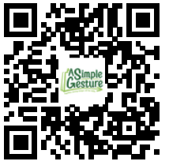
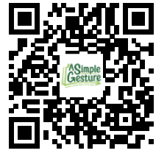
Sorry We Missed You!
helps
We came by today to pick up your bag. If you’d still like to participate, use your phone to scan the QR CODE below.
The Next Pickup Date is:
NOVEMBER 15th
If you unable to participate in the next event, open any email from us, and click the link to open your SITE PAGE, go to EVENTS, then click “Sorry, I cannot donate”.
Go to; www.ASGEventManager.com Click “LogIn” and then click “Resend LogIn Link Email”.
More info? Use this QR Code to go to your Site Page. Log In (or request a new log in email with a link)

Slide 3
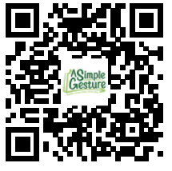
Thank You!
helps
You helped someone today.
The Next Pickup Date is:
NOVEMBER 15th
More Info? Want to change your preferences or status? Use this QR Code to go to your Site Page. Click “Profile” or “Events”
Need help logging in? After scanning, click “LogIn”, theh click “Resend LogIn Link Email”
Email any comment or question to: info@asghelps.com

Slide 4
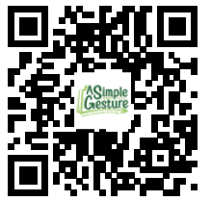
I Registered!!
I Registered!!
You Can Too!!
Leave a bag of Shelf Stable Foods on Your Doorstep, help fight hunger
The Next Pickup Date is:
__________________________________
Scan this QR Code to REGISTER and for more INFORMATION

Slide 5
Sticker
I Registered!!
You Can Too!!

Slide 6
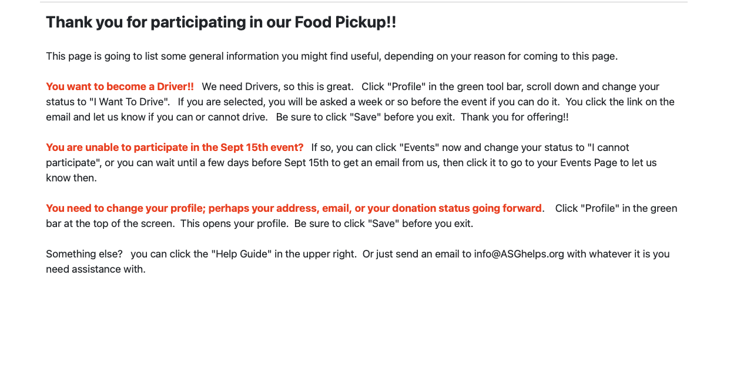
helps

