Slide 1



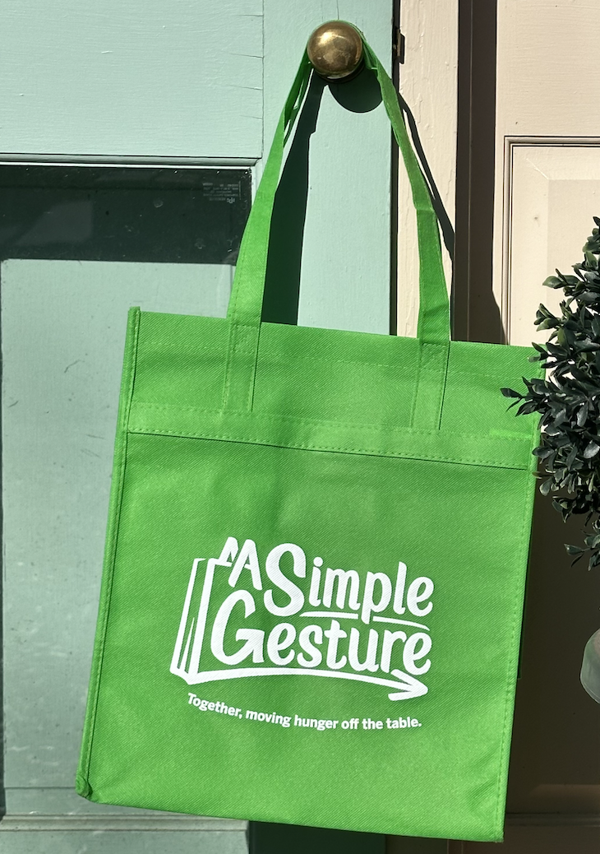
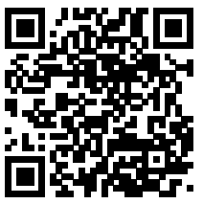
Join Your Neighbor!
Food insecurity is everywhere. 13% of our neighbors are struggling to put nutritious food on the table. Here is a simple way where YOU can make a difference. Help when you can, skip when you can’t. Its that simple.
Your Neighbor; ____________________________
is helping, can you join us?
Fill the paper bag with shelf stable foods, we will drop off a reusable bag for next time.
Needs List:
Canned Meats are especially great
Cereals: healthy, &/or bran, and low sugar
Canned vegetables
Ground Coffee
Peanut Butter, other high protein spreads
Rice and Pasta; flavored rice kits
Scan this QR Code to register, and we will be back Saturday, November 8 @ 9:00am.
Or https://sgevents.org/396
More Info: www.SimpleGesture.org
Email: info@SimpleGesture.org
Flip this card over for more info
Notes:
Rohnert Park JYN Nov 1 to Nov 8

Slide 2
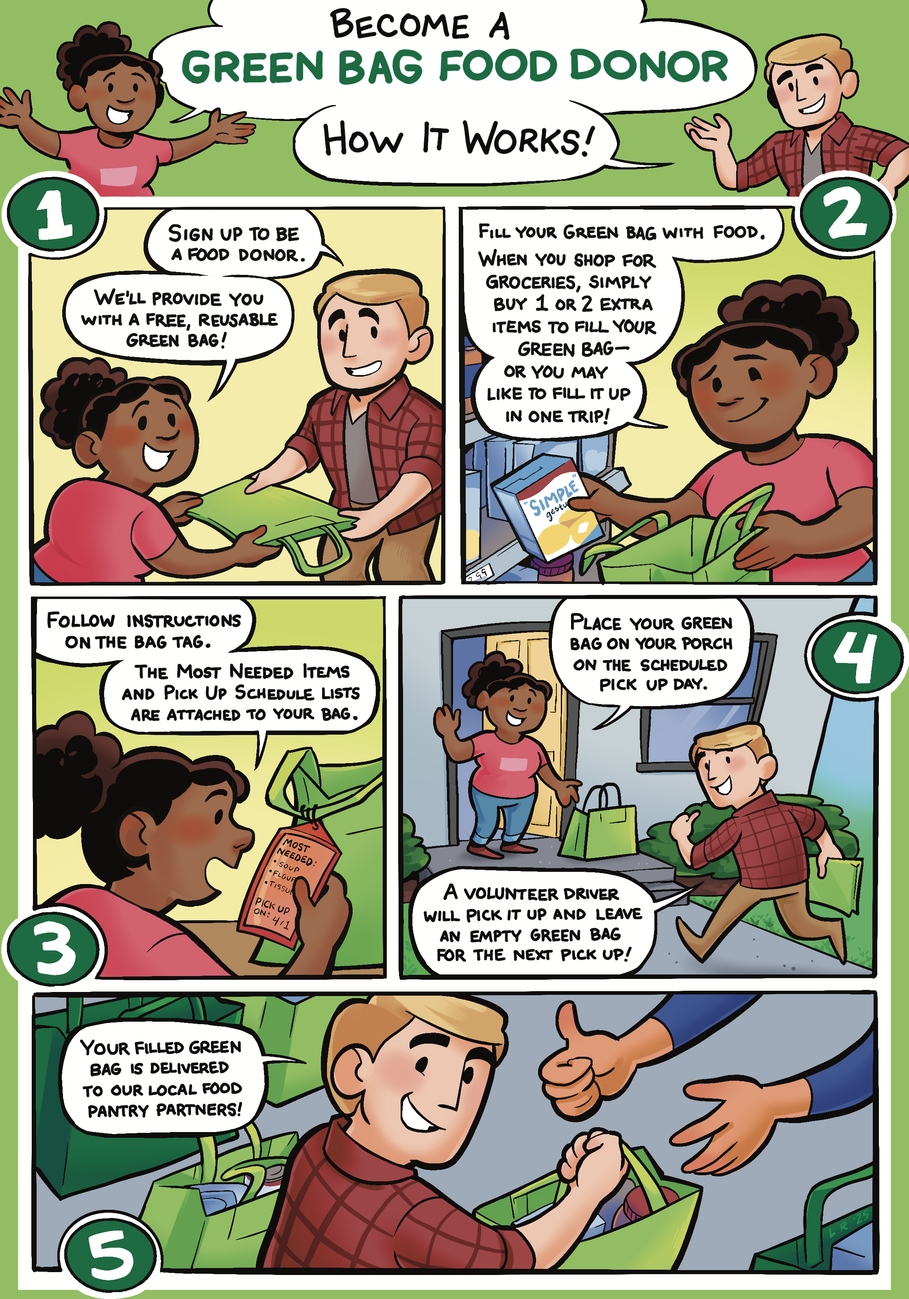
SIMPLE GESTURE Food Donor
Notes:
cartoon

