Slide 1
Welcome to the 2022 Annual Sweetwater Station HOA Meeting
The call to order will be made when a quorum is reached. The requirement is 60 members in attendance.
If a quorum is not reached by 3:15pm, the meeting will be adjourned.
February 20, 2022

Slide 2
Today’s Agenda
I. Call to Order
II. Approval of Prior Meeting Minutes
III. Annual Reports
A. President’s Report
B. Treasurer’s Report
IV. Business
A. New Business
V. Election of Board Members
VI. Adjournment

Slide 3
Agenda
Call to Order
Approval of Prior Meeting Minutes

Slide 4
2021 Annual Meeting Minutes

Slide 5
President’s Report

Slide 6
President’s Report
Board of Directors
Lost 3 directors in 2021, leaving only 6
4 expiring now
Elections today for 7 board members
New board will determine who fills the two seats with 1 year remaining on those terms
Would like to fill the ARC with other members, 2-5 members

Slide 7
President’s Report
Brief History of the HOA
Founded February 2004
Original developer left in 2010, board was created
Controlled by builders until 2017
2017 budget created a net operating loss
All management by volunteers to reduce costs
2018 amenities plan presented including increases to raise capital
2019 Landmark 24 agreed to participate in the plan
And then came COVID, paused a year on increases at $288

Slide 8
President’s Report
Amenities Plan Update
2021 vote of membership to proceed with the plan
Dues increases each year until we are $600/year (2024 will be $597)
Architectural and engineering plans are complete
General Contractor has been engaged
Awaiting construction costs from the GC
Once we have figures, begin planning to phase and finance
Groundbreaking ASAP

Slide 9
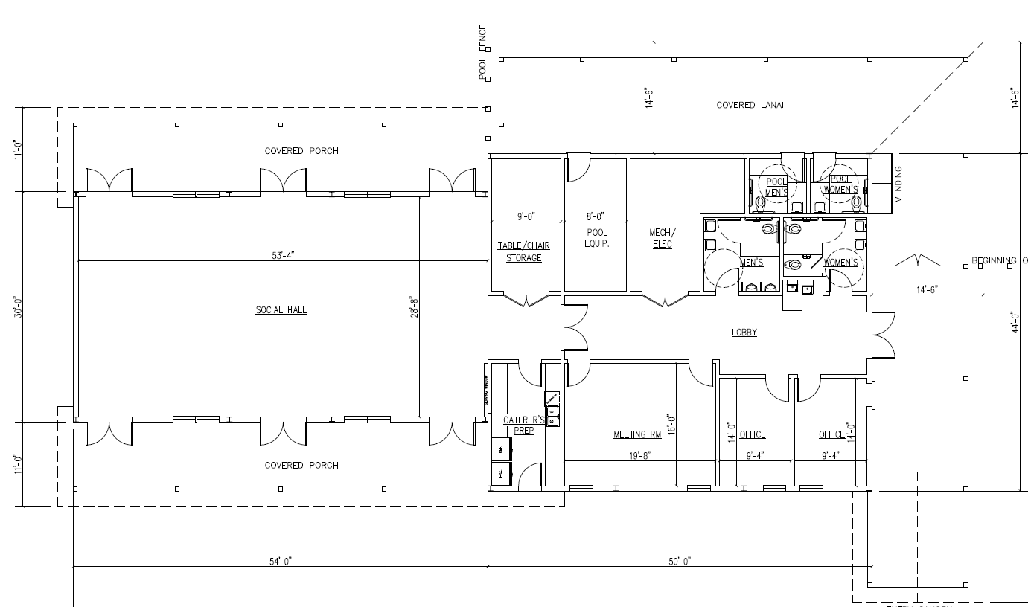

Slide 11
President’s Report
Other highlights from 2021
Entry sign cleaned and repaired
Mailbox added
Began periodic newsletters
First ever community social event, 10/30/21
Landmark 24 presented plan for the back pond shoreline
Engaged CPA firm to conduct an audit to prepare for financing

Slide 12
President’s Report
Other highlights from 2021
Collections attorney has reduced AR by 30%
Attempted to obtain 501c4 status with the IRS
Email conversion from GoDaddy
Updated website to assist realtors and closing attorneys
Landmark 24 obtained additional land, projects another 42 homes

Slide 14
President’s Report
Goals for 2022
Still considering an announcement sign in the entry to improve communication to members
Working with water quality vendor to include the back pond
Continue work with General Contractor on amenities
Further reduce the AR
At least one social event again in 2022
Continue to work toward 501c4 status
Address deficiencies in our covenants, requires 70% of members
Will need volunteers to work through changes and get signatures

Slide 15
President’s Report
Reminders
Dues are assessed annually on April 1st, due by April 30th
Interest begins to accrue if dues are late
ARC applications are required for any changes, additions, or repairs
ARC fees are only applicable for new construction, not repairs
City issues with streets, parking, speeding – Bob Dubois
We need more members to raise their voice to the City

Slide 16
Treasurer’s Report

Slide 17
Treasurer’s Report
Financials were presented at the annual meeting
Financial information is redacted from the website
Financial information is available for any member upon request

Slide 18
New Business
Open discussion

Slide 19
Election of Board Members
Nominations from the floor
Introduction of the Nominees
Ballots
Announcements of the results

Slide 20
Adjournment
Thank you for attending the 2022 Annual Sweetwater Station HOA Meeting

