Slide 1
Craig Vincent Mitchell
Assistant Professor of Christian Ethics
Action Theory

Slide 2

The History of Action Theory
Action theory has its origins in the writings of Aristotle
Action theory is often viewed as a sub-discipline of metaphysics
It is important for the study of ethics and for the study of epistemology

Slide 3
Action Theory: Definitions
An Event is something that happens at a certain time and place
An Event can be unintended
An Agent is something that can have intentions
An Action is an event with agency
Some actions are intentional and some are not

Slide 4
The Metaphysics of Action
Action theory is influenced by one’s metaphysical presuppositions
Metaphysical Realism
  Teleological Action Theory
  Actions are determined by intentionality
  Internalist Causes of Action
Metaphysical Nominalism
  Deontological Action Theory
  There are many separate events in an action
  Externalist Causes of Action

Slide 5
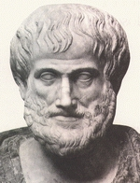
Realism: Teleological Action
Aristotle was a metaphysical realist. He held to a teleological view of action.
In general, actions are intentional.
Actions are purposive and involve reason as a cause.
Teleological views of action tell us the state of affairs toward which the behavior was directed.

Slide 6
Realism: Whole Before Parts
Metaphysical Realists believe that the whole has priority over the parts. In other words, the parts gain their identity from the whole of a thing.
An action may have many parts, but the whole of an action is determined by the intention of the agent. For John Wilkes Booth to kill Abraham Lincoln had to take his gun, aim it, and then shoot it at Lincoln. Rather than being at least three actions, it is only one action because, Booth’s intention was to kill Lincoln with the gun.

Slide 7

Realism: Internalism about Reasons
An internal reason is, roughly, something that one has in light of one's own "subjective motivational set"---one's own commitments, desires (or wants), goals, etc.
Bernard Williams (1981) argues that there are really only internal reasons for action. Such a view is called internalism about reasons (or reasons internalism).

Slide 8
Realism: Internal Reasons
For example, suppose that Sally is going to drink a glass of poison, because she wants to commit suicide and believes that she can do so by drinking the poison. Sally has an internal reason to drink the poison, because she wants to commit suicide. However, one might say that she has an external reason not to drink the poison because, even though she wants to die, one ought not kill oneself no matter what—regardless of whether one wants to die.

Slide 9
Nominalist views of Action
Metaphysical nominalism results in deontology
It can influence action theory in two ways:
David Hume argued for a Belief/ Desire view of action
Some Analytic Philosophers argued for a Causal View of Action
  Ordinary Language Philosophers deny metaphysics altogether
  Some Post- Positivist Philosophers are nominalists who accept causation

Slide 10
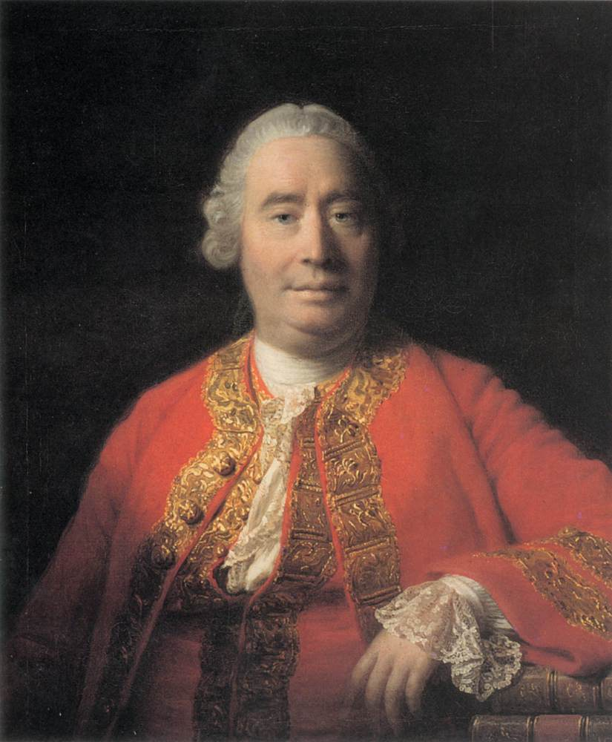
Nominalism: Deontological Action
David Hume argued that actions result from beliefs/ desires.
Hume thought that “reason is and ought always be a slave of the passions.”
Hume was a metaphysical nominalist who held to deontology

Slide 11

Nominalism: Deontological Action
G.E.M. Anscombe was an Ordinary Language Philosopher: She was a student of Ludwig Wittgenstein and wife of philosopher, Peter Geach. She was one of the founding members of the Analytical Thomism movement
She wrote: Intention, one of the first books on action theory in the last century.

Slide 12
Nominalism: Deontological Action
According to Anscombe, “Mental causes are possible, not only for actions, but also for feelings and even thoughts. In considering actions, it is important to distinguish between mental causes and motives; in considering feelings, such as fear or anger, it is important to distinguish between mental causes and objects of feeling.” G.E.M. Anscombe, Intentions (Cambridge, MA: Harvard University Press, 2000), 16.

Slide 13

Nominalism: Deontological Action
Donald Davidson was a Post Positivist Physicalist (1917-2003) who wrote the article “Actions, Reasons, and Causes.”
He was a nominalist who admitted to the existence of the material and efficient causes. He rejected the formal and final causes.
Davidson argued that intentions provide reasons
Davidson argued that reasons are causes of actions

Slide 14
Nominalism: Deontological Action
According to Davidson, “A reason rationalizes an action only if it leads us to see something the agent saw, in his action- some feature, consequence, or aspect of the action the agent wanted, desired, prized, held dear, thought dutiful, beneficial, obligatory, or agreeable.” Donald Davidson, “Actions, Reasons, and Causes” Journal of Philosophy 60 (1963).

Slide 15
Nominalism: Parts before Wholes
Metaphysical nominalists believe that the parts have priority over the whole. In other words, the parts have their own identities.
For John Wilkes Booth to kill Abraham Lincoln had to take his gun, aim it, and then shoot it at Lincoln. There are at least three separate actions that were involved in killing Lincoln.

Slide 16
Nominalism: External Reasons
an external reason is something that one has independent of one's subjective motivational set.
Externalism about reasons (or reasons externalism) is the denial of reasons internalism (Finlay & Schroeder, 2008, §1.1). It is the view that there are external reasons for action; that is, there are reasons for action that one can have even if the action is not part of one's subjective motivational set.

Slide 17
Conclusion
Action theory plays an important role in philosophy of mind, because intentionality is an important part of action and action is involved in emotion.
Action theory is import to ethics, because ethics involves actions.
Action theory is important to epistemology, because knowledge acquisition involves actions.
Action theory is heavily influenced by metaphysical presuppositions.

