Slide 1
Aristotle and Aquinas on Politics
Craig Vincent Mitchell, PhD
Assistant Professor of Christian Ethics
Southwestern Baptist Theological Seminary

Slide 2
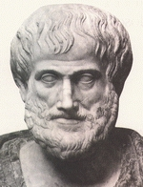
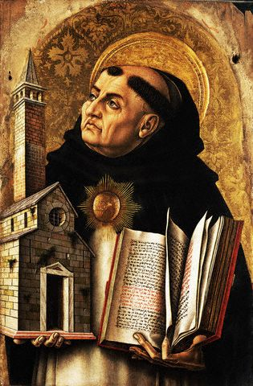
Comparison
Aristotle
Aquinas

Slide 3
Comparisons
Both are great men and great scholars
Aristotle was a student of Plato
Thomas Aquinas combined the ideas of Augustine’s theology with Aristotle’s philosophy.
Aquinas also wrote commentaries on many of Aristotle’s works
One of the commentaries was on Aristotle’s Politics

Slide 4
The Politics
Aristotle argued that man is a more social creature than even the bees, because man can communicate far greater than the bees.
The city (Greek: polis) is natural to men. First there are families, then clans and finally the city.
Man is complete in the city, because the whole comes before the parts.

Slide 5
Aristotle on Virtues
Aristotle argued that just as there is the cardinal virtues for a man, that there are civic virtues for a community leader.
The cardinal virtues include, justice, wisdom, courage, and temperance.
The civic virtues include: magnanimity,
For Aristotle, one can be a good civic leader without being a good man

Slide 6
The civic leader is concerned for the common good.
The common good is justice
Justice is giving every man what is due to him
Justice is a virtue that all men need an extra helping of.
Justice is righteousness in the social order.

Slide 7
Thomas Aquinas believed that one cannot be a good civic leader without being a good man
Aquinas changed the definition of magnamity so that it was in accordance with Christianity
Aquinas also had a problem with the virtue of magnanimity
Aquinas ar

