Slide 1
Introduction to
Game Theory
Craig Vincent Mitchell, PhD

Slide 2
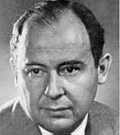
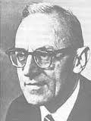
Beginnings
John von Neuman
Oskar Morgenstern

Slide 3
Definition
Game theory is a method of studying strategic decision making. More formally, it is "the study of mathematical models of conflict and cooperation between intelligent rational decision-makers." Game theory is mainly used in economics, political science, and psychology, as well as logic and biology

Slide 4
Definitions
Zero Sum Game- a game such that one person's gains exactly equal net losses of the other participant(s). Most of these are two player games.

Slide 5
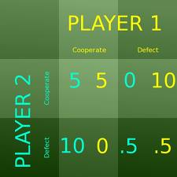
Game Theory: Normal Form

Slide 6
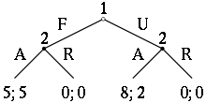
Game: Extensive Form

Slide 7
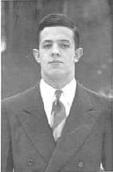
Nash Equilibrium
John Forbes Nash, Jr.is a mathematician whose works in game theory have provided insight into the forces that govern chance and events inside complex systems in daily life.
Serving as a Senior Research Mathematician at Princeton University during the latter part of his life, he shared the 1994 Nobel Prize in economic sciences with game theorists Reinhard Selten and John Harsanyi.
Nash is the subject of the movie A Beautiful Mind.

Slide 8
Nash Equilibrium
Nash equilibrium is a solution concept of a game involving two or more players, in which each player is assumed to know the equilibrium strategies of the other players, and no player has anything to gain by changing only his own strategy unilaterally. If each player has chosen a strategy and no player can benefit by changing his or her strategy while the other players keep theirs unchanged, then the current set of strategy choices and the corresponding payoffs constitute a Nash equilibrium. The practical and general implication is that when players also act in the interests of the group, then they are better off than if they acted in their individual interests alone.

Slide 9
Nash Equilibrium
Stated simply, Amy and Phil are in Nash equilibrium if Amy is making the best decision she can, taking into account Phil's decision, and Phil is making the best decision he can, taking into account Amy's decision. Likewise, a group of players are in Nash equilibrium if each one is making the best decision that he or she can, taking into account the decisions of the others. However, Nash equilibrium does not necessarily mean the best payoff for all the players involved; in many cases, all the players might improve their payoffs if they could somehow agree on strategies different from the Nash equilibrium: e.g., competing businesses forming a cartel in order to increase their profits.

Slide 10
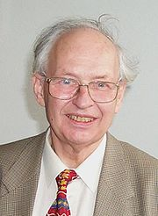
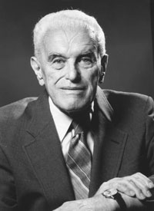
Nash Equilibrium
Reinhard Selten
John Harsanyi

Slide 11
Nash Equilibrium
Reinhard Selten developed the concept of a subgame perfect equilibrium. This is a refinement of a Nash Equilibrium used in sequential games
John Harsanyi developed the concept of a Bayesian Game. This is one in which information about characteristics of the other players (i.e. payoffs) is incomplete.

