Slide 1
Introduction to Metaphysics
Craig Vincent Mitchell, PhD
Assistant Professor of Christian Ethics
Southwestern Baptist Theological Seminary

Slide 2
History of Metaphysics
Metaphysics- the nature of reality
In the pre-modern period metaphysics is first philosophy. Most people were metaphysical realists. Metaphysics contained both ontology and theology
In the modern period, metaphysics was replaced by epistemology as first philosophy. Metaphysics was reduced to just ontology. Theology was separated from metaphysics. Most philosophers were metaphysical nominalists.
In the post-modern period metaphysics was in some cases (Ordinary Language Philosophy) wiped out altogether.

Slide 3
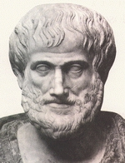
Classical Metaphysics
The first formal work in metaphysics came from Aristotle
His book, “the Metaphysics” was originally a collection of his works
These works were placed “After the Physics”
Andronicus of Rhodes is the man who put these works together

Slide 4
Metaphysical Realism
Metaphysical Realism
  Both forms and concrete particulars exist
    Platonic realism- universals exist in the world of the forms
    Aristotelian Realism- forms are not universals. Forms exist in the concrete particulars of this world. Forms cause change in this world.
    Middle Platonism- based around the concept of “The One”. Everything that exists or has being is “dyad.”
    Augustinian realism- forms are universals that exist in the mind of God
    Thomistic Realism- focuses on potentiality and actuality. Forms are essences
    Possible Worlds realism- possible worlds are a type of universal

Slide 5
Aristotle’s Metaphysics
The Major divisions of The Metaphysics is as follows
Ontology
  Primary Being
    Universals/ forms- what properties are
    Particulars- something that instantiates a property
    Essences- the substance that is unique to a kind
  Cosmology
    Time- when a thing exists
    Space- where a thing exists
    Causation- why a thing exists
Theology- God and the created order

Slide 6
Three Basic Positions
Universals- what properties are. Universals can be instantiated in multiple things. I.E. roundness, whiteness
Tropes- properties are abstract particulars, i.e. the temperature of the sun, the negative charge of this atom. Trope theorists reject the concept of universals. This is a minority position
Nominalism- only concrete particulars exist. Rejects the existence of universals and tropes.

Slide 7
Metaphysical Realism
Metaphysical Realism
  Both forms and concrete particulars exist
    Platonic realism- universals exist in the world of the forms
    Aristotelian Realism- forms are not universals. Forms exist in the concrete particulars of this world. Forms cause change in this world.
    Middle Platonism- based around the concept of “The One”. Everything that exists or has being is “dyad.”
    Augustinian realism- forms are universals that exist in the mind of God
    Thomistic Realism- focuses on potentiality and actuality. Forms are essences
    Possible Worlds realism- possible worlds are a type of universal

Slide 8

Platonic Realism
Plato taught Aristotle
In Plato’s Republic we find that universals exist in a world of the forms.
The world of the forms cannot be sensed. It is known only by reason.
The forms include such things as goodness, truth and beauty.
Things in this world participate with the universal/ forms

Slide 9
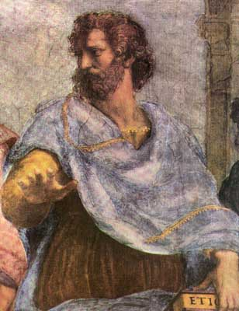
Aristotelian Realism
Aristotle disagreed with his teacher, Plato.
He thought that forms existing in another world cannot explain change in this world.
Aristotle placed the forms in causation (a part of cosmology and ontology). The formal cause
Aristotle did not think that forms were universal.

Slide 10
Aristotle: Entelechy
Entelechy- the chain of causation (Greek-aitia). It explains the movement from potentiality to actuality.
Formal Cause- Aristotle places the forms in the formal cause, because it can explain change. The form is the essence of a living thing. The form exists as an idea in the mind of a person who constructs a thing. The form has potentiality.
Material Cause- the material substance that is the essence of the thing
Efficient Cause- the agent or process responsible for making whatever something is.
Final Cause- the purpose or nature of a thing which naturally results in its maturity or completeness. The is the stage of actuality.

Slide 11
Aristotle: Entelechy
Formal Cause
(Potentiality)
Efficient Cause
(Potentiality)
Final cause
(Actuality)
Material Cause
(Potentiality)

Slide 12

Middle Platonism
Ammonius Saccus of Alexandria
He taught Plotinus for 11 years.

Slide 13
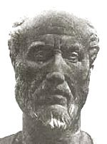
Middle Platonism
Plotinus was the student of Ammonius Saccus of Alexandria
He started what became known as Middle Platonism
He wrote the Enneads

Slide 14
Middle Platonism
Plotinus taught that there is a supreme, totally transcendent "One", containing no division, multiplicity or distinction; likewise it is beyond all categories of being and non-being. The concept of "being" is derived by us from the objects of human experience called the dyad and is an attribute of such objects, but the infinite, transcendent One is beyond all such objects, and therefore is beyond the concepts that we derive from them. The One "cannot be any existing thing", and cannot be merely the sum of all such things, but "is prior to all existents". Thus, no attributes can be assigned to the One. We can only identify it with the Good and the principle of Beauty. Ennead [I.6.9]

Slide 15
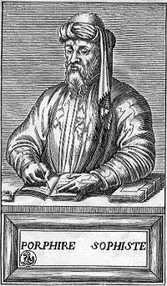
Middle Platonism
Porphyry of Tyre was the student of Plotinus and edited his Enneads
Porphyry wrote the Isagogue
Many Christian philosophers/ theologians applied middle Platonism as expressed through the writings of Porphyry
The creeds employed both Scripture and middle Platonism

Slide 16

Augustinian Realism
Augustine got his ideas from Plotinus, who combined the ideas of Plato and Aristotle.
Augustine believed that universals/ forms exist in the mind of God
The forms also exist in the created thing. For example: the spirit is the form of the human being.

Slide 17

Middle Platonism
Boethius was influenced by Neo Platonism and Aristotle’s works on logic. Specifically, The Categories and The Posterior Analytics
He translated a number of works and was considered a great scholar and philosopher.
He wrote The Consolation of Philosophy

Slide 18

Conceptualism
Abelard was a conceptualist
He believed that universals forms exist only in our minds
Conceptualism was a rarity in this period
Conceptualism is a type of nominalism

Slide 19
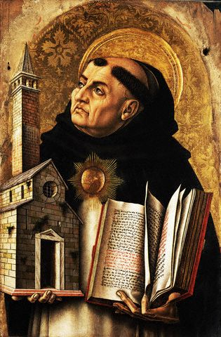
Thomistic Realism
Thomas Aquinas was a Dominican at the University of Paris and the student of Albert the Great
He combined Augustine’s theology with Aristotle’s philosophy

Slide 20
Thomistic Realism
In Thomist philosophy, the definition of a being is "that which is," which is composed of two parts: "which" refers to its quiddity (literally "whatness"), and "is" refers to its esse (the Latin infinitive verb "to be"). "Quiddity" is synonymous with essence, form and nature; whereas "esse" refers to the principle of the being's existence. In other words, a being is "an essence that exists."
Being is divided in two ways: that which is in itself (substances), and that which is in another (accidents). Substances are things which exist per se or in their own right. Accidents are qualities that apply to other things, such as shape or color: "[A]ccidents must include in their definition a subject which is outside their genus." Because they only exist in other things, Thomas holds that metaphysics is primarily the study of substances, as they are the primary mode of being.

Slide 21
Thomistic Realism
The Catholic Encyclopedia pinpoints Thomas's definition of quiddity as "that which is expressed by its definition."] The quiddity or form of a thing is what makes the object what it is: "[T]hrough the form, which is the actuality of matter, matter becomes something actual and something individual," and also, "the form causes matter to be.“ Thus, it consists of two parts: "prime matter" (matter without form), and substantial form, which is what causes a substance to have its characteristics. For instance, an animal can be said to be a being whose matter is its body, and whose soul is its substantial form. Together, these consist of its quiddity/essence.
All real things have the transcendental properties of being: oneness.

Slide 22
Metaphysical Realism
Metaphysical Realism is important for:
  A correspondence theory of truth- truth corresponds to reality
  Epistemological realism- there is an objective reality that can be known.
  Moral realism- there is an objective right and wrong. Moral facts exist independently of an observer.
  Value realism- values are not subjective. Values are an objective aspect of reality.

Slide 23
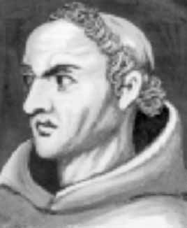
Metaphysical Nominalism
Mtaphysical nominalism arose because of the Franciscan, William of Ockham. He taught at the University of Paris
Ockham was an empiricist, who argued that one cannot sense universals/forms
Ockham’s razor argued that we should not multiply entities without proof of their existence
Ockham rejected universals/ forms

Slide 24

Metaphysical Nominalism
John Buridan was a student of Ockham at the University of Paris.
He was an Aristotelian nominalist who taught at the University of Paris.
He has been described as a medieval analytic philosopher, but he was not a theologian.
His students propagated his ideas about nominalism to the rest of Europe.

Slide 25

Metaphysical Nominalism
Albert of Saxony was a German student of Buridan
He was also an Aristotelian nominalist and natural philosopher
He propagated nominalism in Italy
He was the first rector at the University of Vienna
He also served as Bishop of Halberstadt

Slide 26
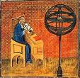
Metaphysical Nominalism
Nicolas Oresme was a student of Buridan at the University of Paris.
He was an Aristotelian nominalist who taught
He wrote influential works on economics, mathematics, physics, astronomy, philosophy, and theology; was Bishop of Lisieux, a translator, and a counselor of King Charles V of France.

Slide 27
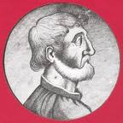
Metaphysical Nominalism
Marsilius of Inghen was a Dutch student of Buridan at the University of Paris
He was an Aristotelian nominalist who also studied theology
He propagated his ideas as the first Rector at the University of Heidelberg

Slide 28
Metaphysical Nominalism
Nominalists eventually got rid of all causes
  Ockham got rid of the formal cause and John Buridan’s students disseminated these ideas throughout all of Europe setting the stage for the modern period.
  The idealists (George Berkeley and others) got rid of the material cause
  David Hume got rid of the efficient cause
  Descartes and Galileo got rid of the final (teleological) cause

Slide 29
Metaphysical Nominalism
Contemporary Metaphysical Nominalism- Only concrete particulars exist, universals do not exist
  Mereological nominalism- properties are mereological wholes of particulars
  Predicate nominalism- a semantic view of properties
  Concept nominalism- universals exist only in the mind- aka conceptualism
  Class nominalism- identifies classes of particulars
  Resemblance nominalism- for a particular to have a property F is for it to resemble all the F particulars

Slide 30
Metaphysical Nominalism
Moderate nominalists accept the material cause and the efficient cause.
Moderate nominalists reject the formal cause, and the final (teleological cause.
Moderate nominalists include:
  Conceptualists- conceptual nominalists
  Class nominalists

Slide 31
Idealism: Realist
Idealism is the idea that reality is in some way mind dependent
Realist types of idealism employ a correspondence theory of truth
  Objective idealism- aka Platonic idealism, the world of the forms is known by reason. Our world is less real than the world of the forms
  Subjective idealism- George Berkeley, all that exists is God’s mind and our minds.

Slide 32
Idealism: Nominalist
Idealism is the idea that reality is in some way mind dependent
Nominalist types of idealism employ a coherence theory of truth
  Transcendental Idealism- Immanuel Kant
  Absolute Idealism- G.W.F. Hegel

Slide 33
States of Affairs
States of Affairs are a type of universal
States of Affairs that obtain have existence
States of Affairs that do not obtain do not have existence
States of affairs can be employed by all types of metaphysical realists
Some moderate types of metaphysical nominalists also employ the use of states of affairs

Slide 34
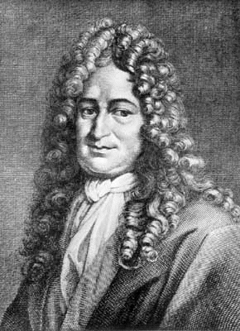
Possible Worlds
The first work that focused on possible worlds came from G.W. Liebniz
He believed that possible worlds exist in the mind of God.
Liebniz was a metaphysical nominalist.
Liebniz also thought that essences were an important feature of everything that exists

Slide 35
History of Metaphysics
Analytic Philosophers made philosophy of language “first philosophy” and took different views of metaphysics. There are five different groups. They began with the Logical Realists.
  The Logical Realists were metaphysical realists
  The Logical positivists rejected metaphysics
  The Ordinary Language Philosophers rejected metaphysics
  Post- Positivist Physicalists- affirmed metaphysics (most were nominalists)
  Linguistic Essentialists- affirmed metaphysical realism and made philosophy of mind “first philosophy.”

Slide 36

Possible Worlds: Ruth Barcan Marcus
Ruth Barcan Marcus wrote many articles on the subject of modal logic and possible worlds
She was a professor at Yale University

Slide 37

Possible Worlds: Saul Kripke
Saul Kripke (lingusitic essentialist) wrote Naming and Necessity
Kripke made the study of possible worlds fashionable by relating them to language and meaning.
Kripke’s use of possible worlds employs the ideas of necessity, contingency and essences.
Kripke’s use of essences is different from Aristotle’s

Slide 38
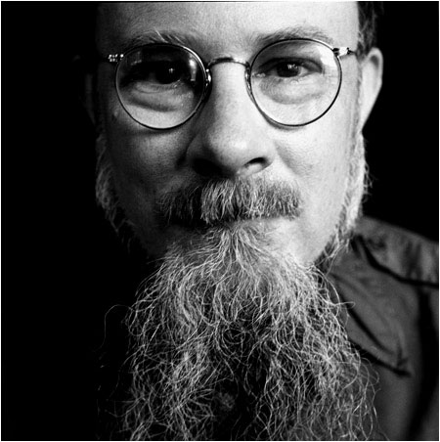
Possible worlds: David Lewis
David Lewis (post positivists/ physicalist) wrote Counterfactuals and eventually he wrote On the Plurality of Worlds
Modal Realism is a view of possible worlds consistent with metaphysical nominalism.
Lewis argued that every possible world is actual.

Slide 39
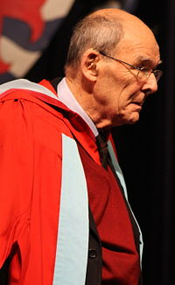
Possible Worlds: David M. Armstrong
David M. Armstrong (post-positivist/ physicalist) wrote A Combinatorial Theory of Possibility
Combinatorial Realism is a view that possible worlds are states of affairs that do not obtain.
The actual world is a combination of all the possible worlds.
He is Aristotelian realist who rejects the concept of essences

Slide 40

Possible Worlds: Alvin Plantinga
Alvin Plantinga (linguistic essentialist) wrote The Nature of Necessity
possible worlds are states of affairs that exist in the mind of God.
The actual world is a maximal possible state of affairs
He holds a Platonic or Augustinian realism.

Slide 41
Parts and Wholes
Metaphysical Realists- the whole comes before the parts. The parts gain their identity from the whole. For example; an arm is important only when it is attached to a body. A human being is more than the sum of his parts.
Metaphysical Nominalists- the parts come before the whole. The parts have identity apart from the whole.

Slide 42
Identity of Indiscernables
The Identity of Indiscernibles is a principle of analytic ontology first explicitly formulated by Wilhelm Gottfried Leibniz in his Discourse on Metaphysics, Section 9 (Loemker 1969: 308).
The Identity of Indiscernibles states that no two distinct substances exactly resemble each other.
This is often referred to as ‘Leibniz's Law’ and is typically understood to mean that no two objects have exactly the same properties.

Slide 43
Philosophy of Mind
Philosophy of mind is a sub-discipline within metaphysics. It is a part of ontology.
The major divisions within philosophy of mind are as follows:
  Mind /body problem- the nature of mental and physical events
  Intentionality- the ‘ofness’ or ‘aboutness’ of our thoughts
These are influenced by metaphysical realism and nominalism

Slide 44
Philosophy of Mind
The mind/body problem concerns how the mind relates to the body
Metaphysical realist perspectives
  Hylomorphism- psycho-somatic unity
  Mind and body interaction- there are mental and physical events that affect each other
Metaphysical nominalist perspectives
  Occassionalism- Mind and body do not interact, physical and mental events are coordinated by God. Malebranche
  Materialism- there are no mental events
  Idealism- there are no physical events
  Epiphenomenalism- the mind is only a by-product of the body

Slide 45
Philosophy of Mind
Intentionality- the ‘ofness’ or ‘aboutness’ of our thoughts.
Metaphysical realism
  Externalism- our thoughts are least partially influenced by what happens in the world outside of us
Metaphysical nominalism
  Internalism- Our thoughts are wholly influenced only by what happens within us.

Slide 46
Sub Disciplines of Metaphysics
Metaphysics
Value Theory
Philosophy of Mind
Philosophy of Religion
Philosophy of Mathematics

