Slide 1

Is Economics a Science?
Craig Vincent Mitchell, PhD
Lecturer
University of Texas in Arlington

Slide 2
Part 1
The Nature of Science
Types of Science
Economics as Social Science

Slide 3
What is science?
Science is an empirical- inductive approach to knowledge.
Empirical- knowledge from sensory experience
Inductive- an informal type of logic based upon probability

Slide 4
The Scientific Method
Hypothesis- an unproved theory, proposition or supposition
Theory- a formulation of apparent relationships or underlying principles of certain observed phenomena which has been verified (or tested) to some degree
Law- a sequence of events in nature that has been observed (or tested) with unvarying uniformity under the same conditions. There are not many laws of science.

Slide 5
The Scientific Method
One progresses from a hypothesis to a theory by testing or observation
One progresses from a theory to a law by testing or observation
Each level provides an increased degree of certainty. Complete certainty cannot be achieved.

Slide 6

The History of Science
Francis Bacon wrote The Advancement of Learning
He argued that scientific knowledge results from continuously experimenting
Observation and experimentation is the key to knowledge of the natural world

Slide 7
Scientism and Positivism
Scientism is the belief that all that can be known, must be known through the scientific process. Anything that cannot be known through the scientific process is nonsense.
Most who hold this position are not scientists at all. The scientists who hold this position are generally naturalists
Positivism is view that is similar to scientism. Positivism argues that science should be free of the influence of theology, metaphysics and value if it will reflect true knowledge.

Slide 8

Scientism
The Post- Positivist Physicalist philosopher, Wilfred Sellars, said that “in the dimension of describing and explaining the world, science is the measure of all things, of what is that it is, and of what is not that it is not.”

Slide 9
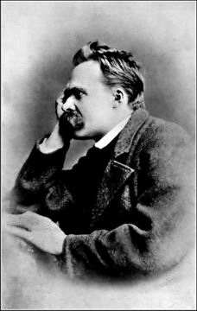
Science and Postmodernity
Friedrich Nietzsche was the grandfather of post-modernity
He thought that there is no objective truth
He also believed that the world picture that physicists construct differs in no essential way from the subjective world picture
Science is just another will to power

Slide 10
Postmodernity and Science
The post-moderns did not believe that there is such a thing as objective truth
They also believed that science is just another example of a will to power
Science cannot get to “the truth” because there is no “truth”
Science points to no objective truth: theory of relativity, Heisenberg uncertainty principle
Science cannot answer such things as: the Heisenberg uncertainty principle, psychotherapy,
Post-modernity does not put faith and science i

Slide 11
Two Views of Science
Scientific Realists believe that science get to “the truth”
Scientific Anti-Realists believe that science does not get to “the truth”
Both sides have good reasons for their positions

Slide 12
Scientific Realism
Scientific Realists believe that science gets to “the truth” because:
The success of science- science provides so much new technology with increasing efficiency that science must get at the truth
Mathematics- numbers and mathematics seem to mirror reality extremely well. This is a cause for the success of science. This suggests a metaphysical basis for scientific realism.
Science aims at truth (correspondence theory), thus requiring metaphysical realism.

Slide 13

Scientific Realism
Karl Popper wrote Conjectures and Refutations and The Logic of Scientific Discovery
He believed that science should be an empirical deductive method
He believed that science requires testing

Slide 14
Karl Popper and Scientific Realism
It is easy to find confirmation of the validity of theories
Confirmation should only be considered if it results from a risky prediction
The more that a theory forbids, the better it is.
A theory that is not possibly refutable is a poor theory
Genuine tests of theories are attempts to refute them
The only good evidence is negative evidence- i.e. an unsuccessful attempt to refute a particular theory

Slide 15
Scientific Anti-Realism
Problem of Under determination- for any given data set, there is an infinite number of theories that can explain it. One cannot test all of them so one cannot be sure that he has the right theory
Instrumentalists believe that science does not get at “the truth” but it is useful. It denies semantic realism. It is also a type of phenomenalism
Positivism- is a rejection of metaphysical realism
Some argue that there is no scientific method because of the inconsistency of its use.

Slide 16
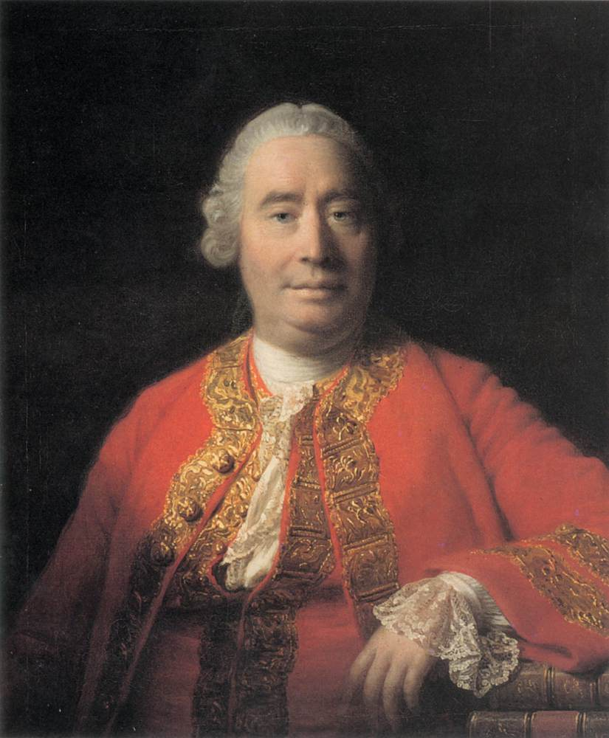
Scientific Anti- Realism
David Hume was a scientific anti- realist because of his argument against causation
One can know that one thing follows another, but one cannot know that one thing causes another

Slide 17
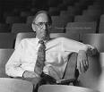
Scientific Anti Realism
Thomas Kuhn wrote The Structure of Scientific Revolutions
He argued that science is really about power
Younger scientists test the existing paradigm, while older scientists maintain the status quo and hold on to power

Slide 18

Scientific Anti Realism
Bastian Van Fraassen is a professor of philosophy at Princeton University
He wrote The Scientific Image and Laws and Symmetry
He is a leading figure among those who hold to anti realism in philosophy of

Slide 19
Science and Value:
The Fact/ Value Dichotomy
David Hume is also known for his fact/value dichotomy, which argues that
1. there is no connection between facts and values.
2. facts are judged by reason, while values like morality and beauty are evaluated by emotions
Conclusion: science has nothing to do with values. This view supports positivism.
Both W.V.O. Quine and Ludwig Wittgenstein have destroyed this argument

Slide 20
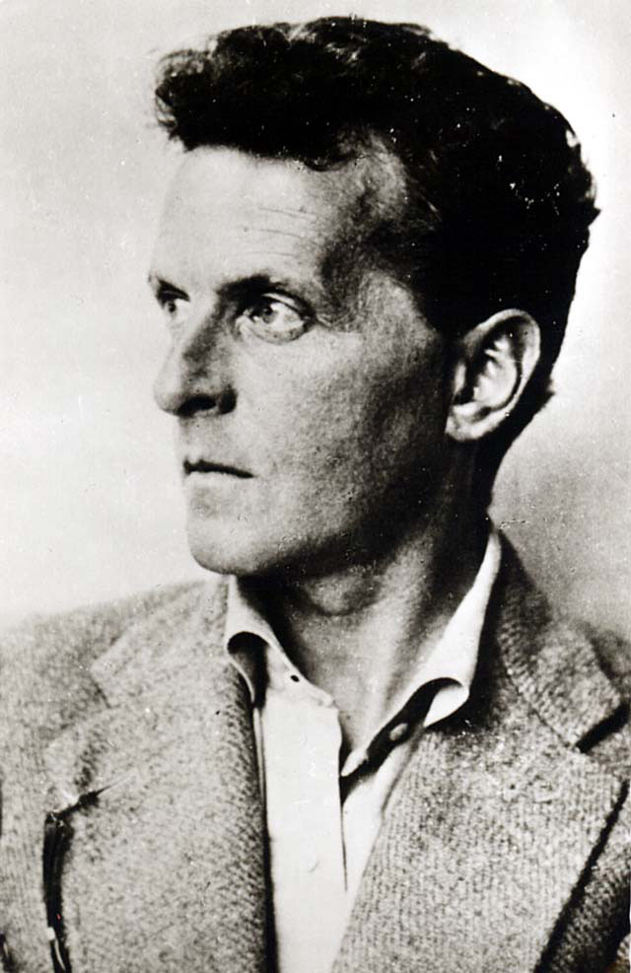
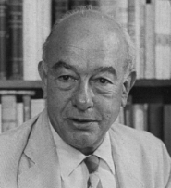
Science and Value:
The Fact/ Value Dichotomy
WVO Quine
Ludwig Wittgenstein

Slide 21
Science and value
Ernan McMullin writes: “the maxim that scientific knowledge is ‘value-laden’ seems almost entrenched as its opposite was earlier. The supposed wall between fact and value has been breached, and philosophers of science seem quite at home with the thought that science and values may be closely intertwined after all.” Ernan McMullin, “Values in Science” in A Companion to Philosophy of Science, W.H. Newton Smith editor (Malden, MA: Blackwell, 2000), 550.

Slide 22
Science and value
The scientific process requires that every scientist is fair, open-minded and objective.
Good science requires that the scientific method be adhered to
Thomas Kuhn explained normal science in his Structure of Scientific Revolutions, as the natural process of scientific change

Slide 23
Science and Value
Post-Normal Science is a concept developed by Silvio Funtowicz and Jerome Ravertz,
It attempts to characterize a methodology of “science” that is appropriate for cases where "facts are uncertain, values in dispute, stakes high and decisions urgent“
It suggests that it is alright to drop the scientific method when it is important to one’s agenda

Slide 24
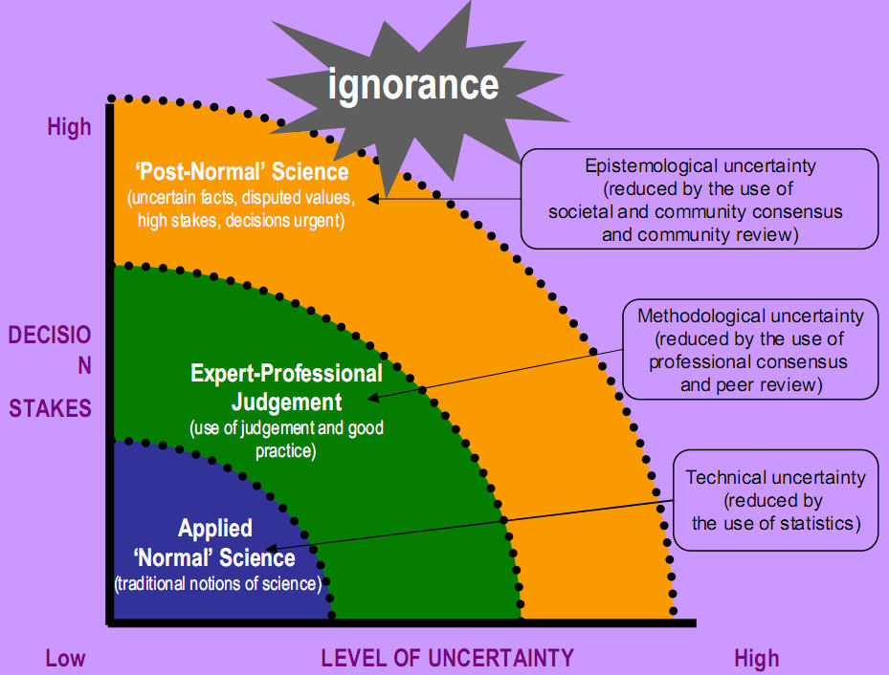
Science and Value
Post-normal science is primarily applied in the context of long-term issues where there is less available information than is desired by stakeholders. For example: Global warming.
It is not an ethical approach to science

Slide 25
Science and Value
Some scientific realists believe that if a scientific theory is true, it will also be beautiful or beautifully simple.
Some realists assume that the true, the good and the beautiful are tied to metaphysics (metaphysical realism).
Positivists argue that there is no connection between the true and beautiful

Slide 26
Part 2
The Nature of Science
Types of Science
Economics and Social Science

Slide 27
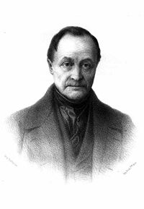
Types of science
Comte was the first modern philosopher of science. He was the first to distinguish the physical sciences from the social sciences.
Comte believed that the physical sciences had to come before the "Queen science" of human society itself.
Comte’s concept of positivism is a rejection of theology and philosophy so that science can be effective.

Slide 28
Types of Science
Science
Physical (or hard) Sciences
Social (or soft) Sciences

Slide 29
Hard and Soft Science
Hard science and soft science are colloquial terms often used when comparing scientific fields of academic study, with hard meaning perceived as being more scientific, rigorous, or accurate.
Fields of the physical, and engineering sciences are often described as hard, while the social sciences and similar fields are often described as soft.
The hard sciences are characterized as relying on quantifiable empirical data, relying on the scientific method, and focusing on accuracy and objectivity.

Slide 30
Types of science
Physical
(or hard) Sciences
Biology
Physics
Chemistry

Slide 31
From Moral Philosophy to Social Sciences
Moral Philosophy
Politics
Economics
Law

Slide 32
Social Sciences
Social sciences came forth from moral philosophy and was influenced by the industrial and French revolutions. The intent of the social sciences was to develop systematic knowledge-bases or prescriptive practices, relating to the social improvement of society.
The beginnings of the social sciences in the 18th century are influenced by the ideas of Diderot, Rousseau and other pioneers.

Slide 33
Types of Science
A related aspect of the hard versus soft distinction has to do with the ease of drawing strong conclusions. In soft sciences, there are often numerous variables that might have an influence on some variable of interest, and many of those variables either may be non-quantifiable or may be quantifiable but difficult to obtain data on; but further, even with plentiful data, it may be difficult to disentangle the effects of such a large number of variables. In contrast, typically in the hard sciences there are only a few, readily identified, causative variables, making it easier to infer specific causative effects.

Slide 34
Part 3
The nature of Science
Types of Science
Economics and Social Science

Slide 35
Definition of Economics
Economics is a social science that seeks to analyze and describe the production, distribution, and consumption of wealth. The word "economics" is from the Greek οἶκος [oikos], "family, household, estate," and νόμος [nomos], "custom, law," and hence means "household management" or "management of the state.“
Economics can also be defined as "the study of how people seek to satisfy needs and wants" and "the study of the financial aspects of human behaviour."

Slide 36
Economic Science
Economics is viewed as harder than many other social sciences because, while most of its data are empirically observed and not experimentally generated, there nevertheless is a large amount of available data to be analyzed statistically.
The field of econometrics is the statistical analysis of economic data to determine whether one thing causes another or whether there is mere correlation between things.
Economics is the social science that has applications to both politics and business

Slide 37
19th Century
Economic Thought
Economic Schools
Austrian
British
Lausanne (Swiss)

Slide 38

The Austrian School of Economics

Slide 39
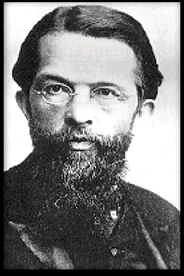
Austrian school of economics
Carl Menger was the founder of the Austrian School of Economics.
They remained uninfluenced by positivism.
They held to a more philosophical/ moral approach to economics.

Slide 40
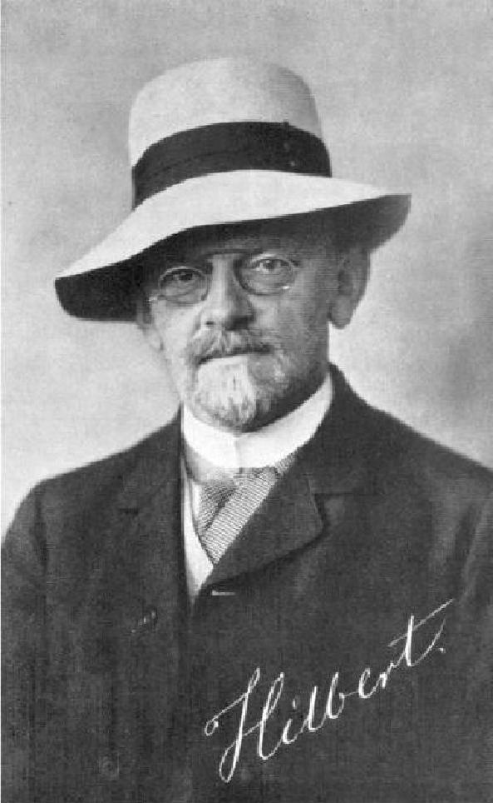
Austrian school of economics
David Hilbert was a professor of mathematics at the University of Gottingen who influenced the Austrian School of Economics with formalism in the 1930s.
His influence resulted in general equilibrium theory and game theory.

Slide 41
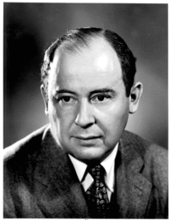
Austrian school of economics
John von Neumann was influenced by both Menger and Hilbert.
He and Abraham Wald developed general equilibrium theory.
He and Oskar Morgenstern developed game theory

Slide 42
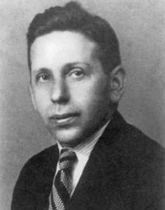
Austrian school of economics
Abraham Wald was influenced by both Menger and Hilbert.
He worked with John von Neumann to develop general equilibrium theory
He also helped to develop econometrics

Slide 43

The British School of Economics

Slide 44

The British (Cambridge)
School of Economics
Alfred Marshall was the founder of the Cambridge School of Economics.
He required mathematics to study political economy

Slide 45
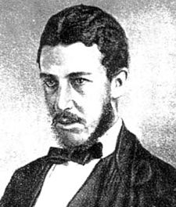
The British (Cambridge)
School of Economics
Willaim Stanley Jevons
his book The Theory of Political Economy (1871) as beginning the mathematical method in economics. It made the case that economics as a science concerned with quantities is necessarily mathematical. In so doing, it expounded upon the "final" (marginal) utility theory of value.

Slide 46
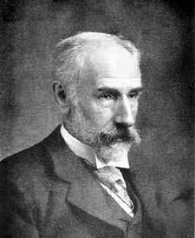
The British (Cambridge)
School of Economics
Francis Ysidro Edgeworth Edgeworth was a highly influential figure in the development of neo-classical economics.
He was the first to apply certain formal mathematical techniques to individual decision making in economics.
He developed utility, introducing the indifference curve and the Edgeworth box.

Slide 47
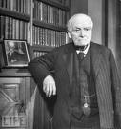
The British (Cambridge)
School of Economics
John Neville Keynes was a professor at Cambridge University.
He followed positivist thinking and divided economics into positive, normative and applied branches.

Slide 48
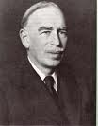
The British (Cambridge)
School of Economics
John Maynard Keynes is the eldest son of John Neville Keynes.
Like his father , he was a professor at Cambridge University.
He developed macroeconomics.

Slide 49

The Lausaunne School of Economics

Slide 50
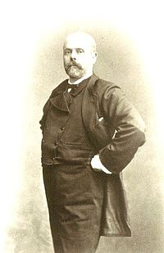
The Lausanne
School of Economics
Leon Walras was the founder of the Laussane School of Economics.
He mathematized economics and developed general equilibrium theory

Slide 51
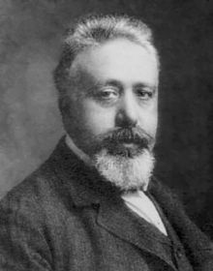
The Lausanne
School of Economics
Vito Volterra sought to mathmatize economics and biology by replacing mathematical analogies with rigorous mathematical models.

Slide 52
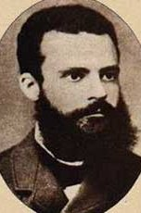
The Lausanne
School of Economics
Vilfredo Pareto led the charge to mathematize economics.
He introduced the concept of Pareto Efficiency and helped develop the field of microeconomics.
He also was the first to discover that income follows a Pareto distribution, which describes the allocation of wealth within a society. The Pareto Principle was named after him and built on observations of his such as that 80% of the land in Italy was owned by 20% of the population.
He also contributed to the fields of sociology and mathematics.

Slide 53
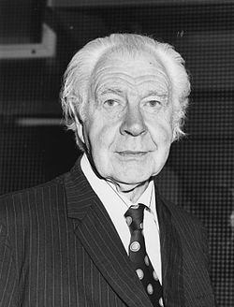
Contemporary
Definition of Economics
The classic brief definition of economics, set out by Lionel Robbins in 1932, is "the science which studies human behavior as a relation between scarce means having alternative uses.“

Slide 54
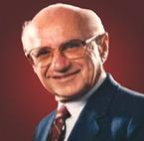
Chicago School of Economics
Milton Friedman was a leader of the Chicago School of Economics.
He emphasized a positivist and empiricist approach to economics.
He believed that economics should be a science.

Slide 55
Economic Imperialism
Because economics is the “hardest” of the social sciences and the most influential, many of the other of the other social sciences are being influenced by economics.
There is an ever growing use of statistical and mathematical techniques that came from economics in political science and sociology.

Slide 56
So if economics is a science, why is there so much disagreement?
Science cannot provide certainty
There is not much disagreement in microeconomics
The big disagreements are in macroeconomics
There are disagreements in the approaches to econometric techniques
There are disagreements in forecasting techniques.
There are

Slide 57
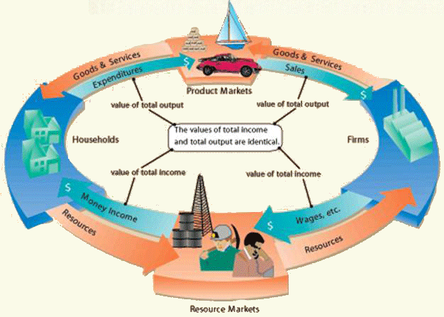
Microeconomic Circular Flow

Slide 58
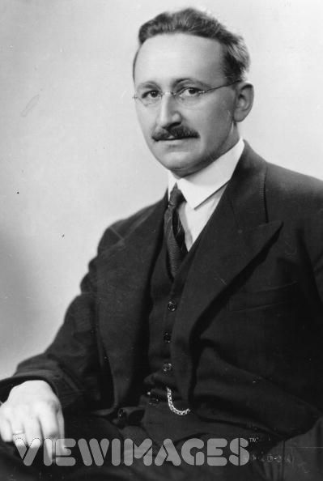
Macroeconomic Confusion
John Maynard Keynes
Friedrich von Hayek

Slide 59
http://www.youtube.com/watch?v=d0nERTFo-Sk
http://www.youtube.com/watch?v=5NIyCJC9ehQ

Slide 60
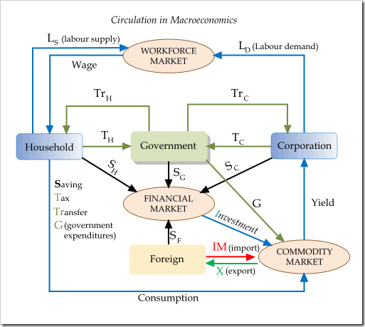
Macroeconomic model

