Slide 2
Domestic Economy and the Household
Craig Vincent Mitchell, PhD
Associate Professor of Christian Ethics
Southwestern Baptist Theological Seminary

Slide 3
Overview
The family is the basic building block of society
The family is central to the economic welfare of a country
The family can be studied as an economic entity

Slide 4

Different views of society
Plato and Aristotle disagreed on the family and politics
Plato argued for communal wives and children. He held to an ideal society.
Aristotle argued for natural families with a natural political society

Slide 5
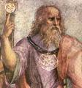
Plato’s View of Society
Plato held to an ideal society that had few citizens who would benefit from the good life.
Plato believed that the necessary economic functions should be performed by non- citizens or slaves

Slide 6
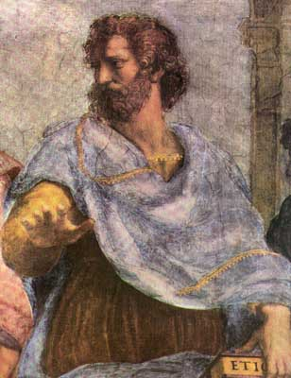
Aristotle
Man is naturally a political animal
Service to others is natural to human beings.
A division of labor among free people is necessary for the common good.
Civic association is necessary for justice peace and virtue

Slide 7
Natural Human Associations According to Aristotle
The Village
The Clan
The Family

Slide 8
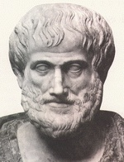
Aristotle on the Family
The family is concerned with procreation, sustenance and education of offspring
A lone family is not capable of providing the best possible life for its members
Clans and villages are natural and rational extensions of the family.
Political Society is needed

Slide 9
Society According to Aristotle
The City
Villages
Households

Slide 10
The City and the Good Life
Politics
Economics
The common good is justice
Political society is necessary to achieve justice
Politics requires virtue
The common good is service to others through a division of labor.
This allows for a diversity of skills, trades
Economics requires virtue

Slide 11
Aristotle on Virtue
Virtues
Moral
Intellectual
Civic

Slide 12
Aristotle on the family
Aristotle believed that natural families ensure that wives and children get the care that they need.
Aristotle believed that families would teach their children virtues so that they would be productive members of society
Aristotle believed that the state should pass laws to encourage virtue and thereby secure healthy families and society
Aristotle believed that one could have the civic virtues without having the cardinal (moral) virtues.

Slide 13
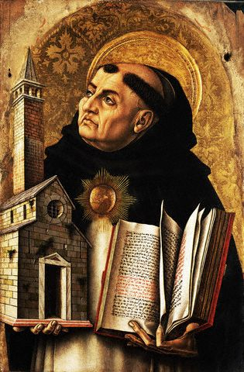
Thomas Aquinas
Aquinas generally agreed with Aristotle
He disagreed with Aquinas about civic virtues.
One cannot be a good statesman without being a good man
Aquinas held to a biblical view of the family, politics and economics

Slide 14
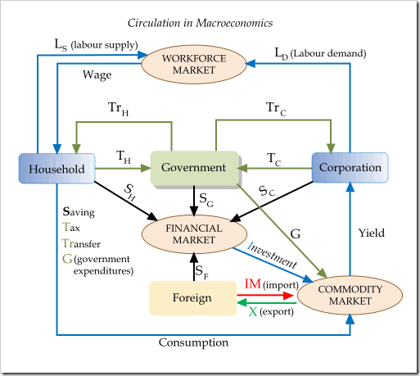
Macroeconomic Theory
Macroeconomic theory has four actors and three markets
The actors include the household, the firm (or corporation), government and foreign countries.
The three markets include: the factors (or workforce) market, the financial markets and the goods (or commodity) markets.

Slide 15
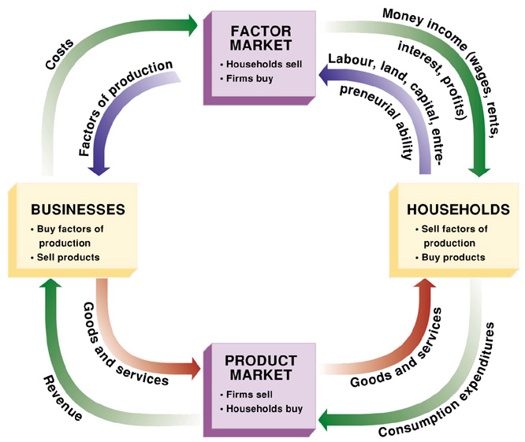
Households and Firms
The household supplies the basic factors of the economy.
Households provide labor to firms and are rewarded with wages
Households provide capital to firms and are rewarded with profits

Slide 16
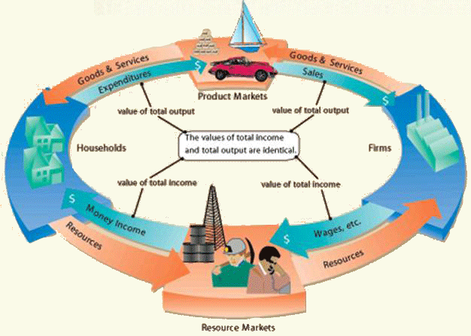
Households and Firms

Slide 17
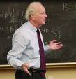
Economics of the Family
Gary S Becker is a professor of economics at the University of Chicago
He won the Nobel Prize in economics in
He pioneered the study in the economics of the family

Slide 18
Gary S. Becker on the Family
Becker’s research on human social interactions has had many implications for the family such as for the marriage market, divorce, fertility, and social security. Becker argued that such decisions are made in a marginal-cost and marginal-benefit framework. For example, he concluded that wealthier couples have higher cost to divorce and thus a lower divorce rate.

Slide 19

Economics of the Family
Without households (families), the economy will fail.
A family requires a father, a mother and children.
The family unit should be protected by the laws of a country.

Slide 20
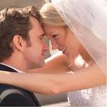
Marriage
Marriage partners are economic agents
A person is altruistic towards someone if his (or her) welfare depends on the welfare of that other person.
A man and a woman marry because they are altruistic towards (love) each other.
Maximizing welfare results in a redistribution of income (generally from the man to the woman)

Slide 21
Altruism and Marriage
Both partners in marriage take actions to raise their joint income
Both parties avoid actions to lower income
Altruism does not eliminate conflict
Altruism does not always generate efficient outcomes.

Slide 22
Men Work More than Women

Slide 23
Men Work More than Women

Slide 24
Men Work More than Women

Slide 25
Women Do More
Part- time Work than Men

Slide 26
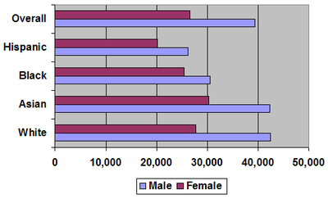
Men Earn More than Women

Slide 27
Household Production
Market
Market
Marcia
John
20*15 = $300
Slope = -1.5
20*5 = $100
Slope = -0.25
Household
Household
20*20 = $400
20*10 = $200
If Marcia and John decided separately how much to work…

Slide 28
Household Production: Joint Labor Supply Decision
At “c” no one is working in the market and both John and Marcia allocate all their time to the household. If they wish to buy market goods, John gets a job first because he is relatively more productive in the market.
At “b” John is out of market hours and
Marcia must join the workforce.
At “a” no one is working at home.
.
John
Marcia
Market
Both are working
a
$400
b
$300
Only John works
$100
c
$200
$400
$600
House

Slide 29
Game Theory and
The Marriage Market
 | John Commits | John Does not Commit
Marcia Commits | Cooperation is the best strategy Marriage and eventually children Social optimum | Cohabitation Possibly children out of wedlock Less than optimal
Marcia Does Not Commit | Both may end up single Less than optimal | They go their separate ways and find suitable partners elsewhere Social optimum

Slide 30
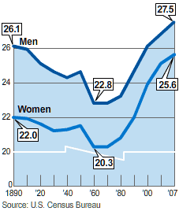
Search Theory and Marriage
In recent decades, the average age at first marriage has been on the rise for the population as a whole, as has the fraction of people cohabiting. There are likely many factors that have contributed to this, but can changes in attitudes toward risk partially explain these phenomena?

Slide 31

Search Theory and Marriage
In equilibrium, search theory predicts that the more risk averse will marry the more risk averse at an earlier age, while the risk lovers will be more likely to marry each other later in life.
A theory of risk pooling has different implications for assortative mating.

Slide 32

The Benefits of Marriage
Men and women both desire to be married
Men generally work outside of the home
Women generally work at home
Both benefit from this situation in different ways

Slide 33

Children
Children are a type of public good.
Public goods are the result of a type of market failure.
Neither economic agent is capable of producing or providing for this type of good on their own.
Both economic agents pay for this good in their own ways

Slide 34
Children
Natural parents will do far more for a child than the government would
Natural parents see their children as individuals with different needs, abilities, and interests. The state would treat them all the same.
The government should not have more authority over children than their parents.
Laws should be in place to protect parent’s rights from the state.

Slide 35
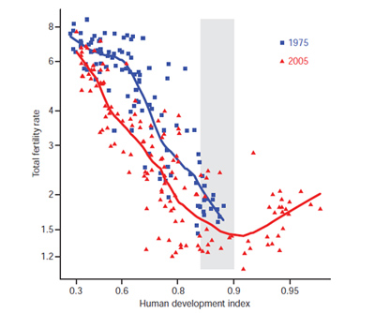
Gary S. Becker on Fertility Rates
Becker’s research showed that as women increase investment in human capital and enter the work force the opportunity cost of childcare rises. Additionally, the increased rate of return to education raises the desire to provide children with formal and costly education. Coupled together, the impact is to lower fertility rates.

Slide 36
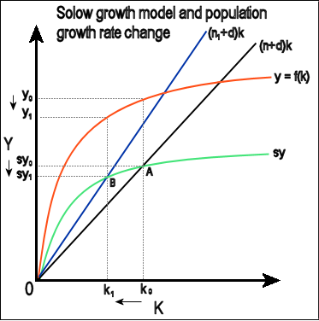
Children and Economic Growth
Y= Income or GDP
K= capital
D= depreciation
N= labor force
S= savings rate
Too many people lowers economic growth
Too few people lowers economic growth

Slide 37
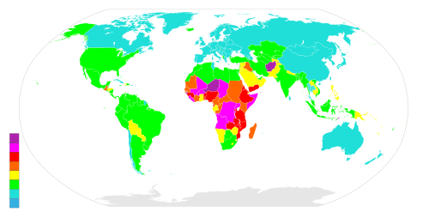
World Fertility Rates

Slide 38
Population Problems
Wealthy Countries
Poor Countries
Too few children
Labor shortages
Economic decline
Too many children
Too little capital per person
Further economic decline

Slide 39

Gary S Becker:
The Rotten Kid Theorem
The rotten kid theorem suggests that family members, even if they are selfish, will act to help one another if their financial incentives are properly linked.

Slide 40

Gary S Becker:
The Rotten Kid Theorem
The theorem posits that the rotten kid has an incentive to avoid hurting his sibling, and will in fact behave in such a way as to increase her happiness, because her happiness has a direct effect on the amount of money he will receive. Without creating any formal incentive structure, the altruistic parent can induce the rotten child to behave benevolently by making his welfare contingent upon the welfare of his sibling.

Slide 41

Gary S Becker:
The Rotten Kid Theorem
The theorem suggests that parents should delay gifts of money to their children until they are older, or possibly until after they die. If parents plan to will their children money in accordance with their needs, each child will have an incentive to help his siblings maximize their income, because higher earnings by the other siblings will mean that more of the money will be given to the rotten sibling.

Slide 42

Gary S. Becker on
Inter Generational Transfers
Becker concluded that parents often act altruistically towards selfish children by highly investing in a child in an effort to indirectly save for old age. Becker believed that the rate of return from investing in children was often greater than normal retirement savings.

Slide 43
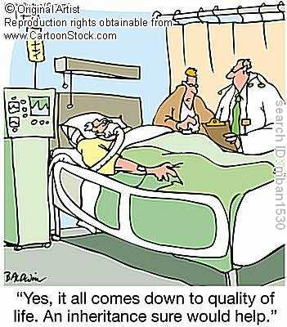
Gary S. Becker on
Inter Generational Transfers
Parents can not know for sure that the child will take care of them. Since they cannot legally bind a child to care for them they often resort to manipulation through instilling a sense of “guilt, obligation, duty and filial love that indirectly, but still very effectively... commits children to helping them out.”

Slide 44
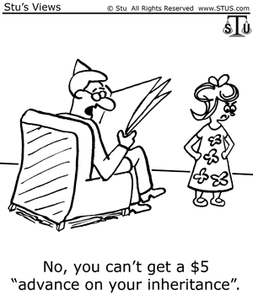
Gary S. Becker on
Inter Generational Transfers
Becker explains that social security can cause families to be less interdependent by removing the motivation of parents to use altruistic behaviors in motivating their children to care for them.

Slide 45
Game Theory and Marital Health
 | John works at marriage | John does not work at marriage
Marcia works at marriage | Social optimum Mutual cooperation is the best strategy Optimal situation for children | John is a free rider Spousal discord Less than optimal marriage
Marcia does not work at marriage | Marcia is a free rider Spousal discord Less than optimal marriage | Divorce Worst case scenario for children

Slide 46

Divorce
The higher the income the lower the probability of divorce
Divorce results in efficiency loss
Mother usually retains child custody and decides level of expenditure on children
The father transfers wealth to the mother to increase his welfare

Slide 47
The Effects of Divorce on Children
 | Father Cooperates | Father does not cooperate
Mother cooperates | Parents and children have higher welfare | Mother and children’s welfare is minimized Boys end up in crime Girls sexually active
Mother does not cooperate | Father ‘s welfare is minimized Children have lower welfare | Parent’s and children’s welfare is minimized Boys end up in crime Girls sexually active

Slide 48
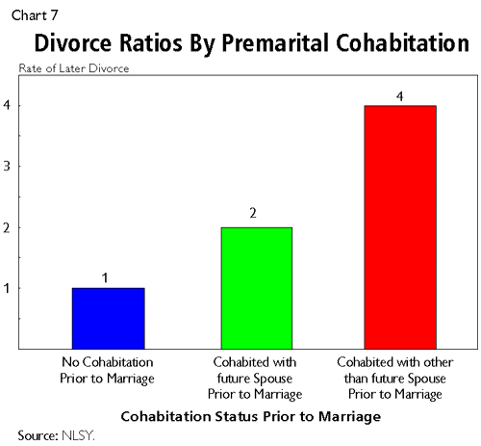
Cohabitation
People are more choosy about forming marriages than cohabitating unions.
Premarital cohabitation results in higher rates of divorce.

Slide 49
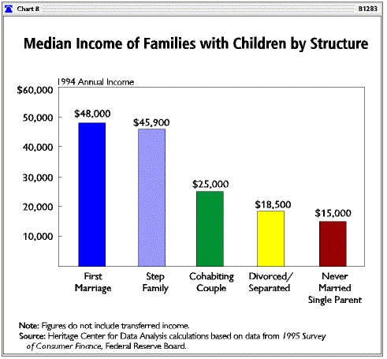
Income and family Structure

Slide 50

Family Structure and School Expulsion

Slide 51

Gay Marriage
Homosexuality is contrary to nature.
Gay marriage cannot make a family
Homosexuality cannot provide this public good (children)
Gay marriage does not result from altruism, but rather selfishness.
Gay marriage is harmful to society

Slide 52
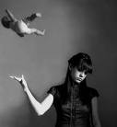
Abortion
Abortion is the waste of the public good and a societal loss
Abortion results in personal loss and psychological damage
Abortion removes people from the labor force and reduces their contribution to social security

Slide 53
Conclusions
The economics of the family support a biblical view.
God’s design for natural families are the best type of household for a society.
Children are necessary for the economic growth of a country.
Homosexuality, abortion, and cohabitation are not only immoral, but they are bad for the economy.
Good public policy will protect the family from these immoral actions.

