Slide 1
Market Failure and
Government Intervention
Craig Vincent Mitchell, PhD
Associate Professor of Christian Ethics
Southwestern Baptist Theological Seminary

Slide 2
Types of market Failure
Market Failure
Asymmetrical Information
Externalities/ Public Goods

Slide 3
Overview
Social Welfare
Theory
Asymmetrical Information
Externalities/ Public Goods

Slide 4
Efficiency and Welfare Analysis
An outcome is efficient or socially optimal if total gains from trade are maximized
Efficient outcomes (quantities) are characterized as the quantity such that the Marginal Social Benefit (MSB) equals Marginal Social Cost (MSC)

Slide 5
First Welfare Theorem
Perfectly competitive markets (PCM) are efficient.
Perfectly Competitive markets are:
  Many firms
  Homogeneous goods
  Ease of entry and exit
  Perfect information
  No externalities
In other words, the equilibrium quantity is the Socially Optimal quantity

Slide 6
The Second Welfare Theorem
Any socially optimal allocation of resources can be achieved by a perfectly competitive market, assuming that endowments can be redistributed
Social Optimum= MPB=MSB=MSC= MEC+ MPC

Slide 7
Overview
Social Welfare
Theory
Asymmetrical Information
Externalities/ Public Goods

Slide 8
Asymmetrical Information
(Imperfect Information)
Asymmetrical Information
Adverse Selection:
When you don’t know if you are taking a bad risk
Moral Hazard:
Bail outs can encourage
bad behavior

Slide 9
Asymmetrical Information
There are two types of asymmetrical Information:
Adverse Selection- when business is entered into without carefully selecting Partners/ customers
Moral Hazard- bailing someone out will result in continued bad behavior

Slide 10
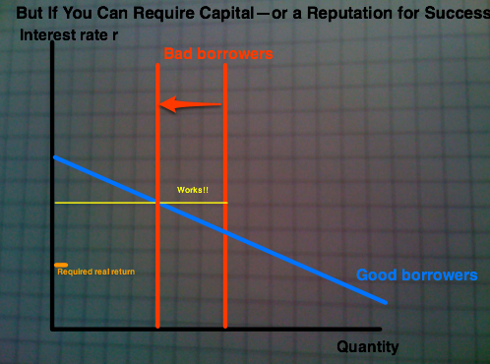
Adverse Selection

Slide 11
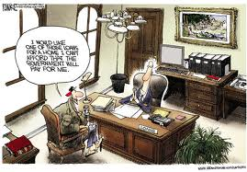
Moral Hazard

Slide 12
Government Provision of Insurance
Government sometimes intervenes in the market to take care of failure.
The government will provide different types of insurance to deal with market failure.
The motivations include the following:
  Market failure due to asymmetric information
  Paternalism
  Redistribution

Slide 13
Two Primary Costs of Social Insurance
Crowding out of self insurance- anything that is a substitute for insurance, i.e. savings or borrowing from others
Moral Hazard about choices- insuring people against adverse events causes them to change their behavior in ways that increase the likelihood of the adverse event

Slide 14
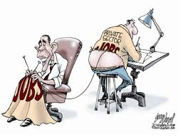

Crowding out

Slide 15
Overview
Social Welfare
Theory
Asymmetrical Information
Externalities/ Public Goods

Slide 16
Government Intervention is Sometimes Necessary
Market
Failure
Externalities
Public Goods

Slide 17
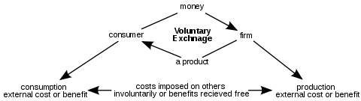
Externalities
(Spillovers, third party effects)

Slide 18
Externalities
An externality exists whenever one person’s actions affect someone else’s utility of some firms profits, other than through the price system
  Externalities can be positive or negative
  If an externality exists, then there are side effects on third parties, thus violating our perfect competition requirements

Slide 19
Externalities
If a positive externality exists, then MSB are greater than MPB
  The difference between MSB and MPB is called Marginal External Benefits (MEB) MEB= MSB-MPB
If a negative externality exists, then MSC are greater than MPC
  The difference between MSC and MPC is called Marginal External Costs or Marginal Damages MEC= MSC-MPC

Slide 20
Positive Externalities
Positive Production Externalities- production benefits parties other than the producer, yet the producer is not compensated
  MSB= MPC-MEB
Positive Consumption Externalities- when an individual’s consumption increases the well- being of others, but the consumer is not compensated by others
  MSC= MPC+ MEB

Slide 21
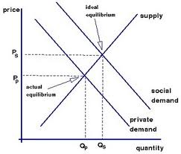
Positive Externality

Slide 22
Negative Externalities
Negative Production Externalities- a company makes its products and pollution
  MSC= MPC+MEC
Negative Consumption Externalities- After eating dinner, you begin to smoke cigarettes. The smoke from your cigarette affects my enjoyment of my meal.
  MSB= MPB-MEC

Slide 23
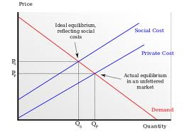
Negative Externality

Slide 24
Externalities
Equilibrium= MPB+ MPC
Social Optimum= MSB+ MSC
Socially Optimal quantity= Qd such that MSB=MSC
Goods that generate negative externalities are overproduced relative to the social optimum
Goods that generate positive externalities are underproduced relative to the social optimum
In either case, market failure is the result

Slide 25
Solutions for Externalities
Solutions
Pigovian:
Taxes or subsidies
Regulation
Coasian:
Bargaining with assigned property rights

Slide 26
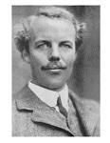
Externalities: Solutions
Arthur Cecil Pigou
Pigouvian Tax (or subsidy) is a price approach named after Pigou
Tax per unit equal to marginal damages at the socially optimal quantity

Slide 27
Externalities: Solutions
Pigou's major work, Wealth and Welfare (1912, 1920), brought welfare economics into the scope of economic analysis. In particular, Pigou is responsible for the distinction between private and social marginal products and costs. He originated the idea that governments can, via a mixture of taxes and subsidies, correct such perceived market failures — or "internalize the externalities". Pigovian taxes, taxes used to correct negative externalities, are named in his honor.

Slide 28
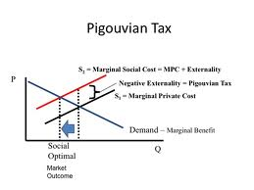
Externalities: Solutions

Slide 29
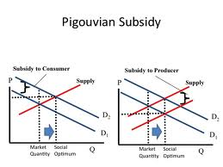
Externalities: Solutions

Slide 30
Externalities: Solutions
Regulation is a quantity approach
Heterogeneity in the population of producers leads to different producers with different cost of reducing the negative externality
Set a target for reducing the externality, which may or may not be socially optimal
The social cost of externality reduction= private cost of externality reduction

Slide 31

Externalities: Solutions
Coase Solution is named after Ronald Coase professor at the University of Chicago and Nobel prize winner
Establish property rights where they are missing
Then let people bargain over ownership of those rights

Slide 32
Externalities: Solutions
In law and economics, the Coase theorem, attributed to Ronald Coase, describes the economic efficiency of an economic allocation or outcome in the presence of externalities. The theorem states that when trade in an externality is possible and there are no transaction costs, bargaining will lead to an efficient outcome regardless of the initial allocation of property rights. In practice, obstacles to bargaining or poorly defined property rights can prevent Coasian bargaining.

Slide 33
Externalities: Solutions
The Coase Solution works when the agents are easy to identify
The fewer the agents, the less the bargaining costs
Enforcement costs are associated with rights

Slide 34
Types of Goods
 | Rival | Non-Rival
Excludable | Private goods | Club Goods
Non-excludable | Common resources | Public Goods

Slide 35
Public Goods
Non Rival- one person’s consumption of a specific unit of a good does not rule out someone else consuming the same unit
  i.e. a movie shown in a theater
Non-Exclusive (or non-excludable) people who do not pay for a good cannot be prevented from consuming the good
  i.e. law and order or air quality, national defense

Slide 36
Public Goods
In general, the socially optimal quantity of a public good is Q0 such that
MSB (Q0)= sum MPB (Q0)= MSC

Slide 37
Public Goods: Private Provision
Private provision of public goods is sub-optimal because of the free rider problem
Free Rider Problem- someone who enjoys the benefits of consuming a good without contributing to the costs

Slide 38
Public Goods: Private Provision
Mechanisms for optimal provision of public goods includes:
  Strong preferences
  Altruism- someone is altruistic if other people’s utility level enters his or her utility function
  “Warm Glow”- utility depends on their own consumption and level of contribution to the public good

Slide 39
Public Goods: Public Provision
Issues include:
Crowd out- individuals change behavior in response to government provision
Measuring costs and benefits
Determining the public preference

Slide 40
Public Goods
Government Finances
Taxation
Bonds

Slide 41
Taxation
Wealth is a stock
Direct times- individual income, corporate income taxes on wealth
Taxes on consumption are indirect

Slide 42
Factors in Taxation
Tax Policy
Efficiency
Equity

Slide 43
Tax Policy
Tax Equity
Vertical Equity
Horizontal Equity

Slide 44
Tax Fairness
Marginal Tax rate- additional tax rate on a dollar of income
Average tax rate- equal to total tax paid as a fraction of total income
Statutory Tax Rate- tax rates specified in tax schedule
Effective Tax Rate- tax rates people actually pay

Slide 45
Tax Definitions
Term | Definition
Tax Incidence | Who bears the burden of the tax
Ability to pay Principle | Taxes should be levied based on the person’s ability to shoulder the burden
Vertical Equity | Taxpayers with the greater ability to pay taxes should pay larger amounts
Horizontal Equity | Taxpayers with similar abilities should pay the same amount
Proportional Tax | A tax for which all pay the same percentage
Regressive Tax | High income taxpayers pay a lower fraction than low income taxpayers
Progressive Tax | High income taxpayers pay a larger percentage of their income than do low income taxpayers

Slide 46
Tax Equity
Vertical Equity- people with more income pay more taxes
  Progressive- average tax rates increases with income
  Proportional or Neutral- average effective tax rates are constant
  Regressive- average effective tax rates decrease with income
Horizontal Equity- similar individuals pay similar taxes, regardless of the economic choices that they make

Slide 47
Tax Incidence
In economics, tax incidence is the analysis of the effect of a particular tax on the distribution of economic welfare. Tax incidence is said to "fall" upon the group that, at the end of the day, bears the burden of the tax. The key concept is that the tax incidence or tax burden does not depend on where the revenue is collected, but on the price elasticity of demand and price elasticity of supply. For example, a tax on apple farmers might actually be paid by owners of agricultural land or consumers of apples.

Slide 48
Optimal Taxation: Ramsey Rule 1
Taxation and efficiency In general, deadweight loss (DWL) is approximately = ½ tax per unit x change in Q

Slide 49
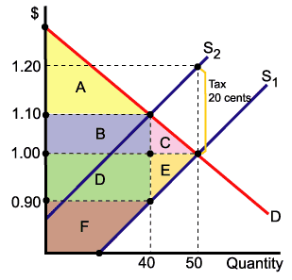
Deadweight Loss

Slide 50
Optimal Income Tax
How do we choose tax rates for people with different income levels to raise a fixed amount of revenue when keeping DWL as low as possible?
Increase the tax rate
  Raise more revenue
  People work less to avoid tax, tax base shrinks
  The Laffer Curve shows that increasing the tax rate will increase revenues for only a limited time

Slide 51
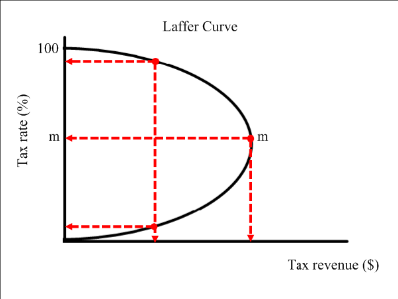

Laffer Curve

