Slide 1
Metaphysics and Hermeneutics
Craig Vincent Mitchell, PhD

Slide 2
Overview
Pre-modernity
Semantic Externalism
Modernity
Semantic Internalism
Post-modernity
Semantic Internalism

Slide 3
Pre-modernity
Recorded History- 1600
Metaphysical Realism

Slide 4
Premodern Philosophy
 | Metaphysics | Relation to the world | Explanation
Philosophy of Mind | realism | Externalism | teleological
Epistemology | realism | Externalism- Knowledge results from proper functioning and true belief | Teleological
Philosophy of Language | realism | Semantic externalism- Causal theory of meaning | Teleological
Action Theory | realism | Internalism | teleological
Ethics | realism | Internalism | teleological
Theory of truth | realism | correspondence

Slide 5
Internalism/ Externalism
Philosophy of Mind is a sub-discipline of Metaphysics
Externalism in philosophy of mind, philosophy of language, and epistemology means that intentional states of mind owe their content to causal relations that agents bear to the world.
Internalism in action theory means that intentional states in the agent’s mind are driven by reasons.
Internalism in ethics means that intentional states are motivated by objective morality.
Philosophy of Mind
Epistemology
Action Theory
Philosophy of Language
Ethics

Slide 6
Semantic Externalism
Metaphysics | Relation to a Word | Explanation
Universal Forms Intension refers to the set of all possible things a word or phrase could describe. This includes the use of possible worlds | Intension is any property or quality connoted by a word, phrase or other symbol. | Intension of dog, is like a platonic form or universal that can refer to any concept of dog in any possible world.
Concrete Particulars Extension- refers to the set of all actual things the word describes. In other words, | Extension concerns the denotation of a word. | Extension of dog refers only to all actual dogs that have ever, or will ever exist. It is like concrete particulars

Slide 7
Pre-modernity
Most Pre-moderns were metaphysical realists
Hebrews and the early Church assumed metaphysical realism
Origen and Augustine believed that the forms existed in the mind of God
Platonic Realism- Universal forms exist in another world and concrete particulars exist in this world.
Universal Forms in the mind of God include:
  Numbers
  Truth, Morality and Beauty
  Meaning
Concrete particulars exist in this world
  Numbers of things
  Civil laws and morays
  Meanings of words and texts

Slide 8
Pre-moderns
Words and things existed in the mind of God before the creation of reality
  Words are tied to things in God’s mind
  God has a universal grammar
  God spoke these things into existence
Human beings operate with concrete particulars
  Languages
  Grammars
  Syntax
  Words

Slide 9
Pre-modernity
Meaning is found in a speaker’s or writers intent.
Meaning is teleological (this requires metaphysical realism).
People communicate for the purpose of transmitting the ideas or meanings from one person’s mind to another.
The transmitter begins the communication by using the words, grammar and syntax of a given language.
The receiver has a duty to attempt to understand the transmitter

Slide 10
Pre-modern Action Theory for Communication
Agent: Transmitter
Agent: Receiver
PURPOSE: Agent/Transmitter has REASONS to communicate his intent (meaning).
ACTION: uses externalist epistemology to order language (syntax, grammar, and words) for a receiver.
ETHICS: To accomplish his purpose, the transmitter is regulated by intellectual virtues (wisdom, skill, art and understanding) and proper functioning resulting in eudaimonia
This process is teleological
PURPOSE: Agent/Receiver has REASONS to understand the transmitter’s intent.
ACTION: Receiver uses externalist epistemology to process information from the transmitter by using language (syntax, grammar, and words)
ETHICS: To accomplish his purpose, the receiver is regulated by the intellectual virtues, proper functioning and a hermeneutic of trust. This results in eudaimonia.
This process is teleological

Slide 11
Pre-modern Authorship of the Bible
DIVINE Authorship
  God is the primary author of the Bible
  The meaning of the Bible is in the mind of God
  God has more than one intent or meaning for the texts of Scripture (sensus plenior)
Human Authorship
  The human is only the secondary author of the text
  The human author has only one meaning or intent behind the Scripture

Slide 12
Pre-modern
Hermeneutic of Trust
A Hermeneutic of Trust assumes that the community is a legitimate source of authority. The community affirms, witnesses or testifies to the truth, rather than making it up.
The community employs tradition and creeds to determine who is within the community and who is outside of it.
In reference to the Bible, the Hermeneutic of Trust also assumes that the Bible is inerrant, authoritative and sufficient.

Slide 13
Premodernity: The Text
Parts and Whole
The Value of the Text
Metaphysical Realism suggests that the whole comes before the parts
Intrinsic value- the value of a text is objective.
Instrumental Value- The value the community has for the text
Principle of Organic Unities- the value of a text is from the whole of the text and not the parts. The whole of the text does not lose its value with a loss of the parts

Slide 14
Pre-modern Reading of the Bible: Hebrews
The Hebrews employed four types of Biblical interpretation, all based on a hermeneutic of trust:
Literal interpretation is used to understand the human author (employed the historical grammatical method)
Allegory is used to understand the divine author (anything the human author did not intend)
Peshat is used to understand the divine author (eschatological interpretation)
Midrash is employed to understand the divine author

Slide 15
Pre-modern Reading of the Bible
Human Authorship
DIVINE Authorship
Oriented towards concrete particulars
Literal Interpretation to understand the human author
The human author has only one meaning or intent
Employed a hermeneutic of trust: the Bible is inerrant, authoritative and sufficient
Oriented towards the universal forms
Allegorical Interpretation: employed to understand the divine author
The divine author can have more than one meaning or intent
Employed a hermeneutic of trust: the Bible is inerrant, authoritative and sufficient

Slide 16
Pre-modern Reading of the Bible
Antiochene School
Alexandrian School
Emphasized the literal approach to interpretation
They still also used the allegorical approach of interpretation
Emphasized allegorical approach
They still employed the literal approach of interpretation

Slide 17
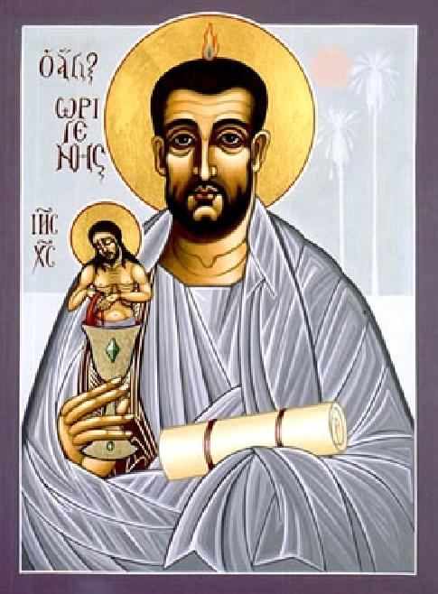
Pre-modern Reading of the Bible
Origen noted that every scripture has an allegorical meaning, but not every scripture has a literal meaning.
Consequently, allegory is the first level of interpretation
The literal is the second level of interpretation (employed the historical grammatical method)
Employed hermeneutic of trust

Slide 18

Pre-modern Reading of the Bible
Augustine saw problems with Origen’s methods
Augustine argued that one must have the right kind of character to understand the scriptures
Augustine emphasized the theological virtues to have Christian character
Augustine also employed the theological virtues to get spiritual knowledge or a Christian interpretation

Slide 19
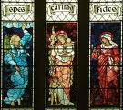
Pre-modern Reading of the Bible
Augustine knew that we cannot be righteous on our own.
We gain the knowledge and power to live righteously by being in Christ through the Holy Spirit
The Theological Virtues are special gifts of the Holy Spirit given to every believer
These gifts are faith, hope and love (agape)

Slide 20

Pre-modern Reading of the Bible
Augustine believed that we must be empowered and regulated by the theological virtues
We must also be regulated by the creeds
The creeds tell who is within or outside of the community.
Any interpretation contrary to the creeds or theological virtues is not Christian.

Slide 21
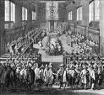
Pre-modern Reading of the Bible
Augustine believed that the literal is the first level of interpretation.
The allegorical is the second level of interpretation
The Christian is regulated by the creeds and the theological virtues.
He operates with a hermeneutic of trust

Slide 22
Modernity
1600-1950
Metaphysical Nominalism

Slide 23
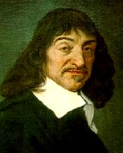
Modernity
Rene Descartes was the father of modernity. He was responsible for the epistemological turn.
He employed methodological doubt to achieve what we now call “Cartesian Certainty.” This is knowledge of which we have absolute certainty.
From methodological doubt, the modern period gained a hermeneutic of doubt. This left no room for the Bible’s inerrancy, authority, or sufficiency. It is anti-super-natural.

Slide 24
Modernity:
Major Movements
Modernity
British Empiricists
Pragmatism
Analytic Philosophy
Continental Rationalists
Continental Philosophers

Slide 25
Modern Philosophy
 | Metaphysics | Relation to the world | Explanation
Philosophy of Mind | nominalism | internalism | deontology
Epistemology | nominalism | Internalism- Knowledge is justified true belief | deontology
Philosophy of Language | nominalism | Semantic internalism- Ideational theory of meaning | deontology
Action Theory | nominalism | externalism | deontology
Ethics | nominalism | externalism | deontology
Theory of Truth | Coherence and pragmatic | Theories of truth based on knowledge. No connection to the world

Slide 26
Internalism/ Externalism
Philosophy of Mind is a sub-discipline of Metaphysics
Internalism in philosophy of mind, philosophy of language, and epistemology means that intentional states of mind do not owe their content to anything outside of the agent.
Externalism in action theory means that intentional states in the agent’s mind are driven by beliefs/desires.
Externalism in ethics means that intentional states are not motivated by morality.

Slide 27
Semantic Internalism
The Human Mind | Theory of meaning | Metaphysics
Semantic internalism suggests that the contents of our minds is the only source for meaning and language. | Ideational Theory of Meaning- the meaning of a word is the idea with which it is regularly associated or for which it stands. Ideas are private and independent of language. Language is a tool for providing publicly observable indications of private ideas and to convey these ideas to others. | Semantic internalism is consistent with metaphysical nominalism and is not compatible with a correspondence theory of truth.

Slide 28
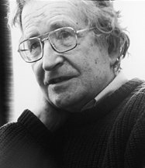
Semantic Internalism:
Generative Grammar
Noam Chomsky argues that we are designed for communication and that this ability could not have evolved
We have an internal grammar in our minds that has a universal capability. This universal grammar is open to any language.
As we learn a language, our minds learn to operate with one specific language.
This idea can be compatible with semantic externalism

Slide 29
Modernity
William Occam separated philosophy from theology in the 14 century
Epistemological Turn: the move from metaphysics to epistemology for first philosophy
Occam also pushed for metaphysical nominalism
By the modern period (1600) philosophers moved towards nominalism
Moved from the community to the individual
Modernity had significant effects on hermeneutics

Slide 30
Modernity
Epistemology
Ethics
Language
Metaphysics

Slide 31
Modernity
Modernity meant that philosophy had nothing to do with theology.
Theology no longer had a “Metaphysic”
Theology is also nominalistsic.
Meaning resides only in the text
There is only a human author
There is no place for the creeds
The Holy Spirit is replaced by human reason

Slide 32
Modern Action Theory for Communication
Agent: Transmitter
Agent: Receiver
Motive: Agent has BELIEF/ DESIRES to communicate.
Many Actions: Agent uses internalist epistemology to order language (words, syntax and grammar) for a receiver.
Ethics: Agent is regulated by some individual and arbitrary rule.
This process is deontological
Motive: Agent has BELIEF/ DESIRES for Cartesian Certainty to understand transmitter’s information.
Many Actions: Agent uses internalist epistemology to process the transmitter’s information into language (words, syntax and grammar).
Ethics: Agent is regulated by hermeneutic of doubt
This process is deontological

Slide 33
Modernity: The Text
Parts and Whole
Value of the Text
Metaphysical nominalism suggests that the parts come before the whole.
Intrinsic Value- every individual text has intrinsic value.
Instrumental value- the value of the text is determined by the subjective taste of the reader.
The Principle of Summation- the value of a text is the value of the sum of its parts.

Slide 34

Modernity:
Continental Rationalists
Spinoza wrote A Theological Political treatise to solve a political problem.
He invented the historical critical method to show that you cannot know what the Bible means.
The historical critical method operates with a hermeneutic of doubt. There is nothing supernatural about the Bible.
Scripture had only one meaning, the human author’s intent.

Slide 35
Modernity:
Continental Philosophy
Romanticism
Existentialism
Phenomenology
Classical Liberalism
Neo-Orthodoxy

Slide 36
Classical Liberalism and Neo-Orthodoxy
19th and 20th Centuries

Slide 37
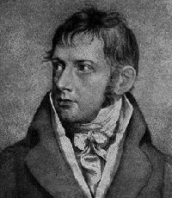
Modernity:
Classical Liberalism
F.D.E. Schleiermacher was the father of Classical Liberalism.
  It combined Romanticism with Christianity
  Jesus Christ is only a moral example
  Christianity is about feeling, not doctrine
He is also the father of modern hermeneutics.
  The Bible should be read like any other book.
  There is only a human author

Slide 38
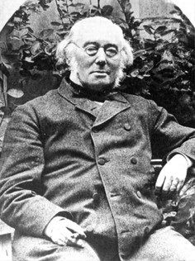
Modernity:
Classical Liberalism
Albrecht Ritschl was a Classical Liberal and a historian.
He founded the school of Classical Liberalism
He combined Classical Liberalism with the Historical Critical Method.

Slide 39
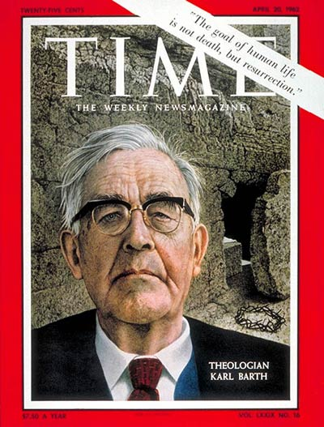
Modernity:
Neo-Orthodoxy
Karl Barth began as a Classical Liberal, but later rejected it.
He emphasized a return to the Bible and the creeds.
He still employed the historical critical method and operated with a hermeneutic of doubt.
He also employed existentialism in his interpretation.
He started Neo-orthodoxy

Slide 40
The Linguistic Turn
Within Analytic Philosophy

Slide 41
Modernity:
Analytic Philosophy
Analytic Philosophy arose in response to the Romanticism of Continental Philosophy.
It stressed the importance of logic and meaning.
Philosophy of language replaces epistemology as first philosophy. This is known as the linguistic turn.
There are five movements within Analytic Philosophy

Slide 42
Modernity:
Analytic Philosophy
Philosophy of Language
Epistemology
Metaphysics
Ethics

Slide 43
Analytic Philosophy:
Logical Realists
G.E. Moore and Bertrand Russell began the Analytic Philosophy movement.
The were joined by the early Ludwig Wittgenstein. His work The Tractatus was in accordance with these ideas
They were metaphysical realists and Common Sense Realists (epistemological).
These three started a new movement that gained many followers.

Slide 44
Analytic Philosophy:
Logical Positivists
The Logical Positivists began with the Vienna Circle (Otto Neurath, Moritz Schlick, Rudolf Carnap, and others) , who were joined by Alfred James Ayer.
The Logical Positivists were metaphysical nominalists (anti-metaphysicalists).
They were also radical empiricists.
They held to the Verification Principle- if something is not empirically verifiable, then it does not even make sense to talk about it.
Their position was attacked and defeated by the Ordinary Language Movement and the Post Positivist/ Physicalists

Slide 45
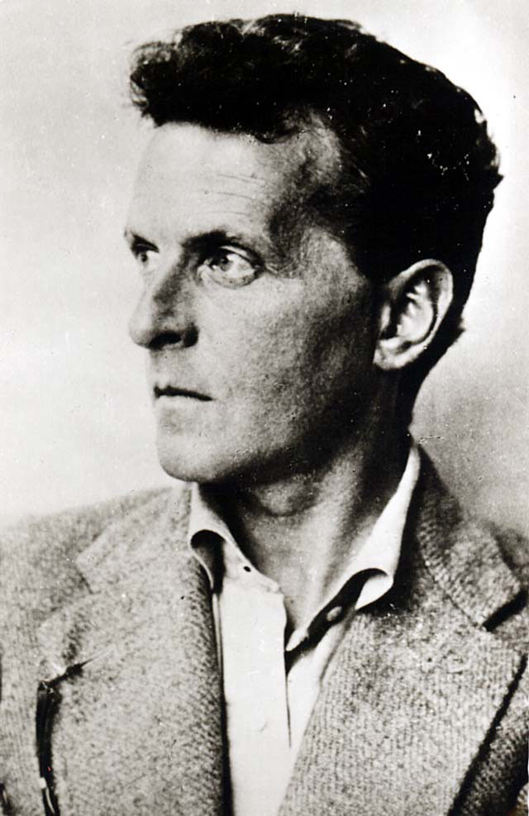
Analytic Philosophy:
Ordinary Language Analysis
The later Ludwig Wittgenstein started the Ordinary Language Analysts movement within the Analytic Philosophy movement.
They were anti-metaphysicalists, in other words they were metaphysical nominalists and idealists.
They believed that meaning is use. Meaning is found in the community. Speech Act Theory resulted from this movement.
OLA died in 1967. John Searle and Alasdair MacIntyre are the last holdouts of this movement.
OLA leads to post-modern thought

Slide 46
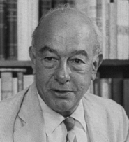
Analytic Philosophy:
Post Positivists/ Physicalists
The Physicalists attempted to reduce philosophy to science. They wanted to replace metaphysics with physics. They wanted to replace ethics and epistemology with psychology.
They include men like Willard Van Orman Quine, Wilfrid Sellars, D. M. Armstrong, and David Lewis.
Some were metaphysical nominalists and some were Aristotelian metaphysical realists

Slide 47
Analytic Philosophy:
The Cognitive Turn
With the Cognitive Turn, philosophy of mind replaces philosophy of language as first philosophy.
Ordinary Language Philosophy failed to properly deal with intentionality, compositionality and truth conditionals.
Post Positive/ Physicalists allowed for a variety of metaphysical positions that could handle truth conditionals. They did not provide a clear answer for language.
Philosophy of mind is a sub-discipline of metaphysics. Language, action, ethics and epistemology are now sub-disciplines of philosophy of mind. All can be understood in terms of realism and nominalism.

Slide 48
Analytic Philosophy:
The Cognitive Turn
Philosophy of Mind
Action Theory
Ethics
Philosophy of Language
Epistemology

Slide 49
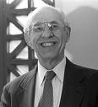

Analytic Philosophy:
The Cognitive Turn
Hilary Putnam
Saul Kripke

Slide 50
Analytic Philosophy:
The Cognitive Turn: Linguistic Essentialism
Saul Kripke employed modal logic to explore language and meaning. He concluded that meaning is tied to metaphysical essences.
Kripke began a movement known as Linguistic Essentialism. This movement includes Alvin Plantinga, David Owen Brink and many others.
Hilary Putnam was a Physicalist who introduced the concept of semantic externalism. He also introduced the concept of the causal theory of meaning.
Their ideas in philosophy of language are the state of the art.

Slide 51
Postmodernity
1950- Present
Metaphysical Nominalism

Slide 52
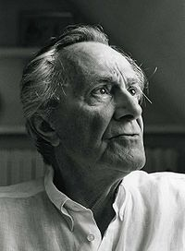
Post-Modernity
Jean Francois Lyotard
Jean Francois Lyotard was a literary critic.
He was against all types of universals (forms). As an extreme nominalist he rejected generalities and meta-narratives.
He argued that post-modernity is incredulity against meta-narratives.
He is also known for arguing that post-modernity has a hermeneutic of suspicion.

Slide 53
Postmodern Philosophy
 | Metaphysics | Relation to the world | Explanation
Philosophy of Mind | nominalism | internalism | deontology
Epistemology | nominalism | Internalism- Knowledge is justified true belief | deontology
Philosophy of Language | nominalism | Semantic internalism-Use theory of meaning | deontology
Action Theory | nominalism | externalism | deontology
Ethics | nominalism | externalism | deontology
Theory of Truth | Deflationary theories | No relation to the real world

Slide 54
Post-Modern Action Theory for Communication
Agent: Transmitter
Agent: Receiver
Motive: Agent has BELIEF/ DESIRE to communicate
Many Actions: Agent uses internalist epistemology to order language (words, syntax, and grammar).
Ethics: Agent is not regulated
Process is deontological
Motive: Agent has BELIEF/ DESIRE to interpret information (transmitter is dead and has no rights over information).
Many Actions: Agent uses internalist epistemology to process information into language (words, syntax, grammar).
Ethics: Agent is regulated by hermeneutic of suspicion and community standards
Process is deontological

Slide 55
Postmodernity: The Text
Parts and Whole
Value
Metaphysical nominalism suggests that the parts have priority over the whole
Intrinsic value- the value of the text is determined solely by the subjective values of the community.
Instrumental Value- determined by the degree to which is fulfills the desires of the community
Principle of Summation- the value of a text is found in the sum of all of its parts.

Slide 56
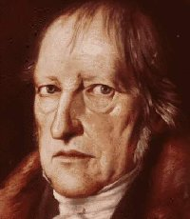
Hermeneutical Phenomenology
G.W.F. Hegel was a modern Continental Philosopher who was heavily influence by Spinoza’s panentheism, Kant’s idealism and Romanticism.
He was a metaphysical nominalist and idealist who emphasized the concept of Geist (collective human spirit). He thought that history was moving towards Absolute Spirit.
He believed that whole has priority over the parts, so his philosophy was based around the community and had little or no place for the individual.

Slide 57
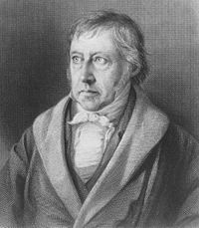
Hermeneutical Phenomenology
Hegel was an advocate for a type of virtue ethics because he emphasized the community. He thought that language is the essential part of the community.
Among his many works, he wrote Phenomenology of the Spirit and Phenomenology of the Mind
Hegel developed the idea of phenomenology. This is an epistemology based not on empiricism, but experience.

Slide 58

Hermeneutical Phenomenology
Edmund Husserl was a student of Franz Brentano. He studied Descartes and Kant. He was also heavily influenced by the writings of Hegel.
He was the founding editor for The Journal of Philosophy and Phenomenological Research.
He wrote, among other works, Ideas Pertaining to a Pure Phenomenology and Phenomenological Philsophy, and Lectures on the Phenomenology of Inner Time Consciousness.

Slide 59
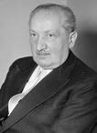
Post-Modernity:
Hermeneutical Phenomenology
Martin Heidegger was an atheistic metaphysical nominalist philosopher who combined existentialism with phenomenology. He was a student of Husserl and was heavily influenced by Hegel.
His most significant work is Being and Time. He tied meaning to being, thereby starting the Hermeneutical Phenomenology movement.
He led the Continental Philosophers into the linguistic turn.

Slide 60
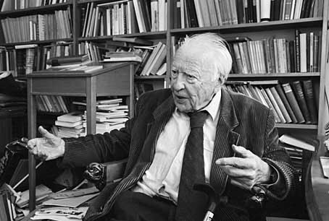
Post-Modernity:
Hermeneutical Phenomenology
Hans Georg Gadamer was a student of Martin Heidegger.
He attempted to complete Heidegger’s hermeneutical phenomenology.
His main work was Truth and Method. Gadamer's goal was to uncover the nature of human understanding. In the book Gadamer argued that "truth" and "method" were at odds with one another.

Slide 61

Post-Modernity:
Hermeneutical Phenomenology
Paul Ricoeur was a Huegenot who was also a Hermeneutical Phenomenologist. He was influenced by Hegel Husserl, Jean Paul Sartre, and Albert Camus.
He was a theologian and philosopher who had a strong interest in the Bible.
His major work was Time and Narrative.

Slide 62

Post-Modernity:
Hermeneutical Phenomenology
Jacques Derrida was the assistant of Paul Ricoeur. He is heavily influenced by Heidegger and G.W.F. Hegel.
He argued that meaning is found only in the reader. He also believed that the author of a text is dead and has no right to the meaning of the text.
He is known for Deconstruction, which is a reaction against structuralism for meaning.

Slide 63

Post-Modernity
Structuralism
Structuralism is an idea that began with Ferdinand Saussure. He argued that meaning is found in the community rather than the individual. He developed semiotics, the study of signs.
Saussure was followed by Claude Levi-Strauss, Roland Barthes, Jacques Lacan, and Michelle Foucault (the Gang of Four)
Lacan and Foucault broke away and began Post-structuralism because they found structuralism too confining.

Slide 64


Gang of Four:
Structuralists
Claude Levi Strauss
Roland Barthes

Slide 65


Gang of Four:
Post-Structuralis
Jacques Lacan
Michel Foucault

Slide 66
Postmodernity
Post-modernity is based on the idea that we cannot know an objective reality. It is a mixture of ideas that all lead to the same place.
Ordinary Language Analysis argues that nothing exists outside of language. It is the community that determines meaning and morality.
The Structuralists argued that meaning, truth and morality is found in the community.
The hermeneutical phenomenologists argue that everything is relative to the community.

Slide 67
Conclusion:
Hermeneutics is tied to metaphysics.
Metaphysical realists understand that meaning has a transcendental nature.
Pre-modern theologians were metaphysical realists who realized that the Bible is a special book that requires a hermeneutic of trust for one to interpret it Christianly.
Modern and Post-modern scholars are metaphysical nominalists. Their hermeneutical methods are reductionistic. As such, they have nothing to offer the reader of the Bible

