Slide 1
Philosophy of Language
Craig Vincent Mitchell
Assistant Professor of Christian Ethics
Southwestern Baptist Theological Seminary

Slide 2
Important Distinctions
Philosophy of Language- a philosophical investigation into the nature of language.
Linguistics- the scientific study of language.
Hermeneutics- is the art and science of interpretation. Philosophical hermeneutics attempts to relate interpretation with certainty. It is not really concerned with language.
These three areas of study are not the same!

Slide 3
Continental Philosophy
Continental Philosophy made no contributions to philosophy of language.
Continental philosophy is concerned only with HERMENEUTICS. Continental Philosophy includes the following fields:
  Existentialism
  Phenomenology
  Structuralism: includes semiotics
  Post- structuralism

Slide 4
Major Divisions in Philosophy of Language
Both Philosophy of Language and Linguistics encompass a number of sub-fields, such as:
Syntax- language structure or grammar
Semantics - covers the meaning of sentences and phrases. But there is more to meaning than can be gained from semantics.
Pragmatics- the study of meaning in different contexts. Pragmatics attempts to discover the different ways in which social context influences what a speaker says and what the hearer understands. For example; word choice, facial expression, posture, vocal tone and situation all influence the meaning of a sentence or phrase. Speech acts are one area of study in pragmatics.

Slide 5
The History of Philosophy of Language
Philosophy of Language, when properly understood is a part of philosophy of mind
As such, Philosophy of Language is really a sub-discipline of metaphysics
Within Analytic Philosophy, philosophy of Language replaced epistemology as “first philosophy.” This is known as the “linguistic turn.”
Philosophy of Mind has supplanted Philosophy of Language as “first philosophy” within Analytic Philosophy. This is known as the “cognitive turn.”

Slide 6
The History of Philosophy of Language
British Empiricists- epistemology replaces metaphysics as “first philosophy”. AKA “the epistemological turn.” They employed the ideational theory of meaning
Early Analytic Philosophy- Founded by G.E. Moore and Bertrand Russell. Philosophy of language replaces epistemology as “first philosophy.” AKA the “Lingustic Turn”
Late Analytic Philosophy- philosophy of mind replaces philosophy of language as “first philosophy.” “the Cognitive Turn.”

Slide 7

British Empiricists:
John Locke
Ideational theory of meaning- A theory holding that the meaning of a word is the idea with which it is regularly associated or for which it stands. According to the theory, ideas are private and independent of language. Language is a tool for providing publicly observable indications of private ideas and to convey these ideas to others. A linguistic expression gets its meaning by being used to indicate ideas. The classical version of this theory was elaborated by Locke in his Essay Concerning Human Understanding, I, 2, III.

Slide 8
British Empiricists:
John Locke
John Locke says: “The use, then, of words is to be sensible marks of ideas; and the ideas they stand for are their proper and immediate signification.” Since the ambiguous word “idea” for Locke refers to mental images, this theory is also called the “image theory of meaning.” The strength of this theory is that it catches the insight that language is an instrument for the communication of thought.

Slide 9
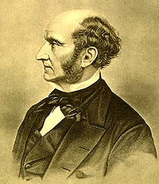
British Empiricists:
John Stuart Mill
In the System of Logic, Mill accepts the traditional doctrine that propositions as used to describe the world are divided into subject and predicate terms, or, as he would say, names, joined by a copula, either affirmative or negative. Among names there are singular and general. All names denote, either individuals or the attributes of individuals. Names are either singular or general.

Slide 10
British Empiricists:
John Stuart Mill
A general name connotes an attribute and denotes all individuals which have that attribute. Thus, ‘white’ connotes the attribute whiteness, and denotes all things that have that attribute. Some singular names only denote; they have no connotation. ‘Caesar’ is such a name. However, many singular names not only denote, they also have a connotation. Thus, ‘the conqueror of Gaul’ is a singular name. It denotes the same individual as is denoted by ‘Caesar’, but unlike ‘Caesar’ it also connotes; it connotes the attribute of being a conqueror of Gaul. In terms of logic, Mill is less concerned that later thinkers would be about the uniqueness implied by the connotation: Caesar is not only a conqueror of Gaul but the conqueror.

Slide 11
British Empiricists:
John Stuart Mill
In a proposition, names are joined by a copula, either affirmative or negative. The meaning of a proposition—its “import”, as Mill says—is determined by the connotation of its parts, the sole exception being given in the case of proper names, where the meaning is determined by the denotation.

Slide 12
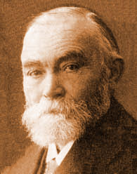
Friedrich Ludwig
Gottlob Frege
He was a German philosopher , mathematician and logician who taught at the University of Jena.
Frege suggested that the terms of a language have both a sense and a denotation, i.e., that at least two semantic relations are required to explain the significance or meaning of the terms of a language. This idea has inspired research in the field for over a century and we discuss it in what follows.

Slide 13
Friedrich Ludwig
Gottlob Frege
Frege developed the theory of sense and denotation into a thoroughgoing philosophy of language. This philosophy can be explained, at least in outline, by considering a simple sentence such as ‘John loves Mary’. In Frege's view, the words ‘John’ and ‘Mary’ in this sentence are names, the expression ‘loves’ signifies a function, and, moreover, the sentence as a whole is a complex name. Each of these expressions has both a sense and a denotation. The sense and denotation of the names are basic; but sense and denotation of the sentence as a whole can be described in terms of the sense and denotation of the names and the way in which those words are arranged in the sentence alongside the expression ‘loves’.

Slide 14
Analytic Philosophy
Analytic Philosophy has five major movements
  The Logical Realists were metaphysical realists.
  The Logical Positivists rejected metaphysics altogether.
  The Ordinary Language Philosophers rejected metaphysics. They also rejected the ideas of Logical Positivists.
  Post- Positivist Physicalists- affirmed metaphysics (most were nominalists). They rejected the ideas of the Logical Positivists and the Ordinary Language Philosophers
  Linguistic Essentialists- affirmed metaphysical realism and made philosophy of mind “first philosophy.” Philosophy of Mind or metaphysics replace philosophy of language as “first philosophy.”

Slide 15
Analytic Philosophy
Logical Realists
The Logical Realists began with G.E. Moore, who wrote Principia Ethica
Moore was followed by Bertrand Russell
The early Ludwig Wittgenstein was a member of the Logical Realist group
  He was a student of Russell
  He wrote The Tractatus

Slide 16

Analytic Philosophy
Logical Realists
Bertrand Russell was a Logical Realist
He rejected Frege’s ideas.
Direct Reference Theory of meaning- claims that the meaning of an expression lies in what it points out in the world.
Russell held to a correspondence theory of truth

Slide 17
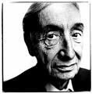
Analytic Philosophy
Logical Positivists
Alfred Jules Ayer was a Logical Positivist and rejected metaphysics.
He wrote Language Truth and Logic
Verification Principle- If something is not empirically verifiable it does not make sense to talk about it.
Employed Tarski’s or the Semantic theory of truth

Slide 18
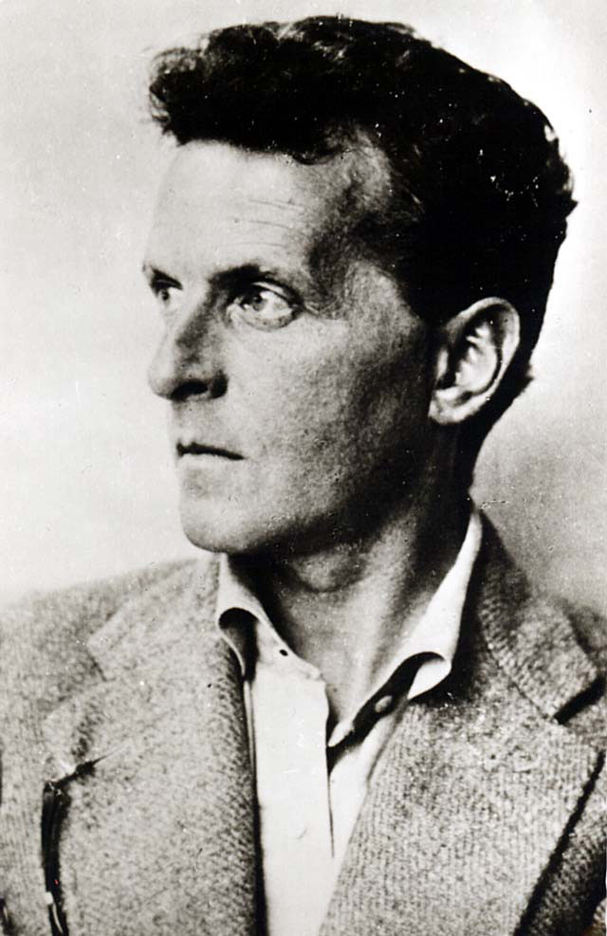
Analytic Philosophy
Ordinary Language Philosophy
The later Ludwig Wittgenstein started the Ordinary Language Philosophy (OLP) movement along with John Wisdom and others after he departed from the Logical Realists.
He rejected his earlier ideas
He wrote Philosophical Investigations
He argued that “meaning is use.”

Slide 19
Analytic Philosophy
Ordinary Language Philosophy
Philosophical problems arise from misunderstanding and misusing ordinary expressions.
Philosophy is concerned with questions of conceptual necessity, rather than empirical or contingent matters
Necessity is linguistic in origin
They employed Tarki’s Semantic Theory of Truth and P.F. Strawson’s Performative Theory of Truth
They rejected the Verification Principle of the Logical Positivists

Slide 20
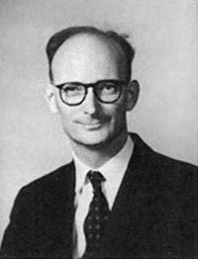
Analytic Philosophy
Ordinary Language Philosophy
John Langshaw Austin (1911-1960) wrote How to do Things with Words
Austin is widely associated with the concept of the speech act and the idea that speech is itself a form of action. Consequently, in his understanding language is not just a passive practice of describing a given reality, but a particular practice to invent and affect those realities.

Slide 21
Analytic Philosophy
Ordinary Language Philosophy
Speech Acts include:
  Locutions- uttering words (i.e., saying “hello”)
  Illocutions- what we do when we say something (i.e., greeting, promising, commanding)
  Perlocutions- what we bring about by saying something (i.e., persuading, surprising)

Slide 22

Analytic Philosophy
Ordinary Language Philosophy
John Searle was a Ordinary Language Philosopher
He worked with J.L. Austin on Speech Act Theory
The Mediated Reference Theory is a semantic theory that posits that words refer to something in the external world, but insists that there is more to the meaning of a name than simply the object to which it refers.
His recent works are in philosophy of mind because he was concerned with “intentionality.”

Slide 23
Analytic Philosophy
Ordinary Language Philosophy
Speech Act Theory fails to deal with intentionality.
Speech Act Theory fails to deal with the problem of “truth conditionals.”
Speech Act Theory fails to deal with compositionality
Speech Act Theory does less that punctuation
Speech Act Theory has nothing in common with Action Theory (the study of actions and events)
Speech act theory should not be confused with speech acts

Slide 24

Analytic Philosophy
Ordinary Language Philosophy
H.P. Grice held to the ideational theory of meaning.
His main idea is called “Conversational Implicature.”
Ordinary Language Philosophy came to an end in 1967 with his lecture “Logic and Conversation” at Harvard University.
He showed that meaning is not use and that a separate theory of semantics is required.

Slide 25
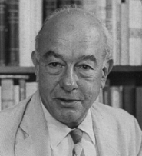
Analytic Philosophy
Post- Positivist Physicalists
Willard Van Orman Quine was a leader in the Post-Positivist Physicalist movement. He taught at Harvard University.
He was also a pragmatist.
He destroyed the Logical Positivists with his article “The Two Dogmas of Empiricism.”
He opposed the OLP movement.

Slide 26

Analytic Philosophy
Post- Positivist Physicalists
Donald Davidson wrote the article “Truth and Meaning.”
Davidson argued that "giving the meaning of a sentence" was equivalent to stating its truth conditions, so stimulating the modern work on truth conditional semantics.

Slide 27
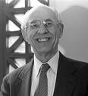
Analytic Philosophy
Post- Positivist Physicalists
Hilary Putnam is a moderate nominalist and pragmatist.
He accepts material and efficient causation. Consequently, he holds to a Causal Theory of Meaning.
He invented the term “semantic externalism.”

Slide 28
Analytic Philosophy
Post- Positivist Physicalists
Hilary Putnam is generally considered to have invented semantic externalism in his 1975 paper "The Meaning of 'Meaning'", and the Twin Earth thought experiment he employed there to argue for the position is frequently cited in arguments over externalism to this day.

Slide 29

Analytic Philosophy
Linguistic Essentialists
Saul Kripke wrote Naming and Necessity. He related meaning to essences by the use of possible worlds.
Kripke’s approach to these problems admit the use of intentions.
Additionally, this method correlates intentions to states of affairs in the world and in possible worlds.
He agrees with Mill and rejects Frege’s ideas.

Slide 30
The Ontology of
Philosophy of Language
Philosophy of language is influenced by whether one is a metaphysical realist or nominalist
If one is a metaphysical realist he holds to externalism (moderate nominalists can also hold to externalism)
If one is a metaphysical nominalist he is usually an internalist

Slide 31
The Ontology of
Philosophy of Language
The terms “internalism” and “externalism” come from philosophy of mind
Internalism is the belief that the contents of our thoughts arise independently of an outside reality
Externalism- is the belief that the contents of our thoughts arise at least partially from the world external to the individual.

Slide 32
The Ontology of
Philosophy of Language
Most philosophers are metaphysical nominalists.
Most approaches taken in philosophy of language have been dominated by nominalists.
Some approaches to philosophy of language are characterized by semantic internalism.
The Contemporary scene in philosophy of language is dominated by semantic externalism because of the reaffirmation of metaphysics by the PPP and the LE.

Slide 33
Semantic Internalism
Semantic internalism suggests that the contents of our minds is the only source for meaning and language.
The British Empiricists held to a form of semantic internalism known as the ideational theory of meaning.
Semantic internalism is consistent with metaphysical nominalism and is not compatible with a correspondence theory of truth.

Slide 34
Semantic Internalism
There are a few reasons that semantic internalism and the ideational theory of meaning is the minority view. William Lycan notes that there is no clear explanation of the kind of mental entity that an idea is. He then notes that there are too many words that have no mental images attached to them. Some meaningful sentences do not actually present any idea. Finally, there is the problem of subjectivity.

Slide 35
Semantic Externalism
Semantic externalism- suggests that the content of our minds and languages is at least in part due to things external to the individual. An example of semantic externalism can be seen in the work of the Linguistic Essentialists. Semantic externalism is consistent with metaphysical realism and a correspondence theory of truth
Causal Theory of Meaning-A theory of meaning based on the work of Saul Kripke (Naming and Necessity). This approach relates metaphysical essences, with intentions and meaning.

Slide 36
Semantic Externalism
The contemporary scene in philosophy of language is still attempting to employ the ideas of Kripke and Putnam. In other words, The project that these men started has yet to be finished.
Semantic externalism also allows for the meaning being employed with possible worlds. This includes the ideas of intensionality and extensionality. These terms have a different meaning from the way that they are employed in philosophy of mind.

Slide 37
Semantic Externalism
Intension refers to the set of all possible things a word or phrase could describe. An intension is any property or quality connoted by a word, phrase or other symbol.
Extension- refers to the set of all actual things the word describes. In other words, Extension concerns the denotation of a word.
The intension of dog, is like a platonic form or universal that can refer to any concept of dog in any possible world. However, the extension of dog refers only to all actual dogs that have ever, or will ever exist.

Slide 38
Semantic Externalism
Another example of this For an example of extension, consider that Bruce Wayne is also the Batman, the Detective and the Dark Knight. But if we are viewing Bruce Wayne by intension, we do not mean any of these other names or identities.
Intensionality involves connotation, while extensionality involves denotation.

Slide 39
Semantic Externalism
Linguistic semantic externalism- the meaning of a word is environmentally determined.
Cognitive semantic externalism- concepts (or contents) are available to a thinker are determined by their environment, or their relation to their environment.

Slide 40
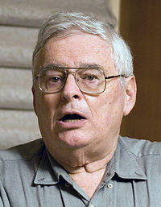
Semantic Externalism and Philosophy of Mind
Jerry Fodor is a philosopher of mind and language. His contributions in this area include the Asymmetric Causal Theory of Reference
Fodor strongly opposes reductive accounts of the mind.
He argues that mental states are multiply realizable and that there is a hierarchy of explanatory levels in science such that the generalizations and laws of a higher-level theory of psychology or linguistics.

Slide 41
Semantic Externalism and philosophy of Mind
Fodor argues that mental states, such as beliefs and desires, are relations between individuals and mental representations. He maintains that these representations can only be correctly explained in terms of a Language of Thought in the mind. Further, this language of thought itself is an actually existing thing that is codified in the brain and not just a useful explanatory tool. Fodor adheres to a species of functionalism, maintaining that thinking and other mental processes consist primarily of computations operating on the syntax of the representations that make up the language of thought.

Slide 42
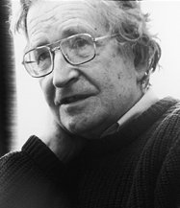
Semantic Internalism and Linguistics
In the 1950s, Chomsky began developing his theory of generative grammar, which has undergone numerous revisions and has had a profound influence on linguistics. His approach to the study of language emphasizes "an innate set of linguistic principles shared by all humans" known as universal grammar, "the initial state of the language learner," and discovering an "account for linguistic variation via the most general possible mechanisms.”

Slide 43
Semantic Internalism and Linguistics
Chomsky also established the Chomsky hierarchy, a classification of formal languages in terms of their generative power. In 1959, Chomsky published a widely influential review of B.F. Skinner's theoretical book Verbal Behavior, which was the first attempt by a behaviorist to provide a functional, operant analysis of language. Chomsky used this review to broadly and aggressively challenge the behaviorist approaches to studies of behavior dominant at the time, and contributed to the cognitive revolution in psychology. His naturalistic approach to the study of language has influenced the philosophy of language and mind.

Slide 44
Conclusions
Philosophy of language has been subsumed under philosophy of mind
Philosophy of mind is a branch of metaphysics
Philosophy of mind and linguistics have much in common but they differ in their views of intentionality.
Contemporary Philosophy of Language is dominated by semantic externalism.
There is still much work to be done in semantic externalism.

