Slide 1
A History of the American Political Economy
Craig Vincent Mitchell, PhD
Associate professor of Christian Ethics
Director of the Land Center for Cultural Engagement

Slide 2
American Economy
Before the Revolution
The United Kingdom was colonial America’s dominant trading partner because of mercantilism
56% of American exports went to the UK, while 80% of American imports came from the UK
18% of exports went to southern Europe, while 2% of imports to America came from southern Europe
26% of American exports went to West Indies while 18% of imports came from the west Indies
.1% of American exports went to Africa while 1% of imports came from Africa

Slide 3
Pre- revolutionary
American Economy
20% of New Englanders owned 66% of the total wealth
In the middle colonies 20% held 53% of the total wealth
In the southern colonies 20% held 70% of total wealth

Slide 4
The Articles of Confederation: A Confederal System of Government
League of equal and sovereign members
Abstinence on part of central government from internal administration or governance
Member units only effect people directly
Equal suffrage of member units

Slide 5
The Articles of Confederation: A Confederal System of Government
Based upon the Iroquois Confederacy, which had existed since the 14th or 15th century. Known as the “Great Law of Peace” which describes a federal union of five (and later six) Indian nations. Benjamin Franklin was greatly influenced by this model of government. He followed the advice of Canassatego (speaker of the Onandaga) that the colonies form a similar government. The Articles of the Confederation were agreed to by Congress November 15, 1777, ratified in force, March 1, 1781.

Slide 6
The Founder’s Political Economy
The founders took their position based on their view of the Constitution. The Federalists were for the Constitution while the Anti-federalists were against it. There was no one view in regard to what form the economy should take.
Founder | John Adams | Thomas Jefferson | James Madison | Alexander Hamilton
Politics |  | Anti-federalist | Federalist | Federalist
Economics | Mercantilist | Physiocrat: He wanted an agrarian society with small communities | Malthusian: no systematic economic thought | Free market: He wanted a strong national economy that could grow and compete with the other world powers

Slide 7
Federalism
Constitutional division (or sharing) of governmental powers
Each government supreme in its own sphere
Both governments act directly over people
Both derive their power from the constitution
neither dependent upon the other for its existence

Slide 8
The History of American Federalism
Nation Centered Federalism 1787-1860s | National government is free to expand authority unless specifically prohibited by the constitution When states and national government are in dispute, the states must give way National government can judge acts of Congress and of the states as constitutional
State Centered 1787-1860s | National government has delegated powers only National government has no right to judge constitutionality of state actions States have right to nullify actions within their boundaries
Dual Federalism 1860-1930s | Separate spheres of legitimate authority Spheres should not encroach upon one another Role of the courts to referee in case of conflicts Court rulings are generally friendly to the states Beginning of grants in aid
Cooperative Federalism 1930-1970s | The New Deal | Shared federal/ state activities Court rulings generally favorable to the national government Growth of grants in aid
 | The Great Society | Explosion of grants in aid Direct federal aid to city programs Strong emphasis on nationally set priorities and goals Functional shift in grants from “bricks and mortar” to social needs
Coercive Federalism 1970s-2000 | Increasing use of federal mandates and preemptions Court decisions favorable to the national government
Rediscovered Federalism | Increasing state challenges to federal legislation Increasing policy activism at state level state friendly court decisions

Slide 9
Political Parties
The political parties initially formed on the basis of their views about the U.S. Constitution. The Federalists were for the Constitution, while the Anti-Federalists were against it. The parties went on to later reflect their economic views as well.
Age | Political Parties
 | Federalists | Anti-federalists
Dual Federalism | Whigs | Democratic Republicans
Cooperative Federalism | Republicans | Democrats/ Progressives

Slide 10
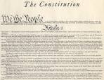
U.S. Constitution
The U.S. constitution explains what the duties and responsibilities are given to the federal government.
It also explains the process by which it is to be done.

Slide 11
Preamble to the U.S. Constitution
We the People of the United States, in Order to form a more perfect Union, establish Justice, insure domestic Tranquility, provide for the common defence, promote the general Welfare, and secure the Blessings of Liberty to ourselves and our Posterity, do ordain and establish this Constitution for the United States of America.

Slide 12
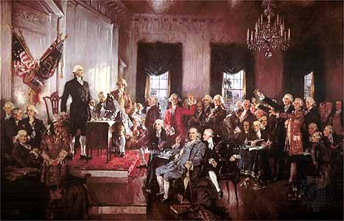
U.S. Constitution
All of the signers of the U.S. Constitution had an idea mind when they put together the document.
They did not all have the same economic theory in mind when they put it together.
This resulted in a great deal of political wrangling about how the U.S. economy should work

Slide 13

Article 7 of the U.S. Constitution
All Bills for raising Revenue shall originate in the House of Representatives; but the Senate may propose or concur with Amendments as on other Bills.

Slide 14
Constitutional Expenses:
Article 8
Federal
Expenses
Defense
Justice
General Welfare

Slide 15
Constitutional Revenue:
Article 8
Federal Revenue
Taxes
Duties
Imposts and Excises

Slide 16
Dominant Economic Theories
Among the Founders
Economic Theories
Mercantilism
Free Markets
Physiocrats

Slide 17
Mercantilism/ Thomas Malthus
Mercantilism is the doctrine that says government control of foreign trade is of paramount importance for ensuring the prosperity and security of a state. In particular, it demands a positive balance of trade. In thought and practice it dominated Western Europe from the 16th to the late-18th century

Slide 18

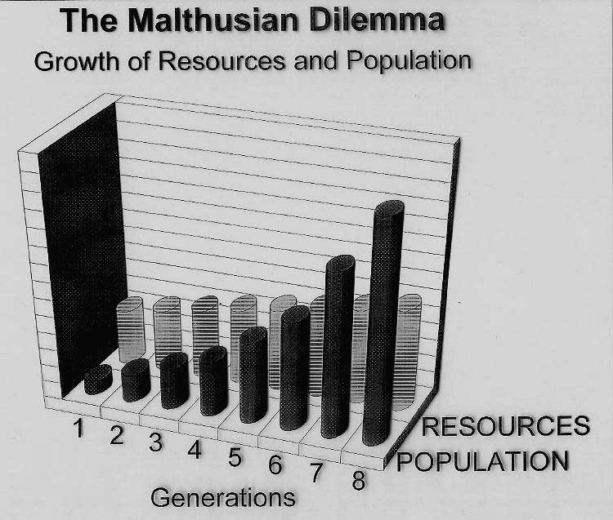
Mercantilism
Thomas Robert Malthus
The Malthusian Problem

Slide 19
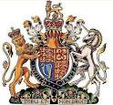
Mercantilism
In the British Empire, mercantilists intended to achieve power and wealth for the state.
Mercantilists passed and enforced strict legislation that regulated economic life in the colonies.

Slide 20
Mercantilism
All trade of the colonies was to be carried in vessels that were English built and owned. Theses vessels were commanded by a British captain and manned by a crew that were three quarters British.
Foreign merchants were forbidden from dealing with the commerce of the English colonies.
Goods like sugar, tobacco, cotton, indigo, ginger and various dyewoods could only be exported to England

Slide 21

French Physiocrats
PHYSIOCRATS
French Coat of Arms
a group of economists who believed that the wealth of nations was derived solely from the value of "land agriculture" or "land development." Their theories originated in France and were most popular during the second half of the 18th century. Physiocracy is perhaps the first well-developed theory of economics.

Slide 22
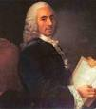
French Physiocrats:
Francois Quesnay
In 1758 he published the Tableau économique (Economic Table), which provided the foundations of the ideas of the Physiocrats. This was perhaps the first work to attempt to describe the workings of the economy in an analytical way, and as such can be viewed as one of the first important contributions to economic thought.

Slide 23
French Physiocrats:
Francois Quesnay
The publications in which Quesnay expounded his system were the following: two articles, on "Fermiers" and on "Grains", in the Encylopedie of Diderot and D’ Alembert (1756, 1757); a discourse on the law of nature in the Physiocratie of Dupont de Nemours (1768); Maximes générales de gouvernement economique d'un royaume agricole (1758), and the simultaneously published Tableau économique avec son explication, ou extrait des économies royales de Sully (with the celebrated motto, Pauvres paysans, pauvre royaume; pauvre royaume, pauvre roi); Dialogue sur le commerce et les travaux des artisans; and other minor pieces.

Slide 24
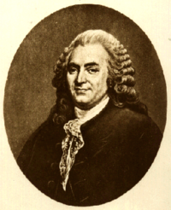
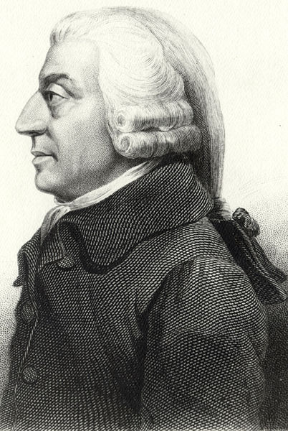
Free Markets
Bernard Mandeville
Adam Smith

Slide 25
Free Markets
Bernard Mandeville wrote The Fable of the Bees
subscribed to the division of labor
He concluded that vice, at variance with the "Christian virtues" of his time, was a necessary condition for economic prosperity. His viewpoint is more severe when juxtaposed to Adam Smith’s.
Both Smith and Mandeville believed that individuals’ collective actions bring about a public benefit

Slide 26
Adam Smith: Wealth of Nations
Book V; Of the Revenue of the Sovereign or Commonwealth
Chapter I; Of the Expenses of the Sovereign or Commonwealth
Part 1; Of the Expense of Defense
The first duty of the sovereign, therefore, that of defending the society from the violence and injustice of other independent societies, grows gradually more and more expensive, as the society advances in civilization. The military force of society, which originally cost the sovereign no expense either in time of peace or in time of war, must, in the progress of improvement, first be maintained by him in time of war, and afterwards even in time of peace.

Slide 27
Adam Smith: Wealth of Nations
Book V; Of the Revenue of the Sovereign or Commonwealth
Chapter I; Of the Expenses of the Sovereign or Commonwealth
Part II; The Expense of Justice
The second duty of the sovereign, that of protecting, as far as possible, every member of society from the injustice or oppression of every other member of it, or the duty of establishing an exact administration of justice.

Slide 28
Adam Smith: Wealth of Nations
Book V; Of the Revenue of the Sovereign or Commonwealth
Chapter I; Of the Expenses of the Sovereign or Commonwealth
Part III; of the Expense of Public Works and Public Institutions
The third and last duty of the sovereign or commonwealth is that of erecting and maintaining those public institutions and those public works, which are useful but not capable of bringing in a profit to individuals.

Slide 29
The Economics of the American Founders

Slide 30

Mercantilism: John Adams
John Adams was a founding father and eventually President of the United States. His son, John Quincy Adams also became President of the United States.
He opposed the ideas of Alexander Hamilton
He negotiated many trade treaties.

Slide 31

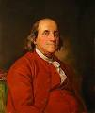
American Physiocrats:
Thomas Jefferson
Benjamin Franklin

Slide 32
American Physiocrats
Working closely with Aaron Burr of New York, Jefferson rallied his party, attacking the new taxes especially, and ran for the Presidency in 1800. Before the passage of the 12th amendment, a problem with the new union's electoral system arose.
Hamilton convinced his party that Jefferson would be a lesser political evil than Burr and that such scandal within the electoral process would undermine the new constitution. On February 17, 1801, after thirty-six ballots, the House elected Jefferson President and Burr Vice President.
The physiocrats thought that America should focus on agriculture and would not be involved with international trade

Slide 33

Free Markets: Alexander Hamilton
Alexander Hamilton (January 11, 1755 or 1757 – July 12, 1804) was a founding father, soldier, economist, political philosopher, one of America's first constitutional lawyers and the first United states Secretary of the Treasury.

Slide 34
Free Markets: Alexander Hamilton
Alexander Hamilton has been described as one who "more than any other designed the Government of the United States: As Secretary of the Treasury, Hamilton was the primary author of the economic policies of the George Washington administration, especially the funding of the state debts by the Federal government, the establishment of a national bank, a system of tariffs, and friendly trade relations with Britain

Slide 35
Free Markets: Alexander Hamilton
In the two years, Hamilton submitted five reports:
  First Report on the Public Credit: Communicated to the House of Representatives, January 14, 1790.
  Operations of the Act Laying Duties on Imports: Communicated to the House of Representatives, April 23, 1790.
  Second Report on Public Credit: Report on a National Bank. Communicated to the House of Representatives, December 14, 1790.
  Report on the Establishment of a Mint: Communicated to the House of Representatives, January 28, 1791.
  Report on Manufactures: Communicated to the House of Representatives, December 5, 1791.

Slide 36

First Bank of the United States
Hamilton intended for the bank to issue notes that would replace some of the gold and silver in circulation.
He thought that with the bank the U.S. would not have to export in order to increase the stock of its money.
It ended in 1811

Slide 37

First Bank of the United States
Aaron Burr and others fought against the first bank of the U.S. because:
It was unconstitutional
It would create a money monopoly
It helped the commercial North but not the agricultural South

Slide 38

The Second Bank of the U.S.
Chartered in 1816
Andrew Jackson and the democrats fought the recharter of the second bank of the U.S.

Slide 39
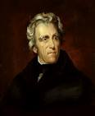
Andrew Jackson:
Democratic Republican
Andrew Jackson was the seventh president of the United States. He stood against the central bank. His opposition resulted in its collapse
In January 1835, Jackson paid off the entire national debt, the only time in U.S. history that has been accomplished.
The accomplishment was short lived. A severe depression from 1837 to 1844 caused a tenfold increase in national debt within its first year.[

Slide 40
The Contemporary Situation
The Whig Party
Abraham Lincoln and the Republican Party
The Progressives

Slide 41

The Whigs
The Whigs celebrated Clay's vision of the "American System" that promoted rapid economic and industrial growth in the United States. Whigs demanded government support for a more modern, market-oriented economy, in which skill, expertise and bank credit would count for more than physical strength or land ownership

Slide 42
The Whigs
. Whigs sought to promote faster industrialization through high tariffs, a business-oriented money supply based on a national bank and a vigorous program of government funded "internal improvements," especially expansion of the road and canal systems. To modernize the inner America, the Whigs helped create public schools, private colleges, charities, and cultural institutions. Many were pietistic Protestant reformers who called for public schools to teach moral values and proposed prohibition to end the liquor problem.

Slide 43
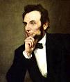
The Whigs
Abraham Lincoln began his political career as a member of the Whig party.
He later moved to the Republican party and became President of the United States
His econ0mics were in sympathy with the Whig party.

Slide 44
The Progressives
.
Progressivism is a political attitude favoring or advocating changes or reform through governmental action.
The term progressivism emerged in reference to a more general response to the vast changes brought by industrialization: an alternative to the traditional conservative response to social and economic issues and, despite being associated with left wing politics, to the various more radical streams of communism or anarchism.

Slide 45
The Progressives
The Progressive Movement began in the late 19th and early 20th centuries in cities with settlement workers and reformers who were interested in helping those facing harsh conditions at home and at work. The reformers spoke out about the need for laws regulating tenement housing and child labor. They also called for better working conditions for women.

Slide 46
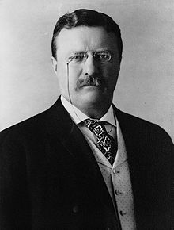
The Progressive Party
The Progressive Party, organized at the start of the 20th century, and progressivism made great strides under the American president Theodore Roosevelt.
Roosevelt served two terms as a President in the Republican Party
He ran for a third term in the progressive Bull Moose Party

Slide 47
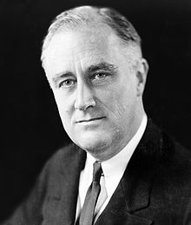
Progressives and the Democratic Party
After Theodore Roosevelt the progressives moved into the Democratic Party.
Major figures include; Woodrow Wilson, Franklin Delano Roosevelt, and Lyndon Baines Johnson.

Slide 48
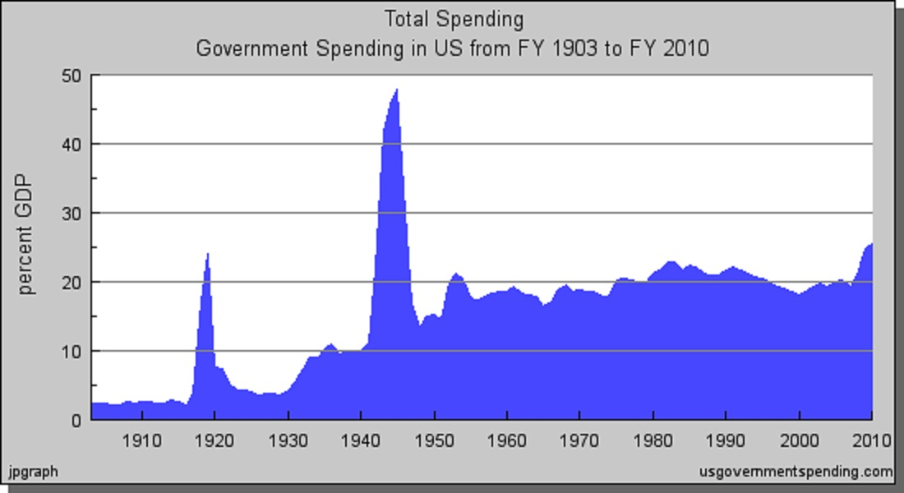
Federal Spending as Percentage of GDP

