Slide 1
The Progressive Movement
Craig Vincent Mitchell, Phd

Slide 2
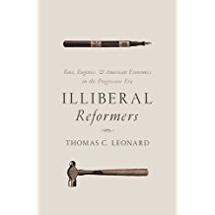
The Progressive Movement
Based on Thomas C Leonard’s Illiberal Reformers
Published by Princeton University Press in 2016.
He shows how bad theology, economics and politics came together to form a system that was the mirror image of the ideas of Karl Marx.

Slide 3
Before the Progressives
Classical Liberalism
Gospel of Jesus Christ
Free Market Political Economy
Small Federal Government
Natural Law

Slide 4
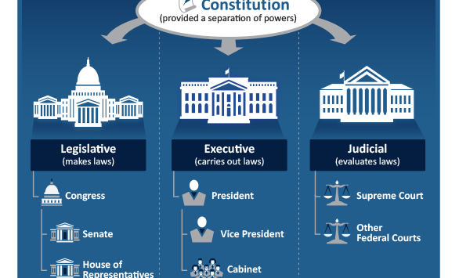
Before the Progressives

Slide 5
The Progressives:
Who Were They?
They were economists, sociologists, ministers of the social gospel, municipal reformers, efficiency experts, journalists and reform minded politicians.
The first generation progressives were born between 1850-1870. (too young for the Civil War)
Mostly descended from families from the Massachusetts Bay area.
Mostly the children of ministers or missionaries. They wanted to redeem America.
They were nationalists to the core
They emphasized the primacy of the collective over the individual

Slide 6
Types of Progressives
Left Progressives
Right Progressives
They rejected Classical Liberalism
They identified more with Hamilton, because he believed that too much liberty leads to anarchy.
Woodrow Wilson and Franklin Delano Roosevelt are examples
American Conservative thinking was not always anti-statist.
They rejected Classical Liberalism
They identified more with Jefferson, who was more for liberty than for a strong government.
Theodore Roosevelt

Slide 7

Goals
To make government less corrupt.
To make government more democratic
To give government a far bigger role in the economy.
To re-shape society through a large administrative state.
To emphasize the collective and to reduce the individual.

Slide 8
Progressive Discontent
They were discontented with liberal individualism
  Evangelicals viewed this as un Christian
  Secularists viewed this as “licensed selfishness.”
They were discontented with the waste, disorder, conflict and injustice that they associated with capitalism.
They were discontented with monopolies.
They broke with Classical Liberalism (political)

Slide 9

Society
Society comprises and is prior to the individual
Society is an evolved organism, to which constituent individuals owe responsibility and deference.
They supported women’s suffrage
They supported Prohibition

Slide 10
Government
They believed that America needed a new government which was non-partisan, scientific and had the discretionary powers required to control the world’s largest economy.
The U.S. Constitution was antiquated and tied the hands of the president.
Government should be run by people who were disinterested experts, university educated and credentialed.
They believed in the application of science to achieve efficiency. Thus they were supporters of the social engineer to improve life. They also emphasized efficiency in business and public administration.

Slide 11
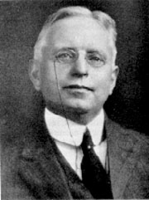
Economic Progressives
1854-1943
Richard Theodore Ely
“The good Christian should be concerned with this world, not the next. The good Christian must go among the poor, as had Christ, lifting up even the most degraded by providing them personal contact with superior natures.” R. Ely
He was a political economist and a leader in the Social Gospel Movement
He graduated from Columbia College in 1876. He earned his PhD in Germany (University of Heidelberg) in 1879. His advisor at Heidelberg was Karl Gustav Adolf Knies.
He was only 31 years old at the formation of the AEA.

Slide 12
Economic Progressives
Richard T. Ely taught there were three schools of thought in political economy.
The Classical School reasoned from a priori first principles. Ely placed Adam Smith in this category.
The Historical School relied on the use of statistics and history.
The Socialist School of Marx and Engels
Ely wanted to replace the British School of Classical Political Economy with the German Historical School of Political Economy.
Schools of Economics
Classical
Historical
Socialist

Slide 13
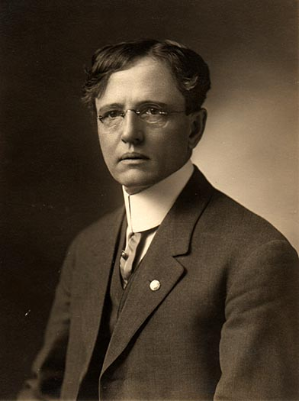
Economic Progressives
(1865-1947)
John R Commons
Originally intended to be a minister.
He became a political economist
“Social progress required the individual to be controlled, liberated, and expanded by collective action.”
He was a student of Richard T. Ely

Slide 14
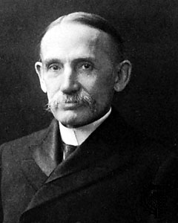
Economic Progressives
(1847-1938)
John Bates Clark
Originally intended to be a minister.
His mentor at Amherst college persuaded him to study economics rather than go to Yale Divinity School.
He studied economics under Karl Knies at Heidelberg University.
He taught at Columbia University.

Slide 15
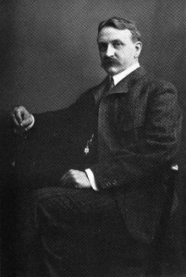
Economic Progressives
1851-1921
Henry Carter Adams
His father was a Congregationalist minister.
He intended to follow in his father’s footsteps by going to Andover Theological Seminary in 1875.
When he could not be born again, he left school to study political economy.
He was a professor of political economy at the University of Michigan

Slide 16

Economic Progressives
Founded 1885 by Richard T. Ely
55 charter members
23 were clergymen, many were leaders of the social gospel movement.
7 of the AEA’s charter members were presidents at major universities. These include: Brown, Cornell, Illinois, MIT, Northwestern, Princeton, Wisconsin and Yale.

Slide 17
Economic Progressives
The social gospel reformers believed that a Kingdom of Heaven could be built on earth without the return of Christ.
Christian men and women, providentially equipped with science and the state would build it with their own hands.
The economic reformer consciously adopts an ethical ideal, shows how it is to be attained, and encourages people to strive for it.
“The expert economist is like a priest, with priestly functions. He first acquainted the people on what they should want and only then acquainted them with the means of their satisfaction.” Edwin R.A. Seligman

Slide 18
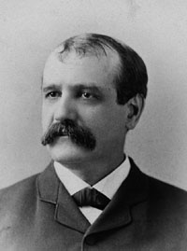
Economic Progressives
1840-1897
Francis Amasa Walker
First president of the AEA
President of MIT for 15 years
They dumped the British approach to political economy, with its ideas of economic laws and laissez fair view of government.
They adopted the German approach with a positive view of state intervention into the economy

Slide 19
Professionalized Economics
In 1880 there were three faculty members at the leading universities who focused on political economy.
The industrial revolution resulted in a geyser of money that flowed into American universities.
Brand new universities included: Ezra Cornell (1868), Cornelius Vanderbilt (1871), John Hopkins (1876), Jonas Clark (1889), Leland Stanford (1891), John D Rockefeller (University of Chicago 1891).
Between 1870 and 1900 American university students quadrupled, as did the ranks of faculty members.

Slide 20
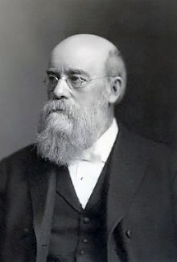
Social Gospel Leaders
1836-1918
Solomon Washington Gladden
Leader in the social gospel movement. Charter member of the AEA.
Condemned individual liberty as an unsound basis for democratic government.
He preached that it was a radical defect in the thinking of the average American

Slide 21
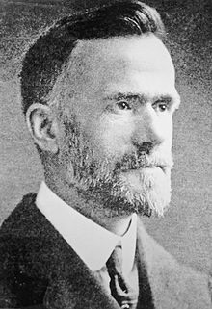
Social Gospel Leaders
1861-1918
Walter Rauschenbush
Baptist pastor who taught at Rochester Theological Seminary
Key figure in the Social Gospel and Single Tax movements.
He rejected biblical inerrancy and substitutionary atonement.
He believed that capitalism could be solved by getting rid of the “unfit”

Slide 22
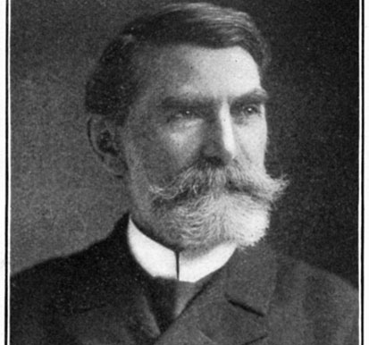
Social Gospel Leaders
1847-1916
Josiah Strong
He was an American Protestant clergyman, organizer , editor and author.
He was a leader in the Social Gospel Movement.
He argued that Anglo- Saxons are the superior race who must Christianize and civilize the “savage” races.

Slide 23
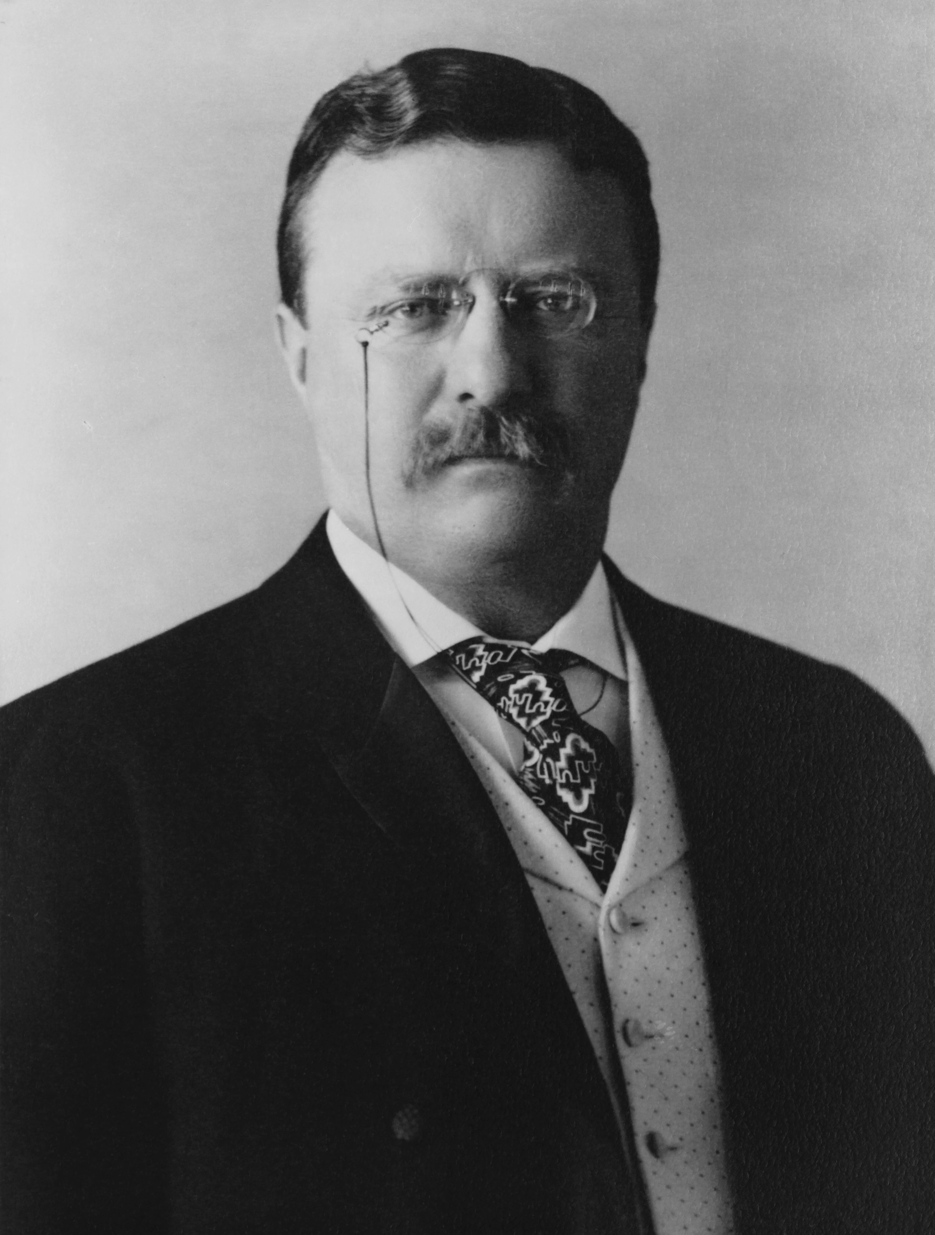
Progressive Politicians
1858-1919
Theodore Roosevelt
He was 26th president of the U.S.A.
He was both a Republican and a progressive.
He formed the Progressive Party (Bull Moose Party) in 1912 after splitting with his successor, William Howard Taft.
He was defeated by the Democrat, Woodrow Wilson, who was also a progressive.

Slide 24
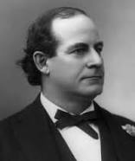
Progressive Politicians
William Jennings Bryan was both a progressive politician and a theological conservative.
People often ask me why I can be a progressive in politics and a fundamentalist in religion. The answer is easy. Government is man made and therefore imperfect. It can always be improved. But religion is not a man made affair. If Christ is the word, how can anyone be a progressive in religion? I am satisfied with the God we have, with the Bible and with Christ.”
He was the leader of the Democratic party from 1896 until the election of Woodrow Wilson in 1912

Slide 25
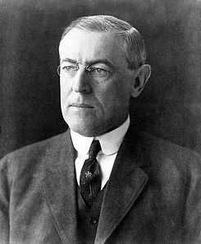
Progressive Politicians
Woodrow Wilson was the 28th President of the U.S. He erected the US administrative state during his first term as president.
He had served as president of Princeton University.
He created the study of public administration in the US, while a professor of politics at Princeton University.
He was a student of Richard T. Ely at John Hopkins University, where he earned his PhD.
He studied ethics/ economics at Princeton University and law at the University of Virginia.
His father and both of his grandfathers were Presbyterian ministers.

Slide 26
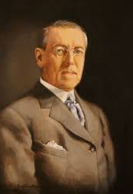
Progressive Politicians
Woodrow Wilson Believed that the difference between socialism and democracy was a matter of means rather than ends.
He claimed Edmund Burke as his master at first, but he later repudiated Locke and the Founding Fathers.
He appears to have converted from a conservative Democrat to a progressive Democrat in 1908.
He rejected any limit over the power of the state and defended private property on pragmatic grounds

Slide 27
Progressive Politicians
Wilson believed that American democracy was not an American invention. It was instead a racial inheritance dating back to the Teutonic tribes of ancient Germany.
Other races lacked the founding fathers capacity for democratic government.
Democracy had taken root in the U.S. and in a few other places “begotten of the English race.”
He was a southerner and racist. He removed blacks from many places in government service.

Slide 28
Progressive Politicians
Progressive Party, 1924
Progressive Party, 1948
Wisconsin Senator Robert La Follette ran for president.
He won the support of labor unions and socialists.
He carried only Wisconsin.
The Progressive party remained a force in Wisconsin until the 1940s.
Former Vice President Henry A. Wallace ran for president.
He won only 2% of the vote.
Most liberals denounced the party because it came under the control of communists.
The part faded away after 1948.

Slide 29
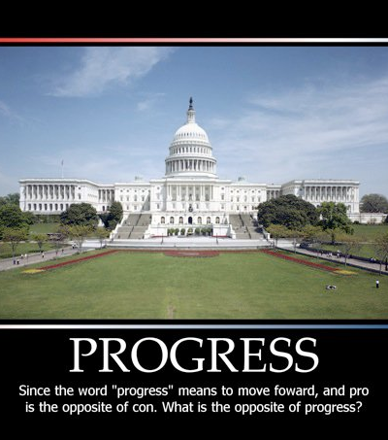
Fourth Branch Agencies
Progressives justified the administrative state on the grounds that judges and legislators lacked the technical expertise required to understand the increasingly complex matters before them.
Judges were black letter men who only considered legal precedent and who stubbornly upheld individual liberties.

Slide 30

Fourth Branch Agencies:
Taxation
The 16th Amendment to the US Constitution allowed for taxation (1913).
In 1880 the US government raised 90 % of its tax revenue from customs duties (56%) and excise taxes on tobacco and alcohol (34%)
By 1930, income taxes accounted for nearly 60% of US government receipts.

Slide 31
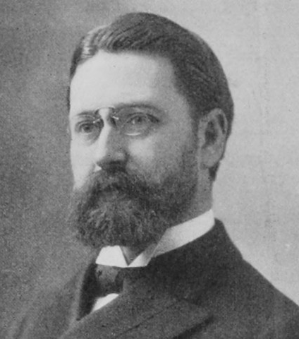
Fourth Branch Agencies:
Taxation
Progressive economist, Edwin R.A. Seligman, argued that “We pay taxes because the state is a part of us.”
Each individual should “help the state in proportion to his ability to help himself.”
He said of the Revenue Act of 1917, that it was “the most gigantic fiscal enactment in history” and that it was “the high water mark thus reached in the history of taxation.”

Slide 32

Fourth Branch Agencies
Fourth branch agencies were chartered to be independent of their creators.
They were uniquely endowed with legislative, executive, and judicial powers combined.
Agencies make law, and their regulatory rules have the full power of federal legislation.
Agencies enforce regulation and adjudicate regulatory disputes.

Slide 33

Fourth Branch Agencies:
How they were Created
An economic outrage
A government commission is convened to resolve the problem
Economists were tapped to serve as commissioners, staff members or both.
Recommendation for a permanent regulatory agency be created and staffed by economic experts.

Slide 34
Fourth Branch Agencies
Federal Government
Department of Commerce
US Industrial Commission (1902)
US Bureau of Corporations (1903)
Federal Trade Commission (1914)
Department of Labor

Slide 35
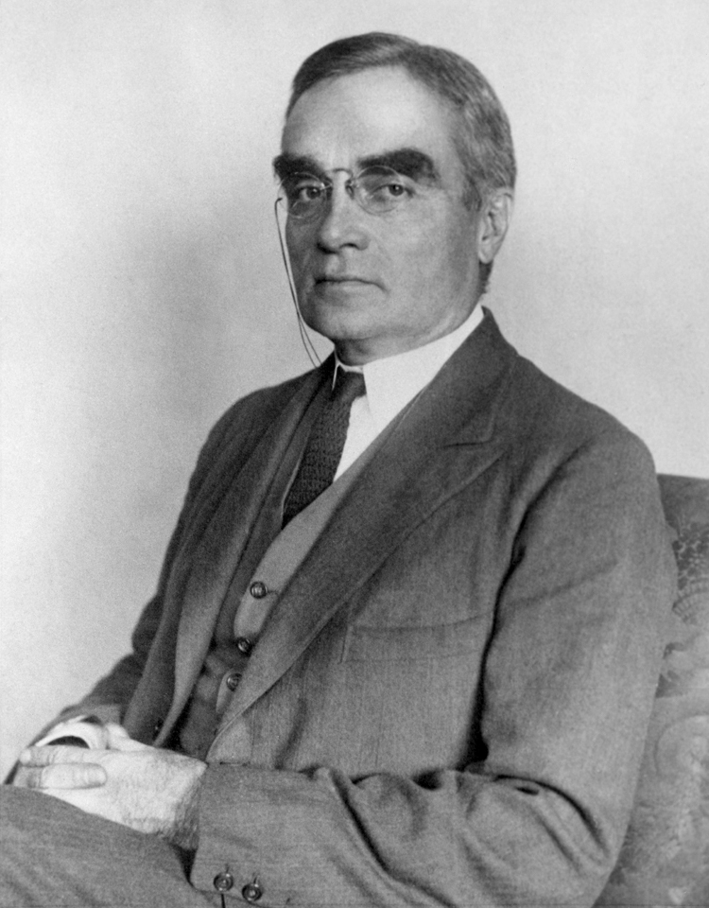
Progressive Lawyers
Learned Hand was a proponent of Legal Realism.
While a student at Harvard, he lost faith in God and became a skeptic.
He was a positivist and denied natural law as well as natural rights in the Bill of Rights.
Moral values are only a matter of taste and of their times.
The U.S. Constitution should be understood in light of historical analysis

Slide 36
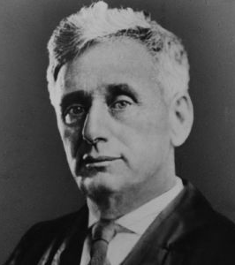
Progressive Lawyers
Louis Dembitz Brandeis (1856-1941). He was a progressive Associate Justice on the U.S. Supreme Court.
He was nominated by Woodrow Wilson and served from 1916-1939.
He was a militant crusader for social justice. He used the law as the instrument for social change.

Slide 37
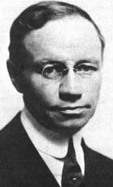
Progressive Journalism
1869-1930
Herbert David Croly
He was an intellectual leader of the progressive movement.
He was an editor and co-founder of the New Republic.
His political philosophy influenced Theodore Roosevelt, Judge Learned Hand as well as Supreme Court Justice Felix Frankfurter.

Slide 38
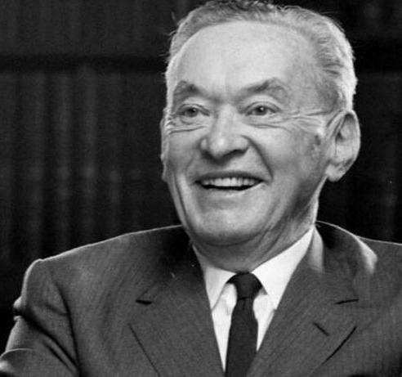
Progressive Journalism
The New Republic
Walter Lippmann
The New Republic was founded in 1914 by progressive journalists, Walter Lippmann and Walter Weyl.
The magazine was responsible for replacing the word “progressive” with the word “liberal.”
It has been the mouth piece of progressive ideas.

Slide 39
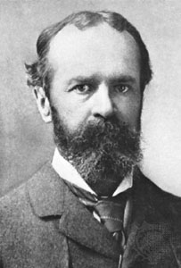
Progressive Philosophers
Pragmatism
William James
William James (1842-1910) was a philosopher and psychologist.
He was known as the “father of American psychology.”
Held a relativistic view of truth

Slide 40
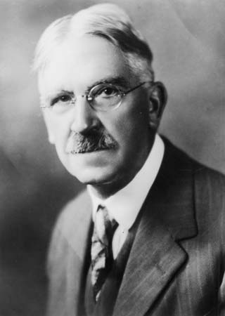
Progressive Philosophers
1859-1852
John Dewey
A pragmatic philosopher known for his advocacy of democracy.
Education is a social process and a institution for social reform
Civil society should be reformed around a strong state
Journalism should shape public opinion for collectivism and a strong state. Experts and politicians should communicate the right ideas and values.

Slide 41
Progressives and Darwinism
Progressive economists represented their program as scientific, a claim founded on the authority of Darwinism.
They viewed society as an organism, with instincts of self- preservation, purposes and a conscience.
The state should administer the economy and the polity for the good of all. What is good for the organism is good for the parts. What is good must be determined by experts
An organism has boundaries and cells. Consequently, foreign parasites and microbes are a threat to the organism’s health and integrity.

Slide 42
Reform Darwinism
No one was an advocate of Social Darwinism.
Natural selection is wasteful, slow, inhumane and indifferent to progress- moral or other.
Natural selection should not be a model for human society. Artificial selection substituted human mastery for Darwinian drift.
All true social progress was artificial. Intelligent management will improve, direct, and hasten social evolution.
The state has a responsibility to interfere on behalf of the really fittest.

Slide 43
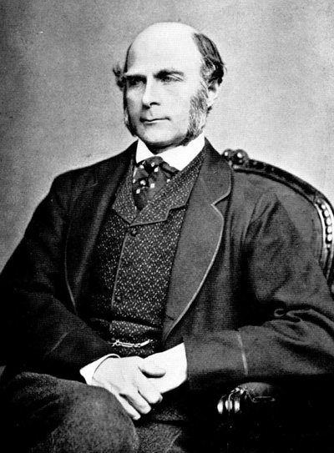
Eugenics and Race Science
Eugenics (Greek for “well born”). In the 1880s, Francis Galton had three governing premises in eugenics.
Differences in intelligence, character and temperament are due to heredity
Human heredity can be improved.
Improvement of mankind should not be left to chance

Slide 44
Eugenics and Race Science
Galton argued that: “what nature does blindly, slowly and ruthlessly, man may do providently, quickly and kindly.”
American Race Betterment Foundation founded at Battle creek, Michigan in 1906 by the Kellog.
In 1910 the American Breeders Magazine began publication and was renamed the Journal of Heredity.
Forcible sterilization began in Indiana in 1910. Thirty other states followed them in this practice.
Eugenics grew into a popular part of college education.
Eugenics advocates attempted to unite science and religion.

Slide 45

Eugenics and Race Science
1865-1946
Frederick Ludwig Hoffman
The AEA published Hoffman’s Race traits of the American Negro in 1896.
The same year as Plessy vs Ferguson (separate but equal ruling), upholding the constitutionality of Jim Crow legislation.

Slide 46
Eugenics and Race Science
Hoffman asserted that that American blacks had become “lazy, thriftless and unreliable” and were soon to attain a condition of “total depravity and utter worthlessness.” He further warned that “the white race will not hesitate to make war upon those races who prove themselves useless factors in the progress of mankind.”
Richard T. Ely argued that “Negroes are for the most part grown up children and should be treated as such.”

Slide 47
Eugenics and Race Science
Edward A. Ross asserted “The black millions of inferior race dragged down American energy and character.”
John R. Commons described American blacks as “indolent and fickle.” He also suggested that “The negro could not possibly have found a place in American industry had he come as a free man. If such races are to adopt that industrious life which is second nature to races of the temperate zones, it is only through some form of compulsion.”

Slide 48
Eugenics and Race Science
They argued that race suicide also resulted from some European immigrants. Those from southern Italy, Hungary, Austria and Russian were described as beaten men from beaten races. Francis Amasa Walker (first president of the AEA) asserted that these people were inferior.
Theodore Roosevelt blamed the established Anglo- Saxon elite for failing in its racial duty to produce sufficiently large numbers of offspring. He believed that race suicide was the greatest problem of civilization.
John R Commons believed that labor should be organized to keep these inferior immigrants from lowering the standard of living which undercut American wages.
Scott Nearing believed that race suicide was infinitely worse than murder. Defectives should be isolated from society.

Slide 49
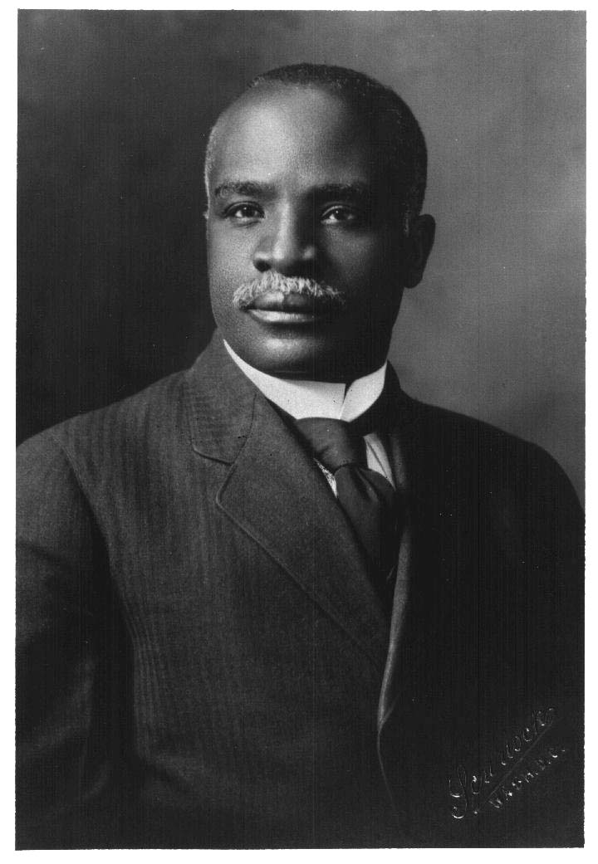
Eugenics and Race Science
1863-1939
Kelly Miller
First African American to attend John Hopkins.
He was a sociologist, mathematician and newspaper columnist. He was also a faculty member and dean of Howard University.
He feared that the higher element of the Negro race were being outbred by ordinary blacks. The average Howard professor produced less than one child. (The talented tenth)

Slide 50
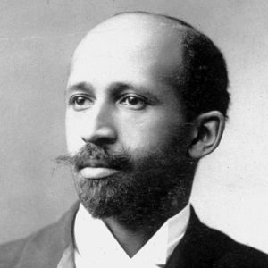
Eugenics and Race Science
1868-1963
W.E.B. Du Bois
Used the term “the talented tenth.”
He debunked racial inferiority, but warned of hereditary differences across individuals.
There were degenerate types among blacks just as there were among Europeans.

Slide 51
After the Progressives
Progressivism
The Social Gospel
Interventionist Economic Science
4th Branch of Government
Legal Realism

