Slide 1
Structural Functionalism
Craig Vincent Mitchell
Enrietta Shino

Slide 2
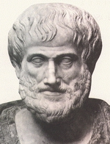
Aristotle
Aristotle took a teleological approach to morality.
Teleology- that branch of cosmology that is concerned with final causes
This affected his epistemology and ethics

Slide 3
Premodernity
Metaphysics
Ethics
Epistemology

Slide 4
Aristotle’s chain of causation
Entelechy
formal
material
efficient
final

Slide 5
Aristotle’s view of the Social Sciences
Metaphysics
Action
Ethics

Slide 6
From Moral Philosophy to Social Sciences
Moral Philosophy
Politics
Economics
Law

Slide 7
Modernity:
The End of Causation
William of Occam (metaphysical nominalist) removed the formal cause
George Berkeley (metaphysical nominalist and idealist) removed the material cause
David Hume (metaphysical nominalist and epistemological sceptic) removed the efficient cause
Rene Descartes and Gallileo (metaphysical nominalists) removed the final cause- teleology

Slide 8
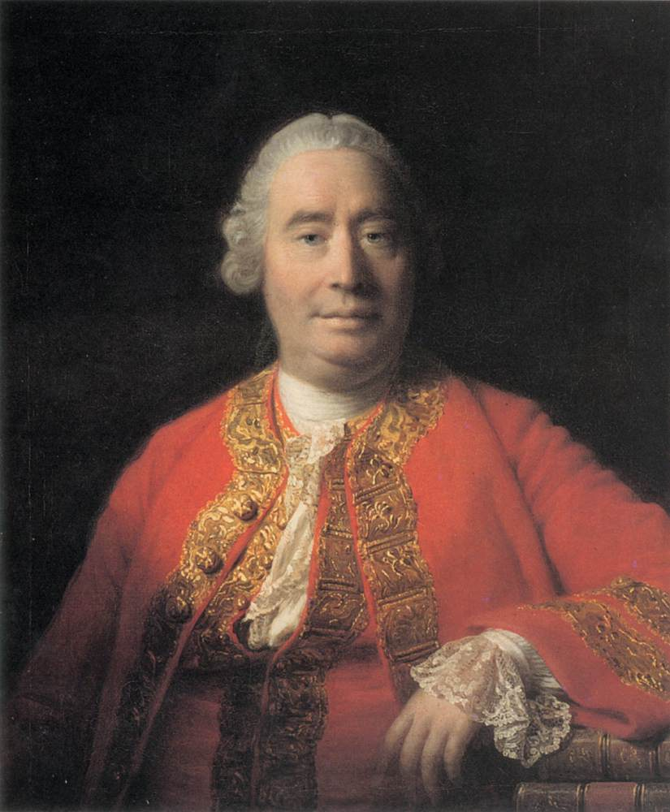
Modernity: David Hume
David Hume was known as a sceptic, because he suggested that you cannot know anything st because of his argument against causation
One can know that one thing follows another, but one cannot know that one thing causes another

Slide 9
Modernity: David Hume
Hume argued against induction
He argued that arguments for causation were essentially arguments based on induction
You can know that one thing follows another, but you cannot know that one thing causes another
He separated metaphysics from ethics with his version of positivism
Fact/value dichotomy: you cannot derive an ought from an is. In other words metaphysics do not determine morality. Morality is useful, but is only based on emotions

Slide 10
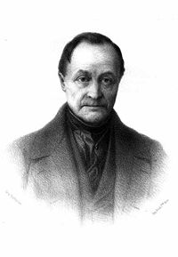
Types of science
August Comte was the first modern philosopher of science. He was the first to distinguish the physical sciences from the social sciences.
Comte believed that the physical sciences had to come before the "Queen science" of human society itself or sociology.
Comte’s concept of positivism is a rejection of theology and philosophy so that science can be effective.

Slide 11
Comte’s Positivism
1st stage | Remove theology
2nd stage | Remove metaphysics
3rd stage | Pure Science

Slide 12
Types of Science
Science
Physical (or hard) Sciences
Social (or soft) Sciences

Slide 13
Hard and Soft Science
Hard science and soft science are colloquial terms often used when comparing scientific fields of academic study, with hard meaning perceived as being more scientific, rigorous, or accurate.
Fields of the physical, and engineering sciences are often described as hard, while the social sciences and similar fields are often described as soft.
The hard sciences are characterized as relying on quantifiable empirical data, relying on the scientific method, and focusing on accuracy and objectivity.

Slide 14
Hard and Soft Science
Hard science and soft science are colloquial terms often used when comparing scientific fields of academic study, with hard meaning perceived as being more scientific, rigorous, or accurate.
Fields of the physical, and engineering sciences are often described as hard, while the social sciences and similar fields are often described as soft.
The hard sciences are characterized as relying on quantifiable empirical data, relying on the scientific method, and focusing on accuracy and objectivity.

Slide 15
Types of science
Physical
(or hard) Sciences
Biology
Physics
Chemistry

Slide 16
From Moral Philosophy to Social Sciences
Social Science
Politics
Economics
Law
sociology

Slide 17
Social Sciences
Social sciences came forth from moral philosophy and was influenced by the industrial and French revolutions. The intent of the social sciences was to develop systematic knowledge-bases or prescriptive practices, relating to the social improvement of society.
The beginnings of the social sciences in the 18th century are influenced by the ideas of Diderot, Rousseau and other pioneers.

Slide 18
Types of Science
A related aspect of the hard versus soft distinction has to do with the ease of drawing strong conclusions. In soft sciences, there are often numerous variables that might have an influence on some variable of interest, and many of those variables either may be non-quantifiable or may be quantifiable but difficult to obtain data on; but further, even with plentiful data, it may be difficult to disentangle the effects of such a large number of variables. In contrast, typically in the hard sciences there are only a few, readily identified, causative variables, making it easier to infer specific causative effects.

Slide 19
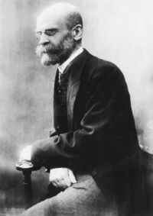
Emile Durkheim
David Émile Durkheim (French: [emil dyʁkɛm, dyʁkajm]) (April 15, 1858 – November 15, 1917) was a French sociologist. He formally established the academic discipline and, with Karl Marx and Max Weber, is commonly cited as the principal architect of modern social science and father of sociology.^{[1][2]}
Much of Durkheim's work was concerned with how societies could maintain their integrity and coherence in modernity; an era in which traditional social and religious ties are no longer assumed, and in which new social institutions have come into being.

Slide 20
Emile Durkheim
Durkheim was also deeply preoccupied with the acceptance of sociology as a legitimate science. He refined the positivism originally set forth by Auguste Comte, promoting what could be considered as a form of epistemological realism, as well as the use of the hypothetico-deductive model in social science. For him, sociology was the science of institutions,^{[citation needed]} its aim being to discover structural social facts. Durkheim was a major proponent of structural functionalism, a foundational perspective in both sociology and anthropology. In his view, social science should be purely holistic; that is, sociology should study phenomena attributed to society at large, rather than being limited to the specific actions of individuals.

Slide 21
Structural Functionalism
Structural functionalism concentrates on the positive and negative functions of social structures. Societal functionalism is a particular type of structural functionalism that aims to explain the role of social structures and institutions in society, the relationship between these structures, and the manner in which these structures constrain the actions of individuals. According to structural functionalists, individuals have little to no control over the ways in which particular structures operate. Indeed, structural functionalists understand individuals in terms of social positions. For example, when the structural functionalists Kingsley Davis and Wilbur Moore discuss social stratification, they do not refer to individuals, but to the positions these individuals occupy. It is not individuals who are ranked, but positions that are ranked according to the degree to which they contribute to the survival of society. High-ranking positions offer high rewards that make them worth an individual’s time and effort to occupy. The structural functionalist account of stratification has been criticized on the grounds that there must be other ways to motivate individuals to occupy particular positions and perform certain tasks without such a disparate system of rewards." (1)

Slide 22
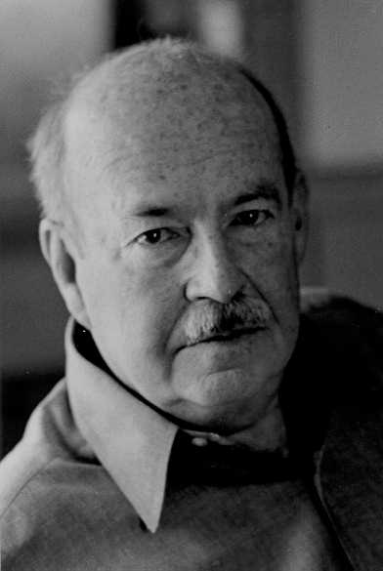
Talcot Parsons

Slide 23
Talcot Parsons
Micro approach, rooted in Weber.
Yet, focused on “consciousness”
  Consciousness as “social”
  Intentionality
  Appropriate means
  Constrained by situation
  Choose and Judge
  Rules and norms guide
  Need to use "Verstehen."
3. Essence of Parson’s action theory:
Giddens on Parsons (http://www.youtube.com/watch?v=Zy_UzSm0NnY)
)

Slide 24
Talcot Parsons
Unit act: actor, end or goal (future state), takes place within a situation that contains conditions (constraints—not controlled by actor) and means (actors can control), and Norms and Values shape means and ends. “no such thing as action except as effort to conform to norms" (The Structure of Social Action, 1937, pages 76-77, in Ritzer, Classical Sociological Theory, p. 463.
Voluntarism, yet understanding the act is not (totally) free—constraints and directions: social structure and culture.
Verstehen
4. By late 1940s he is turning away from action theory, and 1951: The Social System:

Slide 25
Talcot Parsons
Unit act becomes status-role (position within structure). (link to local original)
Personality: needs-dispositions, socio-culturally shaped biological needs,
Value and Motivational orientations (internalization).
The issue becomes needs-dispositions and orientation of actors to situations.
Motivational orientations: analyze social phenomena to see if fits needs disposition. Cognitive, Cathetic, and Evaluative
Value Orientations: norms, standards, and criteria for choice. Cognitive, Appreciative, Moral

Slide 26
Talcot Parsons
Four types of action:
Intellectual (cognitive interests and standards)
Expressive (cathectic and appreciative)
Moral (evaluative and moral)
Instrumental (goals: cathectic and appreciative, means: cognitive).

Slide 27
Talcot Parsons
Pattern-Variables (local copy of this): “five dichotomous choices of action that actors must make in every situation—tools for analyzing conscious processes.—fundamental problem of orienting oneself to the situation.” (Ritzer, Classical Sociological Theory, page 467)
Affectivity—Affective neutral (emotion dr. patient role)
Specificity—Diffuseness (accept dr. opinion on health, but politics)
Universalism—Particularism (judge based on universal standards or special (evaluating dr. versus own children)
Ascription—Achievement (endowed or learned)
Self—Collectivity (who benefits

Slide 28
Talcot Parsons
Enter Structural-Functionalism and AGIL (system (any type of system) functions—actually functional imperatives) (local copy)
Adaptation (working with and through the environment—harmony, manipulation, external dangers)
Goal Attainment (future—survival and growth)
Integration (regulate inter-relationship between parts and the relationships between AGIL)
Latency/Pattern Maintenance (furnish, maintain, and renew: motivation of individuals and cultural patterns that create motivation. (Latency: success stories, differential rewards, deviance. Pattern maintenance: macro: insuring values and norms (for success) remain visible and accessible, and are internalized

Slide 29
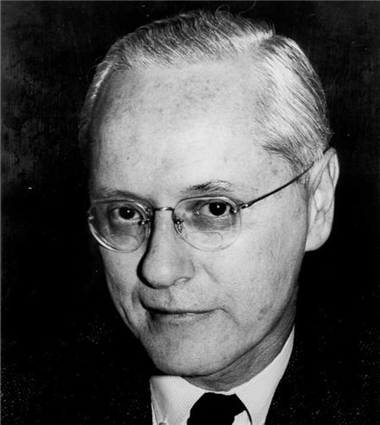
Robert Merton

Slide 30
Robert Merton
Robert Merton’s Middle Range Theory
"Robert Merton expanded Parsons’s understanding of structural functionalism by explaining not only the function of social structures, but also their dysfunctions, nonfunctions, and net balances. Merton’s theory of structural functionalism has been called “middle range” because he moved away from trying to analyze society as a whole toward studying different levels of the social world such as organizations and groups. Merton also introduced the concepts of manifest and latent functions — referring, respectively, to intended and unintended consequences. According to Merton, functions can also be characterized as displaying unanticipated consequences."(see)
Social Structure and Anomie

Slide 31
Robert Merton
ACriticized “functional unity” (some structures endure and may not be functional)
Structural-Functional Model
Criticized “universal functionalism” (some may be a problem).
Criticized “indispensability.”

Slide 32
Robert Merton
Argued for empirical test, and standardization—societal functionalist
  Functions: have observable consequences that help system adapt/adjust
  Dysfunction—always a possibility (also non-function)
  Net Balance: not simple add/subtract—things are complex. Points to relative significance
  Levels of Functional Analysis: system, institution, organization, group. Any standardized and repetitive phenomenon
  Manifest Functions
  Latent Functions
  Unanticipated Consequences
  Debunking

