Slide 1
Tax Incidence
Who Pays Bears the Economic Burden of a Tax?

Slide 2
Who ultimately bears the economic burden of the tax is not so obvious
Economic burden of the tax reflects equity of the tax

Slide 3
Tax Equity
Two basic principles to equity
  Ability to pay
    Horizontal equity
      Those of equal circumstances pay the same
    Vertical equity
      Progressive
      Proportional
      Regressive
  Benefit Principle
    Difficult to assess
    We often want all citizens to benefit from public good regardless of whether they can pay for it.

Slide 4
Effects of a Specific Tax – Shifting the Supply Curve
S_{T}
Increase in Consumer Cost per Gallon
S
P_{o} + T
B
Price Paid by Consumers ($/gallon)
P_{b}
T
P_{o}
A
P_{s} = P_{b} - T
Decrease in Firms’ Receipts per Gallon
D
Q_{T}
Q_{o}
Gallons of Gas per Month
15-4

Slide 5
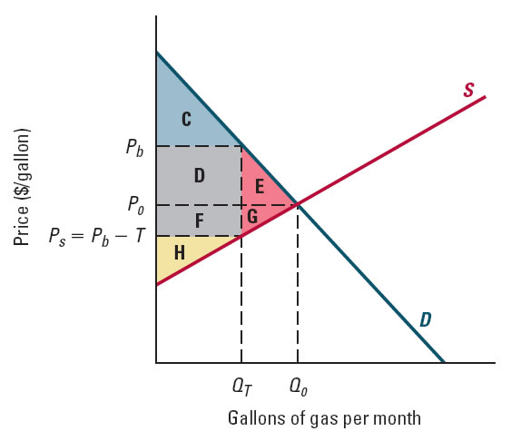
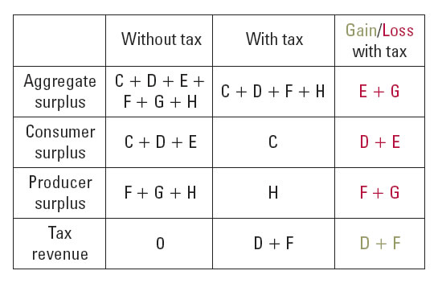
Welfare Effects of a Specific Tax
15-5

Slide 6
Tax Incidence
Incidence of a tax depends on the shapes of the demand and supply curves
In general, the more elastic is demand and less elastic is supply, the more of the tax is borne by firms
Consumers bear the larger share of the tax when demand is less elastic than supply
15-6

Slide 7
Questions:
Who pays the taxes on
Cigarettes
Gas
Yahts

Slide 8
Example of Tax on Soft Drink Market

Slide 9

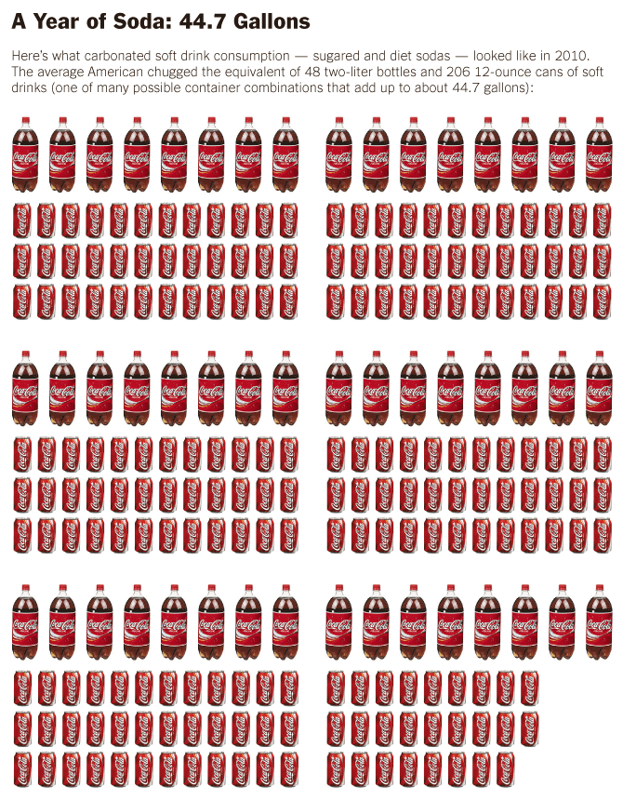
Introduction
Several cities and states have considered taxing soft drinks because of their high sugar content, which can negatively impact health and increase healthcare costs. Concerned about high rates of obesity, diabetes, and other chronic diseases, proponents of taxation argue that a tax can reduce consumption to improve people's health and raise revenues to help cover the high costs of expenditures related to obesity. Americans consume about 44.7 gallons of soft drinks each year and spend approximately $147 billion each year on obesity-related medical expenses. One study suggests that a one-cent-per-ounce excise tax could reduce consumption by 13% and the average person's weight by two pounds per year. The elasticity of demand for soft drinks has been estimated, on average, to be 0.8. Opponents of taxation argue that consumption behavior will not change much and are concerned about excessive government intervention in the lives of people.
This lesson shows the potential impact of a hypothetical excise tax on soft drinks. It explores the impact on price and quantity, tax incidence, tax revenues, and deadweight loss. It also examines how the results are effected by the magnitude of the elasticity of demand.

Slide 10
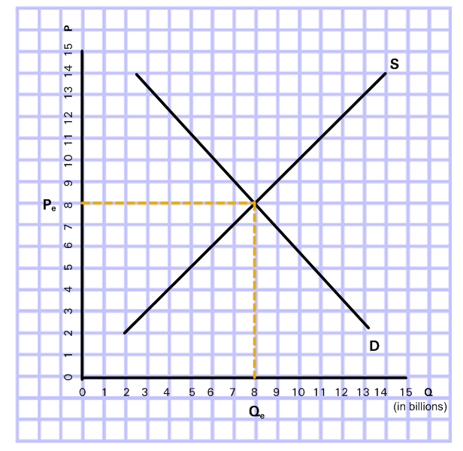
Market for Soft Drinks
Determine the equilibrium price and quantity:
Pe =____ cents per ounce
Qe = ____ billion ounces
Graph 1
Graph 1 represents the market for soft drinks.

Slide 11
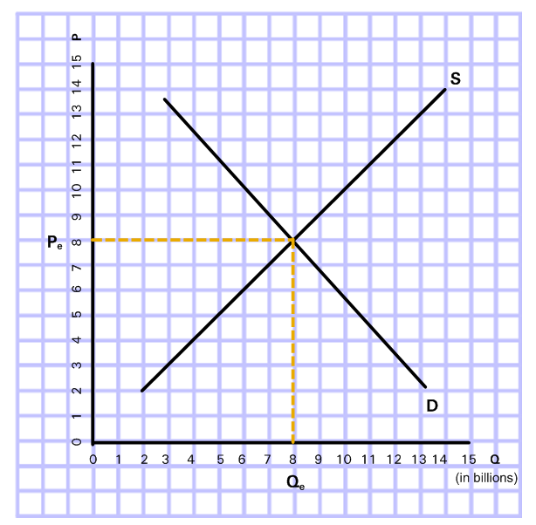
Market for Soft Drinks - Answer
Determine the equilibrium price and quantity:
Pe =__8__ cents per ounce
Qe = __8__ billion ounces
Graph 1
Graph 1 represents the market for soft drinks.

Slide 12
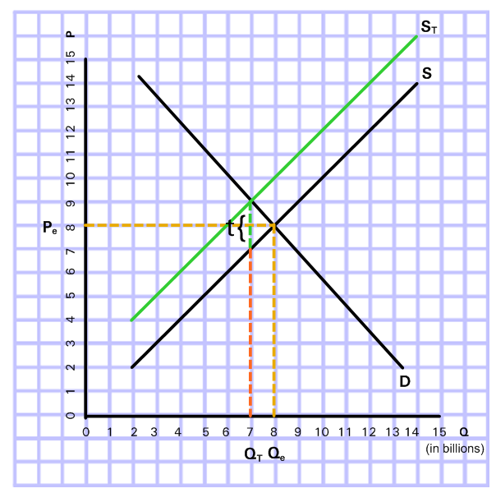
Effect of Excise Tax on Price
Suppose the government imposes an excise tax (t) of 2 cents per ounce on soft drink producers.
New Price Consumer Pays
New Price Producer Receives
Graph 2
Graph 2 represents the market for soft drinks with the excise tax.

Slide 13
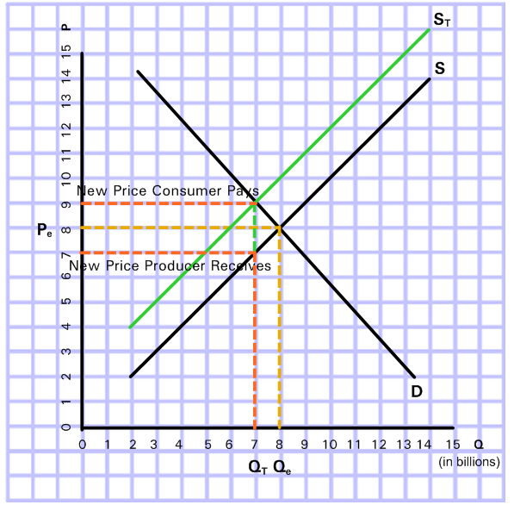
Effect of Excise Tax on Price - Answer
Suppose the government imposes an excise tax (t) of 2 cents per ounce on soft drink producers.
Graph 2
Graph 2 represents the market for soft drinks with the excise tax.

Slide 14
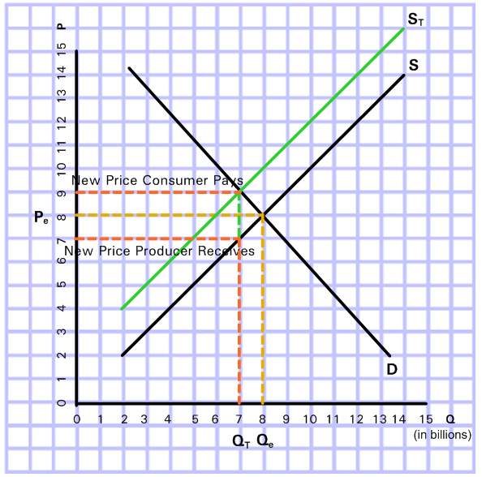
Graphical Analysis of Tax Incidence
While the excise tax is officially imposed on producers, the tax burden may be shared between consumers and producers.
Drag each tax burden area to the appropriate place in Graph 3:
Consumer Tax Burden
Producer Tax Burden
Calculate the tax revenue collected from the excise tax on soft drinks.
Tax Revenue=(t*QT)
Graph 3
Graph 3 represents the market for soft drinks with the excise tax.

Slide 15
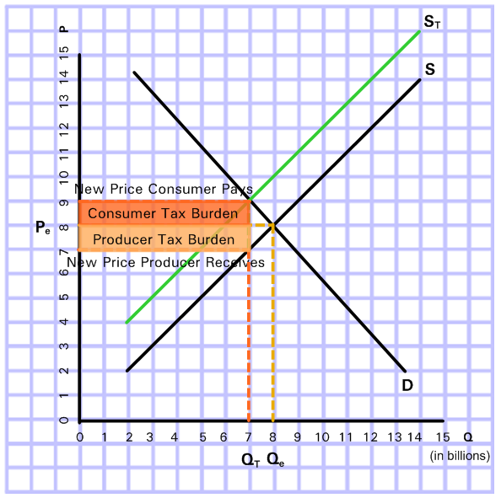
Graphical Analysis of Tax Incidence - Answer
While the excise tax is officially imposed on producers, the tax burden may be shared between consumers and producers.
Drag each tax burden area to the appropriate place in Graph 3:
Calculate the tax revenue collected from the excise tax on soft drinks.
Tax Revenue=(t*QT)=(2*7)=14 billion cents
Graph 3
Graph 3 represents the market for soft drinks with the excise tax.

Slide 16


Deadweight Loss
Deadweight Loss (DWL) = the inefficiency caused by the loss of consumer and producer surplus from a policy or action
An excise tax causes a loss of both consumer surplus and producer surplus. Surplus is reduced when consumers and producers pay some of the tax.
CS
PS

Slide 17
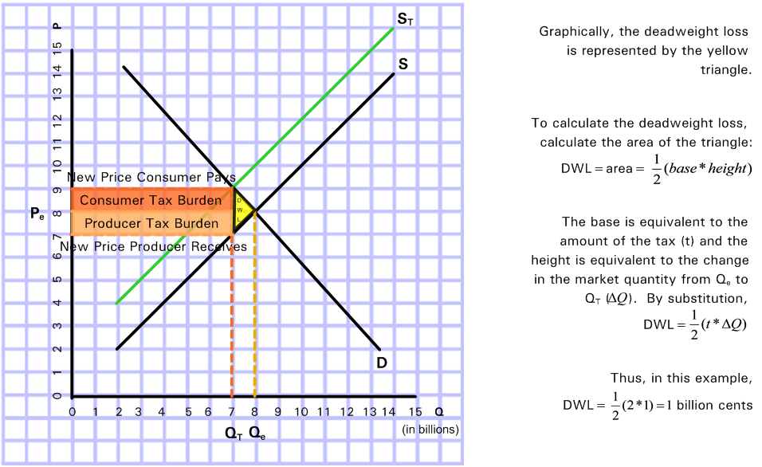
Graphical Analysis of Deadweight Loss
Graph 4
Graph 4 shows the deadweight loss caused by excise tax on soft drinks.
Notes:
1 billion cents is $10 million.

Slide 18
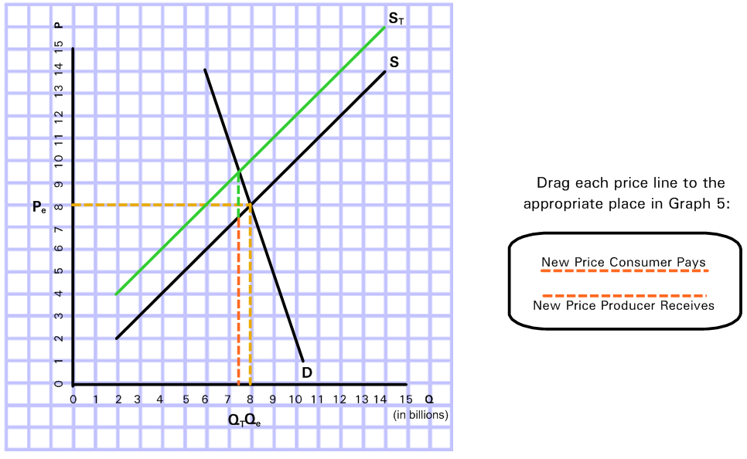
Graphical Analysis of Less Elastic Demand
Graph 5
Graph 5 represents the market for soft drinks with the excise tax where demand is more inelastic than _{supply.}

Slide 19
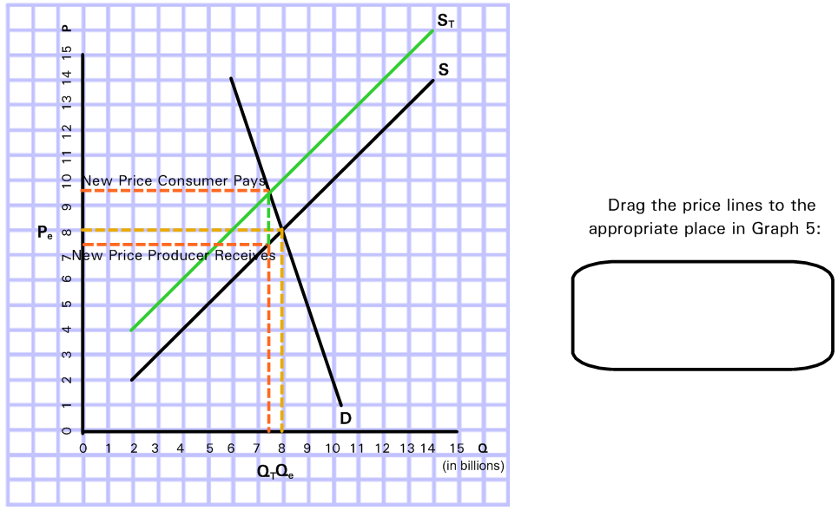
Graphical Analysis of Impact of Elasticity - Answer
Graph 5
Graph 5 represents the market for soft drinks with the excise tax where demand is more inelastic than _{supply.}

Slide 20
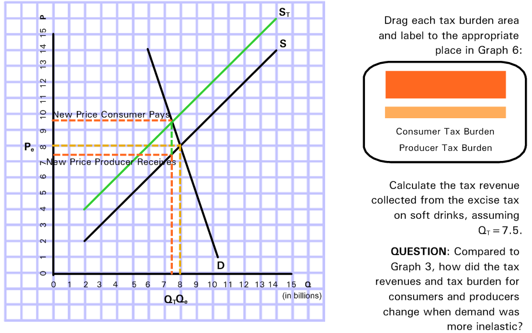
More Inelastic Demand and Tax Incidence
Go to Graph 3
Graph 6
Graph 6 represents the market for soft drinks with the excise tax where demand is more inelastic than _{supply.}

Slide 21
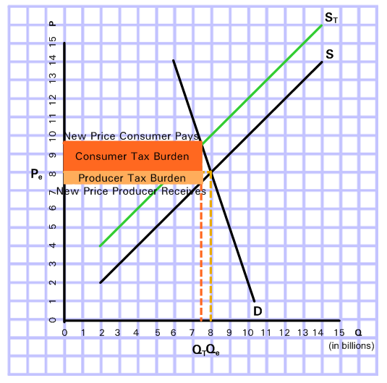
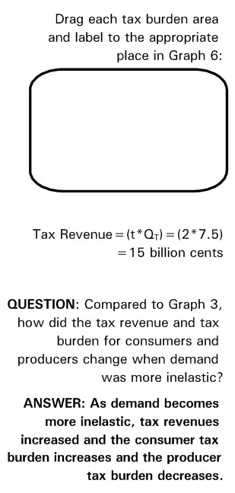
More Inelastic Demand and Tax Incidence - Answer
Graph 6
Graph 6 represents the market for soft drinks with the excise tax where demand is more inelastic than _{supply.}

Slide 22
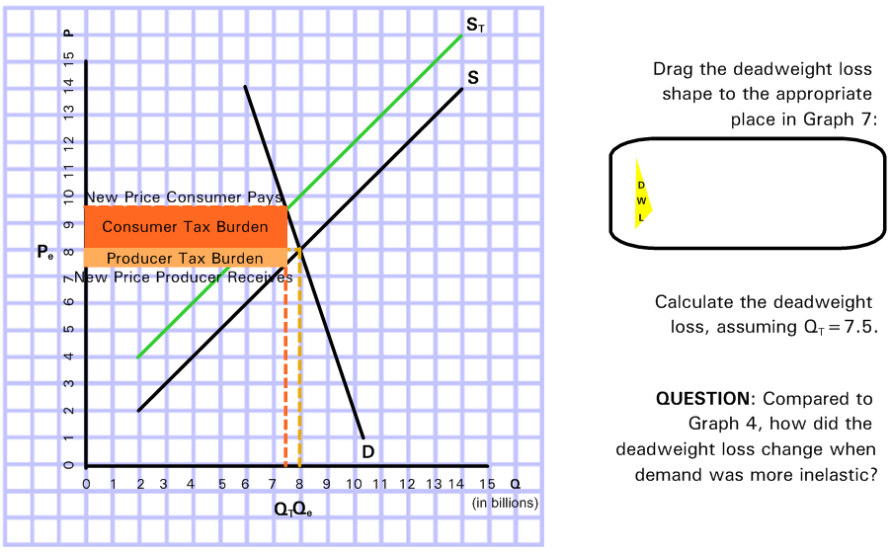
More Inelastic Demand and Deadweight Loss
Go to Graph 4
Graph 7
Graph 7 represents the market for soft drinks with the excise tax where demand is more inelastic than _{supply.}

Slide 23
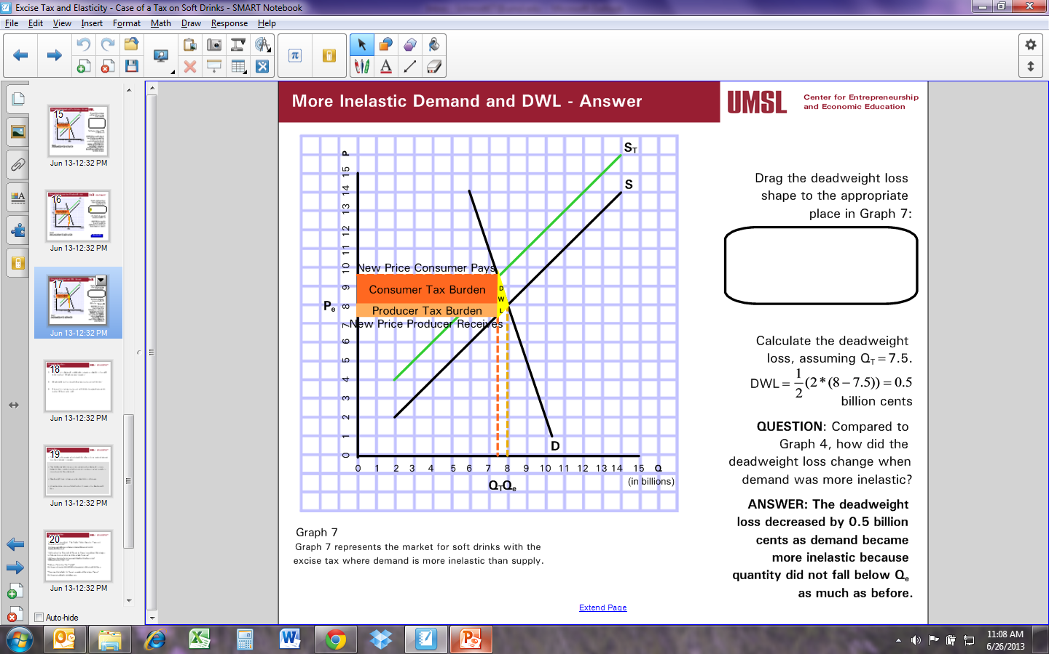
More Inelastic Demand and DWL - Answer
Graph 7
Graph 7 represents the market for soft drinks with the excise tax where demand is more inelastic than _{supply.}

Slide 24
Discussion Questions
Do you think demand is relatively inelastic or elastic in the soft drink market? What are your reasons?
What could be the impact of an excise tax on soft drinks?
Do you think an excise tax on soft drinks is a good economic policy? Why or why not?

Slide 25
Conclusions
Tax revenue increases when elasticity is less since responsiveness to price changes is weaker.
Tax incidence falls more on consumers when demand is more inelastic than supply but falls more on producers when supply is more inelastic than demand.
Deadweight loss increases when elasticity is stronger.
A tax becomes more efficient when it lessens the deadweight loss.

Slide 26
Incidence of the Property Tax

Slide 27
Traditional View
Property tax is an excise tax
Increases price of commodities and services
Increases price of housing services
Tax is regressive for consumers purchasing goods and services.
Tax is proportional for housing owners as the house expenditure is proportional to household income.

Slide 28
Benefit View
Reflects Tiebout model (Hamilton and Fischel)
Property tax is the price one pays for local goods and services.
No incentive to reallocate capital. Tax payment=value of benefit.

Slide 29
Capital Tax View
Property tax is tax on capital rather than consumer goods.
Capital market is national and capital is mobile.
Property tax used so extensively that we can think in terms of an national average rate.
Capital will be reallocated until the after tax return on capital is equal across all jurisdictions.

Slide 30
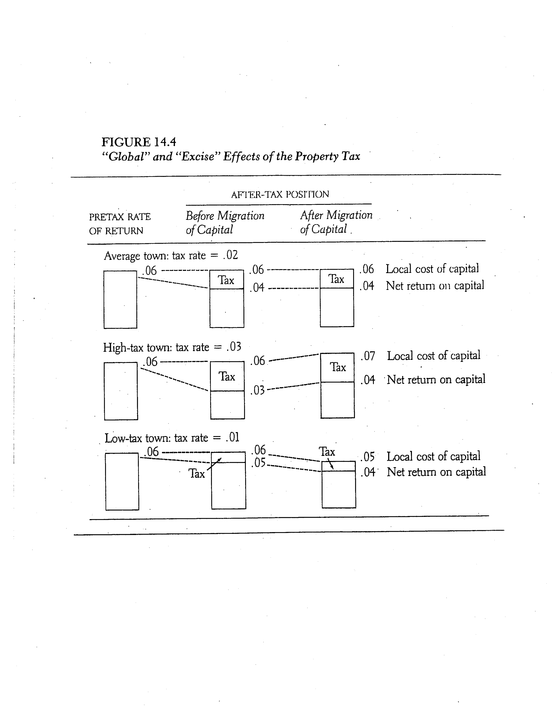
Capital Tax View

Slide 31
Why does it matter?

Slide 32
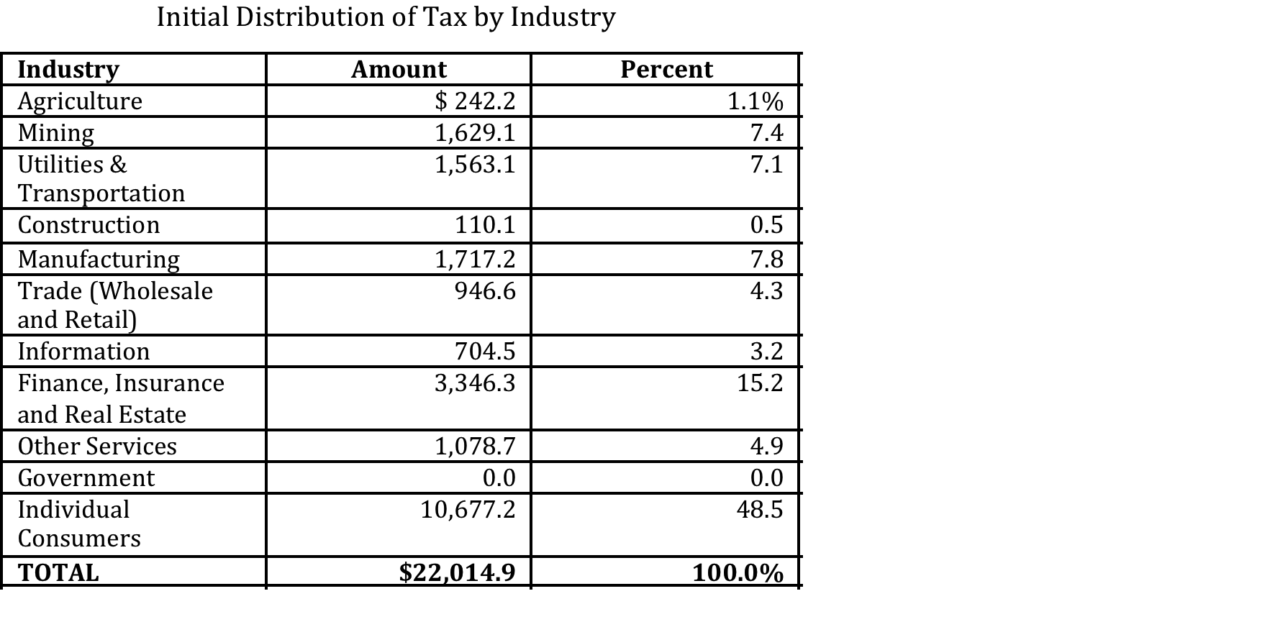
Initial Distribution and Final Incidence of Total School Property Tax Revenue
Tax Year 2013 (dollar amounts in millions)

Slide 33
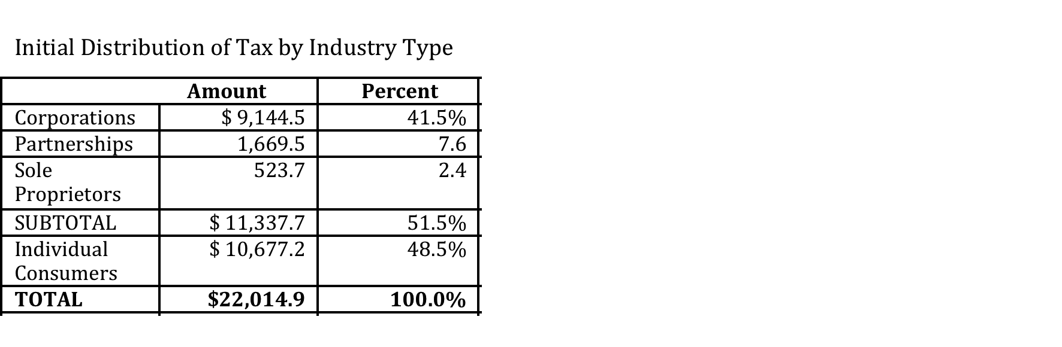

Slide 34
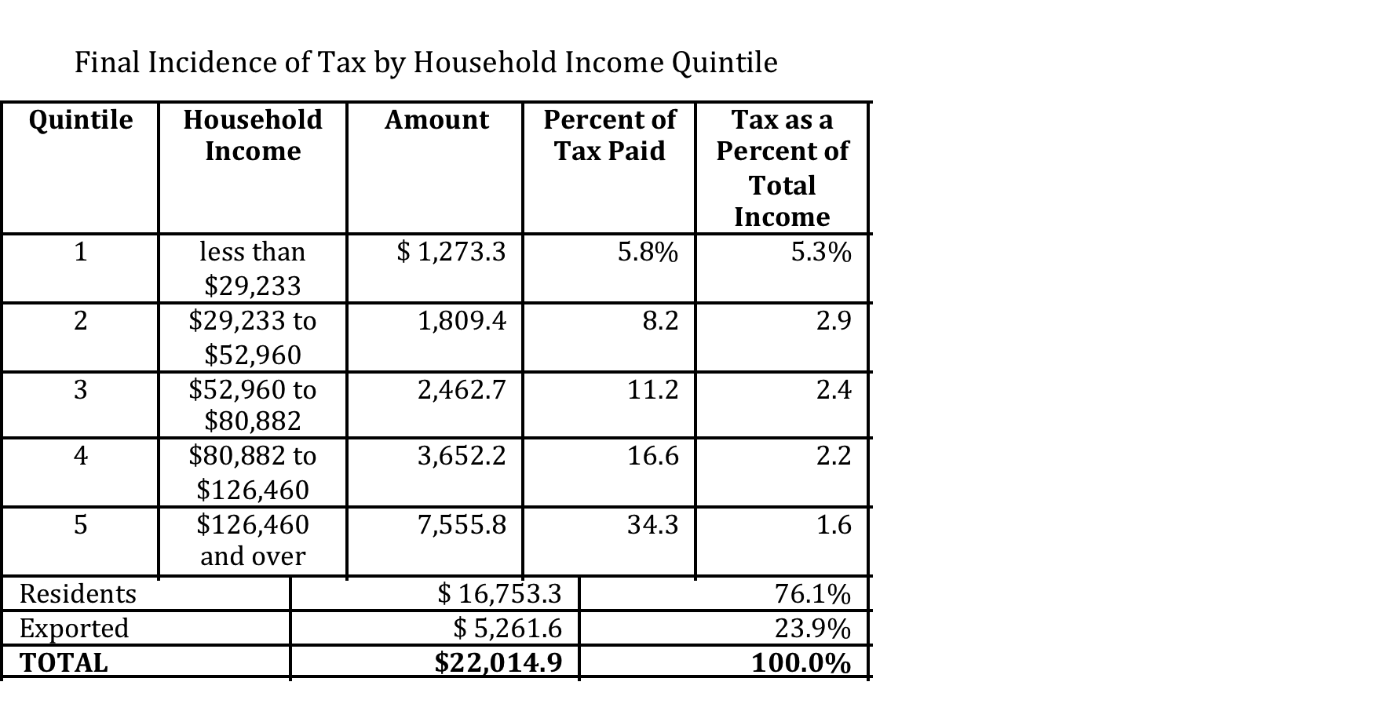
Estimated Equity of Tax
Suits Index: -0.09

Slide 35
