Slide 1
The History of Economics
Craig Vincent Mitchell, PhD

Slide 2
Overview
Providence favors trade among peoples in order to promote universal brotherhood; providence also creates social inequality because it is part of the Divine plan. Providence designed a world in which commerce was necessary, in which good business benefited not only the individual but all of mankind, in which inequality in rank and income was part of the scheme of things.
Jacob Viner, Professor of Economics at the University of Chicago, Author of The Role of Providence in the Social Order (1966)

Slide 3
Overview
Periods in Economic History
Pre- Scholastic | Aristotle, Augustine, Aquinas | 300 B.C.- 1275 A.D.
Scholastic | The Salamanca School of Economics | 1500-1700 A.D.
Classical | Adam Smith | 1776- 1870
Neo-Classical | Marginal Revolution | 1871- present

Slide 4

Pre-Scholastic Political Economy
Xenophon was a contemporary of Plato.
He wrote a number of things that specifically focused on economic issues

Slide 5
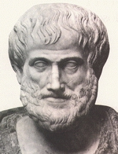
Pre-Scholastic Political Economy
Aristotle wrote the first works on Political Economy
He wrote The Politics and The Economics
He took a teleological approach to the subject

Slide 6
Pre Scholastic Political Economy
Aristotle believed that law, politics, economic theory and morality are all tied together.
He believed that these different disciplines should work together
He based all of these disciplines on natural law, which is based on the ontology of man and the order of the world
He separated economics from business (money-making)
He thought that good government would result in good economies

Slide 7
Aristotle Divisions
Economics
(oikos nomos)
Business
(chremastistics)
Economics are virtuous.
Economic or natural transactions are concerned with the satisfaction of needs. Thus wealth is limited by purpose.
Chrematistics (money making) are vicious.
Chrematistic or un-natural transactions, on the other hand are aimed at increasing wealth without limits. Chrematistics are vicious because wealth can become an end unto itself.

Slide 8
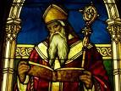
Pre Scholastic Political Economy
Augustine of Hippo wrote about economic theory in his City of God.
Like Aristotle, he believed that political economy was a sub-discipline within ethics

Slide 9
Augustine’s Economics
Augustine’s Theory of Love and Hate
Kind of Love | Inner Act | Outer acts toward self | Outer Acts towards others
Ordinate | Benevolence (good will) | Virtue (utility) | Beneficence (doing good or gifts)
Inordinate | Malevolence (ill will) | Vice | Maleficence (doing evil or crimes)

Slide 10
Pre Scholastic Political Economy
Augustine’s theory of personal distribution explains how people are motivated by self love and by the love for his neighbor
The tradesman loves his customers with benevolence (wishing good to them) and not with beneficence because of scarcity.
The tradesman loves his family with both benevolence and beneficence (doing good to them).
The tradesman sells his product to customers to earn the means to provide for himself and his family.

Slide 11
Augustine’s Economics
Augustine’s Levels of Economy
Level | Explanation | Includes
Personal | Individual
Domestic | Household/ family | Firms/ non-profits
Political | Government | City, State, Nation

Slide 12
Augustine’s Economics
Elements in Augustine’s Economics
For Whom? | Theory of final distribution | Is concerned with the purposes for our actions. Distributive justice
What? | Theory of Utility | Explains how we value goods and services to be consumed
How? -A | Theory of Production | How capital and labor are used to produce goods and services
How? -B | Theory of Justice in Exchange | Equilibrium- the point at which no rational person will change his behavior

Slide 13
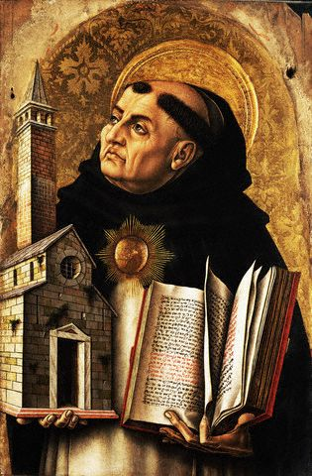
Pre-Scholastic Political Economy
Thomas Aquinas wrote also wrote on the subject of political economy.
He combined Aristotle’s political economy with Augustine’s theology

Slide 14
Pre-Scholastic Political Economy
Thomas Aquinas combined Aristotle’s ideas on political economy with Augustine’s
There are four types of economic actions associated with human and non-human goods
Production
Exchange
Distribution or giving
Consumption or use

Slide 15
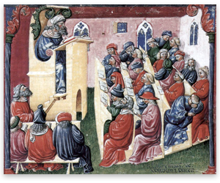
Scholastic Political Economy
The Salamanca School of Economics began in the 15th century with Dominican Monks who relied upon the works of Thomas Aquinas

Slide 16

Scholastic Political Economy
They began in Salamanca Spain, but also spread to the University of Coimbra in Portugal
The Dominicans were followed by Franciscan Monks
Finally, Jesuit monks joined in the work of political economy

Slide 17
1776-1870
Classical
Political Economy

Slide 18
Classical Political Economy
Dominant Theories
Mercantilism
Bernard Mandeville and Adam Smith
Physiocrats

Slide 19
Classical Political Economy
Mercantilism
Physiocrats
the doctrine that says government control of foreign trade is of paramount importance for ensuring the prosperity and security of a state. In particular, it demands a positive balance of trade. In thought and practice it dominated Western Europe from the 16th to the late-18th century.
Physiocrats, a group of economists who believed that the wealth of nations was derived solely from the value of "land agriculture" or "land development." Their theories originated in France and were most popular during the second half of the 18th century. Physiocracy is perhaps the first well-developed theory of economics.

Slide 20
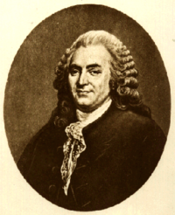
Classical Political Economy
Bernard Mandeville wrote The Fable of the Bees
subscribed to the division of labor
He concluded that vice, at variance with the "Christian virtues" of his time, was a necessary condition for economic prosperity. His viewpoint is more severe when juxtaposed to Adam Smith’s.
Both Smith and Mandeville believed that individuals’ collective actions bring about a public benefit

Slide 21
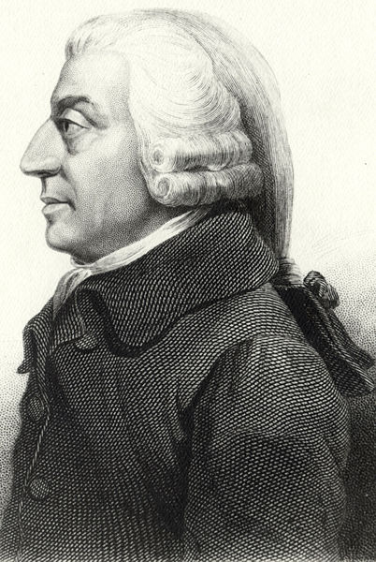
Classical Political Economy
Adam Smith was a student of Francis Hutchison, who developed “the division of labor.”
Smith wrote The Wealth of Nations, it was published in 1776
He employed a deontological (utilitarian) approach to political economy

Slide 22
Classical Political Economy
Smith was influenced by stoicism
Smith based his economic theory on an earlier work The Theory of Moral Sentiments
He wanted to produce something like Isaac Newton’s Principia that would reduce economics to a single, ultimate moral principle.
He eliminated Augustine’s theory of personal distribution.
He created a labor theory of value.

Slide 23
Classical Political Economy
Harvard professor Joseph Schumpeter explains that Adam Smith got many of his ideas from the Salamanca School.
Schumpeter argued that what Smith did that was good was not original. What Smith did that was original was not good.
Smith’s theory of value retarded the development of a workable theory for eighty years.

Slide 24
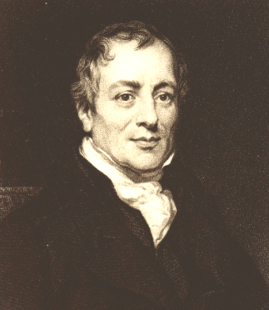
Classical Political Economy
David Ricardo is known for the theory of comparative advantage, a fundamental argument in favor of free trade among countries and of specialization among individuals. Ricardo argued that there is mutual benefit from trade even if one party is more productive in every possible area than its trading counterpart.

Slide 25
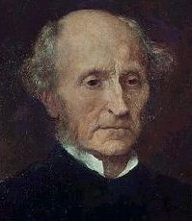
Classical Political Economy
John Stuart Mill's early economic philosophy was one of free markets.
He also accepted the principle of legislative intervention if there were sufficient utilitarian grounds.
Mill believed that progressive taxation penalized those who worked harder and saved more and was therefore "a mild form of robbery"

Slide 26

Classical Political Economy
Jean Baptist Say is known for Say’s Law
In a market economy, goods and services are produced for exchange with other goods and services. Employment multipliers, therefore arise from production and not exchange alone. In the process a sufficient level of real income is created to purchase the economy's entire output. In other words, it is production or supply that drives an economy.

Slide 27
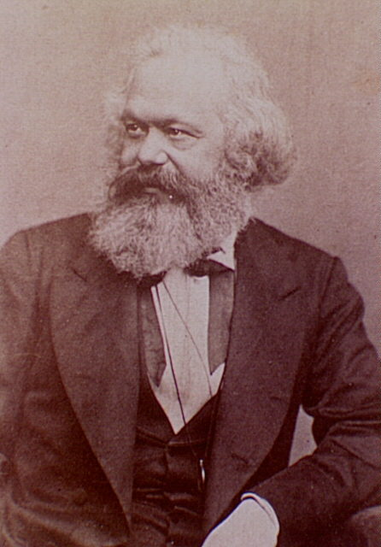
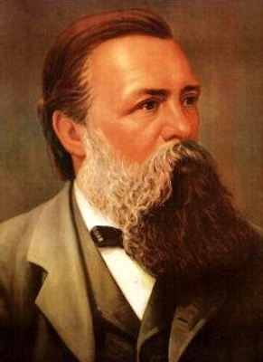
Classical Political Economy
Karl Marx
Friedrich Engels

Slide 28
Classical Political Economy
Marx, along with Friedrich Engels wrote, The Communist Manifesto, and Das Kapital.
He combined Hegelian political thought with metaphysical materialism.
He believed that the state should control the economy and not individuals.
He was a metaphysical nominalist and deontological

Slide 29
Classical Political Economy
Goals of Communism
1. Abolition of property in land and application of all rents of land to public purposes.
2. A heavy progressive or graduated income tax.
3. Abolition of all right of inheritance.
4. Confiscation of the property of all emigrants and rebels.
5. Centralization of credit in the hands of the state, by means of a national bank with state capital and an exclusive monopoly.

Slide 30
Classical Political Economy:
Communist Goals Continued
6. Centralization of the means of communication and transport in the hands of the state.
7. Extension of factories and instruments of production owned by the state; the bringing into cultivation of waste lands, and the improvement of the soil generally in accordance with a common plan.
8. Equal liability of all to labor. Establishment of industrial armies, especially for agriculture.
9. Combination of agriculture with manufacturing industries; gradual abolition of the distinction between town and country, by a more equable distribution of the population over the country.
10. Free education for all children in public schools. Abolition of children’s factory labor in its present form. Combination of education with industrial production, etc

Slide 31
The Marginalist Revolution
1871-Present
Neo-Classical Economics

Slide 32
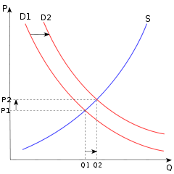
Neo Classical Economics
Neo Classical Economics (or Microeconomics) is based on rational choice theory. It assumes that individuals are utility maximizing and that firms are profit maximizing.
It is an approach that employs the use of supply and demand curves to arrive a proper understanding of price.
Equilibrium is the point at which no rational person will change his behavior. It is also the point at which supply equals demand.

Slide 33
Neo-Classical Economics
Marginalist Revolution
Lausanne School
Austrian School
British School

Slide 34
Neo- Classical Economics
Lausanne School
Leon Walras
Vilfredo Pareto
Antoine Augustine Cournot
Leon Winiarski

Slide 35
Neo-Classical Economics:
Austrian School
Carl Menger
Friedrich von Weiser
Ludwig von Mises
Frierich von Hayek
Abraham Wald
Eugen Bohm Bawerk

Slide 36
Neo-Classical Economics:
Austrian School
Karl Menger started the Austrian School of Economics
Most of its members assumed a causal realist approach to economics
To the degree that it is realist it is also a teleological approach to economics
It places little importance on mathematics because economics is a social science
It combines law, politics, and economic theory
It acknowledges the existence of macroeconomic problems, but rejects Keynesian macroeconomics.
It focuses on microeconomics and political economy
Macroeconomic problems are solved via microeconomic foundations.

Slide 37
Neo-Classical Economics:
Austrian School
Praxeology is concerned with the conceptual analysis and logical implications of preference, choice, and means-end schemes.
The basic principles of praxeology were first discovered by the Greek philosophers, who used them as a foundation for a eudaimonistic ethics. This approach was further developed by the Scholastics, who extended praxeological analysis to the foundations of economics and social science as well.

Slide 38
Neo-Classical Economics:
Austrian School
In the late nineteenth century, the praxeological approach to economics and social science was rediscovered by Carl Menger, founder of the Austrian School. The term praxeology was first applied to this approach by the later Austrian economist Ludwig von Mises. Von Mises and his followers employed praxeological principles to show that much existing economic and social theory was conceptually incoherent.

Slide 39
Neo-Classical Economics:
Austrian School
Methodological Individualism: Ultimately, we can trace all economic phenomena back to the actions of individuals; thus individual actions must serve as the basic building blocks of economic theory.
2. Methodological Subjectivism: Economics takes man's ultimate ends and judgments of value as given. Questions of value, expectations, intent and knowledge are created in the minds of individuals and must be considered in this light.
Marginalism: All economic decisions are made on the margin. All choices are choices regarding the last unit added or subtracted from a given stock.
4. Tastes and Preferences: Individuals' demands for goods and services are the result of their subjective valuations of the ability of such goods and services to satisfy their wants.

Slide 40
Neo-Classical Economics:
Austrian School
5. Opportunity Costs: All activities have a cost. This cost is the most highly valued alternative that is forgone because the means for its satisfaction have been devoted to some other (more highly valued) use.
6. Time Structure of Consumption and Production: All decisions take place in time. Decisions about how to allocate resources for the purposes of consumption and production across time are determined by individuals' time preference.
7. Consumer Sovereignty: In the marketplace consumers are king. Their demands drive the shape of the market and determine how resources are used. Intervention in the marketplace stifles this process.
8. Political Individualism: Political freedom is impossible without economic freedom

Slide 41
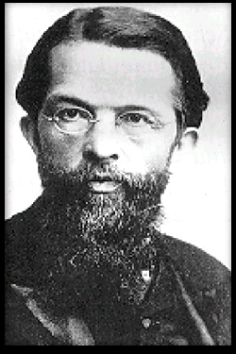
Neo-Classical Economics:
Austrian School
The Austrian School of Economics began with Carl Menger
Menger Held to a causal or - metaphysical realist approach to political economy
He emphasized the importance of free markets

Slide 42
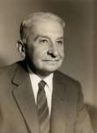
Neo-Classical Economics:
Austrian School
Ludwig von Mises studied under the Austrian economist Eugen von Bohm Bawerk, Karl Menger, and the sociologist, Max Weber
He wrote Human Action
His work was in monetary economics and inflation
He also studied government controlled economies and free trade.
He was a friend and mentor to Friedrich von Hayek

Slide 43
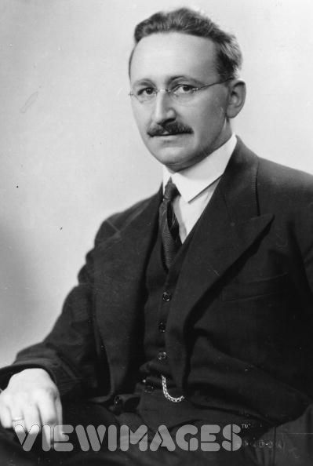
Neo-Classical Economics:
Austrian School
Freidrich von Hayek was a student of the Austrian professors, Friedrich von Wieser and Karl Menger
He wrote The Road to Serfdom
He taught at the University of Chicago and influenced Milton Friedman and others
He won the Nobel prize in economics with Gunner Myrdal

Slide 44
Neo Classical Economics:
The British School
Alfred Marshall
William Stanley Jevons
Francis Ysidro Edgeworth
John Neville Keynes
Arthur Cecil Pigou

Slide 45

Neo Classical Economics:
The British School
Alfred Marshall was a professor at Cambridge University.
He emphasized positive economics.
He was the leader of the mathematizing of economics

Slide 46
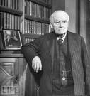
Neo Classical Economics:
The British School
John Neville Keynes was the father of John Maynard Keynes
He was a professor of political economy at Cambridge University
He divided economics into positive, normative and practical sub- disciplines.
He brought an end to political economy

Slide 47
Neo-Classical Economics
Keynesian Economics

Slide 48
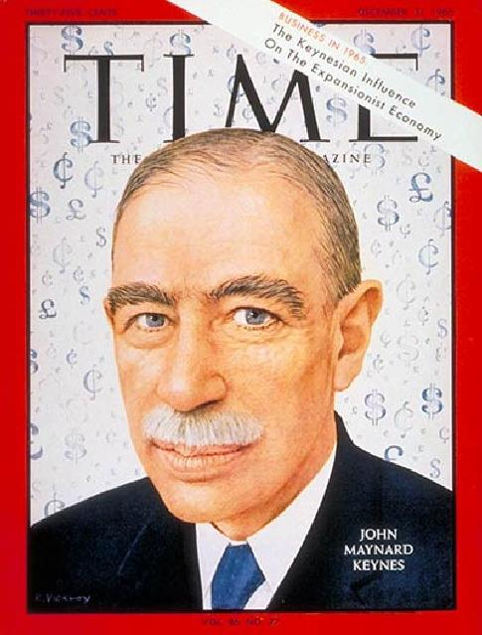
Neo Classical Economics:
Keynesian Macroeconomics
John Maynard Keynes invented macroeconomics.
He hated communism and capitalism.
His system is in between the other systems.
It is a socialist approach to economics
He believed that governments should control markets.
He also believed in a progressive income tax

Slide 49
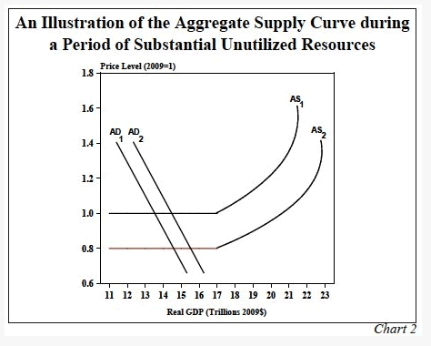
Neo Classical Economics:
Keynesian Macroeconomics
Keynes wrote The General Theory of Employment, Interest and Money.
He believed that individual markets behaved differently from markets in aggregate.
He believed that Government should manipulate the demand s by changing tax rates and the amount of government spending.

Slide 50
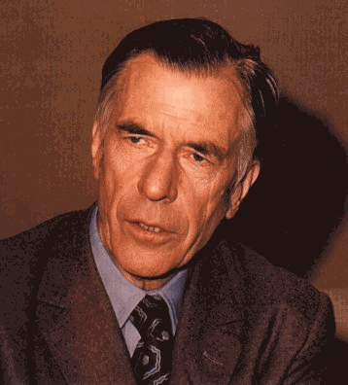
Neo Classical Economics:
Keynesian Macroeconomics
John Kenneth Galbraith was the major proponent of Keynesian economics in America.
He was a professor at Harvard University
Harvard University became the Keynesian School of Economics in America

Slide 51
Neo Classical Economics:
Keynesian Macroeconomics
John Maynard Keynes
New Keynesians
Post-Keynesians
Neo- Keynesians

Slide 52
Neo Classical Economics:
Post-Keynesian Macroeconomics
Michael Kalecki
Joan Robinson
Paul Davidson
Robert
Skidelsky
Hyman Minsky
Nicholas Kaldor

Slide 53
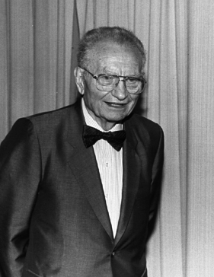
Neo Classical Economics:
Neo-Keynesian Macroeconomics
Paul Anthony Samuelson was a Keynesian economist who got his PhD from Harvard University and taught at MIT
He was author of the largest-selling economics textbook of all time: Economics: An Introductory Analysis.
He was a founder of Neo-Keynesianism and the central figure behind the Neo- Classical Synthesis.
He received the Nobel prize in economics

Slide 54
Neo Classical Economics:
Keynesian Macroeconomics
The Neo Classical Synthesis is the combination of Neoclassical Microeconomic Theory with Keynesian Macroeconomic Theory
The Keynesian macroeconomists who accepted this synthesis were known as Neo-Keynesians
From 1945-1980 this approach was known as Mainstream Economics in America.
The Germans and Austrians rejected Keynesian macroeconomics outright.

Slide 55
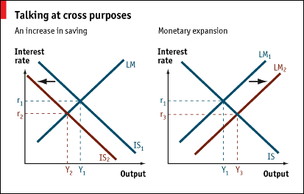
Neo- Classical Synthesis:
John Hicks

Slide 56
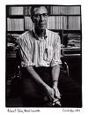
Neo Classical Economics:
New Keynesian Macroeconomics
Robert Solow earned his PhD at Harvard University.
He taught at MIT with Paul Samuelson.
He earned the Nobel prize in economics for his theory of economic growth

Slide 57
Neo Classical Economics:
New Keynesian Macroeconomics
Gregory Mankiw
Stanley Fischer
David Romer
Olivier Blanchard

Slide 58
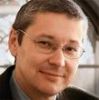
Neo Classical Economics:
New Keynesian Macroeconomics
New Keynesian Macroeconomic (NKM) Theory arose in response to New Classical Macroeconomics (NCM).
NKM bases Keynesian macroeconomics on neo-classical microeconomics
Gregory Mankiw, a professor of economics at Harvard University is a major figure in NKM and served as the head of President George W. Bush’s Council of Economic Advisors.
They developed DSGE models based on Keynesian principles

Slide 59
Neo-Classical Economics
The Chicago School of Economics

Slide 60
Neo-Classical Economics:
The Chicago School
Frank H. Knight and Jacob Viner, Knight presided over the Department of Economics at the University of Chicago from the 1920s to the late 1940s
Three basic characteristics of the Chicago School:
  First, theory is of fundamental importance
  Second, theory is irrelevant unless set in a definite empirical context
  Third, that in absence of evidence to the contrary, “the market works.”

Slide 61
Neo-Classical Economics:
The Chicago School
The Chicago School argues for the supremacy of the free market for organizing resources. It also rejects government intervention into economic affairs. The Chicago School also emphasizes the quantity theory of money as a key factor in producing inflation.
There are eleven (out of 60) Nobel prize winners from the Chicago School of Economics, including: Milton Friedman, Theodore Schultz, George Stigler, Merton Miller, Ronald Coase, Gary Becker, Robert Fogel, Robert Lucas Jr., James Heckman, Douglass C. North and Oliver E. Williamson.

Slide 62
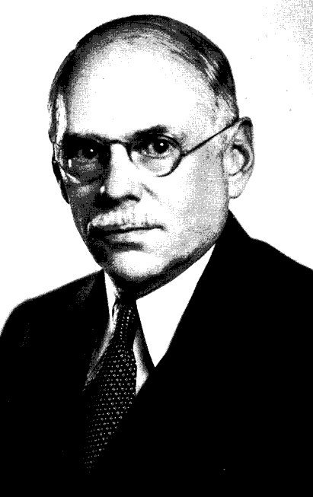
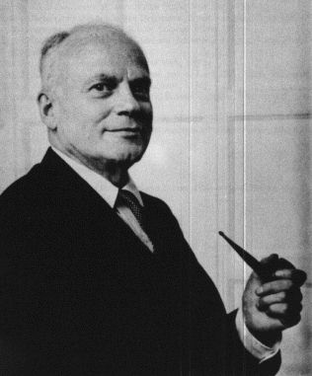
Neo-Classical Economics:
The Chicago School
Frank Knight
Jacob Viner

Slide 63
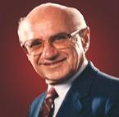
Neo-Classical Economics:
The Chicago School
Milton Friedman was influenced by Friedrich von Hayek and Ludwig von Mises
He became the leader of the Chicago School of Economics.
He emphasized a positive/ empirical approach to economics
He was an advocate of free markets
He specialized in macroeconomic theory, focusing in monetary theory
He earned the Nobel Prize in economics

Slide 64

Neo-Classical Economics:
The Chicago School
George Stigler was the other leader at the Chicago School of Economics.
He specialized in microeconomics
He focused on price theory and the government regulation
He earned the Nobel Prize in economics

Slide 65
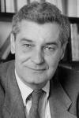
Neo-Classical Economics:
The Chicago School
Robert Lucas Jr. won the Nobel Prize in economics for his work in Real Business Cycles.
He is a leader in New Classical Macroeconomics (NCM).
NCM is a rejection of Keynesian macroeconomics.
NCM argues that the study of aggregate markets should be based entirely on neoclassical microeconomics.

Slide 66

Neo-Classical Economics:
The Chicago School
Ronald Coase specialized in microeconomic theory
His work focused on a type of market failure known as externalities
He argued that this problem can be solved via property rights
He won the Nobel prize in economics for his work

Slide 67
Neo-Classical Economics:
Mainstream Economics
From 1945-1980 mainstream economics was dominated by the Neoclassical Synthesis
From 1981-2000 mainstream economics was dominated by New Classical Macroeconomics (the Chicago School of Economics ).
From 2000- present mainstream economics has been dominated by New Keynesian Macroeconomics.

Slide 68
Neo-Classical Economics:
Salt Water Economics
Saltwater macroeconomics is dominated by schools located by the oceans. For example, Harvard University, MIT, Princeton, Yale, University of California at Berkeley and Stanford University.
They are in favor of fiscal policy, like economic stimulus.
They believe that business cycles result from market failure.
They reject the rational expectation theory of economics. Believing instead, that the market process is dominated by animal spirits or irrationality.

Slide 69
Neo-Classical Economics:
Fresh Water Economics
Freshwater macroeconomics or New Classical Macroeconomics is dominated by universities located near the great lakes. University of Chicago, Carnegie Mellon University, University of Rochester, University of Minnesota.
They accept Say’s law- supply creates its own demand.
They subscribe to the Rational Expectation Theory of economics. Individuals are rational, forward looking, and utility maximizing. Hence, markets act rationally.

Slide 70
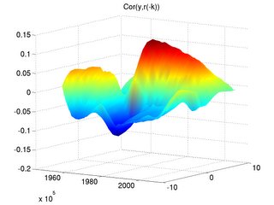
Neo-Classical Economics:
Fresh Water Economics
Real Business Cycles- a sub school within NCM; they believe that periods of recession and growth are efficient responses to changes in the economic environment
They reject government intervention into the economy, like fiscal policy, monetary policy and stimulus
They developed the first Dynamic Stochastic General Equilibrium (DSGE) models.

