Slide 1
Value Theory
Craig Vincent Mitchell, PhD
SWBTS

Slide 2
Value Theory
Value theory is concerned with why we value anything. It answers a number of questions like:
What gives a thing its value?
Why is one thing valued more or less than another thing?
Is value subjective or objective?
What are the effects of value?

Slide 3

The History of Value Theory
Value theory dates back to Plato and Aristotle
They both held that intrinsic value is based on forms
They differed on the nature of the forms
Extrinsic value is based on concrete particulars

Slide 4
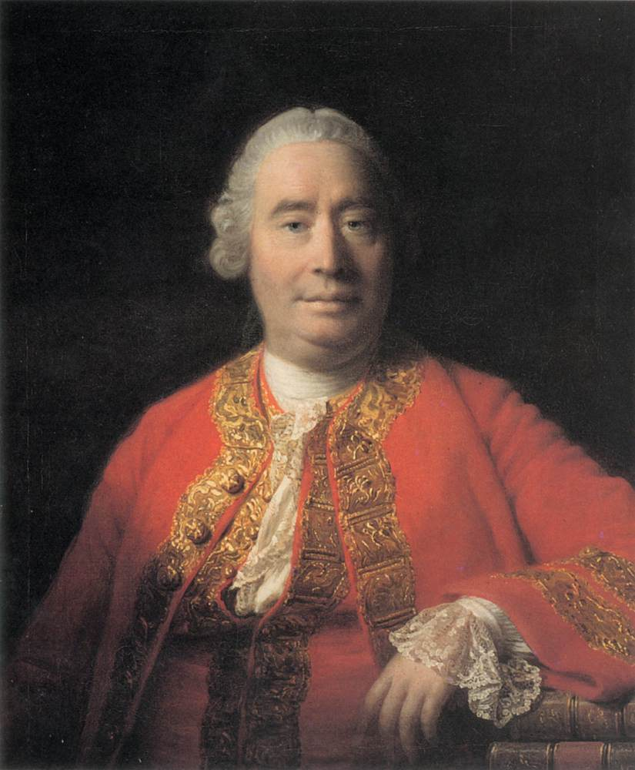
The History of Value Theory
David Hume argued that value is subjective and is based only on feelings.
Hume is responsible for the Fact/ Value Dichotomy
Hume was a metaphysical nominalist

Slide 5
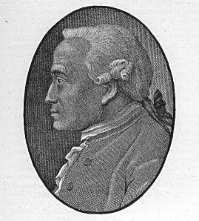
The History of Value Theory
Immanuel Kant asserted that there are two kinds of value, relative worth and intrinsic worth.
Aesthetic value is a distinct category of non-moral worth

Slide 6

The History of Value Theory
Franz Brentano is the connecting point for both Analytic and Continental Philosophy
He studied both Aristotle and Kant
He emphasized the importance of intentionality

Slide 7

The History of Value Theory
Alexius Meinong was a student of Brentano
He was a metaphysical realist
He explained the nature of a “value experience.”

Slide 8
Alexius Meinong: Requirements for a Value Experience
Value Subject- the evaluator who experiences
Value Feeling- a positive or negative emotion
Value Object- a real or an intentional thing that is evaluated by the value subject
An existence judgment about the realization or existence of this value object

Slide 9
The Language of Value
Value Subscriber- a person who subscribes to a certain value
Value Object- whatever is being evaluated
Locus of Value-

Slide 10
Major Divisions within
Value Theory
Value Theory
Object of Value
Object Valuer

Slide 11
Object of Value:
Ontology of Value
The metaphysics of value- the nature of value
  Intrinsic value- that which is valued as an end in itself
  Extrinsic value- ( AKA instrumental value) that which is valued as a means for something else

Slide 12
Objects of Value: Metaphysics
 | Type of Value | Monism/ Pluralism | Parts/ Wholes
Realism | Platonic realist believe that universals like truth, beauty, goodness or states of affairs have intrinsic value. Aristotelian realists believe that only states of affairs that obtain have intrinsic value. Concrete particulars have only extrinsic value. | Value Monism- An object has only one thing that has intrinsic value | Principle of Organic Unities- The value of a object is more than the sum of the value of its parts
Nominalism | Concrete particulars have intrinsic value while States of affairs have extrinsic value | Value Pluralism An object may have more than one intrinsic value | Principle of Summation- value is the sum of an object’s parts

Slide 13
Object Valuer: Epistemology
 | Fact/ value dichotomy | Theory of knowledge | Emotions
Metaphysical Realism | Does not apply Values are objective | Externalism- knowledge results from true belief via a reliable belief forming process. Can include causal theories of knowledge | Emotions are driven by reason Good things result in love or attraction. Bad things result in hate or repulsion.
Metaphysical Nominalism | Does apply Values are not objective | Internalism- knowledge is justified true belief. Can include causal theories of knowledge | Emotions are irrational. Love (attraction) and hate (repulsion) have nothing to do with objective value.

Slide 14
Conclusions
Value theory has a long history.
Metaphysics influence which theory of value that one holds.
Value provides motivation for an action or course of action.
Value theory affects ethics (moral psychology) and epistemology (the value of knowledge).

