Slide 1
Why Currencies Crash
Craig Vincent Mitchell, PhD
Associate Professor of Christian Ethics
Southwestern Baptist Theological Seminary

Slide 2
Currency Crashes
What is a currency crash?
What causes currency crashes
How many currency crashes have there been?
What is the most recent currency crash?
What can be done to avoid currency crashes?

Slide 3

Iceland’s Economic Growth
2003 Iceland’s three biggest banks had assets of a few billion dollars, about 100% of GDP
Over next three years they grew to over $140 billion
The most rapid expansion of a banking system in the history of mankind
Icelandic stock market multiplied nine times

Slide 4

Robert Aliber: Professor of Economics
University of Chicago
Developer of the Program of International Studies in Business and the Center for Studies in International Finance
He updated Charles Kindleberger’s 1978 classic book, Manias, Panics and Crashes

Slide 5
Aliber’s Analysis of Iceland
Aliber took an interest in Iceland in April 2006
Using the Minsky model, he called Iceland’s rise the “Perfect Bubble”
May 2008 Aliber spoke to the University of Iceland’s economic department
Aliber said “I give you nine months. Your banks are dead. Your bankers are either stupid or greedy. And I’ll bet they are on planes trying to sell their assets right now.”

Slide 6
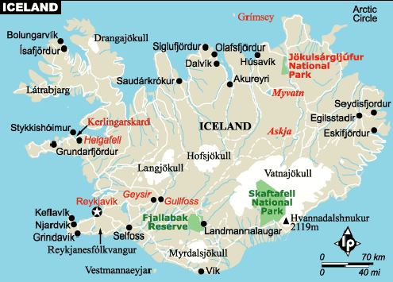
Iceland: October 2008
By 2007 Icelanders owned 50 times more foreign assets than they had in 2002
Icelandic debt amounted to 850% of GDP
Any one of the three Icelandic banks suffered losses too big for the nation to bear

Slide 7
Iceland: October 2008
To acquire a loan from the IMF, on 28 October 2008, the Icelandic government raised interest rates to 18%
Trading on the Icelandic Krona (ISK) resumed on the open market, after the rate hike
The Krona is now valued at around 250 ISKs per Euro, or less than one-third its value during most of 2008,
A drop from the 1:150 exchange ratio of the week before.
Iceland’s 300,000 citizens each owe $330,000 on top of their personal losses.

Slide 8
Currency Crash: Definition
According to Jeffrey A. Frankel and Andrew K. Rose : a currency crash is a large change of the nominal exchange rate of at least 25% that is also at least a 10% increase in the rate of nominal depreciation
According to Joseph Gagnon, a currency crash is an exchange rate depreciation that exceeds 15% over four quarters
Also called a balance-of-payments crisis, occurs when the value of a currency changes quickly, undermining its ability to serve as a medium of exchange or a store of value. It is a type of financial crisis.

Slide 9
Currency Crisis: Definition
Includes both the large depreciation and speculative attacks that are successfully warded off by authorities.
Currency crises are sufficient but not necessary conditions for a currency crash.

Slide 10
Currency Carry Trades
Currency Carry Trade- consists of selling low interest rate currencies (funding currencies) and investing in high interest rate currencies (investment currencies).
Sudden exchange rate moves unrelated to news can be due to the unwinding of carry trades when speculators near funding constraints.
Speculators holding on to investment currencies too long can lead to an exchange rate “bubble.”
There is evidence of a strong link between currency carry trade and currency crash risk.

Slide 11
Contagion: Definition
Contagion results when financial difficulties in one country spreads to other nearby countries and thereby impairing economic growth worldwide.
Panics are transmitted from one country to another by arbitrage in commodities or securities and movement of money in various forms, cooperation among monetary authorities and pure psychology.

Slide 12
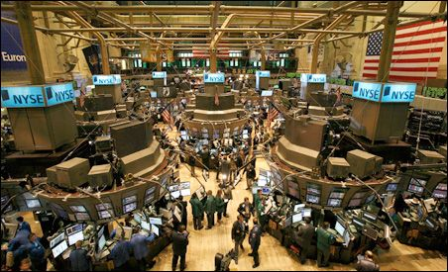
Number of Crashes 1971-2003
There were at least 188 currency crashes
74 countries have had multiple crashes within three year windows

Slide 13
Common Characteristics
Exchange rates that are over-valued by over 10%
Debt burdens are high and rising
Crash may be precipitated by slow economic growth
Crashes tend to occur when Foreign Direct Investment (FDI) inflows dry up
Rising unemployment
Slow GDP growth

Slide 14
Common Characteristics
Current account deficits can be small and shrinking
Government budgets can have small and shrinking deficits
Crashes may not be caused by sharp recessions
Associated with inflationary macroeconomic policies
Before 1986 crashes were almost always caused by inflationary macroeconomic policies
Since 1985 crashes were caused by negative shocks to economic activity

Slide 15

The Mexican Crisis of 1994
AKA The December Mistake
Mexico had a fixed exchange rate system that accepted pesos during the reaction of investors to a higher perceived country risk premium and paid out dollars.
Mexico lacked sufficient foreign reserves to maintain the fixed exchange rate and was running out of dollars at the end of 1994.

Slide 16

The Asian Crisis of 1997
The Asian Crisis of 1997 had both currency crashes and contagion
Only a few months before, the region was proclaimed as enjoying the East-Asia growth miracle (these countries were known as the Asian tigers)
Global GDP growth fell by 1% (to 2%)

Slide 17
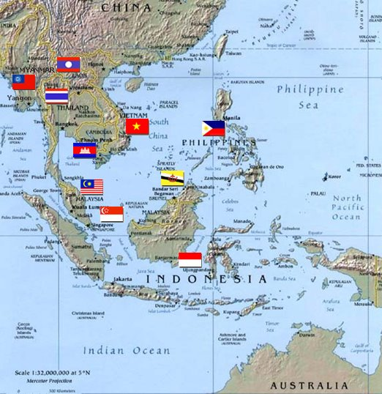
The Asian Crisis of 1997
The Asian tigers crashed
  The Thai baht crashed on July 2, 1997
  Philippine peso crashed
  Indonesian rupiah crashed
  Malaysian ringitt crashed
  Korean won crashed

Slide 18
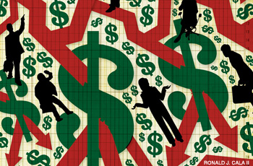
Business Week: April 20, 2009
What Good are Economists Anyway?

Slide 19
Business Week: April 20, 2009
What Good are Economists Anyway?
According to Peter Coy, if economists were any good;
  they should have been able to predict the current economic crisis
  they should know how to solve this economic crisis
  From the 1930s to the 1960s agreed that government spending increases and tax cuts were essential for avoiding deep recessions. But over time the conventional wisdom swung to the idea that interest rate cuts by the Federal Reserve- monetary policy- were the best way to fight downturns.

Slide 20

Currency Crisis Models:
First Generation (1979)
First generation models of currency crises starts with the Paul Krugman.
He argued that a currency crisis arises from a sudden speculative attack on a fixed exchange rate
Fell out of favor because in many crises the crucial disequilibria were absent

Slide 21


Currency Crisis Models:
Second Generation (1986)
Maurice Obstfeld
Ken Rogoff

Slide 22
Currency Crisis Models
Second generation models of currency crises started with Maurice Obstfeld and Ken Rogoff. Doubts about whether the government is willing to maintain its exchange rate peg lead to multiple equilibria, suggesting that self fulfilling prophecies may be possible, in which the reason investors attack the currency is that they expect other investors to attack the currency.
Fell out of favor because the emphasis on mounting unemployment and domestic recession was at odds with the facts in Mexico 1994 and East Asia 1997

Slide 23
Currency Crisis Models
Third generation models of currency crises have explored how problems in the banking and financial system interact with currency crises, and how crises can have real effects on the rest of the economy.
The key role is assigned to financial structure and financial institutions, especially domestic banking
There are a number of models after this fashion which are concerned with liquidity of a bank’s assets.
There is no one definitive model

Slide 24


Currency Crisis Models:
Third Generation
Andres Velasco
Roberto Chang

Slide 25
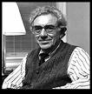
The Minsky Model
Named after Hyman Minsky (1919-1996), Professor of Economics at Washington University St Louis (1965-1990)
"A fundamental characteristic of our economy is that the financial system swings between robustness and fragility and these swings are an integral part of the process that generates business cycles."

Slide 26

The Minsky Model
Minsky argued that these swings, are an inherent part of a free market economy
Government should step in in to control these swings through regulation and central bank action
He opposed the deregulation that characterized the 1980s.

Slide 27
Minsky Model:
Three Types of Borrowers
A key mechanism that pushes an economy towards a crisis is the accumulation of debt. He identified 3 types of borrowers that contribute to the accumulation of insolvent debt:
  Hedge borrower borrows with the intent of making debt payments from cash flows from other investments.
  Speculative borrower borrows based on the belief that the appreciation of the value of the assets (e.g. real estate) will be sufficient to refinance or pay-off their debt but who does not have sufficient resources to repay the original loan.
  Ponzi borrower relies on continually rolling over the principal into new investments. (a nonsustainable pattern of finance, Ponzi Scheme- named after Carlos Ponzi)

Slide 28
Minsky Model
Events that lead to a crisis start with an outside shock to the macroeconomic system
The nature of these shocks vary from one speculative boom to another
These booms are fueled by the rapid expansion of credit
Euphoria develops as investors buy goods and securites to profit from capital gains
Making money seems easy so banks and borrowers move from euphoria to mania

Slide 29
Minsky Model
Most manias or bubbles center on real estate and stocks
Minsky moment - the point in a business cycle when investors have cash flow problems due to spiraling debt incurred by financing speculative investments. This results in a major selloff and a slowing of the economy.
When an economy slows some of the firms involved in hedge finance group are moved to the group involved in speculative finance
When an economy slows some of the firms involved with speculative finance now find that they are in the Ponzi finance group.

Slide 30
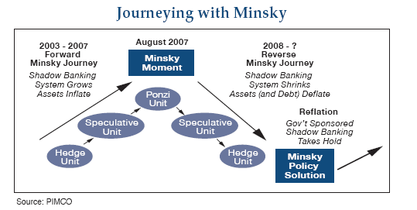
Minsky Model

Slide 31
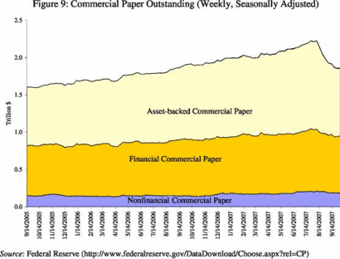
Minsky Model

Slide 32
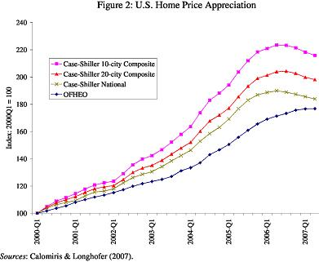
Minsky Model

Slide 33
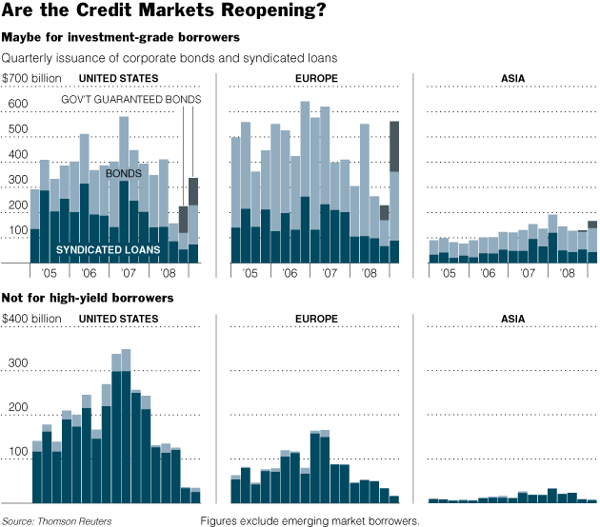
Credit Markets 2005-2009

Slide 34
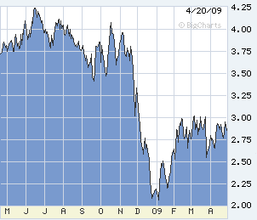
Credit Markets 2008-09

Slide 35

How to Avoid Currency Crashes
According to Avinash Persaud:
IMF should take amore aggressive role in supporting the international finance system
  IMF should offer more speedy assistance
  IMF should extend larger loans
  IMF should anticipate currency crashes
IMF bailouts increase the danger of moral hazard
Moral hazard played a role in the Asian Crisis

Slide 36

Outcomes
According to Joseph E. Gagnon in industrial countries
  Crashes caused by rising unemployment or external deficits have good economic consequences with stable or falling inflation rates
  Poor outcomes are attributable to inflationary policies in general and not the currency crashes in particular

Slide 37
Outcomes
According to Joseph E. Gagnon in industrial countries
  When inflation is high and rising at the time of a currency crash, bond yields tend to rise. Otherwise--and in every currency crash since 1985--bond yields tend to fall.
  Over the past 20 years, inflation rates have been remarkably stable in industrial countries after currency crashes

Slide 38

Outcomes
According to Jeffrey Frankel
  a political leader in a developing country is almost twice as likely to lose office in the 6 months following a currency crash as otherwise.
  This difference, which is highly significant statistically, holds regardless whether the devaluation takes place in the context of an IMF program.

Slide 39
BIBLIOGRAPHY
Brunnermeier, Markus K., Stefan Nagel, and Lasse H. Pedersen, “Carry Trades and Currency Crashes” presented at the German Economists Abroad Conference, American Economic Association meeting, June 2008.
Chang, Roberto and Andres Velasco. “Currency Crisis in Emerging Markets,” 2001.
Gagnon, Joseph, “Currency Crashes in Industrial Countries: Much Ado About Nothing?” Board of Governors of the federal reserve System, Number 966, February 2009.
Gagnon, Joseph, ''Currency Crashes and Bond Yields in Industrial Countries,'' Journal of International Money and Finance (forthcoming. Also available as International Finance Discussion Papers 837).
Frankel, Jeffrey, and Andrew K. Rose. 1996. "Currency Crashes in Emerging Markets: Empirical Indicators." Working Paper 5437
Lewis, Micheal, “Wall Street on the Tundra” in Vanity Fair (April, 2009) No. 584, 140-177.
Kindleberger, Charles P. and Robert Z. Aliber, Manias, Panics and Crashes. Hoboken, N.J.: John Wiley and Sons, 2005.
Persaud, Avinash.

