Slide 1
The Church as the Embassy of the Kingdom of God
Craig Vincent Mitchell, PhD
craigvincentmitchell.com
817-492-1697

Slide 2
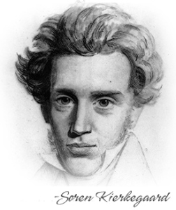
Introductory Thoughts
“Everything that passes for politics today will be unmasked as religion tomorrow.” Soren Kirkegaard
Nothing is more political than Jesus Christ and the biblical worldview

Slide 3
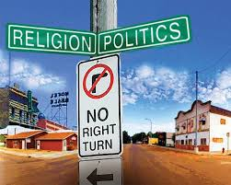
The Social Order
The social order is composed of religion, which informs ethics, economics, politics, education and law.
Religion affects all of the other aspects of the social order.
The Bible has much to say on all of these things
If Jesus is our King then we must try to view each of these things like He does.

Slide 4
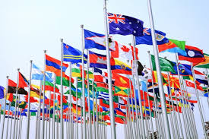
Why the Nations Rage
Psalms 2 explains that all of the nations of the world stand against the Lord God and His anointed.
Most governments and world leaders are immoral
They rebel against the King of Kings
Eventually, Jesus Christ will sit in judgment against them.

Slide 5
Overview: Part 1
King Jesus
The Kingdom of God
The Church as Embassy
The Return of the King

Slide 6
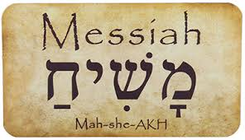
Jesus Christ: The Messiah
Messiah (Meshiach: Hebrew)- the anointed one, the promised king
In ancient Israel, kings were anointed with oil when they were inaugurated
Christ (Christos: Greek)- Messiah
The Gospel of Matthew was targeted to a Jewish audience. This Gospel explains to the Jews why Jesus is the Christ.

Slide 7
Jesus Christ: The Messiah
The Gospel of Matthew
Messiah as Priest
Messiah as King
Moses was the primary example of the priests (from the tribe of Levi)
Jesus Christ is shown to be like a second Moses
Matthew has five discourses
Jesus was called out of Egypt
The Sermon of the Mount mirrors Moses coming down from the mountain with the 10 Commandments
David was the primary example of the kings (from the tribe of Judah)
Jesus Christ is shown to be of the lineage of King David
Jesus came preaching the good news of the kingdom
Jesus was put to death because he was “the king of the Jews.”

Slide 8
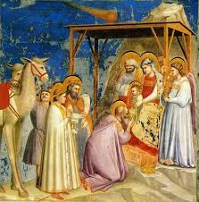
A King is Born
Jesus Christ was born a King (Matthew 2:1-2)
The Magi came from Persia and knew of the prophesies in Daniel
The magi came to pay homage to Jesus because they understood He was both God and King.

Slide 9
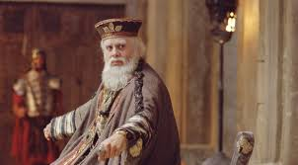
Jesus Christ versus Herod
Jesus Christ was born a King (Matthew 2: 13-18)
Herod was named King by Caesar. He was not Jewish and not a legitimate king. He was an Idumean.
He was a madman who killed his own family members
Herod viewed Jesus as a threat to his rule
Herod attempted to kill baby Jesus because He was a king

Slide 10
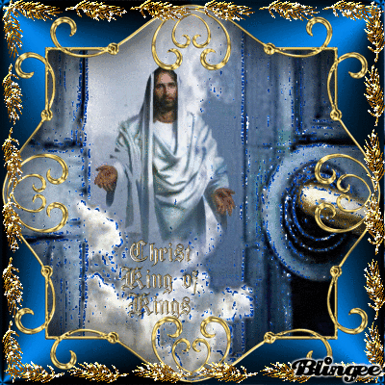
Jesus Christ versus Augustus Caesar
Jesus Christ
King of Kings and Lord of Lords
Jesus Christ claimed to be both God and King (John 4:25-26)
Many Old Testament prophesies foretold of the Messhiach
The Dead Sea Scrolls explain that the Messhiach would represent the kings (Judah) and the priests (Levi)

Slide 11
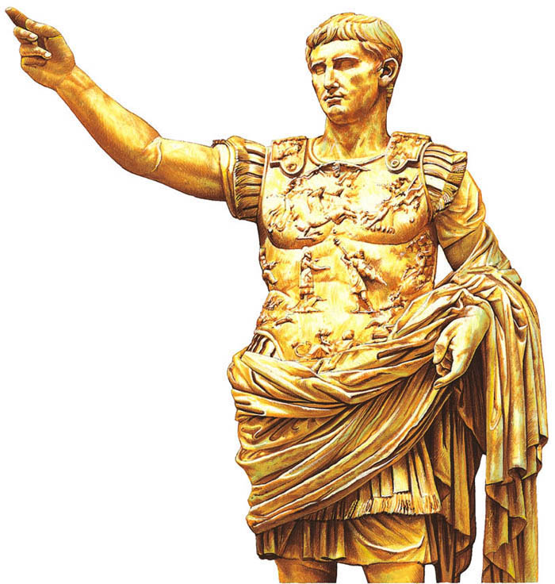
Jesus Christ versus Augustus Caesar
Augustus Caesar
Statue of Caesar
Caesar claimed to be god and king
Virgil’s Aenid claims that Caesar was the prophesied king of Rome
Caesar was the Pontifex Maximus (the chief priest of Rome)
Caesar was the Pater Patria (father of the Nation)

Slide 12
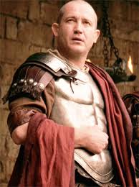
Jesus versus Pilate
Pilate was the representative of Caesar in Israel
Pilate crucified Jesus Christ because He was King of the Jews (Matthew 27: 29- 37)
Jesus Christ was and is a threat to all kingdoms because he is the king of all kings

Slide 13
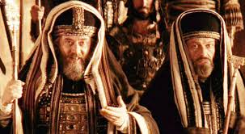
Jesus Christ vs the Jewish Leadership
Jesus came preaching the good news of the Kingdom of God (Matthew 4: 12- 25).
Jesus Claimed that He was God (John 8: 48-58).
Jesus referred to Himself as the “Son of Man” (Daniel 7: 13).
Jesus challenged them and their power (Matthew 23).
They hated him and convinced Pilate to crucify Him (Matthew 27: 23-26).

Slide 14
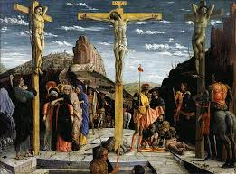
King Jesus and the Kingdom of God
Jesus came preaching about the coming of the Kingdom of God
The Sermon on the Mount explains the ethics of the Kingdom of God.
The Sermon on the Mount also invites people to join the kingdom
Jesus established the kingdom of God with his death, burial, and resurrection.

Slide 15
Overview: Part 2
King Jesus
The Kingdom of God
The Church as Embassy
The Return of the King

Slide 16
Views on the Kingdom of God
Position | Theologian | Explanation
Consistent Eschatology | Albert Schweitzer | The kingdom of God will arrive at some time in the future.
Realized Eschatology | C.H. Dodd | The kingdom of God exists now in the Church
Inaugurated Eschatology | Oscar Cullmann | Cullmann combined the first two positions to form his view. The kingdom of God is already, but not yet. The Church is “the Already,” or first fruits of the kingdom of God. The “Not Yet,” is the fullness of the kingdom of God when Jesus Christ Returns and reigns for 1000 years.

Slide 17
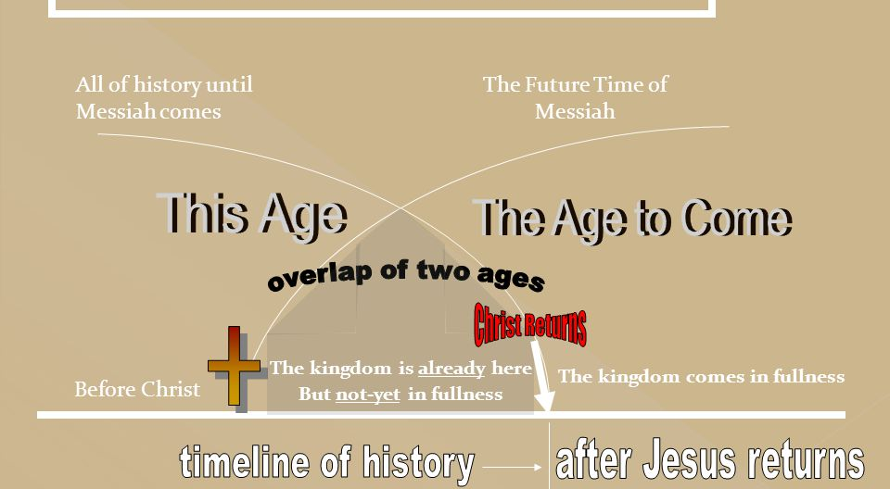
The Kingdom of God

Slide 18
Overview: Part 3
King Jesus
The Kingdom of God
The Church as Embassy
The Return of the King

Slide 19
The Church as an Embassy
 | Embassy | Church
Purpose | To represent their government to the people of a foreign country | To represent the Kingdom of God to the people of a foreign country and thereby transform that culture. We are salt and light (Matthew 5: 13-15).
Mission | To set terms and conditions of peace to a foreign government | The Great Commission Matthew 28: 18-20 Preach the Gospel to the lost and teach believers to grow in Christ-likeness
Policy | The ambassadors follow the policies set by their earthly king or ruler. | The Christian ambassadors find the policy of the Kingdom of God in the Bible.

Slide 20
The Church as an Embassy
 | Embassy | Church
Culture | A temporal earthly, unrighteous kingdom. | An eternal, heavenly, righteous kingdom of priests.
Ambassadors | Ambassadors are the are appointed by officials of their government to represent their interests of their country to a foreign government. The ambassadors live in another country, but they do not identify with it. They seek to achieve the goals of the kingdom that they represent. | 2 Corinthians 5:18-20 All Christians are transformed into new creatures and are made diplomats for Christ. These Christian ambassadors live in the world, but they are not of it. Christian ambassadors seek first the kingdom of God and its righteousness (Mat 6:33).

Slide 21
The Church as an Embassy
 | Embassy | Church
Foreign Service Officer (Diplomat) | A FSO is a diplomat in foreign service whose job is to promote peace, support, prosperity and protect U.S. Citizens while advancing the interests of the U.S. abroad. They work under the Chief of the Mission (the Ambassador) | Every Christian is a Foreign Service Officer. He is to be a diplomat for the kingdom of God to the citizens of the community in which he lives, works and plays. The pastor plays a role similar to the Chief of the Mission.
Citizen | The ambassador is a citizen of the earthly kingdom that he represents. He is lives in a foreign kingdom to help his fellow citizens residing away from their home country | Christians have dual citizenship. Every believer is a citizen of the kingdom of heaven. Every believer also has citizenship in an earthly kingdom.

Slide 22
The Structure of
U.S. Embassies
Ambassador
(Chief of the Mission)
Deputy Chief
of Mission
Foreign Service Officers
Specialists
Representatives of other agencies

Slide 23
The Structure of the Church
Pastor
(Chief of Mission)
Elders
(Deputy Chiefs of the Mission)
Church Member
(Foreign Service Officer)
Church Member
(Foreign Service Officer)
Church Member
(Foreign Service Officer)
Church Staff
(Specialists)
Church Member
(Foreign Service Officer)

Slide 24
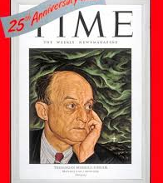
Reinhold Niebuhr:
Christian Realism
The Kingdom of God cannot be realized on earth because of the corrupt tendencies of society.
Due to the injustice and unrighteousness of men, the believer is forced to compromise the ideal of the kingdom of heaven on earth.
Human nature cannot perfected. Humanity is too sinful for us to perfect by scientific means.
Men need Jesus Christ to be saved. The Church is the vehicle

Slide 25

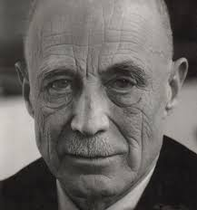
H. Richard Niebuhr

Slide 26
H. Richard Niebuhr
Christ and Culture: H. Richard Niebuhr
Christ against Culture | Fortification: Competing claims of authority that results in removing oneself from the culture
Christ of Culture | Accommodation: A model that recognizes God at work in the culture and looks for ways to affirm this
Christ above Culture | Domination: A synthetic model that advocates supplementing and building on the good in the culture with Christ
Christ and Culture in Paradox | Bifurcation: A dualistic model that views Christians as citizens of two different realms, one sacred and one secular
Christ the transformer of Culture | Transformation: A conversionist model that seeks to transform every part of the culture with Christ

Slide 27
Christ and Culture in Paradox
There is no social evil, no form of injustice whether of the feudal or the capitalist order which has not been sanctified in some way or other by religious sentiment and thereby rendered more impervious to change.
Reinhold Niebuhr

Slide 28
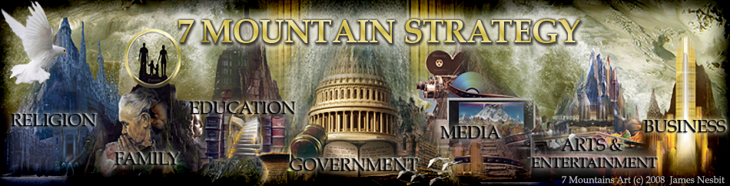
Transformation is Spiritual Warfare

Slide 29
The Embassy and
Transformation
Principles of Cultural Engagement
1 | Every local Church is an embassy of the kingdom of God to the local community, and every Church member is an ambassador (or diplomat) for Christ, not just the pastor.
2 | Every member of the Church is a citizen in the kingdom of God. They are both gifted and called to their workplace as an ambassador for Christ.
3 | The Church is a kingdom of priests who are ambassadors for Christ. Consequently, evangelism is the job of every Church member.
4 | The pastor must remind every church member that they are ambassadors for Christ and that they represent their king wherever they go.
5 | Pastors must teach the church members a Christian worldview so that they can present the views of our king to the lost.
6 | Because every church member is an ambassador for Christ, pastors must teach every church member how to evangelize.
7 | The local Church is an embassy of Jesus Christ in the community in which it is located. Take God’s goodness to everyone in the community. Don’t wait for them to come to you.
8 | Do not classify any sinner as worse than any other. At the same time, be loving, truthful and firm.
9 | Focus on changing people’s relationship to God through Christ, not on their behavior.
10 | Don’t be surprised when you are hated and misunderstood. Remember that a righteous life and good works are your best defense.
11 | Actions speak louder than words. Always lead with love and seek to do good to others. Perform random acts of kindness.
12 | Never fail to show God’s goodness and unconditional love.

Slide 30
Overview: Part 4
King Jesus
The Kingdom of God
The Church as Embassy
The Return of the King

Slide 31
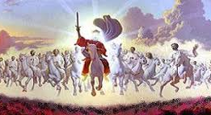
The Return of the King
(Rev 19: 11- 20: 6)

Slide 32
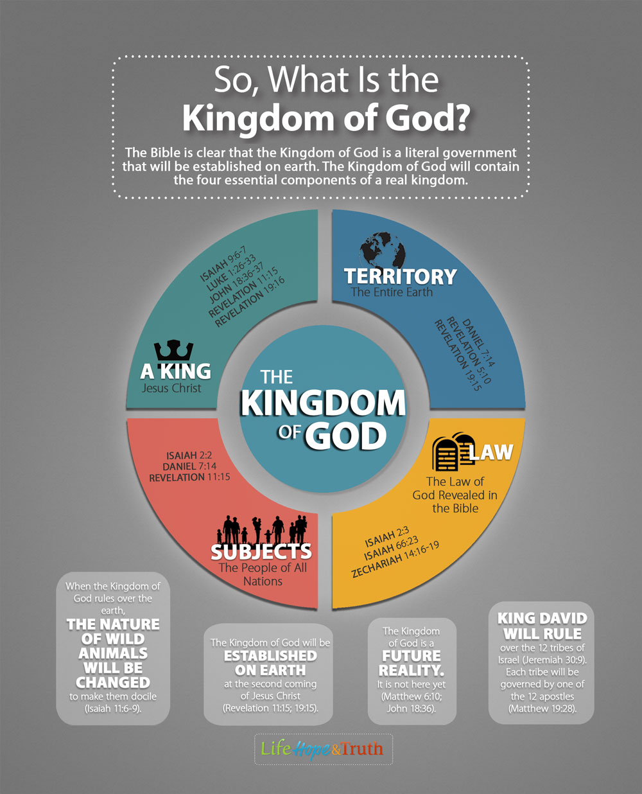
The Future
Kingdom of God

