Slide 1
Craig Vincent mitchell, PhD
Ethicist, Economist and Engineer
Does the Bible Require the State to Redistribute Wealth?

Slide 2
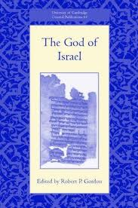
Justice and Righteousness:
Robert P. Gordon
Good- according to Robert P. Gordon, “indicates a state or function appropriate to genre, purpose or situation.” Good also includes the concepts of order fitness, and beauty.

Slide 3
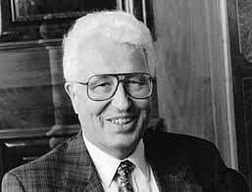
Justice and Righteousness:
Hans Heinrich Schmid
Hans Heinrich Schmid wrote Gerectigkeit Als Weltordnung. After exploring how the concept of righteousness is used throughout the Ancient Near East, he concludes that the Hebrews concept of righteousness is central to law, wisdom, nature, war, sacrifice and to the kingdom.

Slide 4
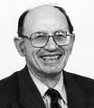
Justice and Righteousness:
Moshe Weinfeld
“The concept of social justice was expressed in Ancient Israel and in the Ancient Near East by means of a hendiadys. The most common word pair to serve this function in the Bible is “justice and righteousness” or “righteousness and justice”. However, alongside this expression, we find “righteousness and equity, word pairs which are found in poetic passages and therefore appear primarily in parallelism.

Slide 5

Justice and Righteousness:
Walter Houston
”Two features of this paradigm of justice in its various textual forms set it apart from modern Western understanding of justice. One, which we have just been examining, is its integral reliance on a concept of cosmic order. The other is the weight given to the commitment of the individual to do justice

Slide 6
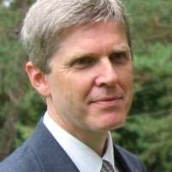
Justice and Righteousness:
David J Reimer
According to David J. Reimer, inanimate things can be said to be righteous, if they serve their purpose or report the truth, such as in measuring accurately (see Leviticus 19:36 and Deuteronomy 25:15).
Another concept that is tied to righteousness is freedom (drirr) which incorporates political and economic freedom. All of these things are good.

Slide 7

Justice and Righteousness
Justice and righteousness are teleological concepts
They are based on the nature and the purpose of God
Justice and righteousness are tied to the nature of a created thing
Justice and righteousness are tied to the natural law and to the 10 commandments

Slide 8
Justice and Righteousness
The 10 commandments are teleological and are in accordance with virtue ethics
  The first four commandments explain how the virtuous man is to relate to God (the Creator)
  The next six commandments explain how virtuous men are to relate to each other (creatures)
  The ten commandments are not arbitrary. They are consistent with God’s nature and order
  The ten commandments are consistent with the created order

Slide 9
Justice and Righteousness
Morality
Politics
Law
Economics

Slide 10
Purpose of laws
To establish and protect individuals rights against encroachment by the state
Case laws – development of laws when new situations are encountered
Daughters of Zelophehad (Numbers 21:1-11; 36:1-12)
Example of the intricacies of personal land ownership
Example of the importance of personal land ownership

Slide 11

Justice and Righteousness
Justice and righteousness includes every part of God’s created order.
The laws of science and the laws of morality are all part of God’s order
God’s morality includes politics, law and economics

Slide 12
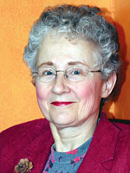

Economics in Christian Perspective (Inter Varsity Press, Downer’s Grove: 2007), 21.
Victor Claar
Robin Klay

Slide 13
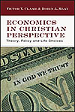
Economics in Christian Perspective (Inter Varsity Press, Downer’s Grove: 2007), 21.
Victor Claar and Robin Klay assert that “It is hard to think of any Christian principle or value that is irrelevant to economic activity.” Victor V Claar and Robin J. Klay,

Slide 14

Richard Lowery, Sabbath and Jubilee (Chalice Press, St. Louis Missouri: 2000), 5.
Today’s consumption based globalizing economy is in many ways vastly different from the agrarian royal economy in which biblical Sabbath was born. But the modern economy puts working people in an updated version of the ancient bind: too much work and not enough money.

Slide 15
Richard Lowery, Sabbath and Jubilee (Chalice Press, St. Louis Missouri: 2000), 68.
Concerning the jubilee, Lowery explains, “relief for the individual poor is not the point of this legislation. The long term survival of households and preservation of ancestral property are at stake in jubilee land redistribution.” One has to remember that the Jubilee laws had application only to Ancient Israel. In the New Testament, the Jubilee is used as an explanation for the salvation that the individual experiences when he comes to Jesus Christ. There is no New Testament requirement for nations to apply the Jubilee to their social policy.

Slide 16
Richard Lowery, Sabbath and Jubilee (Chalice Press, St. Louis Missouri: 2000), 77.
Justice and righteousness is achieved in the Jubilee because it concerned households and ancestral property within ancient Israel. While affirming the ethical significance of the Jubilee, Richard Lowery asserts that; “Jubilee laws are a diverse collection that are mostly impractical as social policy.” Any attempt to incorporate wealth redistribution based on the jubilee in the contemporary world would not be in accordance with a biblical view because such attempts are always oriented towards the needs of the individual poor.

Slide 17
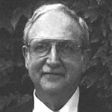
Bruce Malina, The Social Gospel of Jesus (Fortress, Press, Minneapolis: 2001), 101.
Bruce Malina asserts “biblical writings developed exclusively within the context of kinship and politics. They come from writers whose main concerns were with domestic religion and political religion, as well as domestic economy and political economy. Thus, biblical authors never spoke of economics simply and purely.”

Slide 18
Bruce Malina, The Social Gospel of Jesus (Fortress, Press, Minneapolis: 2001), 101.
There is no developed biblical terminology descriptive of market economies or economic theories and the abstract meanings rooted in them.” The Hebrews did not have freestanding religious and economic social systems.

Slide 19
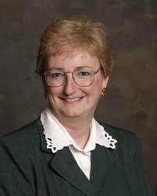
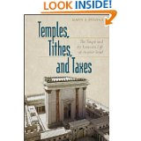
Taxes in Israel
Marty E. Stevens
Marty E. Stevens

Slide 20
Taxes in Israel
The Temple, constructed under the auspices of the king and supported by the king’s generosity, could act as institutional agent on his behalf in society. YHWH interceded on behalf of the needy through the agency of the temple to bring about justice and righteousness. That is, the Psalter’s metaphors derive from a socio-economic reality underlying the imagery- was concerned with the needy in two basic ways: protection (especially of the fatherless) and feeding.
Marty Stevens, 133.

Slide 21
Types of money going into the Temple
 | Religious/ Political | Compulsory/ voluntary | Explanation
Taxes | Political | Compulsory | Took care of government
Tributes | Political | Voluntary | Took care of government
Tithes | Religious | Compulsory | Took care of the temple staff
Gifts and Offerings | Religious | Voluntary | Took care of the needs of the poor

Slide 22
Gleaning of the Fields
The laws concerning the gleaning of fields in the Pentateuch (Leviticus 19: 9-10 and also Dueteronomy 24: 21) require the poor to work by picking up the leftovers at the edge of the fields. Those who own the fields do not have their produce taken by the government and then given to the poor. Since the Old Testament extols the virtue of work and deplores the vice of laziness the contemporary concept of wealth redistribution is alien to the Ancient Israelite conception of justice or righteousness.

Slide 23
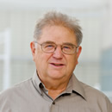
John E Hartley, Word Biblical Commentary: Leviticus volume 19 (Word Books, Dallas Texas: 1992), 314.
The standard of generosity is prudently formulated. On the one hand, it does not place an added burden on the landlord, for he does not have to pay for the collection of these gleanings. On the other hand, the poor and the foreigner maintain their dignity, for in the place of a handout they are given the privilege to labor for their own needs. They have to expend effort to benefit from God’s grace manifested through the landlord’s generosity. Observation of this practice reflect’s God’s merciful concern for the unfortunate.

Slide 24
Duane L. Christensen, World Biblical Commentary: Deuteronomy 21-34 (Thomas Nelson Publishers, Nashville: 2002), 598.
Concerning the parallel verses in Dueteronomy 24:21 Duane Christensen writes:
Such a practice kept the needy from the humiliation of begging for subsistence. The poor were thus able to maintain their dignity by working for their own food, though the owner of the field did not profit directly from their neighbors.

Slide 25
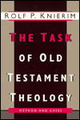
Rolf Knierim, The Task of Old Testament Theology (Grand Rapids: Eerdmans: 1995), 460.
“the New Testament’s portrayal of economic justice is no basis for a concept of secular economic justice.”
Poverty is not idealized; it is taken seriously. The care of the poor is important (474). The marginalized in society are God’s special concern (477). Private property is accepted but dishonest competition criticized. This is exemplified by the cleansing of the monetary and mercantile perversion of the temple (475). Wealth by itself is not rejected. Rather, it is subjected to ethical responsibility. Trust in wealth is rejected as antithetical to trust in God (475-76). The positive criterion is responsible stewardship (476).

Slide 26
Wolfgand Schrage, The Ethics of the New Testament (Fortress, Philadelphia, 1988), 127.
According to Wolfgang Schrage:
The new reality of the Spirit and human transformation extends concretely into the economic sphere (also Mark 12:30). It is wrong, of course to speak of ‘communism’ with or without love. There is no socialized ownership of property or the means of production. Kautzky already pointed out that consumption was shared, not production. Nor is there any notion of revolutionary violence or a universal social system.

Slide 27
Rolf Knierim, The Task of Old Testament Theology (Grand Rapids: Eerdmans: 1995), 460.
Especially problematic is the fact that the New Testament evidence shows that the responsibility for the application of principles of economic justice in society at large is left to the discretion of individual Christians. The Churches themselves are basically concerned with the task of inner- or intercongregational economic justice.
Knierim, 461.

Slide 28
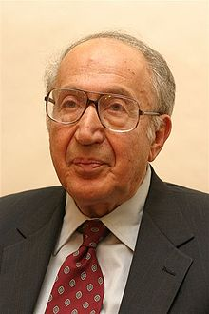
Richard Pipes, Communism (New York, Modern Library Books, 2001), 4.
Richard Pipes agrees with Schrage when he wrote the following:
“There exists a widespread but false notion that socialism and communism are merely up to date secular versions of Christianity. As the nineteenth century Russian philosopher Vladimir Soloviev has pointed out, the difference is that whereas Jesus urged his followers to give up their own possessions, the socialists and communists want to give away the possessions of others.”

Slide 29
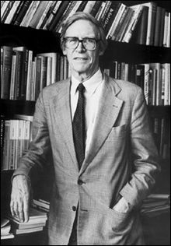
John Rawls, A Theory of Justice (Cambridge, MA: Harvard University Press, 1971)
Thomas Nagel on Rawls
John Rawls
In brief, what Rawls has done is to combine the very strong principles of social and economic equality associated with European socialism with the equally strong principles of pluralistic toleration and personal freedom associated with American liberalism, and he has done so in a theory that traces them to a common foundation. The result is closer in spirit to European social democracy than to any mainstream American political movement.
Thomas Nagel, “Rawls and Liberalism” in The Cambridge Companion to Rawls Samuel Freeman ed. (New York, Cambridge University Press: 2003), 63.

Slide 30
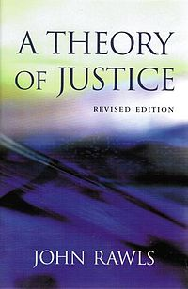
John Rawls, A Theory of Justice (Cambridge, MA: Harvard University Press, 1971)
Edward Zajac on Rawls
John Rawls
At bottom, Rawl’s theory is a secular moral construct, one that tries to replace the notion of a Supreme Being by reasoning, starting with the idea of the original position behind the veil of ignorance and evolving by means of the application of logic. It is hard to imagine that such a secular theory would be accepted by all religious groups within the Western world, much less by all cultures.
Edward Zajac, Political Economy of Fairness (MIT Press, Cambridge, MA: 1996), 88.

Slide 31
Conclusions
The Bible does address economic issues
The Bible does not spell out an economic theory
The Bible does emphasize the concepts of work, stewardship, buying, selling, trading, and fair exchange.
The Bible does emphasize property rights
The Bible does not endorse any kind of wealth redistribution

