Slide 1
THE GOSPEL
8 IMPORTANT QUESTIONS
IN ENGLISH & CHINESE

Slide 2
1. 神是谁？
WHO IS GOD?
万物的创造者
The creator of everything
他住在天堂
He lives in Heaven
神圣的；全能的； 至高无上； 无所不知；无所不在
Holy; all powerful; Sovereign; knows everything; He is everywhere
“In the beginning, God created Heaven and earth.” (Gen. 1:1) 起初, 神创造天地。
Is. 6:3 — "Holy, holy, holy is the Lord of hosts; the whole earth is full of His glory!
“他们彼此高呼着说:“圣哉！圣哉！圣哉！万军之耶和华！他的荣光充满全地.”

Slide 3
2. 我是谁？
WHO AM I?
被神所创造
Made by God
被神所爱
Loved by God
唯一的；特别的；
独一无二的
Unique. One of a kind. Special
Ps.139:13-14 “For you formed my inward parts; you knitted me together in my mother's womb. I praise you, for I am fearfully and wonderfully made. Wonderful are your works; my soul knows it very well.”
我的脏腑是你所造的，在我母腹中你塑造了我。 我要称谢你， 因为我的受造奇妙可畏；你的作为奇妙，这是我深深知道的。

Slide 4
3. 出了什么问题？
WHAT’S THE PROBLEM?
我们都犯了罪
We have all sinned
每个罪人都会被审判
All sinners will be judged
罪人会在地狱里永远与神隔绝
They are eternally separated from God in Hell
Rom. 3:23 “For all have sinned and fall short of the glory of God,”
因为人人都犯了罪，亏缺了神的荣耀，
Rom. 6:23 "For the wages of sin is death but the gift of God is eternal life through Jesus Christ our Lord"
因为罪的工价就是死, 但神的恩赏, 在我们的主基督耶稣里, 却是永生。

Slide 5
4. 什么是罪？
WHAT IS SIN?
我们做一些神不让我们做的
When we do something God tells us not to do
神让我们去做的事， 我们却不做
When we don’t do something God tells us to do
任何神不喜欢的
Anything that God doesn’t like
James 4:17 “So whoever knows the right thing to do and fails to do it, for him it is sin.”
人若知道该行善事，却不去行，这就是他的罪了。

Slide 6
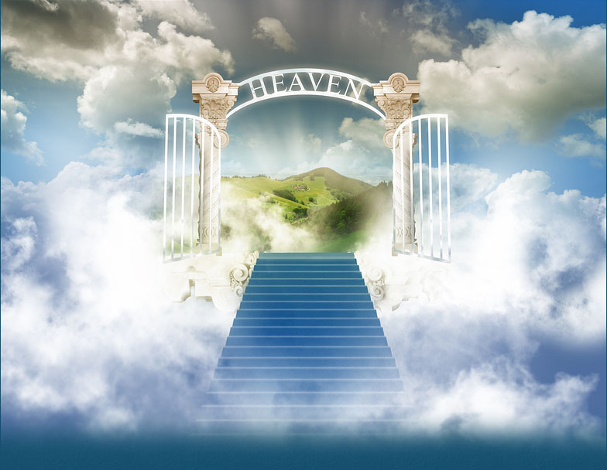
5. 解决方案是什么？
WHAT IS THE SOLUTION?
除掉罪
Get rid of the sin
被视为无罪的
Be considered innocent
跟神永远在天堂
Be together with God in Heaven eternally
Rom. 5:8 “But God shows his love for us in that while we were still sinners, Christ died for us.”
唯有基督在我们还作罪人的时候为我们死，神对我们的爱就在此显明了。

Slide 7
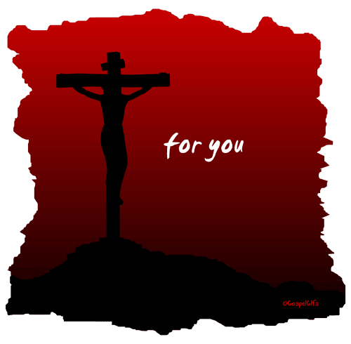
6. 怎么可能？
HOW IS THAT POSSIBLE?
神差他的独生子来为我们死
God sent His Son Jesus to die in our place
耶稣从死里复活
Jesus rose from the grave
耶稣提供了救恩
Jesus makes salvation available
John 3:16 “For God so loved the world that He gave His only begotten Son, that whosoever believes in Him will not perish but have everlasting life.”
神爱世人，甚至把他的独生子赐给他们，叫一切信他的，不至灭亡，反得永生。

Slide 8
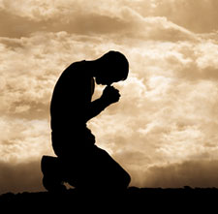
7. 我怎么得救？
HOW CAN I BE SAVED?
相信耶稣说的话
Believe what Jesus said
向神承认你的罪
Confess your sins to God
悔改，远离罪
Turn away from your sin (repent)
接受他白白的救恩
Accept His free gift of salvation
1 John 1:9 “If we confess our sins, he is faithful and just to forgive us our sins and to cleanse us from all unrighteousness.” 我们若承认自己的罪，神是信实的、公义的，必定赦免我们的罪，洁净我们脱离一切不义。
Acts 3:19 “Repent, then, and turn to God, so that he will forgive your sins.”
所以你们应当悔改归正，使你们的罪得着涂抹。

Slide 9
8. 我下一步该做什么？
WHAT DO I DO NEXT?
读圣经找神的旨意
Read the Bible to find God’s will
祷告，顺服祂
Pray to God. Obey Him.
告诉别人耶稣为他们做了什么
Tell others what Jesus did for them
上一个好教会
Attend a good church
John 14:15 “If you love me, keep my commands.”
“如果你们爱我, 就要遵守我的命令.
Mark 16:15 “He said to them, “Go into all the world and preach the gospel to all creation.”
他又对他们说：“你们到全世界去，向所有的人传福音。

