Slide 1
教导原则和方法 Teaching Principles and Methods
Dr. Johnnie S. Achord, Th.D. & Shulan Yang, M.A.

Slide 2
培训目标 (Seminar Goals)
1. 训练教师基本教导原则和方法
To train teachers in some of the basic principles and methods of teaching.
2. 培训教牧同工在教导每一课时均以生命改变作为目标
To train teachers and leaders to teach with life change as the goal of each lesson.
3. 查考神如何看待教导
To see how God views teaching as seen in His holy Word.
4. 提高我们的交流技巧
To improve our communication skills,
5. 预备学生成为真正的老师，不要徒有虚名
To prepare students to become real teachers, NOT just called “teachers”
6. 以知识和技巧装备教师，使之有效传达信息。
Equip teachers with knowledge & skills to effectively communicate their message.

Slide 3
圣经如何看待教导？ (What does the Bible say about teaching?)
教师的目标是什么？ (What should be the goals of a teacher?)
哪种教导方法最有效？ (Which methods of teaching are the most effective?)

Slide 4
圣经如何看待教导？ What does the Bible say about TEACHING?
圣经清楚地表明， 神的意愿是： 要将他的话语和他的道， 教导给他的子民。
Scripture is quite clear that God intends for His Word and His ways to be taught to His People.

Slide 5
神吩咐摩西用神的话语教导百姓。
God Directed Moses to teach the people God’s Word
“这是耶和华你们神所吩咐教训你们的诫命、律例、典章，使你们…..遵行。”（申6：1）
“These are the commands, decrees and laws the Lord your God directed me to teach you to observe.” Deut.6:1

Slide 6
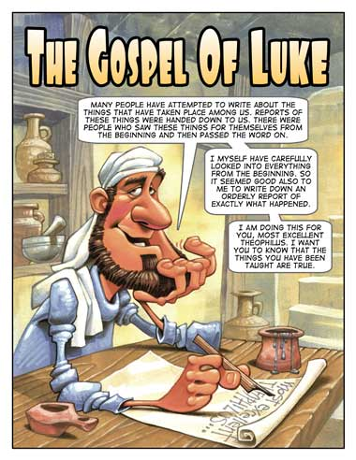
箴言书强调教导的价值.
.
Proverbs emphasizes the value of teaching.
“教导智慧人，
他就越发有智慧.”
(箴 9:9)
“Teaching a righteous man and he will add to his learning.” Prov. 9:9

Slide 7
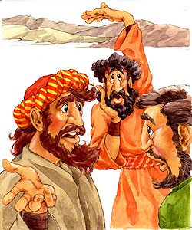
以斯拉定意以神的话语教导人
Ezra devoted himself to teaching God’s Word.
“以斯拉定志考究遵行耶和华的律法，有将律例典章教训以色列人.” （拉：7:10）
“For Ezra had devoted himself to this study and observance of the Law of the Lord, and to teaching its decrees and laws in Israel.” Ezra 7:10-11

Slide 8
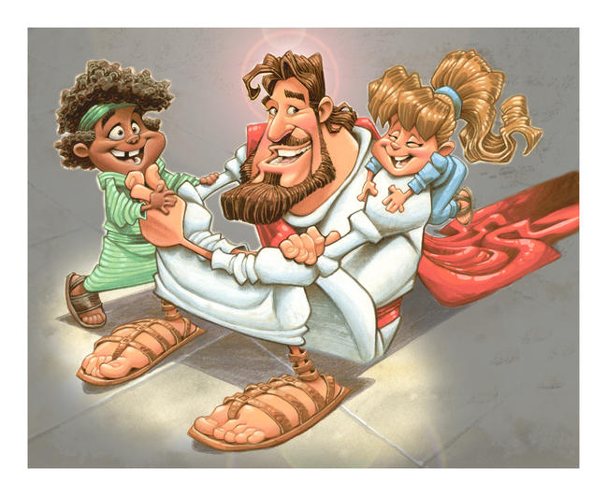
耶稣自己不断地以神的话语教训人。
Jesus commanded us to teach all nations…GO!
“耶稣天天在殿里教训人.”（路: 19:47）
“Every day He [Jesus]was teaching them in the temple.” Luke 19:47

Slide 9
耶稣升天之前一直都在教导人。
Jesus taught until right before His ascension.
“我已经做了前书，论到耶稣开头一切所行所教训的， 直到他…被接上升的日子为止.”（徒 1:1）
“I wrote about all that Jesus began to do and teach until the day He was taken up.” Ac:1:1

Slide 10
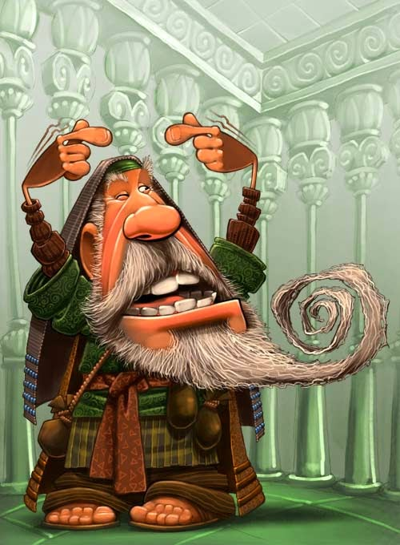
初期教会 强调教导 The early church emphasized teaching.
“他们恒心遵守使徒的教训.” (徒2:42)
“They devoted themselves to the apostles’ teaching.” Acts 2:42

Slide 11
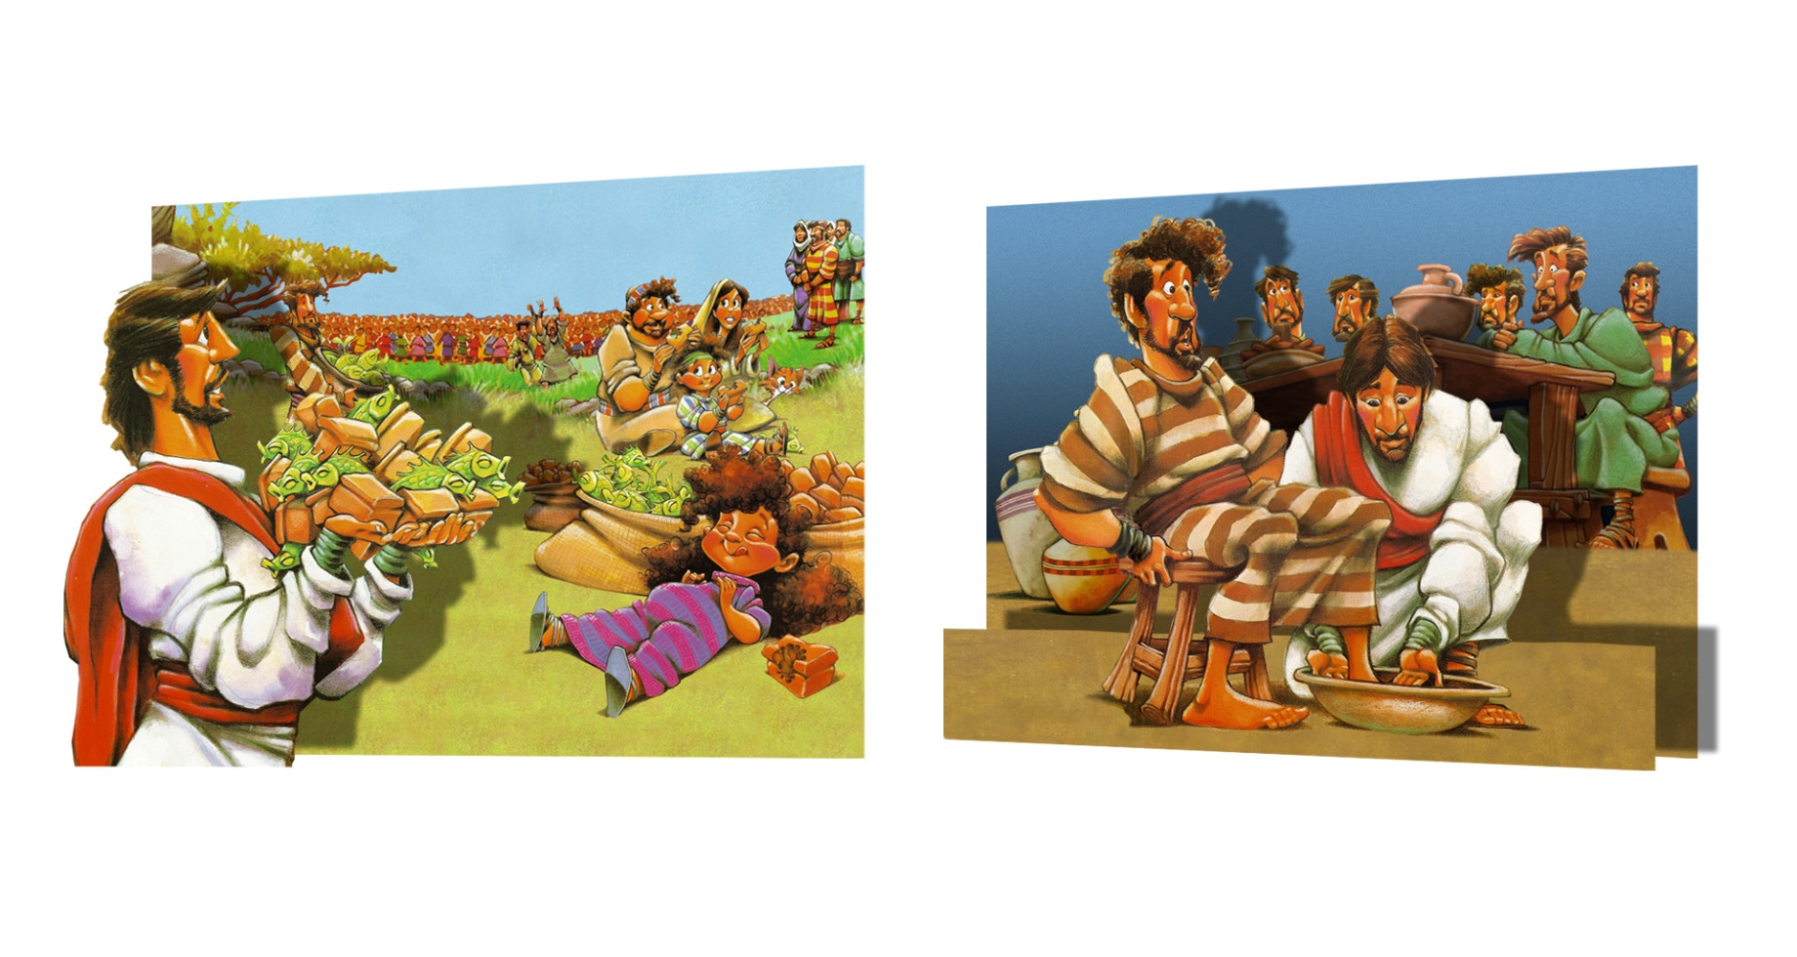
保罗吩咐提摩太教导别人 Paul instructed Timothy to teach others.
“你在许多见证人面前听见我所教训的，
也要交托那忠心能教导别人的人.” (提后 2:2)
“ The things you have heard from me entrust to reliable men who also will be qualified to teach others.” 2 Ti.2:2

Slide 12
牧师当在教会教导纯正的道理。 Pastors are to teach sound (correct) doctrine in the church.
“你所讲的，总要合乎那纯正的道理.” (多2:1）
“ You must teach what is in accord with sound doctrine.” Titus 2:1

Slide 13
雅各书 3:1 (James)
“我的弟兄们，不要多人作师傅，因为晓得我们要受更重的判断.”
“Dear brothers and sisters, not many of you should become teachers in the church,
for we who teach will be judged by God with greater strictness.”

Slide 14
提后 3:16-17 (2 Timothy)
“圣经都是神所默示的 （或作凡神所默示的圣经）， 于教训，督责，使人归正， 教导人学义，都是有益的。 叫属神的人得以完全， 预备行各样的善事。”
“All Scripture is God-breathed and is useful for teaching, rebuking, correcting and training in righteousness, so that the man of God may be thoroughly equipped for every good work.”

Slide 15
路6:40 原则: 每位学成了的就会像他的先生一样.
Luke 6:40 “A student…who is fully trained will be like his teacher.”

Slide 16
教师的目标应是什么？ (What should be the goals of a teacher?)

Slide 17
教育目标 (Education Goals)
增长学问: Increase Knowledge
遵守什么 (WHAT to obey)
行为目标 (Behavior Goals)
改变行为: Change Behavior
如何遵守 (HOW to obey)
态度目标: (Attitude Goals)
改变感情: Change Feelings
为何遵守 (WHY to obey)

Slide 18
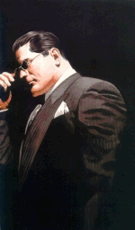
真正的教导是叫学生学会， 真正学会是生命改变。
Teaching does not occur unless learning occurs and learning does not occur unless life change results.

Slide 19
教导学生培养一个合乎圣经 Teach your students to develop a biblical world view…
的世界观，
使他们可以从神的角度看生活中的各种问题。
…where they learn to see all of life’s issues and problems from God’s perspective.
圣经必须成为我们决定信仰什么以及在生活
各方面如何行动的准则和指引。
(The Bible must be the standard and guide for determining what to believe and how to behave in all areas of life!)

Slide 20
哪种教导方法最有效？ (Which methods of teaching are the most effective?)

Slide 21
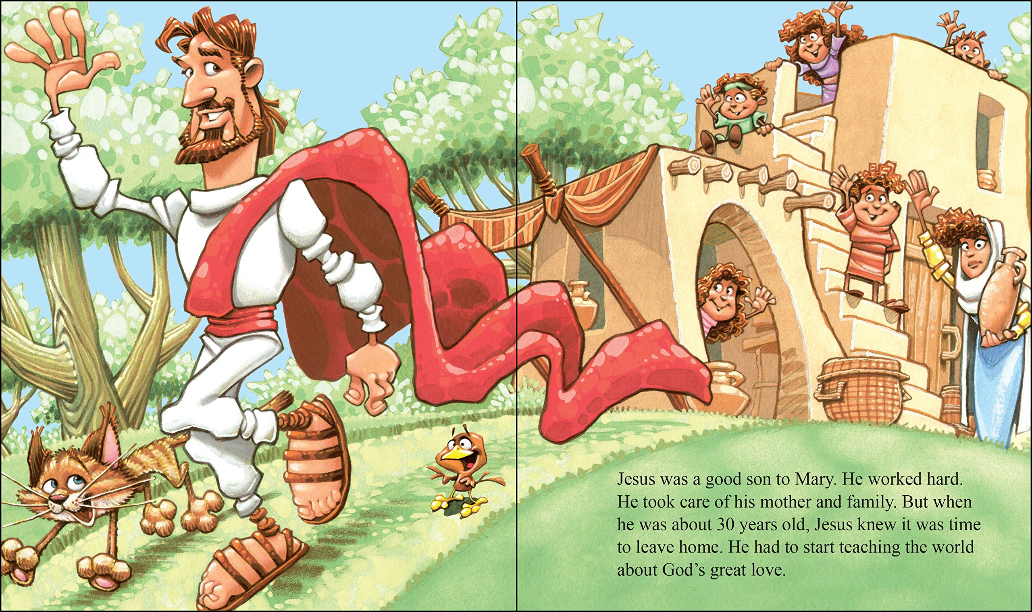
教导方法 Methods of Teaching
我们需要运用和发展好的教导方法。当耶稣看到教导机会时， 他会针对不同情况而使用不同而恰当的教导方法。
Good teaching methods need to be used and developed. Jesus utilized different but appropriate
methods for different teaching situations which He saw as learning opportunities.

Slide 22
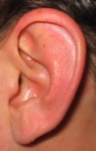
10%
20%
75%
90%
50%
请记住…
(We Remember…)

Slide 23
为何我们花时间这般教导？
10%
20%
75%
90%
50%
90%
8%
1%
.05%
.05%
(SO WHY DO WE SPEND OUR TEACHING TIME THIS WAY?)

Slide 24
五种基本教导方法是：
The 5 Basic METHODS OF TEACHING ARE...
讲述 Lecture
故事 Storytelling
示范 Demonstration
讨论 Discussion
问答 Question/ Answer

Slide 25
请谨记——教导方法并不是神圣不可改动的，它们只是为了达到目的而采用的方法——为了确保学生真正学会！
Remember: Methods of teaching are not sacred,
but are only a means and end—to insure that learning actually occurs!

Slide 26
你为何要参加教导研讨会？
WHY DO YOU WANT TO ATTEND A SEMINAR ON TEACHING?

Slide 27
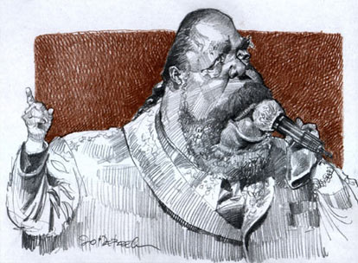
二十个教导建议 Top 20 teaching tips

Slide 28
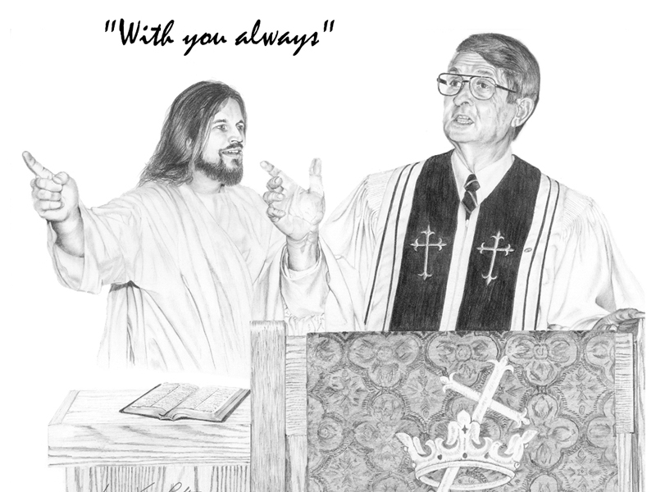
1. 传讲真理 (而非观点)
1. SPEAK TRUTH (NOT Opinion)

Slide 29
“求你用真理使他们成圣;你的道就是真理”
—(约17:17)
“Sanctify them by the Truth; Your Word is Truth.” –John 17:17
当你发表观点时,告诉学生这只是你的个人观点.
要小心不要把教会传统当作圣经那般进行教导。
When you give an opinion, tell your students it is only your opinion.
Be careful NOT to teach your churches traditions as if it were Scripture.

Slide 30
2. 要提前预备 (而非拖延)
2. BE PREPARED (Don’t Procrastinate)

Slide 31
预备是沟通成功的最好保证 Preparation is the best insurance you can take out on your communication.

Slide 32
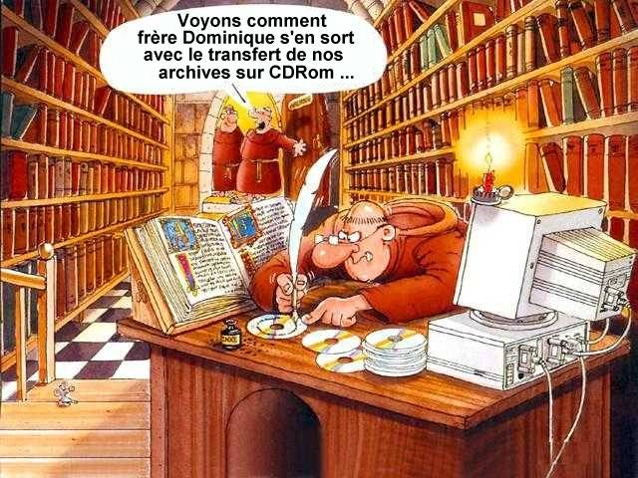
准备法则 The Law of Readiness
准备法则
当学生和老师双方面都准备充分时，教与学的过程将会最为有效。
The Law of Readiness—The teaching-learning process will be most effective when both student and teacher are adequately prepared.

Slide 33
3. 多参与 (少讲述)
3. More INVOLVEMENT than Lecture

Slide 34
活动法则 The Law of Activity
最大化的参与带来最大化的学习结果。
The Law of Activity— Maximum learning is always the result of maximum involvement.

Slide 35
学习者参与程度越高， 学习的潜力就越强。 The higher the learner’s involvement, the greater his potential for learning
我听了，我忘记。
I hear, and I forget.
我看了，我记住。
I see, and I remember.
我做了，我理解。
I do, and I understand.

Slide 36
4. 清楚你的上课目的
4. Know your PURPOSE for the lesson

Slide 37
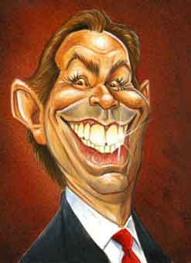
每次你教导，问你自己，“我知道什么——我想让这些学生知道什么？我感觉到什么——我想让学生感觉到什么？我做什么——我想让他们做什么？”
Every time you teach, ask yourself, “What do I know—and what do I want these students to know? What do I feel—and what do I want them to feel? What do I do—and what do I want them to do?”

Slide 38
耶稣的目的是使人: Jesus’ goal was for people to:
成为神的儿女 (约1:12-13 )
become children of God (John)
对神有更深入和密切的认识。(约17:3)
grow in intimate knowledge of God (John)
按神的旨意经历人生。 (约10:10)
experience life as God intended (John)
学习遵行他的道。 (约14:23 )
learn to obey His teaching (John)
以爱接待人 (约15:12)
relate to other people in love (John)
为神多结果子 (约15:8 )
bear fruit for God (John)

Slide 39
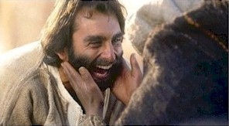
5. 改变生命 (而非信息)
5. LIFE CHANGE (Not Just Information)

Slide 40
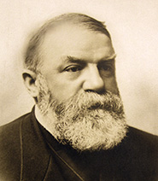
“神将祂的话赐下来不是要给我们信息，而是要我们改变。”
——穆迪
“The Scriptures were not given for our information, but for our transformation.” –D. L. Moody

Slide 41
使信徒的生命变得更象基督 Conforming believers to the image of Christ
教导圣经的目标是改变生命——明白且遵行神的话语可使信徒在性情、行为、 言语上都更像基督。 （雅1:22-25; 林后3:18; 罗12:2）
The goal of biblical teaching is changed lives---- people who, as a result of knowing and obeying God’s Word, are becoming more like Christ in character, conduct and conversation. James 1:22—25; 2 Corinthians 3:18; Romans 12:2

Slide 42
6. 圣灵的能力(而非你的才能)
6. HOLY SPIRIT POWER (Not Talent)

Slide 43
真正优秀的教师会让圣灵透过他作教导 的工作；然而，他亦会同时保留自己的个 性和教导风格 等个人的特质。
诗119:97-102
The truly effective teacher will allow the Holy Spirit to teach through him without suppressing the teacher’s personality, style etc. Ps. 119:97-102

Slide 44
圣灵—— The Holy Spirit…
加给我们分辨对错的能力.（约一2;20,26,27）
gives us the ability to discern error. 1 Jn. 2:20, 26,27
指教我们, 引导我们明白圣经所显明的真理。（约 14:26; 16:13）
teaches and guides us into BIBLICAL truth (Jn. 14:26; 16:13)
开我们心窍，使我们明白和接受神的话语，以神的道为真理. ( 约14:26; 16:13; 林前 2:12-14; 路 24:25; 提后 2:7)
opens our minds to understand and accept God’s Word as the truth. ( Jn. 16:13; 1Co. 2:12-14; Lk 24:45; 2 Ti. 2:7)
赐能力予所传的信息.（林前2:4）
empowers the message. 1 Co. 2:4
促使我们遵守真道.（腓 2:12; 西 1:29）
enables us to obey the truth. Ph. 2:12-13; Col. 1:29
使我们的教导满有果效。
makes our teaching productive.

Slide 45
不要使用“圣灵填补”作为不良预备 和不良学习习惯的借口。 (Do NOT use the “filling of the Spirit” as an excuse for poor preparation and poor study habits!)
警告 (WARNING!)

Slide 46
“啊，还有三十分钟后就讲道了，是时候请求圣灵帮助我预备今天上午的讲章了。”
“Church starts in 30 minutes. It’s time to ask the Holy Spirit to help me prepare my morning sermon for today.”

Slide 47
7. 激励 (而非羞辱)
7. ENCOURAGEMENT not Humiliation

Slide 48
激励法则 The Law of Encouragement
激励法则—— 学习者的动机被合理地激发后，
教学往往最有效。
The Law of Encouragement—Teaching tends to be most effective when the learner is properly motivated.

Slide 49
8. 生活榜样 (而非伪善)
8. LIFE EXAMPLE (NOT Hypocrisy )

Slide 50
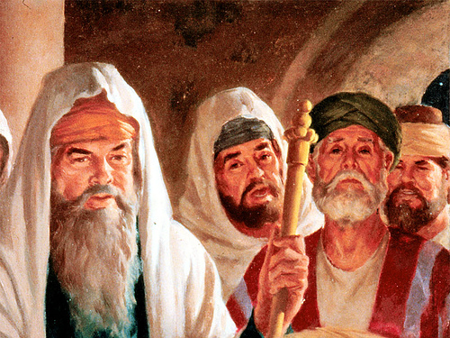
耶稣斥责法利赛人教导一些他们自己也无法遵守的东西.
Jesus rebuked the Pharisees for teaching things that even they could not live up to.

Slide 51
9. 注重应用
9. APPLY the Lesson to their Lives

Slide 52
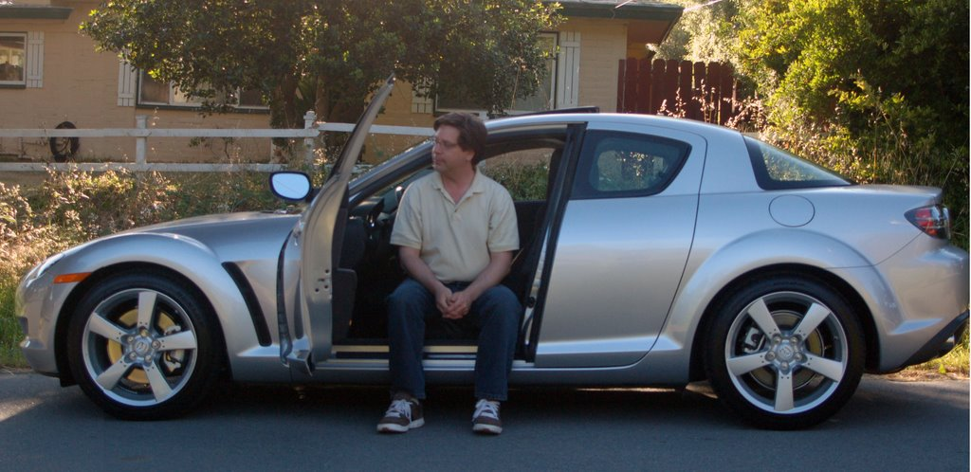
没有应用的知识就如同一辆 没有加油的新车 “Information without application is like a new car with no gasoline.”

Slide 53
10.沟通不只是交谈
10. COMMUNICATION is more than Talking

Slide 54
沟通法则——要真正传递信息需要架设桥梁。
The Law of Communication: to truly impart information requires the building of bridges.

Slide 55
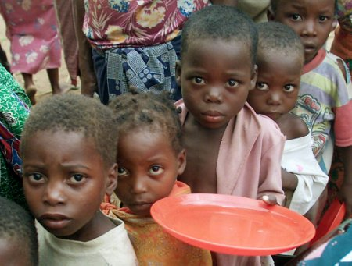
11. 制造渴望 (而非冷漠)
11. CREATE DESIRE (NOT Apathy)

Slide 56
“你可以将马牵到水边， 但是你无法强让它饮水。” “You can lead a horse to water, but you can’t make him drink.”
“你错了，喂它盐吃就行.”
“You’re wrong. You can feed him salt.”

Slide 57
有两个层次的动机：
There are two levels of motivation:
内在的intrinsic
来自里面from within
外在的
Extrinsic
（来自外面） (from without)

Slide 58
12. 装备他们去训练更多!
12. EQUIP them to train others!

Slide 59
装备法则: The Law of Equipping
我们必须充分培训那些要培训别人的人
We must train others well enough to train others.

Slide 60
装备方法的五个步骤： Five Steps of the Equipping Method
我告诉你
I tell you
我看你做
I watch you
继续保持
Keep it up
你看我做
You watch me
我们一起做
We do it together
指导 | Instruct
说明 | Illustrate
参与 | Involve
提高 | Improve
鼓舞 | Inspire

Slide 61
13. 多种学习风格
13. MULTIPLE STYLES of Learning

Slide 62
学习途径: 逻辑推理 (Students who learn through: Logic )
通过推理 Reasoning
教学活动 (teaching activities)
智力游戏、难题解答、 科学实验、心算、数字游戏、批评性思维， 推理等.
Brain teasers, problem solving, science experiments, calculating, critical thinking, questioning.

Slide 63
学习途径: 语言词汇 (Students who learn through WORDS)
通过语言 WORDS
教学活动 (teaching activities)
演讲，讨论、词汇游戏、讲故事、合声朗读，期刊撰写等。
Lectures, discussions, word games, storytelling, choral reading, journal writing, etc

Slide 64
学习途径: 视觉空间 (Students who learn through VISUAL SPACE)
通过形象和图画 PICTURES & IMAGES
教学活动 (teaching activities)
设计、绘画、视觉陈述、 艺术活动、涂鸦、想象游戏、 视觉化等.
Designing, drawing, visual presentation, art activity, doodling, imagination games, visualizations, etc.

Slide 65
学习途径:肢体语言 (Students who learn through BODY USE)
通过身体活动 PHYSICAL ACTION
教学活动 (teaching activities)
实践性学习、戏剧、舞蹈、有教导价值的体育活动、娱乐、锻炼等
Hands-on learning, drama, dance, sports that teach, relaxation, exercises, etc.

Slide 66
学习途径: 音乐韵律 (Students who learn through MUSIC)
通过节奏和旋律 RHYTHM & MELODIES
教学活动 (teaching activities)
说唱音乐、可教导的歌曲.
Rapping, songs that teach, etc.

Slide 67
学习途径: 社交人际 (Students who learn through SOCIAL)
通过与他人分享想法 SHARING IDEAS WITH OTHER PEOPLE
教学活动 (teaching activities)
集体学习、朋辈导修、 社区介入、社交集会等
Cooperative learning, peer tutoring, community involvement, social gatherings.

Slide 68
学习途径: 自知反思 (Students who learn through PERSONAL)
个人的需要，感觉和目标 NEEDS, FEELINGS, GOALS
教学活动 (teaching activities)
个体化教学、独立研究、 选择性课程学习、制定目标、默想、梦想，集会，反思。
Individualized instruction, independent study, options in courses, setting goals, meditating, dreaming, planning, reflecting.

Slide 69
学习途径: 自然主义 (Students who learn through NATURE)
通过自然和大自然的美 NATURE & NATURAL BEAUTY
教学活动 (teaching activities)
与户外相关的一切活动、 植物、动物、园艺、 探索自然、保护环境等
Things that related to the outdoors, plants, animals, gardening, investigating nature, caring for planet earth.

Slide 70
14. 避免无用的事实
14. AVOID USELESS FACTS

Slide 71
耶稣的教训: The teachings of Jesus caused…
使人惊讶 (路4:36)
amazement (Luke)
使他名声传遍各地 (路4:37)
news about Him to travel fast (Luke)
带来称赞 (路4:15)
praise (Luke)
使众多信徒追随他 (约6:60)
many disciples to follow Him (John)
叫众人聚集来听道 (路5:15)
crowds to gather to hear Him (Luke)
叫众人惊奇, 赞美神 (路7:16)
awe and praise to God (Luke)
以神为义 (路7:29)
agreement that He was right (Luke)
叫百姓都侧耳倾听 (路19:48)
people to hang on His words (Luke)

Slide 72
15. 时间意识 (听众不是人质)
15. TIME AWARE (They’re not Hostages )

Slide 73
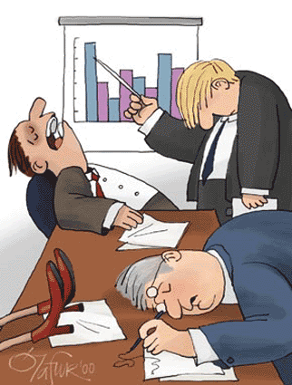
一样好东西给得太多会变成坏东西
TOO MUCH OF A GOOD THING CAN BE A BAD THING.

Slide 74
“永远记住：要让观众离开时意犹未尽… 而不是消化不良！” “ALWAYS LEAVE THE AUDIENCE WANTING MORE…NOT LESS!”

Slide 75
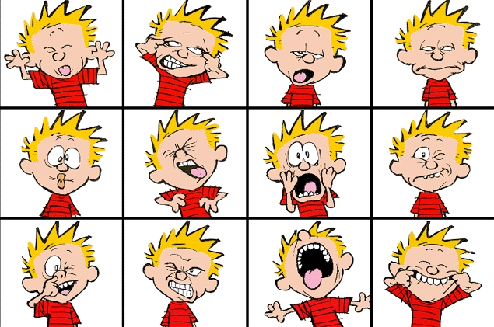
16.给讲员的实用建议
16. PRACTICAL ADVICE for speakers.

Slide 76
.
重要的演讲忠告
Important Speaking Tip #1
说话大声！ (Speak up!)

Slide 77
.
重要的演讲忠告
Important Speaking Tip #2
不要吃麦克风！ (Don’t eat your microphone!)

Slide 78
.
重要的演讲忠告
Important Speaking Tip #3
要有目光接触！(Make Eye Contact)

Slide 79
.
重要的演讲忠告
Important Speaking Tip #4
检查你的衣着！ (check your clothing!)

Slide 80
.
重要的演讲忠告
Important Speaking Tip #5
留意听众信号！ (Watch for signs!)

Slide 81
.
重要的演讲忠告
Important Speaking Tip #6
不要咕咕哝哝！ (don’t mumble!)

Slide 82
.
重要的演讲忠告
Important Speaking Tip #7
不要发怒！ (don’t get angry!)

Slide 83
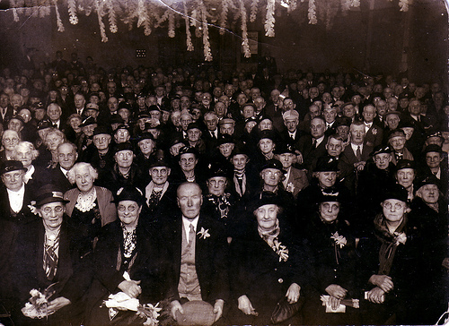
.
重要的演讲忠告
Important Speaking Tip #8
穿着要与场合相符! (dress for the occasion!)

Slide 84
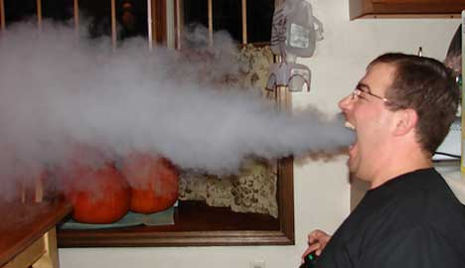
.
重要的演讲忠告
Important Speaking Tip #9
检查你的个人卫生！ (check your hygiene!)

Slide 85
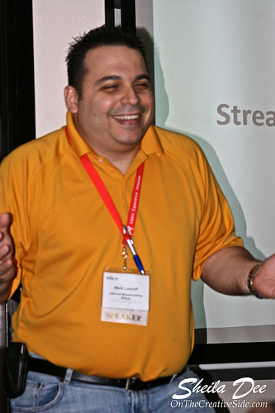
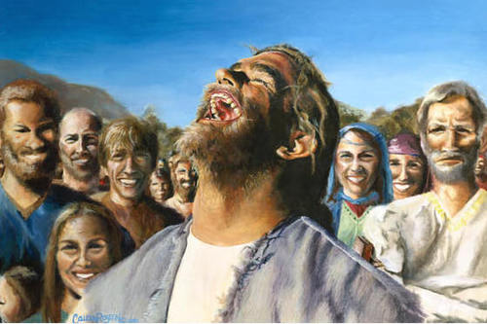
.
重要的演讲忠告
Important Speaking Tip #10
尽情享受你自己 ！ (enjoy yourself!)

Slide 86
17. 使用很多工具 (而非只是讲述)
17. Use many TOOLS (not just lecture)

Slide 87
* 尝试多种， 但只用几种 Try many, but use few. * 观点要表达清晰 Make your point clear. * 工具只是调味品， 不是食物！ The tool is the spice, not the meal.

Slide 88
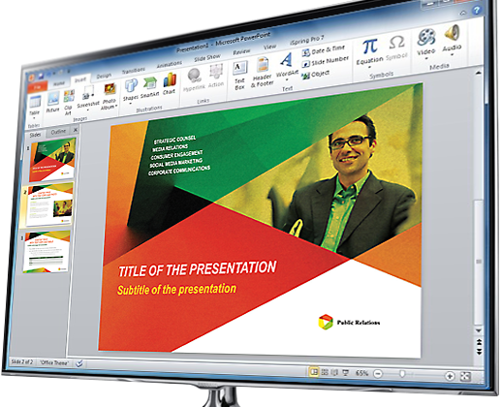
幻灯片 PowerPoint
保持简单
Keep it SIMPLE
保持可读
Keep it READABLE
保持连贯
Keep it CONSISTANT
保持集中
Keep it FOCUSED
保持美观
Keep it ENJOYABLE

Slide 89
幽默 Humor
了解你的听众
Know your audience
了解你的局限
Know your own limits
保持干净
Keep it clean
放松
Relax
使用熟悉的事件
Use familiar events

Slide 90
电影 Movies (DVD)
提前准备
Set up early
使用短片
Use short clips
表达一个观点
Make a point
智慧地选择
Choose wisely
使用适当短片
Use appropriate clips

Slide 91
角色扮演或短剧 Role Play/Skit
保持简短
Keep it short
现场布置
Set the scene
表达一个观点
Make a point
保持正面
Keep it positive
不强迫参与
Don’t force participation

Slide 92
案例学习 Case Studies
保持简短
Keep it short
告诉真理
Tell the truth
表达一
个观点
Make a point

Slide 93
艺术或漫画 Art/Cartoons
保持有趣
Keep it interesting
表达观点
Make a point
风格连贯
Be consistent in style

Slide 94
音乐 Music
选择令人振奋的音乐
Chose Uplifting Music
要对风格敏感
Be style sensitive
一起唱或播放一首歌
Sing together / Play a song

Slide 95
魔术 Magic

Slide 96
特邀讲员 Guest Speakers
选择有趣的讲员
Choose interesting speakers
选择基督徒讲员
Choose Christian Speakers
了解你的听众
Know your audience
全面了解讲员
Know the speaker well

Slide 97
学生技能 Student Skills
使用学生的能力
Use student’s abilities
知道他们在做什么
Know what they are going to do
首先看他们在你面前做
Watch them do it for you first

Slide 98
实物教学课 Object Lessons
使用手头上的任何东西
Use anything handy
使用你熟悉的物品
Use something familiar
使用有趣的物品
Use something interesting

Slide 99
样本: EXAMPLE
相信
实物：5元钱（或两元，一元）
教训：救恩必须有信心（弗2：8-9）
陈述：第一个来到我这里的男孩或女孩可以得到这5块钱。你真得相信我手里有5块钱吗？你真的相信我会给你这5块钱吗？很好，你是对的。我手里的确有5块钱，刚才我说过了第一个来到前面的就会得到它。既然你如此相信我，这钱就是你的了。
你知道这个例子说明什么了吗？信心。
我们的朋友必须自己来到面前取这5块钱。就如同你必须自己接受耶稣那样，没有其他人能代替你做这件事。好，这就是你的钱，我刚许诺过的。你需不需要付出任何什么？你也不需要为救恩付出什么代价。（弗2：8-9）

Slide 100
实地考察 Field Trip
保持有趣
Keep it interesting
负担得起
Keep it affordable
保持实际
Keep it practical

Slide 101
报纸 Newspaper
使用当前的故事
Use current stories
不只是说长道短
Don’t just gossip
不要诋毁领导人
Don’t slander leaders
表达你的观点
Make your point
强大的应用
Strong application

Slide 102
木偶 Puppets

Slide 103
竞赛和奖品 Contests/Awards

Slide 104
更多其它的方法: Unlimited Others

Slide 105
18. 评估你的讲课以便提高.
18. EVALUATE your lessons to Improve

Slide 106
课后 (After the Lesson…)
回顾上课情形，评估一下
review the class session and evaluate whether or not
你是否讲得清楚易明
you communicated clearly
学生是否理解
the students understood the lesson.
你是否已达到目的
You accomplished your goal.
在下堂课，你是否有需要改善的地方
What changes you need to make before the next class.

Slide 107
19. 常见教导错误
19. COMMON TEACHING MISTAKES

Slide 108
.
失败是学习过程中的必要组成部分
Failure is a necessary part of the learning process

Slide 109
教与学的障碍 Hindrances to Teaching and Learning
教导若无果效, 必有其因！
When teaching is ineffective there is always a reason!
如果教师不理解和 实践教导的基本原则， 其教导不会有很好的效果。
Teaching who don’t understand and practice the basic principles of teaching will not be effective teachers.

Slide 110
为何有些教师教导效果不好 Why some teachers are not effective
缺乏足够的预备
Lack of adequate preparation
对课程缺乏热忱
Lack of excitement for the subject matter
讲授不清晰
Lack of clarity in communication
不能紧扣主题
Failure to stay on the subject

Slide 111
为何有些教师教导效果不好 Why some teachers are not effective
5.讲授方式沉闷单调
Dull and boring presentation
6.一次讲授的内容太多
Covering too much material at a time
7. 讲授不相关的内容
Covering irrelevant material
8.作业没有实际的目的
Giving assignments which have no real purpose

Slide 112
为何有些教师教导效果不好 Why some teachers are not effective
9. 对学生缺乏真正的爱心
Lack of genuine personal interest in students
10. 没有理会学生的困难
Failure to respond to students’ problems
11. 不能直接回答问题
Failure to answer questions directly
12. 不愿意承认“我不知道”
Not being willing to admit “I don’t know”

Slide 113
为何有些教师教导效果不好 Why some teachers are not effective
13.自视高学生一筹——“贬低人”
Assuming a superior position over students—“putting them down”
14.言谈间流露出不信 任学生能力的态度。
Communicating lack of confidence in ability of students
15.不能言传身教—— 作坏榜样
Failure to practice what they teach— setting a bad example

Slide 114
为何有些学生不能学会 Why some students don’t learn
如果教师在教导上做得很好， 那么问题就出在学生的身上了！
If the teacher is doing his job well,
then the problem is with the student!

Slide 115
有些学生不能学会是因为—— Some students do not learn because of :
缺乏真正渴慕学习的心
Lack of real desire to learn
懒惰——不想用功
Laziness—unwilling to work hard
没有受教的心—— “我早就知道了”
Lack of teachable spirit—“I already know this”
不愿承认“我不懂”
Not willing to say, “I don’t understand”

Slide 116
有些学生不能学会是因为—— Some students do not learn because of :
5. 不会恰当地提问
Failure to ask appropriate questions
6. 没有实践所学真理及原则
Not putting into practice the truth and principles taught
7.不理解真正的学习会引起生命改变这一事实.
Lack of understanding that true learning involves life change
8.未能将个人或家庭问题说出来让人分担,只由得这些问题困扰自己,阻碍学习。
Failure to resolve serious personal or family problems that are unresolved and distracting

Slide 117
20. 祷告是预备的一部分
20. PRAYER is part of Preparation

Slide 118
祷告神带领 和指引教导内容
Pray for direction and guidance as to what to teach.
祷告神让你察觉学生的实际需要
Pray for discernment as to the real needs of the students
祈求神赐你智慧,叫你懂得决定教导 主题和目标。
Pray for wisdom in determining the theme and purpose.
祈求神光照你的心,使你明白经文,深入了解真道
Pray for understanding and insight
祈求神赐你能力,使你有效地研读和组织教导资料
Pray for ability to study and organize the material effectively.

Slide 119
这堂培训的真正测试
不是你记住了多少，
而是你将多少
运用到你教学中。
The True Test of this Seminar is not seeing how much you remember, but how much
you incorporate into your teaching.

