Slide 1

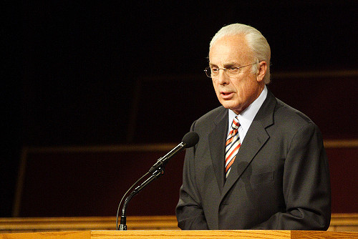

耶稣说: “跟随我”是什么意思？
耶稣所传的福音
约翰·麦克阿瑟

Slide 2
关于作者
约翰·富勒通· 小麦克阿瑟
John Fullerton MacArthur, Jr.
生于1939年6月19日
  Born June 19, 1939
他有一个每日电台节目《赐你恩典》
  His daily radio program, Grace to You
他是广受欢迎的作家和会议讲员
  Popular author and conference speaker
自1969年起一直是“恩典社区教会”的牧师。
  Pastor of Grace Community Church since 1969,
主人大学和主人神学院的校长
  President of The Master's College & Master's Seminary
《今日基督教》说: “这个时代最有影响力的传道人.”
  Christianity Today says “One of the most influential preachers of his time”
About the Author

Slide 3
关于作者
编著了超过150本著作。
Authored or edited more than 150 books
《麦约翰研究圣经》销售过百万, 荣获 “美国图书金奖”。
MacArthur Study Bible sold 1 million + copies; received a Gold Medallion Book Award
《麦约翰新约评注系列》
MacArthur New Testament Commentary Series
麦约翰曾入阿苏撒太平洋大学学习并获得拜欧拉大学塔尔伯特神学院的道学硕士学位.
John MacArthur attended Azusa Pacific University and obtained his Masters of Divinity from Biola University's Talbot Theological Seminary
麦约翰也获得塔尔伯特神学院和恩典研究所的荣誉博士学位.
MacArthur also received an honorary doctorate from Talbot Theological Seminary and an honorary doctorate from Grace Graduate School.
About the Author

Slide 4
麦约翰开通
中文网站
“恩泽亚洲”
http://ezyz.gracetoasia.org/

Slide 5
当今问题 (The PROBLEM)
今天许多人败坏耶稣所教导的福音.
  Many today pervert the Gospel Jesus taught.
善行福音: 许多人在神的恩典之上加入善行.
  WORKS GOSPEL: Many add good works to God’s Grace.
普救论: 许多人教导我们都会上天堂.
  UNIVERSALISM: Many teach we will all get to heaven.
使徒福音: 许多人教导说耶稣的福音只适用于他那个时代, 使徒教导的福音有所不同.
  APOSTOLIC GOSPEL: Many teach that the Gospel of Jesus was only for those in His day and that the apostles taught a different gospel.
但是请谨记保罗说的…
  But remember what Paul said…

Slide 6
警告 (The WARNING)
太1:6-10 “我希奇你们这么快离开那藉著基督之恩召你们的,去从别的福音. 那并不是福音,不过有些人搅扰你们,要把基督的福音更改了. 但无论是我们,是天上来的使者,若传福音给你们,与我们所传给你们的不同,他就应当被咒诅. 我们已经说了,现在又说：若有人传福音给你们,与你们所领受的不同,他就应当被咒诅! 我现在是要得人的心呢？还是要得神的心呢？我岂是讨人的喜欢吗? 若仍旧讨人的喜欢,我就不是基督的仆人了.”
Gal. 1:6-10 “I am astonished that you are so quickly deserting the one who called you to live in the grace of Christ and are turning to a different gospel— ⁷ which is really no gospel at all. Evidently some people are throwing you into confusion and are trying to pervert the gospel of Christ. ⁸ But even if we or an angel from heaven should preach a gospel other than the one we preached to you, let them be under God’s curse! ⁹ As we have already said, so now I say again: If anybody is preaching to you a gospel other than what you accepted, let them be under God’s curse! ¹⁰ Am I now trying to win the approval of human beings, or of God? Or am I trying to please people? If I were still trying to please people, I would not be a servant of Christ.”

Slide 7
当今问题
许多有影响的现代福音派领袖极力向人们鼓吹说不需要降服基督也可以得救.他们说主权救恩是善行加入救恩的异端. 但是圣经和基督教历史表明福音向来就包括了悔改和降服于基督。到了现代布道家才试图 将福音“加速”,拯救更多灵魂,也因而败坏了福音. 这就叫 “易信主义”.
Many influential leaders in modern evangelicalism are telling people with great fervor they need not yield to Christ to be saved. They say that Lordship Salvation is heresy that adds works to salvation. But the Scriptures and Christian history show that the Gospel has always included repentance and a surrender to Christ until modern evangelists attempted to ‘speed up’ the Gospel to save more souls, thus corrupting it. This is called Easy-Believism.
(The PROBLEM)

Slide 8
当今问题
易信主义: “你只要相信就可以了.”
  EASY BELIEVISM: “All you have to do is believe”
让更多人进天堂的企图将福音扭曲了。
  The Gospel has been distorted in an attempt to get more people into heaven.
简化到一个祷告或一个公式; 全然悔改, 向基督降服和委身的内容却被移走了; 耶稣的角色被划分为救主和主两部分。
  It has been reduced to a prayer or a formula; all repentance, commitment and devotion to Christ removed; Jesus’ roles divided between Savior and Lord.
今天我们将对当今教导的假福音与耶稣所教的福音进行比较.
  Today we will look at the false gospel being taught today and compare it to the Gospel that Jesus taught.
(The PROBLEM)

Slide 9

后果
“今日所传的福音并不是耶稣所传的福音. 时下流行的福音给罪人提供了虚假的盼望. 它承诺罪人持续生活在对神的悖逆中亦照样可以承受永生.”
“The message being proclaimed today is not the Gospel according to Jesus. The gospel in vogue today holds forth false hope to sinners. It promises them they can have eternal life yet continue to live in rebellion against God.”
The Result

Slide 10
后果
“因此基督的好消息让位给了危害重重的坏消息,对罪人的生活没有任何道德要求. 这并不是耶稣所传的信息. 这新福音孵出了一代声称是基督徒但行为与未重生的悖逆之子毫无区别的人.”
“Thus the Good News of Christ has given way to the bad news of an insidious easy-believism that makes no moral demands on the lives of sinners. It is not the same message Jesus proclaimed. This new gospel has spawned a generation of professing Christians whose behavior is indistinguishable from the rebellion of the unregenerate.”
The Result

Slide 11
后果
“ 这类如 ‘接受耶稣作救主’,‘邀请基督进入你的生活’和‘请求耶稣入你的心’ 的短语是掺水福音的产品。耶稣基督所传的福音是对门徒的呼召,不是作一个祷告或一个决定的托辞.”
“Phrases like “accept Jesus as personal Savior”, “Invite Christ into your life” and “Ask Jesus into your heart” are the products of a diluted Gospel. The Gospel Jesus proclaimed was a call to total discipleship, not a plea to say a prayer or make a decision.”
“今天, 任何人只要声称是基督徒都会发现会有传福音者急切地接受其认信, 不管其是否有新生命的迹象.”
“Today, anyone claiming to be a Christian can find evangelicals eager to accept his profession of faith whether or not there is ever any sign of new life.”
The Result

Slide 12



现代某些神学家的评注
“进入耶稣基督的救恩从未包括 ‘属灵承诺’”—赞·霍奇
“Coming to salvation in Jesus Christ involves no spiritual commitment whatsoever" - Zane C. Hodges
赖里教导: “不需要从罪中悔改,不需要改变生活方式,不需要委身—甚至连降服于基督主权的心愿都不需要.”
Ryrie teaches "There need be no turning from sin, no resulting change in life-style, no commitment -- not even a willingness to yield to Christ's lordship" (p. 22).
Comments by modern theologians

Slide 13

关键思维
“各各他的呼召必须被正确认识: 一个在耶稣基督主权下的门徒身份. 对这呼召的回应就是成为一个信徒. 任何达不到这要求的都是不信. ”
“The call to Calvary must be recognized for what it is; a call to discipleship under
the Lordship of Jesus Christ. To respond to that call is to become a believer.
Anything less is simply unbelief.”
“神的恩典不是一种他被动接受心硬不悔改罪人的静态属性. 恩典不会只改变一人在神面前的身份却丝毫不触及其品性.”
“God’s grace is not a static attribute whereby He passively accepts hardened, unrepentant sinners. Grace does not change a person’s standing before God
yet leave his character untouched.”
KEY THOUGHTS

Slide 14

经文
“我们原不是传自己,乃是传基督耶稣为主，并且自己因耶稣作你们的仆人.” 林后4:5
* “For what we preach is not ourselves, but Jesus Christ as Lord,
and ourselves as your servants for Jesus’ sake.” 2 Cor. 4:5
“若不是被圣灵感动的,也没有能说耶稣是主的. ” 林前12:3b
* “no one can say, “Jesus is Lord,” except by the Holy Spirit.”1 Cor. 12:3 b
“他们说:当信主耶稣,你和你一家都必得救.” 徒16:31
* “They replied, “Believe in the Lord Jesus, and you will be saved…” Acts 16:31
“他们说:当信主耶稣,你和你一家都必得救.”罗10:9
* “If you declare with your mouth, “Jesus is Lord,” and believe in your heart that
God raised him from the dead, you will be saved.” Rom. 10:9
SCRIPTURES

Slide 15
经文
“凡称呼我‘主啊,主啊’的人,不能都进天国;惟独遵行我天父旨意的人,才能进去.” 太7:21
“Not everyone who says to me, ‘Lord, Lord,’ will enter the kingdom of heaven, but only
the one who does the will of my Father who is in heaven.” Matt 7:21
“凡树木看果子，就可以认出它来.” 路6:44
“Each tree is recognized by its own fruit.” Luke 6:44
“这样,信心若没有行为就是死的.” 雅2:17
“In the same way, faith by itself, if it is not accompanied by action, is dead.” James 2:17
“你们要进窄门.因为引到灭亡,那门是宽的，路是大的,进去的人也多; 引到永生,那门是窄的,路是小的,找著的人也少.” 太7:13-14
“You can enter God’s Kingdom only through the narrow gate. The highway to hell is broad, and its gate is wide for the many who choose that way. But the gateway to life is very narrow and the road is difficult, and only a few ever find it.” Matthew 7:13-14
SCRIPTURES

Slide 16
议题
主权
救恩
LORDSHIP
SALVATION
易信
主义
EASY-
BELIEVISM
THE ISSUES

Slide 17
议题
主权救恩
LORDSHIP SALVATION
易信主义
EASY- BELIEVISM
救恩要求将信心放在耶稣的神性, 生, 死, 埋葬和复活的真理上.
Salvation requires putting our faith in the Truth of Jesus’ Deity, Life, Death, burial and resurrection
救恩要求将信心放在耶稣的神性, 生, 死, 埋葬和复活的真理上.
Salvation requires putting our faith in the Truth of Jesus’ Deity, Life, Death, burial and resurrection
THE ISSUES

Slide 18
议题
主权救恩
LORDSHIP SALVATION
易信主义
EASY- BELIEVISM
必须降服于基
督作为主和救
主才能得救.
One must surrender to Christ as Lord and Savior to be saved
救恩不要求参
与者的委身.
Salvation requires no commitment from the person involved
THE ISSUES

Slide 19
议题
主权救恩
LORDSHIP SALVATION
易信主义
EASY- BELIEVISM
悔改罪是救
恩必需的
Repentance of sin IS
required for salvation
悔改罪不是
救恩必需的
Repentance of sin IS NOT
required for salvation
THE ISSUES

Slide 20
议题
主权救恩
LORDSHIP SALVATION
易信主义
EASY- BELIEVISM
救恩发生在当人完全信靠耶稣, 从罪中悔改并将生命交付他时。
Salvation occurs when a person fully
trusts in Jesus, repents of their sin
and commits their live to Him.
救恩发生在当
人相信救恩的
事实, 请求耶稣进入其内心时。
Salvation occurs when a person believes
the facts of salvation and asks Jesus
to come into their heart.
THE ISSUES

Slide 21
议题
主权救恩
LORDSHIP SALVATION
易信主义
EASY- BELIEVISM
真正的归信总
是带来果实和
属灵成长.
A true conversion will always result in fruit and spiritual growth.
归信可能会,也可能不会影响一个信徒的生命。
Conversion may or may not have an effect on the life of the believer.
THE ISSUES

Slide 22
议题
主权救恩
LORDSHIP SALVATION
易信主义
EASY- BELIEVISM
耶稣基督所传的福音
The Gospel According to Jesus
人所传
的福音
The Gospel According to Man
THE ISSUES

Slide 23
今天 (TODAY)
耶稣传福音 JESUS PROCLAIMS THE GOSPEL
耶稣阐明福音 JESUS ILLUSTRATES THE GOSPEL
耶稣解释福音 JESUS EXPLAINS THE GOSPEL
使徒所传的福音 THE GOSPEL ACCORDING TO THE APOSTLES
教会历史所传的福音 THE GOSPEL ACCORDING TO CHURCH HISTORY
常见的问题 COMMONLY ASKED QUESTIONS

Slide 24
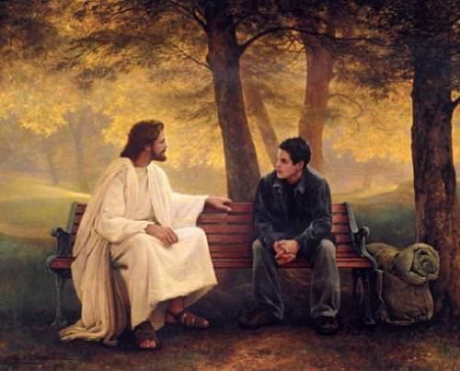
耶稣传福音
JESUS PROCLAIMS THE GOSPEL

Slide 25
耶稣传福音
税吏马太 MATTHEW /TAX COLLECTOR
那瞎子 THE BLIND MAN
年轻的财主 RICH YOUNG RULER
加略人犹大 JUDAS ISCARIOT
撒该 ZACCHAEUS
JESUS PROCLAIMS THE GOSPEL

Slide 26


税吏
TAX COLLECTOR

Slide 27
路5:27-32 “这事以后,耶稣出去,看见一个税吏,名叫利未,坐在税关上,就对他说:“你跟从我来!”他就撇下所有的,起来,跟从了耶稣. 利未在自己家里为耶稣大摆筵席,有许多税吏和别人与他们一同坐席.法利赛人和文士就向耶稣的门徒发怨言说:“你们为甚么和税吏并罪人一同吃喝呢?” 耶稣对他们说:”无病的人用不著医生,有病的人才用得著;我来本不是召义人悔改,乃是召罪人悔改.””
Luke 5:27-32 “After this, Jesus went out and saw a tax collector by the name of Levi sitting at his tax booth. “Follow me,” Jesus said to him, and Levi got up, left everything and followed him. Then Levi held a great banquet for Jesus at his house, and a large crowd of tax collectors and others were eating with them. But the Pharisees and the teachers of the law who belonged to their sect complained to his disciples, “Why do you eat and drink with tax collectors and sinners?” Jesus answered them, “It is not the healthy who need a doctor, but the sick. I have not come to call the righteous, but sinners to repentance.”

Slide 28
  耶稣呼召我们跟随他
耶稣去到罪人那里。
Jesus went to the sinner
耶稣的命令简短但却改变人生… “跟随我! ”
Jesus’ command was short but life-changing…”FOLLOW ME!”
利未撇下一切跟随了耶稣。
Levi left EVERYTHING to follow Jesus
利未(马太) 希望他的朋友也见耶稣。
Levi (Matthew) wanted his friends to meet Jesus also
法利赛人根据他们的宗教规条论断耶稣。
The Pharisees judged Jesus by their religious rules
耶稣拒绝了自义者，接受了悔改者。
Jesus rejected the self-righteous and accepted those who repented
耶稣的呼召是悔改。
Jesus’ call was to REPENTANCE
  Jesus Calls Us to Follow Him

Slide 29
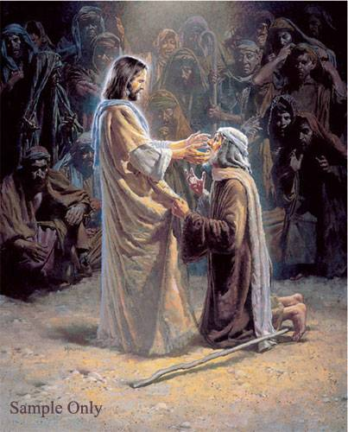
约9
耶稣让 瞎子看见
John 9
JESUS OPENS
BLIND EYES

Slide 30
  耶稣医治了一个盲人(约9章)
耶稣医治了一个盲人并说: “我是世界的光”。
Jesus healed a blind man saying, “I am the Light of the World”
法利赛人责备耶稣在安息日医治病人。
The Pharisees rebuked Jesus for healing on the Sabbath
那个盲人和其父母受审问到底耶稣是谁
The man and his parents were interrogated about who Jesus was
当耶稣听说法利赛人将那盲人丢出来后便去找他.
Jesus went to find the man when He heard the Pharisees had thrown him out
那人相信耶稣, 称他为主，并敬拜他。
The man believed Jesus , called Him LORD, and worshipped Him
耶稣对法利赛人说他们依旧是瞎眼的。
Jesus told the Pharisees that they were still blind
若耶稣已开了你的眼, 称他为主并敬拜他。
IF JESUS HAS OPENED YOUR EYES, CALL HIM LORD AND WORSHIP HIM
  Jesus Heals a Blind man (John 9)

Slide 31
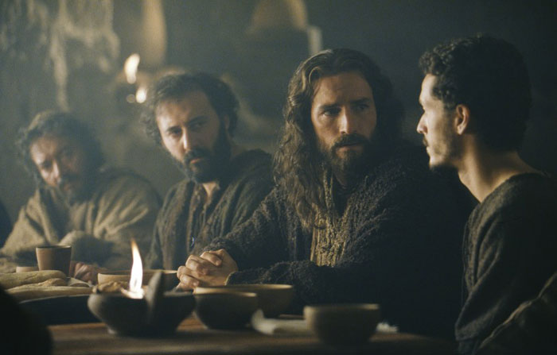
太19:16-26
耶稣挑战一个心切的慕道者
Matthew 19:16-26
JESUS CHALLENGES
AN EAGER SEEKER

Slide 32
太19: 16-26 “有一个人来见耶稣说:
“夫子,我该做甚么善事才能得永生?” 耶稣对他说:“你为甚么以善事问我呢?只有一位是善的.你若要进入永生,就当遵守诫命.” 他说:“甚么诫命?”耶稣说:“就是‘不可杀人,不可奸淫,不可偷盗，不可作假见证,当孝敬父母,又当爱人如己.’” 那少年人说: “这一切我都遵守了,还缺少甚么呢?”
Matt. 19:16-26 “Just then a man came up to Jesus and asked, “Teacher, what good thing must I do to get eternal life?” “Why do you ask me about what is good?” Jesus replied. “There is only One who is good. If you want to enter life, keep the commandments.” “Which ones?” he inquired. Jesus replied, “‘You shall not murder, you shall not commit adultery, you shall not steal, you shall not give false testimony, honor your father and mother,’ and ‘love your neighbor as yourself.’” “All these I have kept,” the young man said. “What do I still lack?”

Slide 33
耶稣说:“你若愿意作完全人,可去变卖你所有的,分给穷人,就必有财宝在天上;你还要来跟从我.” 那少年人听见这话,就忧忧愁愁地走了,因为他的产业很多. 耶稣对门徒说:“我实在告诉你们:财主进天国是难的. 我又告诉你们:骆驼穿过针的眼,比财主进神的国还容易呢!” 门徒听见这话,就希奇得很,说: “这样谁能得救呢?” 耶稣看著他们说:“在人这是不能的,在神凡事都能!”
Jesus answered, “If you want to be perfect, go, sell your possessions and give to the poor, and you will have treasure in heaven. Then come, follow me.” When the young man heard this, he went away sad, because he had great wealth. Then Jesus said to his disciples, “Truly I tell you, it is hard for someone who is rich to enter the kingdom of heaven. Again I tell you, it is easier for a camel to go through the eye of a needle than for someone who is rich to enter the kingdom of God.” When the disciples heard this, they were greatly astonished and asked, “Who then can be saved?” Jesus looked at them and said, “With man this is impossible, but with God all things are possible.”

Slide 34
年轻的财主
他动机正确 HE HAD THE RIGHT MOTIVES
他态度正确 HE HAD THE RIGHT ATTITUDE
他找对了人 HE CAME TO THE RIGHT PERSON
他问对了问题 HE ASKED THE RIGHT QUESTION
THE RICH YOUNG RULER

Slide 35

年轻的财主
他动机正确 HE HAD THE RIGHT MOTIVES
他态度正确 HE HAD THE RIGHT ATTITUDE
他找对了人 HE CAME TO THE RIGHT PERSON
他问对了问题 HE ASKED THE RIGHT QUESTION
被拒
THE RICH YOUNG RULER

Slide 36
年轻的财主
他动机正确 HE HAD THE RIGHT MOTIVES
他态度正确 HE HAD THE RIGHT ATTITUDE
他找对了人 HE CAME TO THE RIGHT PERSON
他问对了问题 HE ASKED THE RIGHT QUESTION
被拒
心怀骄傲
FILLED WITH PRIDE
不承认自己的罪
DID NOT CONFESS HIS GUILT
不愿委身于基督
WOULD NOT SUBMIT TO CHRIST
THE RICH YOUNG RULER

Slide 37
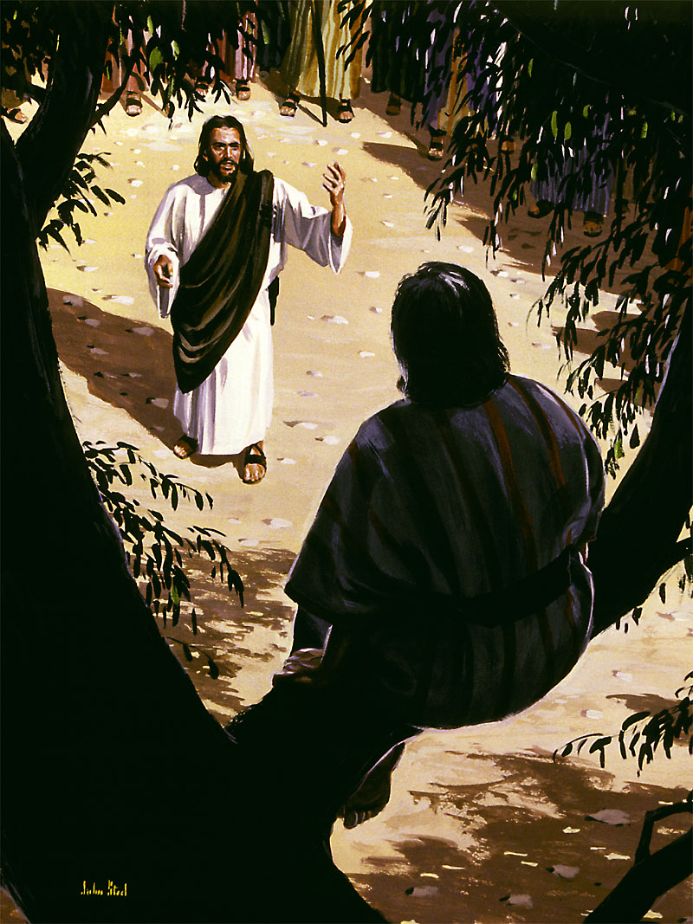
路19:1-10
耶稣寻找和拯救 失丧者
LUKE 19:1-10
JESUS SEEKS AND SAVES THE LOST

Slide 38

路19:1-10 “耶稣进了耶利哥,正经过的时候,有一个人名叫撒该,作税吏长,是个财主.他要看看耶稣是怎样的人;只因人多,他的身量又矮,所以不得看见,就跑到前头,爬上桑树,要看耶稣，因为耶稣必从那里经过. 耶稣到了那里,抬头一看,对他说:” 撒该,快下来!今天我必住在你家里.”
Luke 19:1-10 “ Jesus entered Jericho and was passing through. A man was there by the name of Zacchaeus; he was a chief tax collector and was wealthy. He wanted to see who Jesus was, but because he was short he could not see over the crowd. So he ran ahead and climbed a sycamore-fig tree to see him, since Jesus was coming that way. When Jesus reached the spot, he looked up and said to him, “Zacchaeus, come down immediately. I must stay at your house today.”

Slide 39
他就急忙下来,欢欢喜喜地接待耶稣.
众人看见,都私下议论说:“他竟到罪
人家里去住宿.” 撒该站著对主说:
“主啊,我把所有的一半给穷人;我若讹诈了谁,就还他四倍.” 耶稣说: “今天救恩到了这家,因为他也是亚伯拉罕的子孙.人子来,为要寻找,拯救失丧的人.”
So he came down at once and welcomed him gladly. All the people saw this and began to mutter, “He has gone to be the guest of a sinner.” But Zacchaeus stood up and said to the Lord, “Look, Lord! Here and now I give half of my possessions to the poor, and if I have cheated anybody out of anything, I will pay back four times the amount.” Jesus said to him, “Today salvation has come to this house, because this man, too, is a son of Abraham. For the Son of Man came to seek and to save the lost.”

Slide 40
  撒该的故事
撒该去到能看见耶稣的地方.
Zacchaeus went where he could see Jesus
耶稣对撒该说: “我今晚要住在你家里.”
Jesus called out to Zacchaeus and said, I must stay at your house today”
撒该称耶稣为 “主” 且行为立即翻转。
Zacchaeus calls Jesus “LORD” and immediately reverses his actions
这就是我们所说的悔改.
This is what we call REPENTANCE
耶稣宣布撒该 “得救了”。
Jesus declared Zacchaeus “SAVED”
耶稣说他来是寻拯救失丧的人.
Jesus said HE CAME TO SEEK AND SAVE THE LOST
没有人 “寻求” (罗3) …耶稣才是 “寻找者”.
No man is a “seeker” (Rom. 3)… Jesus is the “Seeker”
  Zacchaeus

Slide 41
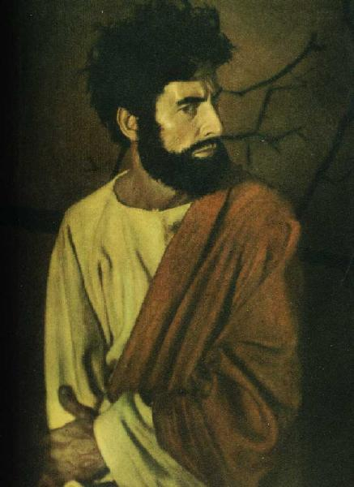
加略人犹大:
耶稣谴责
心硬者
JUDAS ISCARIOT:
JESUS CONDEMNS
THE HARDENED HEART

Slide 42
加略人犹大
知道并相信有关耶稣的事实 KNEW AND BELIEVED THE FACTS ABOUT JESUS
与耶稣和其跟随者生活过 LIVED WITH JESUS AND HIS FOLLOWERS
传道和行神迹者 EVANGELIST AND MIRACLEWORKER
倍受信任的群体领袖(管钱财) TRUSTED LEADER (TREASURER) OF THE GROUP
JUDAS ISCARIOT

Slide 43
加略人犹大
知道并相信有关耶稣的事实 KNEW AND BELIEVED THE FACTS ABOUT JESUS
与耶稣和其跟随者生活过 LIVED WITH JESUS AND HIS FOLLOWERS
传道和行神迹者 EVANGELIST AND MIRACLEWORKER
倍受信任的群体领袖(管钱财) TRUSTED LEADER (TREASURER) OF THE GROUP
被拒
JUDAS ISCARIOT

Slide 44
加略人犹大
知道并相信有关耶稣的事实 KNEW AND BELIEVED THE FACTS ABOUT JESUS
与耶稣和其跟随者生活过 LIVED WITH JESUS AND HIS FOLLOWERS
传道和行神迹者 EVANGELIST AND MIRACLEWORKER
倍受信任的群体领袖(管钱财) TRUSTED LEADER (TREASURER) OF THE GROUP
被拒
钱财-权利-职位
MONEY – POWER - POSITION
假忠诚- 带有欺骗性
FALSE LOYALTY - DECEPTIVE
想要弥赛亚但不想要主.
WANTED A MESSIAH BUT NOT A LORD
JUDAS ISCARIOT

Slide 45
太7:21-23 “凡称呼我 ‘主啊,主啊’的人，不能都进天国;惟独遵行我天父旨意的人,才能进去. 当那日,必有许多人对我说:‘主啊,主啊,我们不是奉你的名传道,奉你的名赶鬼，奉你的名行许多异能吗?’我就明明地告诉他们说: ‘我从来不认识你们,你们这些作恶的人,离开我去吧!’”
Matt. 7:21-23 “Not everyone who says to me, ‘Lord, Lord,’ will enter the kingdom of heaven, but only the one who does the will of my Father who is in heaven. Many will say to me on that day, ‘Lord, Lord, did we not prophesy in your name and in your name drive out demons and in your name perform many miracles?’ Then I will tell them plainly, ‘I never knew you. Away from me, you evildoers!’ “

Slide 46
“救恩的大奇迹不是我们接受基督,而是基督接受了我们!”
得救
SAVED
谦卑下来
HUMBLE YOURSELF
知道事实
KNOW FACTS
悔改罪
REPENT OF SIN
委身于他
SUBMIT TO HIM
相信/信心
BELIEVE IN FAITH
“The great miracle of redemption is not that we accept Christ, but that He accepts us!”

Slide 47





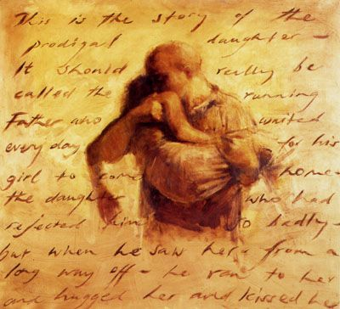

耶稣用以阐明福音的比喻
Jesus’ Parables Illustrate His Gospel

Slide 48
四种土的比喻
PARABLE OF THE SOILS

Slide 49
土 SOIL | 心 HEART | 迹象 SIGNS | 根 ROOTS
硬 HARD | 毫无反应 UNRESPONSIVE | 无 NONE 未得救 UNSAVED | 无 NONE 未得救 UNSAVED
浅 SHALLOW | 肤浅的 SUPERFICIAL | 塑料果实 PLASTIC FRUIT 倒退 BACKSLIDDEN | 无 NONE 未得救 UNSAVED
杂草丛生 WEEDY | 世俗的 WORLDLY | 塑料果实 PLASTIC FRUIT 倒退 BACKSLIDDEN | 无 NONE 未得救 UNSAVED
好土 GOOD | 善于接受 RECEPTIVE | 结果 FRUIT 得救 SAVED | 有 YES 得救 SAVED

Slide 50
麦子和稗子的比喻
PARABLE OF THE WHEAT & TARES

Slide 51
麦子和稗子
播麦者 (SOWER of WHEAT)
耶稣: JESUS
神的道: WORD of GOD
播稗者 (SOWER of TARES)
撒旦: SATAN
谎言: LIES
混合的土壤 (MIXED SOILS)
得救的: SAVED
未得救的: UNSAVED
  The Wheat and the Tares

Slide 52
神国宝藏的比喻
PARABLE OF THE KINGDOM TREASURE

Slide 53
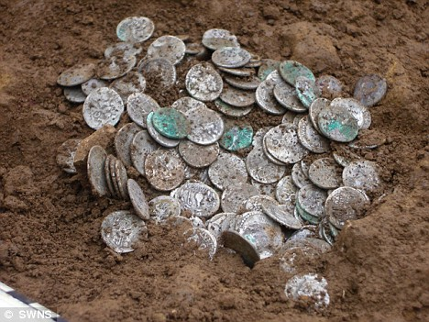

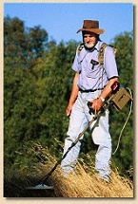

神国宝藏的比喻: The Treasure of the Kingdom
找到 FOUND
买了 BOUGHT
卖掉 SOLD
此屋出售
HOUSE
FOR SALE
找到 FOUND
买了BOUGHT

Slide 54

葡萄园工人的比喻（太20）
PARABLE OF THE WORKERS (Matt 20)

Slide 55
工人的工价不均
1. 主权至高的神主动发起救恩
1. God sovereignly initiates salvation
2. 神设立救恩的条件
2. God established the terms of salvation
3. 神不断呼召人得救
3. God continues to call people to be saved
4. 所有得救的都愿意服事祂
4. All redeemed are willing to work for Him
5. 神施怜悯给贫穷者
5. God shows compassion to the needy
6. 神持守祂永恒赏赐的应许
6. God keeps His promise of eternal reward
7. 神所赐的超出我们应得的
7. God gives us more than we deserve
Workmen Paid Unequal Wages

Slide 56
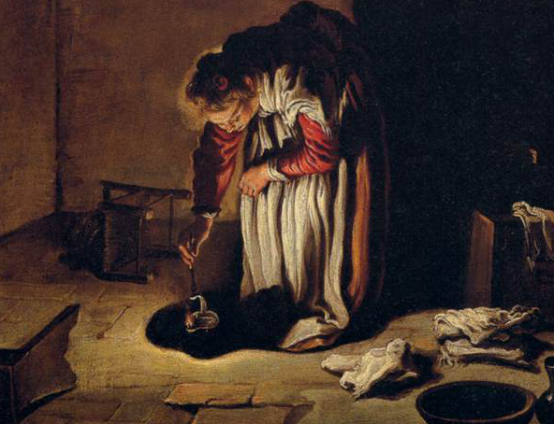
失落钱币的比喻
PARABLE OF THE LOST COIN

Slide 57
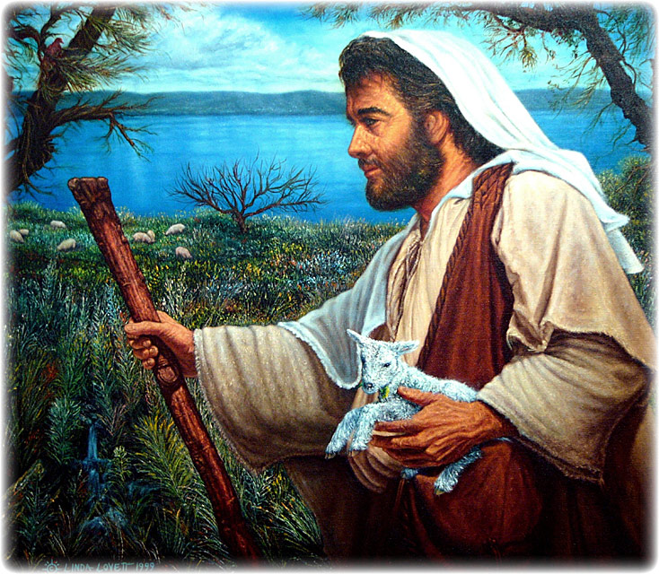
失落羊只的比喻
PARABLE OF THE LOST SHEEP

Slide 58
浪子回头的比喻
PARABLE OF THE LOST SON

Slide 59
  失去& 找回 : LOST & FOUND
羊: SHEEP
钱币: COIN
儿子: SON
找到: FOUND
找到: FOUND
找到: FOUND
欢喜: REJOICED
欢喜: REJOICED
欢喜: REJOICED
承认自己的罪: RECOGNIZED HIS SINFULNESS
谦卑自己: HUMBLED HIMSELF
向他的父亲 认罪: CONFESSED TO HIS FATHER
向父亲委身: SUBMITTED TO HIS FATHER
获得奖赏: REWARDED

Slide 60
葡萄树和枝子的比喻
PARABLE OF THE VINE & BRANCHES

Slide 61



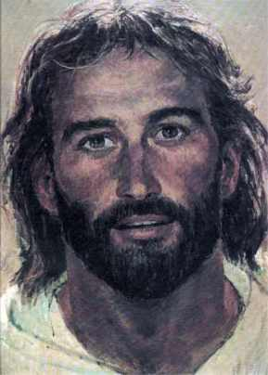

Slide 62
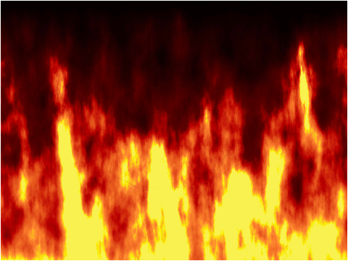

Slide 63
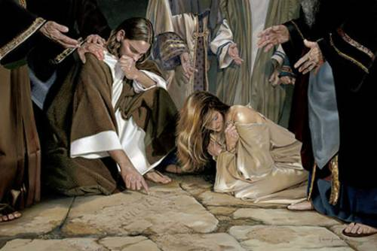
耶稣解释他的福音
Jesus Explains His Gospel

Slide 65

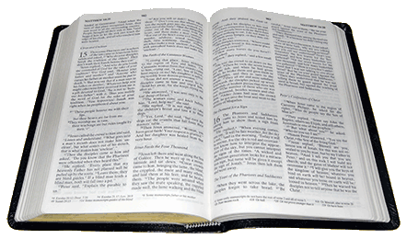
  呼召悔改
福音
GOSPEL
地狱: HELL
  The Call to Repentance

Slide 66
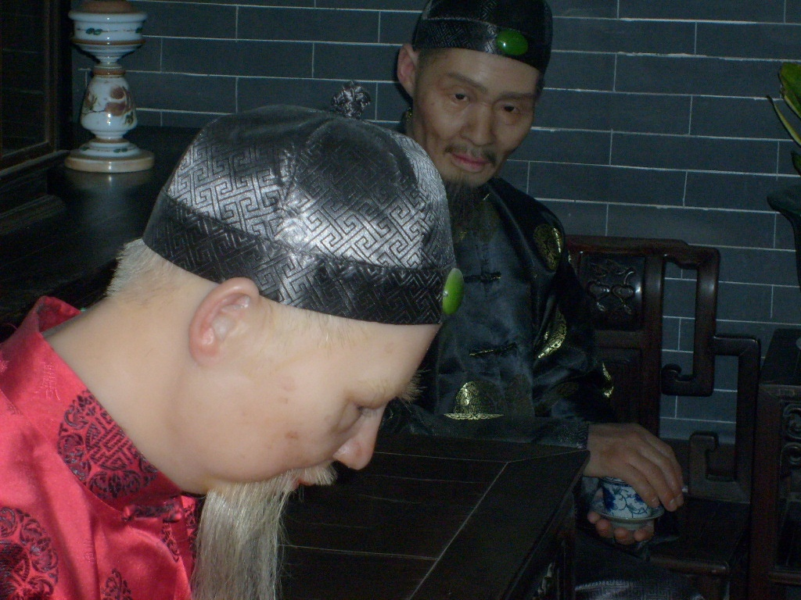
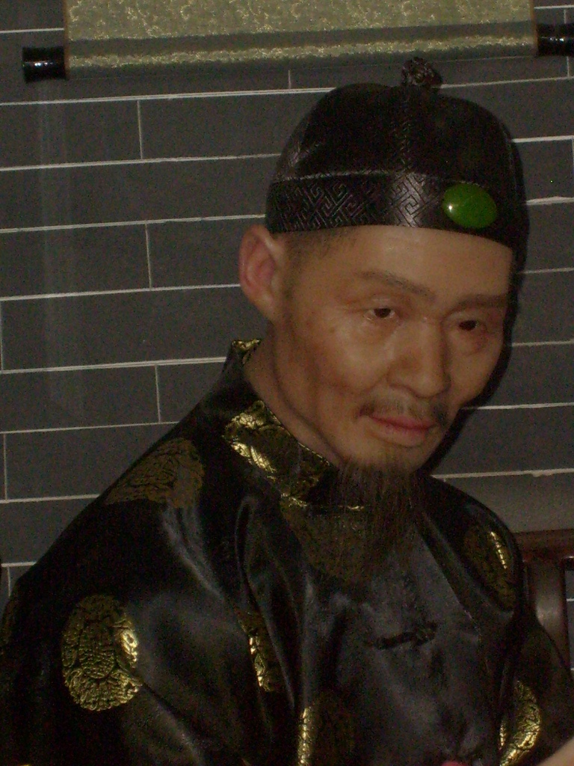
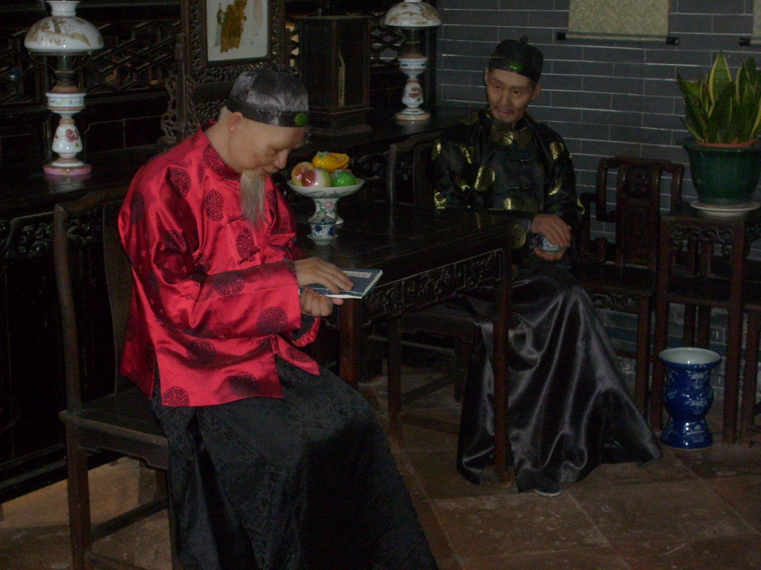
  信心若没有行为就是死的
  FAITH WITHOUT WORKS IS A DEAD FAITH

Slide 67
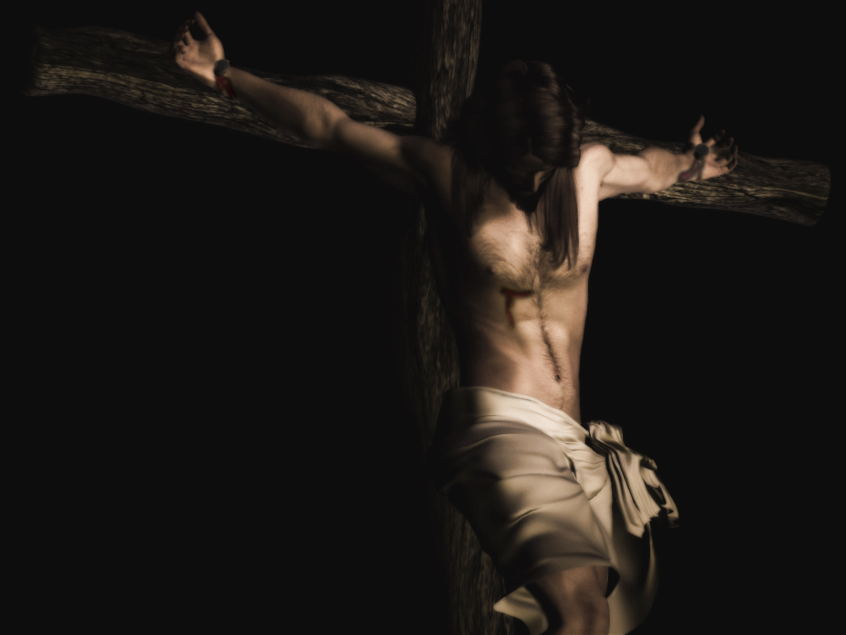
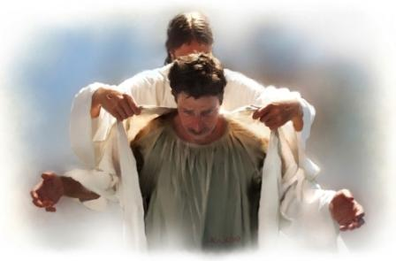
  称义的应许
  我的罪归到他身上
  MY SIN WAS PLACED ON HIM
  他的义披在我身上
  HIS RIGHTEOUSNESS WAS PLACED ON ME
  The Promise of Justification

Slide 68


  得救的路
地狱
HELL
天
堂
HEAVEN
宽
WIDE
窄
NARROW
很多
MANY
很少
FEW
  The Way of Salvation

Slide 69

但我叫你
为主呀！
BUT I CALLED
YOU LORD!
我去了教会!
I WENT TO CHURCH!
我奉你的名行了神迹！
I DID MIRACLES IN YOUR NAME!
我说了方言！
I SPOKE IN TONGUES!
你欠我!
YOU OWE ME!
我奉你的
名赶鬼了！
I CAST OUT DEMONS IN YOUR NAME!
我唱了各
种赞美诗！
I SANG ALL THE PRAISE SONGS!
我做了十
一奉献！
I GAVE MY TITHE!

Slide 70
但我叫你
为主呀！
BUT I CALLED
YOU LORD!
我去了教会!
I WENT TO CHURCH!
我奉你的名行了神迹！
I DID MIRACLES IN YOUR NAME!
我从不认识你…你们这些作恶的人.
I NEVER KNEW YOU… WORKER OF INIQUITY
我说了方言！
I SPOKE IN TONGUES!
你欠我!
YOU OWE ME!
我奉你的
名赶鬼了！
I CAST OUT DEMONS IN YOUR NAME!
我唱了各
种赞美诗！
I SANG ALL THE PRAISE SONGS!
我做了十
一奉献！
I GAVE MY TITHE!

Slide 71
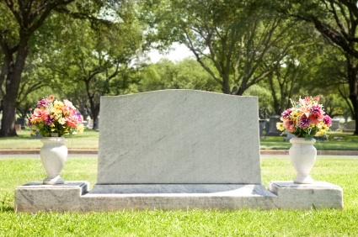
  作门徒的代价
每日 向自己死
Died to Self
-Daily- -
  The Cost of Discipleship

Slide 72
  基督的主权
救主
SAVIOR
主
LORD
  The Lordship of Christ

Slide 73
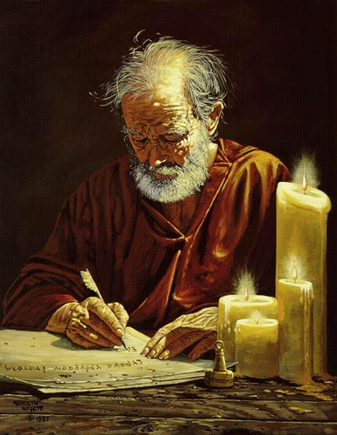
使徒所传的福音
The Gospel According to the Apostles

Slide 74
有人开始教导说耶稣的福音只适用于他当时针对的人群,说使徒后来给教会的福音信息不同. 真相是使徒约翰,保罗,犹大,彼得,犹大和《希伯来书》的作者所传的信息与耶稣的所传是相同的福音:论及救恩和呼召跟随耶稣时都要承认他是主和救主.
People have begun to teach that Jesus’ Gospel was only applicable to the crowd He spoke to, and that the apostles had a different message for the church age. The truth is that the message taught by John, Paul, Jude, Peter, James, and the writer of the Book of Hebrews was the same message that Jesus brought regarding salvation and the call to follow Jesus as both Lord and Savior.

Slide 75
保罗 (罗6:1-2)
“这样,怎么说呢？我们可以仍在罪中,叫恩典显多吗?
断乎不可！
我们在罪上死
了的人岂可仍
在罪中活著呢?”
PAUL (Rom.6:1-2)
“What shall we say, then? Shall we go on sinning so that grace may increase? By no means! We are those who have died to sin; how can we live in it any longer?”

Slide 76
保罗
(提多书2:11-12)
“因为神救众人的
恩典已经显明出来,教训我们除去不敬虔的心和世俗的情欲,在今世自守,公义,敬虔度日.”
PAUL (Titus 2:11-12)
“For the grace of God has appeared that offers salvation to all people. It teaches us to say “No” to ungodliness and worldly passions, and to live self-controlled, upright and godly lives in this present age,”

Slide 77
保罗
(加5:19-21)
“情欲的事都是显而易见的,就如奸淫,污秽,邪荡, 拜偶像,邪术,仇恨,争竞,忌恨,恼怒,结党,纷争,异端, 嫉妒(注:有古卷在此有 “凶杀”二字),醉酒,荒宴等类. 我从前告诉你们,现在又告诉你们,行这样事的人必不能承受神的国。”
PAUL (Gal. 5:19-21)
“The acts of the flesh are obvious: sexual immorality, impurity and debauchery; ²⁰ idolatry and witchcraft; hatred, discord, jealousy, fits of rage, selfish ambition, dissensions, factions and envy; drunkenness, orgies, and the like. I warn you, as I did before, that those who live like this will not inherit the kingdom of God,”

Slide 78
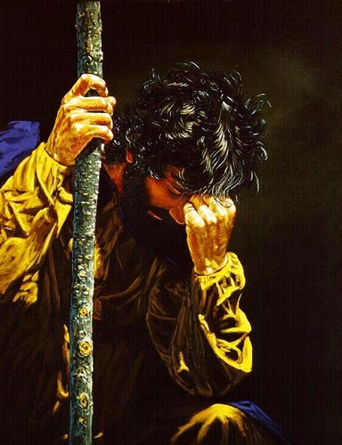
犹大
（犹大书11-12）
“他们有祸了! 因为走了该隐的道路,又为利往巴兰的错谬里直奔,并在可拉的背叛中灭亡了.这样的人在你们的爱席上与你们同吃的时候,正是礁石(注:或作 “玷污”)他们作牧人,只知喂养自己,无所惧怕;”
JUDE (v.11-12)
“Woe to them! They have taken the way of Cain; they have rushed for profit into Balaam’s error; they have been destroyed in Korah’s rebellion. These people are blemishes at your love feasts, eating with you without the slightest qualm—shepherds who feed only themselves,”

Slide 79
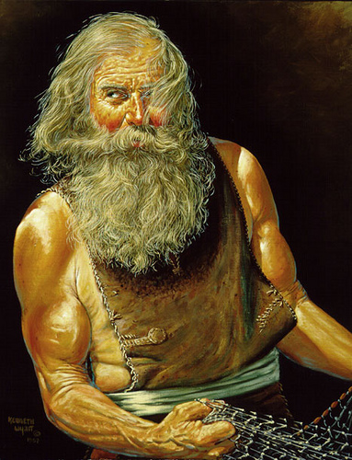
彼得
（徒2:36）
“故此,以色列全家当确实地知道,你们钉在十字架上的这位耶稣,神已经立他为主,为基督了.”
PETER (Acts 2:36)
“Therefore let all Israel be assured of this: God has made this Jesus, whom you crucified, BOTH LORD AND MESSIAH.”

Slide 80
彼得
（彼后1:3）
“神的神能已将一切关乎生命和虔敬的事赐给我们，皆因我们认识那用自己荣耀和美德召我们的主.”
PETER (2 Peter 1:3)
“His divine power has given us everything we need for a godly life through our knowledge of him who called us by his own glory and goodness”

Slide 81
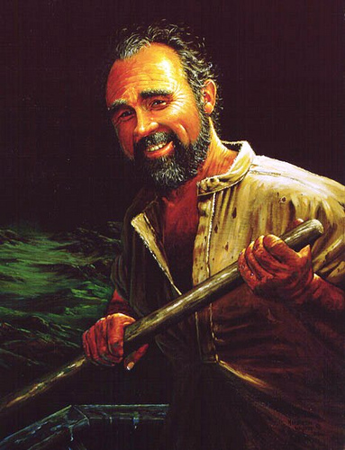
雅各
（2:17,20）
“这样,信心若没有行为就是死的….虚浮的人哪,你愿意知道没有行为的信心是死的吗?”
JAMES (2:17,20)
“In the same way, faith
by itself, if it is not accompanied by action, is dead…You foolish person, do you want evidence that faith without deeds is useless?”

Slide 82
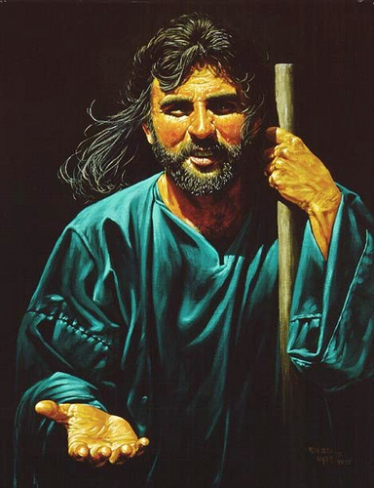
约翰
（约一1:6）
“我们若说是与神相交,却仍在黑暗里行,就是说谎话,不行真理了. ”
JOHN (1 JOHN 1:6)
“If we claim to have fellowship with him and yet walk in the darkness, we lie and do not live out the truth.”

Slide 83
约翰
（约一2:15）
“不要爱世界和世界上的事.人若爱世界,爱父的心就不在他里面了.”
JOHN (1 JOHN 2:15)
“Do not love the world or anything in the world. If anyone loves the world, love for the Father is not in them.”

Slide 84
约翰 (约一3:6-10 )
“凡住在他里面的,就不犯罪;凡犯罪的,是未曾看见他,也未曾认识他. 小子们哪,不要被人诱惑. 行义的才是义人,正如主是义的一样.犯罪的是属魔鬼,因为魔鬼从起初就犯罪。神的儿子显现出来,为要除灭魔鬼的作为. 凡从神生的,就不犯罪,因神的道存在他心里;他也不能犯罪,因为他是由神生的. 从此就显出谁是神的儿女,谁是魔鬼的儿女.凡不行义的就不属神，不爱弟兄的也是如此. ”
JOHN
(1 JOHN 3:6-10)
“No one who lives in
him keeps on sinning.
No one who continues
to sin has either seen him or known him. Dear children, do not let anyone lead you astray. The one who does what is right is righteous, just as he is righteous. The one who does what is sinful is of the devil, because the devil has been sinning from the beginning. The reason the Son of God appeared was to destroy the devil’s work. No one who is born of God will continue to sin, because God’s seed remains in them; they cannot go on sinning, because they have been born of God. This is how we know who the children of God are and who the children of the devil are: Anyone who does not do what is right is not God’s child, nor is anyone who does not love their brother and sister. “

Slide 85
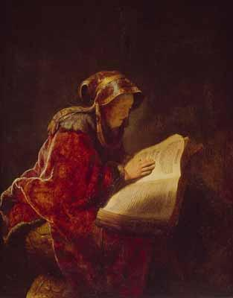
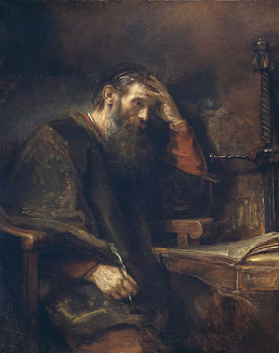
教会历史所传的福音
The Gospel According to Historic Christianity

Slide 86
有人试图将“主权救恩”描绘成新的教义.甚至有人将之定性为异端. 真实情况是教会历史上一直教导这个福音.“轻易恩典”的神学才是“另一个福音”呢.我们在早期教会的著作, 教父, 宗教改革家,各种信经,教义问答,清教徒们的具有重大历史意义著作里,以及学者们,诸如爱德华兹,司布真,慈运理,怀特菲尔德,马太·亨利,沃菲尔德,特里,品克,陶泽,艾恩赛德,瓦因等无数人的著作里可以看到。
Some try to portray ‘Lordship Salvation’ as a new doctrine. There are those who even call it a heresy. The truth is that it is the same Gospel taught throughout the history of the church. Easy Grace theology is ‘another gospel’. This is seen in the earliest known church writings, early church fathers, Reformers, and other Confessions, Catechisms, historic protestant writings of the Puritans, and scholars Edwards, Spurgeon, Zwingly, Whitefield, Matthew Henry, Warfield, Torrey, Pink, Tozer, Ironside, Vine and countless others.

Slide 87
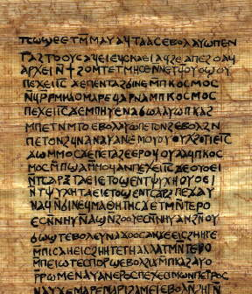
十二使徒遗训
(最早的教会文献之一)
“任何一个教导真理但却不能践行所教真理的先知都是假先知.”
THE DIDACHE
(One of the earliest
church documents)
“Every prophet who teaches the truth but fails to practice what he preaches is a false prophet”

Slide 88
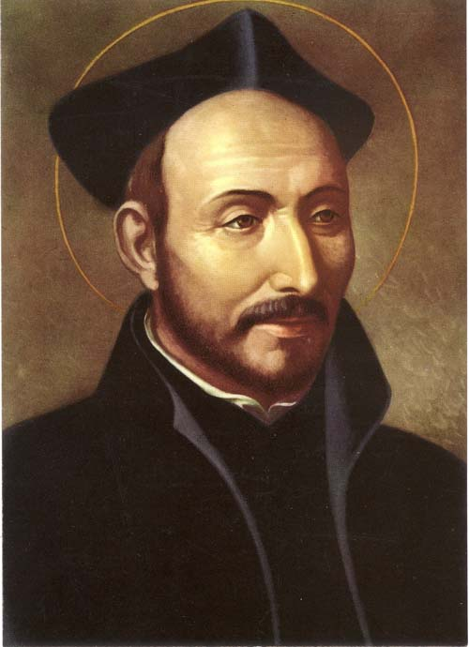
伊格那修
(二世纪安提阿主教)
“重要的不是短暂的认信行为而是坚持不懈地以信心为动机. ”
IGNATIUS
(Bishop of Antioch
2nd cent.)
“What matters is not a momentary act of professing but being persistently motivated by faith.”

Slide 89
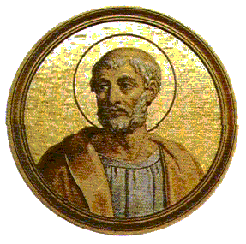
克莱门特
(公元100年)
“让我们不光称他为主,因 为这救不了我们…既这样,弟兄们,让我们透过行为承认他…这个世界和将要来的世界(天堂)是两个仇敌.这个世界意味着奸淫,腐败,贪婪和欺骗，另一个则全然没有这些.我们不能与两者都为友. 要得到其一,必放弃另一个.”
Clement (A.D. 100)
“Let us not merely call Him Lord, for that will not save us….Thus brothers, let us acknowledge Him by our actions…This world and the world to come are two enemies. This one means adultery, corruption, avarice, and deceit, while the other gives them up. We cannot, then, be friends with both. To get the one, we must give up the other up.”

Slide 90
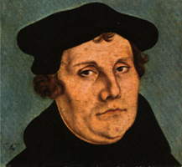
马丁路德
(公元412年)
“我们教导对基督的信心时,也教导了善行. 因为你们是凭信心持有基督,在基督里你们称义.从今开始努力行善,爱神爱人,呼唤神,向祂感恩，赞美祂,向祂认罪…这些实在是从信心里流淌出来的善行.”
Martin Luther (A.D. 412)
“When we have taught faith in Christ, we have also taught good works. Because you have laid hold on Christ by faith, through whom you are made righteous, begin now to do good works. Love God, and your neighbor, call upon God, give thanks to Him, praise Him, confess to Him. ..These are good works indeed which flow out of this faith.”

Slide 91
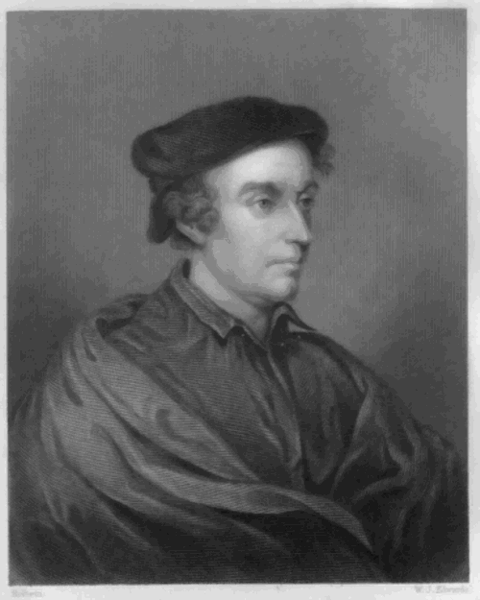
菲利普· 梅来克森
（路德的伙伴和改革战友）
“一个人没有归信是很明显的.他们的心继续犯罪,与良心作对.他们没有渴望和接受对罪饶恕的真信心.圣灵不会居住在对神毫无畏惧,持续违抗蔑视神的人的心里.”
PHILIP MELANCHTHON
(Luther’s companion
and fellow Reformer)
“It must be obvious that if conversion to God does not happen, and the heart continues to sin against conscience, that there is no true faith that desires and receives forgiveness of sins. The Holy Spirit is not in a heart in which there is no fear of God, but instead a continuing defiance.”

Slide 92

比利时信条
（公元1561年）
“我们相信此真信心既由听神的话以及圣灵的工作而来,就重生我们,使我们成为新人,使我们过一种新的生活，释放我们脱离一切罪的捆绑.”
BELGIC CONFESSION
(A.D. 1561)
“We believe that this true faith, being wrought in man by the hearing of the Word of God and the operation of the Holy Ghost, doth regenerate and make him a new man, causing him to live a new life, and freeing him from the bondage of sin.””

Slide 93

海德堡要理问答
(公元1563年)
“那么是否这(因信称义)的教义让人变得草率和不敬吗?...不!那些靠信心被根植在基督里的人不结出感恩的果子是不可能的.”
HEIDELBERG CATECHISM
(A.D. 1563)
“But does this doctrine (justification by faith)
make men careless and profane?...No! For it is impossible that those who are implanted into Christ by true faith, should not bring forth fruits of thankfulness”

Slide 94
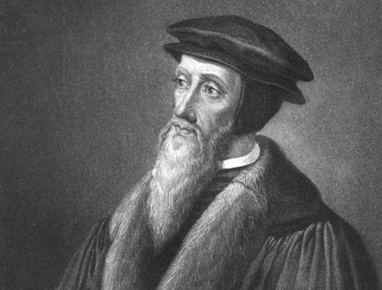
约翰加尔文
“我们不敢设想一个没有善行的信心,或者没有善行的称义…你要在基督里称义吗?你必须先拥有基督. 但是你若不参与他的成圣,你就不能拥有他,因为基督是不能切分的…”
JOHN CALVIN
“We dream NOT of a faith which is devoid of good works ,nor of a justification which can exist without them…Would ye then obtain justification in Christ? You must previously possess Christ. But you cannot possess Him without being made a partaker of His sanctification; for Christ cannot be divided…”

Slide 95

以下人也教导了同样的信息
所有的宗教改革家
威斯敏斯特信仰告白
清教徒
马太亨利
乔治·怀特菲尔德
约拿单·爱德华兹
查尔斯·司布真
B. B 沃菲尔德
R.A. 特里
A.W 陶泽
H. A. 品克
J.I. 巴刻
R.C 司布尔
约翰·派博
麦约翰
艾约翰
ASLO TAUGHT BY
ALL REFORMERS
WESTMINSTER CONFESSION OF FAITH
the PURITANS
MATTHEW HENRY
GEORGE WHITFIELD
JONATHON EDWARDS
CHARLES SPURGEON
B.B. WARFIELD
R.A. TORREY
A.W. TOZER
H.A. IRONSIDE
A.W. PINK
J.I. PACKER
R.C. SPROUL
JOHN PIPER
JOHN MACARTHUR
JOHNNIE ACHORD
And YOU?
你呢？

Slide 96


常见问题
Common Questions

Slide 97
常见问题
我们如何领人归主并给他们立刻的确信？
How can we lead people to Christ and offer them immediate assurance?
Common Questions

Slide 98
常见问题
你不能!
这是圣灵的工作,不是你的!
You can’t. That’s the job of the Holy Spirit, Not You!
林后13:5: “你们总要自己省察有信心没有,也要自己试验.岂不知,你们若不是可弃绝的,就有耶稣基督在你们心里吗?”
2 Cor. 13:5 “Examine yourselves as to whether you are in the faith. Test yourselves. Do you not know yourselves, that Jesus Christ is in you?; unless indeed you are disqualified.”
Common Questions

Slide 99
常见问题
如何知道某人的罪是暂时的还是他们根本未得救？
How do I know if someone’s sin is temporary or if they are unsaved?
Common Questions

Slide 100
常见问题
判断你自己,而不是判断他人。
Judge yourself, not others.
心里沉重忧伤还是找各种借口？
Is the heart troubled or does it make excuses?
罗7:告诉我们保罗希望停止犯罪
Rom. 7: Paul’s desire to stop sinning
Common Questions

Slide 101
常见问题
如果我在罪中挣扎,应怀疑自己得救吗？
Should I doubt my salvation if I struggle with sin in my life?
Common Questions

Slide 102
常见问题
如果你在挣扎,这是好迹象。
If you are struggling, that Is a good sign
我们通常会挣扎直到松手让圣灵掌控。
We usually struggle until we release control to the Holy Spirit
Common Questions

Slide 103
常见问题
如何区分倒退的基督徒和非基督徒?
How can I tell a backslidden Christian from a non-Christian?
Common Questions

Slide 104
常见问题
这不是你的工作. That’s not your job
倒退的基督徒没有出现在圣经里。
Backslidden Christian is NOT in the Bible;
约一3章谈到了那些
持续活在罪里的人.
1 John 3 addresses those who LIVE IN CONTINUAL SIN
Common Questions

Slide 105
常见问题
有没有所谓的属肉体的基督徒？
Is there such thing as a carnal Christian?
Common Questions

Slide 106
常见问题
林前3:3: “你们仍是属肉体的,因为在你们中间有嫉妒,纷争,这岂不是属乎肉体,照著世人的样子行吗？”
1 Cor. 3:3 “For ye are yet carnal: for whereas there is among you envying, and strife, and divisions, are ye not carnal, and walk as men?”
将经文放在上下文里去理解！
LEAVE THE VERSE IN CONTEXT!
Common Questions

Slide 107
常见问题
弟兄们,我从前对你们说话,不能把你们当作属灵的,只得把你们当作属肉体,在基督里为婴孩的.我是用奶喂你们,没有用饭喂你们. 那时你们不能吃,就是如今还是不能.你们仍是属肉体的,因为在你们中间有嫉妒,纷争,这岂不是属乎肉体,照著世人的样子行吗？有说:“我是属保罗的.”有说:“我是属亚波罗的.”这岂不是你们和世人一样吗？
^{(V.1-4)} And I, brethren, could not speak unto you as unto spiritual, but as unto carnal, even as unto babes in Christ. ²I have fed you with milk, and not with meat: for hither to ye were not able to bear it, neither yet now are ye able. ³For ye are yet carnal: for whereas there is among you envying, and strife, and divisions, are ye not carnal, and walk as men? ⁴For while one saith, I am of Paul; and another, I am of Apollos; are ye not carnal?”
Common Questions

Slide 108
常见问题
这是些正在成长的基督…成长很慢;
而不是活在邪恶之中。(属灵婴孩)
These are Christians who are growing…but too slow; NOT living evil lives. (Babes)
保罗一直在灵里喂养他们 (我喂养了你们)。
Paul has been feeding them spiritually (I have fed you)
他们被称为 “属肉体的”,因为他们根据自己与属灵领袖的关系来划分,导致纷争(我属保罗,我属阿波罗, 等).
They are called “carnal” because they are dividing and causing strife over their desire
to be associated with godly people (I am of Paul, I am of Apollos, etc)
他们还是彼此相交的 (你们中间)。
They are still in fellowship (among you)
Common Questions

Slide 109
常见问题
难道我们不可以避免这种争议,保持教会的合一吗？
Shouldn’t we avoid this controversy in order to keep unity in the church?
Common Questions

Slide 110
保罗会如何回答这个问题？
HOW WOULD PAUL ANSWER THAT QUESTION?
加1:8-10 “但无论是我们,是天上来的使者,
若传福音给你们,与我们所传给你们的不同,他就应当被咒诅.我们已经说了,现在又说:
若有人传福音给你们,与你们所领受的不同,他就应当被咒诅!我现在是要得人的心呢?
还是要得神的心呢?我岂是讨人的喜欢吗?
若仍旧讨人的喜欢,我就不是基督的仆人了.”
GAL. 1:8-10 “But even if we or an angel from heaven should preach a gospel other than the one we preached to you, let them be under God’s curse! As we have already said, so now I say again: If anybody is preaching to you a gospel other than what you accepted, let them be under God’s curse! Am I now trying to win the approval of human beings, or of God? Or am I trying to please people? If I were still trying to please people, I would not be a servant of Christ. “

Slide 111
常见问题
那我是基督徒吗?
SO AM I A CHRISTIAN?
只有你自己可以回答这个问题。
ONLY YOU CAN ANSWER THAT QUESTION
Common Questions

Slide 112
常见问题
相信: BELIEVE
认罪: CONFESS
悔改: REPENT
接受: RECEIVE
Common Questions

