Slide 1
Raising
Successful Children

Slide 2
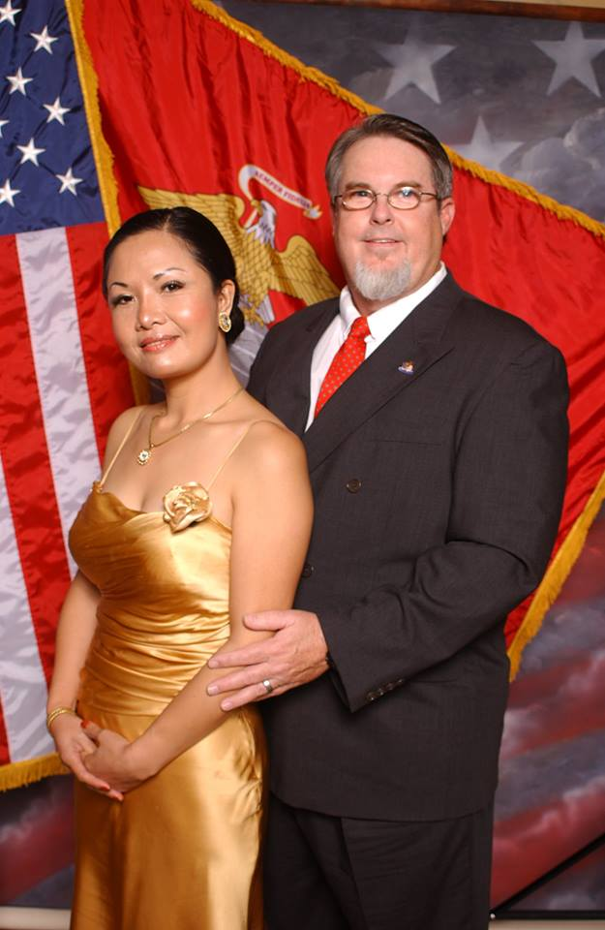
养育成功的孩子
Raising Successful Children
Dr. Jay BarLeon
& Suran
（介巴梁&苏然）

Slide 3

请将所有手机关静音!
PLEASE TURN ALL CELL PHONES OFF!

Slide 4


介绍
INTRODUCTION

Slide 5


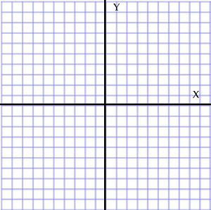


一个全新的世界 A WHOLE NEW WORLD
温暖型象限/控制型象限 THE WARMTH / CONTROL QUADRANT
30 分钟茶歇 (3:30-4:00) 30 Minute Break (3:30-4:00)
成功育儿的劝告 TIPS FOR SUCCESSFUL PARENTING

Slide 6
选择一个讨论伙伴
CHOOSE A DISCUSSION PARTNER

Slide 7

1) 一个全新的世界
1) A WHOLE NEW WORLD

Slide 8

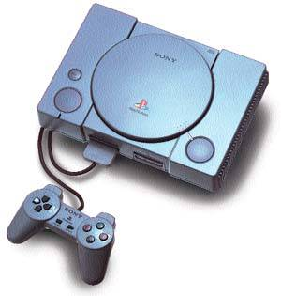
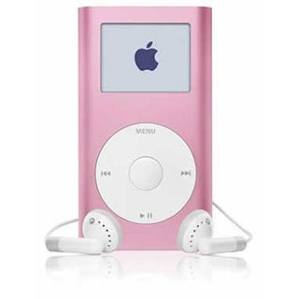
新科技带来更多优势
时也导致新的压力
TECHNOLOGY WILL ALLOW NEW ADVANTAGES AND CAUSE NEW PRESSURES

Slide 9


他们有哪些优势和压力是我们那时没有的？
What advantages and pressures will they have that we didn’t?

Slide 10

更多试探:
MORE TEMPTATION.

Slide 11

今日的儿童和少年遇到更多什么诱惑？
What temptations are now more available to kids and teens?

Slide 12
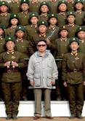
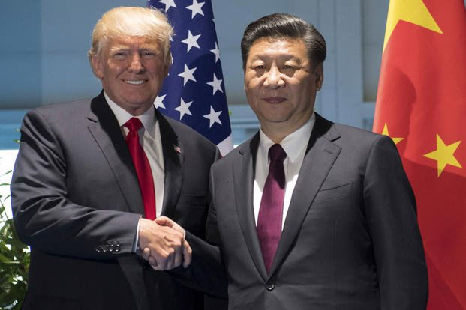

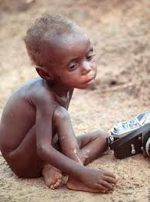
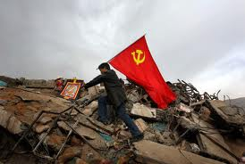

更容易留意到世界大事
MORE AWARENESS OF WORLD EVENTS

Slide 13

这会如何影响到我们的孩子？
What affect might this have on our kids?

Slide 14

一个前所未有的新的
虚拟世界存在着
A NEW VIRTUAL WORLD EXISTS THAT NEVER HAS BEFORE

Slide 15

这个世界会如何影响我们的孩子和社会？
  How does this world affect our kids and society?

Slide 16

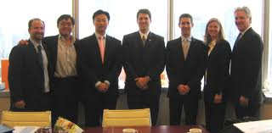
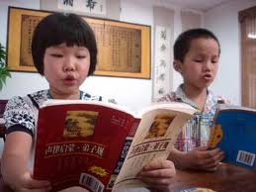
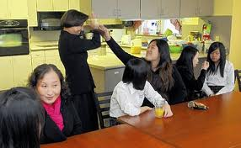
有更多教育和商业个人机会
MORE PRIVATE OPPORTUNITIES FOR SCHOOL & BUSINESS

Slide 17

这会如何影响我们的孩子和家庭？
How does this one affect kids and families?

Slide 18
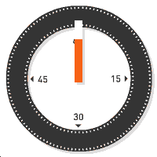

Everyone close your eyes – take a deep breath – relax – 60 seconds

Slide 19

2) 温暖型/控制型象限
2) THE WARMTH / CONTROL QUADRANT

Slide 20




光有规则没有关系导致叛逆
Rules without relationship lead to rebellion

Slide 21
温暖型象限/控制型象限
温暖= 父母有能力在口头上和身体上
以合宜的方式向孩子示范爱和情感。 WARMTH = the parent’s ability to demonstrate love and affection to their child(ren) in both verbally and physically appropriate ways.
控制=父母有能力为孩子建立和保持
合宜的界限和规矩。
  CONTROL = the parent’s ability to establish and maintain proper boundaries and rules for the child(ren).
THE WARMTH / CONTROL QUADRANT

Slide 22

受尊敬型父母
健康的孩子
Respected Parent
Healthy Child
高
high
严格型父母
破碎的孩子
Strict Parent
Broken Child
控制 (control)
温暖 (warmth)
温暖 (warmth)
高
high
低
low
控制 (control)
纵容型父母
悖逆的孩子
Permissive Parent Rebellious Child
忽略型父母
冷漠的孩子
Uninvolved Parent
Indifferent Child
低 low

Slide 23

30 分钟休息
30 MINUTE BREAK

Slide 24

育儿
建议
PARENTING TIPS

Slide 25


没有完美的孩子
THERE ARE NO PERFECT CHILDREN

Slide 26

没有完美的父母
THERE ARE NO PERFECT PARENTS

Slide 27
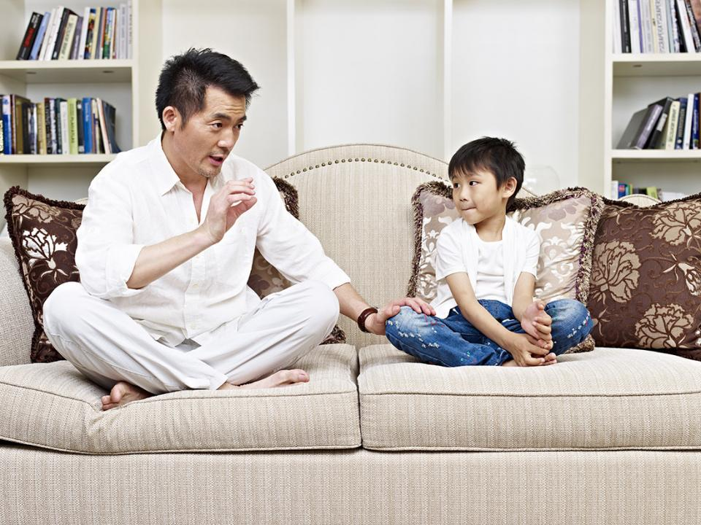
不要争吵…而是讨论
DO NOT ARGUE…DISCUSS

Slide 28

你最经常为什么跟你的孩子争执？
WHAT DO YOU ARGUE MOST ABOUT WITH YOUR CHILDREN?

Slide 29

为做对的事多鼓励他们
Encourage them for the good things they do

Slide 30

你可以从哪些方面鼓励你的孩子？
What are some ways you can encourage your children?

Slide 31


抛弃“不要说话”的规则 Get rid of the ‘no talking’ rule

Slide 32
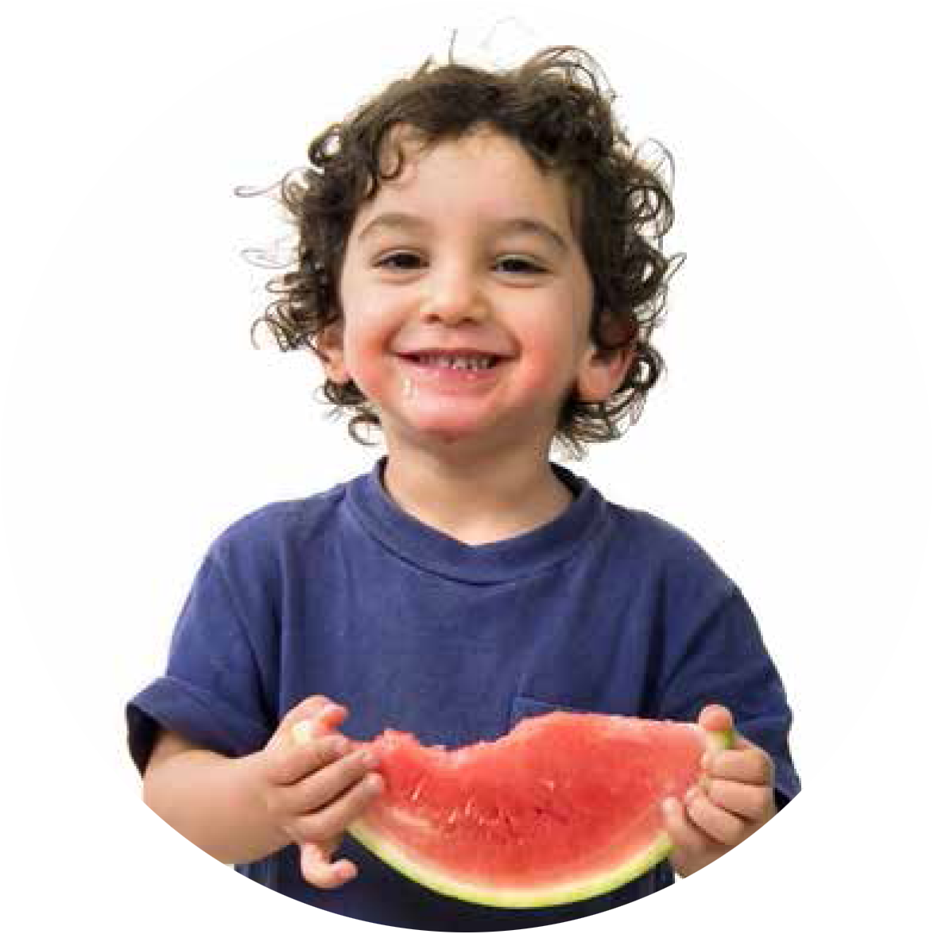
饭桌上你们一家通常谈论什么？
What does your family usually talk about at dinner?

Slide 33

交谈要求你聆听，
而非光是你在说
CONVERSATIONS REQUIRE YOU TO LISTEN, NOT JUST TALK

Slide 34

让生活太容易会伤害孩子
Don’t hurt them by making life too easy

Slide 35
孩子多大时我们可教他们做下面这些事
自己吃饭
  Feed themselves
睡自己的房间
  Sleep in their own room
自己系鞋带
  Tie their own shoes
自己穿衣服
  Dress themselves
自己上厕所
  Use the bathroom alone
自己刷牙
  Brush their teeth
At what age can we teach our children to…

Slide 36


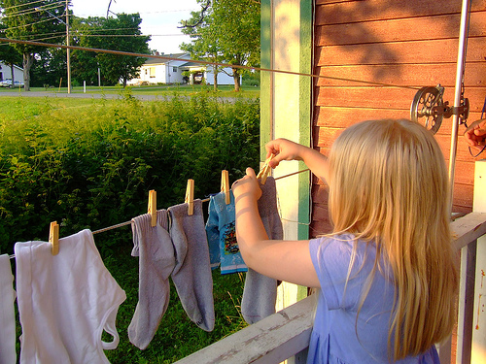
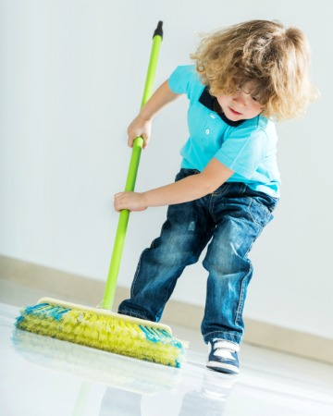

家务是训练的重要部分
CHORES ARE AN IMPORTANT PART OF TRAINING

Slide 37

为什么训练孩子做家务如此重要？
Why is it so important to teach kids to do chores?

Slide 38
2018年哈佛大学的研究认为从小做家务的孩子，成年后更容易成功和快乐。
  2018 Study from Harvard University says that children who grow up doing chores around the house are more likely to be successful and happy as adults.
  “热爱和工作伦理是成功的两个最重要因素.”
    “Love and work ethic are the 2 most important ingredients for success”
  斯坦福大学的研究也同意这个观点。
    Stanford University Researchers agree with this study
  越年幼开始，越好。
    The sooner you start, the better.

Slide 39


“她的家务我全包了,
因为她没时间.”
“I do all of the work for her because she doesn’t have any time”

Slide 40

通过做家务孩子能学会什么功课？
What lessons do kids learn by doing chores?

Slide 41
在他们离家之前你
希望他们学会什么？
WHAT DO YOU WANT THEM TO KNOW BY THE TIME THEY LEAVE HOME?
不要同时教他们每一项家务
DON’T TEACH THEM EVERY CHORE AT THE SAME TIME
你做- 他们看
YOU DO -
THEY WATCH
你们一起做
YOU DO
TOGETHER
他们做-你看
THEY DO -
YOU WATCH
他们做
THEY DO

Slide 42
孩子多大我们该教他们做这些事：
清洁房间
  Clean their own room
洗碗
  Help with the dishes
洗衣服
  Do laundry when needed
做家务
  Do housework
做饭
  Cook a meal
其它？
  Any other?
At what age should we teach our kids to…

Slide 43
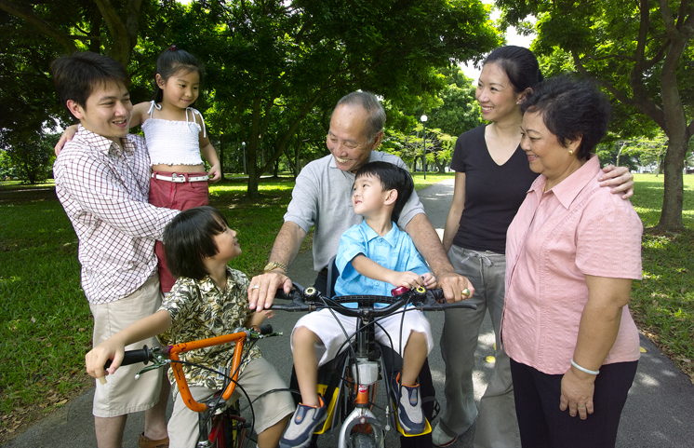
足够的优质时间双方都需要
Quantity time and quality time are both needed .

Slide 44




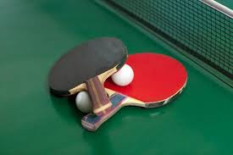


一起玩
PLAY TOGETHER

Slide 45

你跟一个3岁孩子能玩什么?
10？13？17呢？
What can you play with a 3 year old? 10? 13? 17?

Slide 46


请谨记:他们生而独特,并非小型的你
Remember they are UNIQUE; not a miniature YOU

Slide 47

管教和惩罚之间有什么区别？
What is the difference between discipline and punishment?

Slide 48

管教而不是惩罚
Discipline instead of punish

Slide 49
管教和惩罚的不同
“惩罚”
“PUNISH”
报复某人做了
某事.
to get back at someone for something they have done.
“管教”
“DISCIPLINE”
与 “门徒”这个词是同一个词根。意思是教导和训练那些知道自己做错了并愿意改正以避免重蹈覆辙的人,让他们更规律地遵守。
comes from the same root word as ‘disciple.’
It means to teach or train someone in such a way that they are aware of their wrong-doing and desire to correct it in order to avoid the same results in the future and obey more regularly.
The Difference between PUNISH and DISCIPLINE

Slide 50

不要虚张声势。
DO NOT BLUFF

Slide 51

如果你错了请求原谅—
树立谦卑的榜样
ASK FORGIVENESS WHEN YOU ARE WRONG…Model Humility

Slide 52

不要替他们做家庭作业而是帮助他们
DON’T DO THEIR HOMEWORK FOR THEM…HELP THEM WITH IT

Slide 53

不要鼓励易上瘾的行为
DON’T ENCOURAGE ADDICTIVE BEHAVIORS

Slide 54

在哪些领域容易给孩子造成上瘾？
In what areas is it easy to create addicts of our children?

Slide 55

清晰沟通
COMMUNICATE CLEARLY
确保他们明白你说的话
Make sure they understand what you say
若他们从未告知过，不要假设他们明白某事是错的。
Don’t assume they know something is wrong if they have never been told
不要因他们不知道是错的事而管教他们。
Don’t discipline for actions they didn’t know were wrong

Slide 56

不要让他们难堪
DON’T EMBARRASS THEM

Slide 57

在哪些方面我容易让孩子感到难堪？
What are some ways we embarrass our kids and teens?

Slide 58
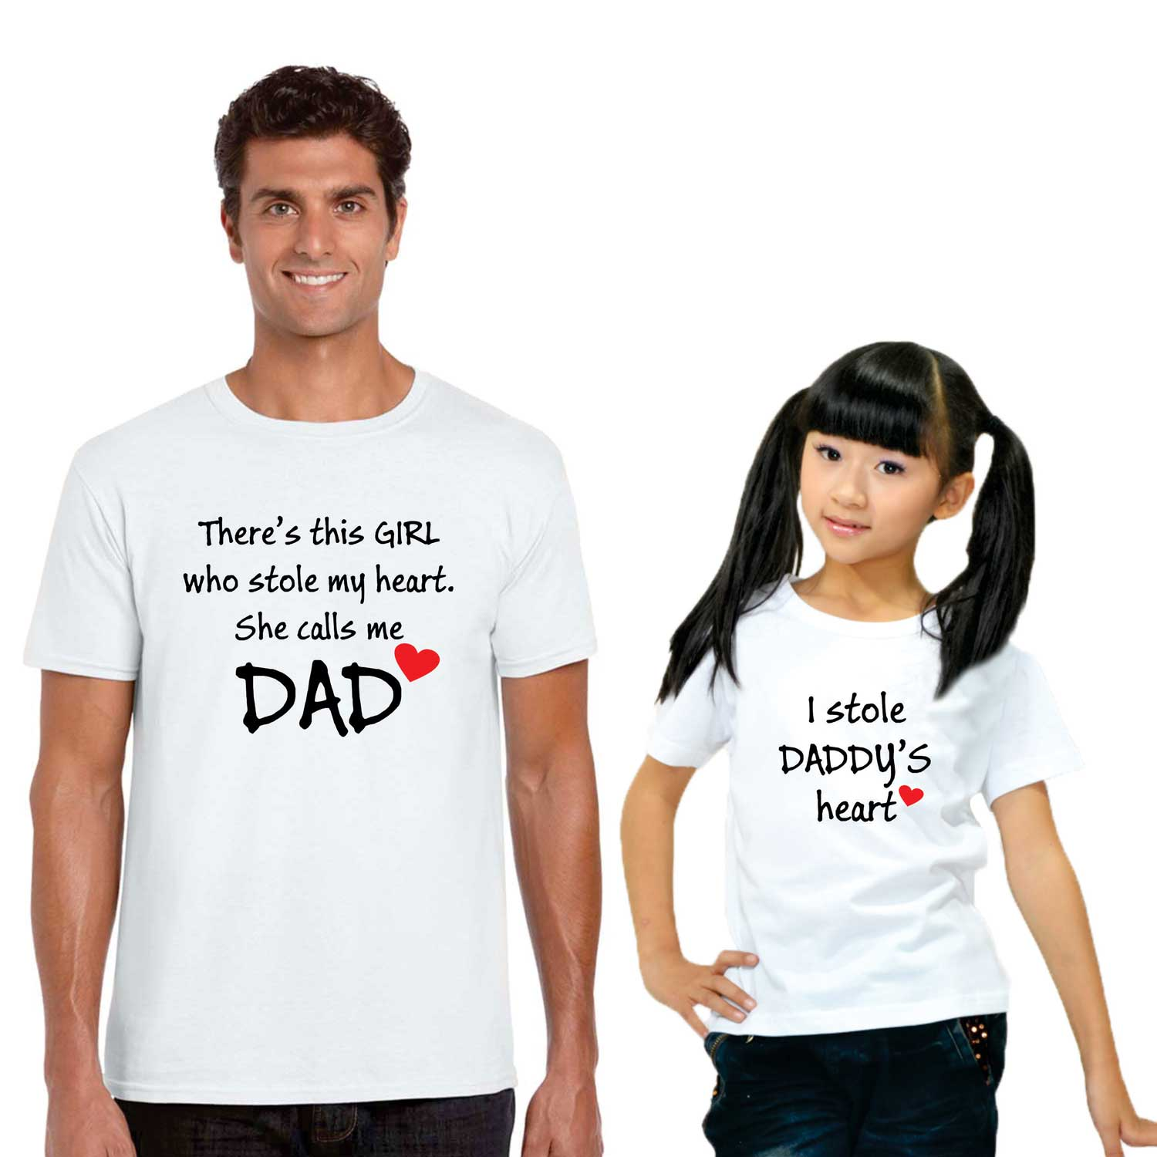
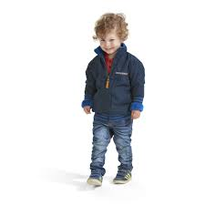

你若有不止一个孩子,
不要偏爱某一个
IF YOU HAVE MORE THAN ONE CHILD, DON’T SHOW PREFERENTIAL TREATMENT

Slide 59
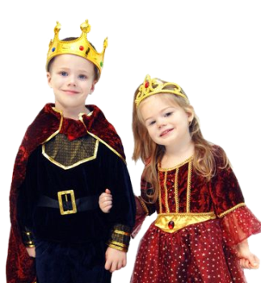
谁最容易引起父母的关注？
Who usually gets the most attention from parents?

Slide 60

如果你只有一个孩子，不要让他们以为自己是宇宙的中心
IF YOU HAVE ONLY ONE CHILD,
DON’T MAKE THEM THINK THEY ARE THE CENTER OF THE UNIVERSE

Slide 61

尽量减少家里的压力
REDUCE THE AMOUNT OF STRESS AT HOME

Slide 62

我们常做哪些事让孩子感到压力重重？
What are some things we do that stress our children?

Slide 63

公开表达你对配偶的爱和情感
OPENLY SHOW LOVE AND AFFECTION TO YOUR SPOUSE

Slide 64

若能,常去旅行…并让旅行有趣
TRAVEL IF YOU CAN…KEEP IT FUN

Slide 65

你希望带孩子去哪里旅行？
Where would you like to take your children someday?

Slide 66
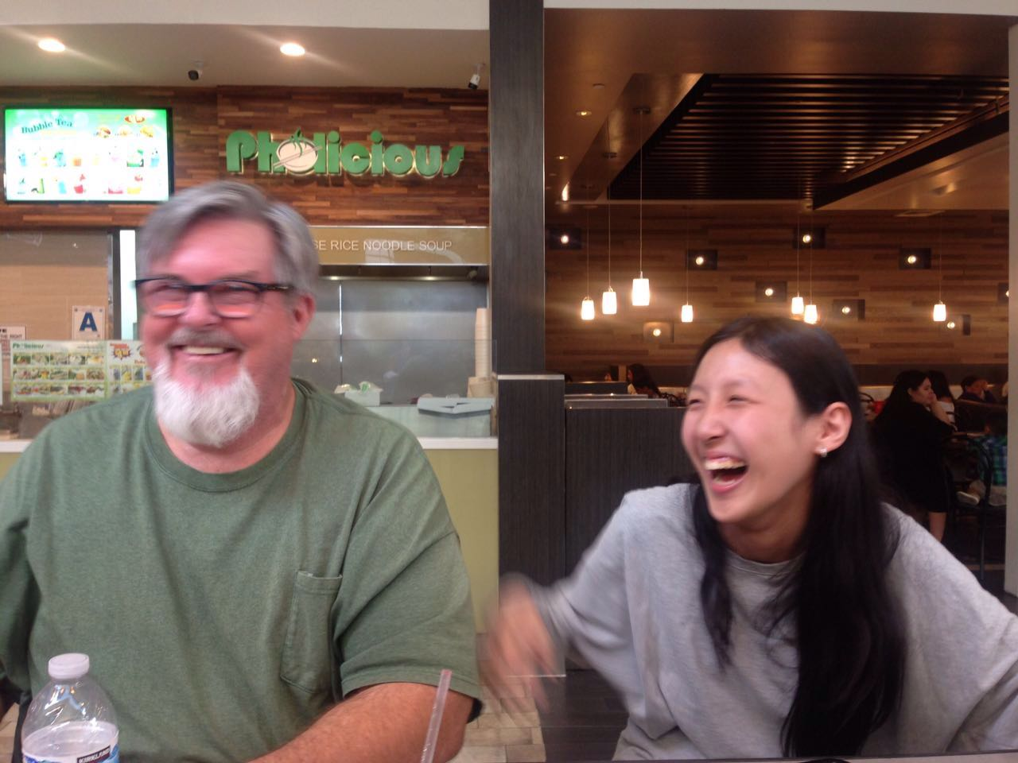
笑
LAUGH

Slide 67
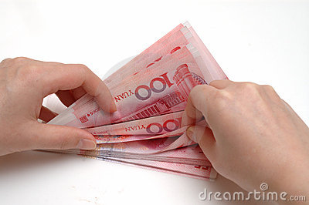
不要关注家庭拥有之物
DONT FOCUS ON WHAT YOUR FAMILY OWNS
珍视爱,时间和信仰
Put value on love, time and faith
生活中最重要的东西依然是免费的
The best things in life are still free

Slide 68
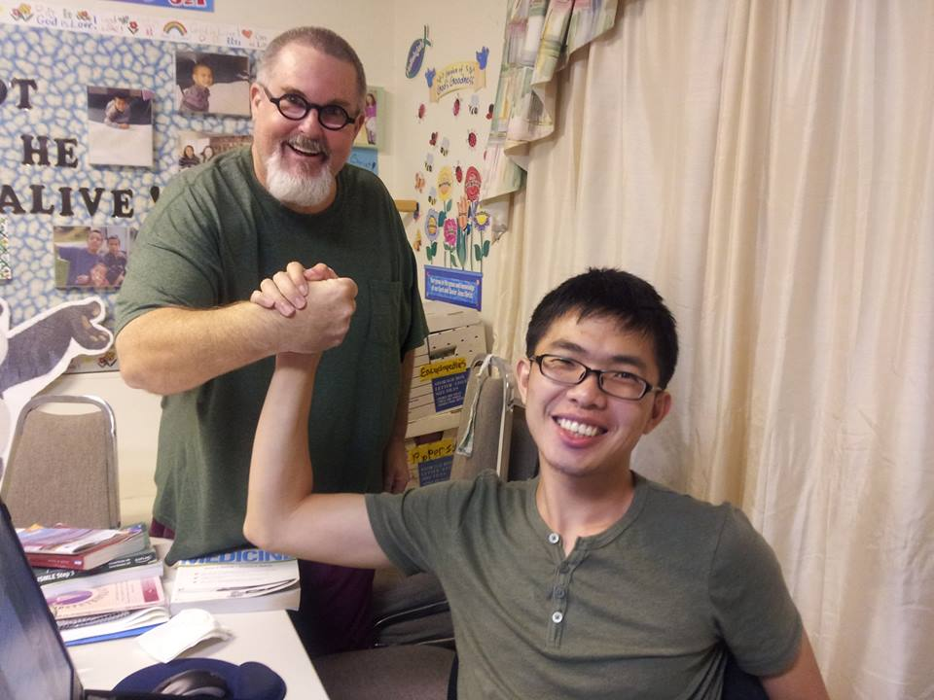
审查你的动机
EXAMINE YOUR MOTIVES
孩子不是：
  CHILDREN ARE NOT…
不只是传宗接代. Just to carry on the family name 你的个人财产或仆人 Your possession or servant
需要完工的项目. A project to complete
小型的你. Mini-YOUs
地位符号或战利品. Status Symbols or Trophies

Slide 69
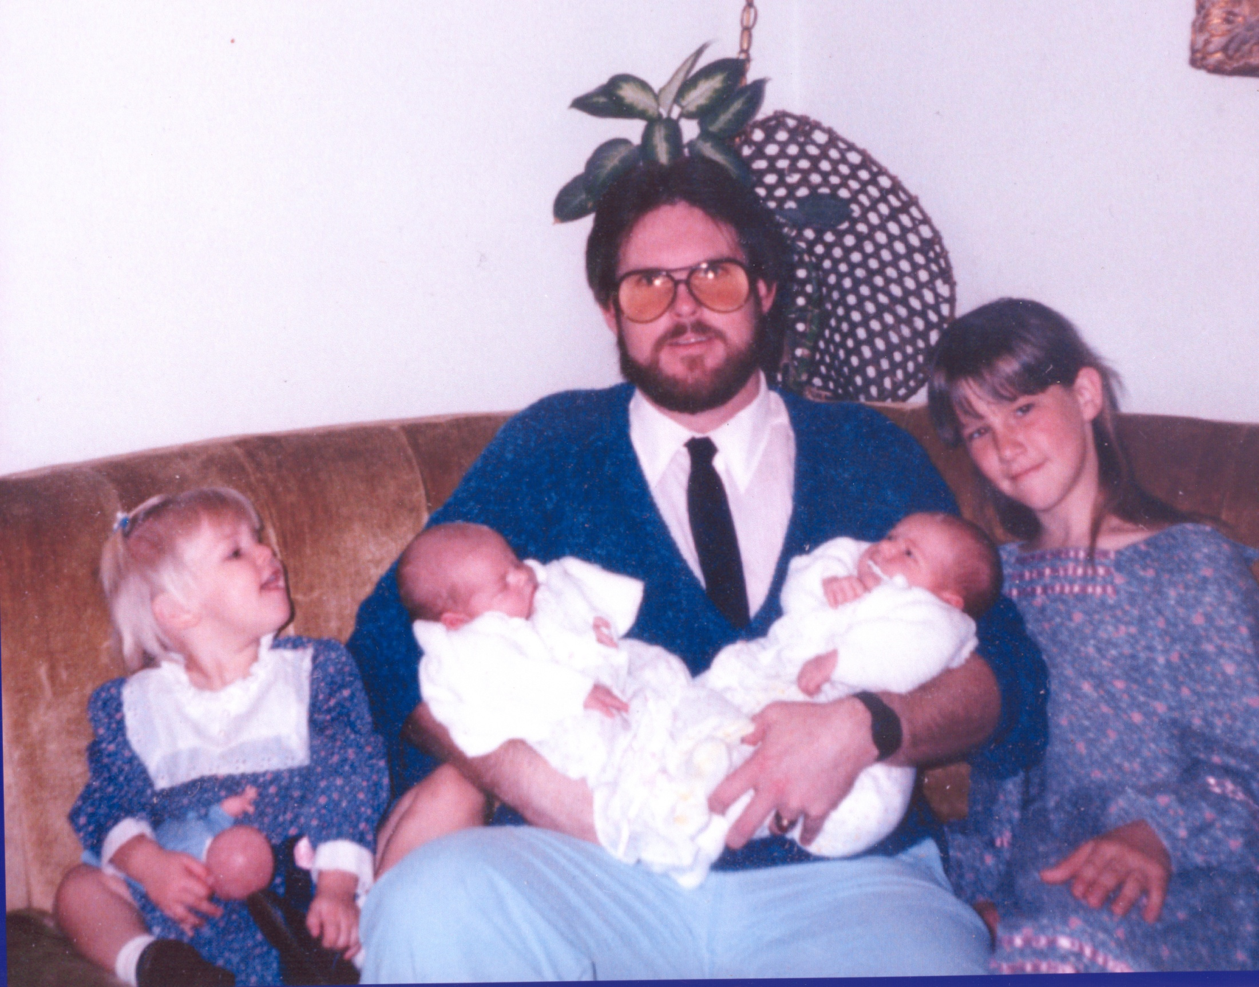
CONCLUSION: LOVE YOUR FAMILY UNCONDITIONALLY
结论:无条件地爱你的家人

Slide 70

WORK AS A TEAM WITH YOUR SPOUCE
与你的配偶密切合作

Slide 71
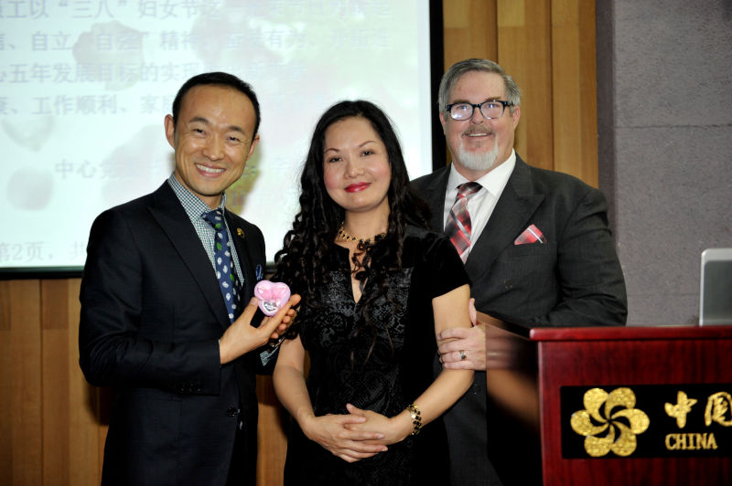

Slide 75

受尊敬型父母
健康的孩子
Respected Parent
Healthy Child
高
high
严格型父母
破碎的孩子
Strict Parent
Broken Child
控制 (control)
温暖
(warmth)
温暖
(warmth)
高
high
低
low
控制 (control)
纵容型父母
悖逆的孩子
Permissive Parent Rebellious Child
忽略型父母
冷漠的孩子
Uninvolved Parent
Indifferent Child
低 low

