Slide 1
EVANGELISM
For INTROVERTS

Slide 2
introduction
What comes to mind when you hear the word “evangelism”?

Slide 3
where do i begin?
LOVE GOD & LOVE OTHERS
KNOW THE GOSPEL WELL
KNOW YOUR OWN STRENGTHS

Slide 4
7
about evangelism

Slide 5
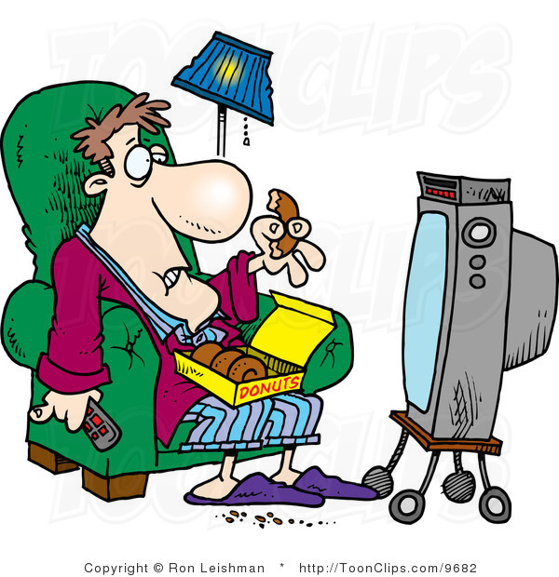
1. “I don’t have that gift or calling”

Slide 6
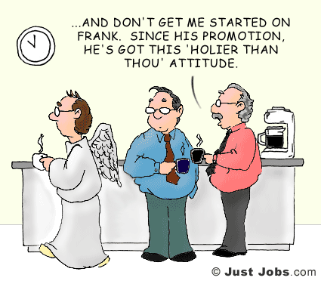
2. “I evangelize through actions, not words”

Slide 7
3. “Evangelism is for extroverts”
Signature: _______________________

Slide 8
4. “Evangelism is the church’s job!”

Slide 9
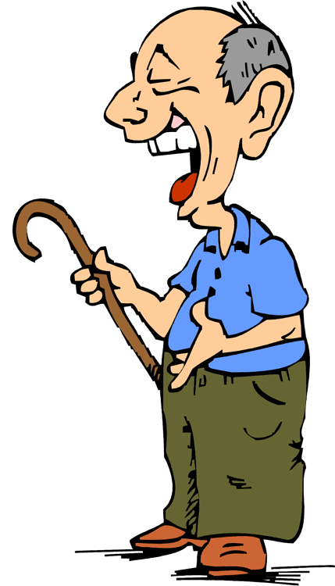
5. “If they don’t accept Jesus, I’ve failed”
GOSPEL TRAC

Slide 10
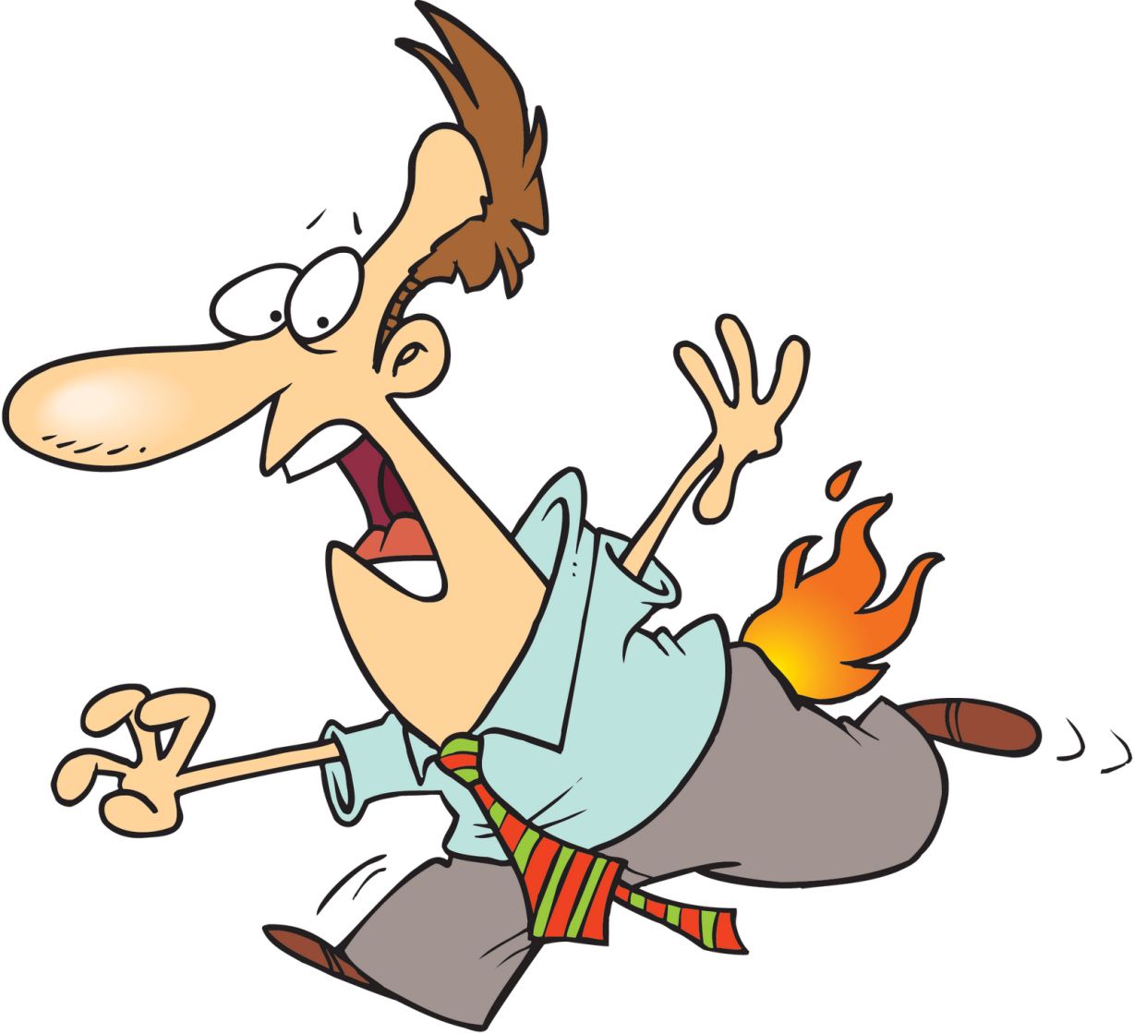
6. “Everyone will reject my message.”

Slide 11
7. “They are already a good person”

Slide 12
10 practical evangelism openers

Slide 13
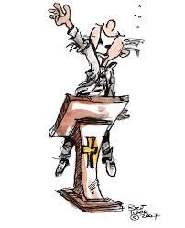
10 PRACTICAL EVANGELISM OPENERS

Slide 14
10 PRACTICAL EVANGELISM OPENERS
EMPATHY

Slide 15
10 PRACTICAL EVANGELISM OPENERS
EMPATHY
VIRAL MEDIA

Slide 16
10 PRACTICAL EVANGELISM OPENERS
EMPATHY
VIRAL MEDIA
ANSWERS

Slide 17
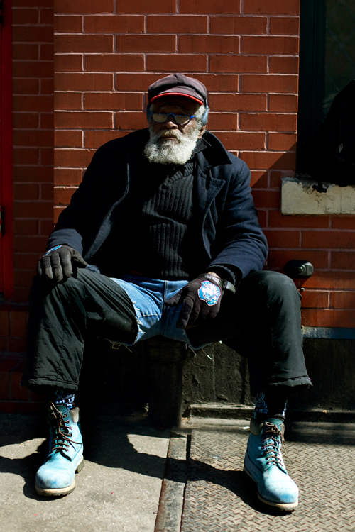
10 PRACTICAL EVANGELISM OPENERS
EMPATHY
VIRAL MEDIA
ANSWERS
NEEDS

Slide 18
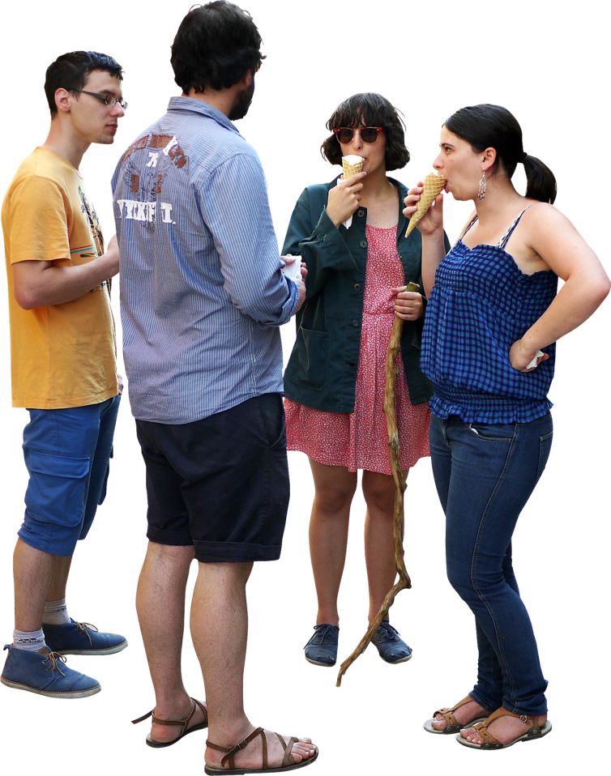
10 PRACTICAL EVANGELISM OPENERS
EMPATHY
VIRAL MEDIA
ANSWERS
NEEDS
GROUPS

Slide 19
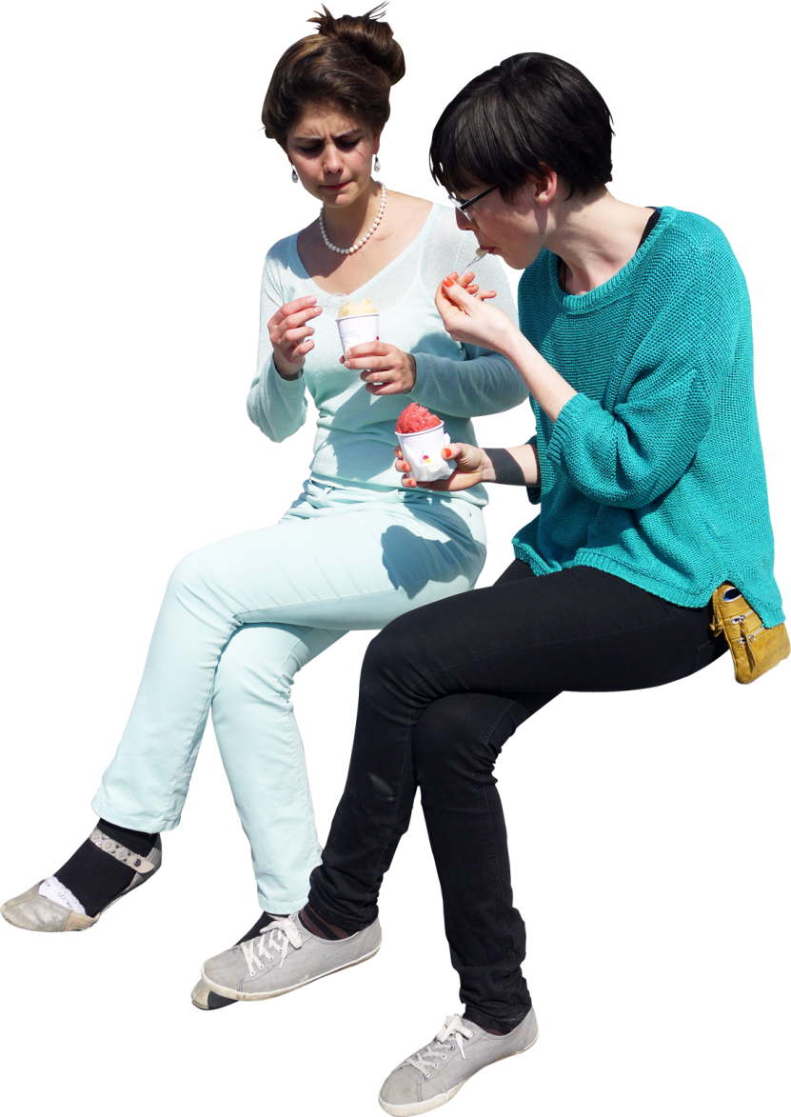
10 PRACTICAL EVANGELISM OPENERS
EMPATHY
VIRAL MEDIA
ANSWERS
NEEDS
GROUPS
EATING

Slide 20
10 PRACTICAL EVANGELISM OPENERS
EMPATHY
VIRAL MEDIA
ANSWERS
NEEDS
GROUPS
EATING
LAUGHTER

Slide 21
10 PRACTICAL EVANGELISM OPENERS
EMPATHY
VIRAL MEDIA
ANSWERS
NEEDS
GROUPS
EATING
LAUGHTER
INVITE

Slide 22
10 PRACTICAL EVANGELISM OPENERS
EMPATHY
VIRAL MEDIA
ANSWERS
NEEDS
GROUPS
EATING
LAUGHTER
INVITE
SUPLICATION

Slide 23
10 PRACTICAL EVANGELISM OPENERS
EMPATHY
VIRAL MEDIA
ANSWERS
NEEDS
GROUPS
EATING
LAUGHTER
INVITE
SUPLICATION
MUSIC

Slide 24
conclusion
Being an introvert is not a sin. It is God’s design on your life.
Do not try to turn an introvert into an extrovert.
Introverts are not immature believers or wolves in sheep’s clothing.
Being an introvert does not exclude you from the mission.
God stretches ALL of us a bit outside our comfort zone in order to grow.
An evangelist isn’t a personality type or a personality disorder,
An evangelist is one who brings GOOD NEWS

