Slide 1



2019 CHURCH LEADERSHIP TRAINING
STORY TELLING
Dr. Jay BarLeon
Shifus International

Slide 2
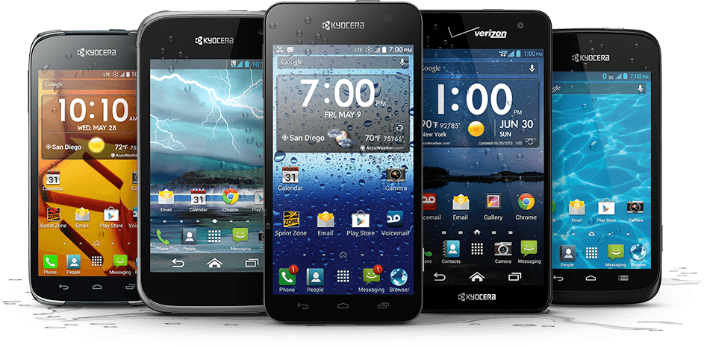
PLEASE TURN ALL CELL PHONES OFF!

Slide 3
STORY TELLING

Slide 4
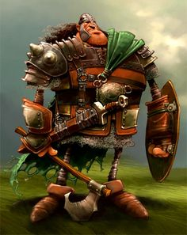
  The Importance of Storytelling
  Stories are BIBLICAL
      2. Stories are TIME TESTED
      3. Stories are THERAPEUTIC
        4. Stories are MEMORABLE
          5. Stories are EDUCATIONAL
            6. Stories are MOTIVATIONAL

Slide 5

  Key Elements of Storytelling
  6. Structured
  7. Emotional
  8. Characters
  9. Compelling
  10. Understandable
  1. Interesting
  2. Intentional
  3. Body Language
  4. Appropriate
  5. Applicable

Slide 6
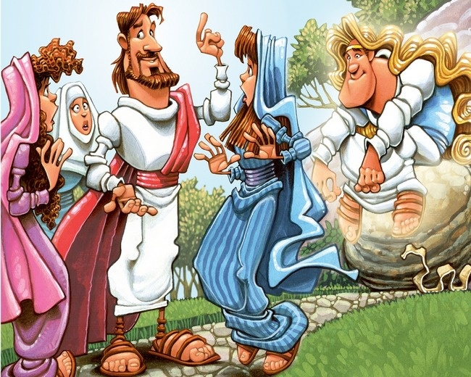
  Types of Stories
  Testimony
  Bible stories
  Oral traditions
  Narrative
  Character
  Fiction
  Visual

Slide 7

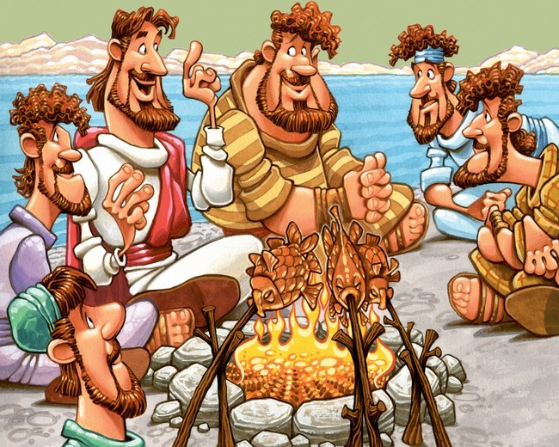
  If Jesus saw stories as absolutely necessary
  and effective, so should we

